Slide 1
Placement preparation portal
Group Members:
Hardik Jethava 92500584003
Hardik Vala 92500584013
internal Guide :
dr. Divyakant Meva
Mca 3a
Group no : 24

Slide 2
1. Introduction to Project Definition
A project is a planned and organized effort undertaken to develop a specific product, system, or solution for solving a particular problem. In software development, a project involves identifying a problem, analyzing user requirements, designing the system, developing the application, testing its functionality, and implementing the final solution.
The proposed project, “Placement Preparation Portal,” is a web-based application developed to provide students with a centralized platform for complete placement preparation. Students often use multiple websites and applications for aptitude preparation, reasoning, English, programming, coding practice, mock tests, interview preparation, resume analysis, and company-specific preparation. This makes the preparation process unorganized and makes it difficult for students to track their overall progress.
The Placement Preparation Portal solves this problem by integrating various placement preparation activities into a single platform. The system allows students to study topic-wise notes, practice MCQs and coding problems, attempt quizzes and mock tests, prepare for different companies, upload and analyze their resumes, and track their preparation progress.

Slide 3
The system consists of two main users: Student and Admin. Students use the platform for learning, practicing, testing, and analyzing their performance. The Admin manages students and dynamically controls notes, questions, coding problems, companies, mock tests, and other preparation content.
The project is developed using the MERN Stack, which includes React.js for the frontend, Node.js and Express.js for the backend, and MongoDB for database management. The system uses JWT authentication for secure user access and provides role-based access for Students and Administrators.

Slide 4
2. PREAMBLE
The AI-Powered Placement Preparation Portal is a web-based application developed to provide students with a centralized and structured platform for complete placement preparation. The project is designed to address the difficulties faced by students who need to use multiple websites and applications for aptitude, reasoning, English, programming, coding practice, mock tests, interview preparation, resume analysis, and company-specific preparation.
The system brings all these preparation activities together into a single platform where students can learn, practice, take assessments, analyze their performance, and improve their skills. The portal follows the complete preparation cycle:
Learn → Practice → Test → Analyze → Improve
The application consists of two main user roles: Student and Admin. Students can access learning materials, solve practice questions and coding problems, attempt quizzes and mock tests, prepare for different companies, upload their resumes for analysis, and monitor their overall preparation progress. The Admin is responsible for managing students and dynamically controlling the content available on the platform, including notes, questions, coding problems, companies, mock tests, and reports.

Slide 5
The project is developed using the MERN Stack, which includes React.js and Vite for the frontend, Node.js and Express.js for the backend, and MongoDB with Mongoose for database management. JWT and bcryptjs are used to provide secure authentication and password protection, while REST APIs are used for communication between the frontend and backend.
The proposed system also includes AI-oriented features such as Resume Review, Resume Suggestions, HR and Technical Interview Question Generation, Skill Gap Analysis, Learning Roadmaps, Career Suggestions, and Interview Feedback. These features are designed to provide more personalized guidance and help students identify areas that require improvement.
Overall, the AI-Powered Placement Preparation Portal provides an integrated solution for placement preparation by combining learning resources, practice activities, assessment systems, performance analytics, resume analysis, company preparation, and administrative content management. The system aims to improve students' technical knowledge, aptitude skills, communication abilities, problem-solving skills, and overall placement readiness.

Slide 6
Problem Statement :
The main problems addressed by the AI-Powered Placement Preparation Portal are:
Scattered Preparation Resources
Students need to visit multiple websites for aptitude, coding, reasoning, English, and interview preparation.
Lack of Centralized Platform
There is no single platform that combines all placement preparation activities.
Difficulty in Progress Tracking
Students find it difficult to track their completed topics, practice activities, and overall preparation progress.
Lack of Structured Preparation
Students may not know which topics to study and practice in a proper sequence.
Difficulty in Identifying Weak Areas
Without proper result analysis, students cannot easily identify their strengths and weaknesses.
Separate Platforms for Different Skills
Aptitude, reasoning, English, programming, coding, and mock tests are usually available on different platforms.

Slide 7
.
Limited Mock Test Analysis
Students need proper test results, scores, accuracy, and performance analysis after completing tests.
Lack of Company-Specific Preparation
Students may find it difficult to get organized preparation material for specific companies.
Resume Preparation Challenges
Students need guidance to analyze and improve their resumes before applying for placements.
Content Management Difficulty
Administrators need an efficient system to dynamically manage notes, questions, coding problems, tests, and other content.

Slide 8
Objectives of the System :
Centralized Placement Preparation
Provide Study Materials
Aptitude Preparation
Reasoning Preparation
English Preparation
Programming Language Learning
Coding Practice
Mock Test System
Company-Specific Preparation
Resume Scanner
AI-Assisted Preparation
Progress Tracking
Performance Analysis
Dynamic Content Management
Secure User Management
Improve Placement Readiness

Slide 9
2.4 Scope of the System :
A. In-Scope Modules & Features
User Authentication
Students and administrators can securely register, log in, log out, and manage their profiles using role-based authentication.
Student Dashboard
Students can view their placement readiness score, daily progress, study streak, completed topics, recent activities, and upcoming tests.
Aptitude Preparation
The system provides aptitude notes, examples, MCQs, quizzes, mock tests, timers, results, and performance analysis.
Reasoning Preparation
Students can study reasoning topics, practice questions, attempt quizzes, and track their performance.
English Preparation
The portal provides English topics such as grammar, vocabulary, reading comprehension, sentence correction, and practice tests.
Programming Language Learning
Students can learn programming languages through notes, syntax, examples, programs, MCQs, and interview questions.
Coding Practice
The system provides coding problems based on topics and difficulty levels such as Easy, Medium, and Hard.

Slide 10
.
Company-Specific Preparation
Students can access selection processes, aptitude, coding, technical, and HR questions for different companies.
Mock Test System
The system conducts Aptitude, Reasoning, English, Coding, and Mixed Placement Tests with timers and result analysis.
Resume Scanner
Students can upload their resumes and receive analysis, identified skills, missing information, and improvement suggestions.
AI-Based Features
The system supports AI-assisted resume review, interview questions, skill gap analysis, learning roadmaps, and career suggestions.
Progress Tracking and Analytics
Students can track their learning progress, test history, subject-wise performance, and placement readiness.
Bookmark and Notification System
Students can save important content and receive notifications related to tests and preparation activities.
Admin Panel
Administrators can manage students, notes, questions, coding problems, companies, mock tests, results, reports, and analytics.

Slide 11
B. Out-of-Scope / Future Boundaries
The following features are not included in the current version but can be implemented in future:
Live Video Mock Interviews
Real-Time Online Code Compiler
Native Android and iOS Mobile Application
Direct Job Application and Recruitment System
Direct Integration with College Placement Cell
Advanced AI Virtual Interviewer
Real-Time Chat Between Students and Recruiters
Online Proctoring During Mock Tests
Integration with External Job Portals
Advanced Multilingual Support

Slide 12
Module description :
1. Authentication Module
This module provides secure registration, login, logout, password management, and profile management for students and administrators. JWT-based authentication and role-based access control are used.
2. Student Dashboard Module
The dashboard provides students with an overview of their preparation activities, including placement readiness score, daily progress, study streak, completed topics, recent activities, and upcoming tests.
3. Aptitude Module
This module provides aptitude preparation through topic-wise notes, examples, MCQs, quizzes, and mock tests. Students can view results and analyze their performance after completing tests.
4. Reasoning Module
The Reasoning module helps students prepare logical and analytical reasoning topics such as puzzles, blood relations, directions, seating arrangements, syllogism, and series through notes and practice tests.

Slide 13
5. English Module
This module helps students improve their English and communication skills through grammar, vocabulary, synonyms, antonyms, reading comprehension, sentence correction, and quizzes.
6. Programming Languages Module
Students can learn programming languages such as C, C++, Java, Python, JavaScript, PHP, SQL, React, Node.js, and MongoDB through notes, syntax, examples, programs, MCQs, and interview questions.
7. Coding Practice Module
This module provides coding and DSA preparation through topics such as Arrays, Strings, Linked Lists, Stacks, Queues, Trees, Graphs, Sorting, Searching, Recursion, and Dynamic Programming.
8. Company Preparation Module
Students can prepare for different companies by accessing information about selection processes, aptitude questions, coding questions, technical questions, HR questions, interview experiences, and preparation tips.
9. Mock Test Module
This module provides different types of timed tests, including Aptitude, Reasoning, English, Coding, and Mixed Placement Tests. It generates detailed results and performance analysis.

Slide 14
10. Resume Scanner Module
Students can upload their resumes for analysis. The module identifies skills and missing information and provides suggestions to improve the quality of the resume.
11. AI Preparation Module
This module provides AI-assisted features such as HR interview questions, technical questions, resume suggestions, skill gap analysis, learning roadmaps, career suggestions, and interview feedback.
12. Progress and Analytics Module
This module tracks student learning activities, completed topics, test history, scores, accuracy, and overall placement readiness through charts and performance reports.
13. Bookmark and Notification Module
Students can save important notes, questions, and coding problems for future reference. The notification system provides updates regarding tests and preparation activities.
14. Admin Panel Module
The Admin Panel allows administrators to manage students, notes, questions, coding problems, companies, mock tests, results, reports, and other system content dynamically.

Slide 15
3. REVIEW OF LITERATURE
Study & Analysis of Existing Systems :
1. Aptitude and Reasoning Preparation Systems
Existing platforms provide quantitative aptitude, logical reasoning, verbal ability questions, practice tests, and timed assessments.
2. Coding Practice Systems
Coding platforms provide programming problems based on topics such as Arrays, Strings, Linked Lists, Trees, Graphs, Sorting, and Dynamic Programming.
3. Mock Test and Assessment Systems
Existing assessment systems provide timed tests, automatic evaluation, score calculation, and performance analysis.
4. Company-Specific Preparation Systems
Some modern placement platforms provide company-wise preparation tracks for companies such as TCS, Infosys, Wipro, Accenture, and others. These include company patterns, practice questions, mock tests, and interview preparation.
5. AI-Based Placement Preparation Systems
AI-based systems are increasingly providing features such as AI mock interviews, interview feedback, skill analysis, personalized learning roadmaps, and resume analysis.

Slide 16
Feature | Existing Systems | Proposed System
Aptitude Preparation | Available | Available
Reasoning Preparation | Available | Available
English Preparation | Available | Available
Programming Notes | Limited / Separate | Integrated
Coding Practice | Available | Available
Mock Tests | Available | Available
Company Preparation | Available in some platforms | Integrated
Resume Analysis | Available in some platforms | Resume Scanner
AI Interview Preparation | Available in some platforms | AI Module
Progress Tracking | Available | Advanced Dashboard
Admin Content Management | Limited | Complete Admin Panel
Centralized Platform | Partial | Complete Integrated System
Comparative Analysis Matrix :

Slide 17
Major Findings & Research Gaps Identified :
A. Major Findings
1. Fragmented Placement Preparation
Students often use multiple platforms for aptitude, coding, resume building, interview preparation, and company-specific information. This makes the preparation process scattered and less efficient.
2. Lack of Centralized Progress Tracking
Existing systems may track progress within individual modules, but students often do not get a complete overview of their overall placement preparation and readiness.
3. Limited Personalized Guidance
Many traditional preparation systems provide the same content to all students and offer limited personalized recommendations based on individual strengths and weaknesses.
4. Isolated Learning and Assessment
Learning materials, practice questions, mock tests, and performance analysis are often available separately instead of being connected in a continuous preparation process.
5. Limited Integration of Placement Skills
Placement preparation requires aptitude, reasoning, communication, technical knowledge, coding, interview skills, and resume preparation, but many existing systems focus only on selected areas.

Slide 18
.
B. Research Gaps Identified
1. Lack of a Complete Centralized Platform
There is a need for a single platform that combines Aptitude, Reasoning, English, Programming, Coding Practice, Mock Tests, Resume Analysis, and Company Preparation.
2. Lack of Integrated Performance Analysis
Existing systems may provide individual test results, but there is a need for centralized analytics that combines performance across different preparation modules.
3. Limited Weak Area Identification
Students need a system that can identify their weak areas based on their learning progress, practice performance, and test results.
4. Lack of Structured Preparation Workflow
Many students do not have a proper preparation sequence. A structured workflow connecting learning, practice, testing, and improvement is required.
5. Limited Dynamic Content Management
There is a need for an Admin Panel where administrators can dynamically manage notes, questions, coding problems, companies, and mock tests.

Slide 19
4. TECHNICAL DESCRIPTION
4.1 Hardware Requirement
The AI-Powered Placement Preparation Portal is a web-based MERN Stack application. The following hardware requirements are recommended for the development and smooth operation of the system.
Hardware Component | Minimum Requirement | Recommended Requirement
Processor | Dual-Core Processor | Intel Core i5 or equivalent
RAM | 4 GB | 8 GB or Higher
Storage | 10 GB Free Space | 20 GB or Higher
Display | 1366 × 768 Resolution | Full HD (1920 × 1080)
Internet Connection | Basic Broadband | Stable High-Speed Internet
Keyboard & Mouse | Standard | Standard

Slide 20
4.2 Software Requirement
Based on codebase analysis of ES2022+ ECMAScript syntax, HTML5 Canvas/SVG, Web Storage APIs, and CSS variable dependencies:
Table 4.2 Software Requirement
Software / Technology | Purpose / Usage
Operating System | Windows 10/11 or Linux
Frontend | React.js
Build Tool | Vite
Styling Framework | Tailwind CSS
Backend Runtime | Node.js
Backend Framework | Express.js
Database | MongoDB
ODM | Mongoose
Programming Language | JavaScript
Authentication | JWT (JSON Web Token)
Password Security | bcryptjs
API Communication | Axios / REST API
Routing | React Router
Code Editor | Visual Studio Code
API Testing Tool | Postman
Version Control | Git and GitHub
Package Manager | npm
Web Browser | Google Chrome / Microsoft Edge

Slide 21
Network & Connectivity Requirements :
Based on codebase analysis of Axios REST API HTTP request payloads and Vite dev/proxy server configurations (vite.config.js port 5173 & Express backend port 5000):
Table 4.3 Network & Connectivity Requirements
Requirement | Details
Internet Connection | Stable Broadband or Wi-Fi Connection
Network Type | LAN / Wi-Fi / Internet
Minimum Speed | Basic Internet Connection
Recommended Speed | 10 Mbps or Higher
Frontend Connectivity | Browser to React Application
Backend Connectivity | React Frontend to Express.js APIs
Database Connectivity | Backend Server to MongoDB
API Communication | REST APIs using HTTP/HTTPS
Cloud Services | Required for MongoDB Atlas and optional AI services

Slide 22
5. SYSTEM DESIGN AND DEVELOPMENT
5.1 Flow Chart:

Slide 23
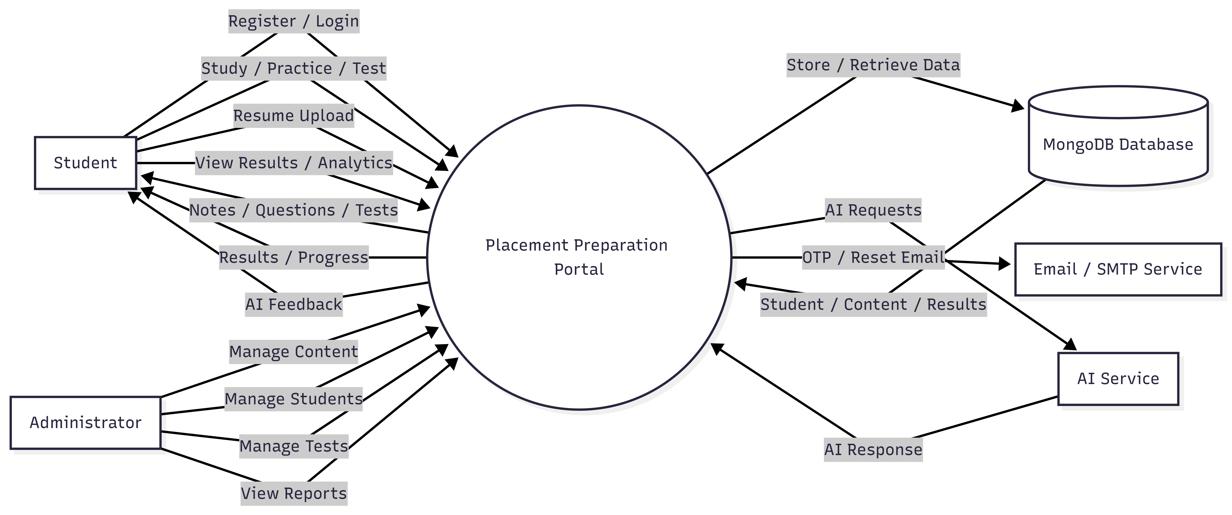
5.2 Data Flow Diagram:
Level 0:-

Slide 24
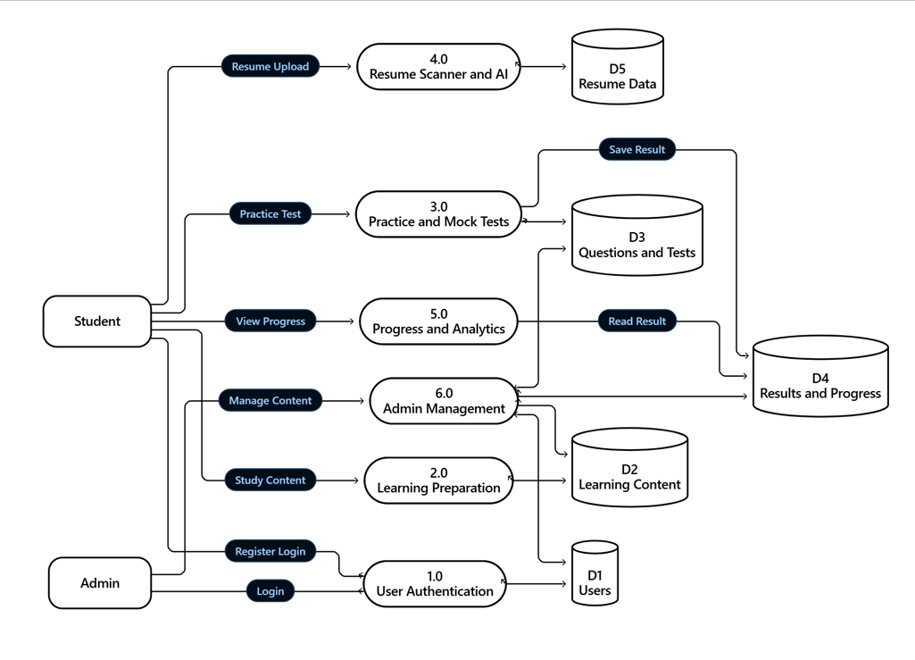
Level 1:-

Slide 25
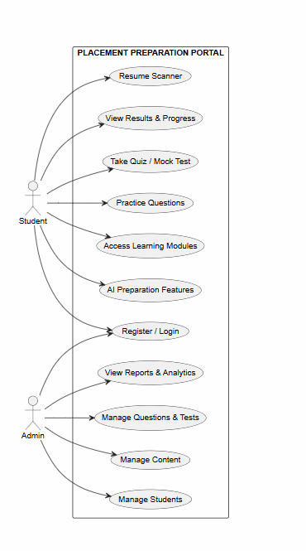
5.3 Use Case Diagram:

Slide 26
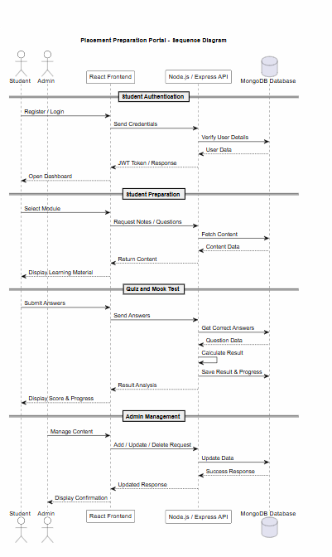
5.4 Sequential Diagram:

Slide 27
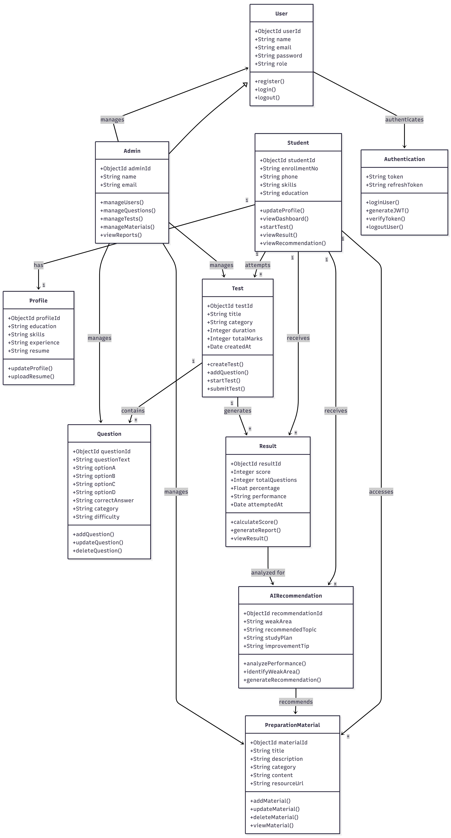
5.5 Class Diagram:

Slide 28
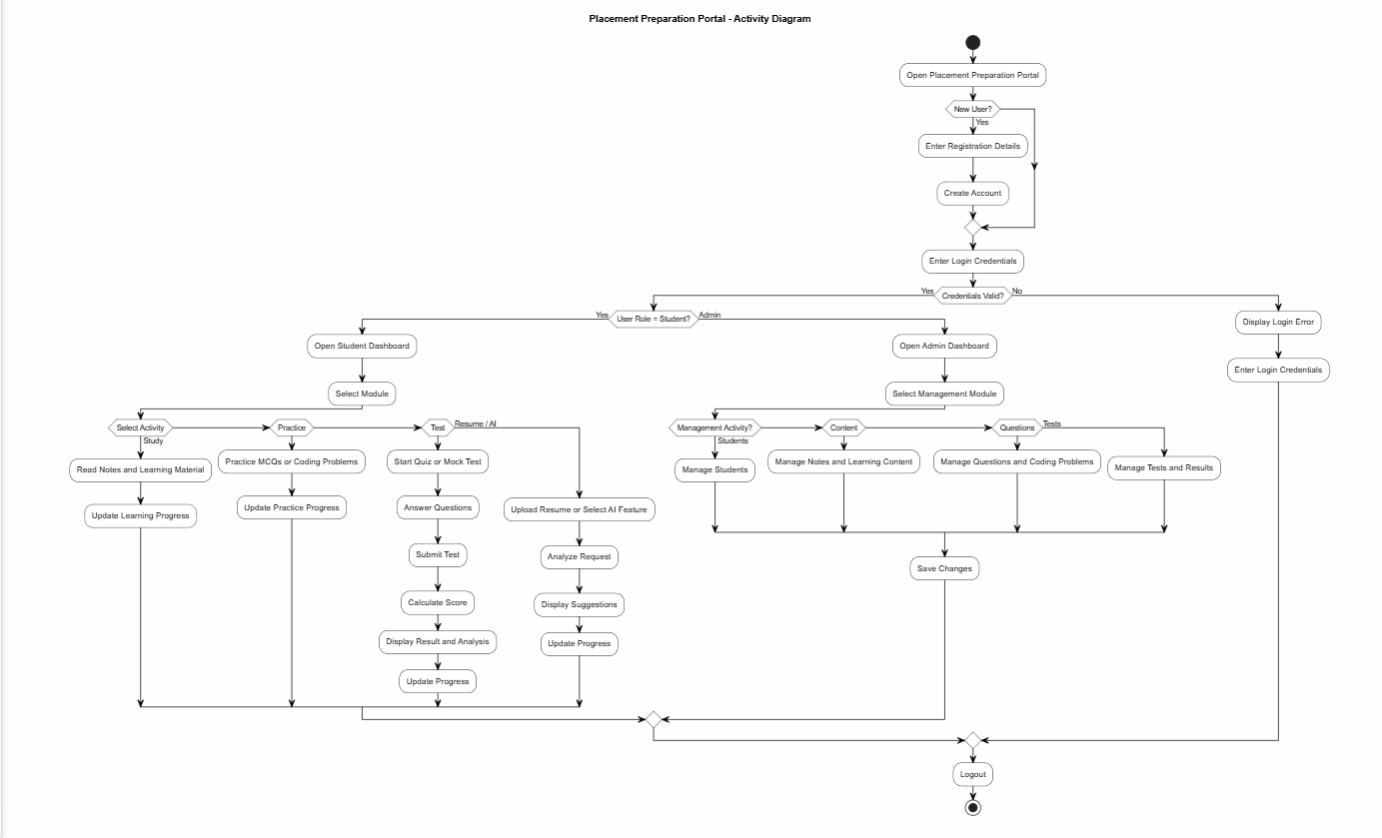
5.6 Activity Diagram:

Slide 29
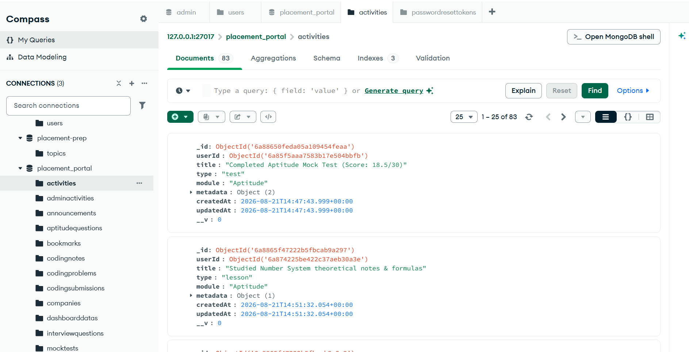
5.7 Database Design:
Figure 5.7.1 Activities

Slide 30
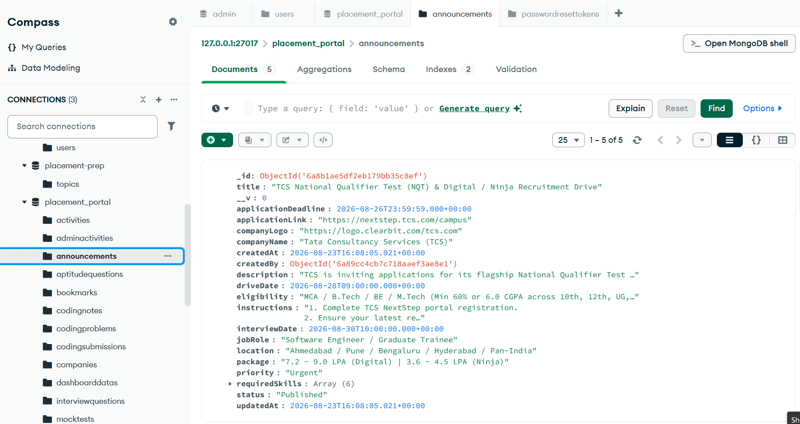
Figure 5.7.2 Announcement

Slide 31
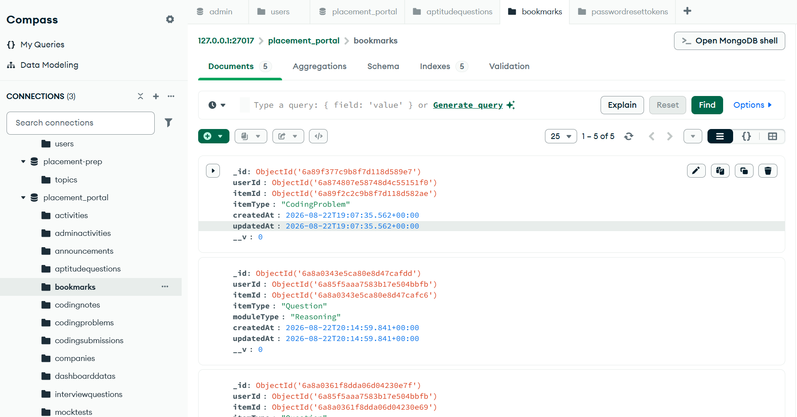
Figure 5.7.3 Bookmark

Slide 32
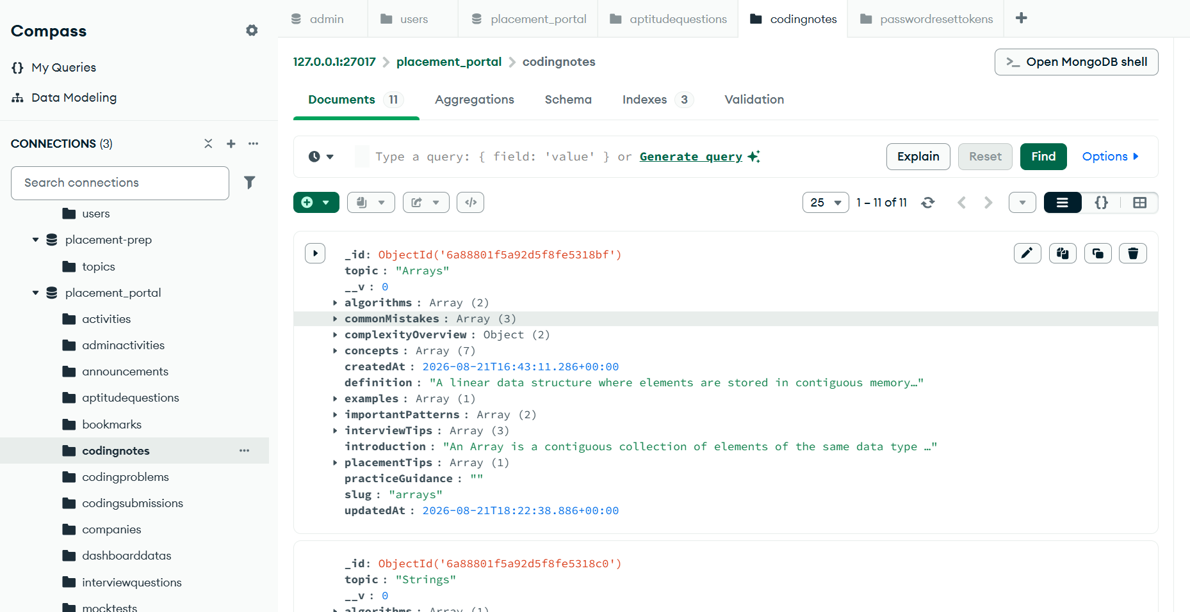
Figure 2.7.4 Codingnotes

Slide 33
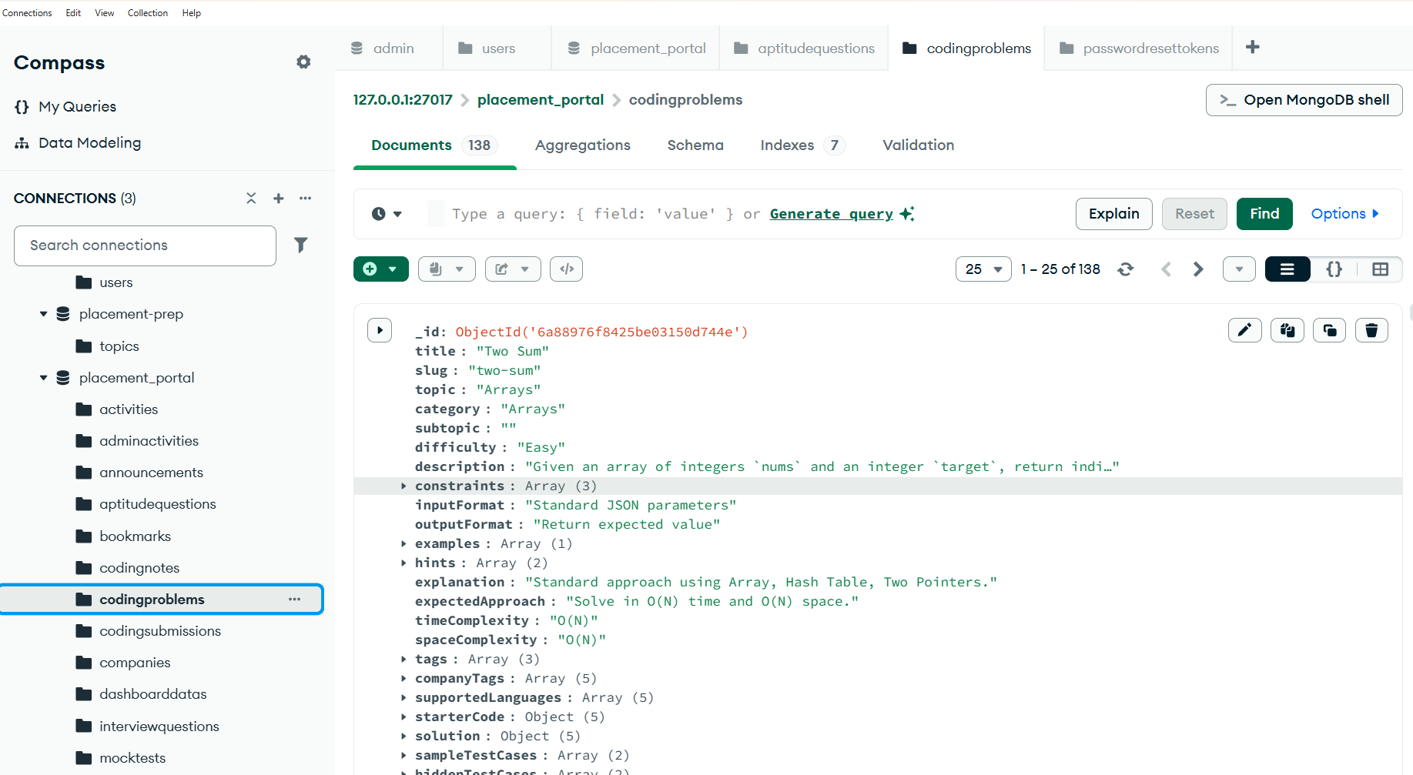
Figure 5.7.5 Coding Problems

Slide 34
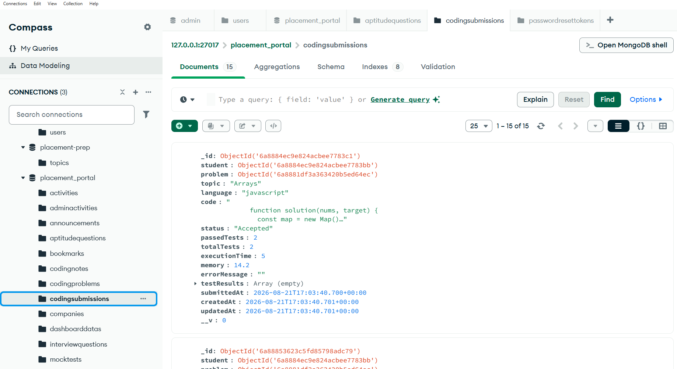
Figure 5.7.6 Coding Submission

Slide 35
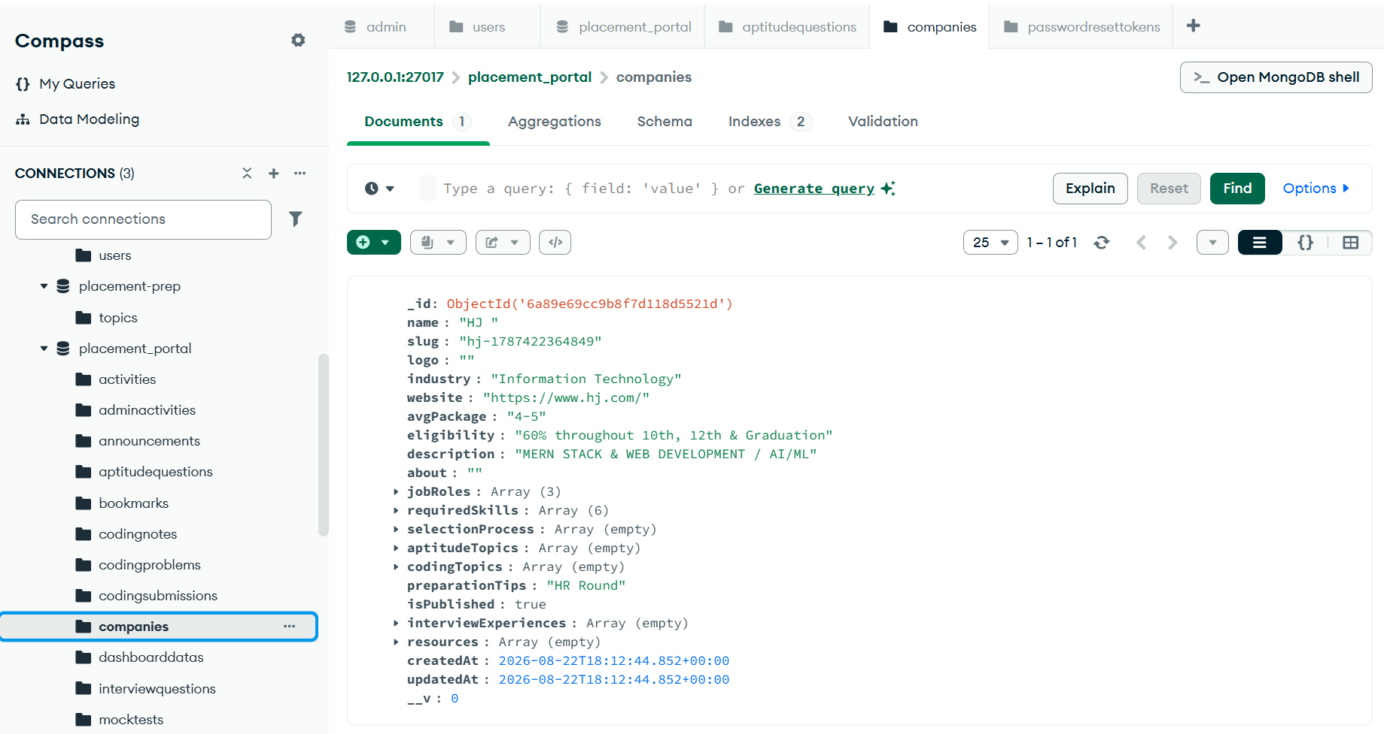
Figure 5.7.7 Companies

Slide 36
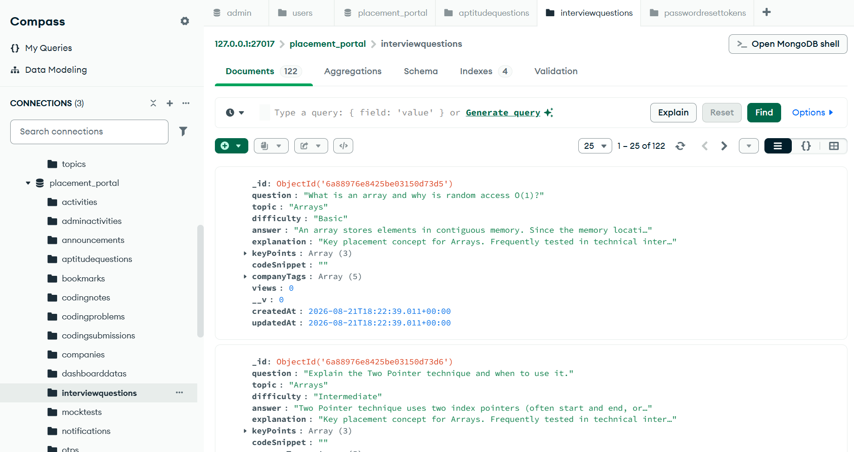
Figure 5.7.8 Interview Questions

Slide 37
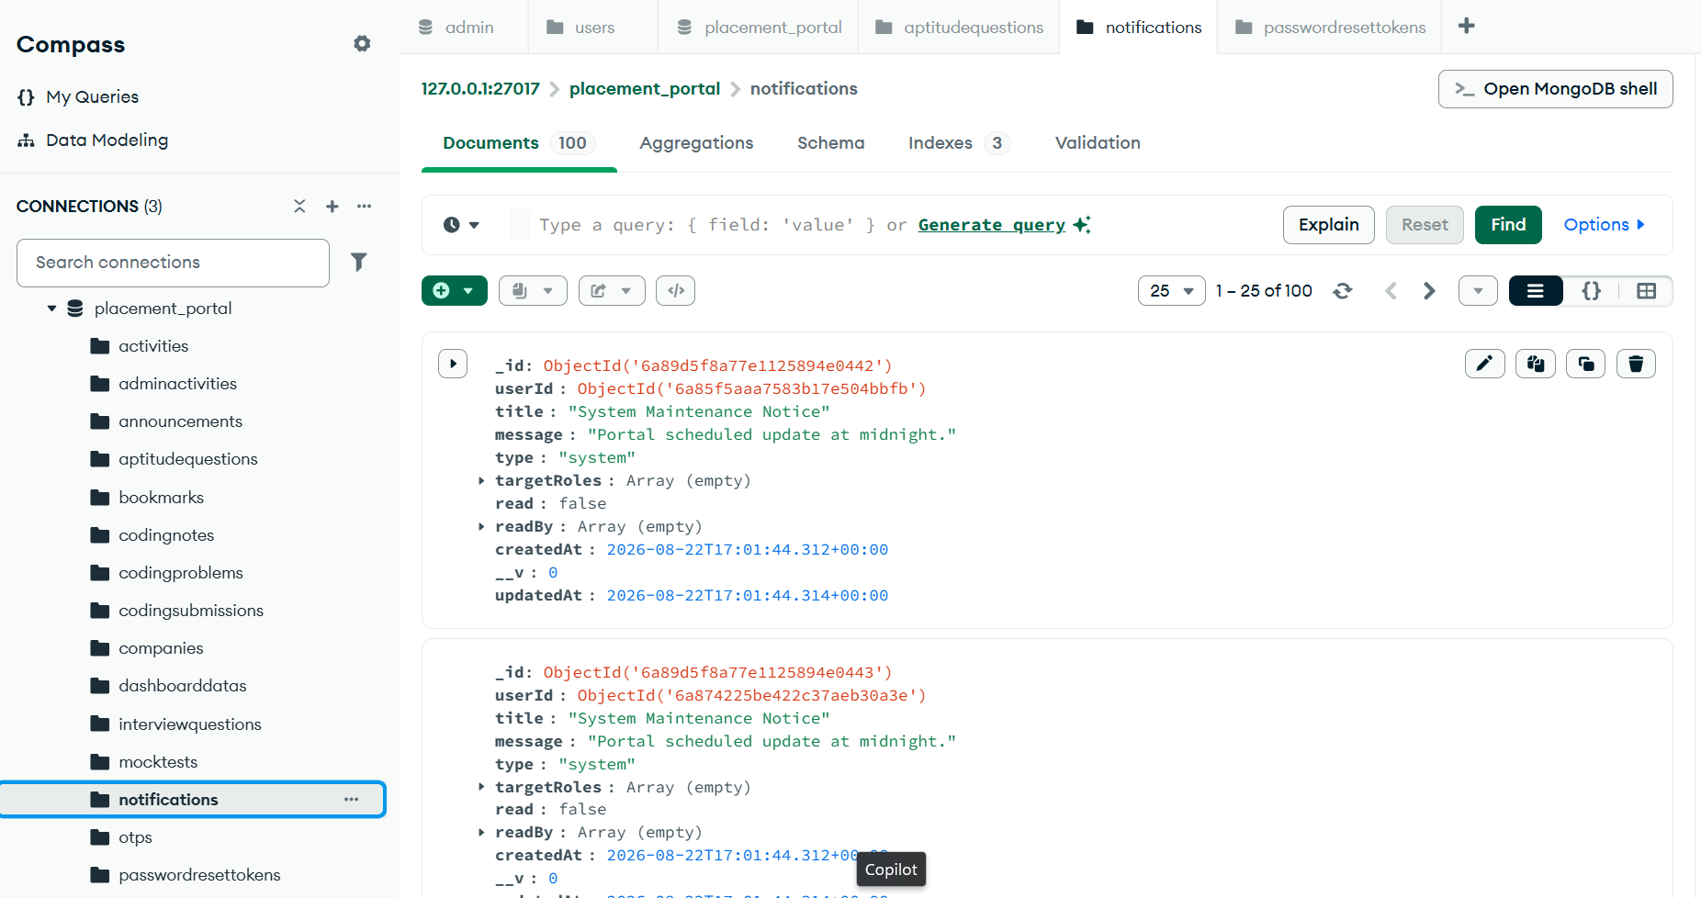
Figure 5.7.9 Notification

Slide 38
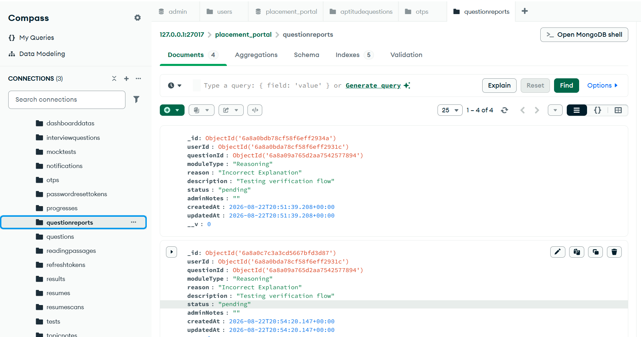
Figure 5.7.10 Question Report

Slide 39
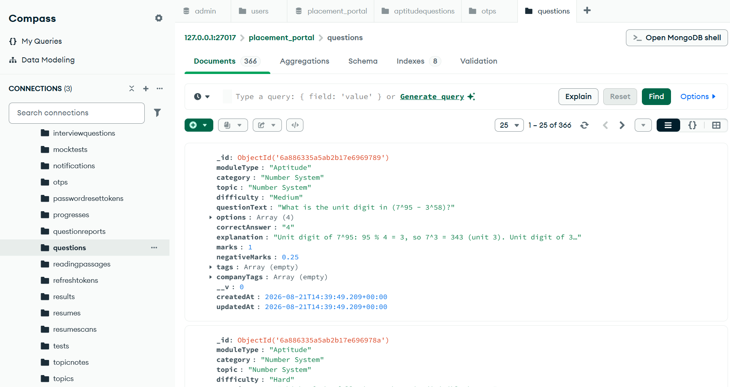
Figure 5.7.11 Questions
.

Slide 40
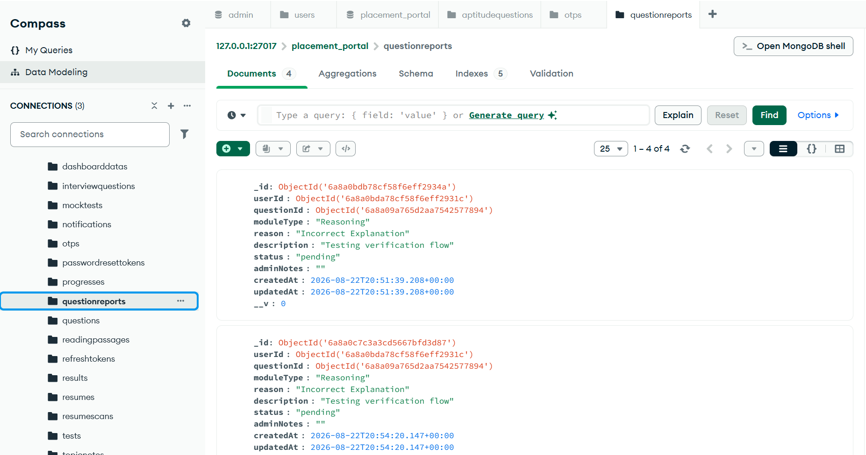
Figure 5.7.12 Question Report
.

Slide 41
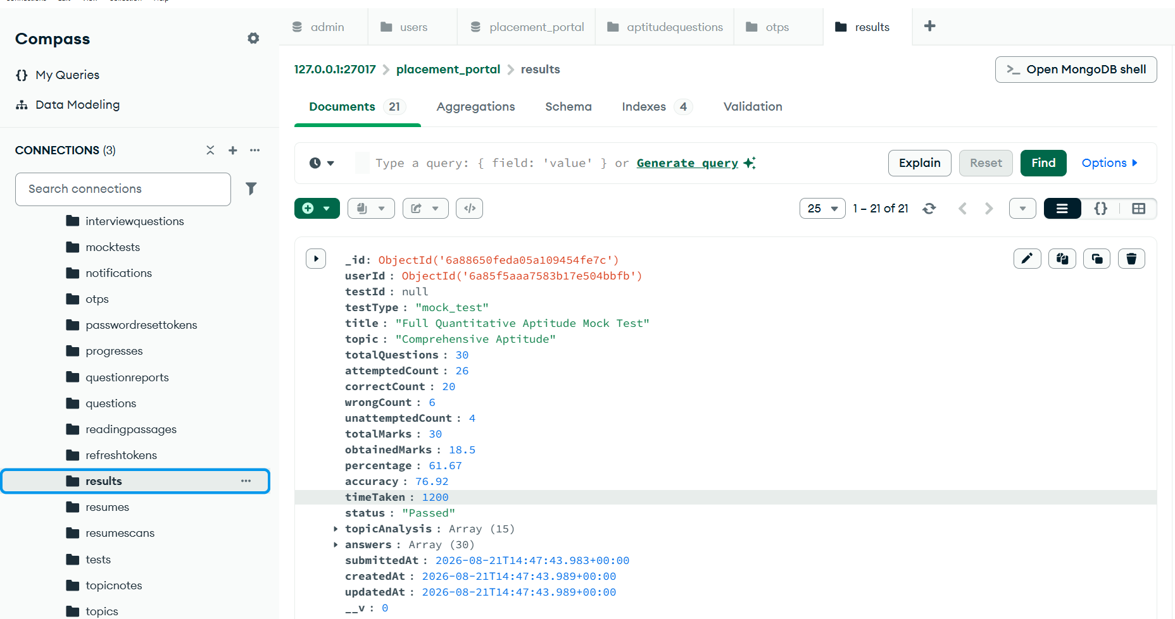
Figure 5.7.13 result
.

Slide 42
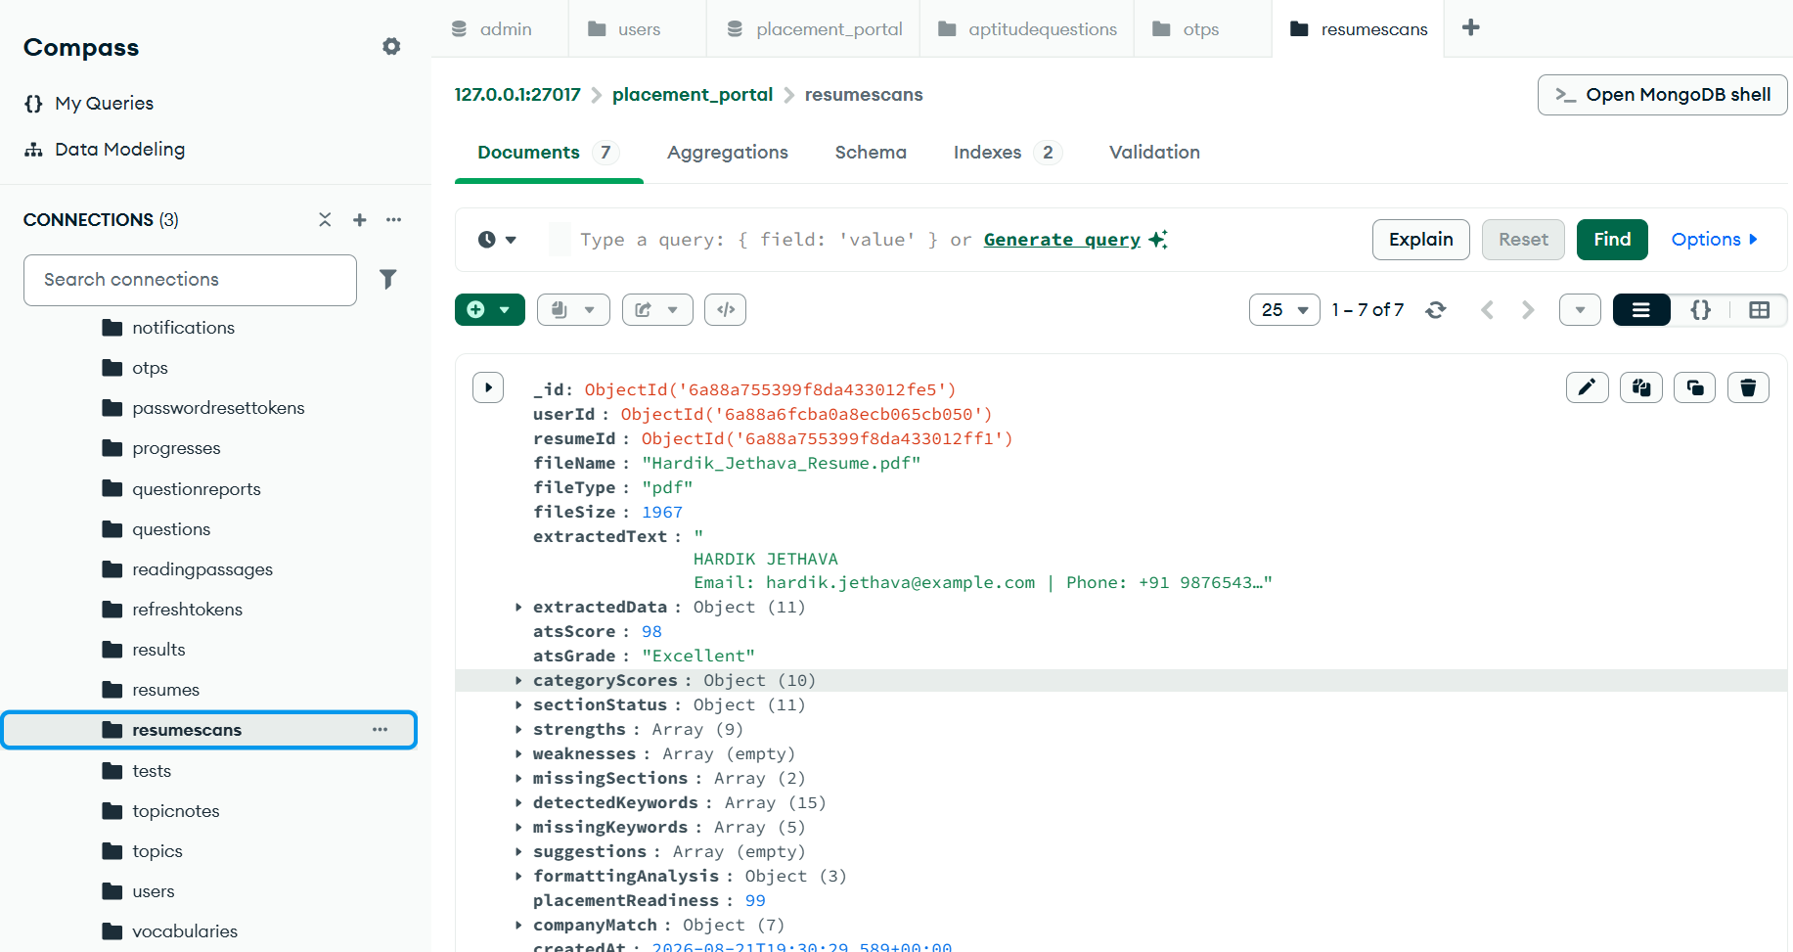
Figure 5.7.14 resume scanning
.

Slide 43
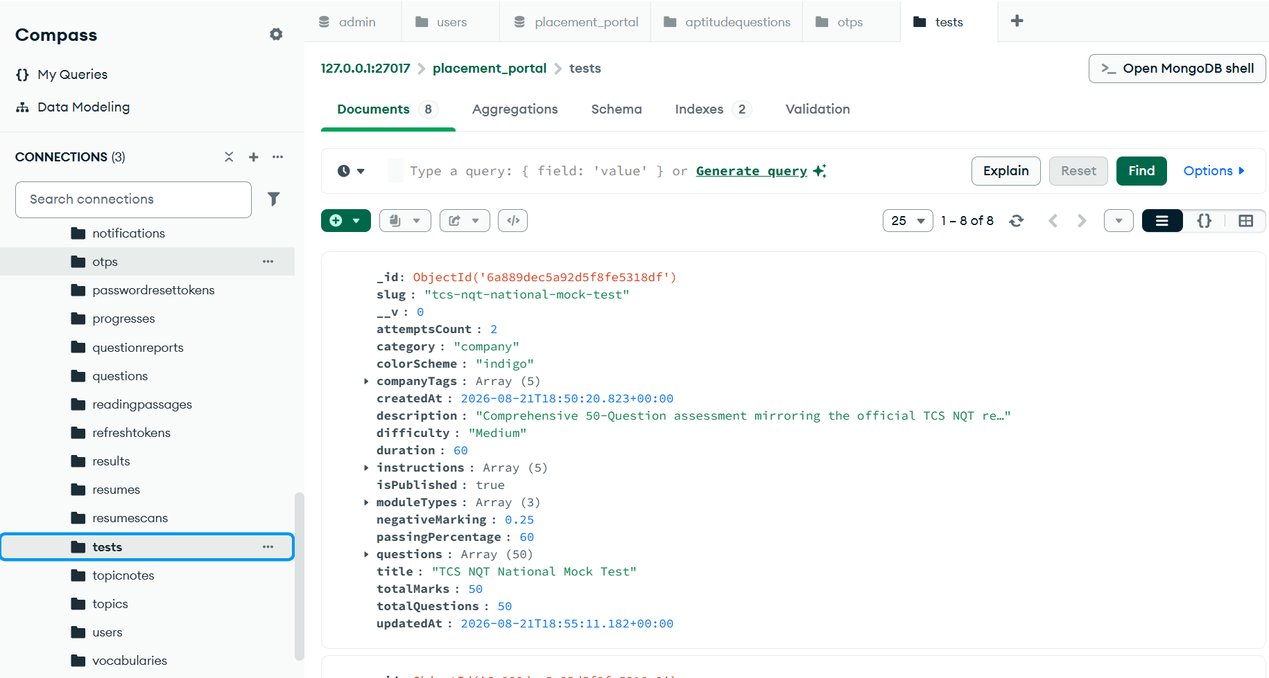
Figure 5.7.15 tests
.

Slide 44
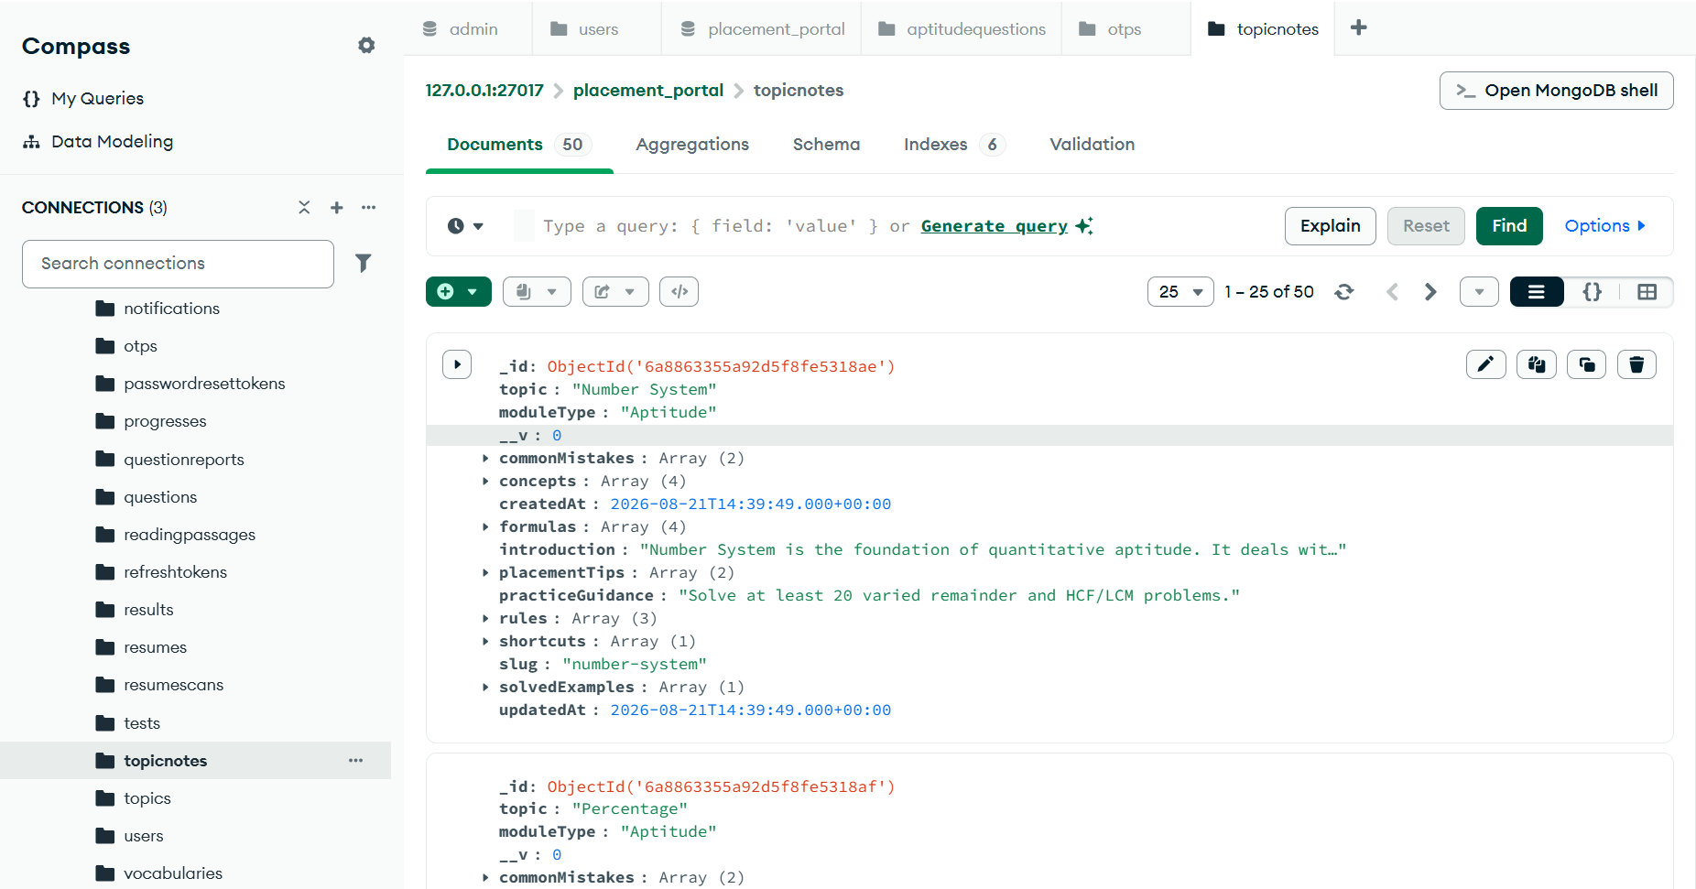
Figure 5.7.16 topic notes
.

Slide 45
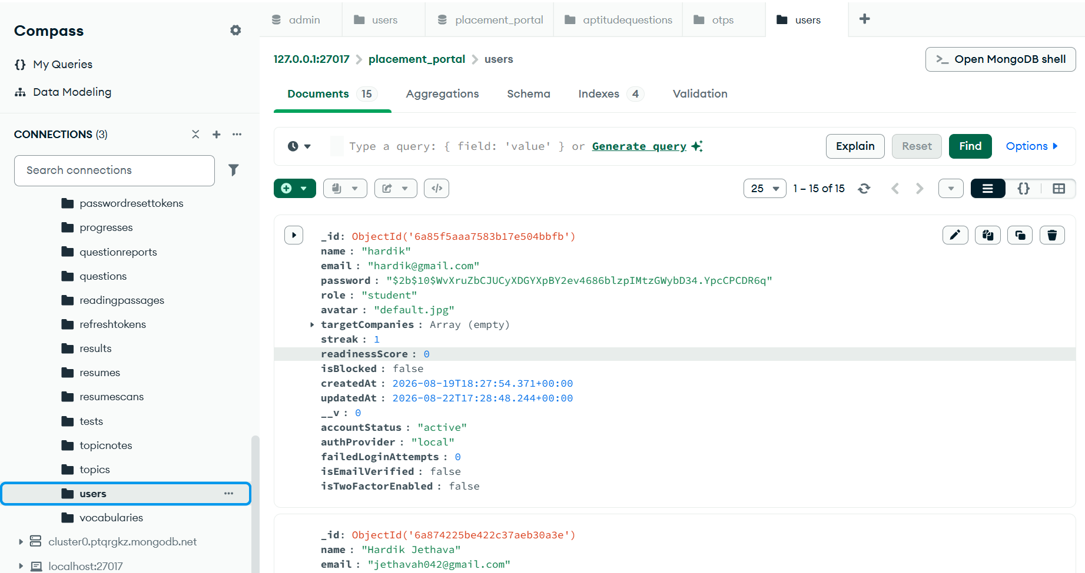
Figure 5.7.17 Users
.

Slide 46
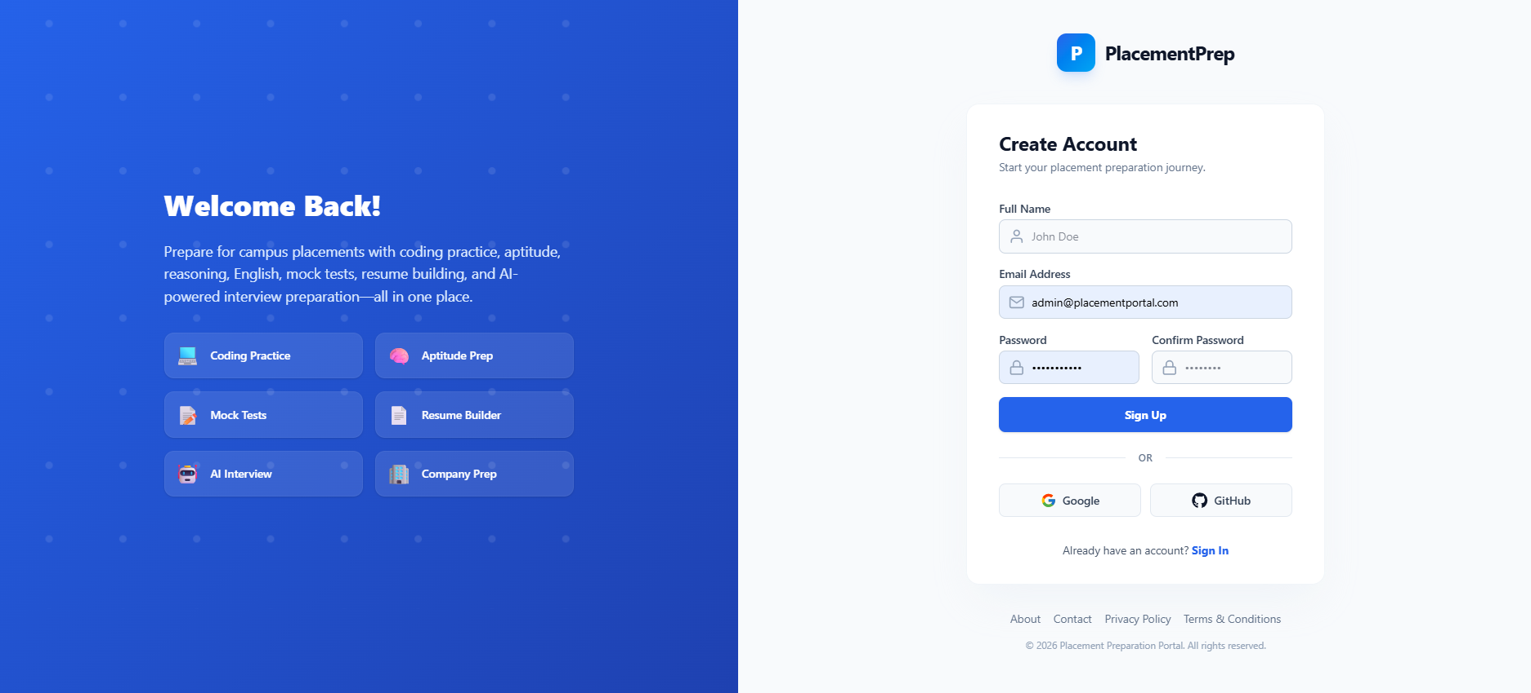
5.8 Menu-Screen Design:
Figure 5.8.1 Registration

Slide 47
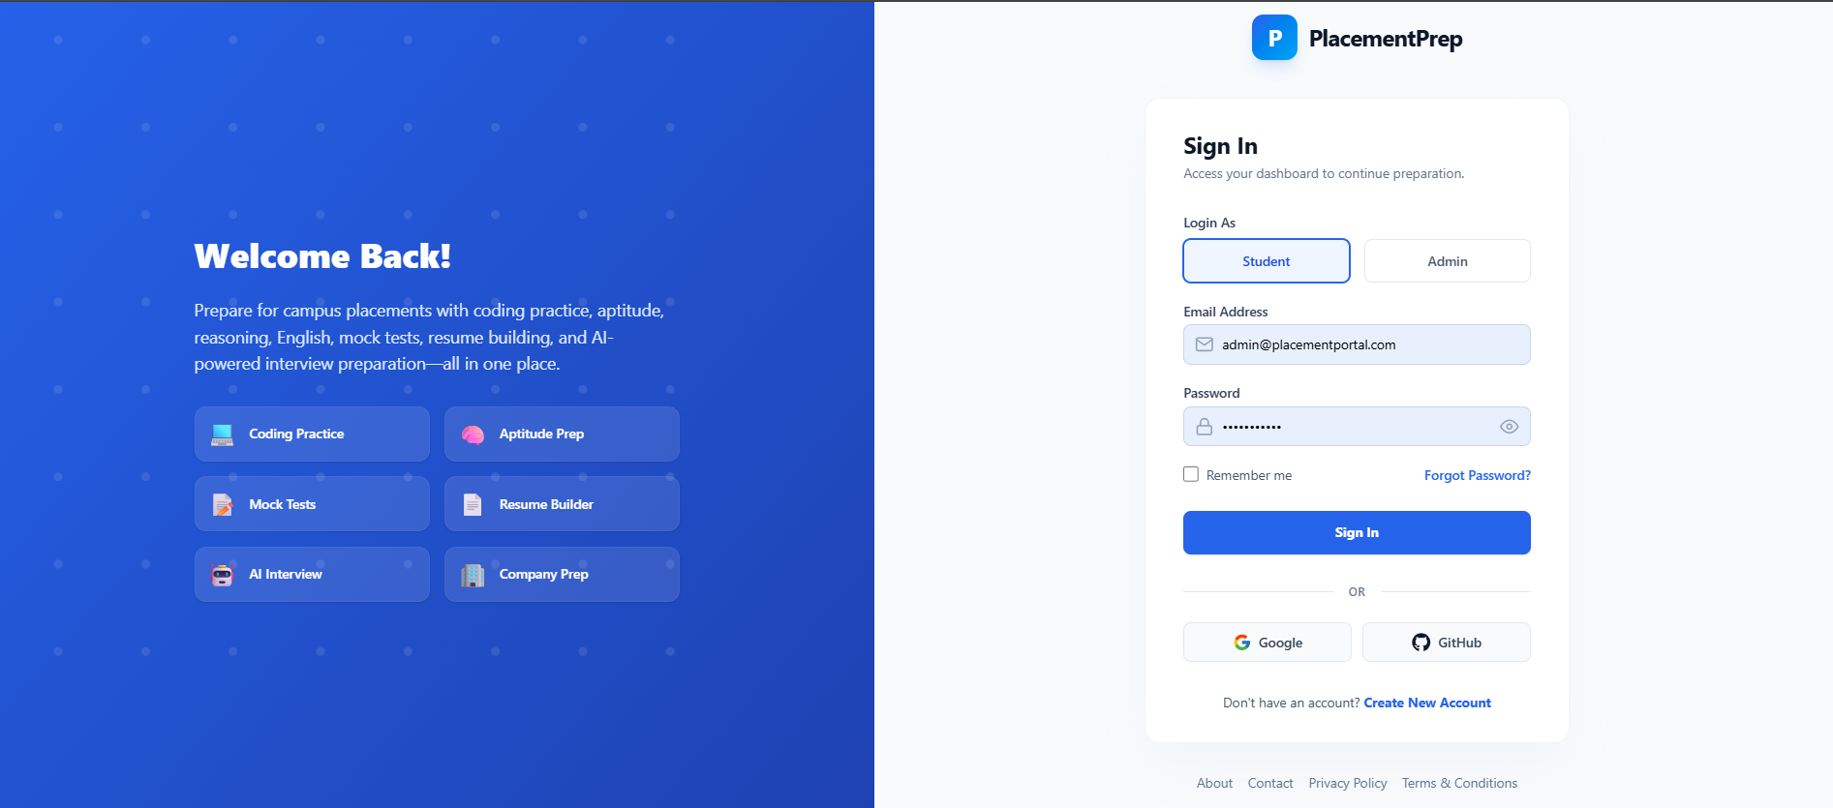
Figure 5.8.2 Login Screen

Slide 48
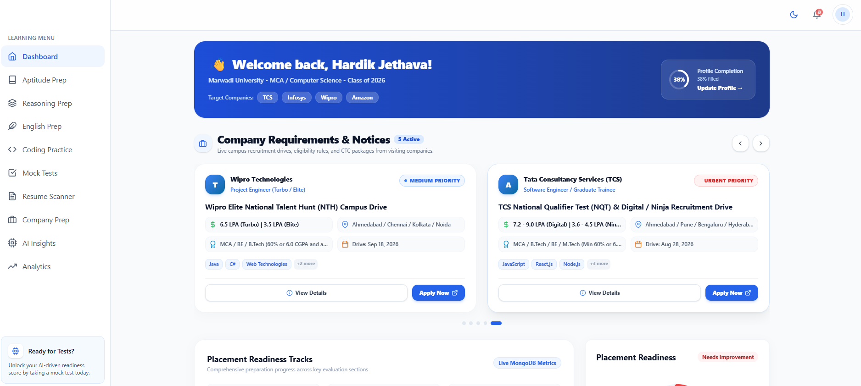
Figure 3.8.3 Student Dashboard Screen

Slide 49
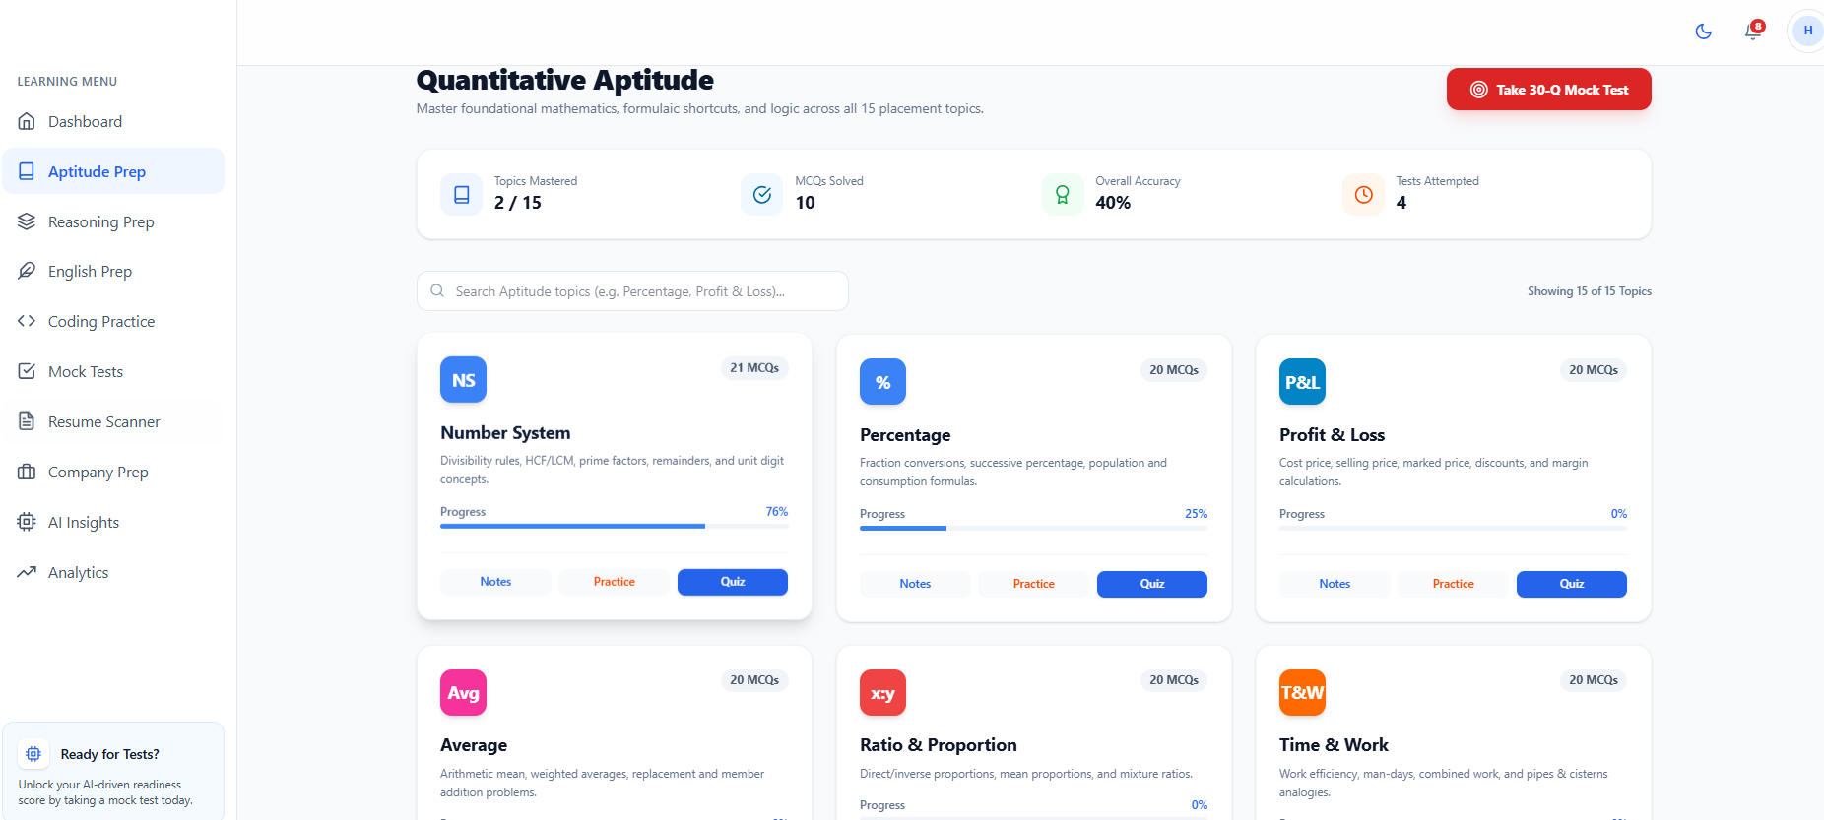
Figure 5.8.Aptitude

Slide 50
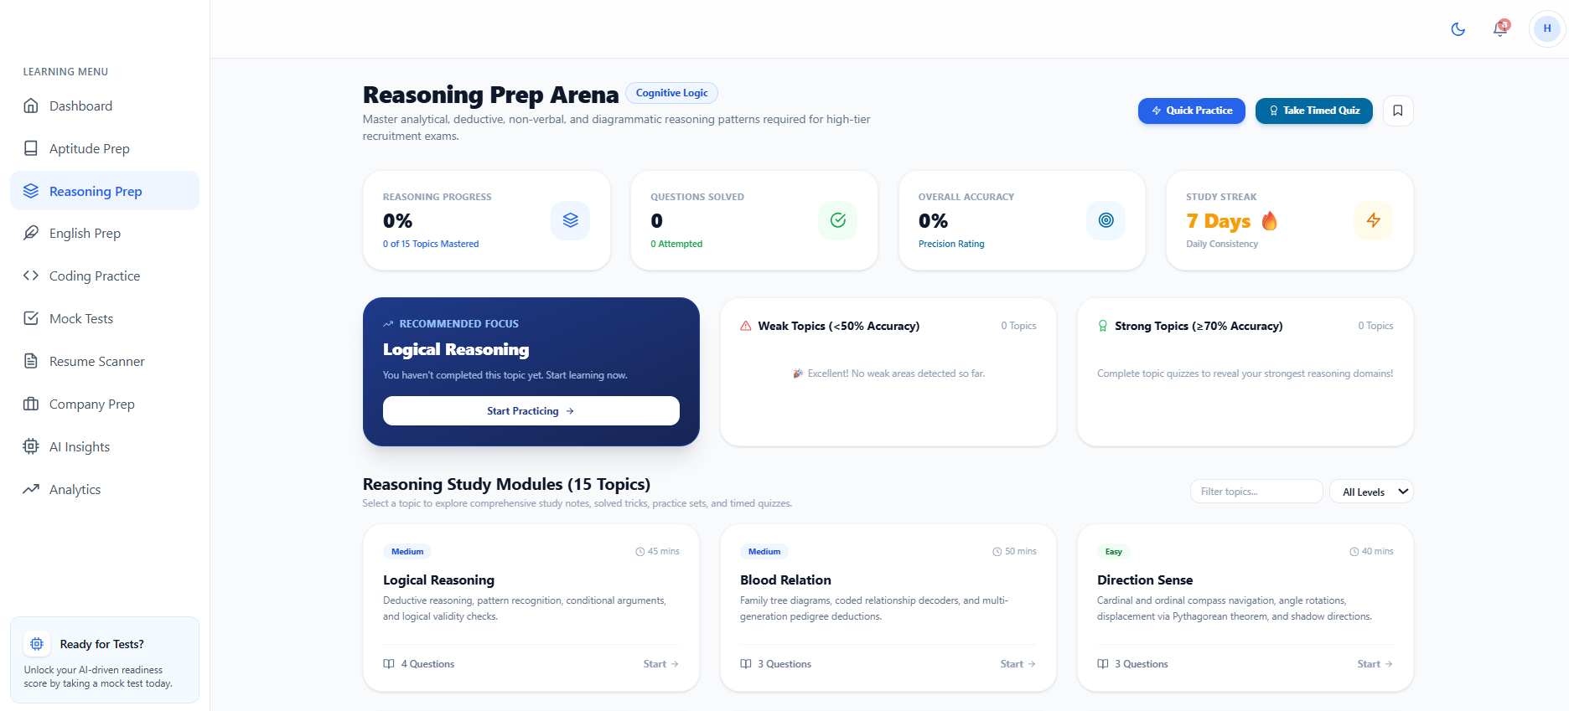
Figure 5.8.5 Reasoning

Slide 51
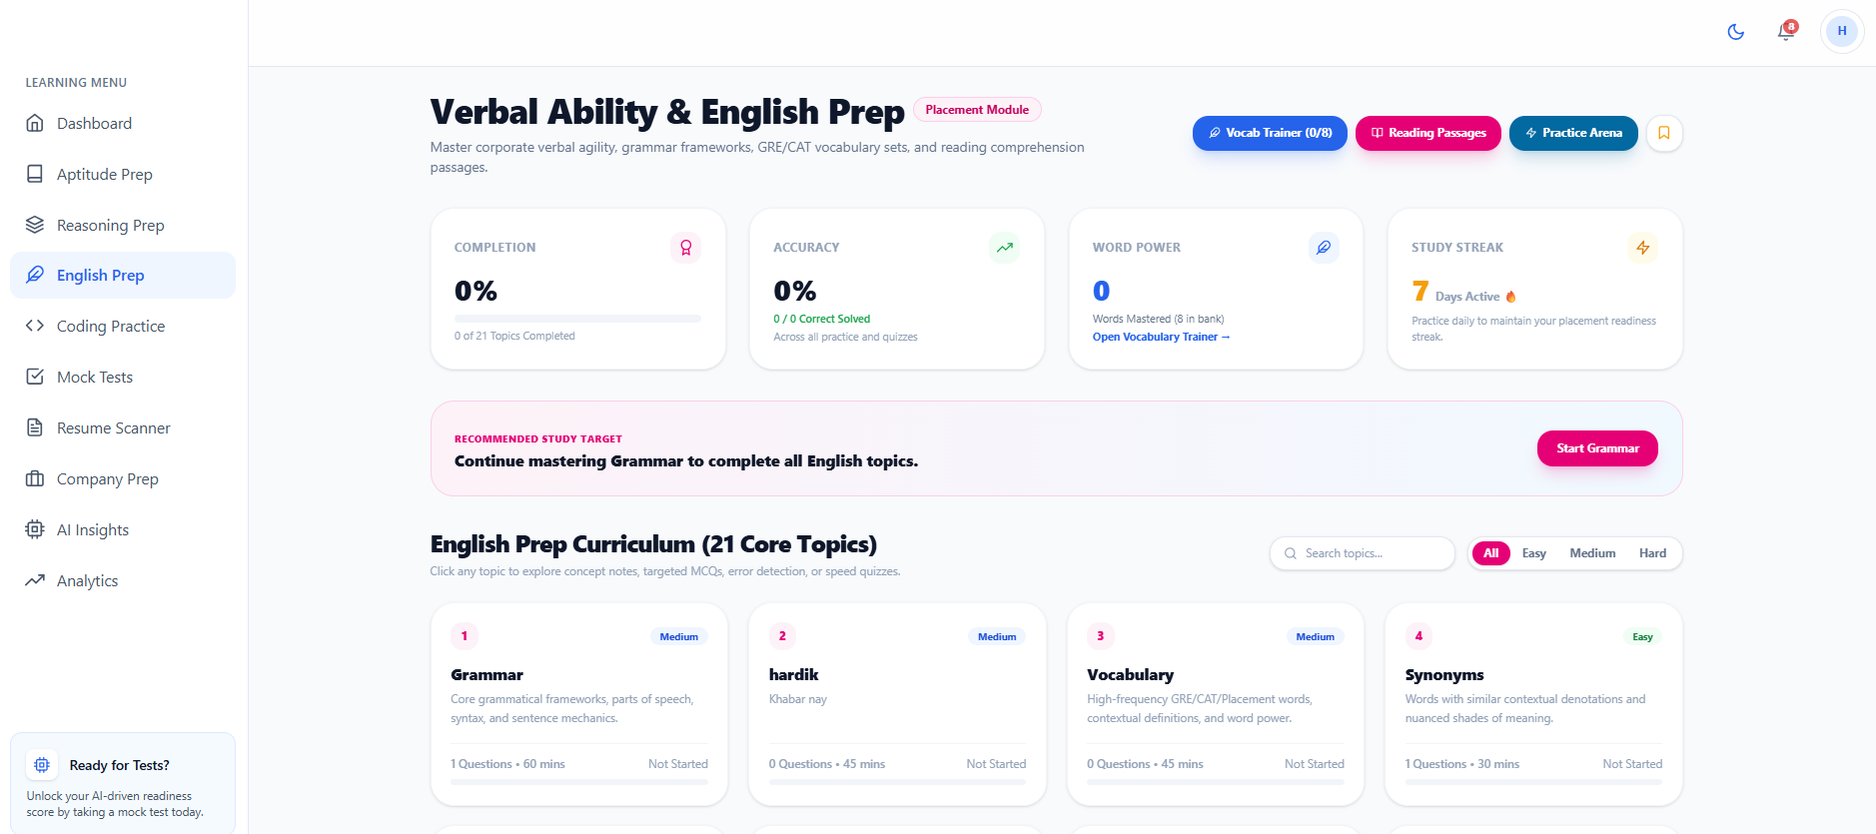
Figure 5.8.6 English

Slide 52
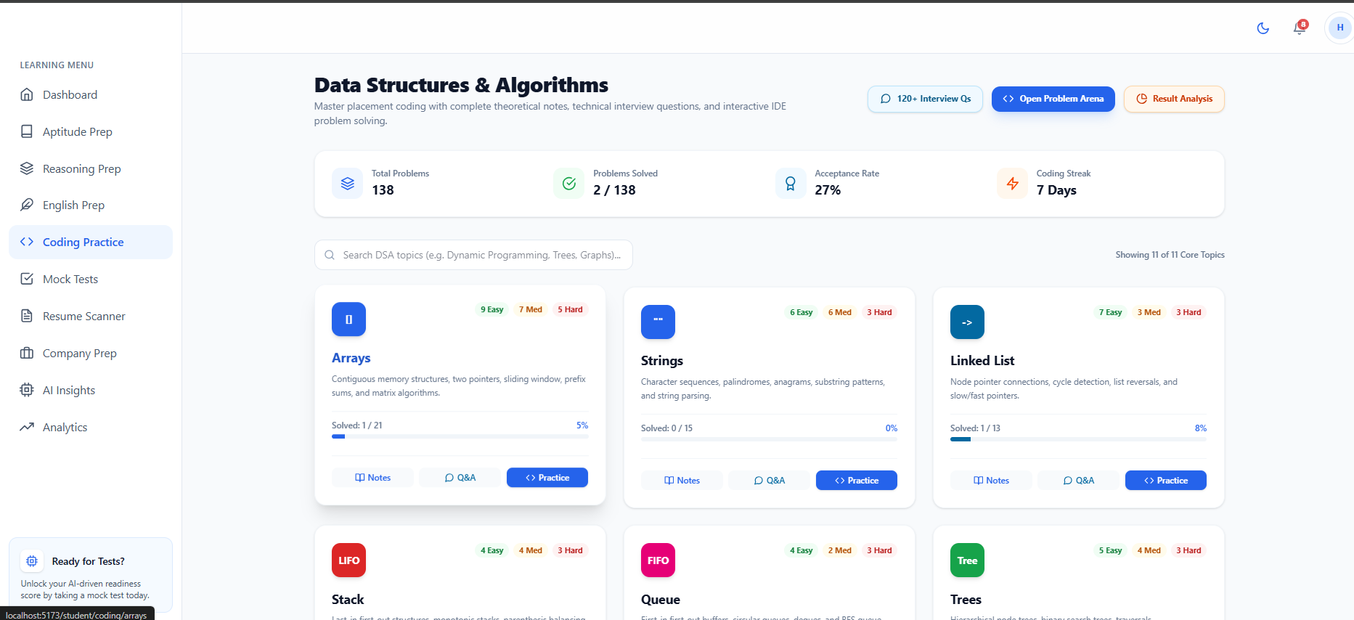
Figure 5.8.7 Coding Practise

Slide 53
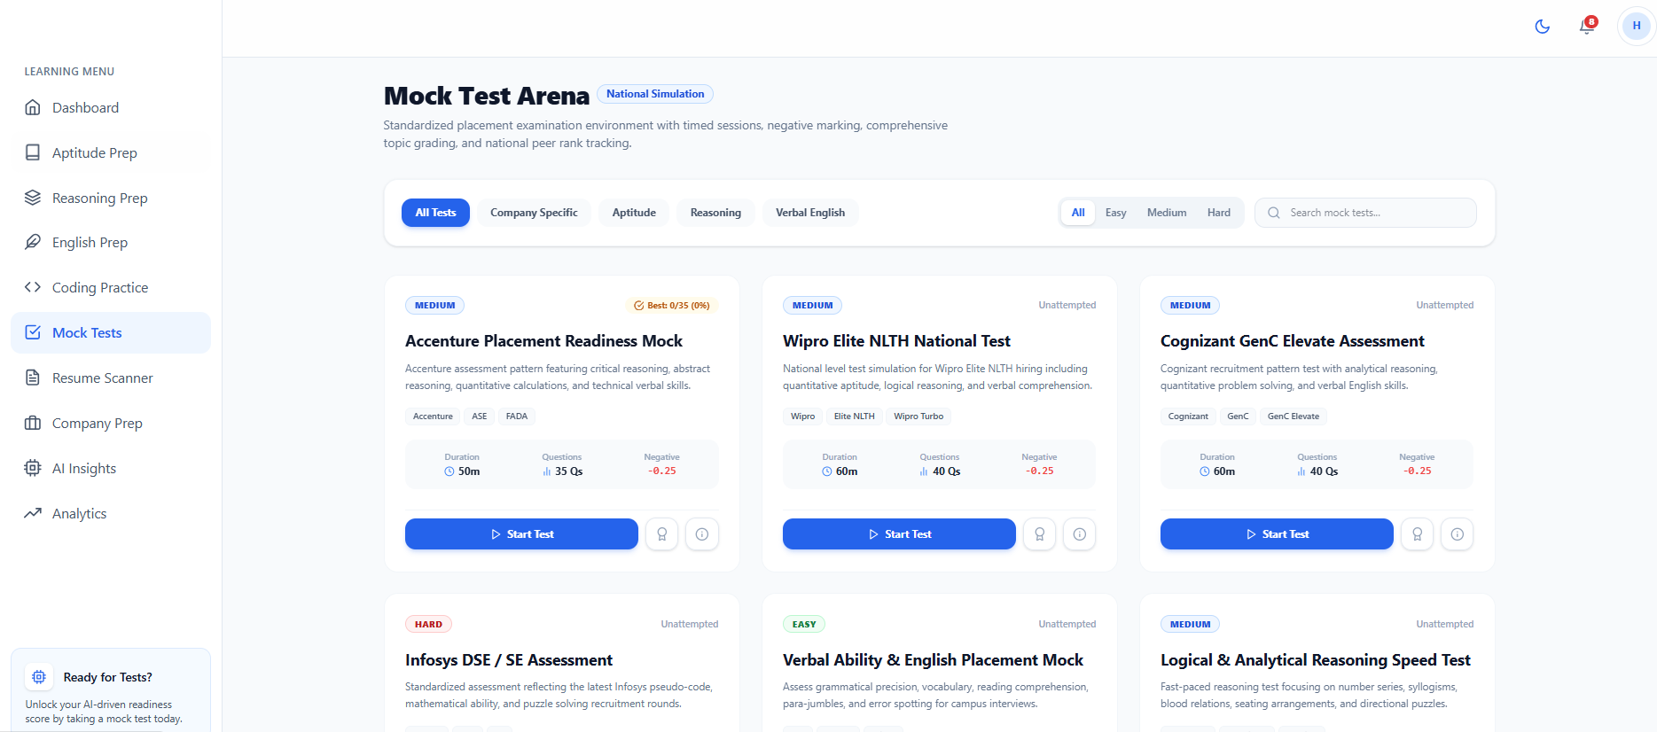
Figure 5.8.8 Mock Test

Slide 54
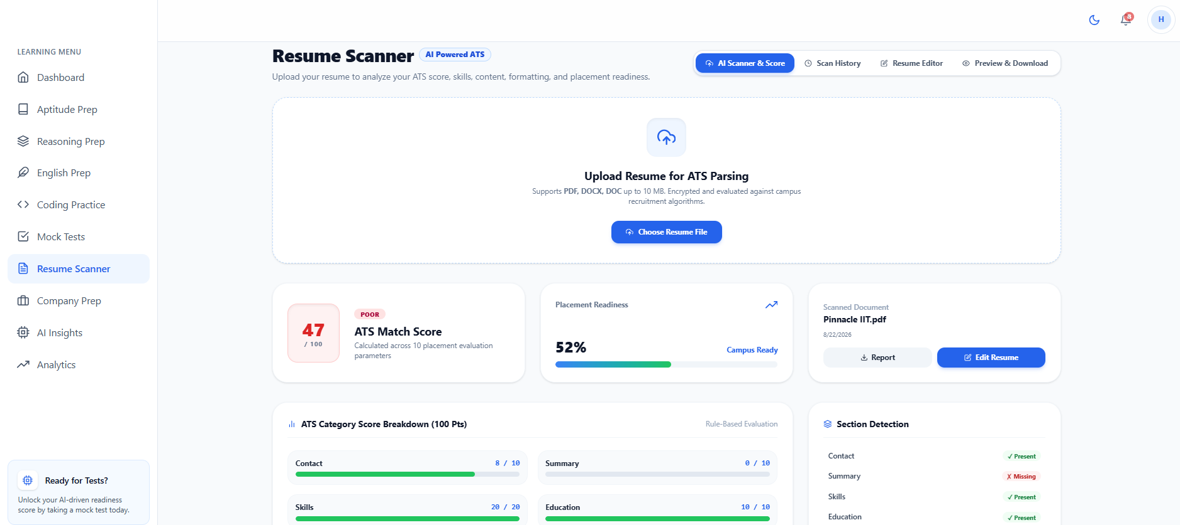
Figure 5.8.9 Resume Scanning

Slide 55
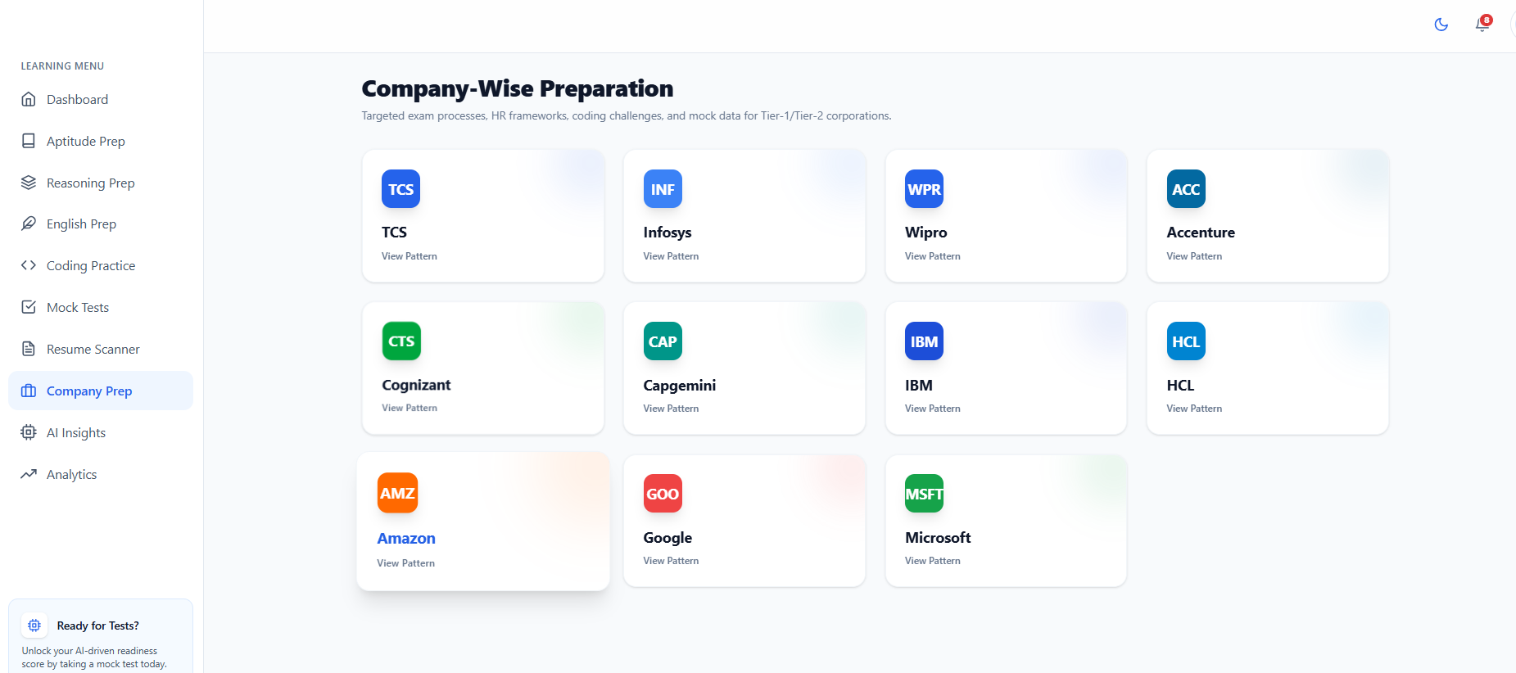
Figure 5.8.10 Company

Slide 56
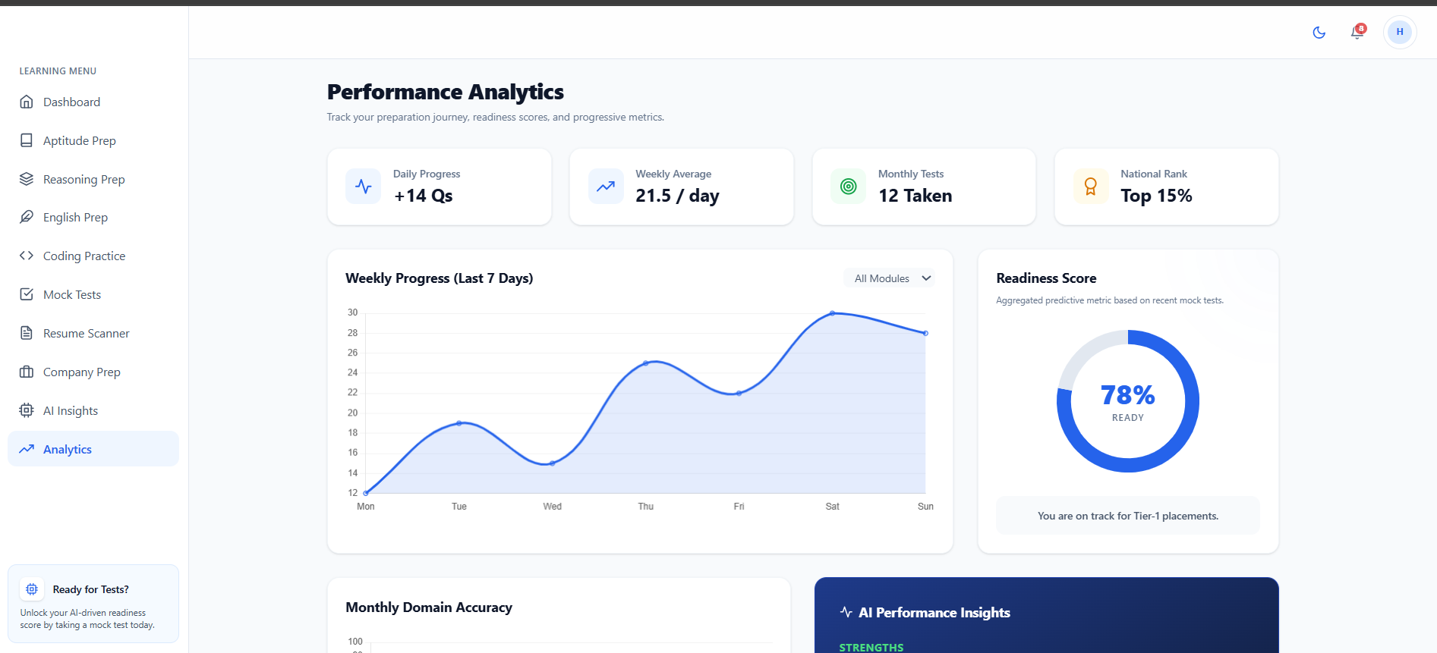
Figure 5.8.11 Analytics

Slide 57
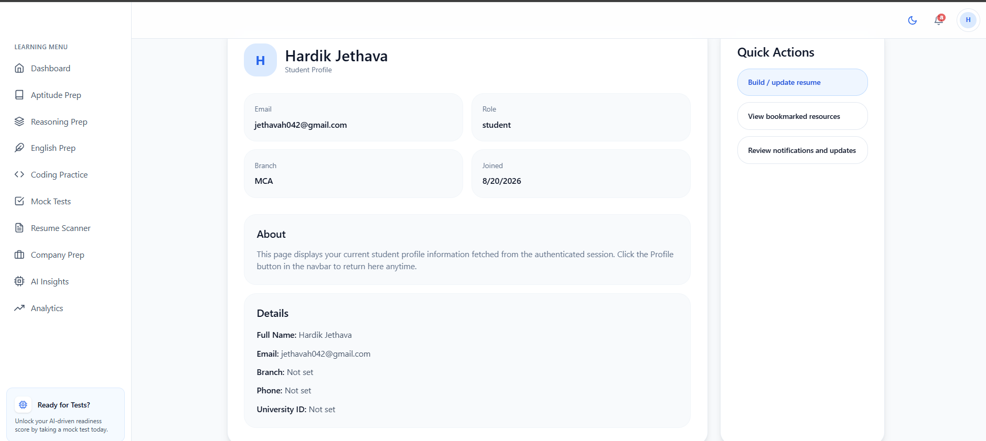
Figure 5.8.12 profile

Slide 58
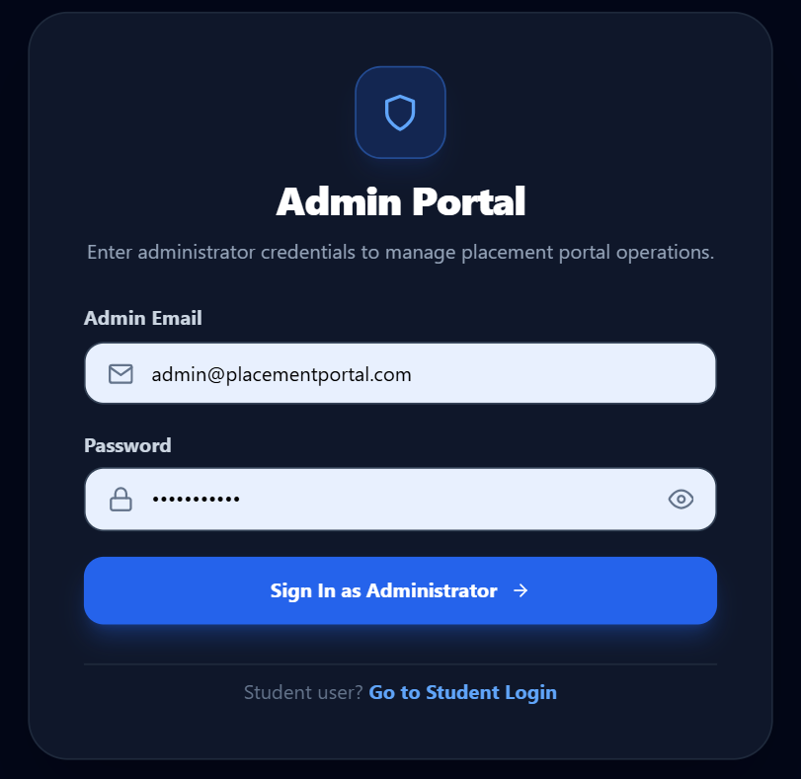
Figure 5.8.13 Admin Login

Slide 59
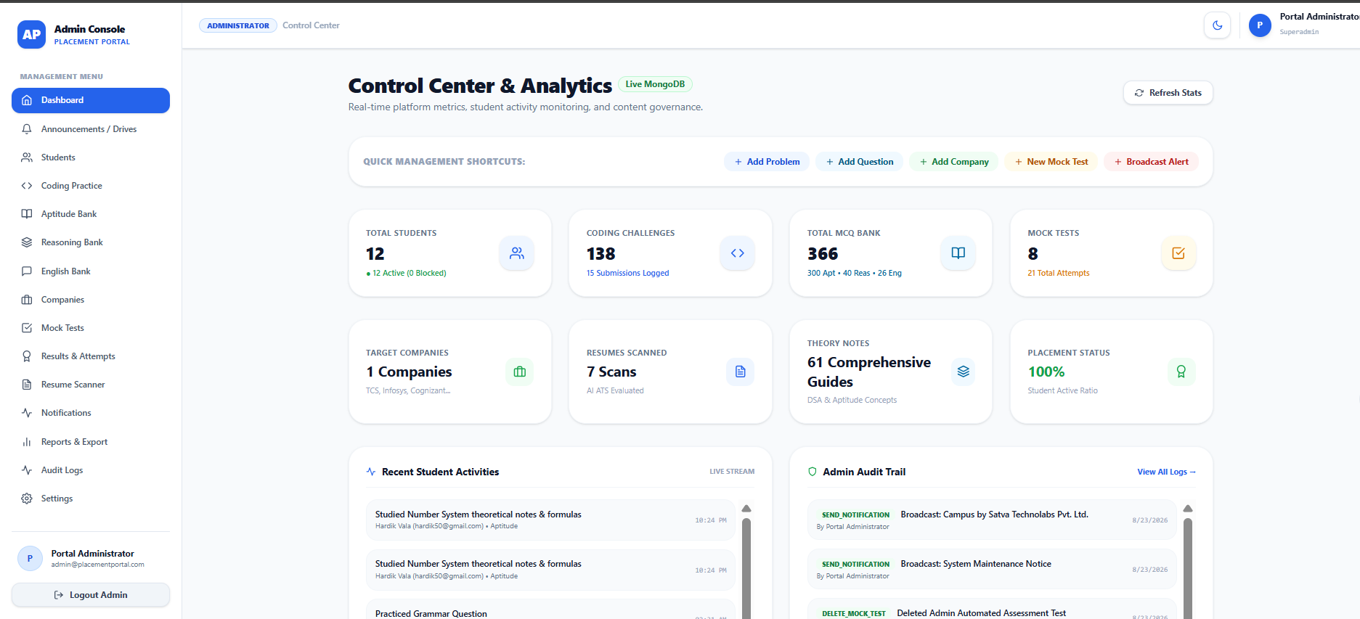
Figure 5.8.14 Admin Dashboard

Slide 60
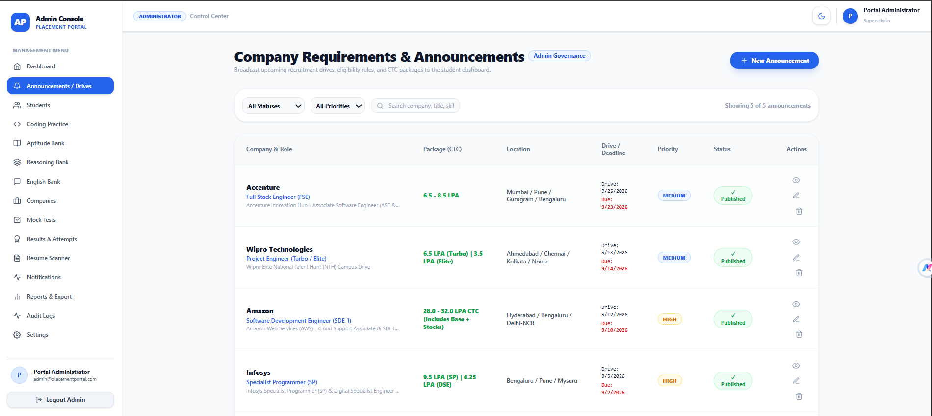
Figure 5.8.15 announcement

Slide 61
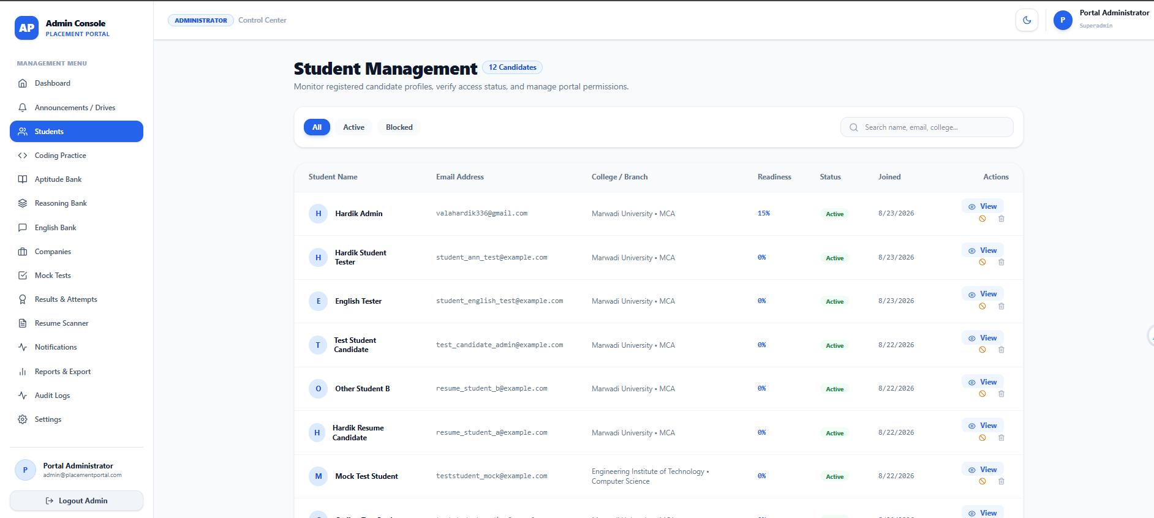
Figure 5.8.16 student management

Slide 62
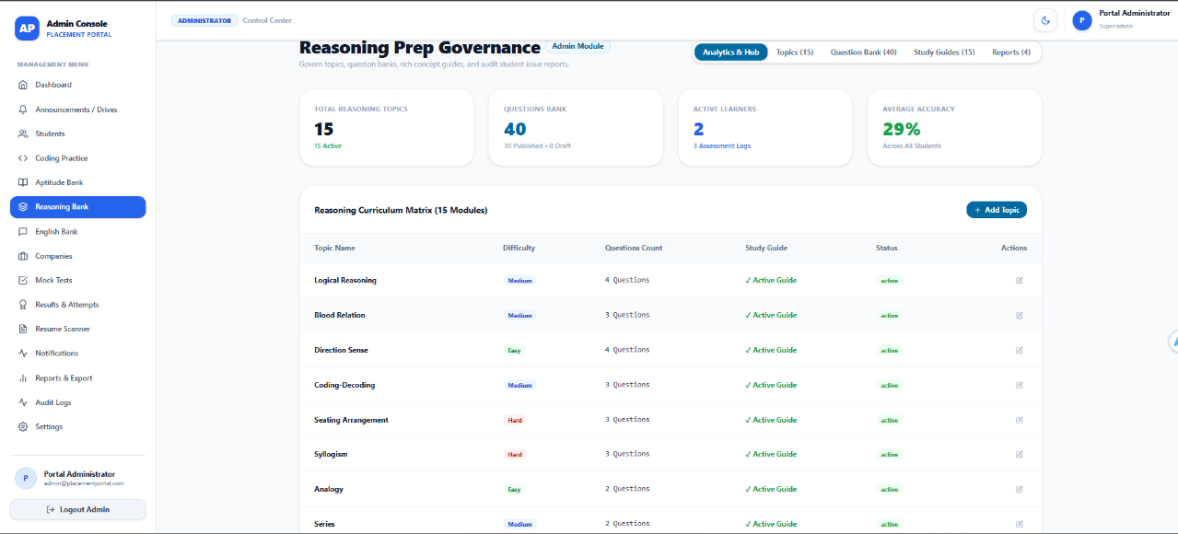
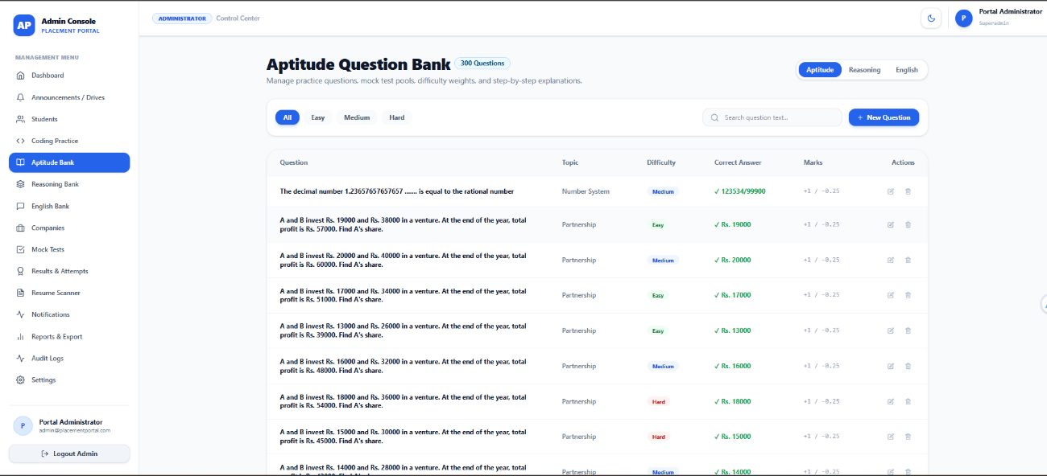
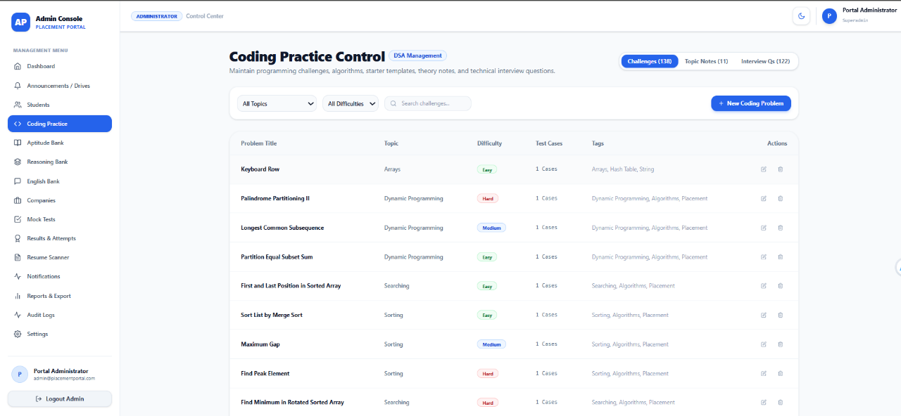
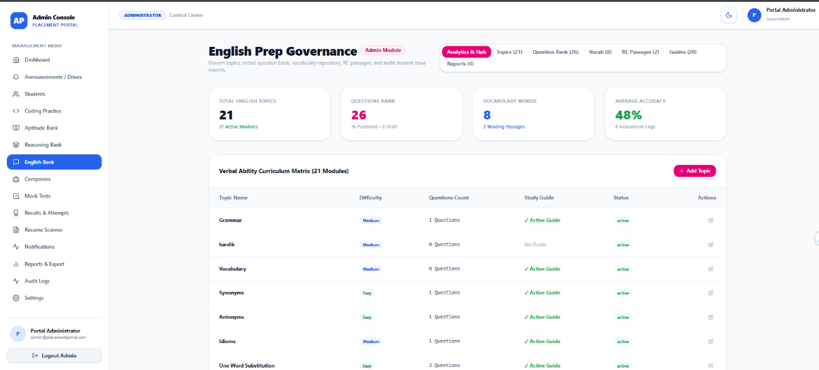
Figure 5.8.17 Manage Components
.

Slide 63
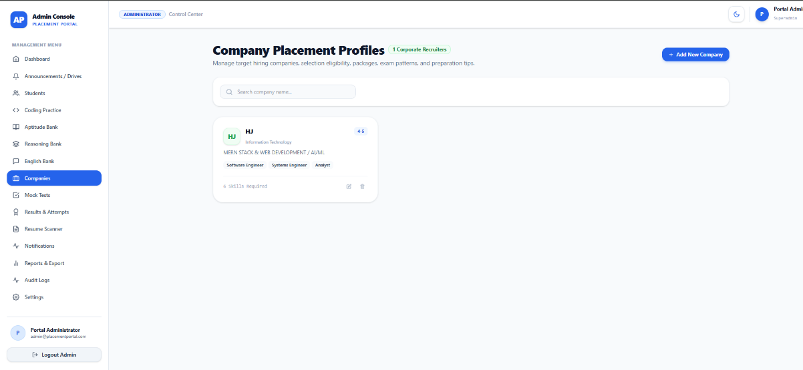
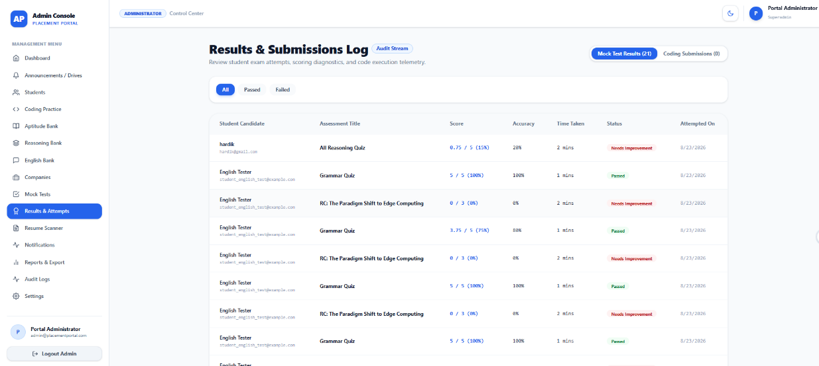
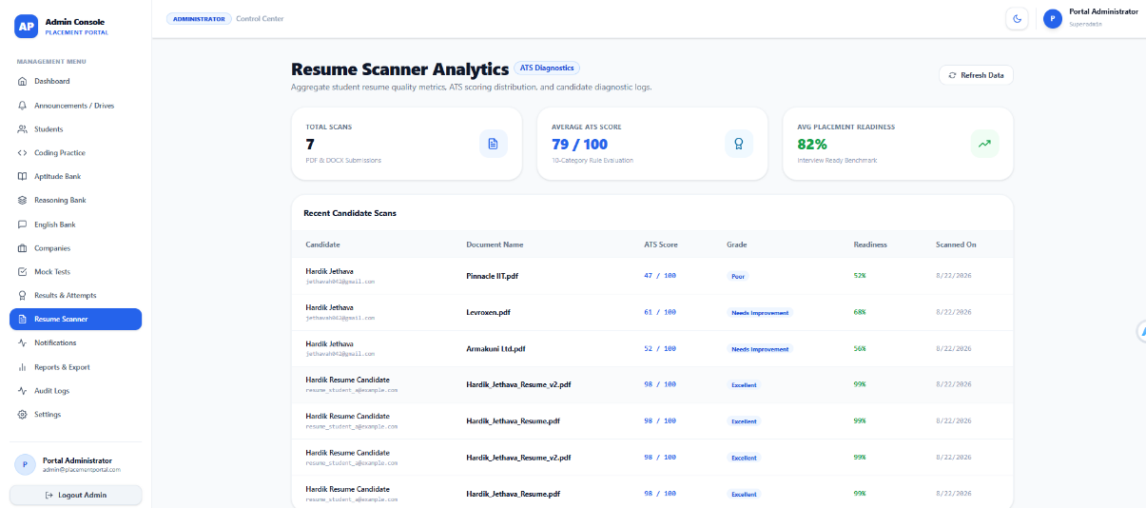
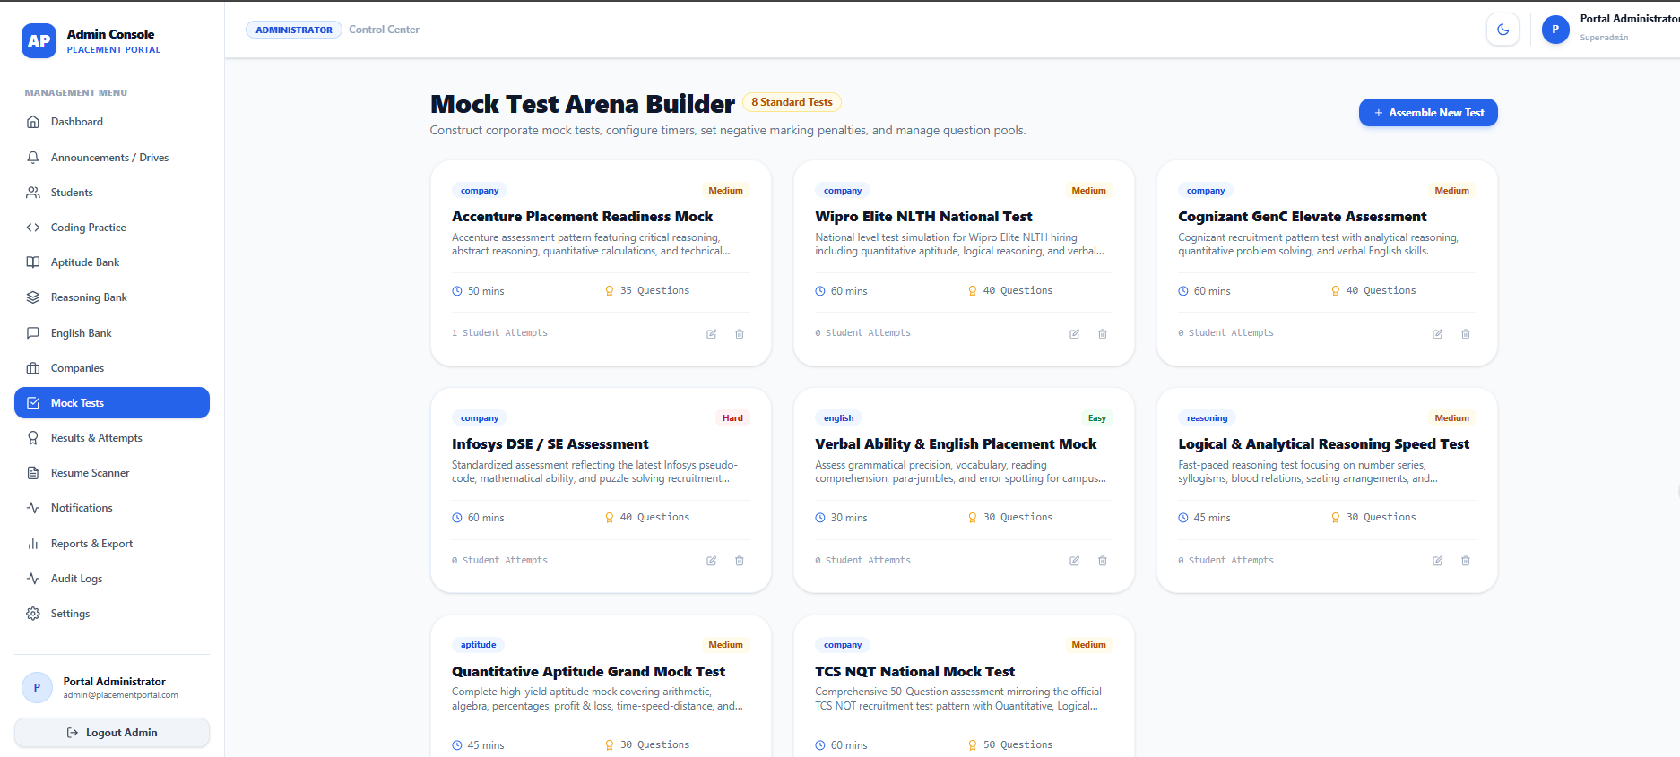
Figure 5.8.18 Manage Component

Slide 64
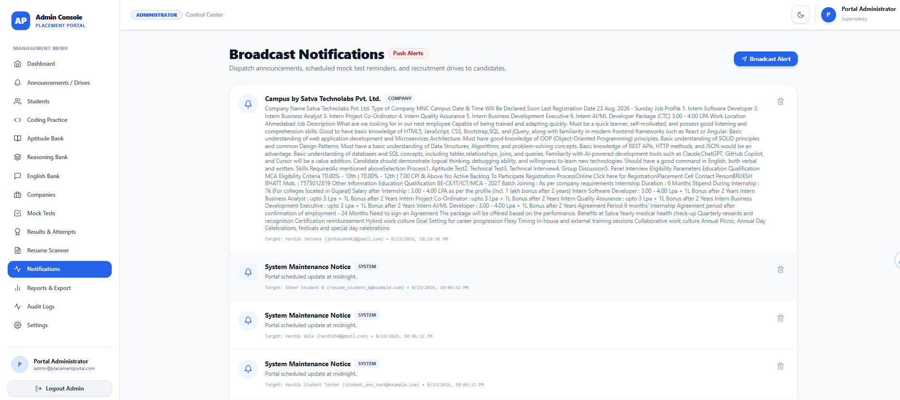
Figure 5.8.19 Notification
.

Slide 65
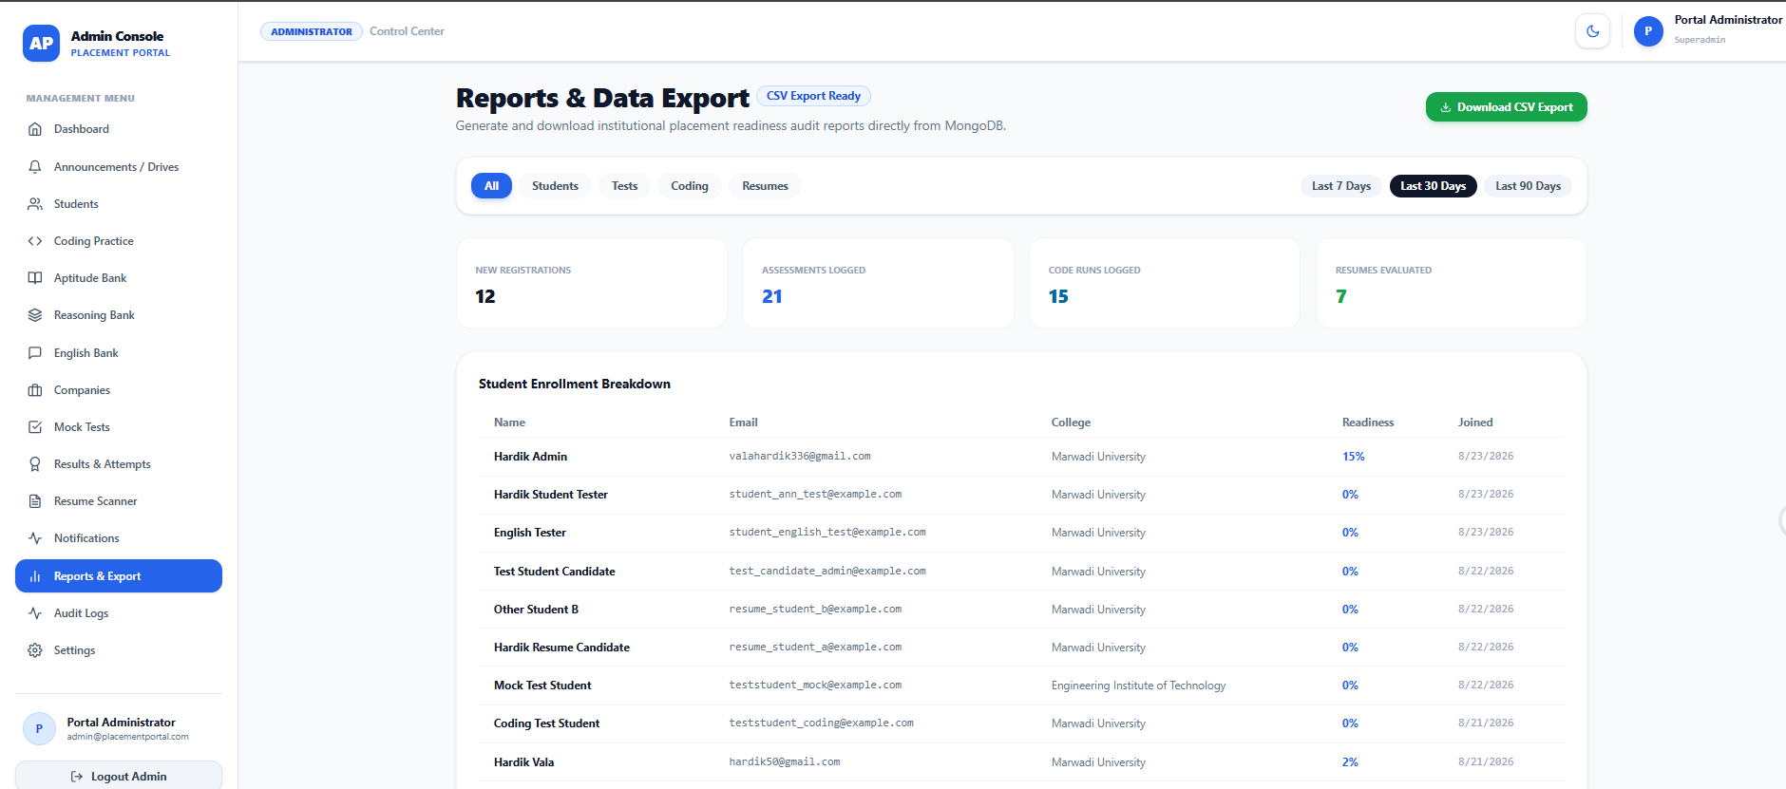
Figure 5.8.20 REPORT
.

Slide 66
6. SYSTEM TESTING
Module 1: Student Registration Testing
Test Case ID | Test Scenario | Test Input | Expected Result | Status
REG-01 | Register with valid details | Valid name, email, password | Account should be created successfully | PASS
REG-02 | Empty name field | Name left blank | Validation message should be displayed | PASS
REG-03 | Empty email field | Email left blank | Validation message should be displayed | PASS
REG-04 | Invalid email format | student@ | Invalid email message should be displayed | PASS
REG-05 | Empty password | Password left blank | Password validation message should appear | PASS
REG-06 | Weak password | Short/weak password | System should reject the password | PASS
REG-07 | Password mismatch | Different password and confirmation password | Mismatch error should be displayed | PASS
REG-08 | Existing email | Already registered email | System should prevent duplicate registration | PASS
REG-09 | Valid registration with optional fields | Valid required and optional information | Account should be created successfully | PASS
REG-10 | Database connection failure | Registration request when database unavailable | Appropriate error message should be displayed | PASS

Slide 67
Module 2: Student Authentication & Login Testing:
Test Case ID | Test Scenario | Test Input | Expected Result | Status
AUTH-01 | Login with valid student credentials | Registered email and correct password | Student should be successfully logged in and redirected to Student Dashboard | PASS
AUTH-02 | Login with valid admin credentials | Admin email and correct password | Admin should be successfully logged in and redirected to Admin Dashboard | PASS
AUTH-03 | Incorrect password | Registered email with wrong password | Login should be rejected with an appropriate error message | PASS
AUTH-04 | Unregistered email | Email not present in database | System should display invalid credentials error | PASS
AUTH-05 | Empty email field | Email left blank | Email validation message should be displayed | PASS
AUTH-06 | Empty password field | Password left blank | Password validation message should be displayed | PASS
AUTH-07 | Invalid email format | Incorrect email format | System should display email validation error | PASS
AUTH-08 | Empty login form | Both fields left blank | Required field validation messages should be displayed | PASS
AUTH-09 | Student accessing Admin Panel | Student token attempts admin route | Access should be denied due to role-based authorization | PASS
AUTH-10 | Admin accessing Student features | Admin token attempts restricted student route | Unauthorized access should be prevented where applicable | PASS
AUTH-11 | Logout testing | Click Logout | User session/token should be cleared and user redirected to Login page | PASS
AUTH-12 | Access protected page without login | Directly open protected URL | User should be redirected to Login page | PASS
AUTH-13 | Invalid/expired JWT token | Expired or invalid authentication token | Request should be rejected and user should be asked to authenticate again | PASS
AUTH-14 | Login after logout | Valid credentials after logout | User should be able to log in successfully again | PASS
AUTH-15 | Database/server unavailable | Login request when backend/database is unavailable | System should display an appropriate error instead of crashing | PASS

Slide 68
Module 3: Placement Content & Question Bank Management Testing
Test Case ID | Test Scenario | Test Input | Expected Result | Status
CNT-01 | Add new preparation note | Valid title, subject, topic, and content | Note should be successfully added | PASS
CNT-02 | Add question with valid details | Question, options, answer, explanation | Question should be stored successfully | PASS
CNT-03 | Add coding problem | Valid problem statement and difficulty | Coding problem should be created successfully | PASS
CNT-04 | View content list | Open Notes/Questions section | All available records should be displayed | PASS
CNT-05 | Edit existing content | Modify title/content/question | Updated information should be saved successfully | PASS
CNT-06 | Delete content | Select an existing record and delete | Selected record should be removed | PASS
CNT-07 | Required field validation | Submit form with required fields empty | Validation messages should be displayed | PASS
CNT-08 | Invalid question data | Missing options or correct answer | System should reject invalid question data | PASS
CNT-09 | Difficulty validation | Select Easy/Medium/Hard | Selected difficulty should be stored correctly | PASS
CNT-10 | Search content | Enter valid keyword | Matching notes/questions should be displayed | PASS
CNT-11 | Filter content | Select subject/topic/difficulty | Relevant records should be displayed | PASS
CNT-12 | Student content access | Student opens preparation module | Admin-created content should be displayed to the student | PASS
CNT-13 | Updated content synchronization | Admin edits existing content | Updated content should be reflected in Student Panel | PASS
CNT-14 | Unauthorized content management | Student attempts Admin CRUD operation | Access should be denied | PASS
CNT-15 | Database/server error | Database unavailable during operation | Appropriate error message should be displayed without crashing | PASS

Slide 69
Module 4: Mock Test & Assessment Testing
Test Case ID | Test Scenario | Test Input | Expected Result | Status
TEST-01 | Open available mock tests | Student selects Mock Test | Available tests should be displayed | PASS
TEST-02 | Start aptitude test | Select Aptitude Mock Test | Test should start successfully | PASS
TEST-03 | Start reasoning test | Select Reasoning Mock Test | Test should start successfully | PASS
TEST-04 | Start English test | Select English Mock Test | Test should start successfully | PASS
TEST-05 | Start coding test | Select Coding Mock Test | Coding test should start successfully | PASS
TEST-06 | Start mixed placement test | Select Mixed Test | Mixed test should load correctly | PASS
TEST-07 | Verify 30 questions | Start configured 30-question test | Exactly 30 questions should be displayed | PASS
TEST-08 | Question navigation | Move between questions | Previous/Next navigation should work correctly | PASS
TEST-09 | Select answer | Select an option | Selected answer should be saved | PASS
TEST-10 | Change answer | Select another option | Previous answer should be replaced correctly | PASS
TEST-11 | Skip question | Move without selecting answer | Question should remain unanswered | PASS
TEST-12 | Timer functionality | Start timed test | Countdown timer should start correctly | PASS
TEST-13 | Timer expiration | Allow timer to reach zero | Test should be automatically submitted | PASS
TEST-14 | Manual submission | Click Submit Test | Test should be submitted successfully | PASS
TEST-15 | Correct answer scoring | Submit correct answers | Correct answers should receive marks | PASS
TEST-16 | Incorrect answer scoring | Submit incorrect answers | Incorrect answers should be evaluated correctly | PASS
TEST-17 | Negative marking | Submit incorrect answer in negative-marking test | Applicable negative marks should be deducted | PASS
TEST-18 | Result generation | Complete test | Score, correct, incorrect, and skipped answers should be displayed | PASS
TEST-19 | Result persistence | Complete and submit test | Result should be saved in MongoDB | PASS
TEST-20 | Performance analysis | View completed test result | Accuracy, percentage, and performance analysis should be displayed | PASS
TEST-21 | Test history | Open previous test attempts | Previous test results should be displayed | PASS
TEST-22 | Unauthorized test submission | Invalid/expired authentication token | Submission should be rejected | PASS
TEST-23 | Refresh during test | Refresh test page | System should handle the session appropriately without corrupting the test result | PASS
TEST-24 | Server/database failure | Submit test when server/database unavailable | Appropriate error should be displayed | PASS

Slide 70
7. CONCLUSION
The Placement Preparation Portal was developed as a comprehensive web-based platform to help students prepare effectively for campus placements through a single centralized system. The project integrates multiple placement preparation activities, including Aptitude, Reasoning, English, Programming Languages, Coding Practice, Mock Tests, Company Preparation, Resume Scanner, AI-assisted Interview Preparation, and Performance Analytics.
The system provides students with topic-wise study material, practice questions, quizzes, coding challenges, and timed mock tests. Students can view their test results, track their preparation progress, identify weak areas, and improve their overall placement readiness. The Resume Scanner further helps students review their resumes and receive suggestions for improvement.
The Admin Panel provides centralized and dynamic management of students, notes, questions, coding problems, companies, mock tests, and results. This allows preparation content to be updated without modifying the application manually.

Slide 71
8. LEARNING DURING PROJECT WORK
During the development of the Placement Preparation Portal, several technical and practical skills were gained through the design, development, testing, and integration of the system.
MERN Stack Development
Frontend Development
Backend Development
Database Management
Authentication and Authorization
API Integration
Dynamic Content Management
Testing and Debugging
Mock Test and Result Processing
Project Architecture
Problem-Solving Skills
Project Management
Documentation Skills
Deployment and Production Concepts

Slide 72
8.1 Future Enhancement:
Native WebHID Barcode Scanner Integration: Implementing browser-level WebHID and WebUSB APIs for zero-latency direct device communication.
Multi-Store Warehouse Synchronization: Extending schema architecture to support multi-branch supermarket chains with central warehouse tracking.
AI-Driven Demand Forecasting: Machine Learning integration (ARIMA time-series models) for predicting product demand trends and automated supplier purchase order drafting.
Customer Loyalty & Rewards System: Points-based customer rewards module integrated into cashier POS checkout.
Offline PWA Support: Service Worker and IndexedDB integration enabling offline POS billing during network outages.
Integrated Dynamic Payment Gateway: Instant UPI QR code generation directly on POS billing screen.

Slide 73
9. BIBLIOGRAPHY
9.1 Online References:
React.js Documentation — https://react.dev/
Vite Documentation — https://vite.dev/
Node.js Documentation — https://nodejs.org/docs/
Express.js Documentation — https://expressjs.com/
MongoDB Documentation — https://www.mongodb.com/docs/
Mongoose Documentation — https://mongoosejs.com/docs/
JWT — https://jwt.io/
Axios Documentation — https://axios-http.com/docs/intro
Tailwind CSS Documentation — https://tailwindcss.com/docs
Mermaid Documentation — https://mermaid.js.org/
MDN Web Docs — https://developer.mozilla.org/
GitHub Documentation — https://docs.github.com/
OpenAI Documentation — https://platform.openai.com/docs/

Slide 74
9.2 Offline References:
Pressman, R. S. — Software Engineering: A Practitioner's Approach, McGraw-Hill Education.
Sommerville, Ian — Software Engineering, Pearson Education.
Silberschatz, Abraham, Henry F. Korth, and S. Sudarshan — Database System Concepts, McGraw-Hill.
Eloquent JavaScript — Marijn Haverbeke, No Starch Press.
JavaScript: The Definitive Guide — David Flanagan, O'Reilly Media.
Learning Web Design — Jennifer Niederst Robbins, O'Reilly Media.
Node.js Design Patterns — Mario Casciaro and Luciano Mammino, Packt Publishing.
MongoDB: The Definitive Guide — Shannon Bradshaw, Eoin Brazil, and Kristina Chodorow, O'Reilly Media.
Clean Code — Robert C. Martin, Prentice Hall.
System Analysis and Design — Kenneth E. Kendall and Julie E. Kendall, Pearson Education.

Slide 75
Thank You

