Slide 1
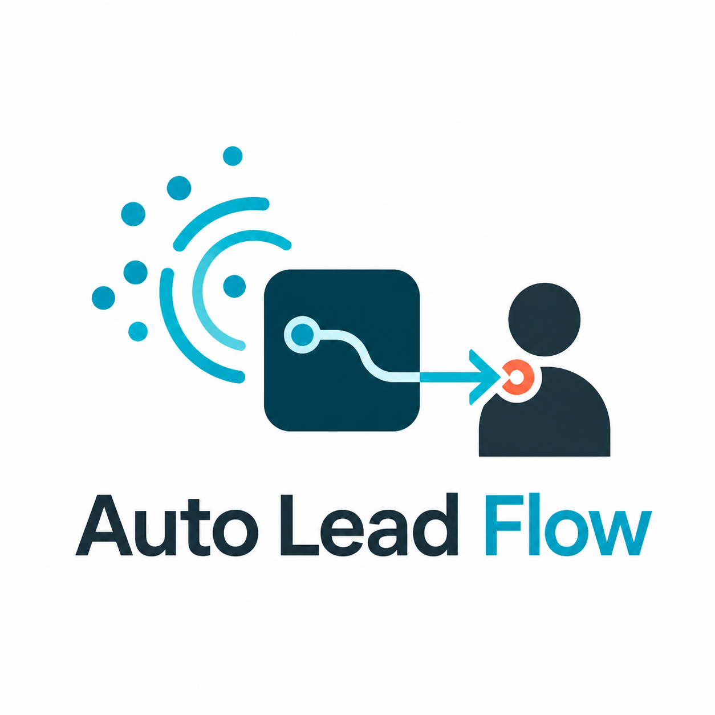
Auto Lead Flow
Verifiable Social Lead Automation
for Configurable Sales Agents
Automated social lead discovery, real outreach, and persistent follow-up
Discover
Qualify
Outreach
Follow-up
Notes:
Open with the simple story: social intent already exists online, but sales teams still find and message people manually. Auto Lead Flow automates discovery, qualification, real-phone outreach, and follow-up.

Slide 2
Social Lead Generation Is Still Too Manual
Social acquisition still depends on manual search, judgment, and repeated outreach.
Manual discovery
Scattered context
Hard to audit
Sales teams scroll posts and comments to find people who may be ready to buy.
Budget, location, urgency, concerns, and past replies are split across conversations.
It is difficult to prove why a lead was scored or why a message was sent.
High-frequency work, low automation, fragile memory.
Auto Lead Flow / 2
Notes:
Use this slide to anchor the pain. The customer problem is not just CRM storage: the manual work starts on social platforms before the lead exists in a CRM.

Slide 3
High-intent Leads Already Express Needs Online
Many potential customers already reveal clear buying needs in social content.
Budget
price-sensitive
Xiaohongshu post / comment
"Looking for a three-bedroom near the High-Tech District. Budget matters, and commute should be easy."
Location
high-tech district
Layout
three-bedroom
This is not a cold lead. It is a visible buying signal.
Concern
commute
Intent
active buyer
Auto Lead Flow / 3
Notes:
The demo scenario starts from a concrete social signal. The system turns unstructured text into a structured lead profile.

Slide 4
Auto Lead Flow: From Social Intent to Outreach
A configurable sales-agent workflow for discovery, qualification, real outreach, and follow-up.
Social
Listening
Qualify
Lead
Memory
Recall
Real-device
Outreach
Reply
Polling
Follow-up
Loop
The agent role, industry scenario, tone, qualification fields, and follow-up strategy are configurable through playbooks.
Playbooks make the same engine adaptable across real estate and other social lead-generation scenarios.
Auto Lead Flow / 4
Notes:
This is the product definition slide. Emphasize that real outreach is part of the workflow, not just a dashboard simulation.

Slide 5
Demo: From Xiaohongshu Signal to Real Outreach
The demo shows the complete loop from social intent to real DM outreach and continued follow-up.
1
2
3
4
5
6
Discover
Extract
Score
Reach out
Listen
Continue
Find buyer intent in posts/comments
Budget, location, layout, concerns
Decide whether the lead is worth outreach
Send personalized DM through a real Android app
Poll customer replies and sync transcript
Recall context and generate next follow-up
Dashboard shows lead status, timeline, memory, outreach records, and verifiable artifacts.
Auto Lead Flow / 5
Notes:
This slide maps directly to the live demo order. Keep it moving: discover, extract, score, send, poll, continue.

Slide 6
Core Capabilities
Built around the real social acquisition workflow, not just a CRM screen.
Social Lead Discovery
Real-device Outreach
Search posts and comments for buying intent, then turn unstructured social content into leads.
Send first-touch private messages through a real social app account on a real Android phone.
Configurable Industry Agent
Long-term Follow-up
Use playbooks to configure role, tone, qualification fields, and follow-up strategy.
Recall customer context across sessions and workers, then continue multi-touch conversion.
Auto Lead Flow / 6
Notes:
The core capability list should make judges remember the differentiators: discovery, phone outreach, configurable playbooks, memory-driven follow-up.

Slide 7
Why Walrus: Make Agent Actions Verifiable
Agent automation should not be a black box; every business action can leave a verifiable record.
Black-box
automation
Verifiable
business records
Walrus stores immutable artifacts that explain what the agent saw, decided, sent, and handed off.
Source evidence
Scoring report
Outreach decision
Trace + handoff proof
Auto Lead Flow / 7
Notes:
Frame Walrus as business trust: source proof, decision proof, trace proof, and handoff proof.

Slide 8
Beyond Real Estate
The demo starts with Xiaohongshu and real-estate sales, but the system is a configurable industry lead agent.
Playbook-configured
Sales Agent
Scenario playbooks
Real Estate
Automotive
Education
Insurance
Home Renovation
B2B SaaS
Any high-consideration sales workflow with social intent, repeated outreach, and long decision cycles can adapt the same engine.
Auto Lead Flow / 8
Notes:
The point is extensibility: configure fields and strategy through playbooks rather than hardcoding real estate forever.

Slide 9
Turn Social Intent
into Verifiable Outreach
Discover, qualify, reach out, and follow up with high-intent social leads automatically.
Social buying intent becomes verifiable, persistent customer outreach.
Discover
Qualify
Outreach
Follow-up
Notes:
Close by repeating the one-line message. Auto Lead Flow converts social intent into real, verifiable outreach.

