Slide 1
Analysis and Predictive Models: Chronic Kidney Disease (CKD)
Holmusk Interview Challenge
Jetin E Thomas

Slide 2
Description of Datasets
The Dataset that is analyzed consists of 300 patients who have been diagnosed with chronic kidney disease (CKD). Their demographic information, medications and lab measurements along with their time is given in the dataset.
The demographic information consists of the race, gender and age of the patients.
The lab measurements performed on the patients are their serum creatinine count in mg/dl, diastolic blood pressure in mmHg, systolic blood pressure in mmHg, Hemoglobin level in g/dl, glucose level in mmol/l, low density lipoprotein level in mg/dl along with the time of measurement in days.
The medications given to them along with the starting and ending day of the prescription.
Additionally, a datasheet telling these patients have progressed in chronic kidney disease or not.

Slide 3
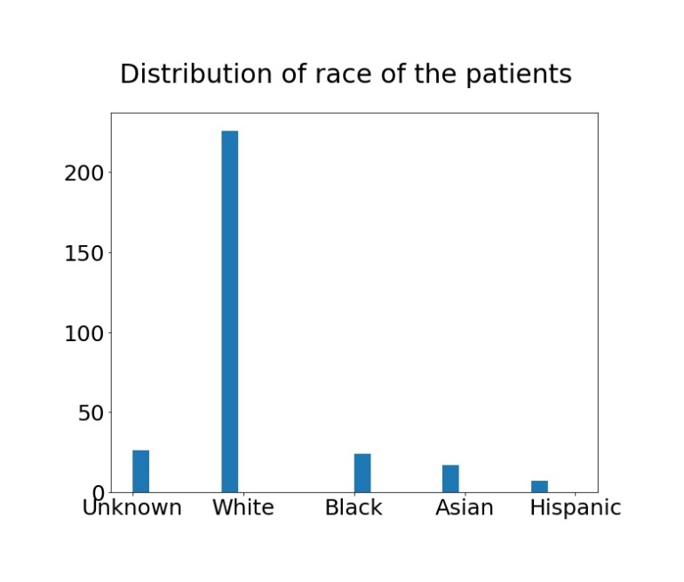
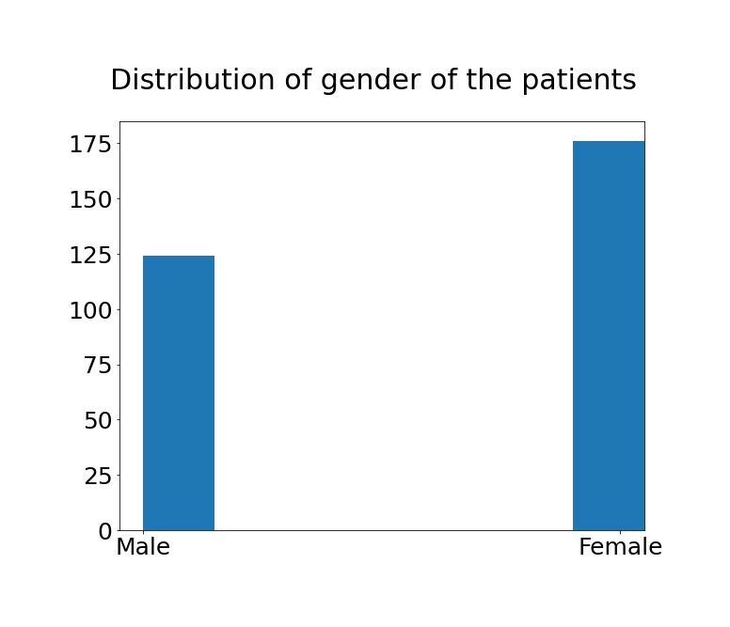
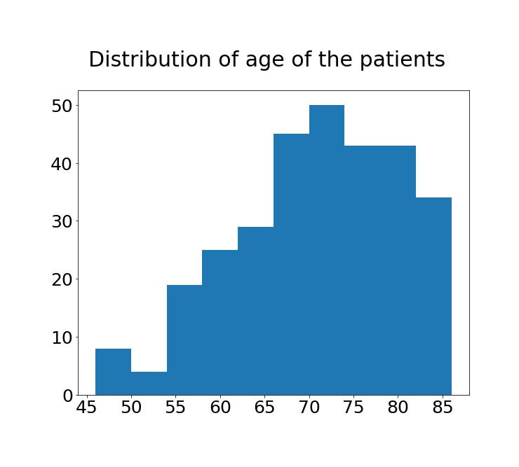
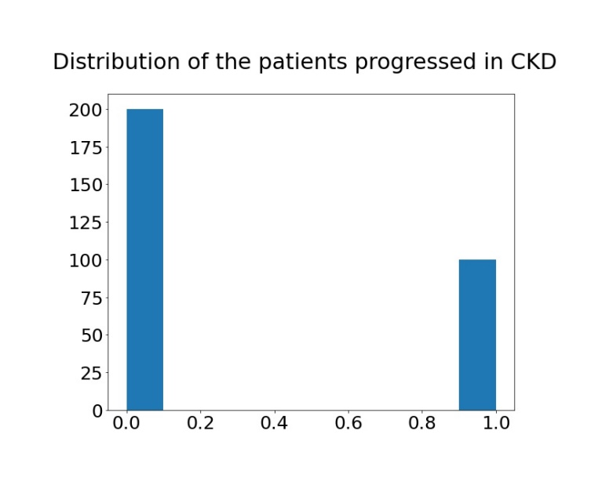
Analysis: Demographic Information

Slide 4
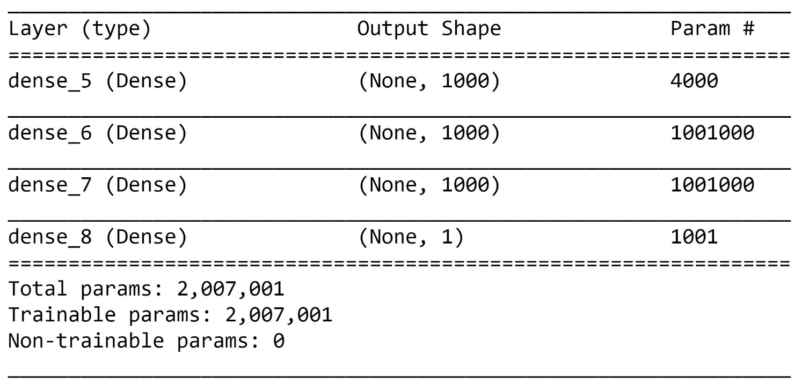
Predictive Model: Lab measurements including time in dataset
Neural Network based on Logistic Regression

Slide 5
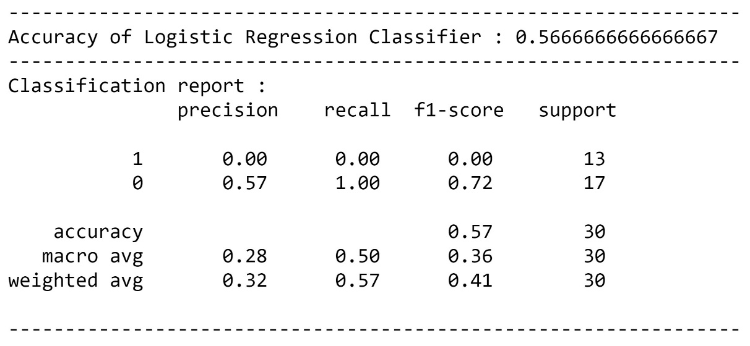
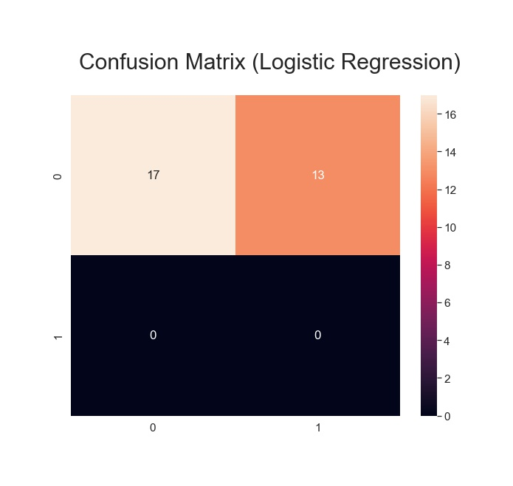
Results: Demographic Information
Logistic Regression

Slide 6
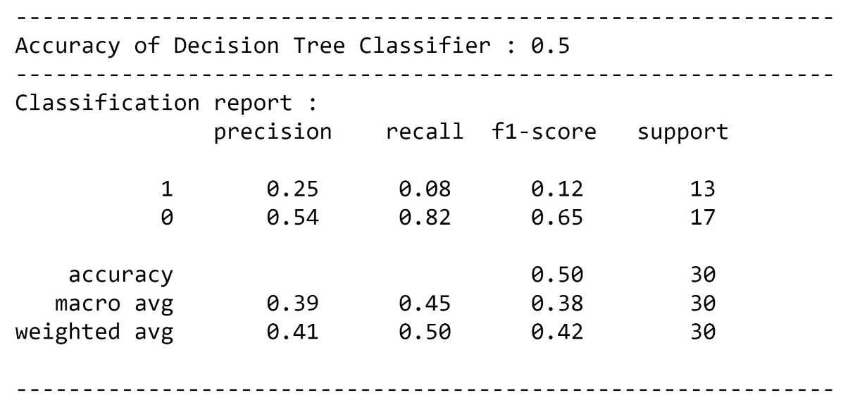
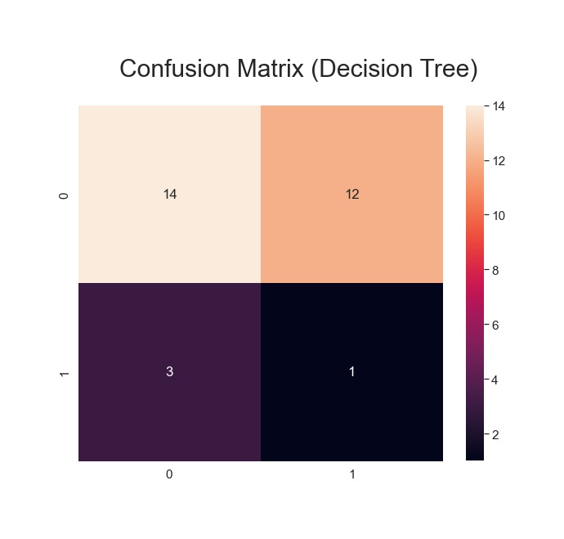
Results: Demographic Information
Decision Tree

Slide 7
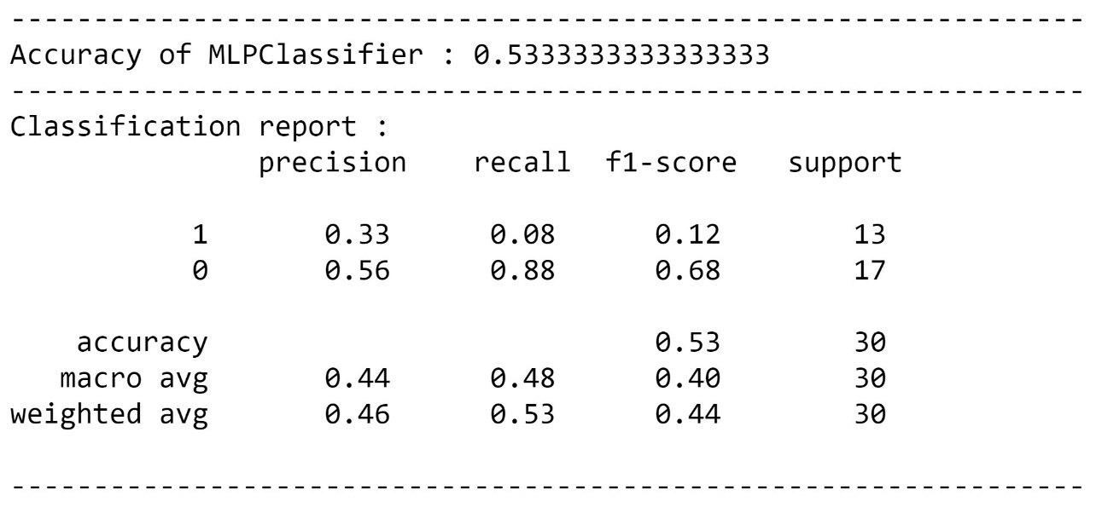
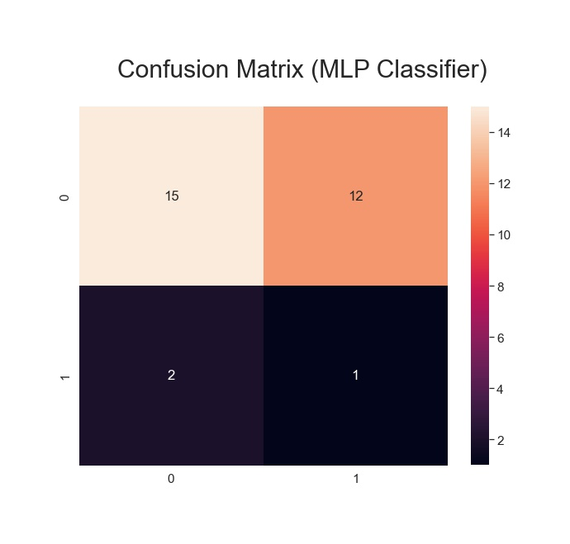
Results: Demographic Information
MLP Classifier

Slide 8
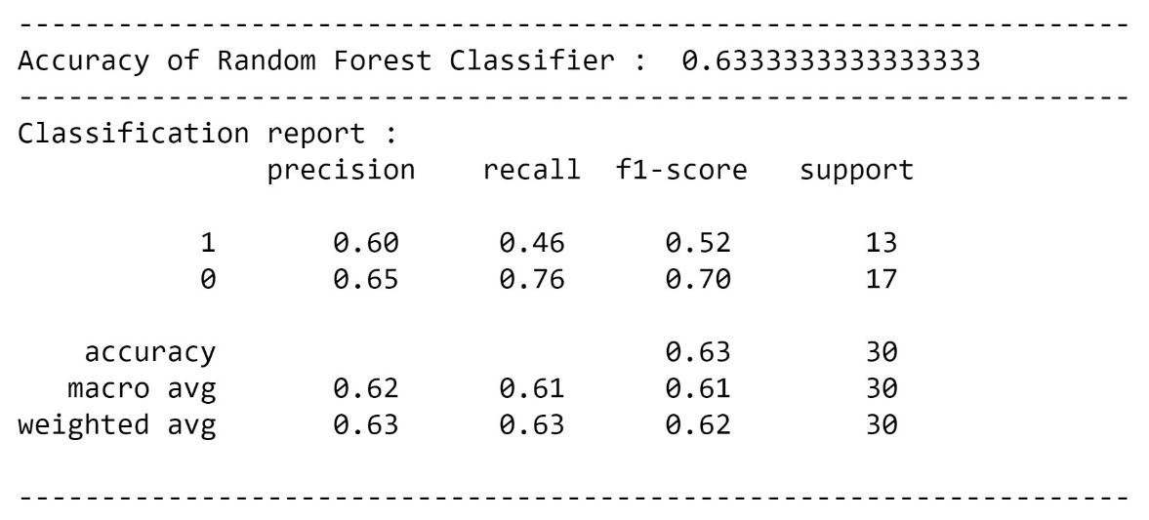
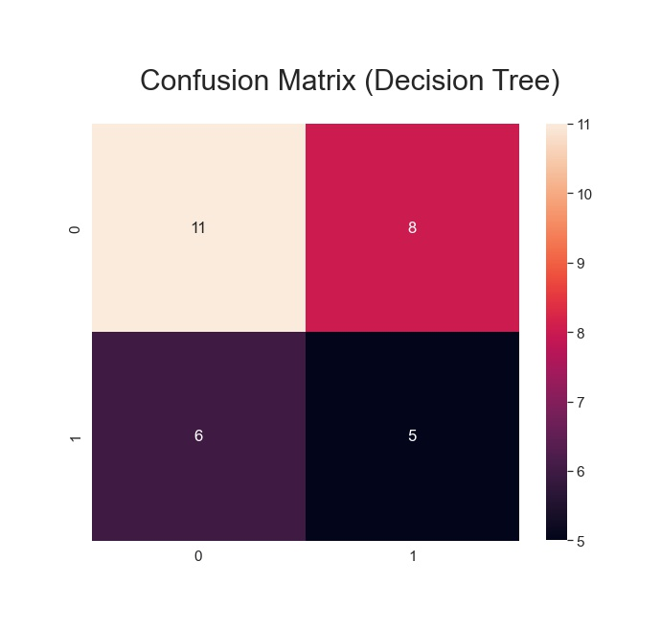
Results: Demographic Information
Random Forest

Slide 9
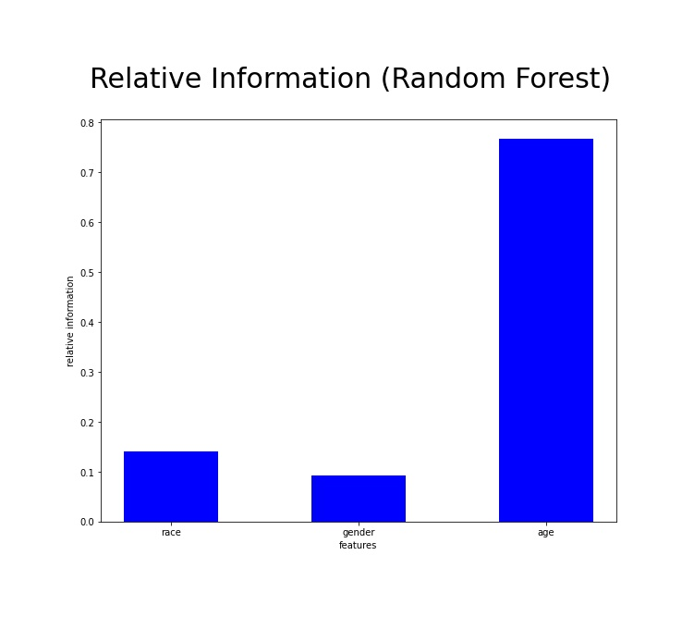
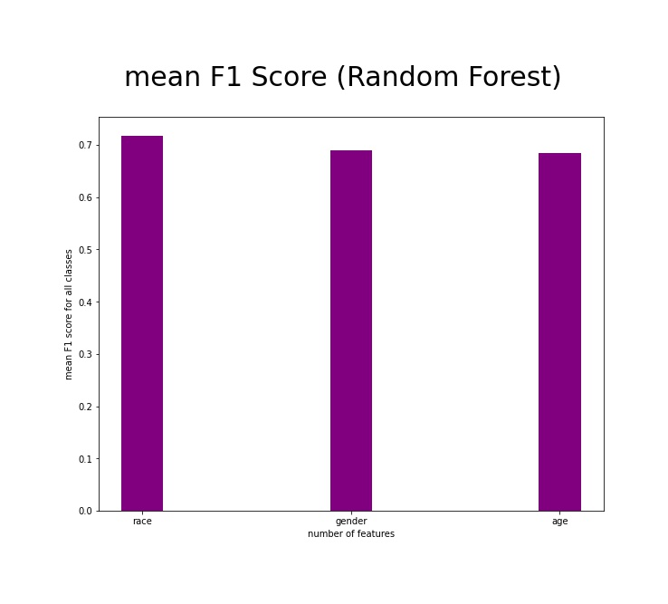
Further Results: Demographic Information
Random Forest

Slide 10
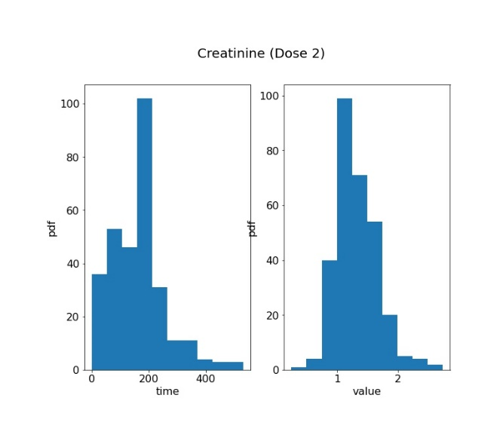
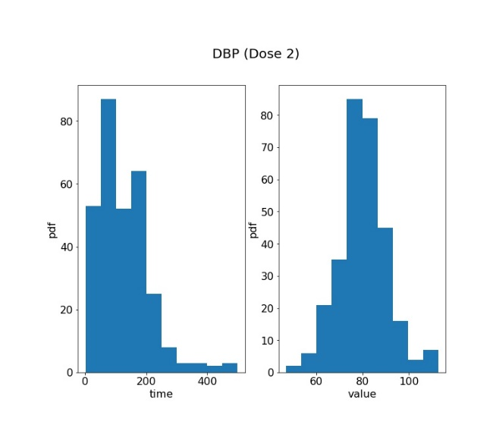
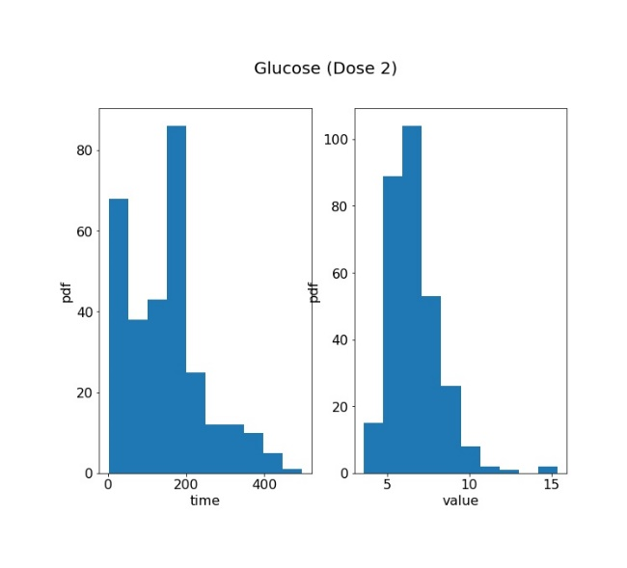
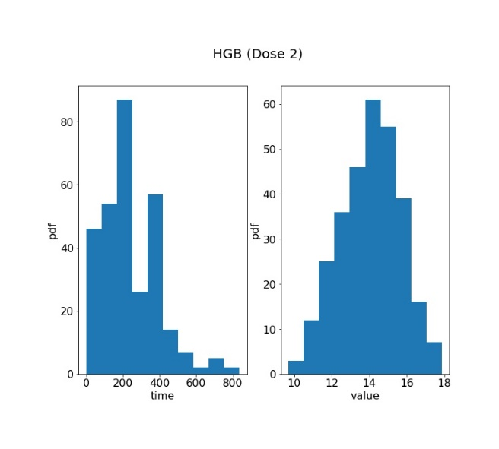
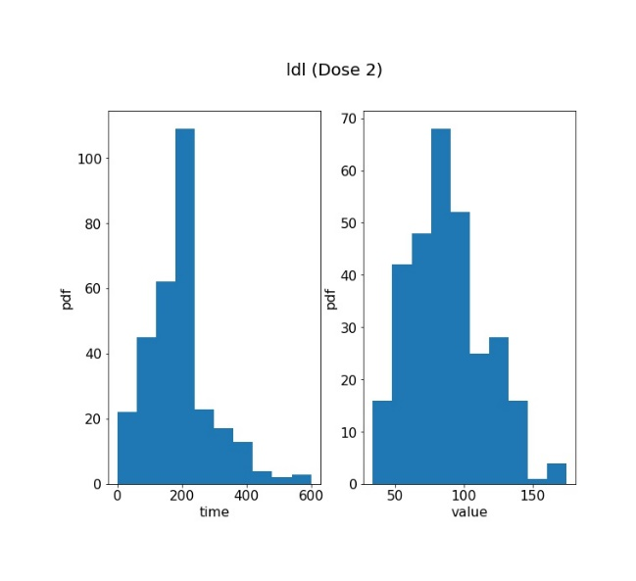
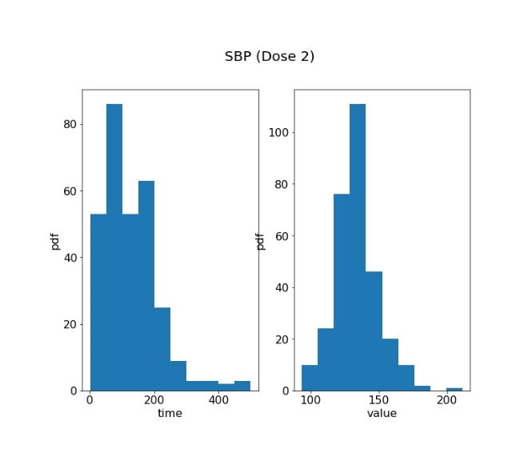
Analysis: Lab measurements including time in dataset

Slide 11
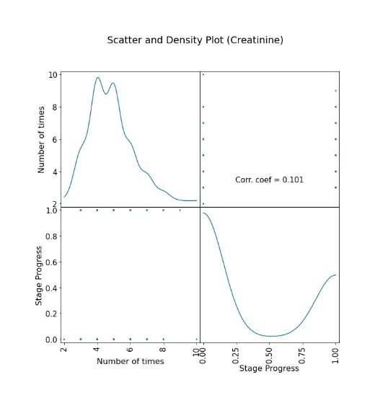
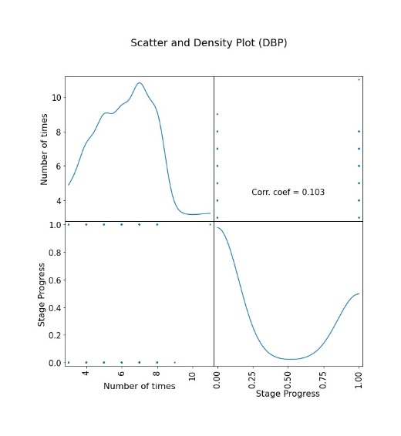
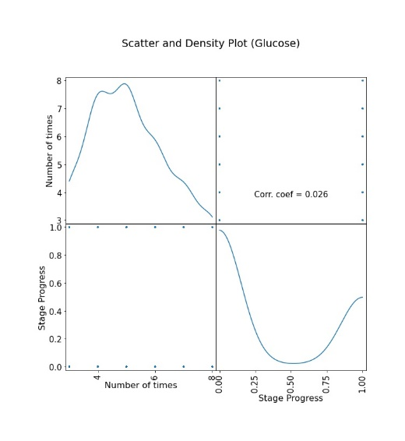
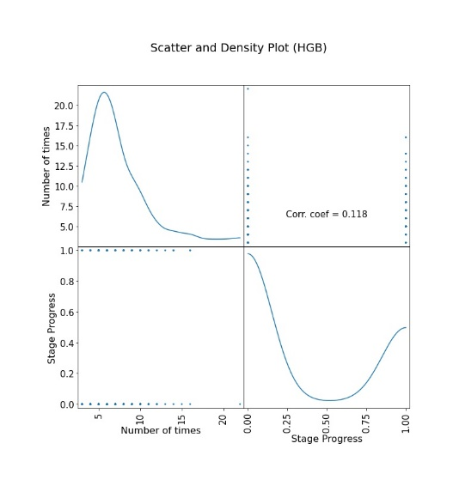
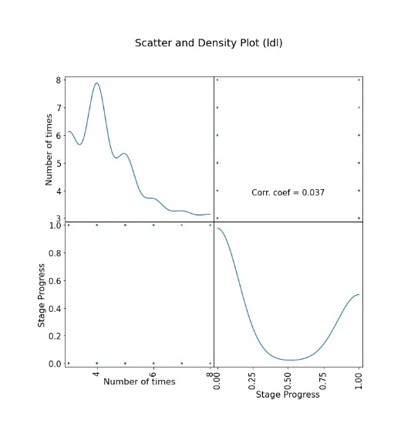
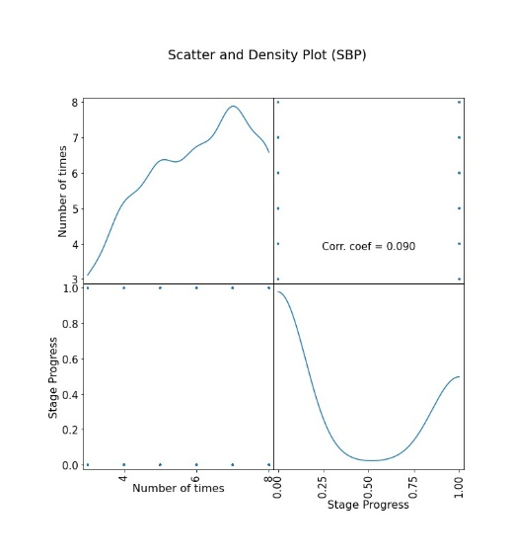
Analysis: Lab measurements including time in dataset

Slide 12
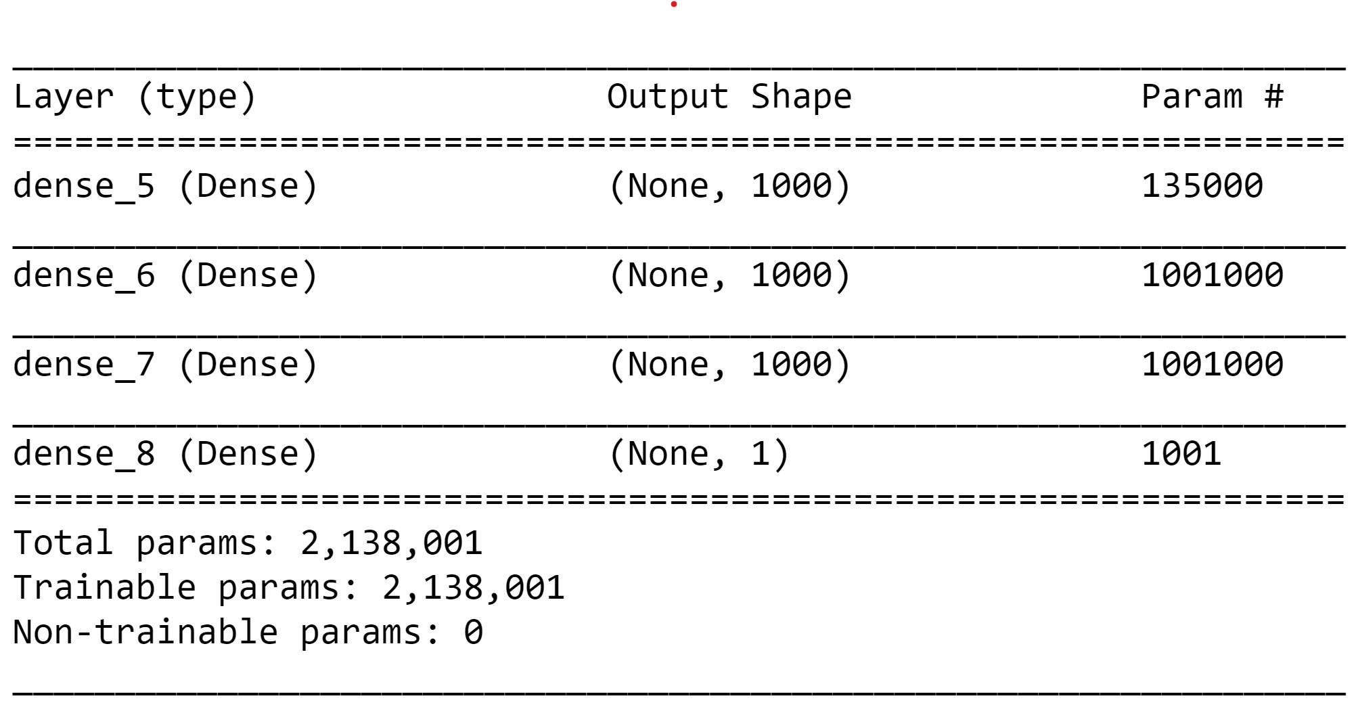
Predictive Model: Lab measurements including time in dataset
Neural Network based on Logistic Regression

Slide 13
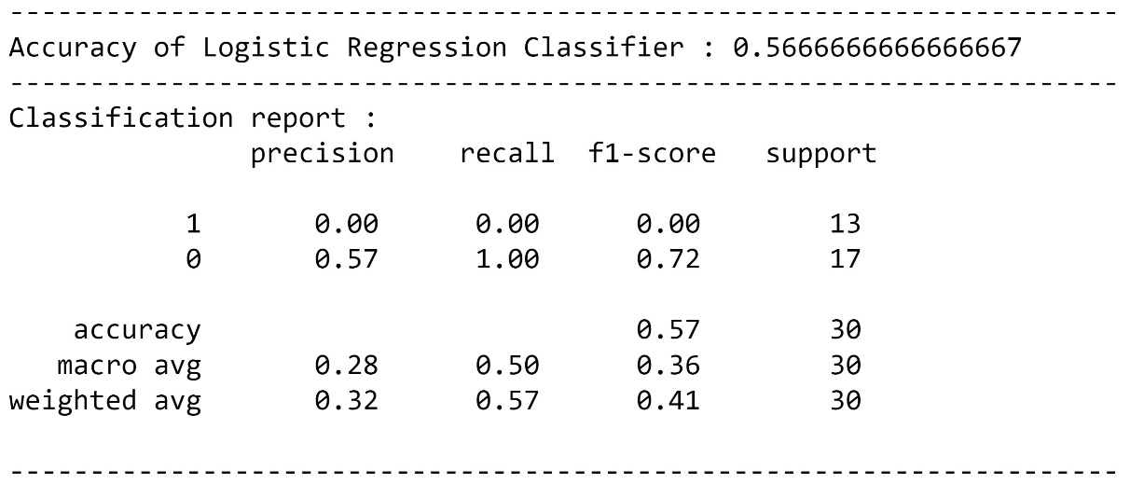
Results: Lab measurements including time in dataset
Logistic Regression

Slide 14
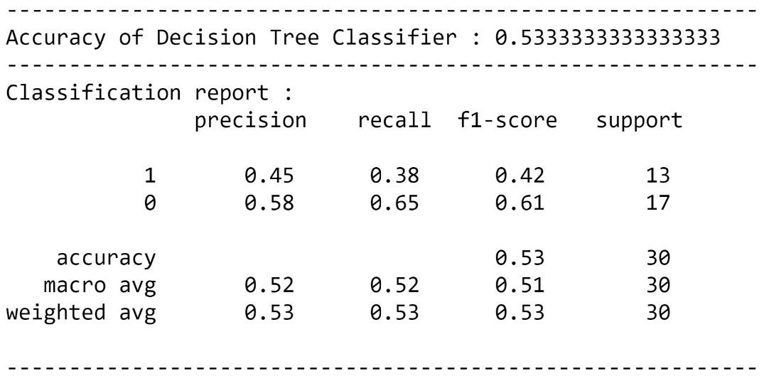
Results: Lab measurements including time in dataset
Decision Tree

Slide 15
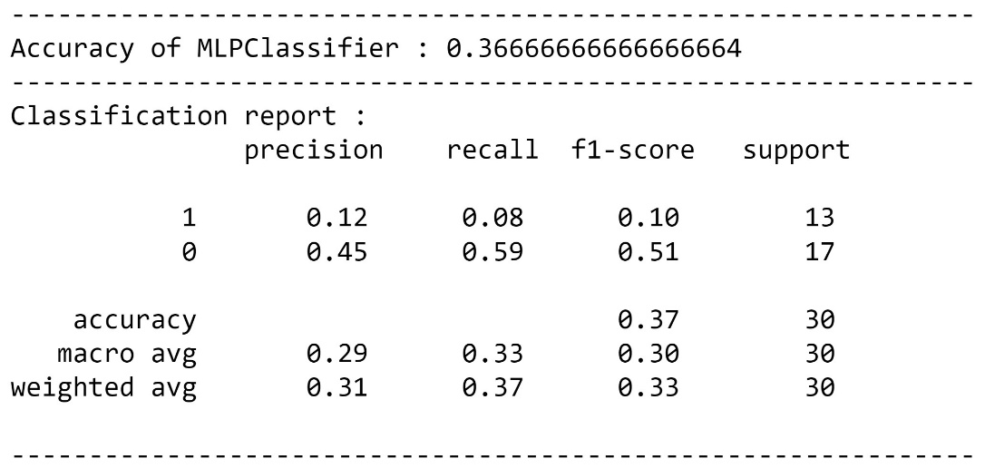
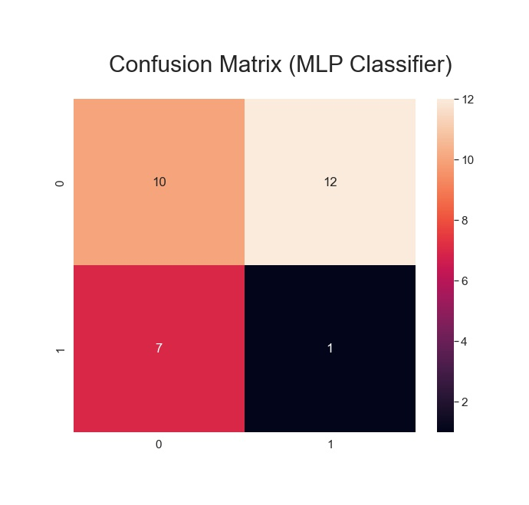
Results: Lab measurements including time in dataset
MLP Classifier

Slide 16
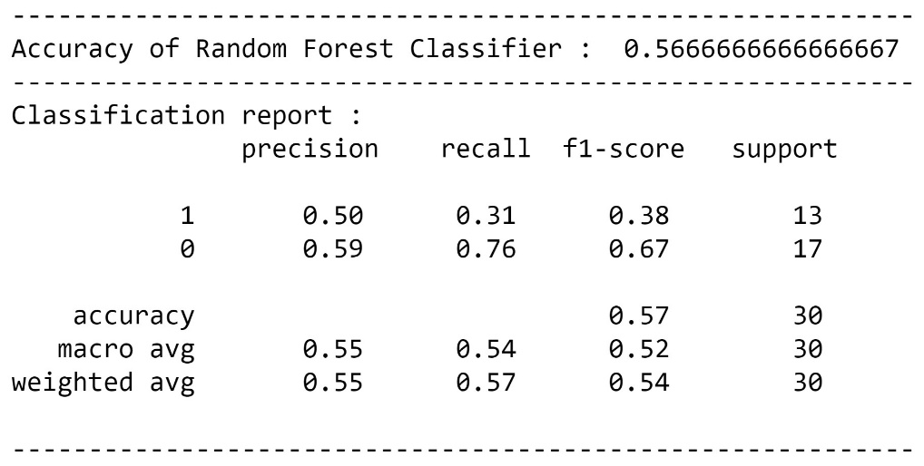
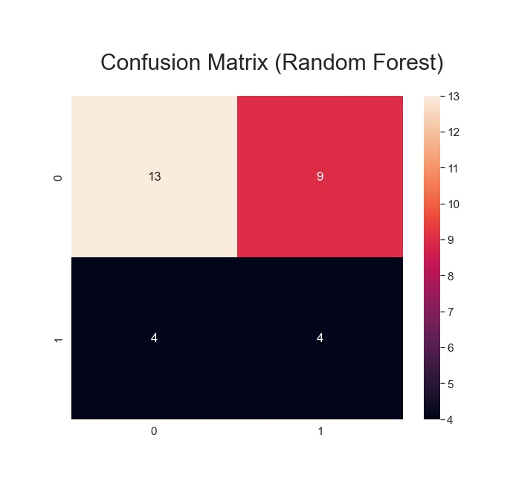
Results: Lab measurements including time in dataset
Random Forest

Slide 17
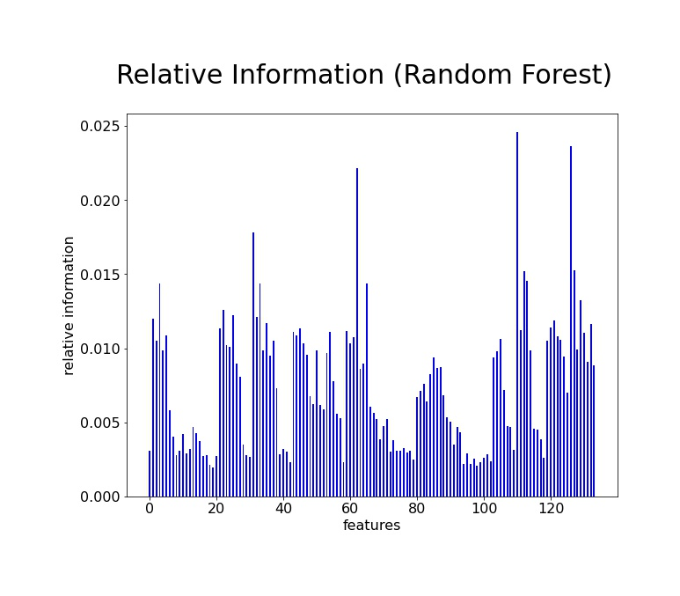
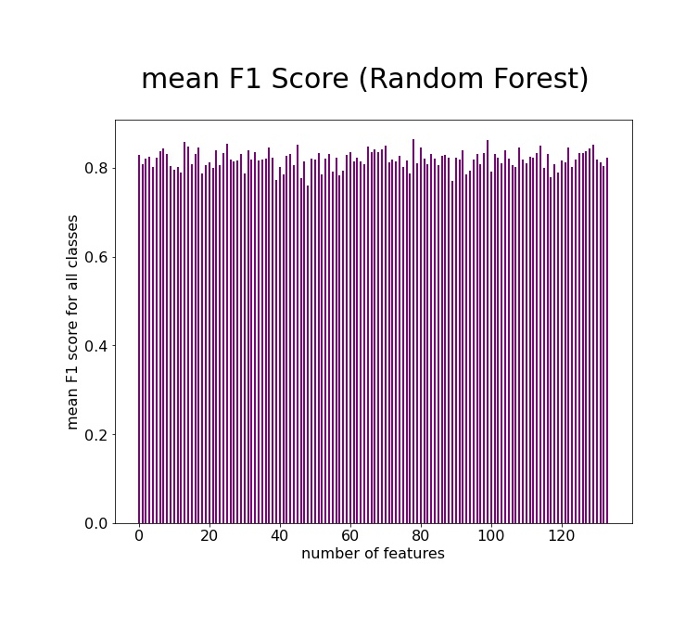
Further Results: Lab measurements including time in dataset
Random Forest

Slide 18
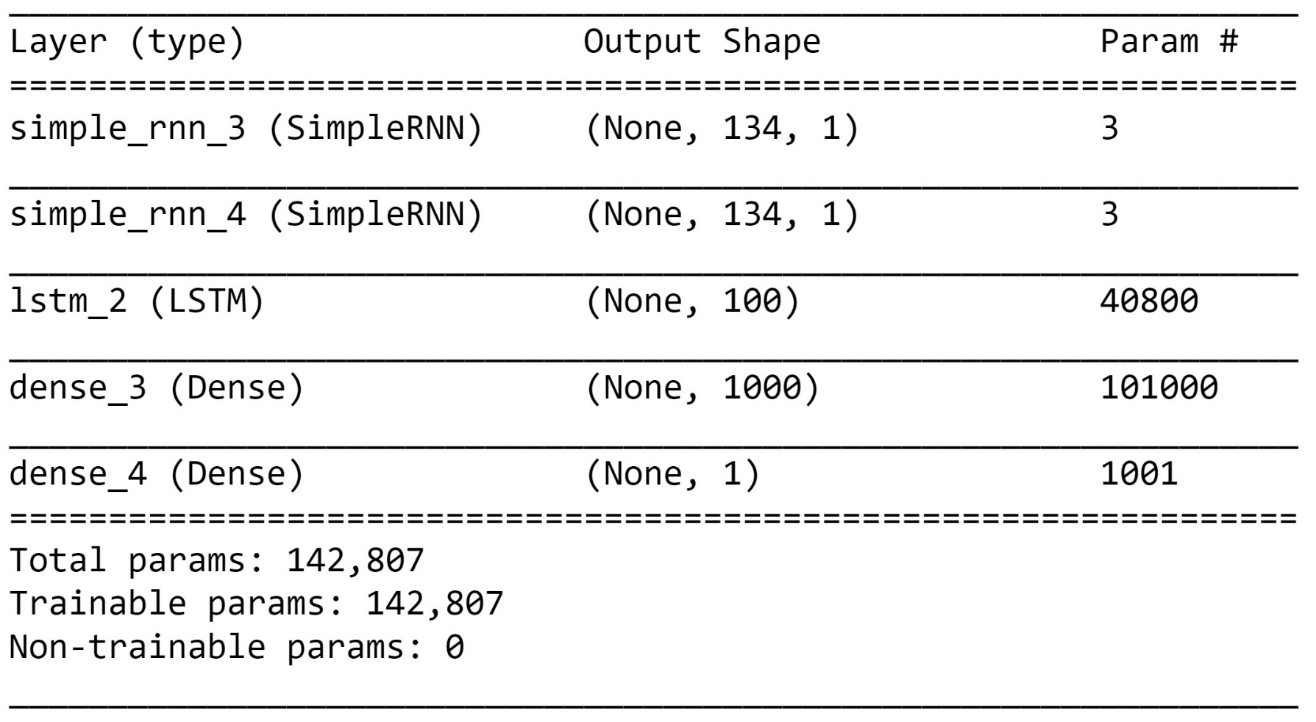
Predictive Model: Using RNN and LSTM
Neural Network based on RNN and LSTM

Slide 19
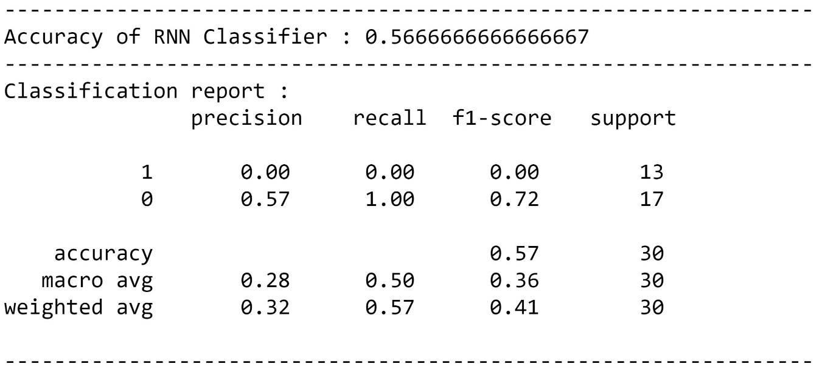
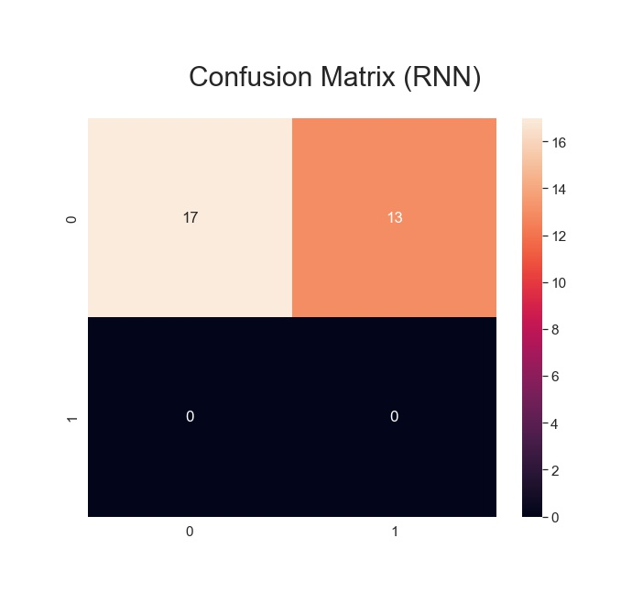
Results: Using RNN and LSTM
RNN and LSTM

Slide 20
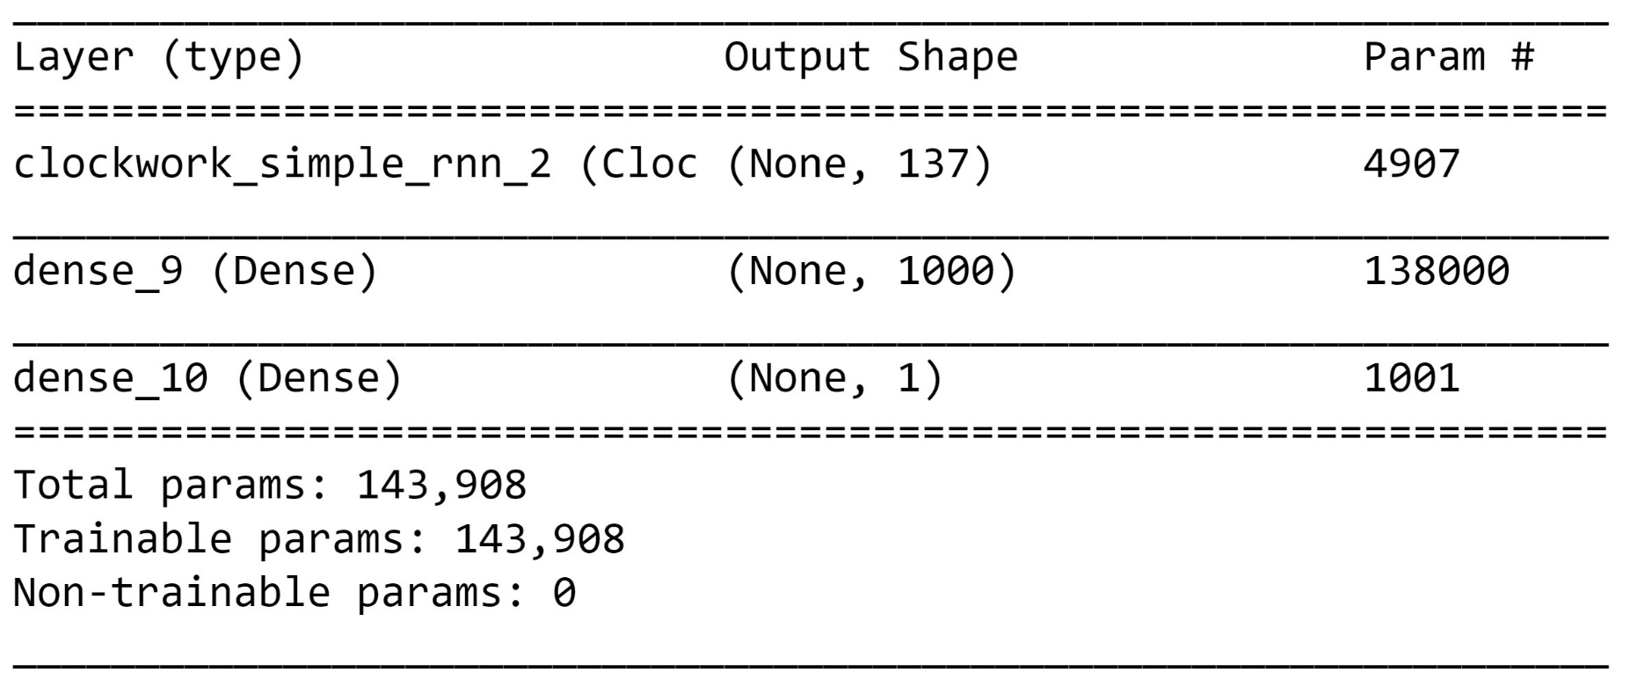
Predictive Model: Using CWRNN
Neural Network based on CWRNN

Slide 21
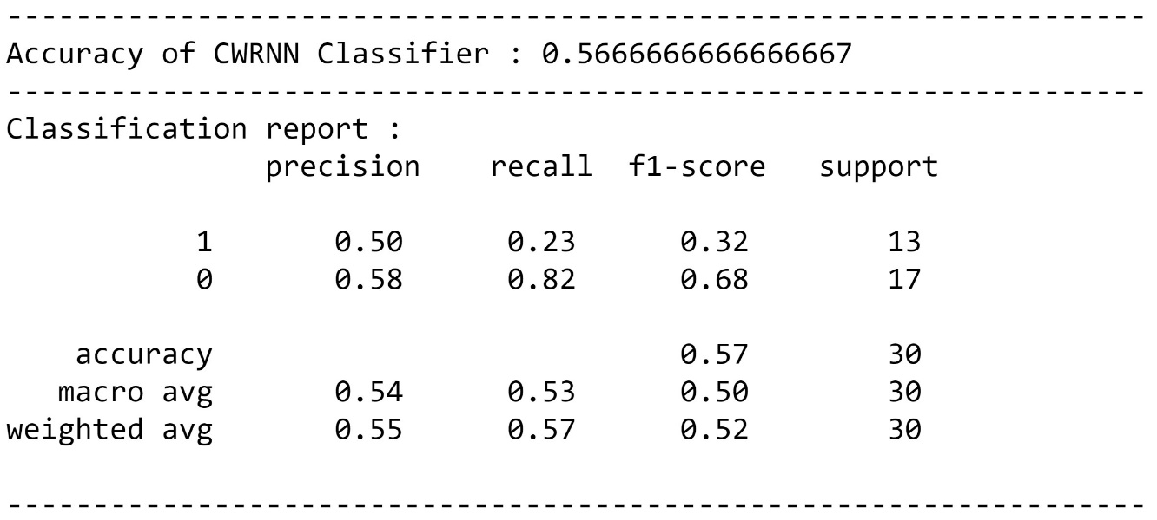
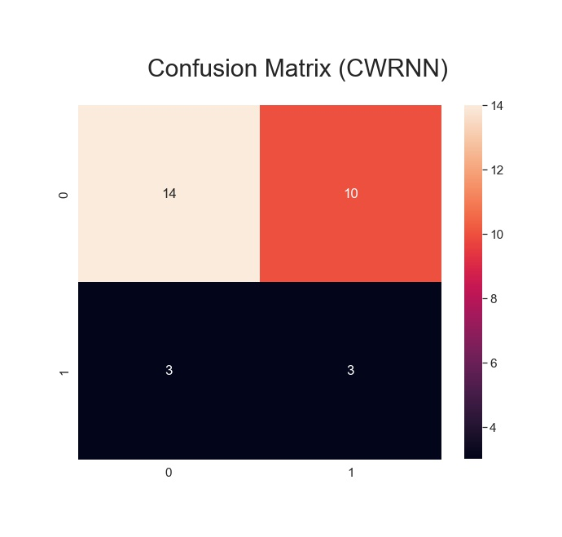
Results: Using CWRNN
CWRNN

Slide 22
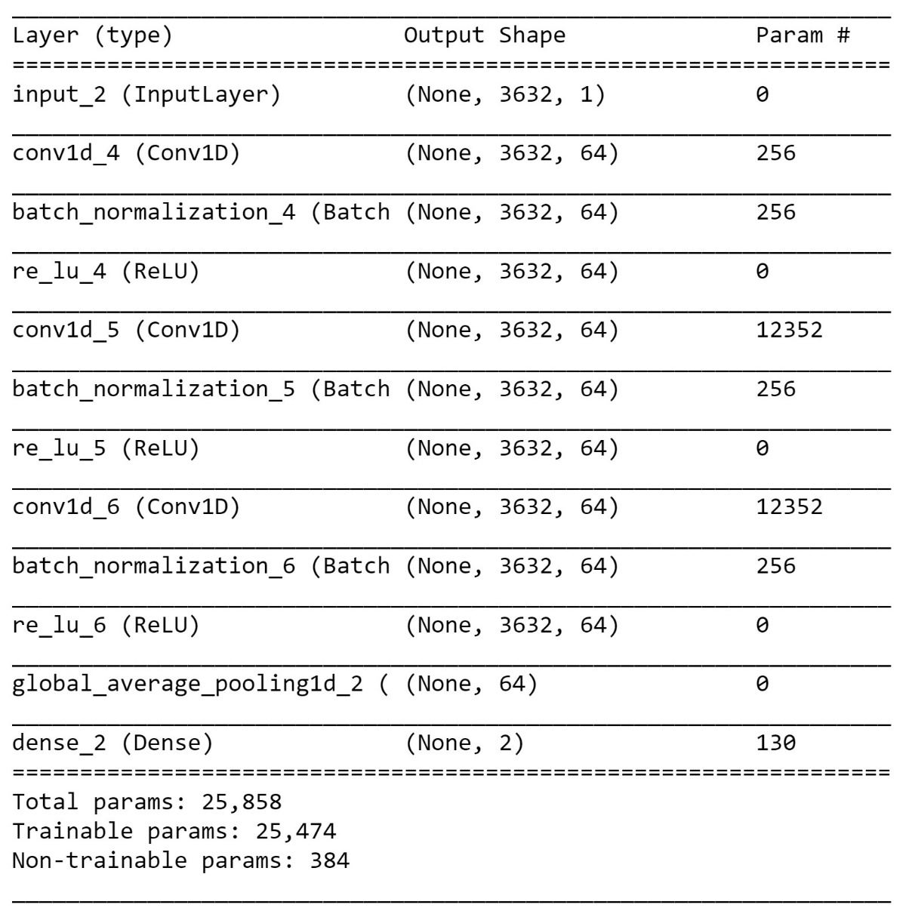
Predictive Model: Lab Measurement placed at the time^{th} entry
Neural Network based on CNN

Slide 23
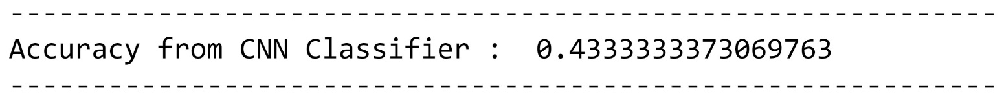
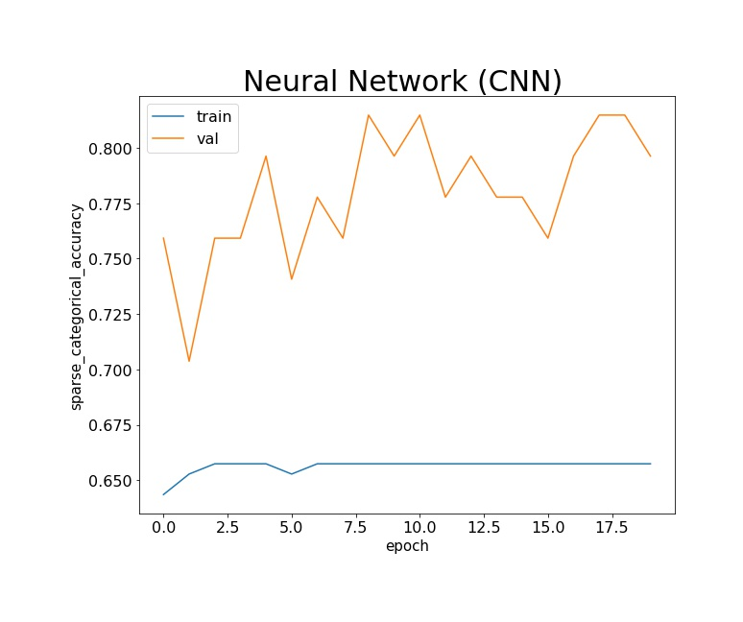
Results: Lab Measurement placed at the time^{th} entry

