Slide 1
AI Canvas and Governance
BUS 297D
September 10, 2026

Slide 2
The course arc — 6 AI roles, 1 consulting project
Week 1–2
Week 3
Week 4
Canvas
Week 4
BASICS
Week 5
Hackathon
Week 7
TRACE
Ethnographer
Explorer
Designer
Auditor
Builder
Adversary
"What is actually broken?"
"What can AI do?"
"What are we building?"
"Can we stand behind this?"
"Can we prove it works?"
"How does this break?"

Slide 3
Six roles —skills behind each hat
Role
Job titles
Hard skill
Soft skill
Ethnographer
UX Researcher · Community Liaison · Policy Analyst
Qualitative coding and interview synthesis
Listening without imposing solutions
Explorer
AI Engineer · Data Scientist · Product Researcher
Capability mapping across AI modalities
Intellectual curiosity without attachment
Designer
AI Product Manager · Solutions Architect
AI Canvas — system design for generative AI
Scope discipline under pressure
Auditor
AI Governance Lead · Risk Analyst · Compliance Officer
NIST AI RMF governance frameworks
Saying no when it matters
Builder
ML Engineer · Full-Stack Developer · Civic Tech Lead
Rapid prototyping with API integration & vibe coding
Resilience when prototypes break
Adversary
Red Team Analyst · AI Safety Researcher · Penetration Tester
Adversarial testing of AI systems
Adversarial curiosity — assume nothing is safe

Slide 4
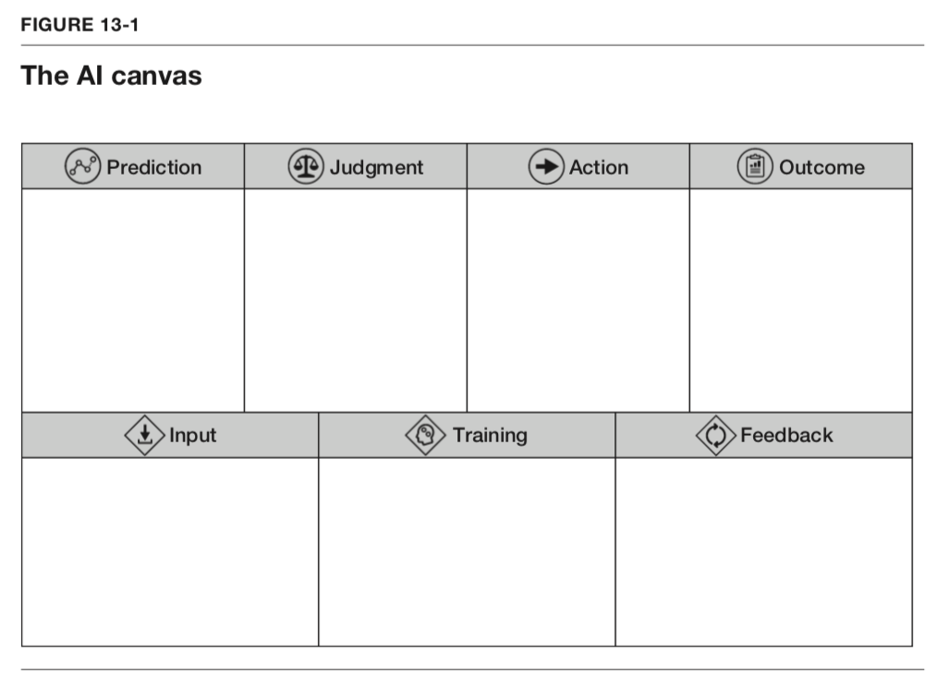

AI Canvas
Designed at the “Prediction” Age
Agrawal, Gans, and Goldfarb (2018) designed the original canvas for supervised ML. Generative and agentic AI require new cells.

Slide 5
AI Canvas — for Generative & Agentic AI
Agrawal, et al (2018) designed the original canvas for supervised ML.
Generative and agentic AI require new cells.
ORIGINAL — Prediction Machine
UPDATED — Generative + Agentic + Civic Projects
What are you predicting?
Capability — which technology, in what sequence?
What input data?
Agent level — how autonomous is this?
Action tier — suggest / draft / execute at each step?
What decision does it support?
Override mechanism — how does a human stop it?
What is the value of better prediction?
Cell 13 — Reality Check (new)
No widely adopted published framework has replaced the Prediction Machine canvas for generative AI. The updates above are original to this course.

Slide 6
AI Canvas — Cells 1–12 (Cell 13 Reality Check follows)
1 — The Problem
2 — The AI System
3 — Human Oversight
Cell 4: Agent level — 1–5, one sentence justification
Cell 9: Intervention point — specific step, specific person, specific decision
Cell 1: Civic problem — one sentence, specific friction from your Problem Brief
Cell 5: Capability — which technologies, in what sequence
Cell 10: Override mechanism — how a human stops or reverses an AI action
Cell 2: Primary persona — the WHO at the specific moment of breakdown (fill individually first)
Cell 6: Input — what the primary persona submits, what modality
Cell 11: Failure mode — most likely wrong output and downstream consequence
Cell 7: Output — what the primary/secondary actor receives, what format
Cell 3: Secondary actor — the city staff or system that acts on the AI output
Cell 12: Accountability owner — named role (not department) responsible for this system
Cell 8: Action tier — suggest / draft / execute at each step
Rule: if a cell could have been written without your Problem Brief and AI Opportunity Memo — it will not score well.

Slide 7
AI Canvas — Section 1: The Problem
CELLS 1–3
Cell 1
Civic Problem
Cell 2
Primary Persona
Cell 3
Secondary Actor
What is broken in the current system?
Who experiences friction most directly?
Who acts on the AI output?
Residents submit dumping reports by phone — each call requires manual data entry. Queue grows. Residents stop calling.
Maria — Spanish-speaking resident in East SJ who calls 311 but gives up when put on hold.
311 Operations Supervisor who reviews flagged cases before routing to field crews.
Civic example:
Civic example:
Civic example:
One sentence. Specific friction, not a category.
Not 'residents.' Named type, specific moment, specific workaround.
The staff member or system that receives and must decide.

Slide 8
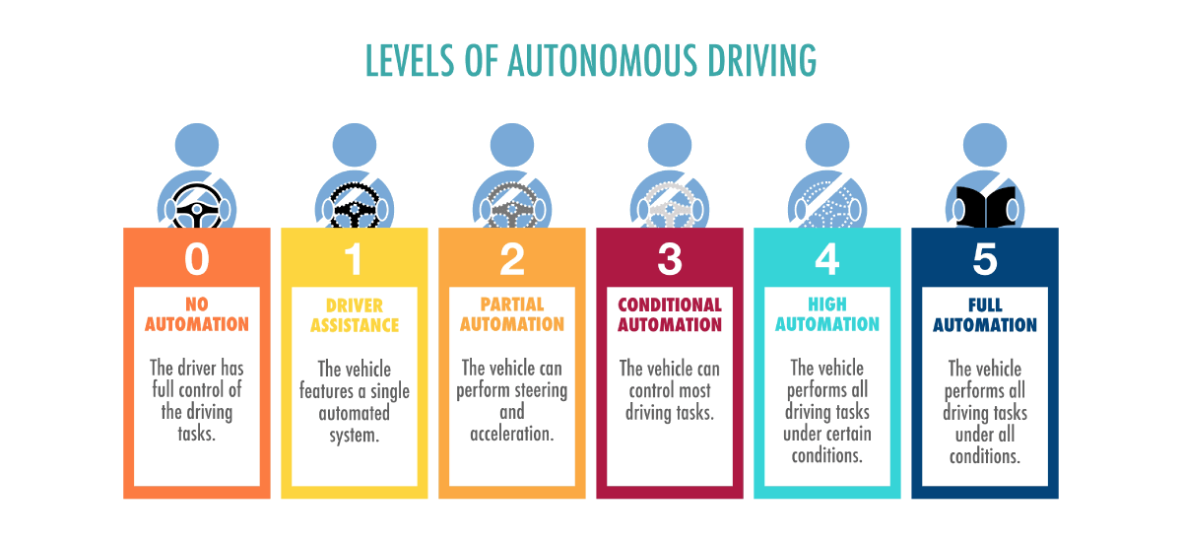
https://ackodrive.com/car-guide/autonomous-cars-and-levels-of-autonomous-driving/

Slide 9
Cell 4 — Agent Level
1
Scripted assistant
Scripted conversation — resident asks 'where do I report dumping?'
User asks, AI answers. No memory, no actions. Single-turn.
2
Configured GPT
← hackathon range
Custom GPT grounded in SJ city policy docs (knowledge base) answers 311 questions
System prompt + knowledge base. Constrained behavior. Still single-session.
3
Workflow agent
← hackathon range
GPT reads sheet → classifies complaint → drafts routing row → supervisor approves
Reads and writes to external systems. Multi-step. Human approves each action.
4
Supervised autonomous
← hackathon range
Agent auto-routes low-risk reports, flags hazmat for human review
Executes sequences without per-step approval. Escalates on uncertainty.
5
Fully autonomous
Agent monitors sensors, dispatches crews, files reports without staff
Self-directed goal pursuit. Minimal human checkpoints.
Most hackathon prototypes operate at Level 2 or 3, possibly Level 4 with caution. Level 3 requires an API integration (Replit/Colab track).
Know your level — it determines your data, your risk, and your governance.

Slide 10
AI Canvas — Section 2: The AI System
CELLS 4–8
4
Agent Level
e.g. Level 2 — configured Custom GPT with knowledge base
How autonomous is this?
5
Capability Chain
e.g. Text generation → Structured extraction → Sheet write
Which technologies, in what sequence?
6
Input
e.g. Free-text message in Spanish or English
What does the primary persona submit?
7
Output
e.g. Structured row: location, waste type, urgency, dept
What does the secondary actor receive?
8
Action Tier
e.g. Extract: execute. Route: draft only. Notify: suggest.
Suggest / draft / execute at each step?

Slide 11
Cell 8 — Action Tier
Civic problems:
higher impact; stronger human checkpoints
Definition
Use when
Example
EXECUTE
Extracting complaint text from a form submission and writing to a draft row in Google Sheet.
AI acts automatically. No human step before action occurs.
Only for low-stakes, reversible, well-tested steps.
DRAFT
Routing decisions, notifications, any output seen by residents.
311 supervisor reviews AI-classified urgency and department routing before case moves to crew queue.
AI proposes an action. Named human approves before anything happens.
SUGGEST
High-stakes decisions, policy calls, novel situations.
AI flags a report as possible hazmat. Supervisor decides whether to escalate — AI does not trigger escalation.
AI surfaces information. Human makes decision independently.
Your canvas must label every step. 'AI sends the notification' without specifying the tier is not an answer — it is a governance gap.

Slide 12
AI Canvas — Section 3: Oversight + Reality Check
9 · Intervention Point
10 · Override Mechanism
11 · Failure Mode
12 · Accountability Owner
Supervisor reviews Sheet row before routing notification sends
Supervisor changes status from PENDING to REJECTED in Sheet
AI misclassifies hazmat as LOW urgency — no expedited response
311 Operations Manager — named individual, not the department
CELL 13 — Reality Check (required before canvas is approved)
A · Prototype sentence
B · Data check
C · Capability audit
D · Gap statement
"In our demo, [named persona] will [specific action] and the AI will [specific output] and [named role] will [approve/reject] before anything happens."
List every input → mark available / can directly collect / can get from API / assume available / not feasible
Circle the ONE capability that addresses the most important friction. This is the most important part for your prototype.
"Our prototype proves [capability]. The full vision also requires [2–3 things]. Those are recommendations, not our prototype."

Slide 13
BASICS — design governance
Adapted from
NIST AI RMF (Risk Management Framework): Govern, Map, Measure, Manage | Risk management across lifecycle
OMB M-24-10 (US Federal Policy for AI, Office of Management and Budget): impact + accountability
AI systems don’t just serve users—they reshape work, responsibility, and risk inside institutions.
BASICS is self-governance. Red teaming is adversarial testing.
BASICS — design governance
TRACE — deployment accountability
Prospective — before you build
Internal — you evaluate your own design
Question: did we design this responsibly?
Used in Week 4 — today
Retrospective — after you build
External — someone else attacks your prototype
Question: can we stand behind what we built?
Revealed in Week 7 — after the hackathon

Slide 14
BASICS — 6 questions, 2 actors
Complete for primary persona AND secondary actor.
Question
Ask yourself
311 example answer
B
Bias
Who could be underserved or harmed?
Spanish-speaking residents if model accuracy drops on non-English messages
A
Action tier
What is automated vs. approved at each step?
Extract: execute · Route: draft · Notify: suggest — maps to Cell 8
S
Stakeholder
Who is the named accountable owner?
Not the department — a specific named role reachable at 9pm when system fails
I
Intervention
Where exactly does a human stay in the loop?
Supervisor reviews before routing notification sends — with override authority
C
Contract
What must the vendor guarantee before deployment?
Audit rights · 24hr incident notification · immediate shutdown clause
S
Scope
What resident rights or services are affected?
Rights-impacting → stronger controls required by OMB M-24-10

Slide 15
B
B — Bias
Who could be underserved or harmed by this system?
Source: OMB M-24-10 — agencies must consider inequitable outcomes and evaluate whether AI use cases are rights- or safety-impacting
Civic example — 311 Illegal Dumping Intake
AI trained on English-language reports may perform worse on Spanish or Vietnamese messages
Neighborhoods with lower smartphone adoption submit fewer photo reports — AI sees less data from those areas
If urgency classification correlates with neighborhood, system could systematically deprioritize lower-income areas
Design question: Before deploying — test performance across languages, neighborhoods, and resident types. Not just on average.

Slide 16
A
A — Action Tier
What can the agent do autonomously vs. what requires human approval?
Source: OMB M-24-10 — focuses on AI outputs that 'inform, influence, decide, or execute' agency decisions or actions
Civic example — Three tiers — every step in your capability chain must have one
SUGGEST ONLY — AI recommends, human decides. Nothing happens without explicit human action.
PREPARE AND DRAFT — AI creates the output, human reviews before it goes anywhere.
EXECUTE — AI acts autonomously. No human approval required for that step.
Design question: For each step in your capability chain — which tier applies, and can you justify why execution is appropriate at that step?

Slide 17
S
S — Stakeholder
Who is the named accountable owner for this system?
Source: NIST AI RMF — Govern function requires assigning accountability across the AI lifecycle
Civic example — 311 Intake Agent
Wrong: 'The City of San Jose' · Wrong: 'The Department of Transportation'
Right: 'Maria Chen, 311 Operations Manager — responsible for weekly accuracy review, escalation path, and quarterly reporting'
The accountable owner must be able to: turn it off immediately · receive incident notifications within 24 hours · explain it to a resident
Design question: Is there a specific person — not a department — who can be called at 9pm when the system makes a wrong decision?

Slide 18
I
I — Intervention
Where exactly does a human stay in the loop — and with what authority?
Source: NIST AI RMF — human oversight design · OMB M-24-10 — strongest review where output affects rights or safety
Civic example — Urgency Escalation Layer
Reviewer: Field supervisor · Trigger: Any case classified HIGH urgency automatically
Override power: Supervisor can downgrade urgency and reassign before notification sends
Audit log: Every override recorded with timestamp and reason
Resident appeal: Resident can call 311 to request reclassification within 48 hours
Design question: Can you fill in all six? Reviewer · Trigger · Override power · Audit log · Escalation path · Resident appeal. If any are undefined — that's the gap.

Slide 19
C
C — Contract
What must the vendor or platform contractually guarantee before deployment?
Source: OMB M-24-10 — procurement as part of AI risk management · Local-government contracting standards
Civic example — Deploying on OpenAI or Gemini APIs
Audit rights — can the city independently inspect what the system did?
Data lineage — where did training data come from? What is excluded?
Incident notification — how quickly must the vendor notify the city of a failure?
Shutdown guarantee — can the city turn off the system immediately with no penalty?
Design question: If you were a city council member — what would you require the vendor to sign before approving this system?

Slide 20
S
S — Scope
What resident rights or public services are affected by this system?
Source: OMB M-24-10 — rights and safety screening required for systems that affect access to services, benefits, enforcement, or public records
Civic example — Two examples at different risk levels
RIGHTS-IMPACTING: EIH site placement — affects housing access for unhoused residents. Requires bias audit, human override at every decision, public transparency.
LOW-IMPACT: Foot traffic analysis — affects investment decisions, not direct resident rights. Standard accuracy review sufficient.
When in doubt — assume rights-impacting and apply stronger controls.
Design question: Does this system affect: access to public services? Benefits or eligibility? Enforcement actions? Public records? If yes to any — it is rights-impacting.

Slide 21
BASICS asks whether you designed it responsibly.
Week 6 Hackathon —Week of 9/21.
You build something. Then something is revealed afterwards.

