Slide 1

Docker
March 2020
Vikash N – Infra Dev Specialist

Slide 2

Agenda
What is Docker
Containers vs VMs
Matrix from Hell
Docker Basic Commands
DEMO
Intro to Docker
Why Docker?
2

Slide 3
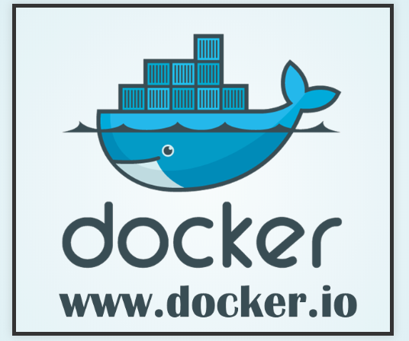
Intro to Docker
Docker Inc. (the company)
Founded in 2009
Formerly dotCloud Inc.
Released Docker in 2013.
Since March 2013
200,000 pulls
>200 significant contributors
>200 projects built on top of docker
UIs, mini-PaaS, Remote Desktop...
1000’s of Dockerized applications
Redis, Node.js, Hadoop...
Integration in Jenkins, Travis, Chef, Puppet

Slide 4
What is docker?
Docker is basically a container engine.
Docker is a tool designed to make it easier to create, deploy, and run applications by using containers.
Docker is a client-server application.
• The Docker daemon Receives and processes incoming Docker API requests.
• The Docker client Command line tool - the docker binary. Talks to the Docker daemon via the Docker API.
• Docker Hub Registry Public image registry. The Docker daemon talks to it via the registry API.

Slide 5
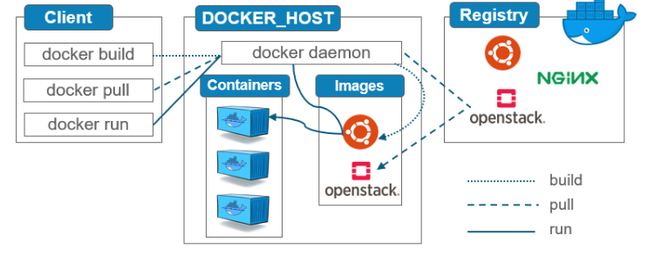
Architecture

Slide 6
Why Docker?
The software industry has changed.
• Applications used to be monolithic, with long lifecycles,
scaled up.
• Today, applications are decoupled, built iteratively, scaled out.
• As a result, deployment is though!
Docker eliminates close coupling within the application modules and works hand-in-hand with microservices architecture.
Shipping and Deployment made easy with Docker.

Slide 7
Advantages
Configure once... run anything
Make the entire lifecycle more efficient, consistent, and repeatable
Increase the quality of code produced by developers.
Eliminate inconsistencies between development, test, production, and customer environments.
Containers are so lightweight, address significant performance, costs, deployment, and portability issues normally associated with VMs
Build once... (finally) run anywhere
A clean, safe, hygienic, portable runtime environment for your app.
No worries about missing dependencies, packages and other pain points during subsequent deployments.
Run each app in its own isolated container, so you can run various versions of libraries and other dependencies for each app without worrying.
Reduce/eliminate concerns about compatibility on different platforms, either your own or your customers.

Slide 8
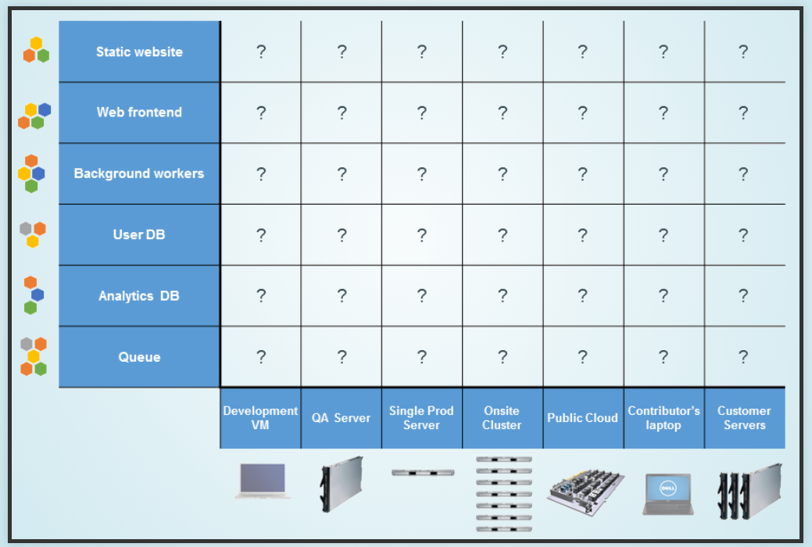
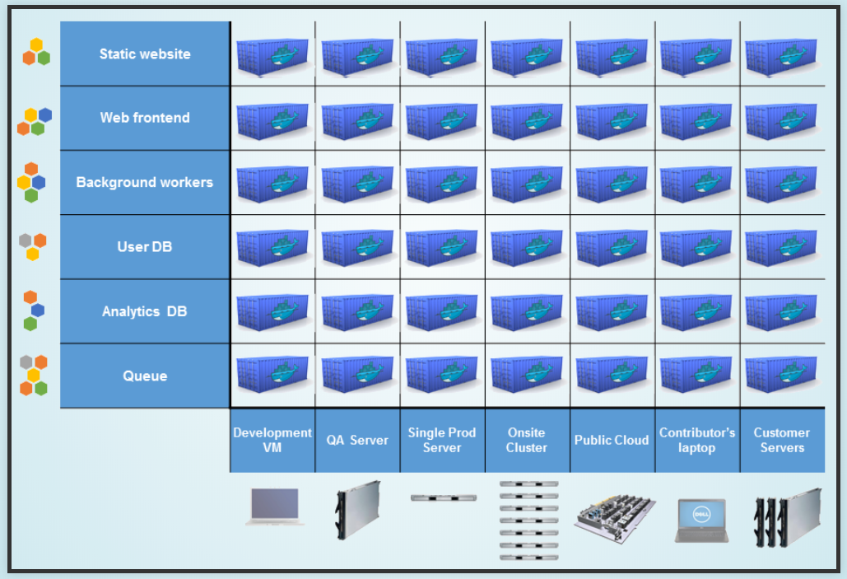
Matrix from Hell
What is the matrix from hell?
To put simply, it is the challenge of packaging any application, regardless of language/frameworks/dependencies, so that it can run on any cloud, regardless of operating systems/hardware/infrastructure.
Docker’s Answer:
Docker solved for the matrix from hell by decoupling the application from the underlying operating system and hardware

Slide 9
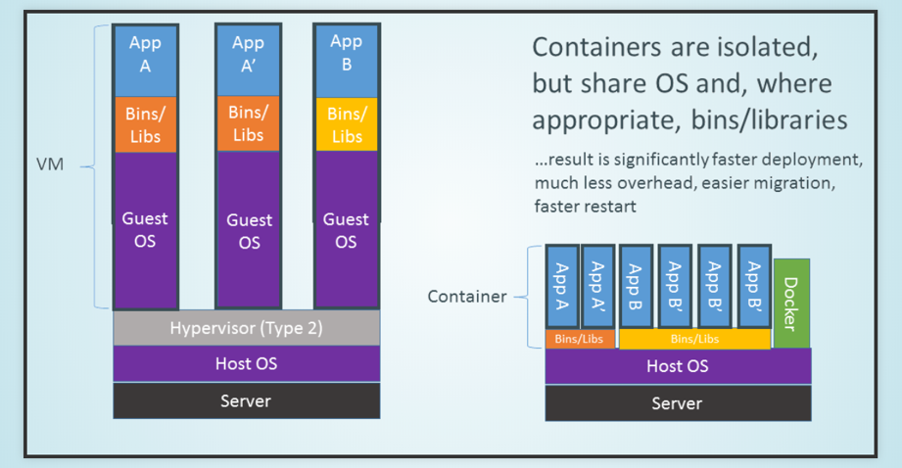
Containers vs VMs

Slide 10
Dockerfile
FROM java
ENV MIRTH_CONNECT_VERSION 3.6.1.b220
RUN useradd -u 1000 mirth
VOLUME /opt/mirth-connect/data
COPY docker-entrypoint.sh /home
WORKDIR /opt/mirth-connect
EXPOSE 8080 8443
ENTRYPOINT ["/home/docker-entrypoint.sh"]
CMD ["java", "-jar", "mirth-server-launcher.jar"]
- FROM instruction initializes a new build stage and sets the Base Image for subsequent instructions
- The ENV instruction sets the environment variable <key> to the value <value>
- The RUN instruction will execute any commands in a new layer on top of the current image and commit the results
- The VOLUME instruction creates a mount point with the specified name and marks it as holding externally mounted volumes from native host or other containers
- The COPY instruction copies new files or directories from <src> and adds them to the filesystem of the container at the path <dest>.
- The WORKDIR instruction sets the working directory
- The EXPOSE instruction informs Docker that the container listens on the specified network ports at runtime
- An ENTRYPOINT allows you to configure a container that will run as an executable
- The main purpose of a CMD is to provide defaults for an executing container

Slide 11


Slide 12

Thank You
Vikash N – Infra Dev Specialist
Vikash.N@cognizant.com

