Slide 1
scikit-learn Machine Learning in Python
Simple and efficient tools for data mining and data analysis
Accessible to everybody, and reusable in various contexts
Built on NumPy, SciPy, and matplotlib
Open source, commercially usable - BSD license

Slide 2
Fields of Application
Classification
Identifying to which category an object belongs to.
Applications: Spam detection, Image recognition.
Algorithms: SVM, nearest neighbors, random forest, ...
Regression
Predicting a continuous-valued attribute associated with an object.
Applications: Drug response, Stock prices.
Algorithms: SVR, ridge regression, Lasso, ...

Slide 3
Fields of Application
Clustering
Automatic grouping of similar objects into sets.
Applications: Customer segmentation, Grouping experiment outcomes
Algorithms: k-Means, spectral clustering, mean-shift, ...
Dimensionality reduction
Reducing the number of random variables to consider.
Applications: Visualization, Increased efficiency
Algorithms: PCA, feature selection, non-negative matrix factorization.

Slide 4
Fields of Application
Model selection
Comparing, validating and choosing parameters and models.
Goal: Improved accuracy via parameter tuning
Modules: grid search, cross validation, metrics.
Preprocessing
Feature extraction and normalization.
Application: Transforming input data such as text for use with machine learning algorithms.
Modules: preprocessing, feature extraction.

Slide 5
Demo
1. Loading an example dataset
The data is a simple flower database known as the Iris dataset.
150 observations of the iris flower
measurements: sepal length, sepal width, petal length and petal width
subtype: Iris setosa, Iris versicolor, Iris virginica.

Slide 6
Demo
1. Loading an example dataset
To load the dataset into a Python object:
>>> from sklearn import datasets
>>> iris = datasets.load_iris()
This data is stored in the .data member:
>>> iris.data.shape
(150, 4) --> (n_samples, n_features)
>>> iris.data
array([[ 5.1, 3.5, 1.4, 0.2],
[ 4.9, 3. , 1.4, 0.2],
[ 4.7, 3.2, 1.3, 0.2],
[ 5. , 3.6, 1.4, 0.2], ...]

Slide 7
Demo
1. Loading an example dataset
The class of each observation is stored in the .target,
a 1D array of length n_samples:
>>> iris.target.shape
(150,)
>>> import numpy as np
>>> np.unique(iris.target)
array([0, 1, 2])

Slide 8
Demo
2. Learning and Predicting
In scikit-learn, we learn from existing data by creating an estimator and calling its fit(X, Y) method.
>>> from sklearn import svm
>>> clf = svm.LinearSVC()
>>> clf.fit(iris.data, iris.target) # learn from the data
LinearSVC(…)
Once we have learned from the data, we can use our model to predict the most likely outcome on unseen data:
>>> clf.predict([[ 5.0, 3.6, 1.3, 0.25]])
Array([0])

Slide 9
Demo
2. Learning and Predicting
parameters of the model
>>> clf.coef_
array([[ 0.18424202, 0.4512277 , -0.80794005, -0.45071561],
[ 0.05303031, -0.8930899 , 0.40346741, -0.93584612],
[-0.85049667, -0.98668971, 1.38108908, 1.86543701]])

Slide 10
Demo
3. Classification
3.1 k-Nearest neighbors (KNN) classifier
Given a new observation, take the label of the training samples closest to it in n-dimensional space, where n is the number of features in each sample.
KNN classification example:
# Create and fit a nearest-neighbor classifier
>>> from sklearn import neighbors
>>> knn = neighbors.KNeighborsClassifier()

Slide 11
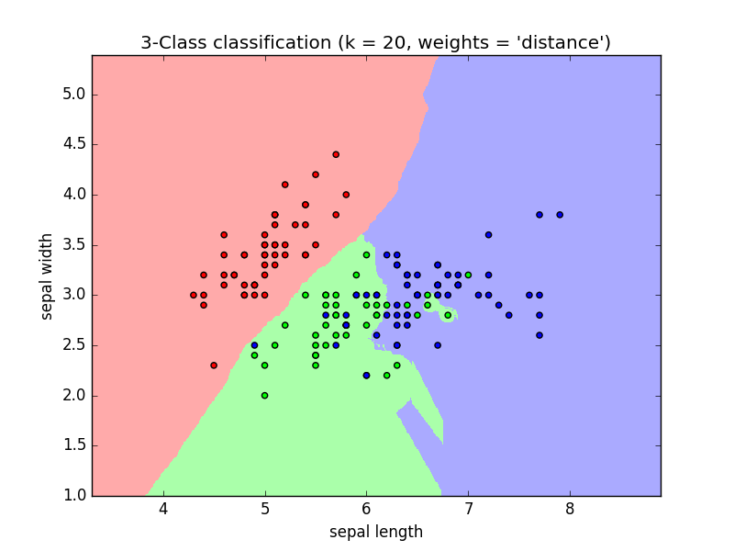
Demo
3. Classification
>>> knn.fit(iris.data, iris.target)
KNeighborsClassifier(algorithm='auto',
leaf_size=30, metric='minkowski',
metric_params=None,
n_jobs=1, n_neighbors=5, p=2,
weights='uniform')
>>> knn.predict([[0.1, 0.2, 0.3, 0.4]])
array([0])

Slide 12
Demo
3. Classification
Training set and testing set
When experimenting with learning algorithms, it is important not to test the prediction of an estimator on the data used to fit the estimator.
Indeed, with the kNN estimator, we would always get perfect prediction on the training set.
>>> perm = np.random.permutation(iris.target.size)
size = 150
>>> iris.data = iris.data[perm]

Slide 13
Demo
3. Classification
Training set and testing set
>>> iris.target = iris.target[perm]
>>> knn.fit(iris.data[:100], iris.target[:100])
KNeighborsClassifier(algorithm='auto', leaf_size=30, metric='minkowski',
metric_params=None, n_jobs=1, n_neighbors=5, p=2,
weights='uniform')
>>> knn.score(iris.data[100:], iris.target[100:])
0.9600

Slide 14
Demo
3. Classification
3.2 Support vector machines (SVMs) for classification
SVMs try to construct a hyperplane maximizing the margin between the two classes. It selects a subset of the input, called the support vectors, which are the observations closest to the separating hyperplane.
Linear Support Vector Machines
>>> from sklearn import svm
>>> svc = svm.SVC(kernel='linear')

Slide 15
Demo
3. Classification
>>> svc.fit(iris.data, iris.target)
SVC(C=1.0, cache_size=200, class_weight=None, coef0=0.0,
decision_function_shape=None, degree=3, gamma='auto', kernel='linear',
max_iter=-1, probability=False, random_state=None, shrinking=True,
tol=0.001, verbose=False)
* “SVC” stands for Support Vector Classifier (there also exist SVMs for regression, which are called “SVR” in scikit-learn)
>>> svc.predict([[0.8, 1, 1.2, 3.4]])
array([0])

Slide 16
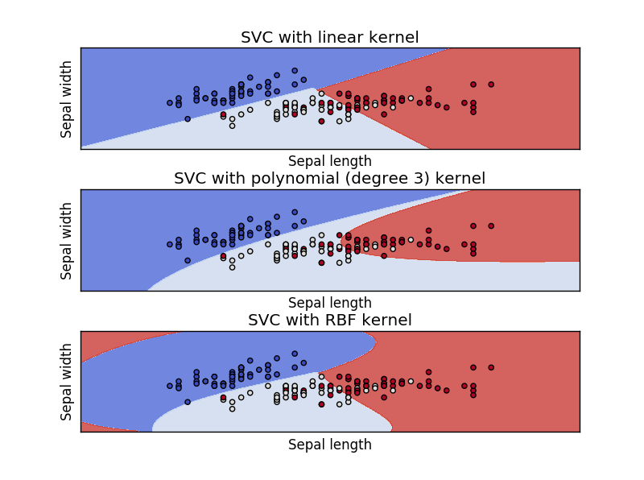
Demo
3. Classification
Using kernels
Polynomial kernel
>>> svc = svm.SVC(kernel=‘poly')
RBF kernel (Radial Basis Function)
>>> svc = svm.SVC(kernel=‘rbf')

Slide 17
Demo
4. Clustering
K-means clustering
Dividing a set into k clusters, assigning each observation to a cluster so as to minimize the distance of that observation (in n-dimensional space) to the cluster’s mean; the means are then recomputed. Then run above operation iteratively until the clusters converge.
>>> from sklearn import cluster, datasets
>>> iris = datasets.load_iris()
>>> k_means = cluster.KMeans(n_clusters=3)
>>> k_means.fit(iris.data)
KMeans(copy_x=True, init='k-means++', k=3, max_iter=300, n_init=10, n_jobs=1, precompute_distances=True, random_state=<mtrand.RandomState object at 0x7f4d860642d0>, tol=0.0001, verbose=0)

Slide 18
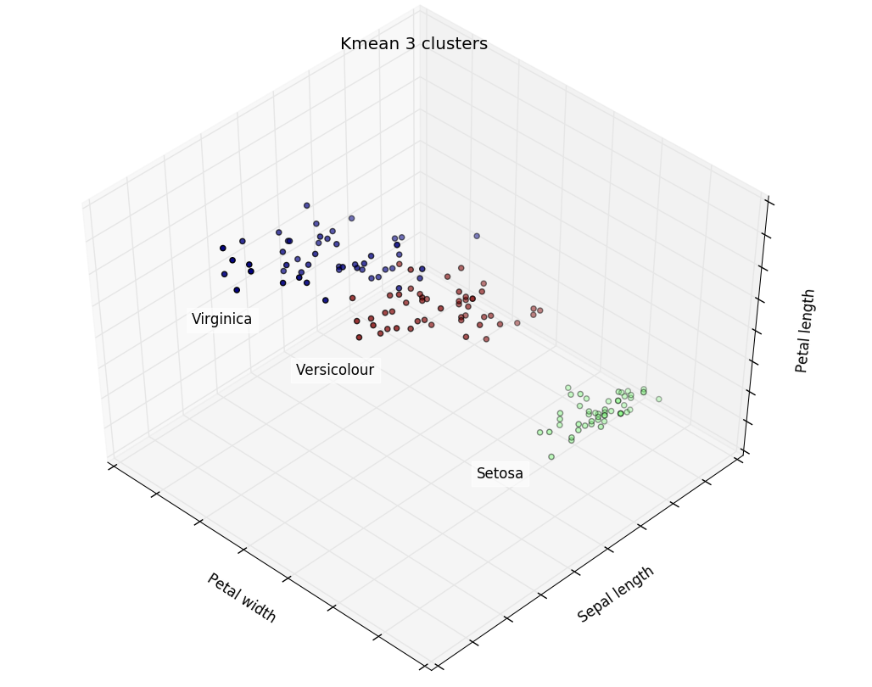
Demo
4. Clustering
>>> print(k_means.labels_[::10])
[1 1 1 1 1 0 0 0 0 0 2 2 2 2 2]
>>> print(iris.target[::10])
[0 0 0 0 0 1 1 1 1 1 2 2 2 2 2]

Slide 19
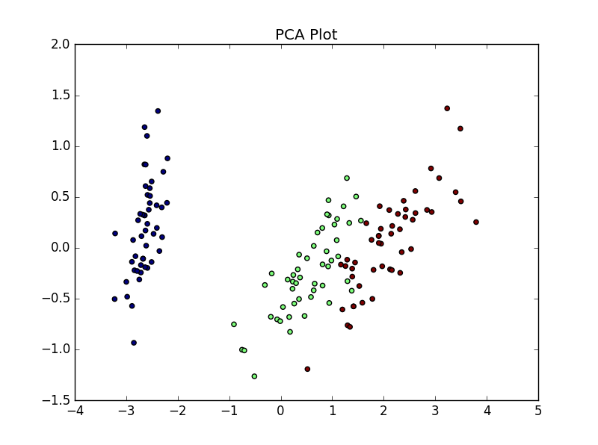
Demo
5. Dimension Reduction with Principal Component Analysis
>>> from sklearn import decomposition
>>> pca = decomposition.PCA(n_components=2)
>>> pca.fit(iris.data)
PCA(copy=True, n_components=2, whiten=False)
>>> X = pca.transform(iris.data)
Then visualizing the (transformed) iris dataset:
>>> import pylab as pl
>>> pl.scatter(X[:, 0], X[:, 1], c=iris.target)

Slide 20
Demo
6. Linear model
Diabetes dataset
It consists of 10 physiological variables (age, sex, weight, blood pressure) measure on 442 patients (442 * 10), and an indication of disease progression after one year(442 * 1).
>>> diabetes = datasets.load_diabetes()
>>> diabetes_X_train = diabetes.data[:-20]
>>> diabetes_X_test = diabetes.data[-20:]
>>> diabetes_y_train = diabetes.target[:-20]
>>> diabetes_y_test = diabetes.target[-20:]
Objective: to predict disease prediction from physiological variables.

Slide 21
Demo
6. Linear model
Sparse models
To improve the conditioning of the problem, selecting only the informative features
and set non-informative ones to 0. Such method is called sparse method.
>>> from sklearn import linear_model
>>> regr = linear_model.Lasso(alpha=.3)
>>> regr.fit(diabetes_X_train, diabetes_y_train)
Lasso(alpha=0.3, copy_X=True, fit_intercept=True, max_iter=1000, normalize=False, positive=False, precompute='auto', tol=0.0001, warm_start=False)

Slide 22
Demo
6. Linear model
>>> regr.coef_ # very sparse coefficients
array([ 0. , -0. , 497.34075682, 199.17441034,
-0. , -0. , -118.89291545, 0. , 430.9379595 , 0. ])
>>> regr.score(diabetes_X_test, diabetes_y_test)
0.5510835453...
very similar to linear regression (Least Squares):
>>> lin = linear_model.LinearRegression()
>>> lin.fit(diabetes_X_train, diabetes_y_train)
LinearRegression(...)
>>> lin.score(diabetes_X_test, diabetes_y_test)
0.5850753022...

Slide 23
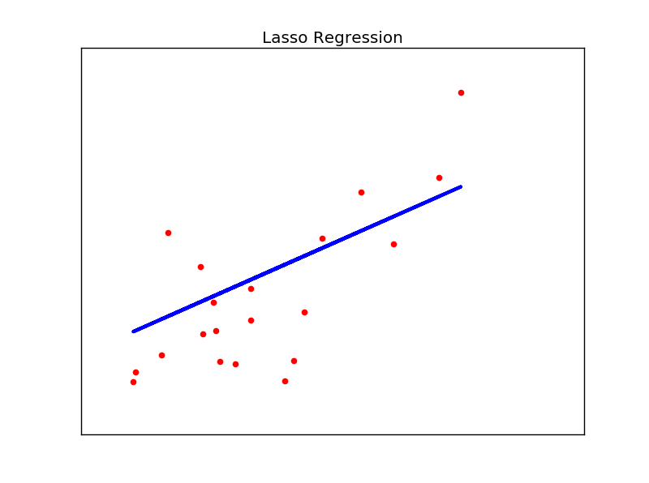
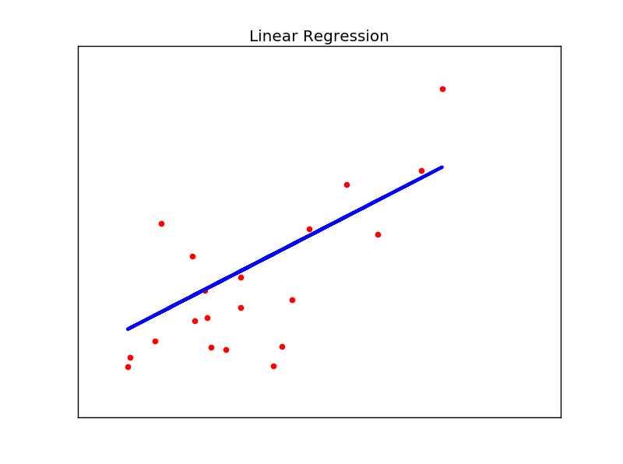
Demo
6. Linear model

