Slide 1
Feature Extraction Machine Learning Methods
Train Data:
11855 * 117 (features)
11855 * 1 (3 tags included)
Test Data:
662 * 117
662 * 1
Objective: Classification + Evaluation
3rd party library:
sk-learn

Slide 2
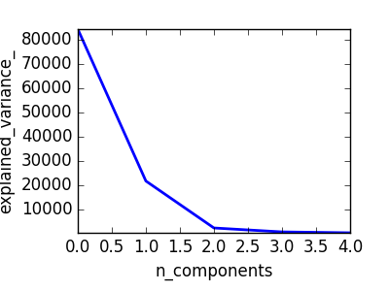
Data Preprocessing
PCA
Train confidence interval:
0.993516107874
Test confidence interval:
0.976402270184
pca feature index: [83, 41, 39, 64, 66]

Slide 3
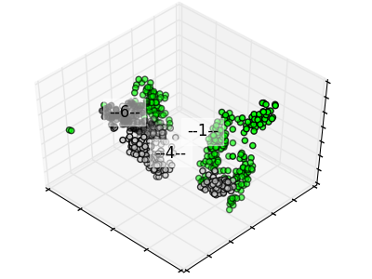
Data Preprocessing
PCA
Train confidence interval:
0.993516107874
Test confidence interval:
0.976402270184
pca feature index: [83, 41, 39, 64, 66]
'--1--', '--4--', '--6--' refers to 3 unique tags respectively

Slide 4
Classification Comparision
Sum Up
ML method | accuracy score
knn | 0.448640483384
svm-linear | 0.448640483384
svm-rbf | 0.444108761329
decision tree | 0.448640483384
random forest | 0.444108761329
neural networks | 0.462235649547
adaBoost | 0.441087613293
naive bayes | 0.622356495468
quadratic discriminant analysis | 0.448640483384

Slide 5
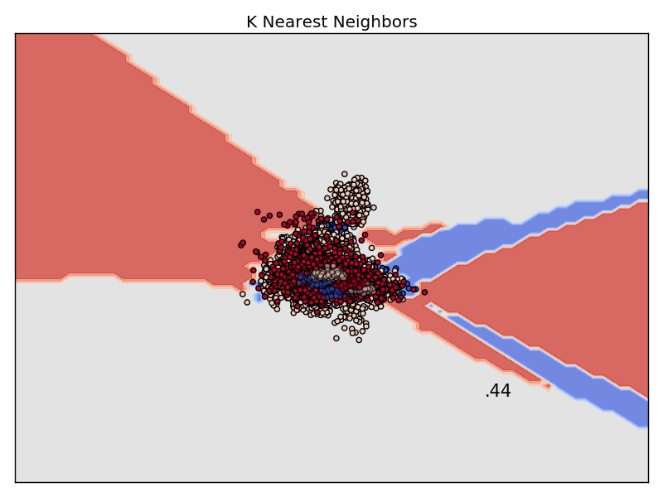
Classification Visualization
knn

Slide 6
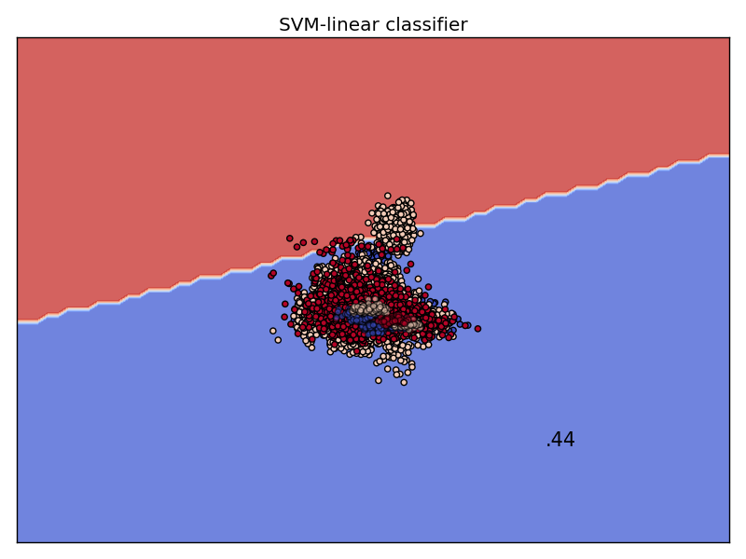
Classification Visualization
svm-linear

Slide 7
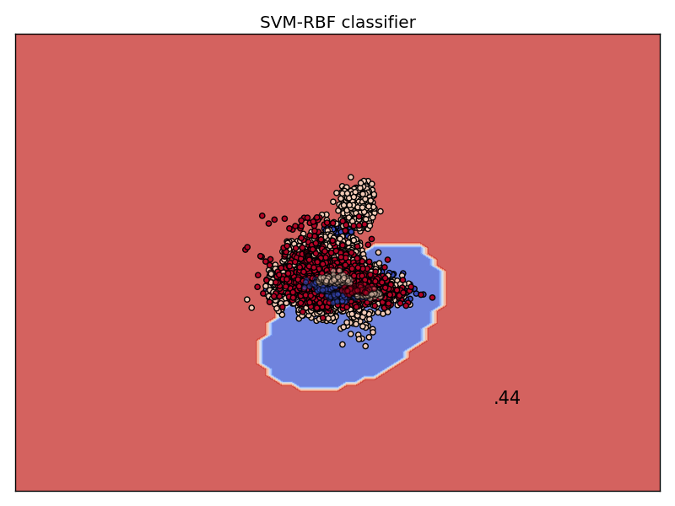
Classification Visualization
svm-rbf

Slide 8
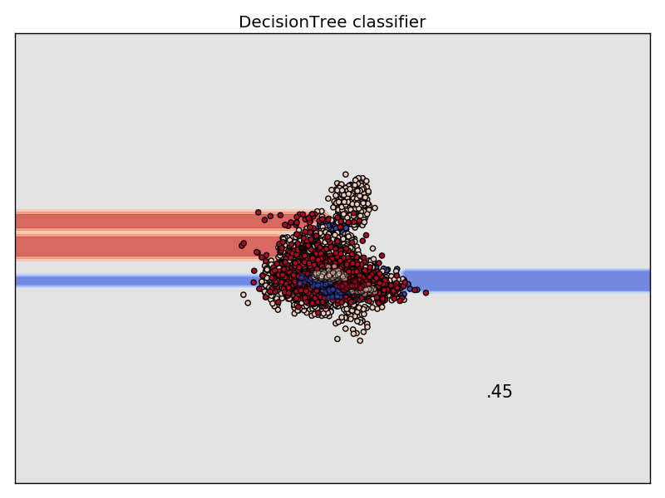
Classification Visualization
decision
tree

Slide 9
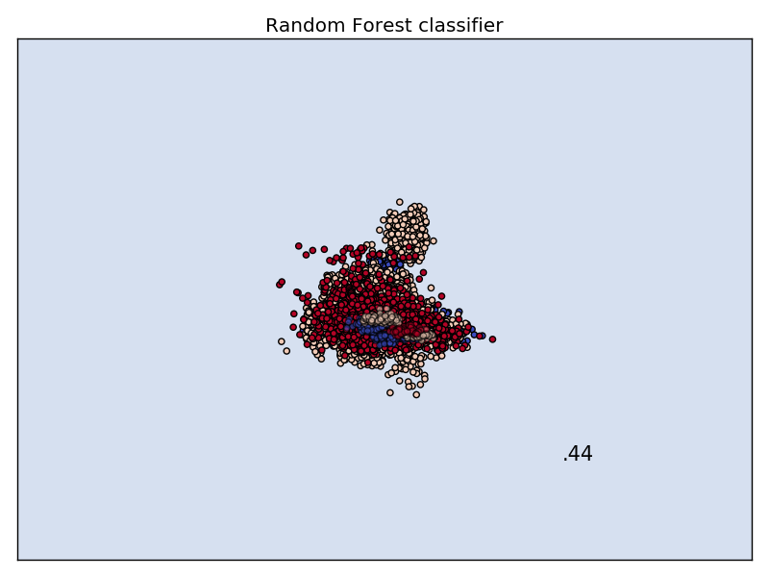
Classification Visualization
random
forest

Slide 10
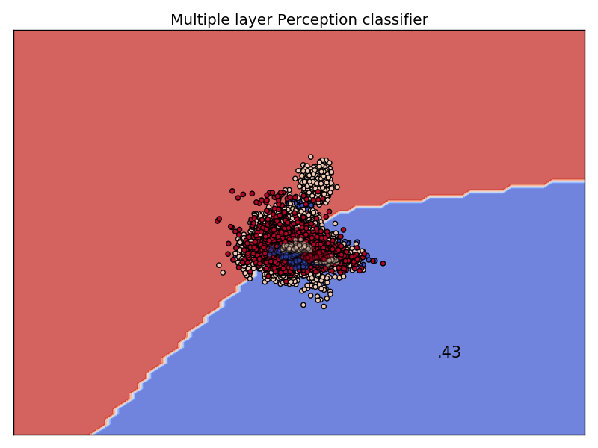
Classification Visualization
neural
networks

Slide 11
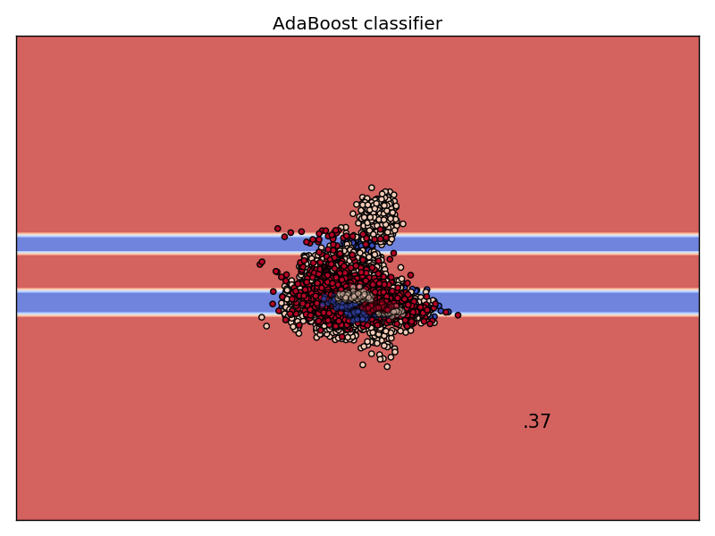
Classification Visualization
adaboost

Slide 12
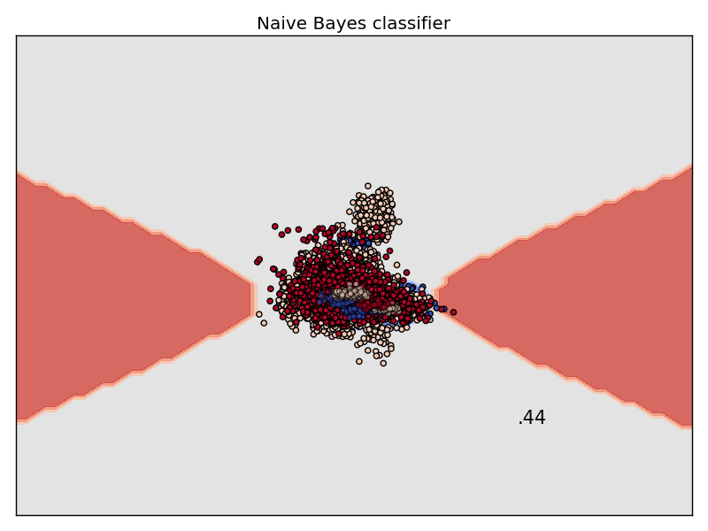
Classification Visualization
naive
bayes

Slide 13
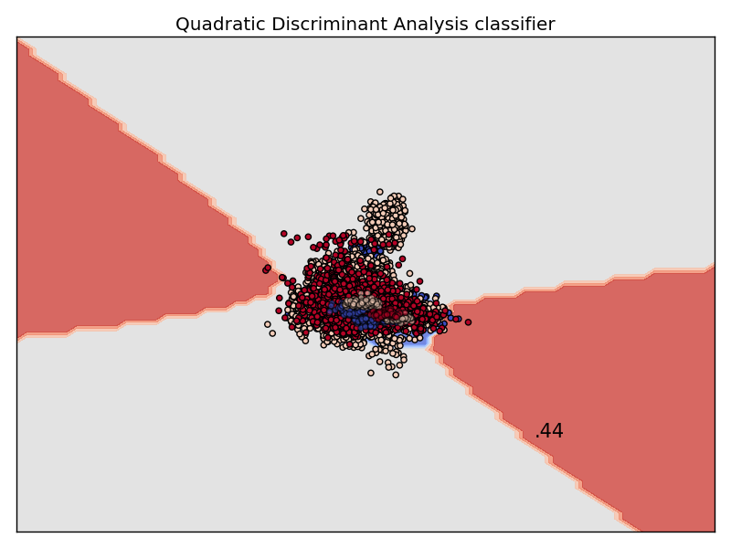
Classification Visualization
qda

