Slide 1
The Race Around The Netherlands
Ironhack project 3
Jet Salomons
19/05/2021

Slide 2
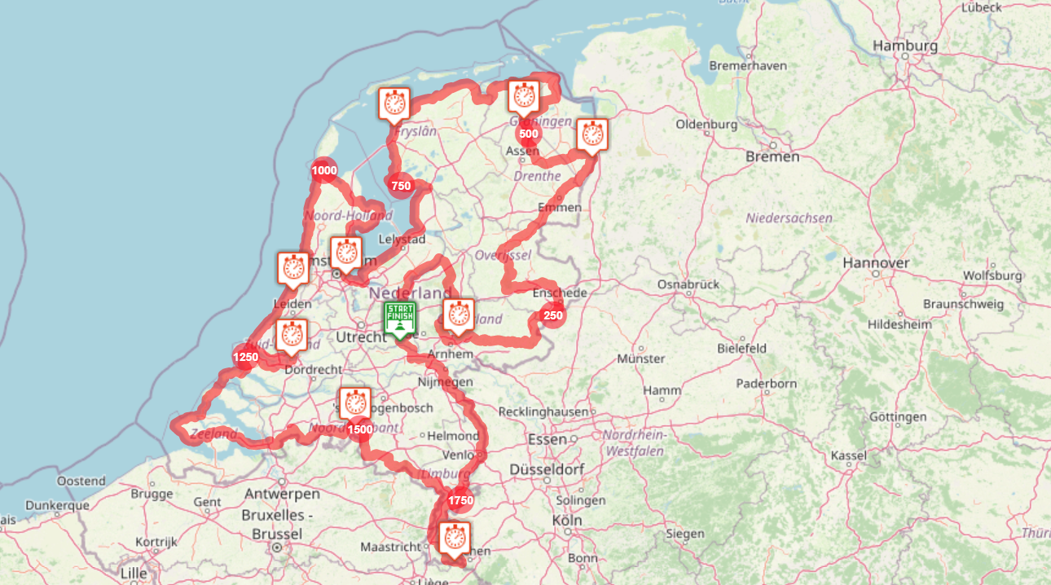
The basics
Predetermined:
~1900 km
Fixed checkpoints
Goal: ride this under 8 days 18h
Variables:
Gender (man / woman / mixed)
Solo riders & duos
Weather (mm rain; hrs rain,
temp, wind speed)

Slide 3
Men versus women
Men are usually faster, but who are tougher?

Slide 4
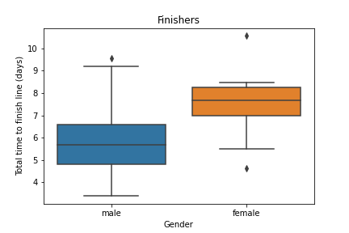
Men versus women: time to the finish
(data: solo riders, finisher)
Women take ~ 2 days longer to get to the finish than men.

Slide 5
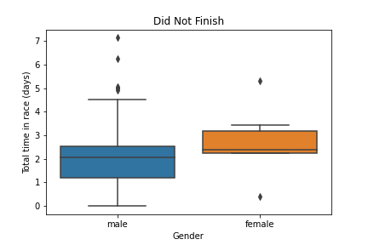
Men versus women: when do you give up? (1)
(data: solo riders, DNF)
Women stay in the race slightly longer.

Slide 6
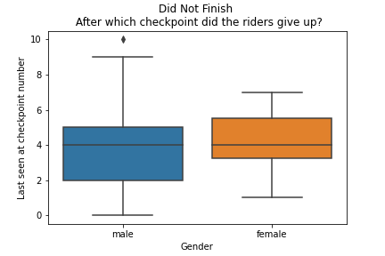
Men versus women: when do you give up? (2)
(data: solo riders, DNF)
Men and women tend give up in the same stretch

Slide 7
The give-up stretch:
(data: solo riders)
Between Harlingen and Amsterdam
Before halfway-point
In the second stretch of open fields
A lot of headwind?
  Dominant wind direction in the Netherlands: south-west

Slide 8
Conclusion: are men and women as tough?
(data: solo riders, DNF)
YES: Men and women tend to give up within the same stretch
NO: Women stay in the saddle longer until they give up
NO: Men do give up slightly more often than women:
  Men DNF: 37%
  Women DNF: 33%

Slide 9
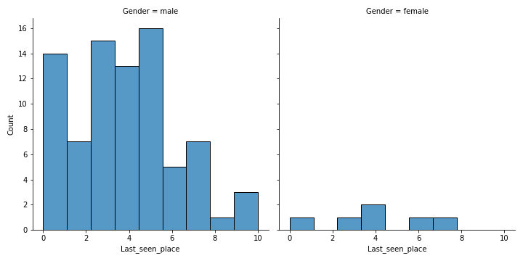
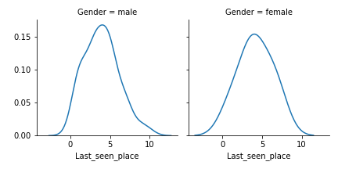
Men versus women: why all those boxplots? (data: solo riders)
Histogram: too little women
Density: could work, I find the boxplots more insightful

Slide 10
The best or worst of both worlds?
How to duo riders perform?

Slide 11
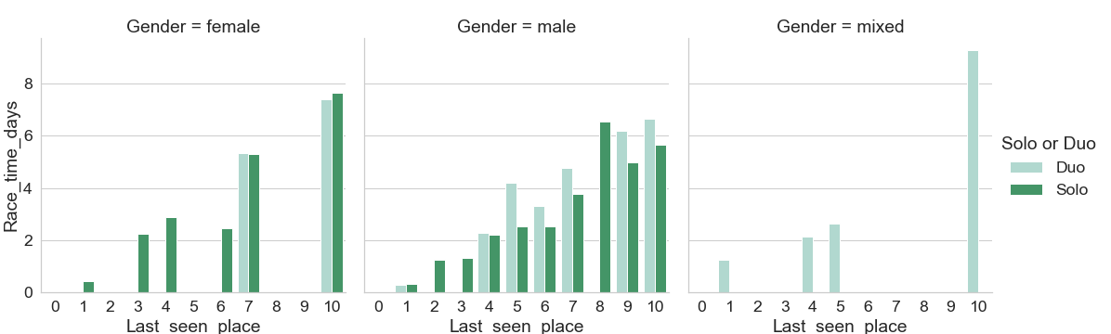
Solo versus duo: worst of both worlds
(data: finishers, DNF)
Together penalty for two men: visible
Together penalty for two women: not really (but beware: little datapoints)
Mixed duos: should be compared to women (but beware: little datapoints)

Slide 12
The weather
Do wind and rain wear riders down?

Slide 13
Weather & ride: hypothesis
(data: finishers, DNF, solo and duos)
Finishers: bad weather increases time in race
  Use: total rain mm, total hours of rain, average temp, average windspeed
DNF: bad weather decreases time in race
  Use: averages of all four weather parameters
    Average: weather parameter / number of stretches the rider finished

Slide 14
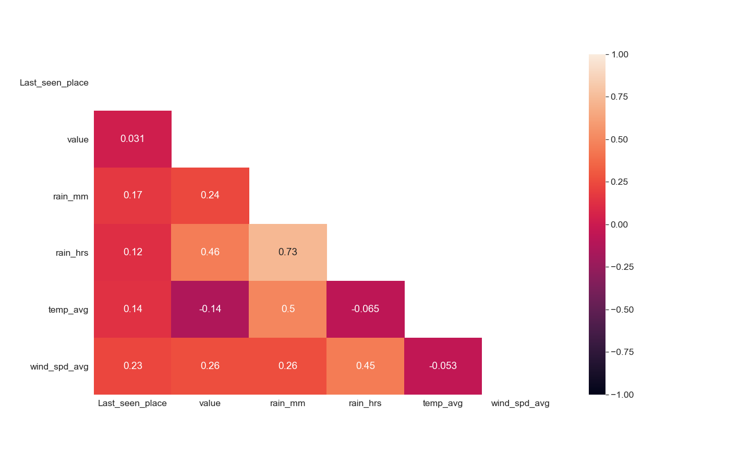
Weather & ride: finishers
(data: finishers only, total ride)
Hours of rain more strongly correlated to time spent on ride than rain in mm or wind speed are.

Slide 15
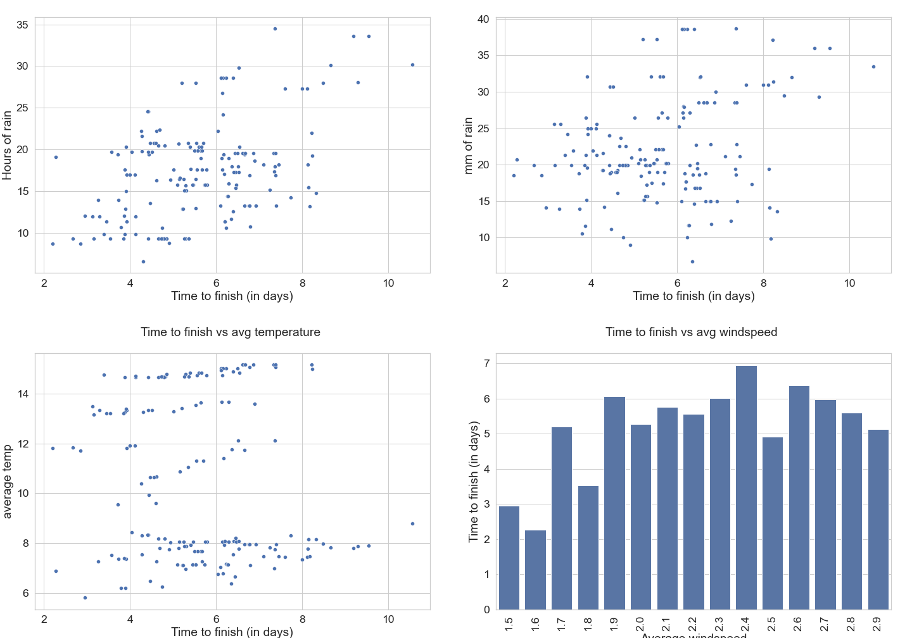
Weather & ride: finishers
(data: finishers only, total ride)
hours rain
mm rain
avg temp
avg windspeed

Slide 16
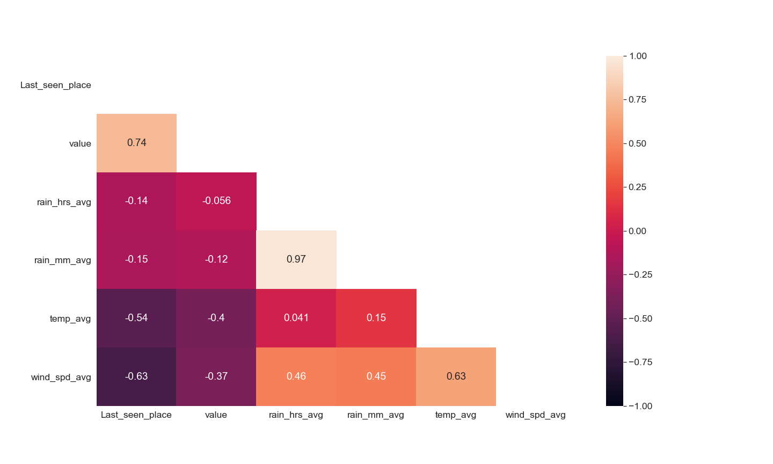
Weather & ride: DNF
(data: DNF only, total (unfinished) ride)
Rain: no speakable correlation
Wind: negative correlation
Temp: negative correlation
  Strange!

Slide 17
Weather & ride: DNF
Might be better to look at last checkpoint than time in race.

Slide 18
Challenges

Slide 19
Challenges
Data cleaning:
  Time travelers
Data wrangling:
  Merging weather- and riders- dataframes
Plotting:
  Save the entire plot (cropping!)

