Slide 1
WHAT / THE TRAINING USE CASE
countersign.
A valid session is not a
human decision.
ONE LOGGED-IN SESSION
?
Learner
AI assistant
Submit
HUMAN VERIFICATION FOR WEB APPS
01
Notes:
SLIDE 1 · 35 seconds · 0:00–0:35
Slide 1 — A valid session is not a human decision
On screen:
A valid session is not a human decision.
Small Countersign wordmark and team names; a simple graphic of learner → AI assistant → Submit inside one logged-in session. Put a question mark at Submit, not a “malicious bot” label.
Say:
“We started with the training use case: a Marine working in a distance-learning portal. Their browser assistant can work inside their logged-in session. To the application, the submission still arrives as the learner. But being logged in does not tell us whether the human confirmed this action. We want AI to help—without quietly removing the human from decisions that matter.
Traditional application logs may show the account used without establishing whether a human was present.”
Transition: “So we put the checkpoint in the application.”
PRODUCTION / EVIDENCE NOTES
Lead with the training use case. The question is fresh confirmation, not identifying a malicious bot. Optional: add presenter names to the small brand area after assigning roles.

Slide 2
WHAT / THE HUMAN CHECKPOINT
countersign.
Countersign.
AI where it helps. Humans where it matters.
Action
Human
confirmation
Decision record
A challenge. A human response.
WebAuthn / passkeys
HUMAN VERIFICATION FOR WEB APPS
02
Notes:
SLIDE 2 · 35 seconds · 0:35–1:10
Slide 2 — Countersign
On screen:
Countersign
AI where it helps. Humans where it matters.
A clean checkpoint graphic: Action → Human confirmation → Decision record. Highlight the human, not an AI-detection score.
Say:
“A sentry's challenge needs a countersign before someone passes. Our version is a biometric confirmation at a governed action. The web app's policy decides where to require it; the server checks the proof before allowing the action and records the decision.”
PRODUCTION / EVIDENCE NOTES
Explain the military countersign meaning once. The human/passkey graphic is conceptual, not a native authenticator dialog.

Slide 3
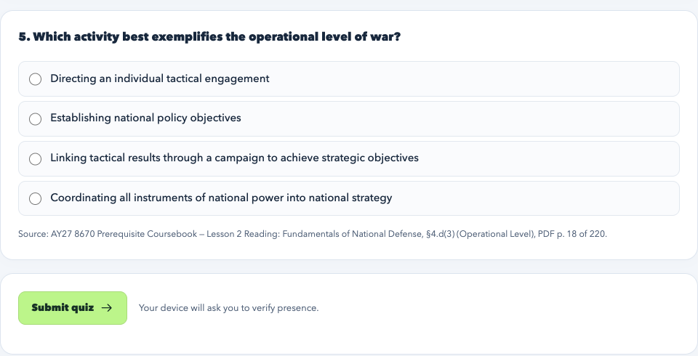
SO WHAT / THE DEMO
countersign.
Same task. Different boundary.
ChatGPT extension · Chrome
Governance off
Governance on
Live demo
or insert your recording
Governed quiz · UI reference
Prepare → Confirm → Inspect proof
HUMAN VERIFICATION FOR WEB APPS
03
Notes:
SLIDE 3 · 105 seconds · 1:10–2:55
Slide 3 — Same task. Different boundary.
On screen: a large video/demo region, with labels Governance off and Governance on. End on an enlarged crop of the actual accepted-proof event, not the whole log.
This is the main event. Use the same ChatGPT extension, Chrome profile, demo user, and rehearsed quiz request in both instances. Keep the mode indicator visible. The full sequence is in §5.
Narrate four beats:
1. “Without governance, the assistant completes the quiz submission in the learner's session.” Show the real result; do not claim all assistants or all prompts behave this way.
2. “Now the app requires a human. The assistant can prepare the answers, but submission waits for confirmation.” Let the real prompt/status remain visible briefly.
3. “I confirm. The server verifies a fresh proof bound to this submission, and the action proceeds.”
4. “The record shows the rule, the action, and the verified assertion—not just that someone had a session.” Highlight `human-verified`, the actual assertion ID, and UP/UV evidence if legible.
Landing line: “The important part isn't whether the assistant looks human. It's that the application requires human confirmation.”
Do not suggest the quiz is graded, that presence proves the answers are the learner's work, or that a waiting browser prompt is itself a logged `blocked` HTTP request.
PRODUCTION / EVIDENCE NOTES
DEMO SLOT — no video is embedded. The picture is a static governed-quiz UI reference. Switch to your prepared Chrome tabs, or replace the dark panel with your real recording. The OFF/ON pills contain localhost hyperlinks; pre-open Chrome because hyperlinks use the OS default browser. Never describe this still as the selected extension submitting or a human touching a sensor.
Demo schedule: 20s ungoverned result; 30s governed preparation; 25s fresh prompt/confirmation/result; 20s matching audit; 10s landing line. In a hybrid handoff, explain where the recording ends and live confirmation starts. Do not pre-issue a challenge.
If live progress stalls for ~10 seconds, use the backup. Show the actual human-verified event and assertion ID from THAT run. Do not substitute UI/test evidence.

Slide 4
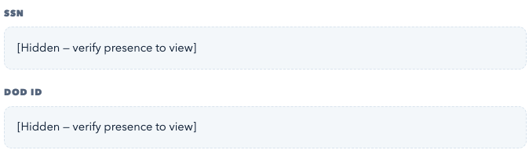
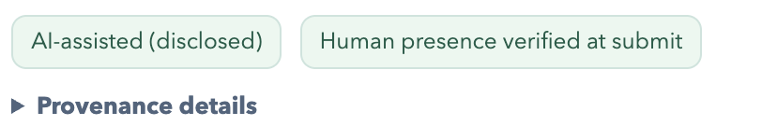
SO WHAT / ACCOUNTABLE PARTICIPATION
countersign.
Participation ≠ authorship.
DISCUSSION
Own work
AI-assisted
Confirm
Protected record
PUBLISHED DISCLOSURE
Masked → Confirm → Reveal
Automated UI reference · virtual authenticator
Extensions can read after reveal.
HUMAN VERIFICATION FOR WEB APPS
04
Notes:
SLIDE 4 · 45 seconds · 2:55–3:40
Slide 4 — Participation ≠ authorship
On screen: the headline above a large discussion crop: Own work / AI-assisted → Confirm → Published disclosure. A smaller record inset: Masked → Confirm → Revealed.
Say, about 35 seconds on discussion:
“Our discussion page makes the distinction between handwritten and AI assisted clear. The post carries the disclosure and verified presence. Composition signals can raise a review flag; they are not an AI-writing verdict. The training content uses a ‘post before you read’ discussion model, so this is a concrete place to make participation more accountable.”
Then, about ten seconds on data:
“Protected records are masked until fresh confirmation, with machine-readable markings. Once revealed, an extension can read them—we don't claim otherwise.”
Use prepared screenshots or a very short clip; do not run two more full live workflows. If showing an AI-written discussion, select AI-assisted. Save contradiction/flag demonstrations for Q&A. Do not portray client telemetry as proof of cheating.
PRODUCTION / EVIDENCE NOTES
The published badges are a real app screenshot from an isolated Chrome virtual-authenticator test. The footer says so. They demonstrate UI and disclosure semantics, NOT a physical Touch ID interaction or a ChatGPT-extension run. The record crop shows synthetic fields withheld by default. Discuss disclosure for ~35s and protected records for ~10s. After reveal, an extension can read the data.

Slide 5
NOW WHAT / REUSABLE INTEGRATION
countersign.
Add a checkpoint, not a new app.
New application or existing application
BROWSER
YOUR APPLICATION SERVER
Your page
Countersign
server gate
Verified
Your action
+ data
+ countersign.js
Human +
passkey
Policy
Reject
Decision log
Client + server integration · Demonstrated in Express
HUMAN VERIFICATION FOR WEB APPS
05
Notes:
SLIDE 5 · 50 seconds · 3:40–4:30
Slide 5 — Add a checkpoint, not a new app
On screen: the diagram in §4, rebuilt as simple editable boxes. Gray is the app you already have; teal/mint is Countersign. Caption: New app or existing app. Client + server integration.
Say:
“The learning portal is our demonstration, not the product boundary. Countersign is intended as reusable instrumentation: a small client script provides the confirmation flow; server-side checks sit before the actions you choose to govern. Your app keeps its sign-in, business logic, and data. Approved policy tells the gate what to require, and the decision goes to the log. A new app can add this from the start; an existing app can add it at selected endpoints.”
Important qualification: “This prototype demonstrates that pattern in Express. It is not yet a zero-change installer for every legacy system.”
The server gate is essential: hiding a button or adding a script alone does not secure a directly callable endpoint. There is no implemented general-purpose governance-injection proxy or packaged cross-framework SDK.
PRODUCTION / EVIDENCE NOTES
All diagram elements are editable PowerPoint text/shapes. Gray/white is the existing app; teal/mint is Countersign. Arrows illustrate the governed action, not every possible request. The server gate is mandatory. Express is the demonstrated implementation; no universal SDK or governance-injection proxy is claimed.

Slide 6


NOW WHAT / AI IN THE SOLUTION
countersign.
AI drafts. People approve.
App pages
AI draft
Human review
Active policy
THE ACTIVATION BOUNDARY
Draft ≠ active.
Policy-review UI · detail crops
HUMAN VERIFICATION FOR WEB APPS
06
Notes:
SLIDE 6 · 45 seconds · 4:30–5:15
Slide 6 — AI drafts. People approve.
On screen: App pages → AI draft → Human review → Active policy. Place one tightly cropped, real policy-review rule below the flow, with its rationale/approval control visible.
Say:
“AI is also part of our solution. The generator reads the demo app's pages and forms, drafts rules and rationales within our supported policy schema, and uses Registry-backed vocabulary for content markings. A person reviews the draft before activation. Generation alone never changes the active policy. That helps an application owner start from a concrete proposal rather than an empty policy file. At runtime, the gate checks the approved rules and the cryptographic proof—not an LLM's opinion about who clicked.”
Use a saved draft/review view, not a fresh model call or a live change to the known-good demo policy. Say clearly that the current crawler targets the three demo routes; arbitrary-app discovery is future integration work. The documented policy-generation run used OpenAI; configurable provider support is not evidence of a GovCloud deployment.
PRODUCTION / EVIDENCE NOTES
Policy-review images are separate detail crops of the real current UI. Active and draft policies were identical at capture. No model call and no approval were performed for the capture. This shows the approval interface, not a claim of live generation. Do not change the known-good policy on stage. The current crawler covers three demo routes. Runtime verification does not call an LLM.

Slide 7
NOW WHAT / BEYOND TRAINING
countersign.
Training is the starting point.
BUILT
POTENTIAL APPLICATIONS
Training
Finance
Access
Operations
Confirm
submission
Release
payment
Grant
privilege
Authorize
production change
Same checkpoint. Higher stakes.
HUMAN VERIFICATION FOR WEB APPS
07
Notes:
SLIDE 7 · 45 seconds · 5:15–6:00
Slide 7 — Training is the starting point
On screen: four simple icons/cards, with a visible separation between Built and Potential applications:
- Built: Training — Confirm submission
- Potential: Finance — Release payment
- Potential: Access — Grant privilege
- Potential: Operations — Authorize production change
Say:
“We focused on training because that was the use case. The same boundary becomes even more consequential when an assistant prepares a payment, a privileged-access change, or a production-system change. Let it do the preparation; require the authorized human's fresh confirmation before the final action. These are future integrations, not deployments we've built. Each would still need its own identity, authorization, approval rules, and safety controls.”
Optional Q&A example, not a fifth card: a clinician confirming a medication order. The checkpoint would not establish clinical correctness or replace clinical safeguards. Prefer the three on-slide examples to avoid turning the pitch into a claim of medical or mission-critical readiness.
PRODUCTION / EVIDENCE NOTES
The training portal is built; finance, access, and operations are POTENTIAL integrations. Fresh confirmation does not replace authorization, separation of duties, domain safety, or comprehension. A medication order can be a Q&A example, but do not imply medical readiness.

Slide 8
NOW WHAT / YOUR FIRST COUNTERSIGN
countersign.
Which action in your application
needs a human’s confirmation?
Choose one action.
Require a countersign.
AI where it helps. Humans where it matters.
HUMAN VERIFICATION FOR WEB APPS
08
Notes:
SLIDE 8 · 30 seconds · 6:00–6:30
Slide 8 — Choose one action. Require a countersign.
On screen:
Which action in your application needs a human's confirmation?
Choose one action. Require a countersign.
One strong checkpoint/checkmark visual and the Countersign wordmark. No roadmap grid, invented QR code, funding ask, or promised 90-day deployment.
Close:
“We don't have to choose between useful AI and human control. Countersign makes that boundary explicit: let AI assist, require a human where the action matters, and keep the record. Our challenge to you is simple: pick one consequential action in an application you own. That is where to put the first countersign.”
Stop. Leave this slide up for questions.
PRODUCTION / EVIDENCE NOTES
Close at 6:30 and keep 30 seconds for recovery. Leave this slide visible during the separately allocated three minutes of Q&A. Do not add a funding ask or a deployment commitment.
Q&A REFERENCE
## 8. Three-minute Q&A preparation
Answer the question in the first sentence; target 15–20 seconds, then offer detail. The first three are the most important to rehearse.
| Likely question | Answer |
|---|---|
| Does this stop a student using AI to answer everything? | No. It establishes fresh confirmation at submission, not knowledge or authorship. Discussion adds explicit disclosure and advisory evidence for review. Assessment design still matters; continuous/per-question proctoring is not built. |
| Isn't this just MFA? What's different? | It uses a familiar standard at a different boundary: a selected action, not just login. The challenge is bound server-side to the user/session, action, form data, and disclosure. Policy, integration, and the decision record make that boundary reusable. We are not claiming to have invented WebAuthn. |
| Why should an application owner care? | The app, not whichever assistant happens to be used, decides what requires human confirmation. Start with an action where silent delegation would be unacceptable. |
| Can the agent bypass the page and call the endpoint? | The protected server endpoint still requires a valid, fresh proof. A session cookie or replayed assertion is insufficient. This assumes trusted enrollment, authenticators, and server enforcement—not a compromised endpoint or signing key. |
| What if the human approves without reading? | That remains possible. Confirmation is not comprehension or judgment. Stronger review, transaction display, separation of duties, and domain-specific approvals are additional controls, not claims of this prototype. |
| Can the agent still read the protected record? | Not the withheld fields before a successful reveal. After reveal, a co-resident extension can read them. Markings can inform cooperating tools; endpoint/egress controls are needed for stronger read/exfiltration guarantees. |
| Can this work with a legacy app? | The intended pattern is to add client confirmation and a server gate to selected actions while retaining the app. Express is the demonstrated integration. Other stacks need adapters; we have not built a universal no-change proxy. |
| What exactly does the AI do? | It drafts policy and rationales from the three demo pages/forms within a constrained schema; a human reviews before activation. It does not identify who clicked, prove authorship, or adjudicate submissions at runtime. |
| Where does policy-generation data go? | To the configured provider; the documented policy-generation run used OpenAI with synthetic portal content. Other adapters exist, but a production owner must authorize the model/environment before sending application content. We have not demonstrated a GovCloud deployment. |
| Who is the human? Do you integrate with CAC? | The registered credential is associated with the app's user/session. This prototype uses demo login and passkeys, not CAC/PIV or independent identity proofing. Production enrollment and enterprise identity integration are additional work. |
| What about accessibility or non-biometric users? | WebAuthn supports multiple authenticator and verification methods, including device PINs where supported. The chosen enrollment flow and required UP/UV must be tested for the deployment; we have not validated every device or accessibility path. |
| Is the audit log tamper-proof? | No. The server verifies cryptographic proof and writes decision/evidence metadata to JSONL. The log itself is not signed or hash-chained, and a governance approval is not proof of every downstream business outcome. |
| What would production require next? | Real identity and role-based policy administration; hardened credential/audit storage; security and accessibility review; deployment-specific integration and failure handling. Validate one consequential action first, rather than promising a universal rollout. |
Do not open Q&A by apologizing for the prototype. Describe the precise guarantee, then its boundary. Keep the final slide visible unless a specific question warrants opening a prepared artifact.

