Slide 1

GROUP I2
GAME CONTROL USING HAND GESTURE RECOGNITION
Department of CSE
Sahrdaya College of Engineering & Technology
Thrissur
13 August, 2024

Slide 2
GROUP MEMBERS
SL NO.
1
2
3
4
Name
John Amal
Joel Joy
Jerin Davis
Kevin Paulson
GUIDE
Mrs Sruthy Sukumaran Assistant Professor
CSE Department, SCET

Slide 3
Vision of the Department
To be a nationally recognized center for quality education and research in diverse areas of computer science engineering, with a strong social commitment.
Mission of the Department
Impart relevant technical knowledge, skills and attributes along with values and ethics.
Enhance creativity and quality in research through project based learning environment.
Mould Computer Science Engineering Professionals in synchronization with the dynamic industry requirements.
Inculcate essential leadership qualities coupled with commitment to the society.

Slide 4
CONTENTS
1. INTRODUCTION
2. PROBLEM STATEMENT
3. SKILLS SET REQUIRED
4. FEATURES
5. OBJECTIVES
6. BASE PAPER
  6.1. DIAGRAMS
  6.2. LIMITATIONS
  6.3.LITERATURE REVIEW
CSE Department, SCET

Slide 5
CONTENTS
7. DESIGN ELEMENTS
  7.1 DATA FLOW DIAGRAM
  7.2 WORK ACCOMPLISHED
8. RESULT AND DISCUSSION
9. CONCLUSION
CSE Department, SCET
4
Notes:
4
4
4
4
4

Slide 6
1. INTRODUCTION
Our project brings down the system of hand gesture recognition to gaming.
It is widely used in interactive gaming and the way of experiencing it using natural hand movements.
The system is designed to integrate seamlessly with existing gaming platforms and to bring a transition from traditional controls to gesture-based controls.
CSE Department, SCET

Slide 7
2. PROBLEM STATEMENT
Traditional gaming controls can limit the players involvement and engagement, making it challenging to create a fully interactive experience.
By implementing hand gesture recognition, we allow players to control games through natural movements, enhancing immersion and creating a more dynamic gaming environment.
CSE Department, SCET

Slide 8
3. SKILLS SET REQUIRED
Python
OpenCV
Media-pipe
Tensor-flow
CSE Department, SCET

Slide 9
4. FEATURES
Gesture Customization
Multi-Gesture Recognition
Real-Time Feedback
Gesture-Based Menu Navigation
Cross-Platform Compatibility
CSE Department, SCET

Slide 10
5. OBJECTIVES
To study and analyze existing hand gesture recognition technologies and their potential applications in gaming, focusing on accuracy, responsiveness, and user experience.
To design a robust gesture recognition system tailored for gaming, ensuring it can interpret a wide range of natural hand movements and integrate seamlessly with existing gaming platforms.
To implement the designed gesture recognition system and bringing it to the gaming environment so that the players can use for it within the games.
CSE Department, SCET

Slide 11
6. BASE PAPER
Real-Time Recognition of the User’s Arm Gestures in 2D Space with a Smart Camera
This paper focuses on developing a novel game-based system for wrist rehabilitation, called HandReha. The idea is to automatically recognize pre-defined hand gestures using a web-camera, so to control an avatar in a three dimensional maze run game.
The pre-defined gestures are picked from a pool of well-defined gestures suitable for wrist rehabilitation.
Deep learning techniques were utilized to perform real-time hand gesture recognition from the images.
Therefore, its main role is to act as an intermediary between the user and the machine to facilitate communication.
CSE Department, SCET

Slide 12
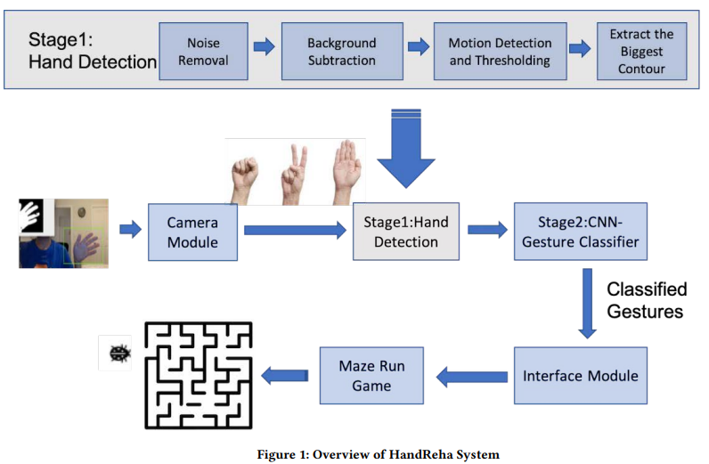
6.1 DIAGRAMS
CSE Department, SCET
16

Slide 13
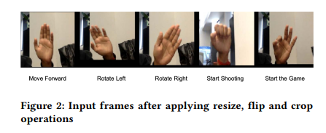
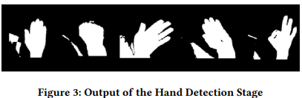
6.1 DIAGRAMS
CSE Department, SCET
17

Slide 14
6.2 LIMITATIONS
The system may struggle to accurately recognize hand movements due to differences in lighting, hand positions, or user movements, which could affect gameplay.
The system might require powerful hardware to work smoothly, making it less accessible for players with lower-end devices.
Players might need time to get used to gesture-based controls, which could make the game harder to play at first.
CSE Department, SCET
18

Slide 15
6.3 LITERATURE REVIEW​
AUTHORS | TITLE | METHODOLOGY | INFERENCE
Farnaz Farahanipad, Harish Ram, Nambiappan, Ashish Jaiswal, Maria Kyrarini, Fillia Makedon Published: 2020 | "HAND-REHA: Dynamic Hand Gesture Recognition for Game-based Wrist Rehabilitation " | Involves developing a two-stage model for gesture recognition, starting with hand detection and followed by gesture classification using a CNN. The model was trained on a dataset specifically created for this purpose, including five distinct hand gestures relevant to wrist rehabilitation. | The system was found to be highly effective, achieving a gesture recognition accuracy of 98.8%. The study highlighted the system's potential to make rehabilitation exercises more engaging. The non-intrusive and cost-effective nature of the setup further underscores its practical applicability in home-based rehabilitation settings.
CSE Department, SCET​
11

Slide 16
6.3 LITERATURE REVIEW
AUTHORS | TITLE | METHODOLOGY | INFERENCE
GVS Manoj Kumar, S.V.S Prasad, V. Manohar, Sreeja Paluvatla, Banoth Ravi, R. Sateesh Published:2022 | "Game Controlling using Hand Gestures " | The system captures real-time video using a webcam, and OpenCV and Mediapipe are used to process these images. The captured video frames are analyzed on-the-fly to identify hand gestures. The system tracks the hand's movement and extracts features such as hand contours. These features are then fed into an artificial neural network for gesture classification. The recognized gestures are mapped to specific game controls, enabling the user to interact with the game in real-time. | The study demonstrates the effectiveness of using hand gestures for controlling video games, offering an intuitive and natural user experience. The real-time processing approach allows for immediate interaction without the need for a pre-stored dataset, making it well-suited for dynamic gaming environments. This system provides a foundation for future developments in gesture-based interfaces, particularly in gaming and other human-computer interaction applications.
CSE Department, SCET​
12

Slide 17
DATASET
Paper 1:
Custom Dataset: 7,405 images of five hand gestures ("Fist," "Ok," "Open Palm," "PalmRight," "PalmLeft") from three participants.
Pre-processing: Images resized to 128x128 pixels, converted to grayscale, with background subtraction to isolate hands. Organized by gesture class.
Training: Dataset split for training and validation, used to achieve high accuracy in CNN-based gesture recognition.
Paper 2:
Real-time Processing: No pre-stored dataset; video frames are captured and analyzed in real-time.
Feature Extraction: Hand contours are detected using OpenCV and Mediapipe, and classified via an artificial neural network.
No Storage: Focus on live data analysis, with no need for long-term data storage.
CSE Department, SCET​

Slide 18
6.3 LITERATURE REVIEW​
AUTHORS | TITLE | METHODOLOGY | INFERENCE
Yande Li Taiqian Wang Aamir Khan Lian Li Caihong Li Yi Yang Li Liu Published: 2018 | "Hand Gesture Recognition and Real-time Game Control Based on A Wearable Band with 6-axis Sensors" | Utilized Microsoft Band 2 with accelerometer and gyroscope for gesture data collection. Developed a gesture recognition system using a sliding window and Dynamic Time Warping (DTW) algorithm. Implemented an Android game, "Fly Birds," to test real-time control through recognized gestures. | The study achieved high accuracy in gesture recognition, enabling seamless real-time control of the game through hand gestures. The system's effectiveness was demonstrated in various scenarios, suggesting that the approach could advance human-computer interaction through wearable devices.
CSE Department, SCET​
13

Slide 19
6.3 LITERATURE REVIEW​
AUTHORS | TITLE | METHODOLOGY | INFERENCE
Chao Peng, Jeffrey Hansberger, Vaidyanath Areyur, Shanthakumar, Sarah Meacham, Victoria Blakley, Lizhou Cao Published: 2018 | "A Case Study of User Experience on Hand-Gesture Video Games" | Motion Capture: Used the Perception Neuron motion capture suit to track hand and arm movements for controlling the "Happy Ball" game. Game Development: Created three mini-games within "Happy Ball," entirely controlled by predefined intuitive hand gestures. User Experience Evaluation: Conducted user studies using User Experience Questionaires (UEQ) to assess player satisfaction and engagement with the gesture-based controls. | The results indicated that using hand gestures provided a high level of user satisfaction, with the gesture control interface scoring in the top 1% of the UEQ study database. The study suggested that gesture-based interaction could enhance user experience in gaming, though improvements could be made in the efficiency and dependability of gesture controls
CSE Department, SCET​
14

Slide 20
DATASET
Paper 1:
Data Collection Device: Data was collected using the Microsoft Band 2, which includes a 3-axis accelerometer and a gyroscope to capture hand motion.
Segmentation and Labeling: Kinect camera video data was used to manually segment and label the hand gestures during the training phase.
Sensor Data: The dataset includes raw sensor data captured during various hand gestures, which were processed using a sliding window technique for feature extraction and classification.
Paper 2:
Motion Capture Suit: The dataset was gathered using the Perception Neuron motion capture suit, which tracks hand, arm, and finger movements.
Gesture Types: Data included various intuitive hand gestures (e.g., swipe, stop, drop-in), each mapped to specific game commands in the "Happy Ball" game.
User Interaction Data: Collected user interaction data during gameplay, including gesture performance (hits, misses, errors) and responses to User Experience Questionnaires (UEQ) for evaluating satisfaction and engagement.
CSE Department, SCET​

Slide 21
6.3 LITERATURE REVIEW​​
AUTHORS | TITLE | METHODOLOGY | INFERENCE
Doe-Hyung Lee and Kwang-Seok Hong Published: 2010 | "Game Interface using Hand Gesture Recognition" | The methodology employed in the study involves three primary steps: stereo image input, hand region detection, and pattern recognition. A Bumblebee 2 stereo camera is used to capture the stereo images, from which a depth map is generated using the Sum of Absolute Differences (SAD) method. The recognized hand gestures are further analyzed using difference image entropy to ensure accurate recognition. | The study concludes that the proposed hand gesture recognition system is effective in real-time applications, particularly in controlling interactive games like Chinese chess. The 85% recognition rate indicates a high level of accuracy, making it a viable solution for user interface design in 3D environments. The research demonstrates the potential for the system's application in fields such as robotics, with future work suggested to focus on hand tracking to further improve the system's capabilities.
CSE Department, SCET​​

Slide 22
6.3 LITERATURE REVIEW​​
AUTHORS | TITLE | METHODOLOGY | INFERENCE
Nhat Vu Le, Majed Qarmout, Cungang Yang, Yu Zhang, and Haoren Published: 2021 | "Hand Gesture Recognition System for Games" | The process starts with converting webcam-captured images into grayscale, followed by Gaussian blurring to reduce noise. The hand gesture recognition is refined by analyzing convex hulls and convexity defects of the hand contours, which helps in accurately identifying the number of fingers held up. This information is then used to send controller inputs to the game via a virtual Xbox 360 controller emulated using the ViGEmBus driver. | The study concludes that the proposed hand gesture recognition system is a feasible and effective solution for enhancing gaming accessibility. With an accuracy of 80% for hand gesture detection and minimal latency, the system shows potential for real-world applications. Future improvements could include enhanced gesture recognition accuracy, support for additional gestures, and broader game compatibility.
CSE Department, SCET​​

Slide 23
DATASET
Paper 1:
1. The dataset contains 240 hand gesture images divided into eight categories: four gestures ("vertical grab," "vertical splay," "horizontal grab," "horizontal splay") for both the left and right hands.
2. The images were used to evaluate the system's ability to recognize hand gestures based on difference image entropy, achieving an overall recognition rate of 85%.
Paper 2:
1. The dataset includes real-time hand gesture data captured via a webcam, focusing on detecting and recognizing hand contours, convex hulls, and convexity defects.
2. The dataset was used to test the accuracy of the system in recognizing various hand gestures, achieving an 80% recognition accuracy, with the gestures being mapped to virtual game controller inputs.
CSE Department, SCET​

Slide 24
6.3 LITERATURE REVIEW​​​
AUTHORS | TITLE | METHODOLOGY | INFERENCE
Rachana R. Chhajed, Komal P. Parmar, Manvi D. Pandya, Neha G. Jaju Published: 2022 | "Messaging and Video Calling Application for Specially Abled people using Hand Gesture Recognition " | Creation of a custom Indian Sign Language (ISL) dataset with 17,500 images to train the neural network for accurate hand gesture recognition Integration of YOLO v4 for fast and precise hand detection, combined with a CNN model for gesture classification | The YOLO v4 model achieved the highest accuracy (Average IoU of 0.932) and the fastest detection speed (0.0091 seconds per frame), outperforming Faster RCNN and YOLO v3 A vision-based system using YOLO v4 and CNN models for gesture classification is both cost-effective and accessible, providing an efficient alternative to sensor-based systems

Slide 25
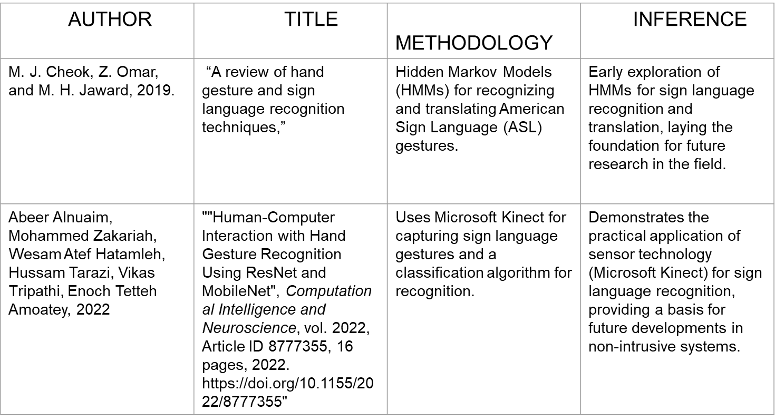
6.3 LITERATURE REVIEW​​​

Slide 26
DATASET​
Paper 1:
1. Custom dataset comprising 17,500 images specifically tailored for Indian Sign Language (ISL).
2. Preprocessing involved converting images to grayscale and standardizing them to a unified dimension suitable for CNN models
Paper 2:
1. Include a variety of gestures covering letters and numbers in Indian Sign Language (ISL).
2. Ensure all images are clear, consistent in size, and color (e.g., grayscale)
3. Use a balanced dataset of around 17,500 images with equal representation for each sign

Slide 27
7. DESIGN ELEMENTS

Slide 28
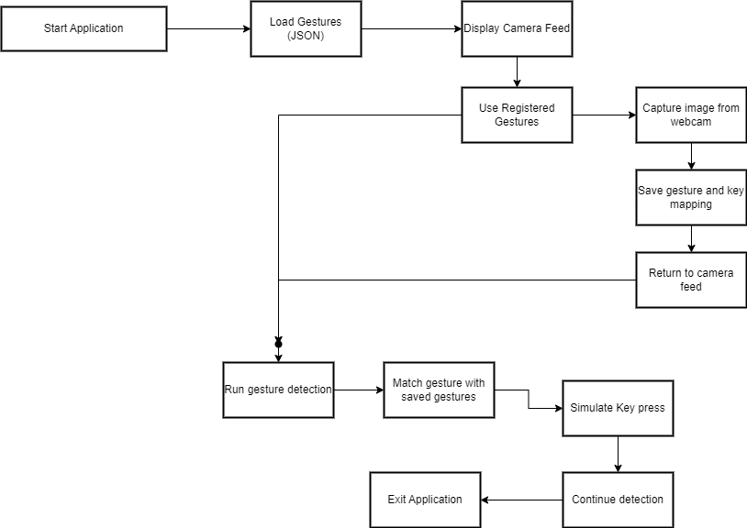
7.1 DATA FLOW DIAGRAM​

Slide 29
7.2 WORK ACCOMPLISHED
Research: Explored gesture recognition techniques and OpenCV, Tkinter for real-time detection.
Design: Developed system architecture, GUI for gesture registration, and webcam integration.
Implementation: Built gesture registration, key mapping, and detection with pyautogui for in-game control.
Validation: Tested system accuracy with different gestures and validated key mappings.
Documentation: Created user guides and documented code for setup and usage.

Slide 30
8. RESULT AND DISCUSSION
DFD Findings: Clarified data flow between user, gesture detection, and game control.
ER Diagram Findings: Identified key entities like gestures and key mappings, simplifying data storage.
Impact on Stakeholders: Improved understanding of system workflow and design.
Impact on System Design: Optimized gesture detection and data handling for faster performance.

Slide 31
9. CONCLUSION
So our main goal for this project is to develop a hand gesture recognition system that enhances gaming experiences through natural, user-friendly controls.
We aim to create an application that seamlessly integrates this system into existing platforms, improving player engagement and immersion while providing a more dynamic and responsive gaming environment.
CSE Department, SCET
19

Slide 32

Thank You
CSE Department, SCET
20

