Slide 1
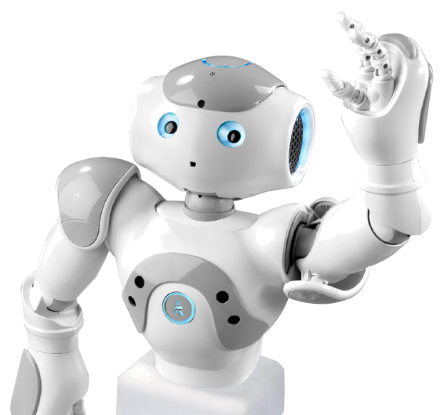
Nao by Nao
An introduction to robotics

Slide 2
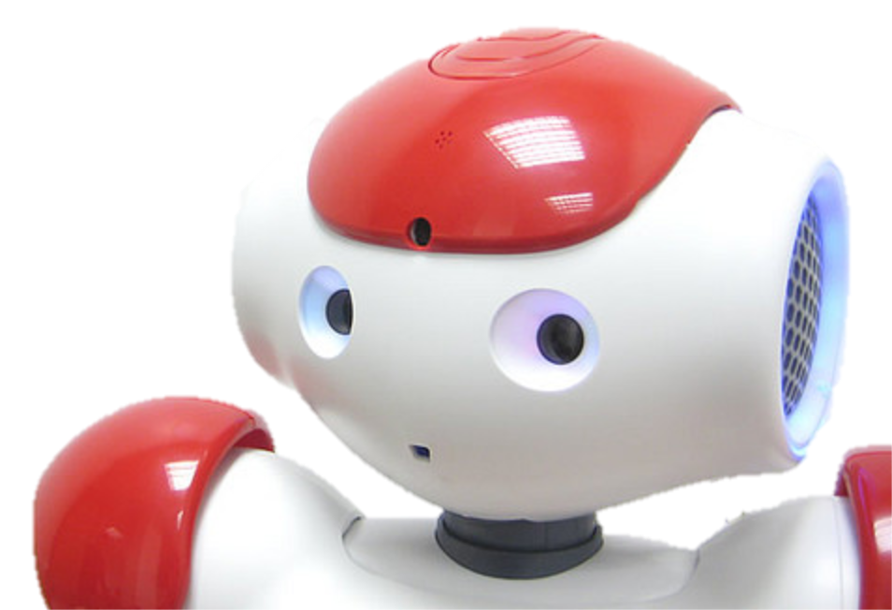
My body – Vision
I have two HD RGB cameras
I can even see you all right now …

Slide 3
My body – Sound
I have four microphones with which I can determine location
I can even recognize the words you say

Slide 4
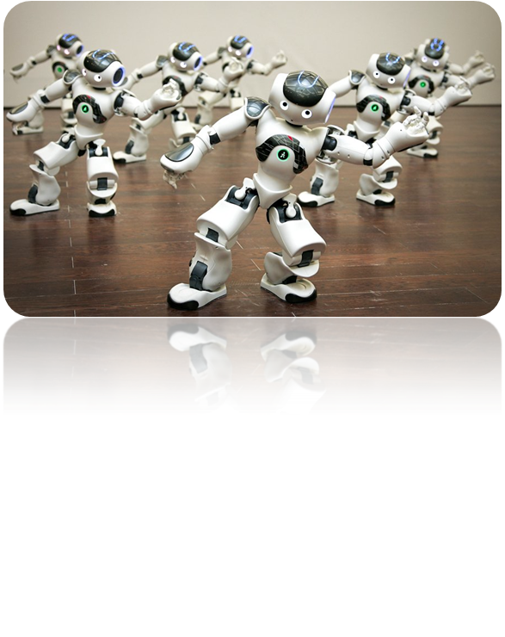
My body – Movement
Humanoid robot
I like to dance sometimes

Slide 5
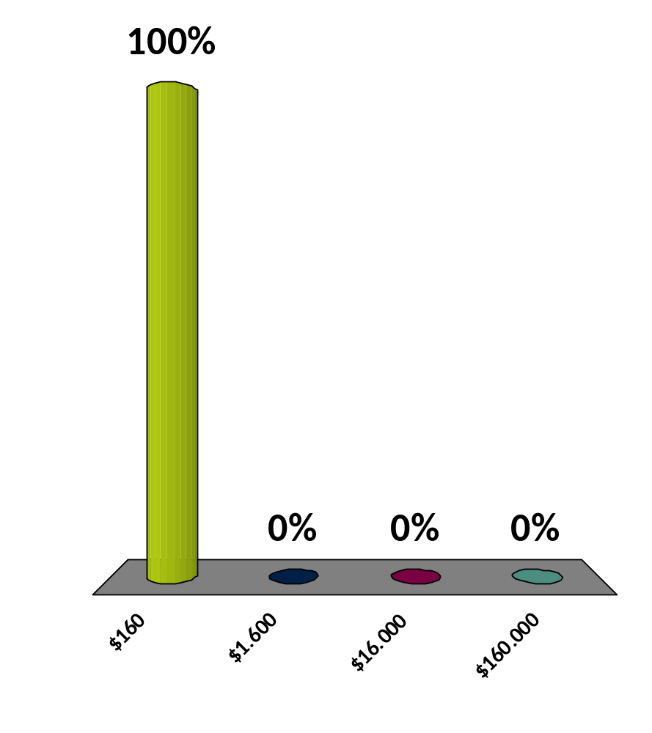
How much do I cost?
$160
$1.600
$16.000
$160.000
:01

Slide 6
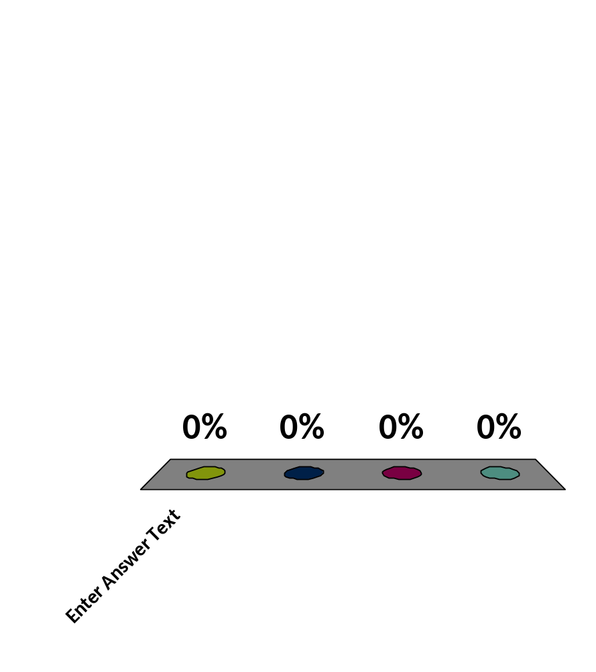
What is the only bird that can fly backwards?
Penguin
Hummingbird
Ostrich
Woodpecker
:08

Slide 7
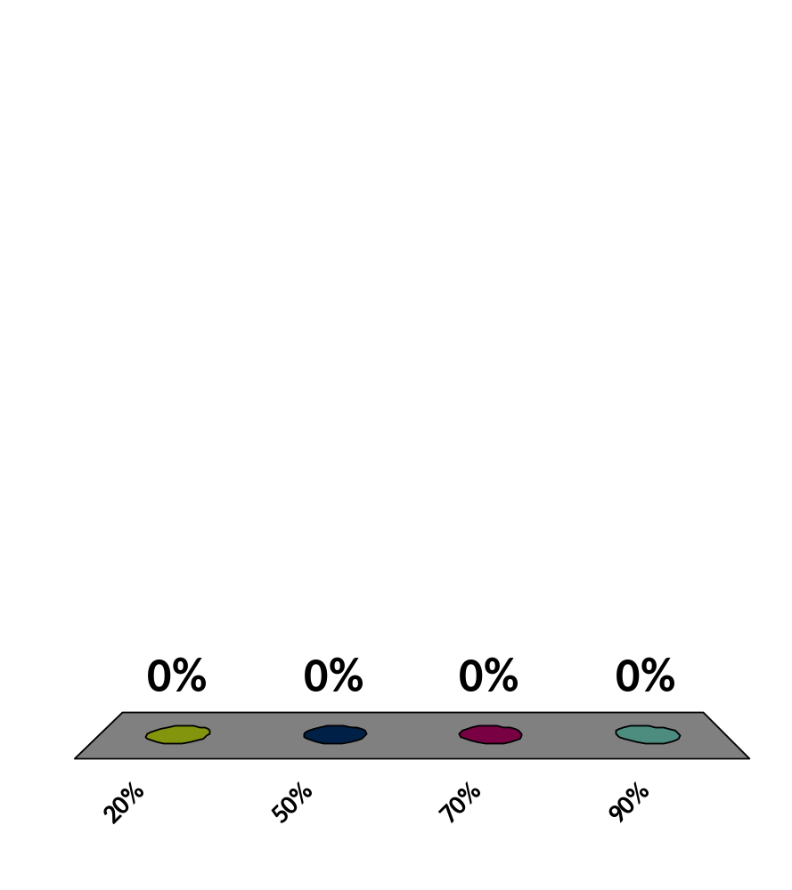

How much sand does the Sahara desert consist of?
20%
50%
70%
90%
9

Slide 8
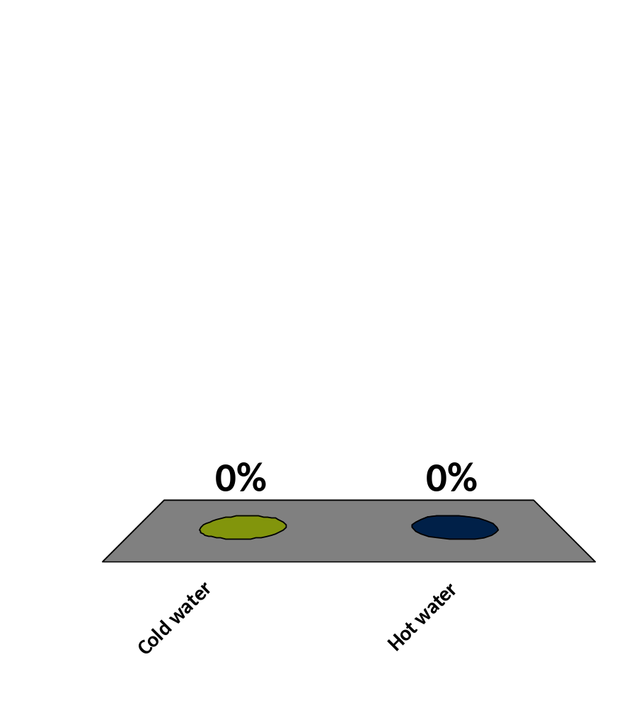
What freezes faster?
Cold water
Hot water
9

Slide 9
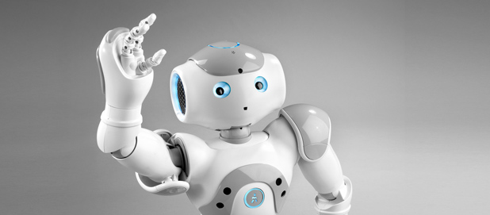
Thank you for your attention!

Slide 10
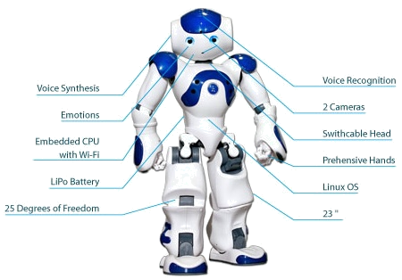
My profile
I have two HD RGB cameras
I come with advanced software from my creators
  Face recognition
  Speech recognition
I understand many
languages (human and machine)
I can stay awake for 90 minutes
without needing to recharge

Slide 11
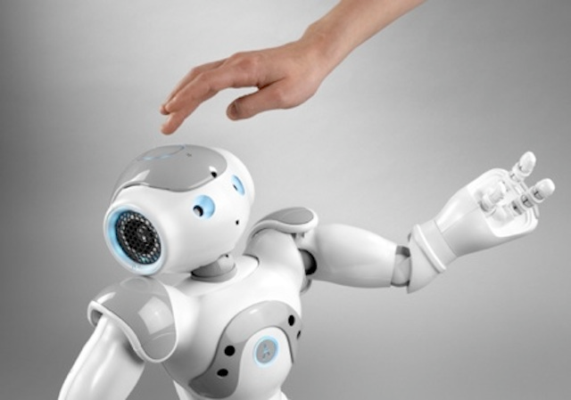
My future
I am useful in many situations
  Personal assistance
  Teaching
  Research
  Entertainment
I just need you to teach me how to do this!

