Slide 1

Biodiversity Project – Data Analytics
Jett Guitteau
April 2025

Slide 2
Goals
Explore data regarding species observations across several national parks.
Compare and contrast types of species and frequencies of each to be at-risk.
Determine which types of species need the most help.

Slide 3
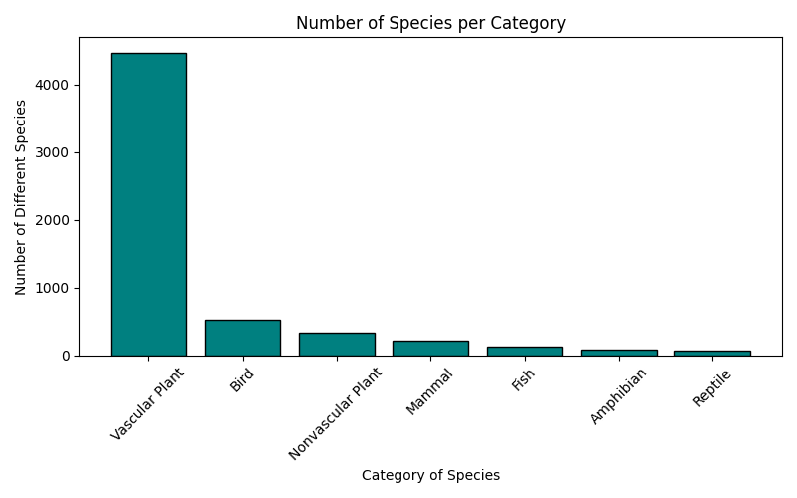
Species Counts
category | total count
Vascular Plant | 4470
Bird | 521
Nonvascular Plant | 333
Mammal | 214
Fish | 127
Amphibian | 80
Reptile | 79
The table and graph show us that vascular plants are by far more common and diverse, with birds in second place with about 1/9 the count of vascular plants, and mammals are less than half of the bird count.

Slide 4
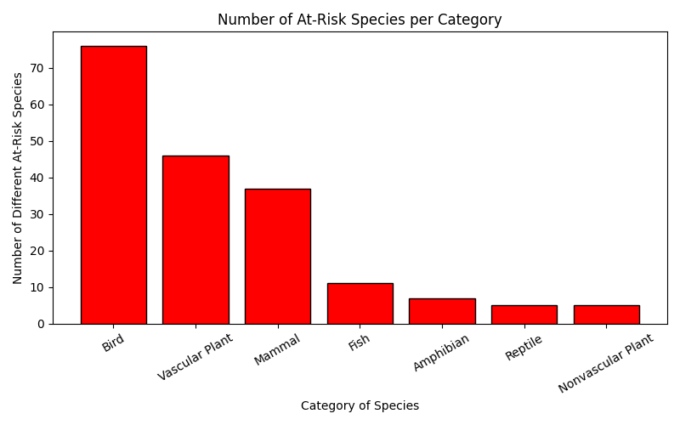
At-Risk Counts
category | at-risk count
Bird | 76
Vascular Plant | 46
Mammal | 37
Fish | 11
Amphibian | 7
Reptile | 5
Nonvascular Plant | 5
This table and graph show the at-risk counts of each species type. However, we see that birds are above vascular plants, despite the counts of vascular plants being significantly higher.
Mammals also have a count close to that of vascular plants despite having smaller overall counts.

Slide 5
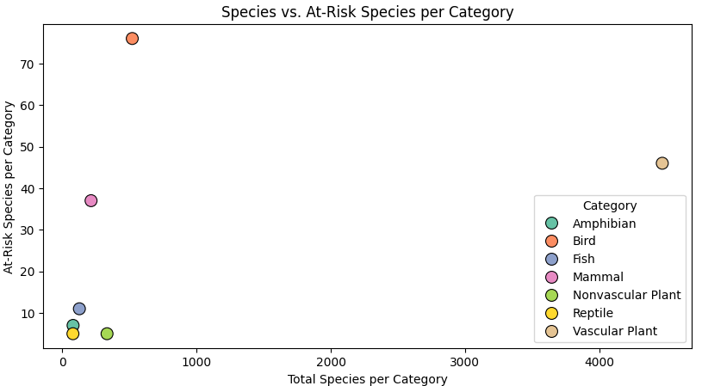
Are Total Species and At-Risk Species Counts Related?
This scatterplot shows us that there is not a correlation between the number of species and number of at-risk species. If there was a correlation between the variables, we could consider that species may have an equal chance of being at-risk. Since they are not correlated, there could be something causing certain groups of species to be at higher risk.
The notable outliers are vascular plants, mammals, and bird.

Slide 6
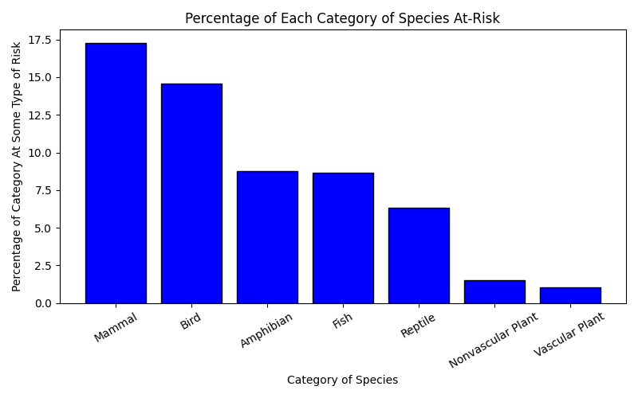
Which Types of Species Need the Most Help?
When we compare the at-risk counts to the total counts for each species type, we see that mammals and birds are at much higher risk than other categories.
This implies that some factors may be affecting these species more than others, increasing their conservation risk.
category | percentage of category at risk
Mammal | 17.28971963
Bird | 14.58733205
Amphibian | 8.75
Fish | 8.661417323
Reptile | 6.329113924
Nonvascular Plant | 1.501501502
Vascular Plant | 1.029082774

Slide 7
Are these numbers statistically significant?
Chi-square test:
Null Hypothesis (H₀):
There is no significant difference between the proportions of at-risk species across categories (mammals, birds, etc.).
Alternative Hypothesis (H₁):
The proportions of at-risk species are significantly different between categories.

Slide 8
Chi-square Values
Chi2 Stat: 1516.5308770800077
The large value indicates that there is a significant difference between the observed and expected frequencies across the categories.
P-Value: 0.0000000000
The very small P-value implies that there is very little chance that the differences between categories are due to random chance.
This is a strong indicator that the proportions of at-risk species differ significantly across species categories.

Slide 9
What does this mean?
The extremely low P-value indicates that the difference in risk is significant, meaning it is not due to random chance. Therefore, we reject the null hypothesis.
There is some factor at play affecting birds and mammals significantly more than other species. These species need extra attention and support, while factors affecting them need to be addressed.

