Slide 1
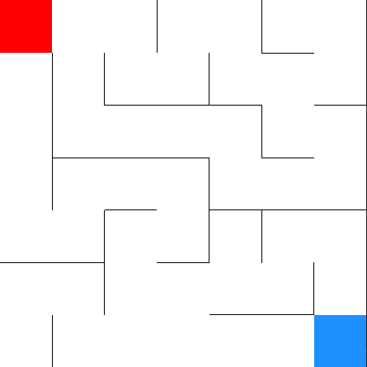
m_{y,1}
s
p_{1,1}
m_{1,x}
p_{2,1}
h_{2,1}
h_{1,1}
e

Slide 2
s
m_{1,1}
h_{2,1} = 7,8
h_{1,1} = 7,8
p_{2,1}
p_{1,1}
m_{2,1}
m_{1,2}
h_{2,2} = 7,8
h_{1,2} = 7,8
p_{1,2}
p_{2,2}
m_{3,1}
m_{1,3}
m_{2,2}
m_{4,1}
m_{2,3}
m_{3,2}
≈
≈
≈

Slide 3
m_{1,x}
m_{y,1}
s
p_{1,1}
h_{1,1}
e
h_{2,1}
p_{2,1}
e

Slide 4
s
m_{1,1}
h_{2,1} = 6,1
h_{1,1} = 5
p_{2,1}
p_{1,1}
m_{2,1}
m_{1,2}
h_{2,2} = 4
h_{1,2} = 5,1
p_{1,2}
p_{2,2}
m_{3,1}
m_{1,3}
m_{2,2}
m_{4,1}
m_{2,3}
m_{3,2}
≈
≈
≈

Slide 5
s
m_{1,1}
h_{2,1} = 6,1
h_{1,1} = 5
p_{2,1}
p_{1,1}
m_{2,1}
m_{1,2}
h_{2,2} = 4
h_{1,2} = 5,1
p_{1,2}
p_{2,2}
m_{3,1}
m_{1,3}
m_{2,2}
m_{4,1}
m_{2,3}
m_{3,2}
≈
≈
≈

Slide 6
s
m_{1,1}
h_{2,1} = 6,1
h_{1,1} = 5
p_{2,1}
p_{1,1}
m_{2,1}
m_{1,2}
h_{2,2} = 4
h_{1,2} = 5,1
p_{1,2}
p_{2,2}
m_{3,1}
m_{1,3}
m_{2,2}
m_{4,1}
m_{2,3}
m_{3,2}
≈
≈
≈

Slide 7
s
m_{1,1}
h_{2,1} = 6,1
h_{1,1} = 5
p_{2,1}
p_{1,1}
m_{2,1}
m_{1,2}
h_{2,2} = 4
h_{1,2} = 5,1
p_{1,2}
p_{2,2}
m_{3,1}
m_{1,3}
m_{2,2}
m_{4,1}
m_{2,3}
m_{3,2}
≈
≈
≈

Slide 8
s
m_{1,1}
h_{2,1} = 6,1
h_{1,1} = 5
p_{2,1}
p_{1,1}
m_{2,1}
m_{1,2}
h_{2,2} = 4
h_{1,2} = 5,1
p_{1,2}
p_{2,2}
m_{3,1}
m_{1,3}
m_{2,2}
m_{4,1}
m_{2,3}
m_{3,2}
≈
≈
≈

Slide 9
s
m_{1,1}
h_{2,1} = 6,1
h_{1,1} = 5
p_{2,1}
p_{1,1}
m_{2,1}
m_{1,2}
h_{2,2} = 4
h_{1,2} = 5,1
p_{1,2}
p_{2,2}
m_{3,1}
m_{1,3}
m_{2,2}
m_{4,1}
m_{2,3}
m_{3,2}
≈
≈
≈

