Slide 1
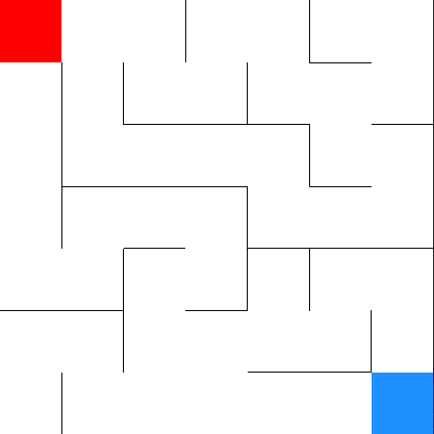
s
p_{1,1}
p_{2,1}
h_{2,1}
h_{1,1}
e

Slide 2
s
h_{2,1}
h_{1,1}
p_{2,1}
p_{1,1}
p_{1,2}
p_{2,2}
≈

