Slide 1
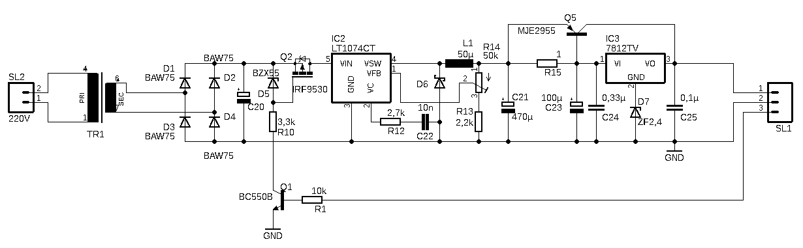
Transformer
Rectification
On/Off Control
Buck Converter
Stabilization

Slide 2
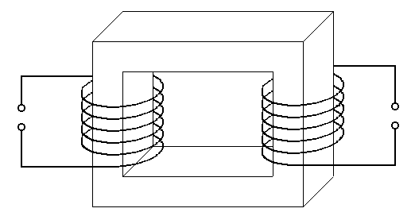

i₁
i₂
u₁
$$\frac{\text{d}\text{φ}}{dt}$$
N₂
u₂
N₁

Slide 3
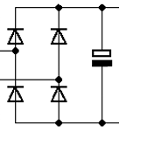
u₂
u₁

