Slide 1
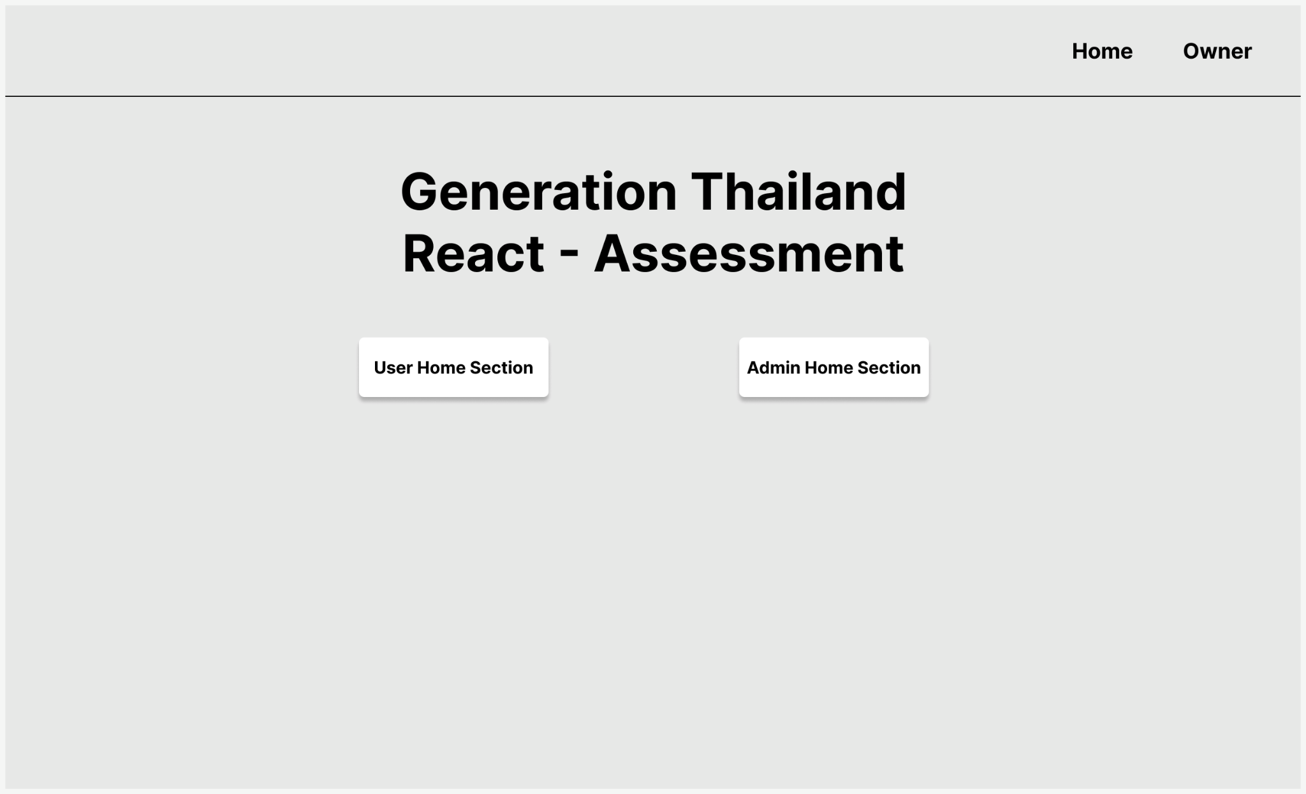

Slide 2
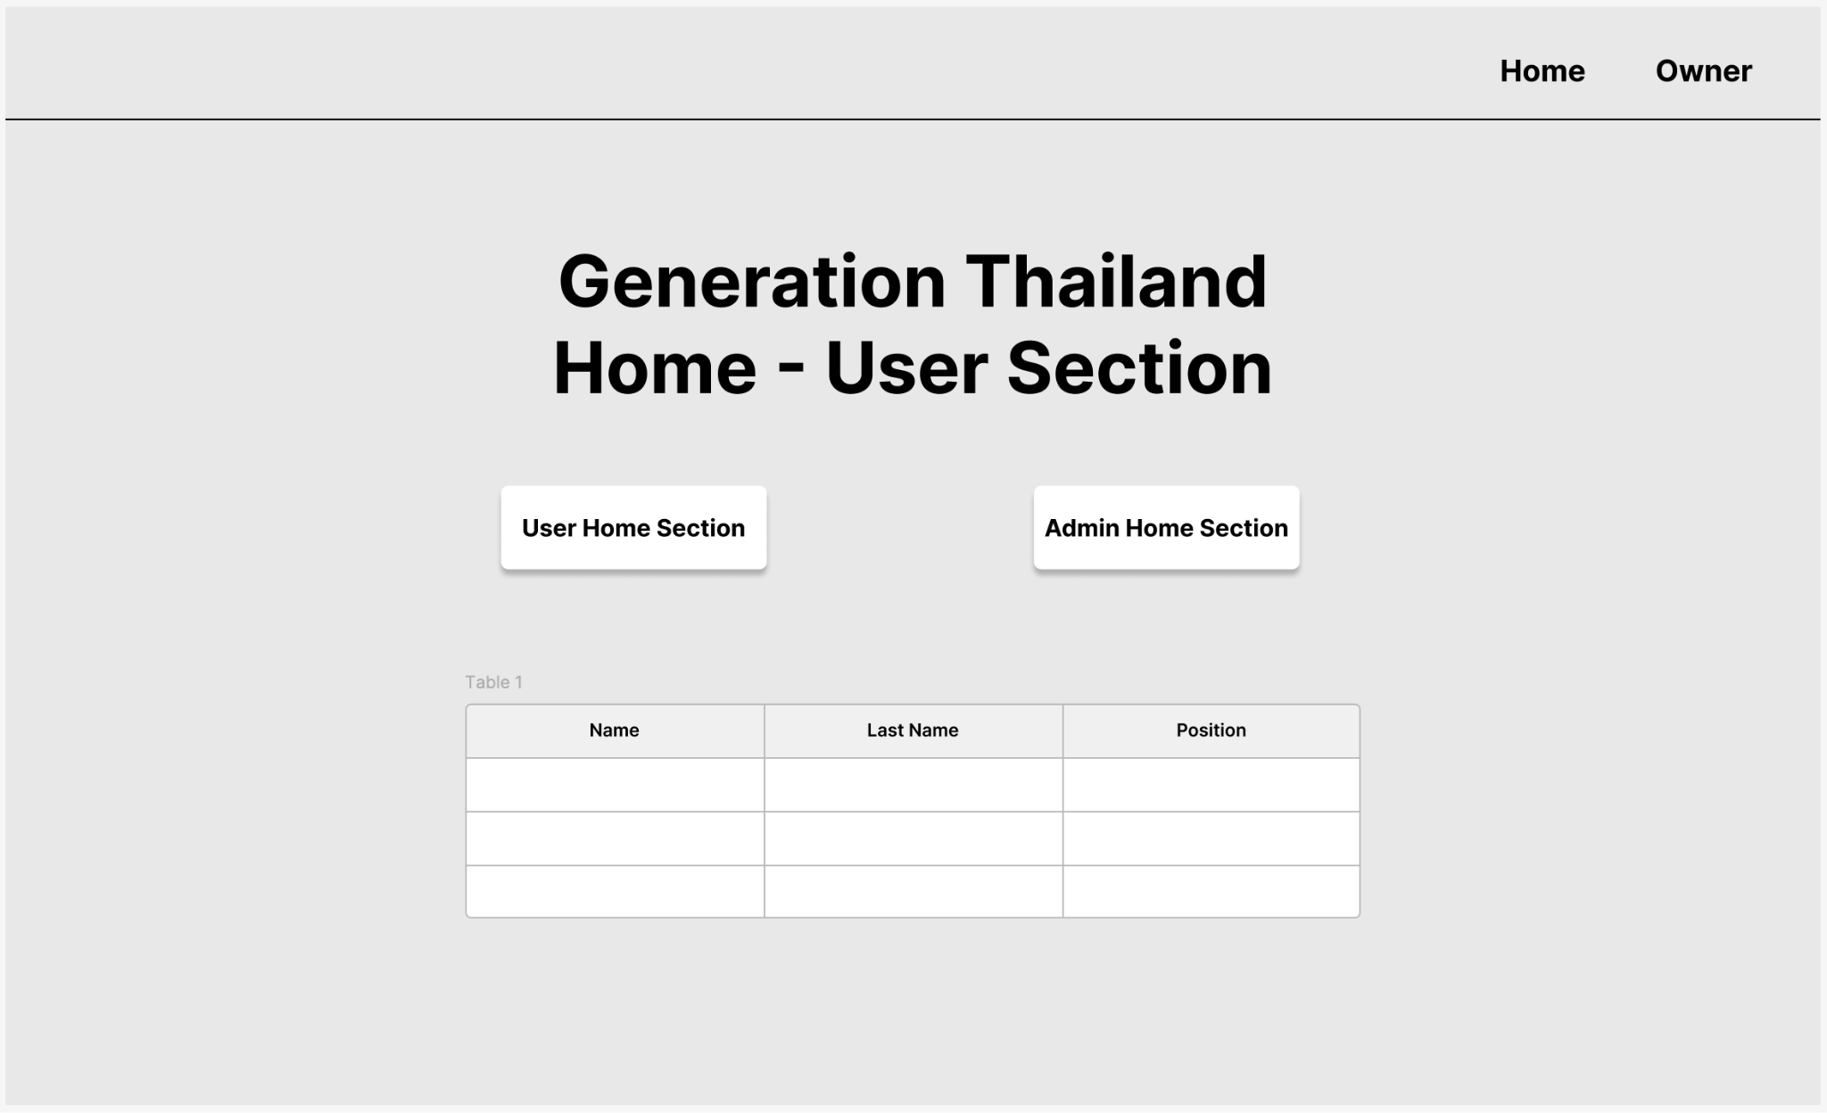

Slide 3
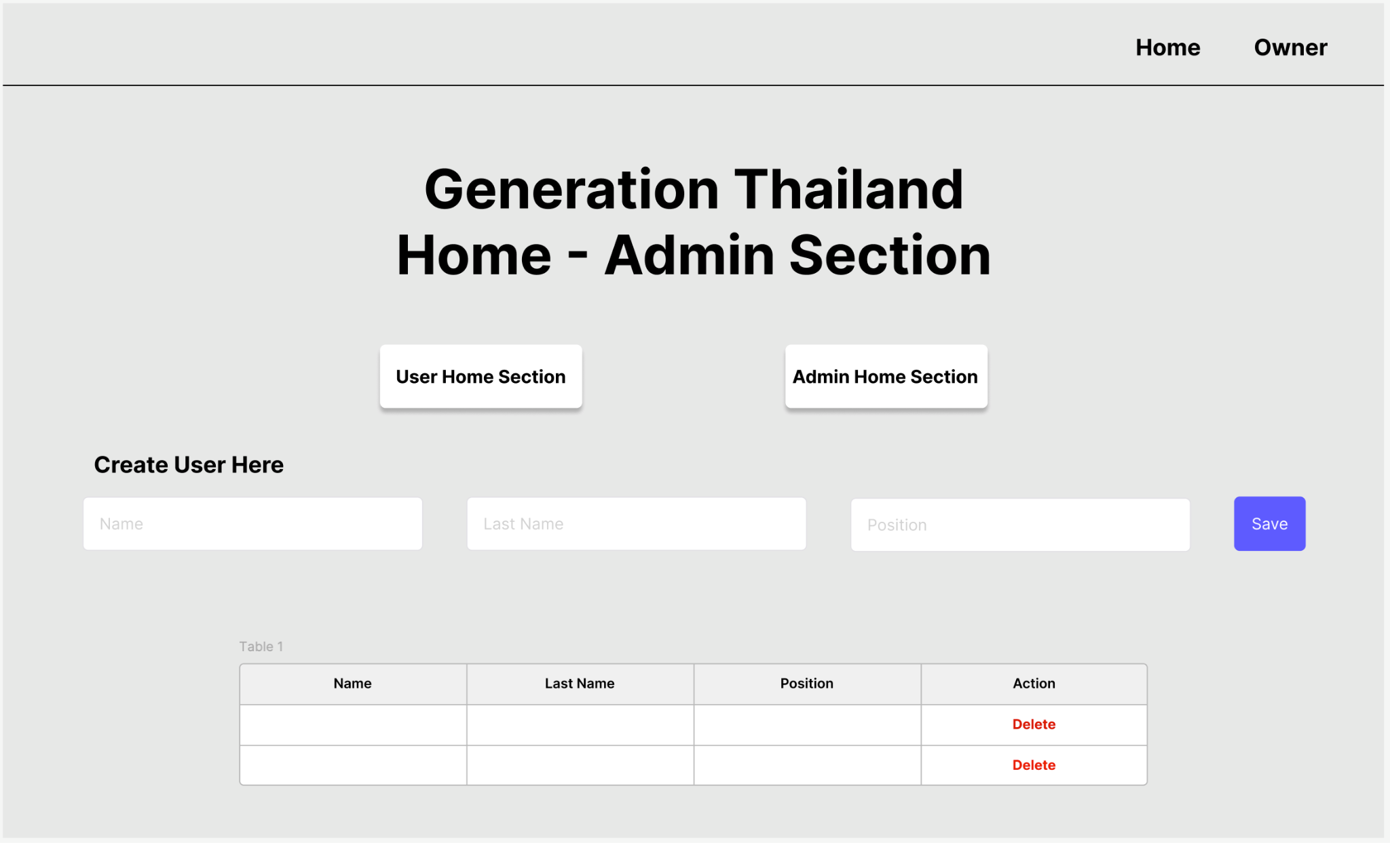

Slide 4
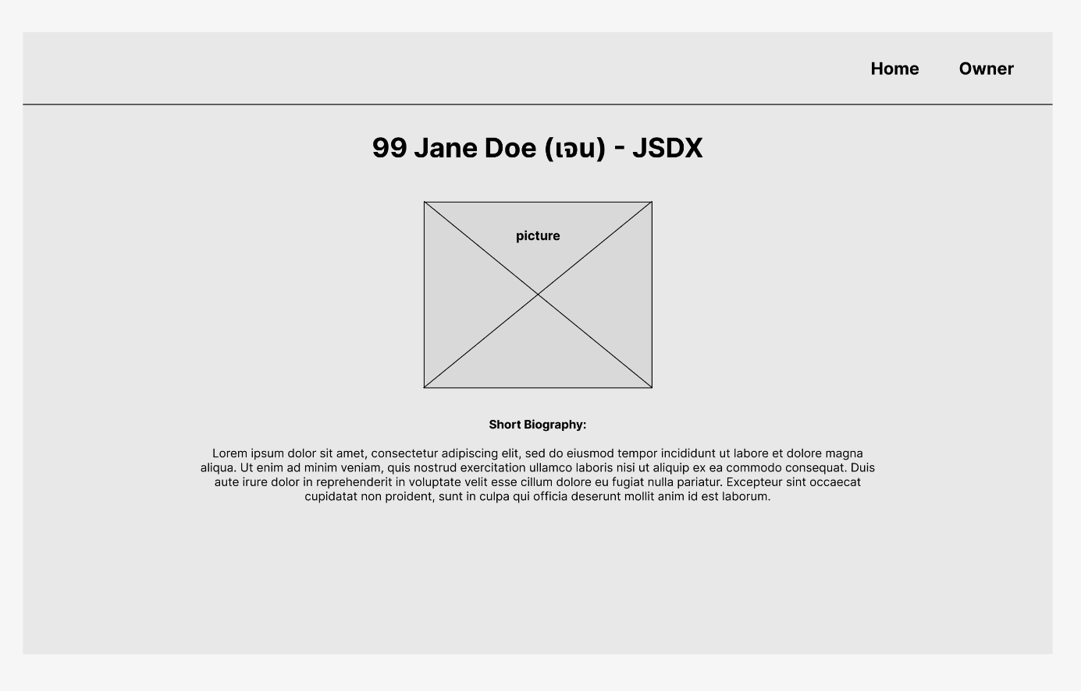

Slide 5
API Specification
🎯 https://67eca027aa794fb3222e43e2.mockapi.io/members
Methods | URL Endpoints | Descriptions
GET | /members | Get a list of members
GET | /members/:memberId | Get a member by ID
POST | /members | Create a new member
PUT | /members/:memberId | Update a member by ID
DELETE | /members/:memberId | Delete a member by ID

Slide 6
Before you submit:
Check that you have a markdown file named my-understanding.md written in your own words.
Use this file to explain your technical design decisions for example,
explain how and why you divided the app’s UI into components,
what state variables did you created and why?,
How did you manage these states? Was it via Passing Props or React Context, why?
Explain how and why you used the useEffect hook?
Explain whether you could and why, you would use fetch() without using useEffect?
Explain whether the use of fetch() should be synchronous or asynchronous JavaScript, why?
Include any other notes about React and Frontend Web Development you want to summarize your understanding of this technical domain . You can also note down questions you have.
Lastly, submit your repo url here and indicate your reliance on AI code generation (0-5)

Slide 7
AI Use Reflection Scale: How much did AI help you build this?
0 = No AI use
I did not use AI to generate code, explain concepts, debug, or teach me.
1 = AI used only for learning
I did not use AI to generate code, but I used AI to explain concepts, clarify errors, or guide my understanding.
2 = Mixed coding with AI support
I wrote some code myself and used some AI-generated code. I also used AI to help me understand, debug, or improve my solution.
3 = Learned from AI-generated code, then coded myself
AI generated example code or guidance, but I used that understanding to write or adapt the final code myself.
4 = AI generated the code, but I fully understand it
AI generated most or all of the code, but I can explain how it works, why it works, and how the main parts connect.
5 = AI generated the code with limited understanding
AI generated most or all of the code, and I cannot confidently explain how or why everything works.

