Slide 1
CODING IN R - Global Warming Analysis Project
Presented by: Jason EUbank

Slide 2
Introduction
The presentation entails a data analysis conducted in R.
The dataset used was formulated from an online database.
The analysis will mainly be comprised of regression analysis.
The main variables will as well be visualized via a scatterplot.
A further statistical inference will be made based on the analysis.
Lastly, a discussion of the results will finalize the analysis.
Notes:
Today's presentation will delve into a data analysis project I conducted using R. The dataset we'll be exploring was compiled from an online database, providing a rich foundation for our investigation. Our primary analytical approach will involve regression analysis to uncover relationships within the data. We'll also visualize the main variables using scatterplots to gain a clear understanding of their distributions and any potential correlations. Following the core analysis, I'll draw further statistical inferences from our findings, and finally, we'll conclude with a comprehensive discussion of the results, summarizing their implications and significance.

Slide 3
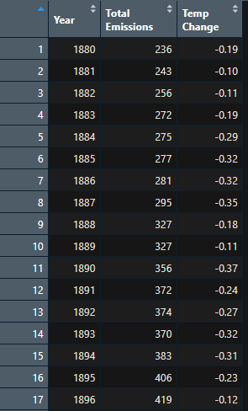
Data
The main data were collected from publicly available sources.
That is NASA’s Goddard Institute for Space Studies (GISS) and the Global Carbon Project.
The dataset includes yearly records from 1880 to 2010.
Two key variables are analyzed: Annual global temperature change (measured in degrees Celsius relative to a pre-industrial baseline) and Annual total CO₂ emissions (measured in gigatons per year).
Notes:
Data obtained from NASA (GLB.Ts+dSST.csv) and Carbon measurements from 1750-2010 (global_CO2_1751_2010.xlsx, originally downloaded from Orak Ridge National Laboratory) to explain global warming. (Links in the references page).

Slide 4
Why the data was selected
The motivation for choosing this dataset arises from my growing interest in the environmental challenges facing our world, particularly climate change.
As global temperatures continue to rise, the consequences, ranging from more frequent natural disasters to sea level rise and disruptions to agriculture are becoming increasingly evident.
I have always been interested in understanding how scientific data can be used to make informed decisions and influence policy.
This dataset provides a direct way to explore the connection between human activity, in the form of CO₂ emissions, and changes in global temperature over time.
The opportunity to examine over a century’s worth of data from credible sources like NASA’s Goddard Institute for Space Studies and the Global Carbon Project adds to its value and credibility.
Notes:
What makes this dataset especially compelling is its relevance to ongoing global discussions about sustainability, clean energy, and climate policy. By analyzing the trends in CO₂ emissions alongside changes in global temperature, I hope to uncover insights that support the scientific consensus that greenhouse gas emissions are a key driver of climate change. This kind of data analysis not only strengthens my skills in statistical modeling and interpretation, but also deepens my understanding of one of the most pressing issues of our time. Ultimately, working with this dataset feels both intellectually engaging and socially impactful, as it ties together academic knowledge and real-world application in a meaningful way.

Slide 5
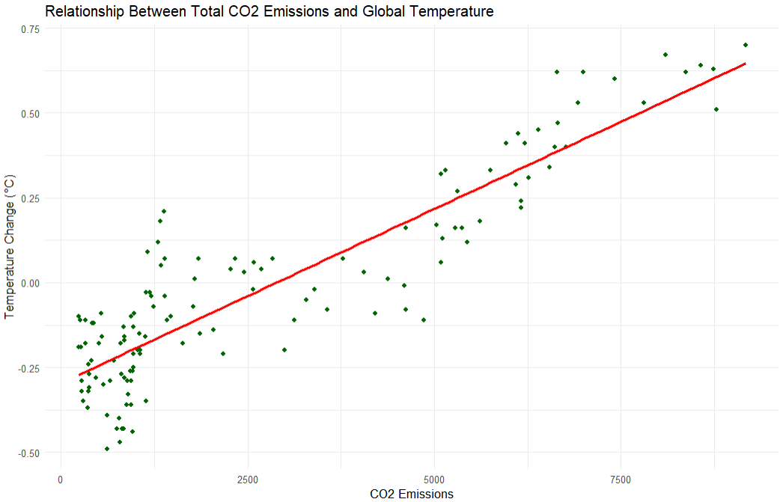
Scatterplot
Notes:
The scatterplot displays the relationship between total CO2 emissions and global temperature change. There appears to be a clear positive correlation, indicated by the upward sloping red line, which represents a linear trend. As CO2 emissions increase, there is a general tendency for the global temperature change to also increase. While the points show some variability around the trend line, suggesting other factors might influence temperature change, the overall pattern strongly indicates that higher CO2 emissions are associated with warmer global temperatures.

Slide 6
Simple linear regression
> summary(model)
Call:
lm(formula = `Temp Change` ~ `Total Emissions`, data = g_warming_data)
Residuals:
Min 1Q Median 3Q Max
-0.31368 -0.08822 0.00097 0.08986 0.36404
Coefficients:
Estimate Std. Error t value Pr(>|t|)
(Intercept) -2.962e-01 1.679e-02 -17.64 <2e-16 ***
`Total Emissions` 1.028e-04 4.497e-06 22.85 <2e-16 ***
---
Signif. codes: 0 ‘***’ 0.001 ‘**’ 0.01 ‘*’ 0.05 ‘.’ 0.1 ‘ ’ 1
Residual standard error: 0.1301 on 129 degrees of freedom
Multiple R-squared: 0.8019, Adjusted R-squared: 0.8004
F-statistic: 522.3 on 1 and 129 DF, p-value: < 2.2e-16
Notes:
A simple linear regression was performed to further evaluate the predictive relationship between CO₂ emissions (independent variable) and global temperature change (dependent variable).
The model was statistically significant, F (1, 129) = 522.30, p < .001 hence an association exists, and explained approximately 80.2% of the variance in temperature change (R² = .8019).

Slide 7
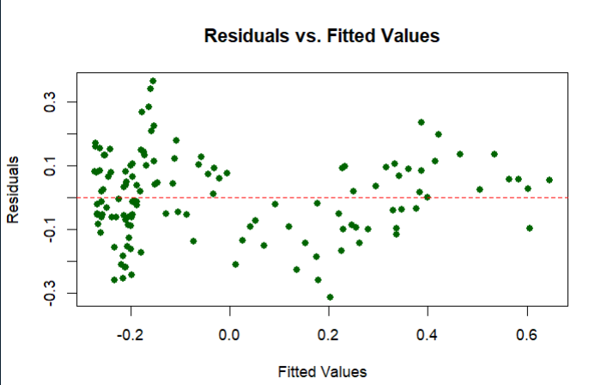
Residual analysis
Notes:
While the residuals are generally centered around zero, the slight increase in spread as fitted values increase could indicate a minor issue with the assumption of constant variance.
However, it doesn't suggest a strong violation of linearity.

Slide 8
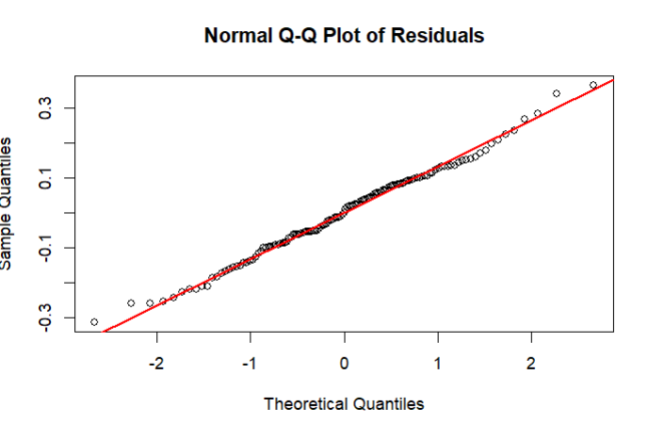
Normality of the residuals
Notes:
For the most part, the points closely follow the red diagonal line, especially in the middle range. This suggests that the residuals are approximately normally distributed.

Slide 9
Statistical Inferences on the model
> anova(model)
Analysis of Variance Table
Response: Temp Change
Df Sum Sq Mean Sq F value Pr(>F)
`Total Emissions` 1 8.8443 8.8443 522.31 < 2.2e-16 ***
Residuals 129 2.1844 0.0169
---
Signif. codes: 0 ‘***’ 0.001 ‘**’ 0.01 ‘*’ 0.05 ‘.’ 0.1 ‘ ’ 1
> confint(model, level = 0.95)
2.5 % 97.5 %
(Intercept) -3.293814e-01 -0.2629533781
`Total Emissions` 9.386763e-05 0.0001116606
Notes:
Because the residual diagnostics support the underlying assumptions of linear regression, we can confidently proceed with statistical inference using the fitted model.
The ANOVA table for the model confirms the statistical significance of 'Total Emissions' in explaining 'Temp Change'. The F-value of 522.31 with a significant p-value (indicated by '***’)
This strongly suggests that 'Total Emissions' is a significant predictor of temperature change.
Furthermore, the 95% confidence interval for the intercept is from −0.3293814 to −0.2629533781. For 'Total Emissions', the 95% confidence interval for its coefficient is from 9.386763×10−5 to 1.116606×10−4. Since this interval does not include zero, it further reinforces the statistical significance of 'Total Emissions' as a predictor of 'Temp Change'. This means we are 95% confident that the true increase in temperature change for every unit increase in total emissions lies between 0.00009386763 and 0.0001116606 degrees Celsius.

Slide 10
Key findings
The regression model is statistically significant (F(1,129) = 522.31, p < .001).
Total CO₂ emissions significantly predict temperature change.
95% Confidence Interval for slope: [0.0000939, 0.0001117] (excludes 0).
Residual analysis showed:
  No pattern in residuals vs. fitted values (homoscedasticity).
  Approximate normality in Q-Q plot.
The model meets key assumptions and supports a positive linear relationship between emissions and global warming.
Notes:
In this analysis, we evaluated whether annual CO₂ emissions predict changes in global temperature. The regression model is statistically significant suggesting that the model explains a substantial portion of the variation in temperature change. The slope coefficient for total emissions is positive and significant, with a 95% confidence interval that does not include zero. This confirms that higher CO₂ emissions are associated with higher global temperatures. Our residual analysis showed no violations of linear regression assumptions—residuals appear normally distributed, independent, and have constant variance. Overall, we conclude that there is strong evidence of a linear and meaningful relationship between global carbon emissions and rising global temperatures.

Slide 11
References
The link to the location for the dataset
https://data.giss.nasa.gov/gistemp/
https://data.giss.nasa.gov/gistemp/tabledata_v3/GLB.Ts+dSST.txt

