Slide 1
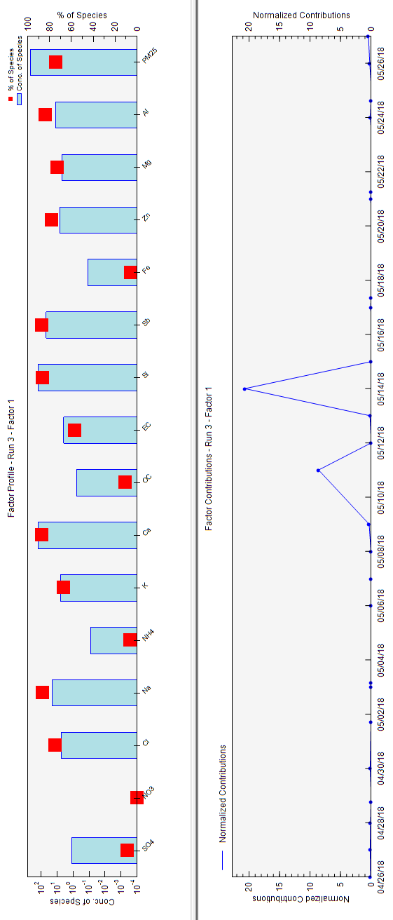
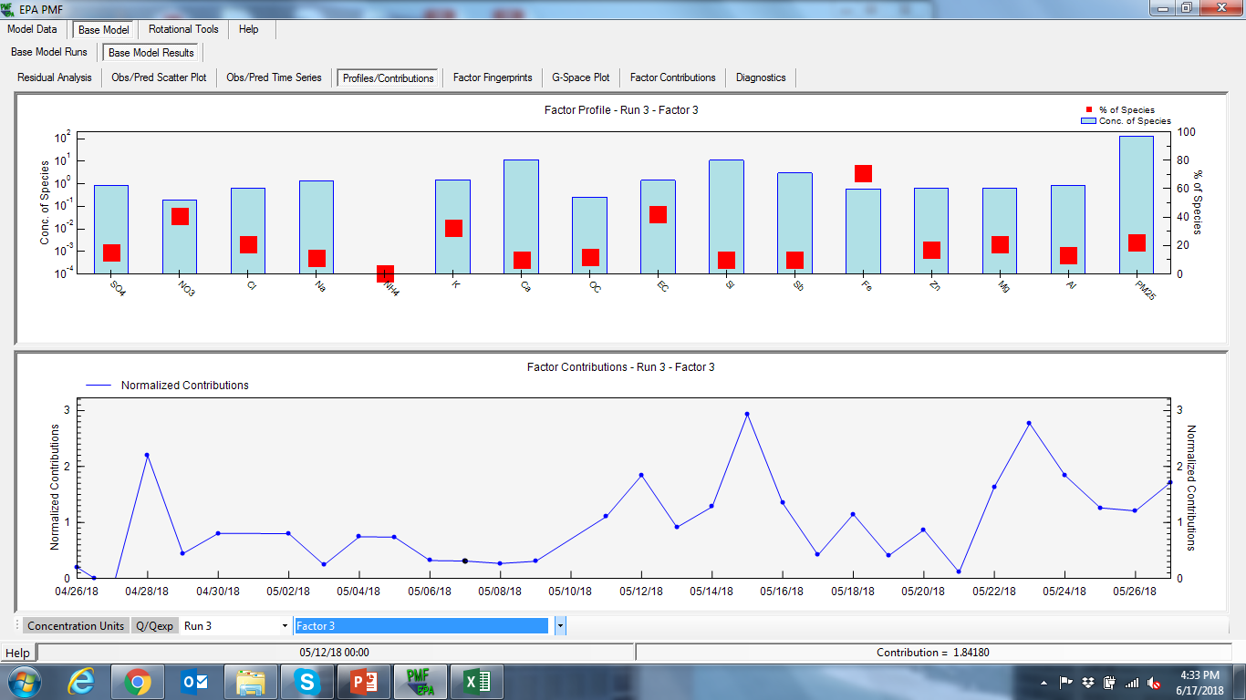
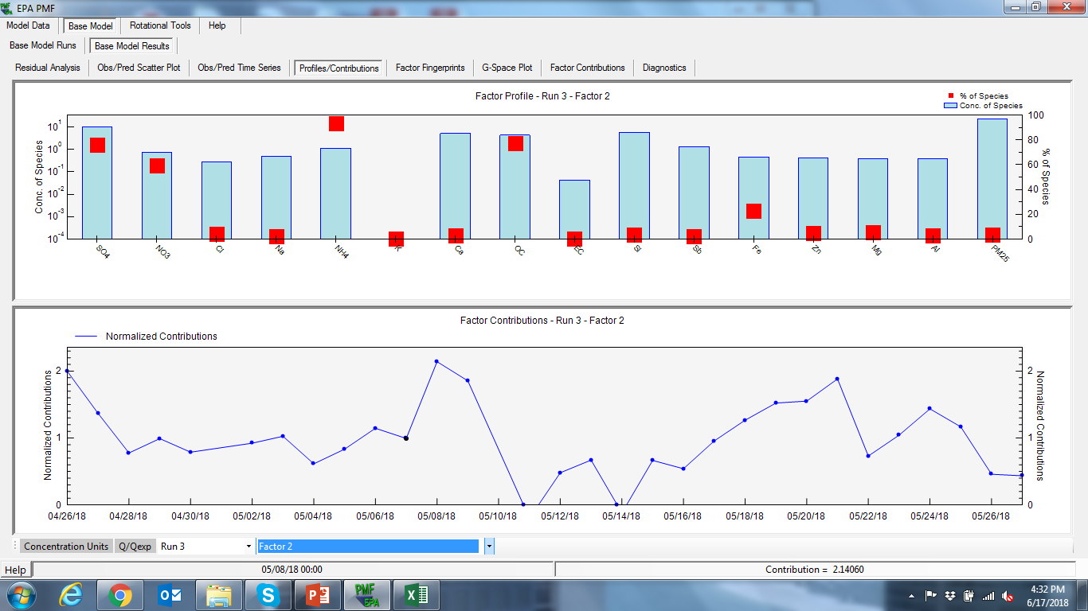
Dust + Sand + Sea Salt
Long Range Transport
Traffic

Slide 2
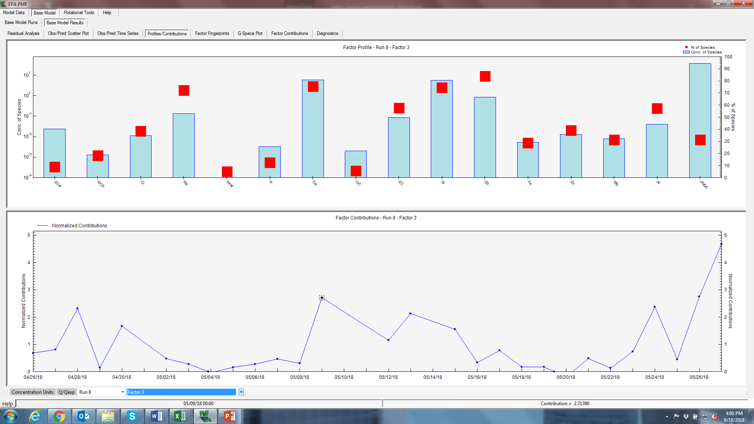
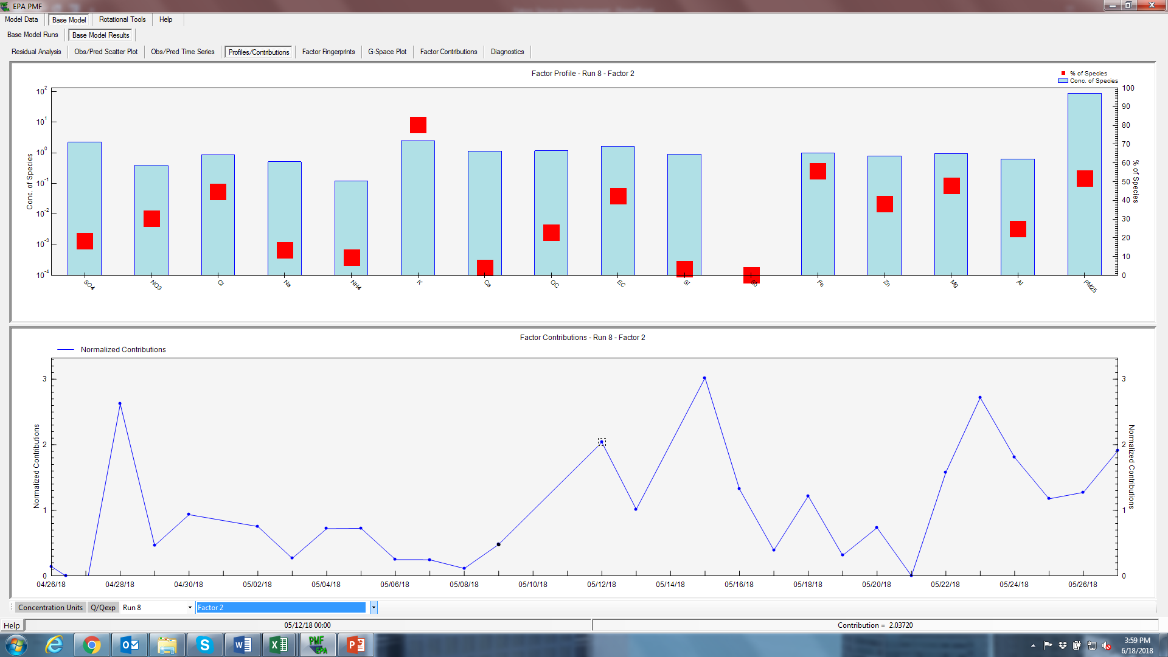
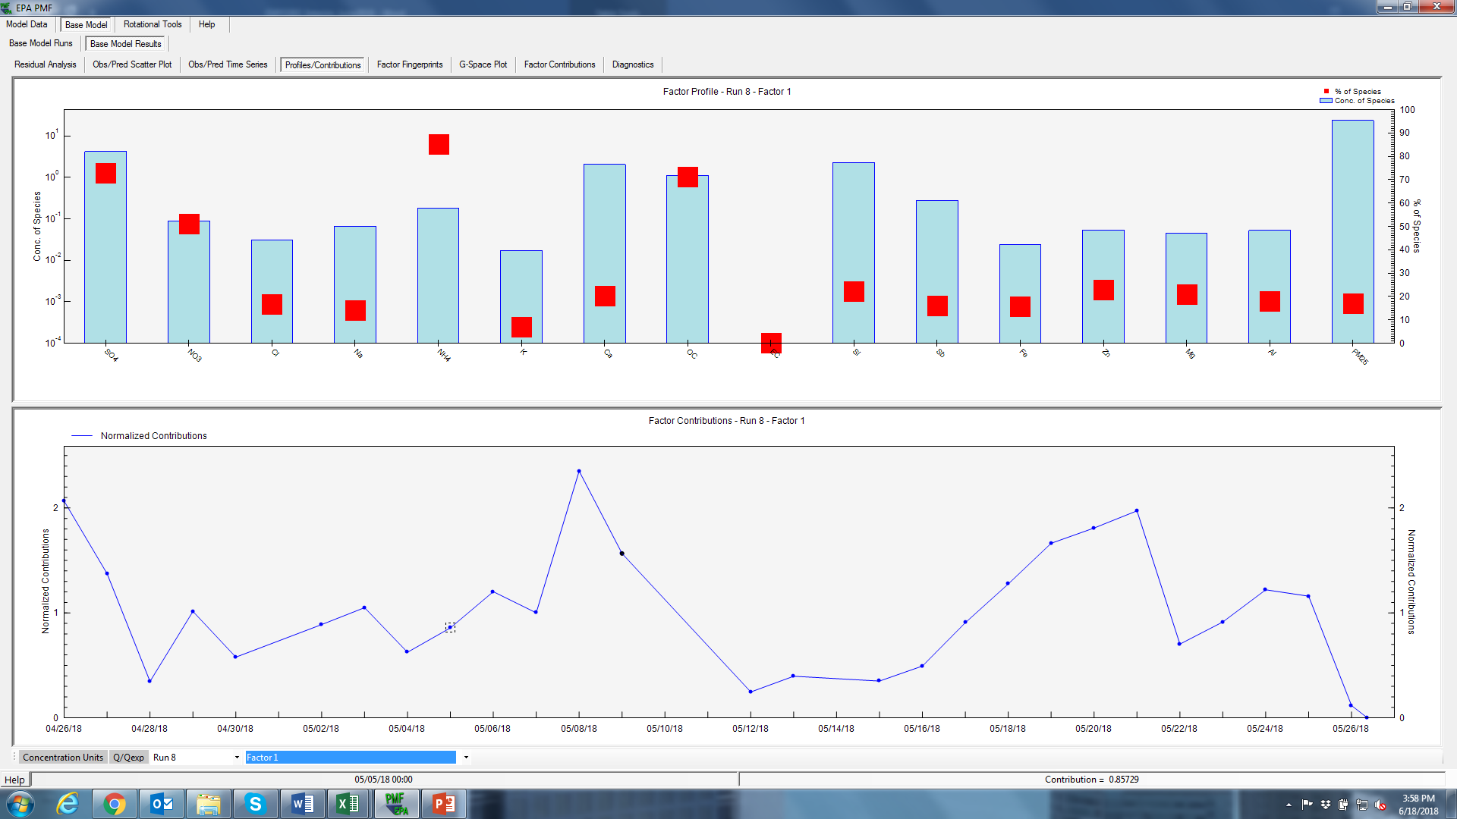
Dust + Sand + Sea Salt
Long Range Transport
Traffic

Slide 3
Long Range Transport

Slide 4
Traffic

