Slide 1

Vel Tech Rangarajan Dr. Sagunthala R&D Institute of Science and Technology
School of Computing
Department of CSE-Cyber Security
10211CC224 / FULL STACK APPLICATION DEVELOPMENT (JAVA)
PROJECT REVIEW : MILESTONE PROJECT – 2
Date: 24-04-2026
CryptoVault: Enterprise-Grade Secure Storage System with AES Cryptography
SDG: SDG 9 – Industry, Innovation and Infrastructure
Presented By:
S JEVIN THANGA RAJA– VTU24512 – 23UESS0028.
Courses Handling Faculty:
Dr. Shahul Hameed C- Assistant Professor

Slide 2
INTRODUCTION
In the digital era, files are often stored without proper security, leading to data risks.
Sensitive information like documents and images require protection from unauthorized access.
This project is important to ensure secure file storage and safe data handling.
The system provides secure upload and download functionality through REST APIs.
This project is highly relevant in industries such as healthcare, legal, and banking, where secure file storage is mandatory for compliance and data protection. Provide a highly secure, encrypted environment for personal file storage
Enable flexible subscription models and compliance features
Key Features:
Client-side AES-128 Encryption - Files encrypted on user's device
Multi-tier Subscription Model - Weekly, Monthly, Annual plans
Mandatory Identity Verification (KYC) - Compliance and security
Centralized Administrative Oversight - Real-time monitoring and control
1
2
3
4
5
6
7
8
9

Slide 3
PROBLEM STATEMENT
Sensitive files stored on local servers are typically saved as plain text or without encryption, making them vulnerable to unauthorized access, data breaches, and insider threats.
There is no standard mechanism in basic Spring Boot applications to automatically encrypt files during upload and decrypt them during download, leaving a critical security gap.
Developers need a beginner-friendly, well-structured reference implementation that demonstrates secure file handling with AES encryption in a real-world Java Spring Boot project.
Without proper file metadata management, retrieving the correct encrypted file and its original filename becomes unreliable, degrading user experience and system integrity.
1
2
3
4
5
6
7
8
9

Slide 4
OBJECTIVE(S)
To design and develop:
A secure file storage system using Spring Boot
A REST API for file upload and download
To implement:
File encryption using AES
Database storage using MySQL for file metadata
To improve:
Data confidentiality and protection against unauthorized access
Efficient file management and retrieval
To evaluate performance of:
Encryption and decryption process efficiency
System performance during file upload and download
1
2
3
4
5
6
7
8
9

Slide 5
PROPOSED SYSTEM
CryptoVault is a Spring Boot application with RESTful endpoints for secure file upload and download.
Files are encrypted using AES-128 symmetric encryption via a dedicated AESUtil utility class before being saved to the uploads/ directory.
Encrypted files are stored on the local filesystem, and their metadata (name, path, size, timestamp) is saved in a MySQL database via Spring Data JPA.
On download, the system retrieves file metadata by ID, reads the encrypted file from disk, decrypts it, and streams the original file bytes to the client.
Layered architecture ensures separation of concerns and clean, maintainable code.
Global exception handling ensures meaningful error messages for scenarios like file-not-found or decryption failure.
The system is beginner-friendly, with simple code patterns, clear naming, and a well-documented.
1
2
3
4
5
6
7
8
9

Slide 6
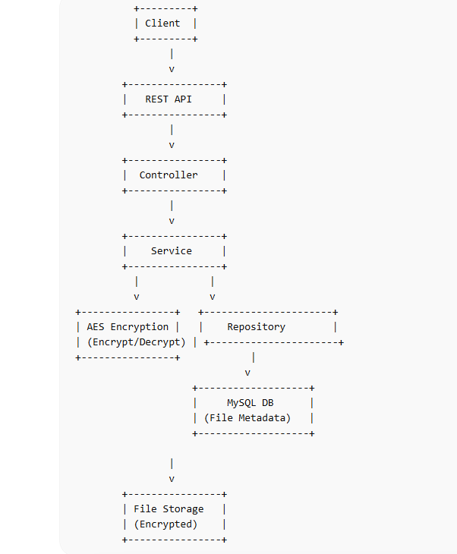
PROPOSED SYSTEM ARCHITECTURE
1
2
3
4
5
6
7
8
Explain:
Input: Client sends file via HTTP POST /upload using MultipartFile
Processing: AESUtil encrypts file bytes using AES/CBC/PKCS5Padding
Database: FileMetadata entity stored in MySQL via FileRepository (JPA)
Output: GET /download/{id} retrieves, decrypts, and returns original file to client
9

Slide 7
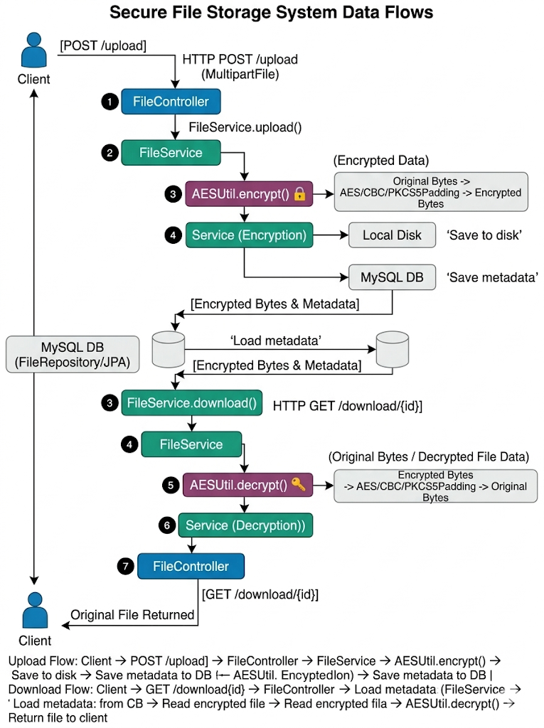
WORKFLOW
1
Three-Tier Subscription System:
Implementation: Dynamic payment modal for seamless upgrades and plan switching
2
Plan | Price | Storage | Support
Weekly Plan | $5 | 10GB | Basic Support
Monthly Plan | $15 | 50GB | Priority Support + AES-256 Upgrade
Annual Plan | $120 | Unlimited | 24/7 Dedicated Support
3
4
5
6
7
8
9

Slide 8
TECHNOLOGIES USED
Frontend:HTML, CSS ,Postman (for API testing)
Backend:Spring Boot,Java (JDK 17+) ,Spring Web (REST API)
Database:MySQL
Tools:Postman,IntelliJ IDEA / Eclipse,Maven (build tool)
Hardware:
Minimum 4GB RAM
Laptop/Desktop System
Software:
Java JDK 17+
Spring Boot
MySQL
IntelliJ / Eclipse IDE
Postman
1
2
3
4
5
6
7
8
9

Slide 9
MODULE DESCRIPTION
Module-wise breakdown of CryptoVault system:
Module 1: File Upload Module
Accepts MultipartFile via POST /upload, passes bytes to FileService for AES encryption and local disk storage.
Module 2: AES Encryption/Decryption Utility
AESUtil class uses javax.crypto with AES/ECB mode and a 16-byte secret key for encrypt() and decrypt() methods.
Module 3: Metadata Management Module
FileMetadata JPA entity and FileRepository (extends JpaRepository) persist and retrieve file info in MySQL.
Module 4: File Download Module
GET /download/{id} retrieves metadata by ID, reads encrypted file from disk, decrypts it, returns original file.
1
2
3
4
5
6
7
8
9

Slide 10
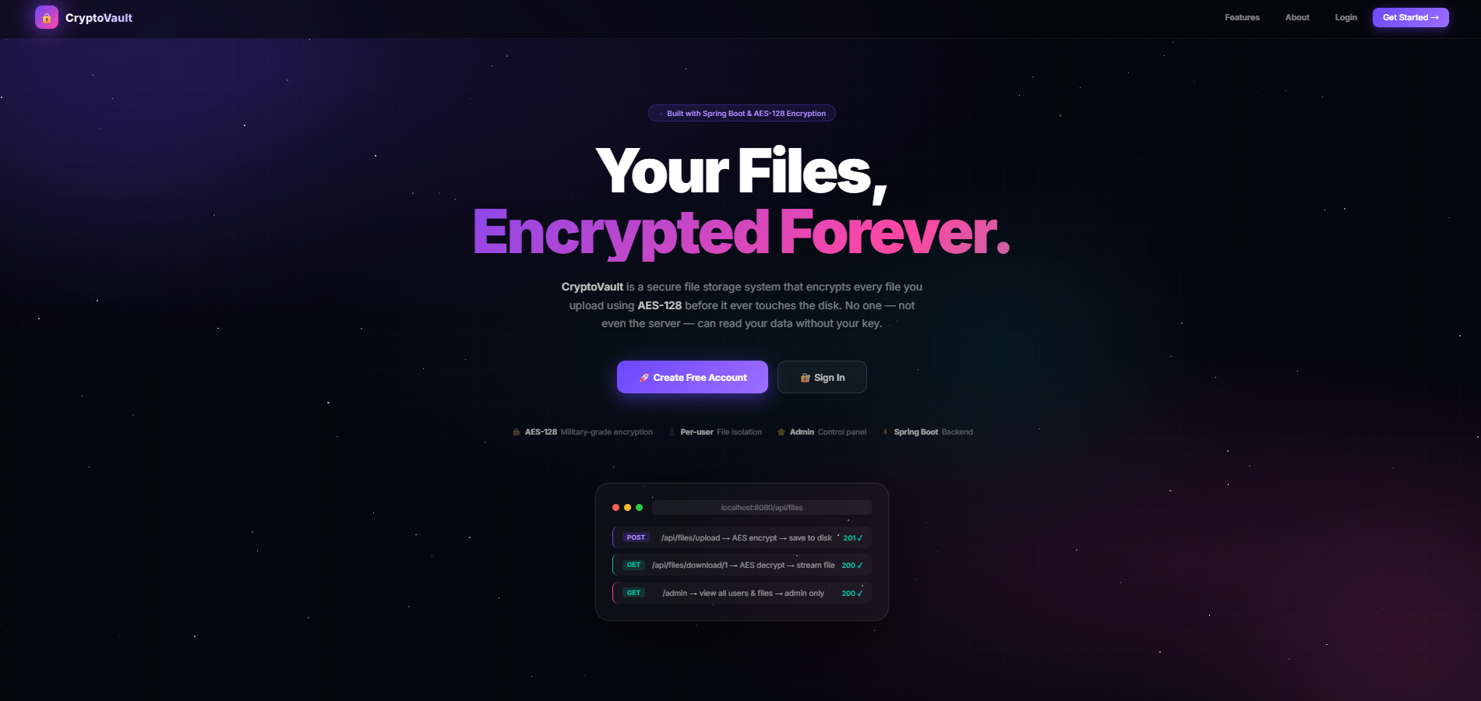
IMPLEMENTATION SCREENSHOTS
1
2
3
4
5
6
7
8
9
The public landing page that introduces CryptoVault to visitors. It shows the project description, features, and the creator Jevin, with buttons to Login or Register.

Slide 11
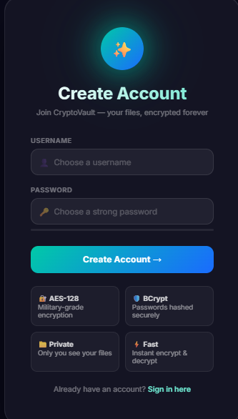
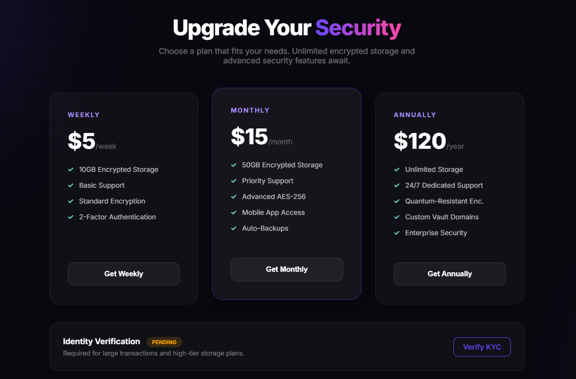
IMPLEMENTATION SCREENSHOTS
1
2
3
4
5
6
7
8(A)
9
Where existing users enter their username and password to access their vault. Spring Security checks the credentials against the database and grants access if correct.

Slide 12
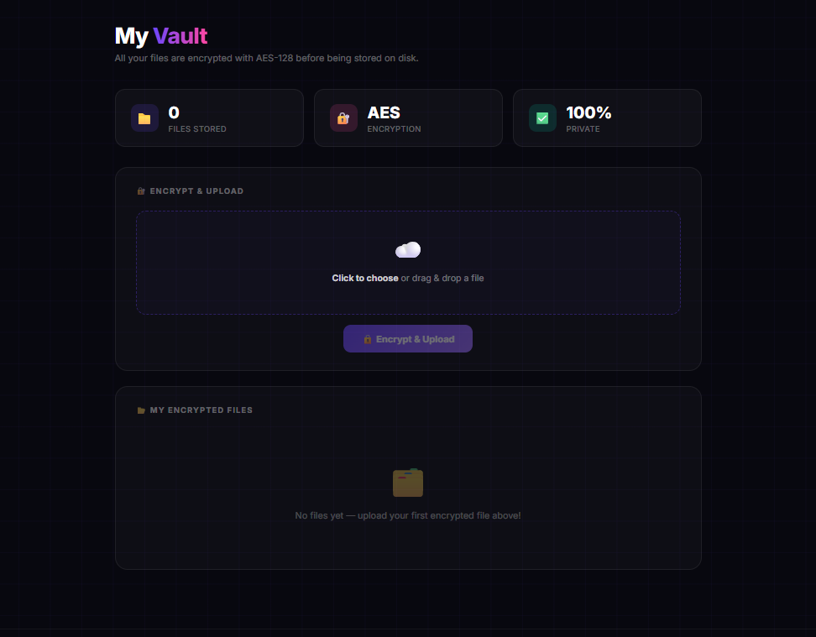
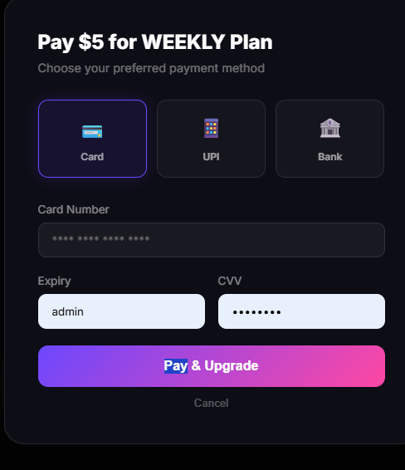
IMPLEMENTATION SCREENSHOTS
1
2
3
4
5
6
7
8(B)
9
The main page for logged-in users where they can upload files (which get AES-encrypted automatically) and download their own decrypted files. Each user only sees their own files.

Slide 13
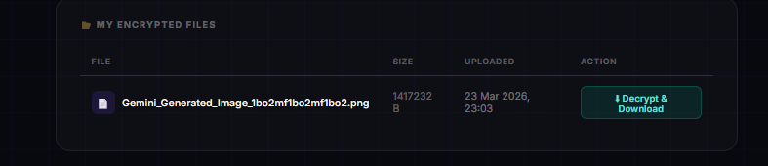
IMPLEMENTATION SCREENSHOTS
1
2
3
4
5
6
7
8(C)
9
It is the page where the encrypted file will be available in which for each and every users and with their login they can find out the encrypted file and decrypt it.

Slide 14
ADVANTAGES & LIMITATIONS
ADVANTAGES:
Strong Security: AES encryption ensures that even if files are accessed from disk, they are unreadable without the secret key.
Clean Architecture: Layered design (Controller/Service/Repository/Util) makes the codebase easy to understand, test, and extend.
REST API Design: Standard HTTP endpoints make the system easy to integrate with any frontend, mobile app, or third-party service.
Persistent Metadata: MySQL database ensures reliable file tracking, even after server restarts or file system changes.
LIMITATIONS:
Hardcoded Secret Key: The AES key is currently hardcoded in source code; production systems should use a secure key vault or environment variable.
No User Authentication: The current version has no login/registration; any user with API access can upload or download files.
Local Storage Only: Files are stored on the local filesystem; future versions should support cloud storage (AWS S3, Google Cloud) for scalability.
1
2
3
4
5
6
7
8
9

Slide 15
Thank you

