Slide 1
AES Encryption over PCI Express
Design Review
Zack Curosh
Matt Swanson
Jevin Sweval

Slide 2
Advanced Encryption Standard (AES)
US government encryption standard since 2002
Based on Rijndael cipher
AES is fast in hardware and requires little memory
User inputs an encryption key and then data in 128-bit blocks
– Key may be 128, 192, or 256 bits long

Slide 3
Our Design
128-bit key AES core
I/O will be done using PCI Express protocol
– PCI Express bridge: we design
– TX/RX FIFOs: gold_lib
– PCI Express transceiver: external hardware
Hardware implementation gives high-throughput and low power
PCI Express selected for high performance and widespread use

Slide 4
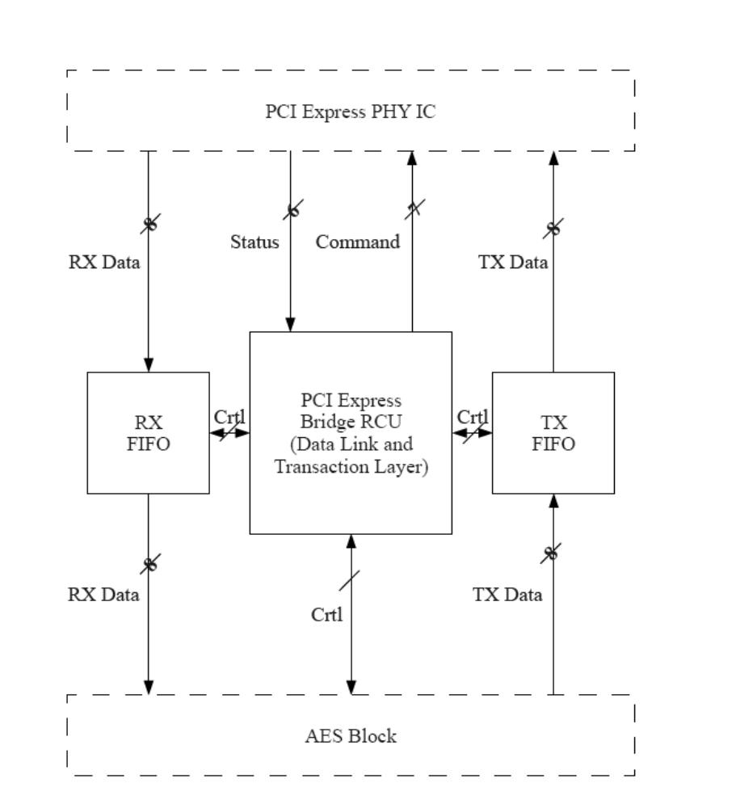
System Level Diagram
NXP PX1011B PCIe PHY IC

Slide 5
AES Flowchart
Data
Add RoundKey
+ Cipher Key
1 - SubBytes
Repeat 8
2 – ShiftRows
times
3 - MixColumns
4 – Add RoundKey
+ Cipher Key
After 9 rounds
SubBytes
ShiftRows
Add RoundKey
+ Cipher Key
Cipher text

Slide 6
AES Top Level Diagram
AES
State
Register
data
128
Identity
8
SubBytes
State
Filter
In
State
Filter
Out
32
ShiftRows
32
MixColumns
3
8
subblock
Add
RoundKey
key
8
3
encryption_key
RCU
3
subblock
128
Key
Scheduler
iteration
go

Slide 7
AES_RCU
4
roundcount
Round Counter
Next State
Logic
nextroundcount
4
clk
nrst
blockcount
start_key
Output
Logic
5
Subblock Counter
p
subblock
Next State
Logic
nextblockcount
state
5
3
clk
nrst
State Register
Next State
Logic
nextstate
3
clk
key_done
nrst

Slide 8
State_Filter_In
Smart
Mux
32
state_q
filtered_out
128
3
4
g_index
subblock

Slide 9
State_Filter_Out
8
subbytes_out
32
shift_rows_out
128
32
Smart
Mux
mix_columns_out
state_d
8
add_round_key_out
8
load_out
3
4
g_index
subblock

Slide 10
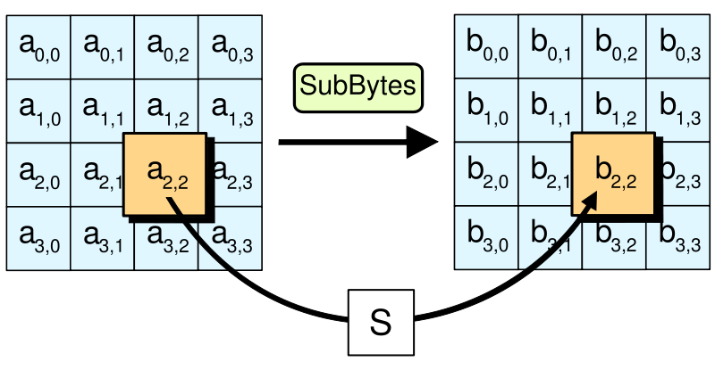
SubBytes Step

Slide 11
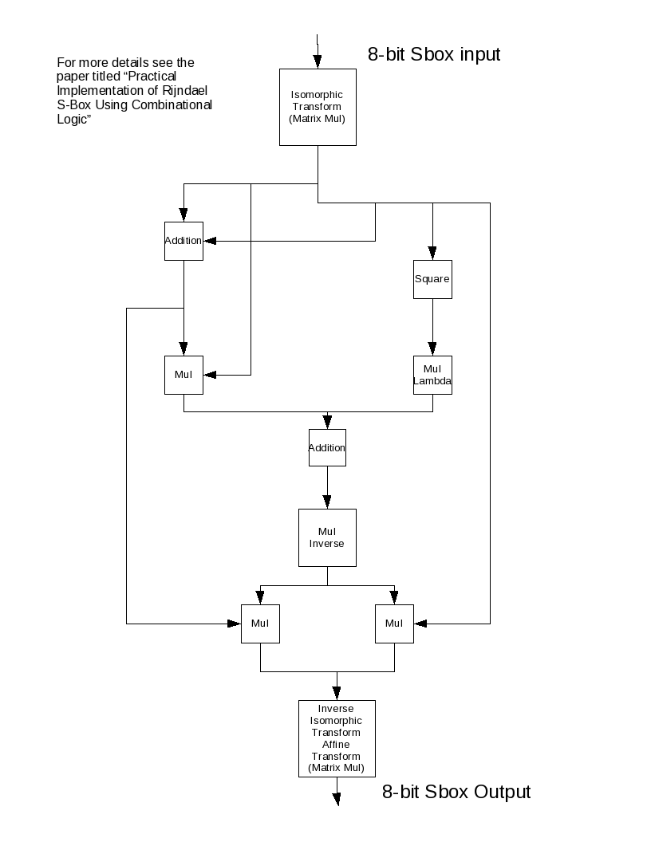
SubBytes

Slide 12
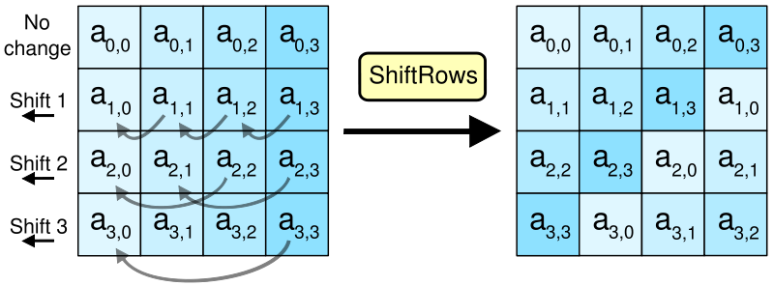
ShiftRows Step

Slide 13
Shift_Rows
Variable-Length
Rotate
2
num_shifts
32
data_out
32
data_in

Slide 14
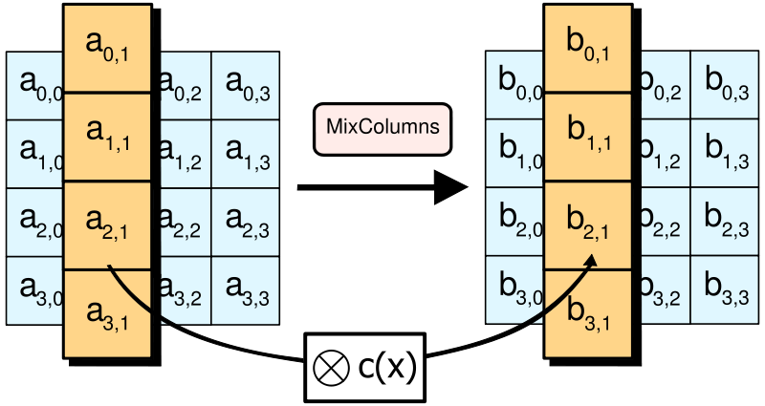
MixColumns Step

Slide 15
Mix_Columns
Galois Field
Rotate
b
4
Matrix Multiply
(Cascaded XORs)
4
d_out
d_in
4

Slide 16
Key_Scheduler
4
state
State Register
Next State
Logic
nextstate
go
iteration
4
Output
Logic
done
3
store
128
stored_key
Key Register
128
Next State
Logic
next_stored_key
128
encryption_key
128
round_key
sbox_lookup
SBOX
8
rcon
sbox_return
RCON
3
iteration

Slide 17
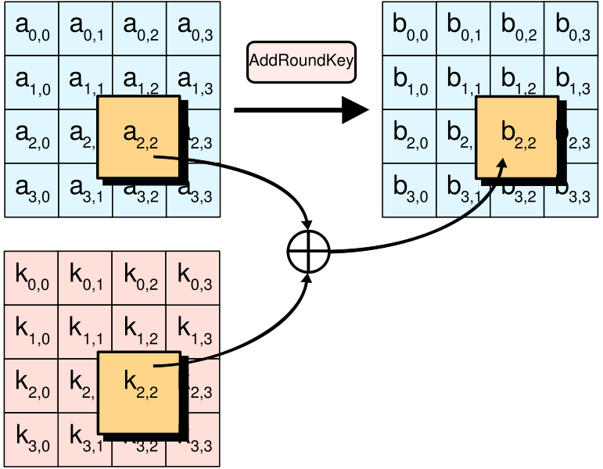
AddRoundKey Step

Slide 18
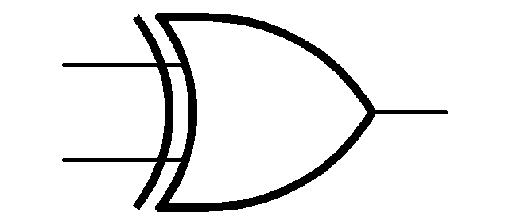
Add_Round_Key
8
data_in
8
data_out
8
key_in

Slide 19
PCIe Bridge Flowchart
rst
Receive Data
key
Key?
yes
Load Key
Read Data Block
no
AES
data
Transmit
Receive Command

Slide 20
PCIe Bridge Diagram
5
state
State Register
8
Next State
Logic
nextstate
Output
Logic
tx_fifo
8
rx_fifo
aes_ctl
5
3
8
frame
Frame
LUT
3
aes_status

