Slide 1
AES Encryption over PCI Express
Design Review
  Zack Curosh
  Matt Swanson
  Jevin Sweval

Slide 2
Advanced Encryption Standard (AES)
US government encryption standard since 2002
Based on Rijndael cipher
AES is fast in hardware and requires little memory
User inputs an encryption key and then data in 128-bit blocks
  Key may be 128, 192, or 256 bits long

Slide 3
Our Design
128-bit key AES core
I/O will be done using PCI Express protocol
  PCI Express bridge: we design
  TX/RX FIFOs: gold_lib
  PCI Express transceiver: external hardware
Hardware implementation gives high-throughput and low power
PCI Express selected for high performance and widespread use

Slide 4
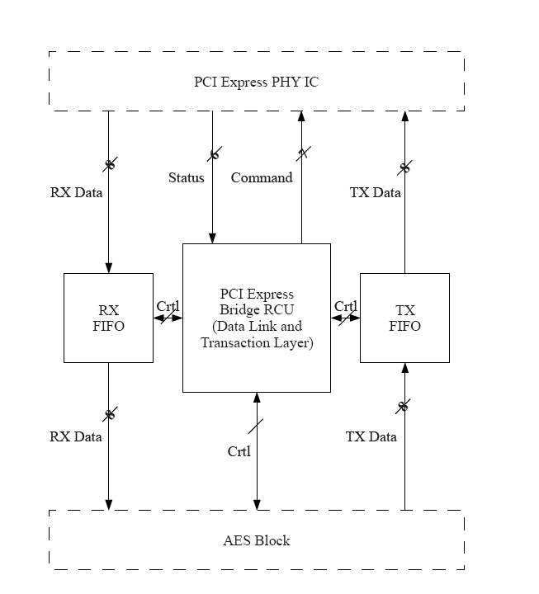
System Level Diagram
NXP PX1011B PCIe PHY IC

Slide 5
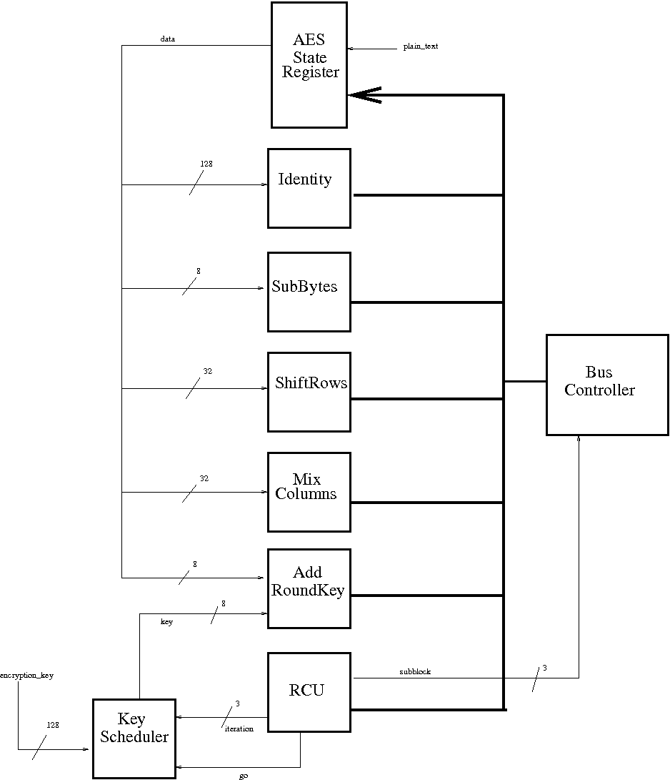
AES Top
Level
Diagram

Slide 6
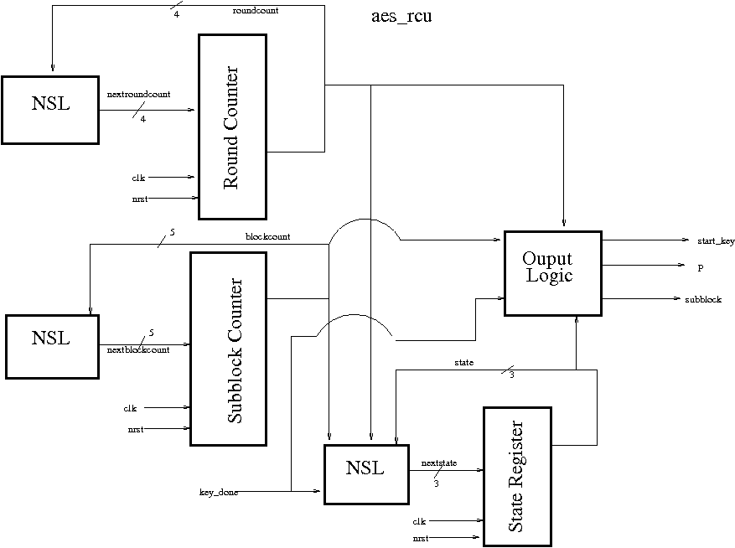

Slide 7
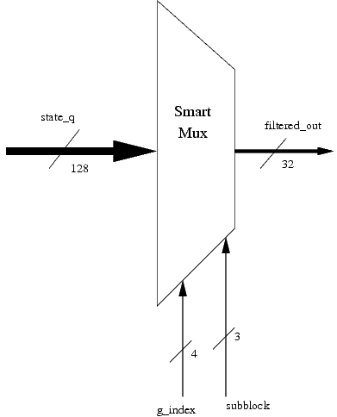
bus_controller (from state)

Slide 8
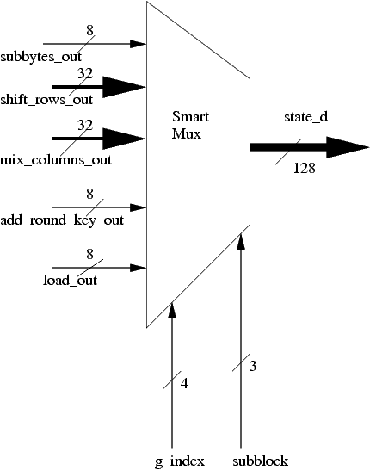
bus_controller (to state)

Slide 9
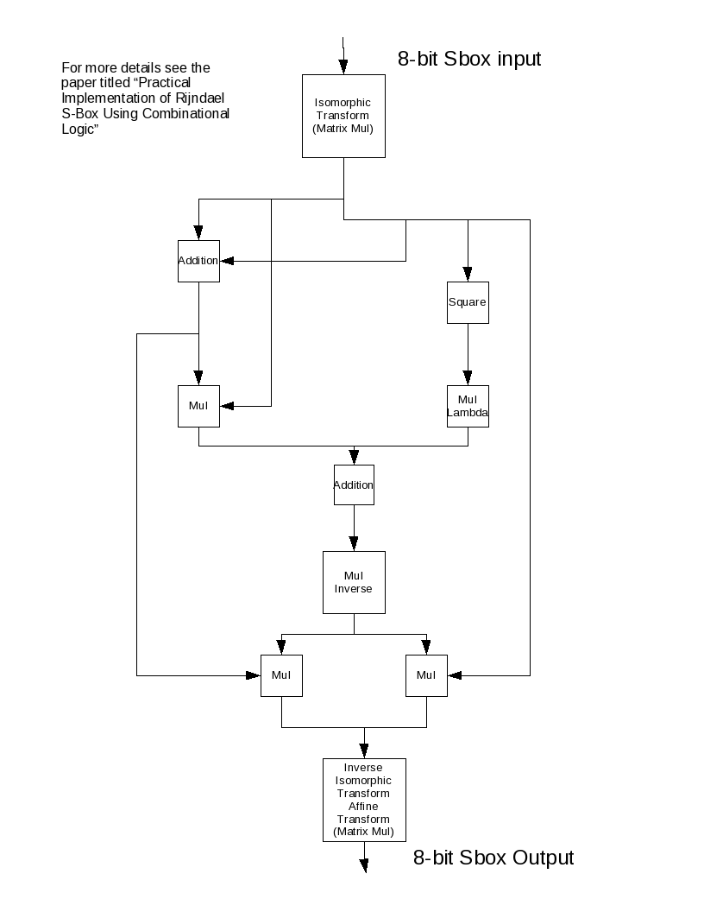

Slide 10
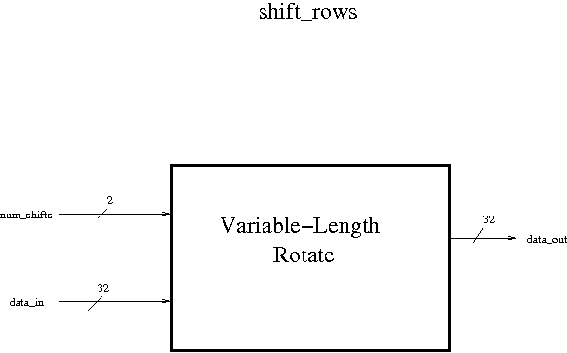

Slide 11
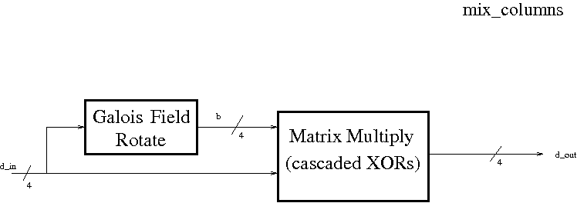

Slide 12
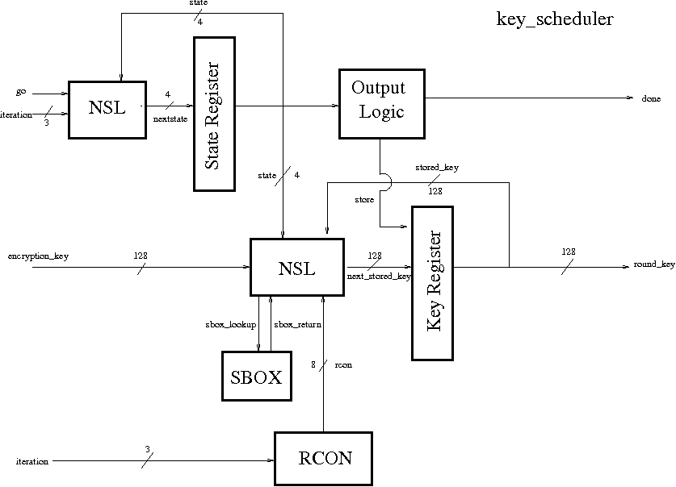

Slide 13
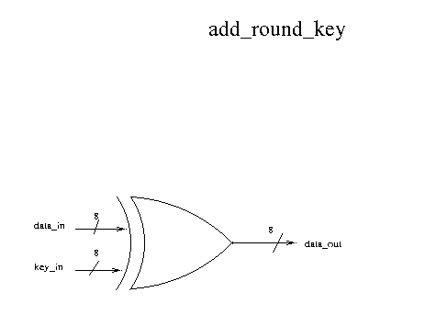

Slide 14
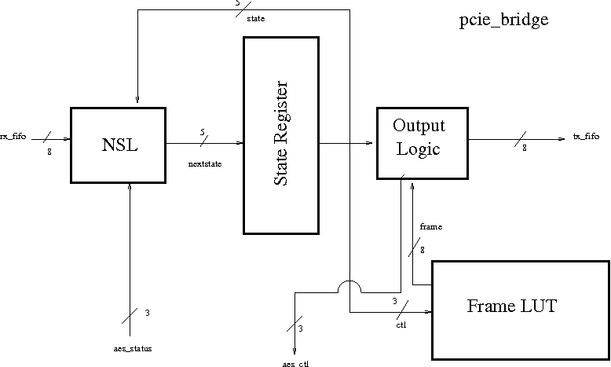
PCIe Bridge Diagram

Slide 15
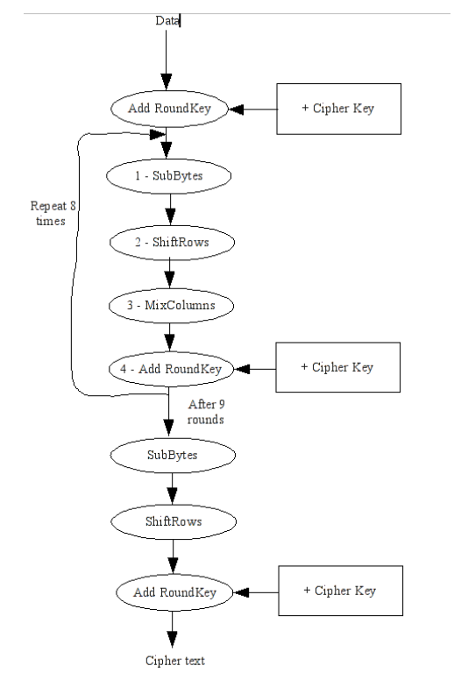
AES Flowchart

Slide 16
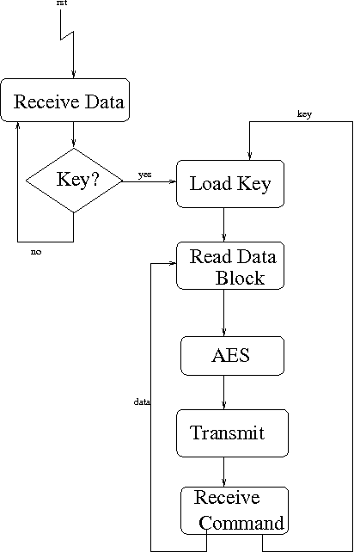
PCIe Bridge
Flowchart

