Slide 1
AES Encryption over PCI Express
Design Review
  Zack Curosh
  Matt Swanson
  Jevin Sweval

Slide 2
Advanced Encryption Standard (AES)‏
US government encryption standard since 2002
Based on Rijndael cipher
AES is fast in hardware and requires little memory
User inputs an encryption key and then data in 128-bit blocks
  Key may be 128, 192, or 256 bits long

Slide 3
Our Design
128-bit key AES core
I/O will be done using PCI Express protocol
  PCI Express bridge: we design
  TX/RX FIFOs: gold_lib
  PCI Express transceiver: external hardware
Hardware implementation gives high-throughput and low power
PCI Express selected for high performance and widespread use

Slide 4
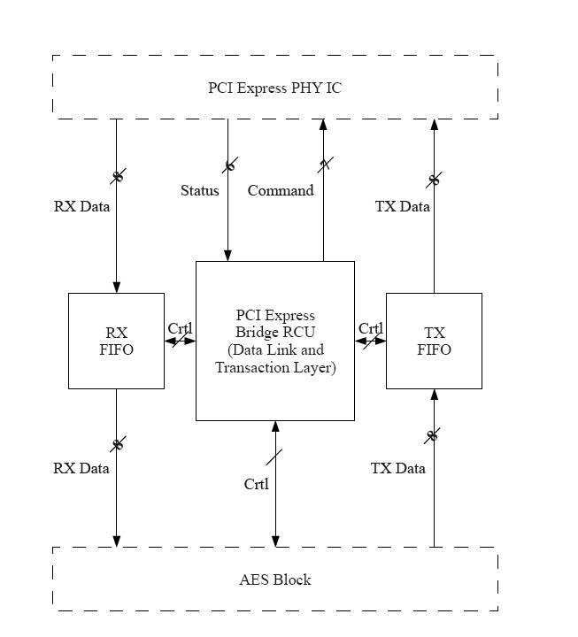
System Level Diagram
NXP PX1011B PCIe PHY IC

Slide 5
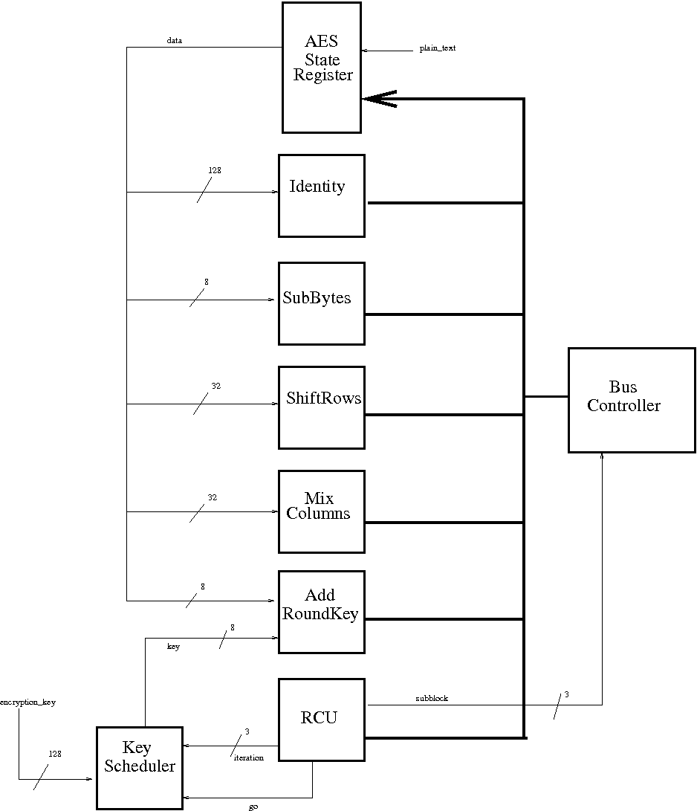
AES Top
Level
Diagram

Slide 6
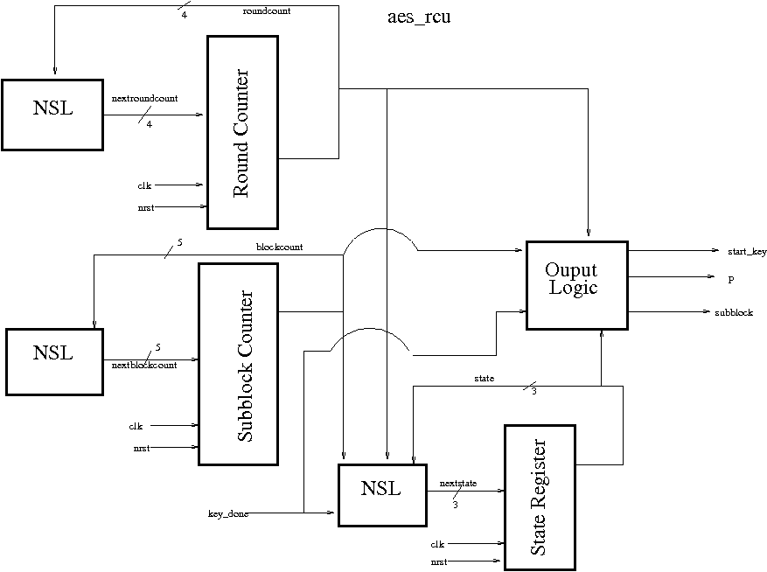

Slide 7
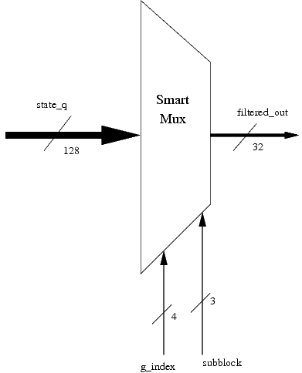
bus_controller (from state)‏

Slide 8
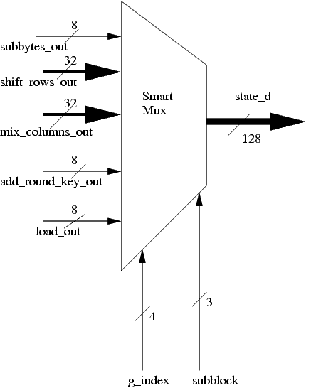
bus_controller (to state)‏

Slide 9
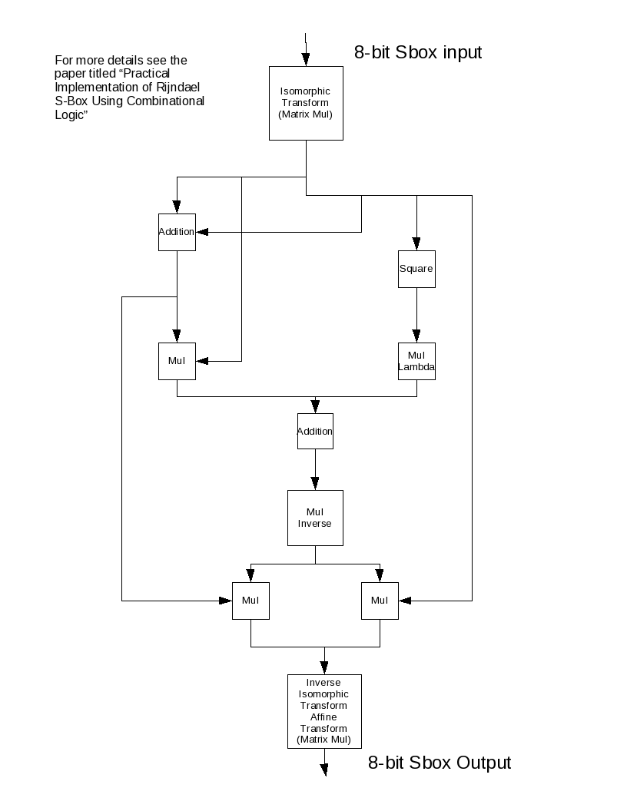

Slide 10
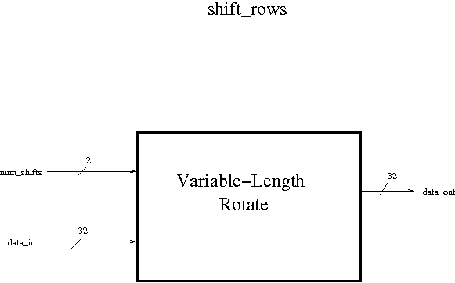

Slide 11
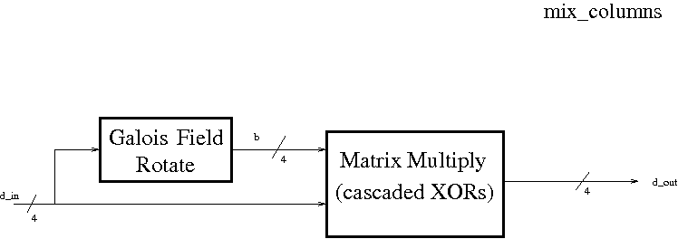

Slide 12
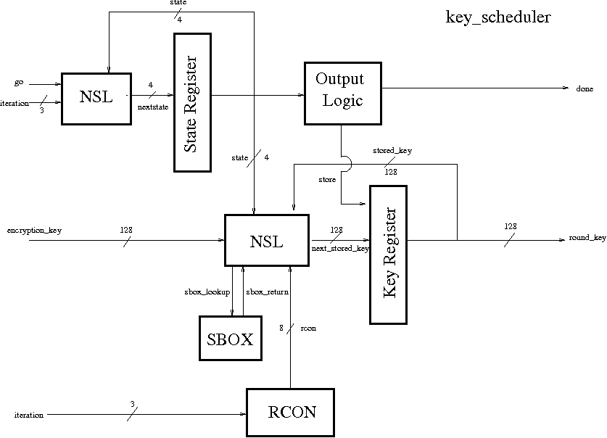

Slide 13
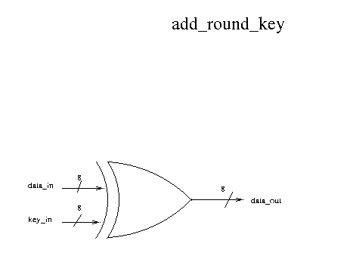

Slide 14
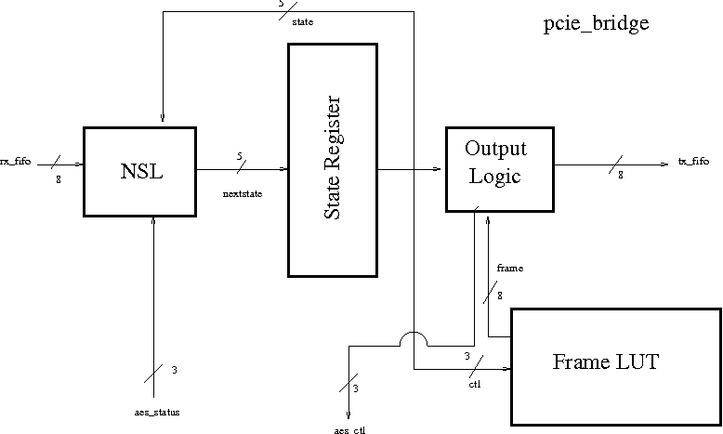
PCIe Bridge Diagram

Slide 15
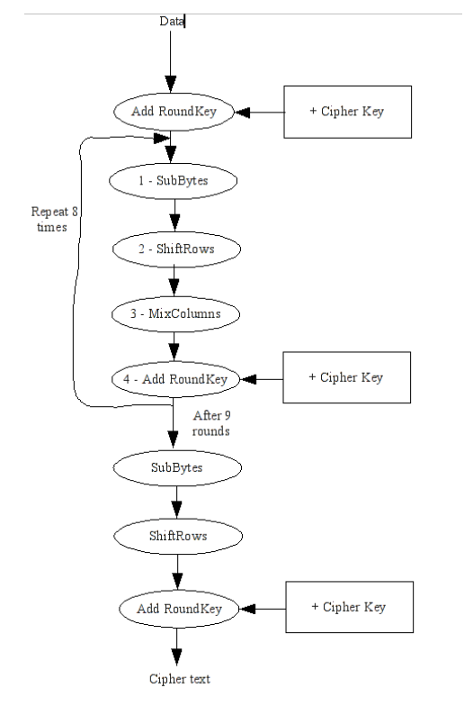
AES Flowchart

Slide 16
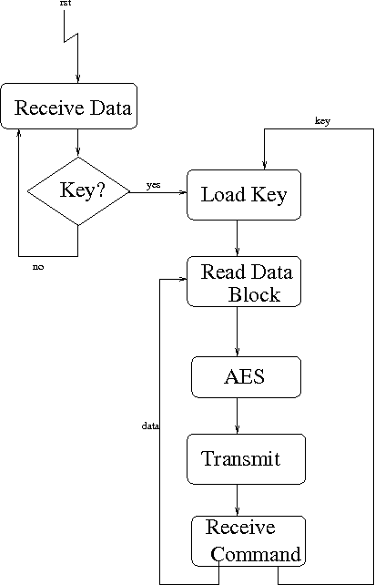
PCIe Bridge
Flowchart

