Slide 1
AES Encryption over PCI Express
  Zack Curosh
  Matt Swanson
  Jevin Sweval

Slide 2
AES/PCIe Design Overview
Allow host (PC) to encrypt sensitive data using PCI Express protocol for I/O
AES encryption standard can be performed at a high speed using ASIC
PCI-Express interface is widespread in personal computers

Slide 3
Top Level Design
NXP PX1011
transceiver

Slide 4
Sequence of Operations
Send key
Load key
Send ack
Send plaintext
Load plaintext
Send ack
(begin encrypting)
Req ciphertext
Req ciphertext
Send ack
Send ciphertext
Send ciphertext

Slide 5
PCI Express Bridge Top Level
Three layers in PCIe protocol
  Physical layer – handled by external IC
  Bridge handles Data Link and Transaction layers
Request/Completion system
  Ack/Nak by receiver based on CRC
Bridge handles packet rx/tx

Slide 6
load_key
load_pt
send_ct
Packet
Info
Registers
reg_in
rx_data_k
rx_data
RCU
(Packet
Constructor/
Deconstructor)
8
reg_out
tx_data_k
clr
tx_data
calc
CRC
LCRC
data
8
check_sum

Slide 7
AES Core Top Level
Performs AES algorithm on 128-bit data block
Requires 128-bit encryption key
Government standard since 2002
Four cipher transformations
  SubBytes, ShiftRows, MixColumns, AddRoundKey

Slide 8
State
Reg
data
data
128
128
128
Identity
128
8
8
tx_data
rx_data
8
SubBytes
8
State Filter In
32
Shift
Rows
32
State Filter Out
32
Mix
Columns
32
subblock
subblock
3
8
Add
RoundKey
8
3
round_key
128
iteration
RCU
load_key
encryption_key
load_pt
Key
Scheduler
3
send_ct
128
go

Slide 9
Design Specific Success Criteria
(AES)
(1 point) AES block encrypts the standard test vectors correctly.
  Completed for all published vectors
(2 points) AES block encrypts random data identically to a PC-hosted reference AES implementation.
  Completed for over 1000 random cases per simulation (Python powered test bench)‏
(1 point) AES core will encrypt 128-bit data block in under 1000 cycles
  Completed, 830 cycles

Slide 10
Design Specific Success Criteria
(PCI Express)
(2 points) Can correctly transmit and receive data using the subset of PCI Express that we implement.
  Completed, send and receive correct packets using PCI Express 1.1 spec
(2 points) A host can initiate encryption of a data block using PCI Express and read back the correctly encrypted data.
  Completed for over 100 random cases per simulation (Python powered test bench)‏

Slide 11
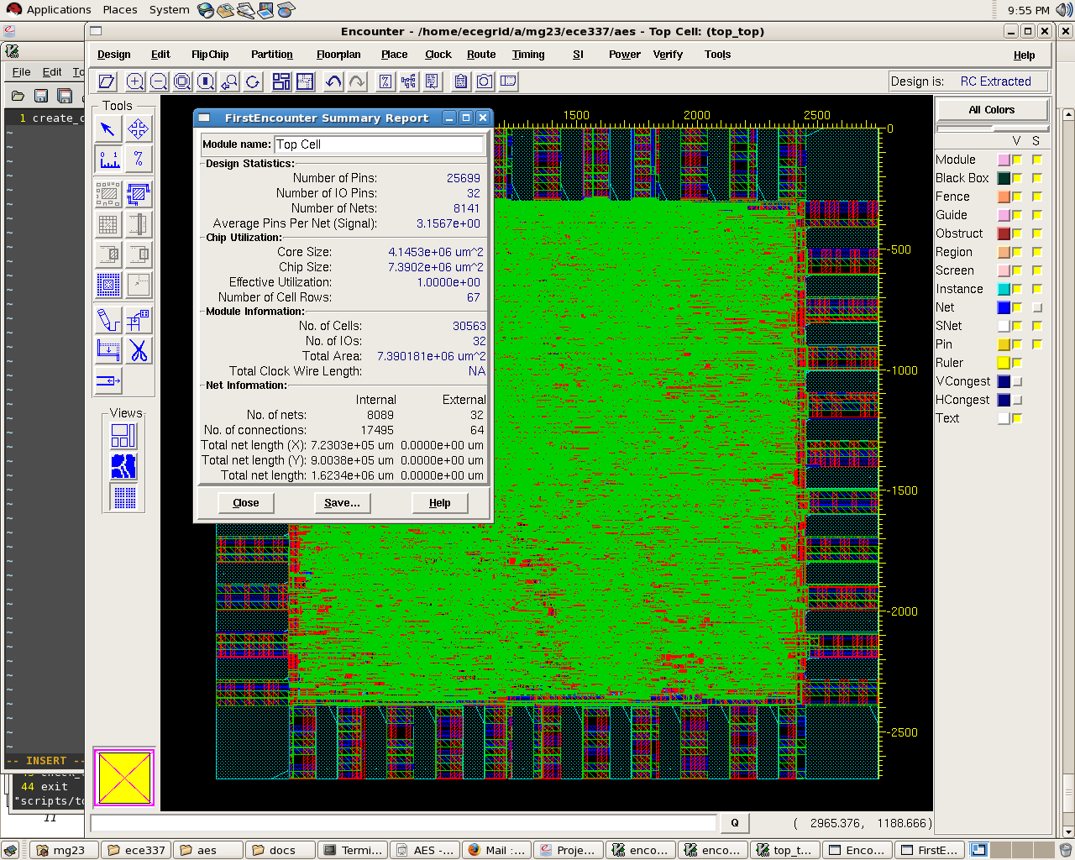
Encounter Layout
Core Size: 4.14 mm^2
Chip Size 7.39 mm^2

Slide 12
Layout (cont)
Several violations that we were unable to resolve
Critical path delay:
  Estimated: 4 ns
    (state -> state_filter_in -> sbox -> state_filter_out)‏
  Synthesized: 4 ns
    (pipelined register -> logic -> different register)‏
  Actual: ??

Slide 13
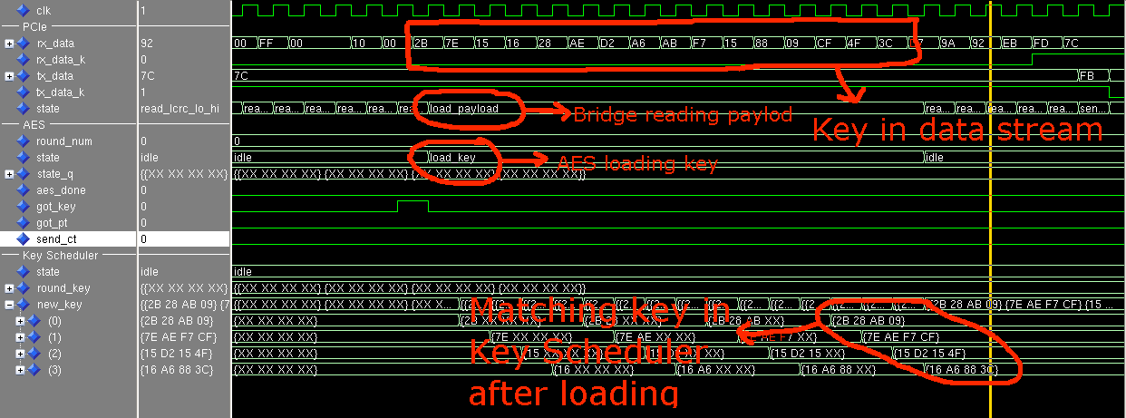
Loading a key over PCIe

Slide 14
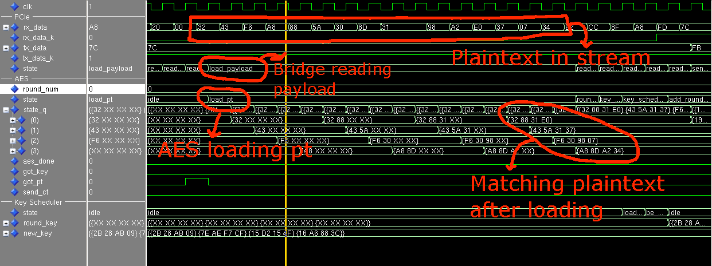
Loading plaintext over PCIe

Slide 15
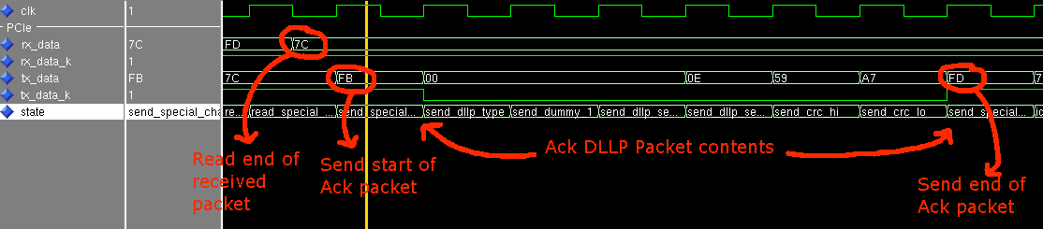
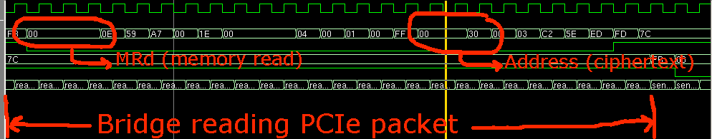
Ack’ing a correct packet
Reading a PCIe memory request

Slide 16
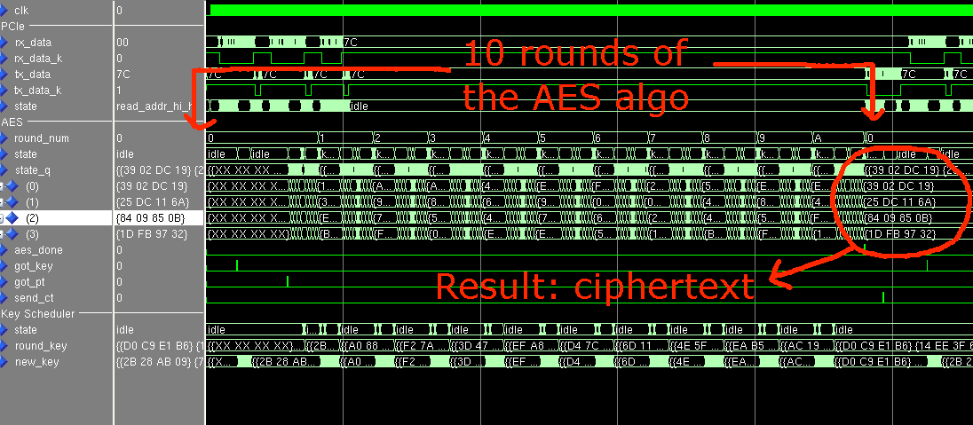
Complete AES operation

Slide 17
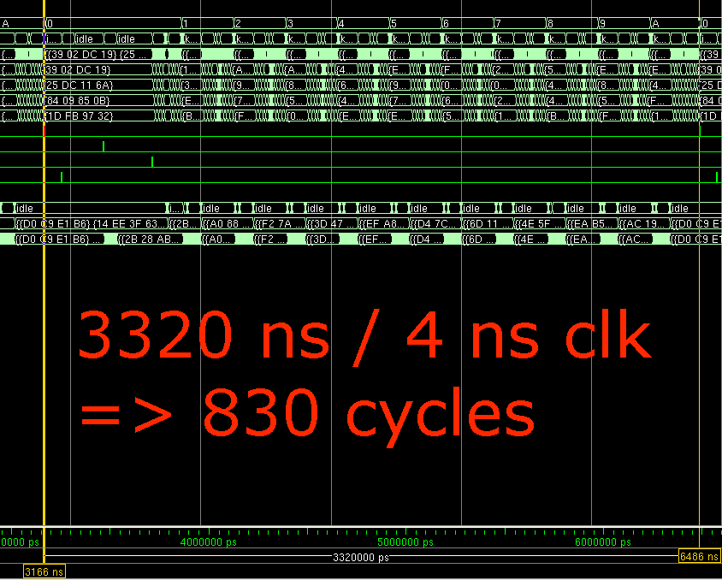

Slide 18
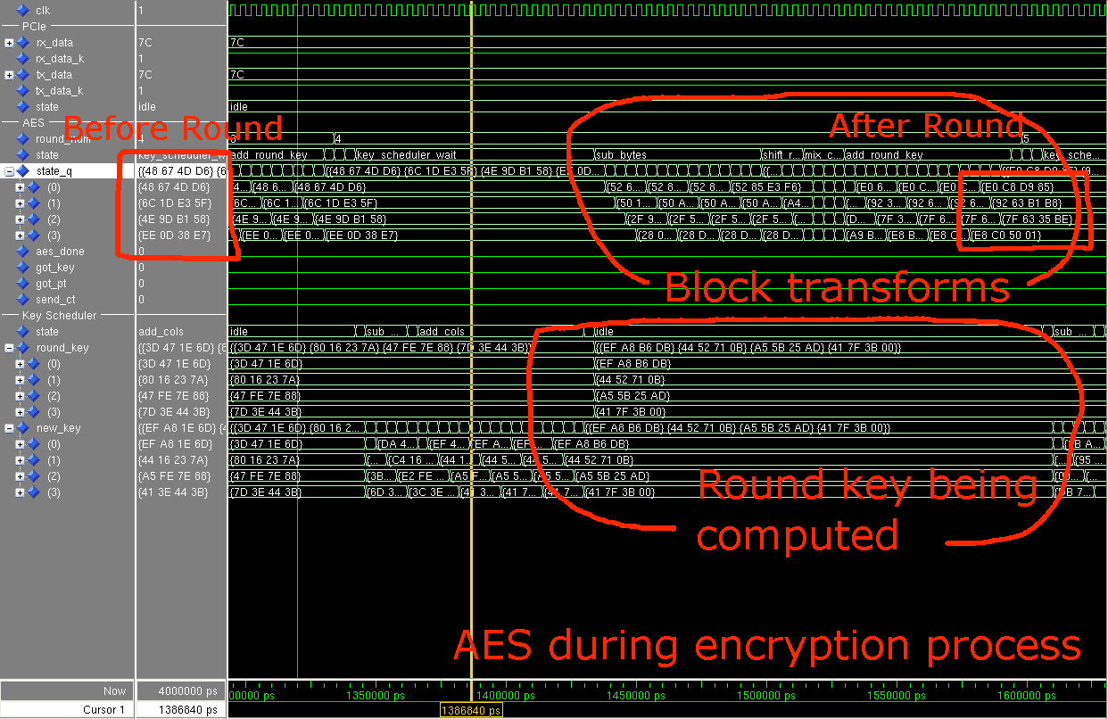

Slide 19
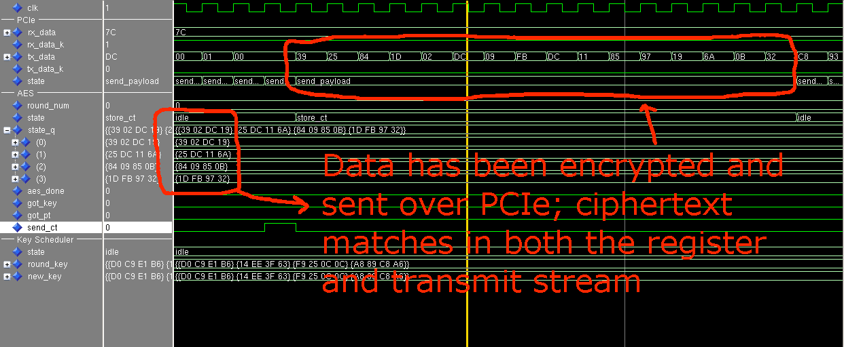
Transmitting ciphertext over PCIe

Slide 20
Conclusions
Challenges
  PCI Express spec
  Decomposition of AES
  State filter in/out “smart mux”
  Encounter/Layout violations
Spend more time on PCI Express bridge design, more parallelization to reduce critical path, investigate layout
Pipeline AES sub-blocks, spend more time on synthesis/layout scripts

Slide 22
Reference Slides

Slide 23
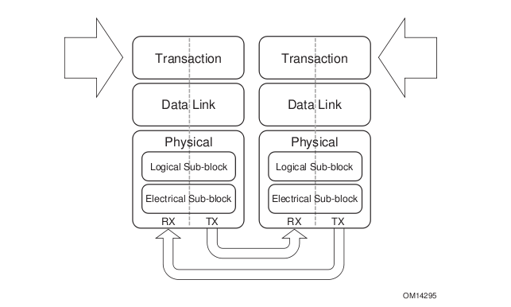

Slide 24
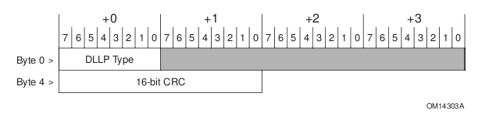
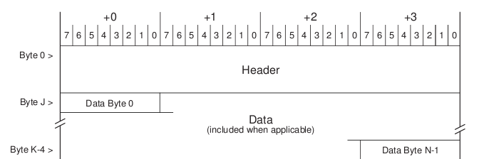

Slide 25
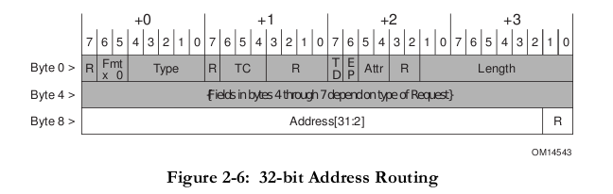
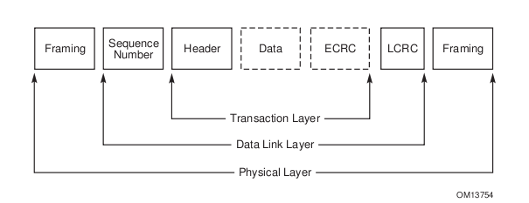

Slide 26
AES Flowchart
Data
Add RoundKey
+ Cipher Key
1 - SubBytes
Repeat 8
2 – ShiftRows
times
3 - MixColumns
4 – Add RoundKey
+ Cipher Key
After 9 rounds
SubBytes
ShiftRows
Add RoundKey
+ Cipher Key
Cipher text

Slide 27
PCIe Bridge Diagram
CRC
LCRC
6
state
clr
calc
data
check_sum
8
Output
Logic
tx_data
rx_data
8
Next State
Logic
nextstate
tx_data_k
rx_data_k
State Register
6
load_key
load_pt
send_ct
reg_out
reg_in
Packet
Info
Registers

Slide 28
AES Top Level Diagram
AES
State
Register
data
128
Identity
8
SubBytes
State
Filter
In
State
Filter
Out
32
ShiftRows
32
MixColumns
3
8
subblock
Add
RoundKey
key
8
3
encryption_key
RCU
3
subblock
128
Key
Scheduler
iteration
go

Slide 29
AES_RCU
4
roundcount
Round Counter
Next State
Logic
nextroundcount
4
clk
nrst
blockcount
start_key
Output
Logic
5
Subblock Counter
p
subblock
Next State
Logic
nextblockcount
state
5
3
clk
nrst
State Register
Next State
Logic
nextstate
3
clk
key_done
nrst

Slide 30
State_Filter_In
Smart
Mux
32
state_q
filtered_out
128
3
4
g_index
subblock

Slide 31
State_Filter_Out
8
subbytes_out
32
shift_rows_out
128
32
Smart
Mux
mix_columns_out
state_d
8
add_round_key_out
8
load_out
3
4
g_index
subblock

Slide 32
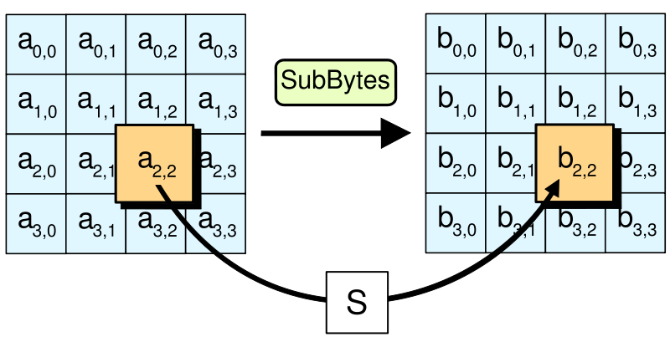
SubBytes Step

Slide 33
SubBytes
Isomorphic
Transform
(Matrix
Mul)‏
Addition
Square
Multiply
Multiply
Lambda
Addition
Multiply
Inverse
Multiply
Inverse
Isomorphic
Transform
(Matrix
Mul)‏
Multiply

Slide 34
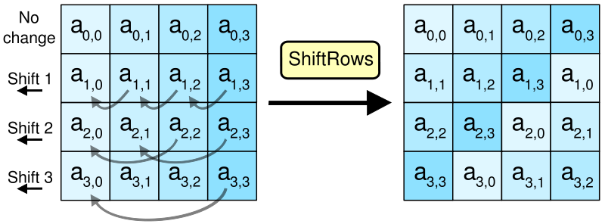
ShiftRows Step

Slide 35
Shift_Rows
Variable-Length
Rotate
2
num_shifts
32
data_out
32
data_in

Slide 36
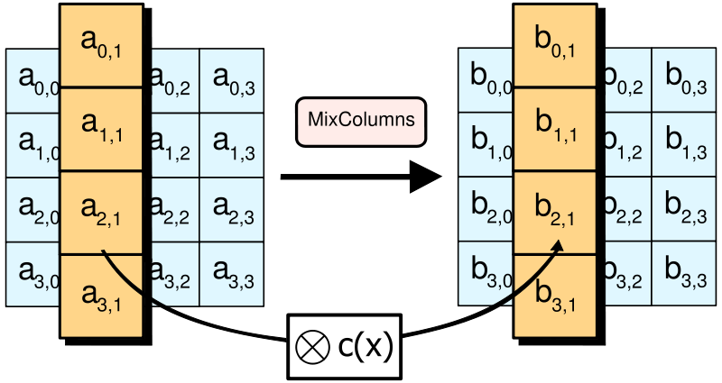
MixColumns Step

Slide 37
Mix_Columns
Galois Field
Rotate
b
4
Matrix Multiply
(Cascaded XORs)‏
4
d_out
d_in
4

Slide 38
Key_Scheduler
state
4
State Register
Next State
Logic
nextstate
go
iteration
4
Output
Logic
done
3
store
128
stored_key
Key Register
128
Next State
Logic
next_stored_key
128
encryption_key
128
round_key
sbox_lookup
SBOX
8
rcon
sbox_return
RCON
3
iteration

Slide 39
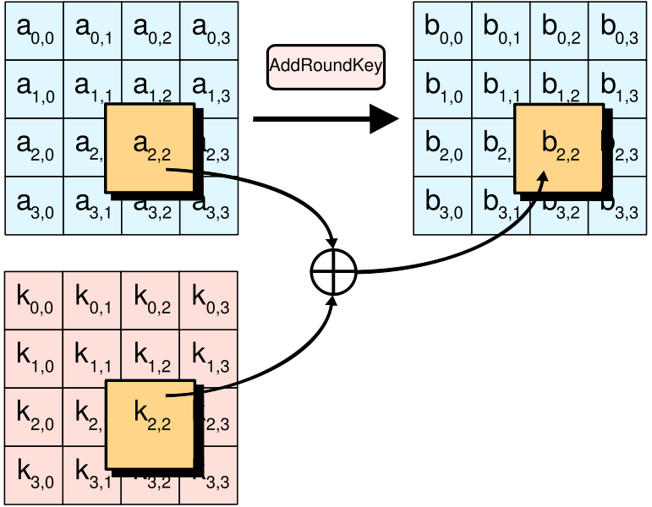
AddRoundKey Step

Slide 40
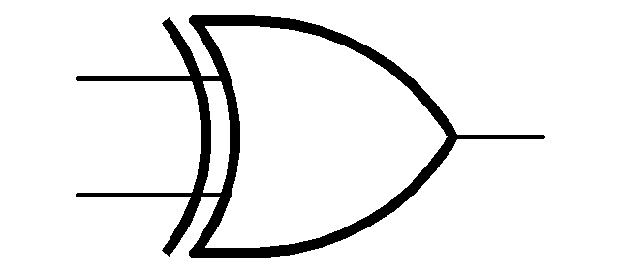
Add_Round_Key
8
data_in
8
data_out
8
key_in

Slide 41
PCIe Bridge Diagram
5
state
State Register
8
Next State
Logic
nextstate
Output
Logic
tx_fifo
8
rx_fifo
aes_ctl
5
3
8
frame
Frame
LUT
3
aes_status

