Slide 1
Investigation of Non-normality in a Simple Errors-in-variables Model
Lee Chun Yin [3035469140]
4-5-2021
Supervisor: Dr. Raymond W.L. Wong
STAT3799 Directed studies in statistics

Slide 2
Introduction

Slide 3
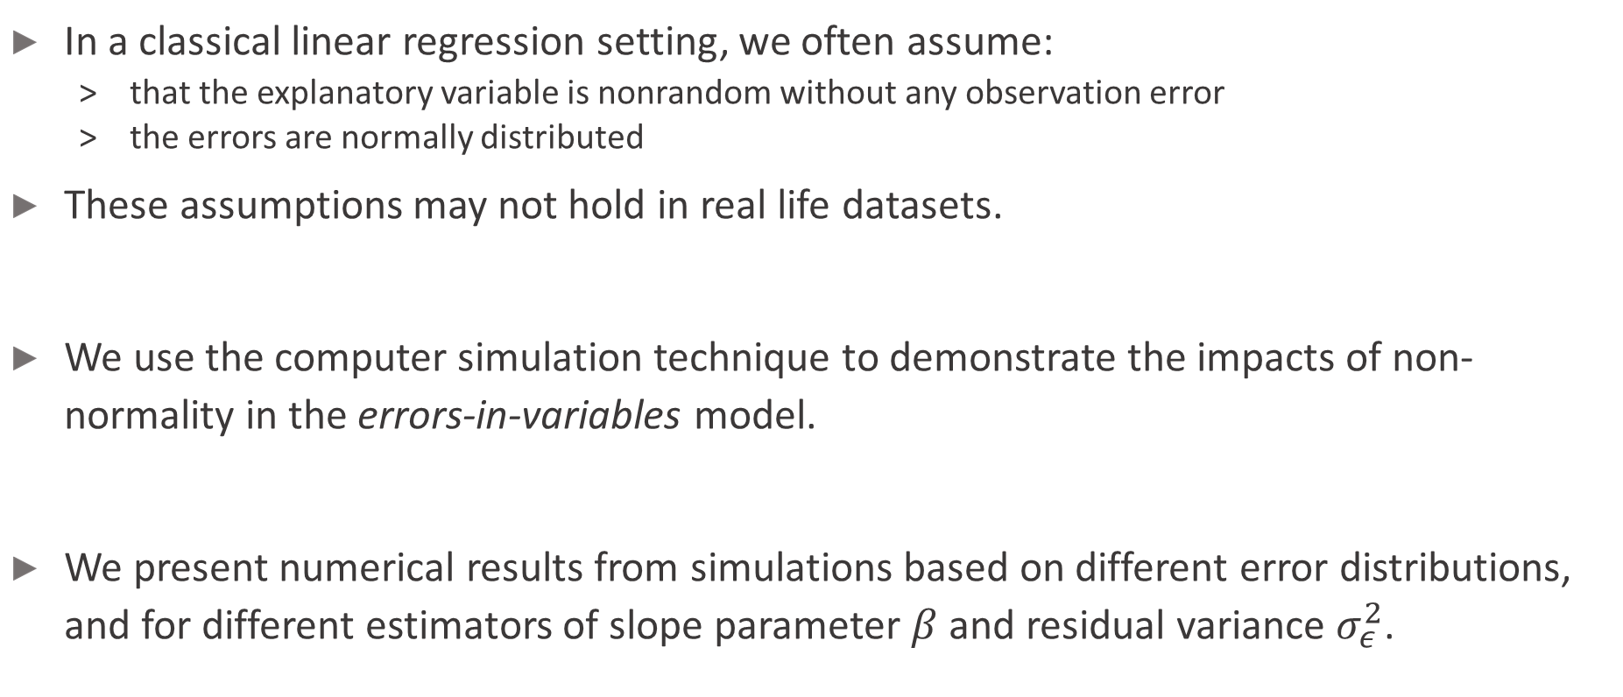
Background
In a classical linear regression setting, we often assume:
that the explanatory variable is nonrandom without any observation error
the errors are normally distributed
These assumptions may not hold in real life datasets.
We use the computer simulation technique to demonstrate the impacts of non-normality in the errors-in-variables model.
We present numerical results from simulations based on different error distributions, and for different estimators of slope parameter $β$ and residual variance $σ_{ε}^{2}$.

Slide 4
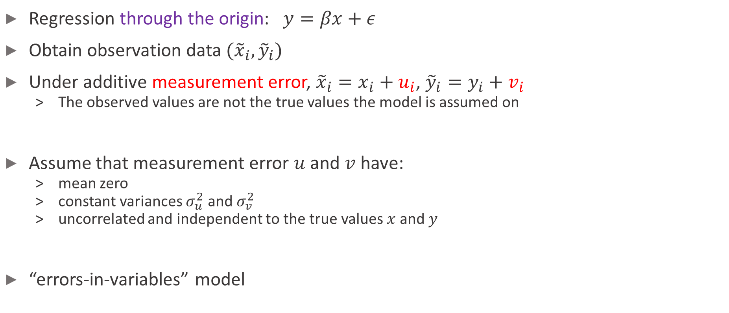
Regression setting – Observation error
Regression through the origin: $y=βx+ε$
Obtain observation data $({\tilde{x}}_{i},{\tilde{y}}_{i})$
Under additive measurement error, ${\tilde{x}}_{i}=x_{i}+u_{i}$, ${\tilde{y}}_{i}=y_{i}+v_{i}$
The observed values are not the true values the model is assumed on
Assume that measurement error $u$ and $v$ have:
mean zero
constant variances $σ_{u}^{2}$ and $σ_{v}^{2}$
uncorrelated and independent to the true values $x$ and $y$
“errors-in-variables” model

Slide 5
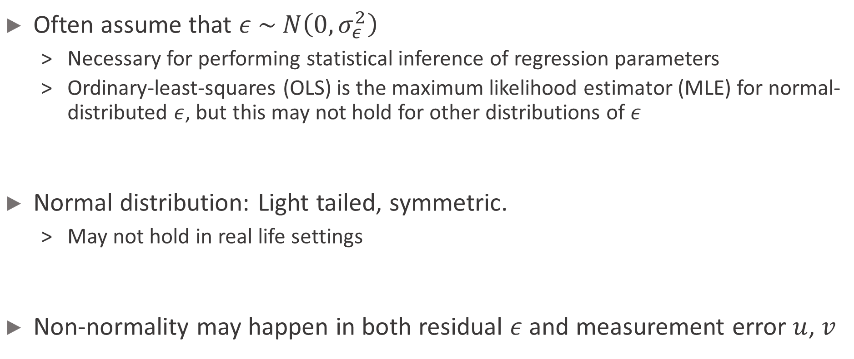
Regression setting – Non-normality
Often assume that $ε \sim N\left(0, σ_{ε}^{2}\right)$
Necessary for performing statistical inference of regression parameters
Ordinary-least-squares (OLS) is the maximum likelihood estimator (MLE) for normal-distributed $ε$, but this may not hold for other distributions of $ε$
Normal distribution: Light tailed, symmetric.
May not hold in real life settings
Non-normality may happen in both residual $ε$ and measurement error $u$, $v$

Slide 6
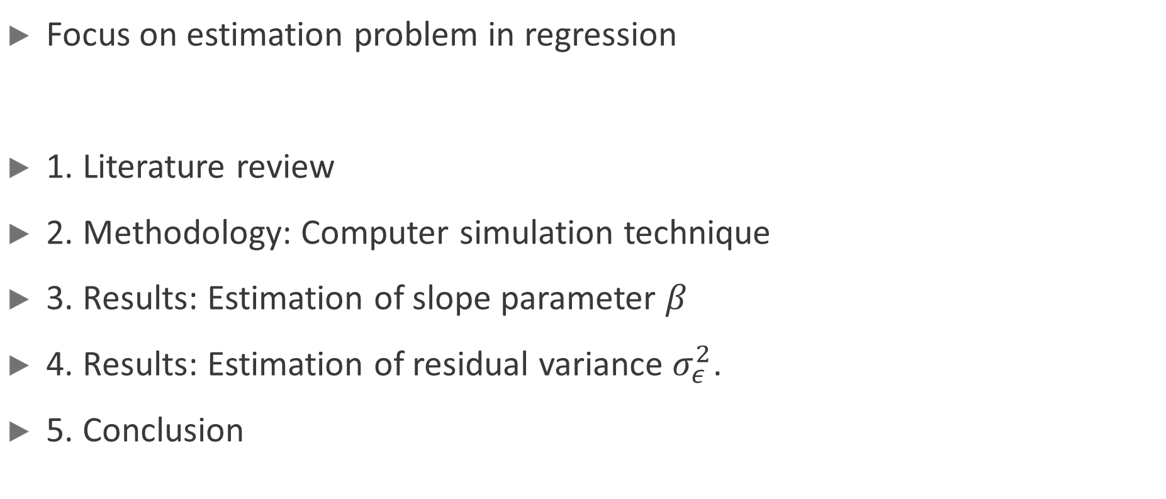
Outline
Focus on estimation problem in regression
1. Literature review
2. Methodology: Computer simulation technique
3. Results: Estimation of slope parameter $β$
4. Results: Estimation of residual variance $σ_{ε}^{2}$.
5. Conclusion

Slide 7
Literature review

Slide 8
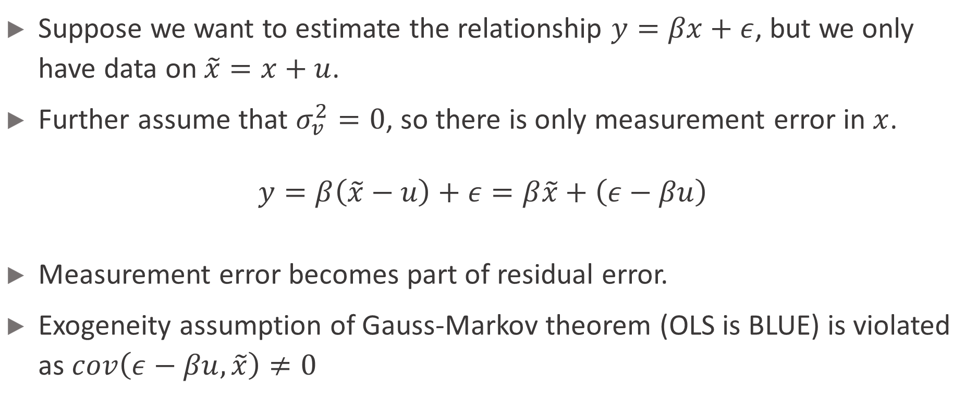
Errors-in-variables model (Pischke, 2007)
Suppose we want to estimate the relationship $y=βx+ε$, but we only have data on $\tilde{x}=x+u$.
Further assume that $σ_{v}^{2}=0$, so there is only measurement error in $x$.
$$y=β\left(\tilde{x}−u\right)+ε=β\tilde{x}+\left(ε−βu\right)$$
Measurement error becomes part of residual error.
Exogeneity assumption of Gauss-Markov theorem (OLS is BLUE) is violated as $cov\left(ε−βu, \tilde{x}\right)≠0$

Slide 9


OLS for $β$ (Pische, 2007)
${\hat{β}}_{OLS}=\frac{cov\left(\tilde{x}, y\right)}{var\left(\tilde{x}\right)}=\frac{cov\left(x+u, βx+ε\right)}{var\left(x+u\right)}$
$plim {\hat{β}}_{OLS}=\frac{βσ_{x}^{2}}{σ_{x}^{2}+σ_{u}^{2}}=λβ$, where $λ=\frac{σ_{x}^{2}}{σ_{x}^{2}+σ_{u}^{2}}$
${\hat{β}}_{OLS}$ biased towards zero, inconsistent estimator

Slide 10
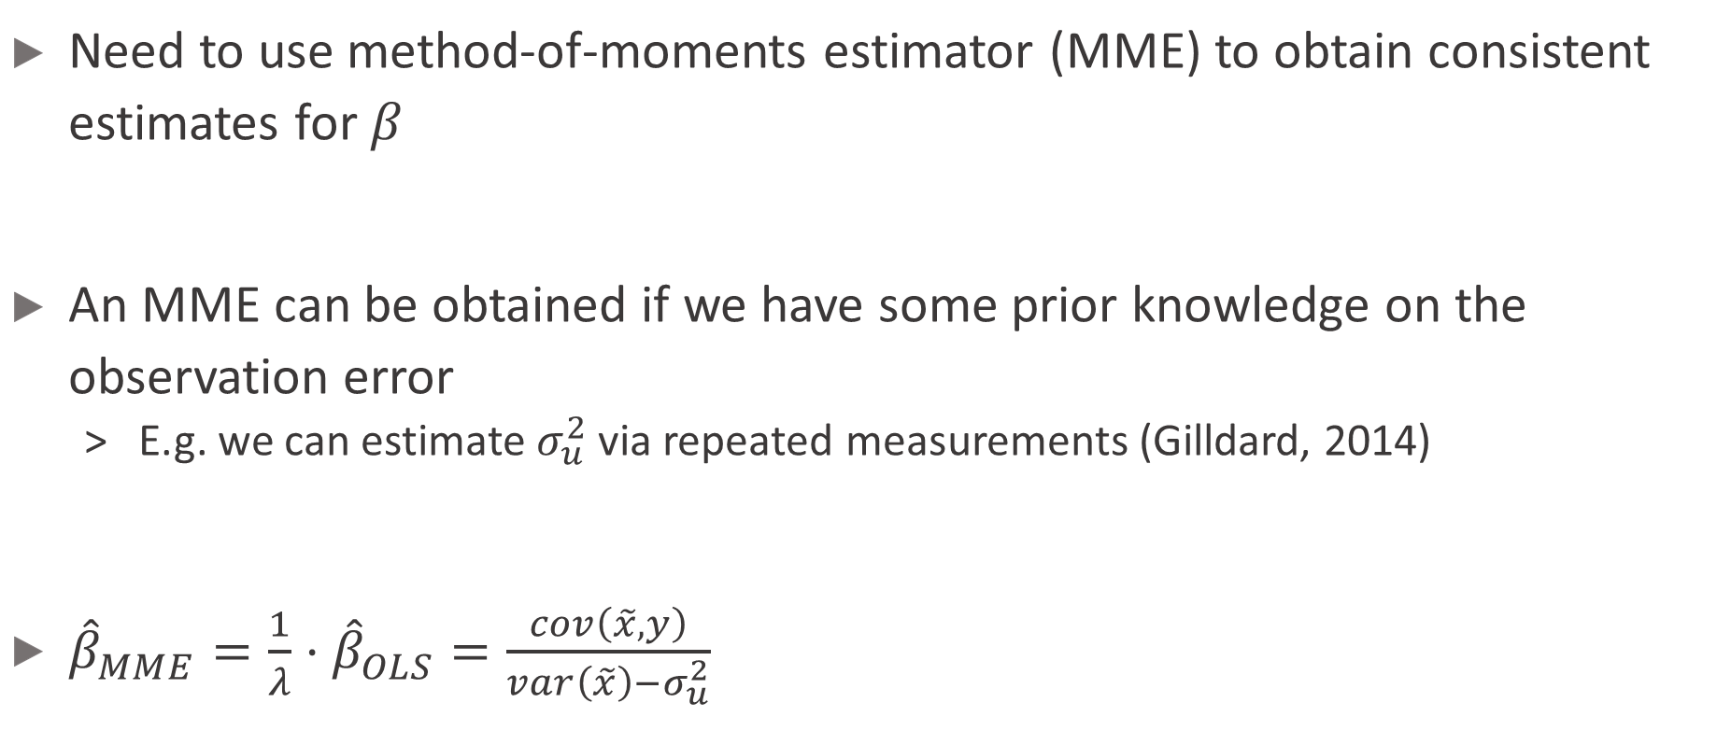

MME for $β$ (Pische, 2007)
Need to use method-of-moments estimator (MME) to obtain consistent estimates for $β$
An MME can be obtained if we have some prior knowledge on the observation error
E.g. we can estimate $σ_{u}^{2}$ via repeated measurements (Gilldard, 2014)
${\hat{β}}_{MME}=\frac{1}{λ}⋅{\hat{β}}_{OLS}=\frac{cov\left(\tilde{x}, y\right)}{var\left(\tilde{x}\right)−σ_{u}^{2}}$

Slide 11
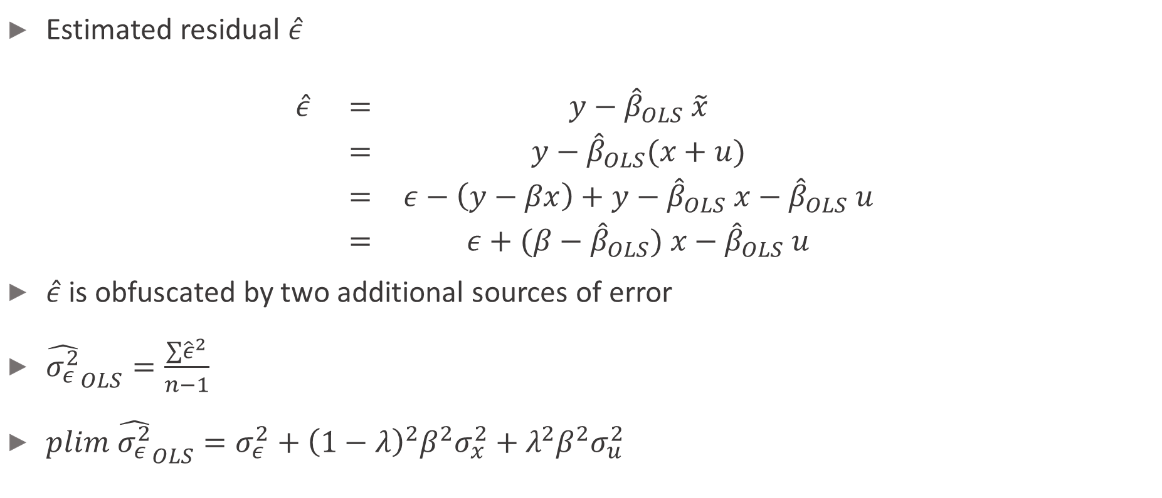

OLS for $σ_{ε}^{2}$ (Pische, 2007)
Estimated residual $\hat{ε}$
$$\begin{matrix}\hat{ε} & = & y−{\hat{β}}_{OLS} \tilde{x} \\ & = & y−{\hat{β}}_{OLS}(x+u) \\ & = & ε−\left(y−βx\right)+y−{\hat{β}}_{OLS} x−{\hat{β}}_{OLS} u \\ & = & ε+(β−{\hat{β}}_{OLS}) x−{\hat{β}}_{OLS} u\end{matrix}$$
$\hat{ε}$ is obfuscated by two additional sources of error
${\hat{σ_{ε}^{2}}}_{OLS}=\frac{∑{\hat{ε}}^{2}}{n−1}$
$plim {\hat{σ_{ε}^{2}}}_{OLS}=σ_{ε}^{2}+{\left(1−λ\right)}^{2}β^{2}σ_{x}^{2}+λ^{2}β^{2}σ_{u}^{2}$

Slide 12
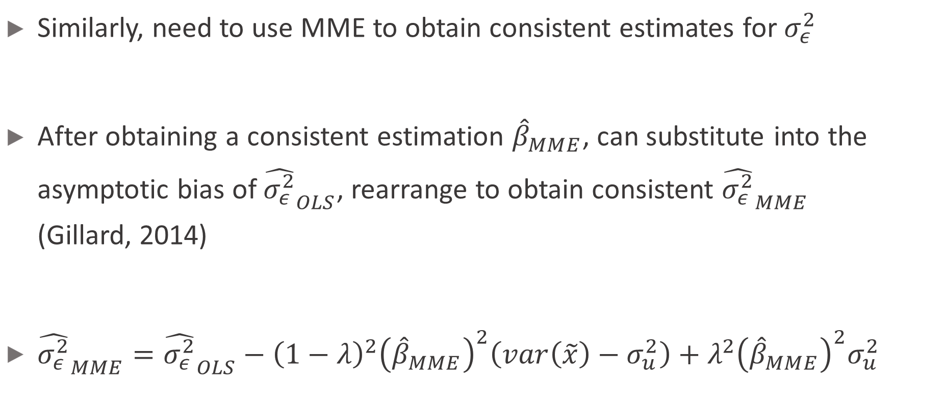

MME for $σ_{ε}^{2}$
Similarly, need to use MME to obtain consistent estimates for $σ_{ε}^{2}$
After obtaining a consistent estimation ${\hat{β}}_{MME}$, can substitute into the asymptotic bias of ${\hat{σ_{ε}^{2}}}_{OLS}$, rearrange to obtain consistent ${\hat{σ_{ε}^{2}}}_{MME}$ (Gillard, 2014)
${\hat{σ_{ε}^{2}}}_{MME}={\hat{σ_{ε}^{2}}}_{OLS}−{\left(1−λ\right)}^{2}{\left({\hat{β}}_{MME}\right)}^{2}\left(var\left(\tilde{x}\right)−σ_{u}^{2}\right)+λ^{2}{\left({\hat{β}}_{MME}\right)}^{2}σ_{u}^{2}$

Slide 13
Methodology

Slide 14
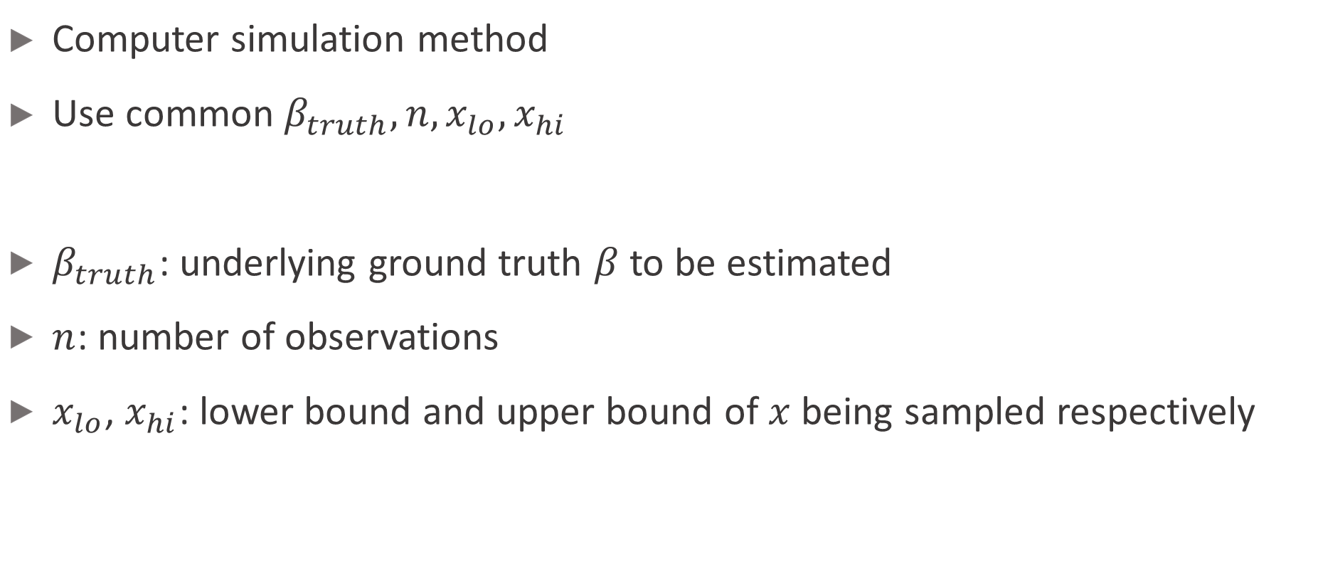
Procedures
Computer simulation method
Use common $β_{truth}, n, x_{lo}, x_{hi}$
$β_{truth}$: underlying ground truth $β$ to be estimated
$n$: number of observations
$x_{lo}$, $x_{hi}$: lower bound and upper bound of $x$ being sampled respectively

Slide 15
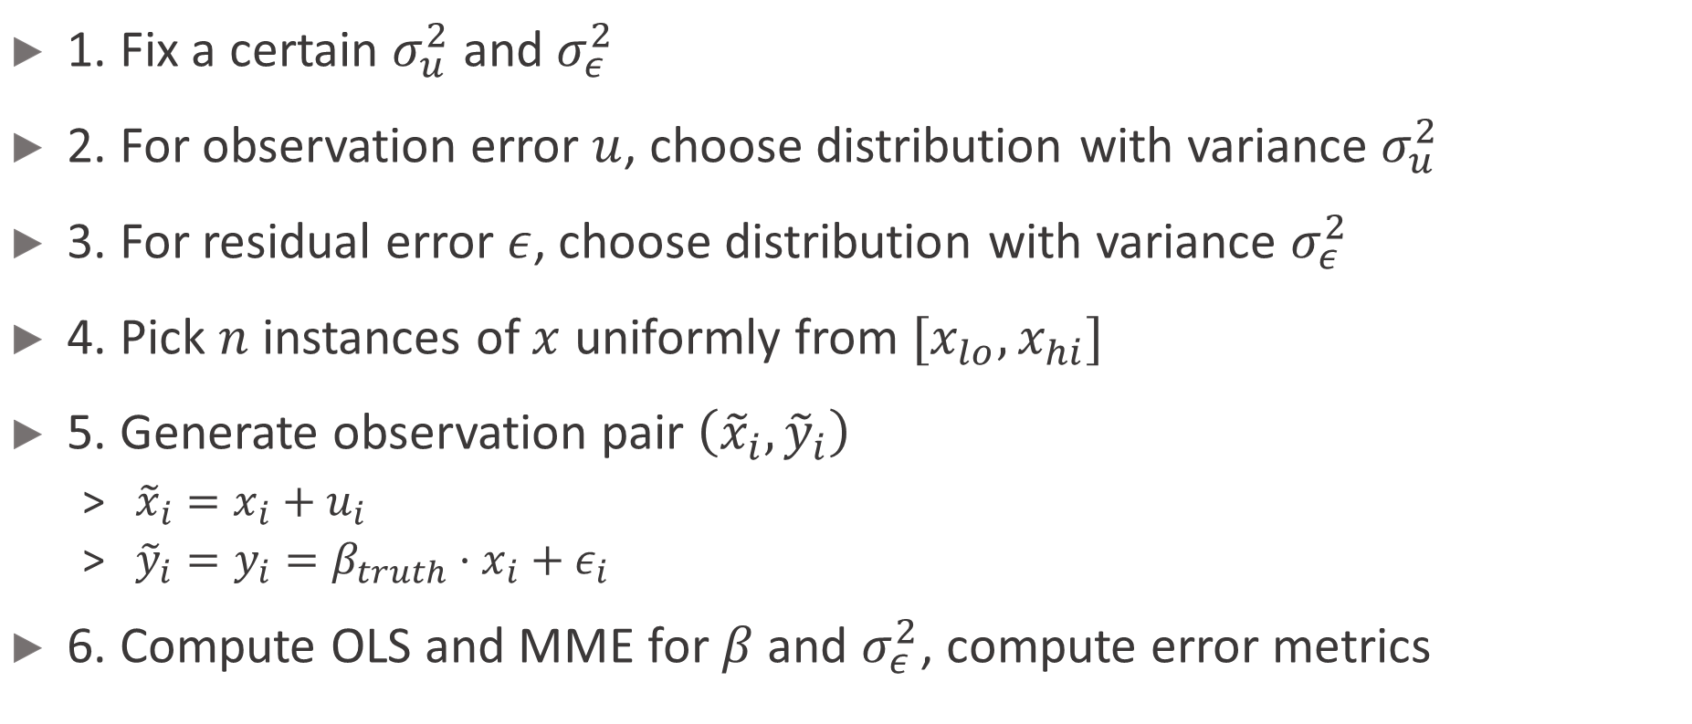
Procedures
1. Fix a certain $σ_{u}^{2}$ and $σ_{ε}^{2}$
2. For observation error $u$, choose distribution with variance $σ_{u}^{2}$
3. For residual error $ε$, choose distribution with variance $σ_{ε}^{2}$
4. Pick $n$ instances of $x$ uniformly from $[x_{lo}, x_{hi}]$
5. Generate observation pair $\left({\tilde{x}}_{i},{\tilde{y}}_{i}\right)$
${\tilde{x}}_{i}=x_{i}+u_{i}$
${\tilde{y}}_{i}=y_{i}=β_{truth}⋅x_{i}+ε_{i}$
6. Compute OLS and MME for $β$ and $σ_{ε}^{2}$, compute error metrics

Slide 16

Iterations and error computation
Perform the procedures for 10,000 iterations for each pair of $(σ_{u}^{2}, σ_{ε}^{2})$
Obtain mean bias error (MBE) and mean squared error (MSE) over all iterations

Slide 17
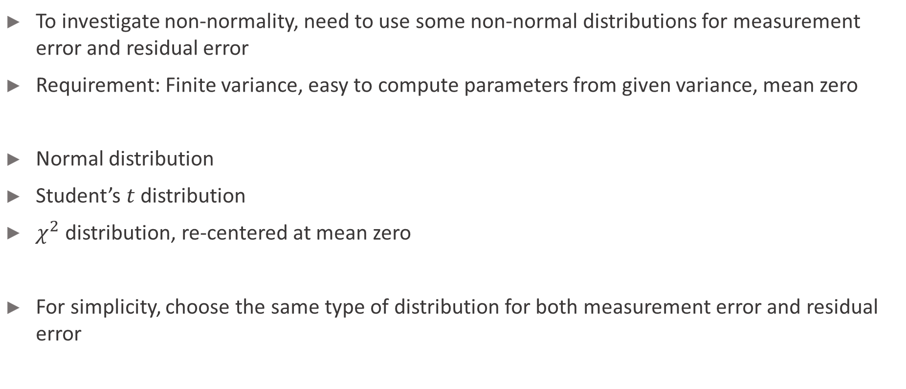
Choice of distribution
To investigate non-normality, need to use some non-normal distributions for measurement error and residual error
Requirement: Finite variance, easy to compute parameters from given variance, mean zero
Normal distribution
Student’s $t$ distribution
$χ^{2}$ distribution, re-centered at mean zero
For simplicity, choose the same type of distribution for both measurement error and residual error

Slide 18

Experiment parameters used
$n=30$
$β_{truth}=2$
$x_{lo}=−20$
$x_{hi}=20$
$σ_{u}^{2}∈\{0, 1.5, 2, 2.5, 3.0, 4.5, 6.0, 8.0, 10.0\}$
$σ_{ε}^{2}∈\{1.5, 2, 2.5\}$
Implemented in Python with Jupyter notebook, scipy package for distributions

Slide 19
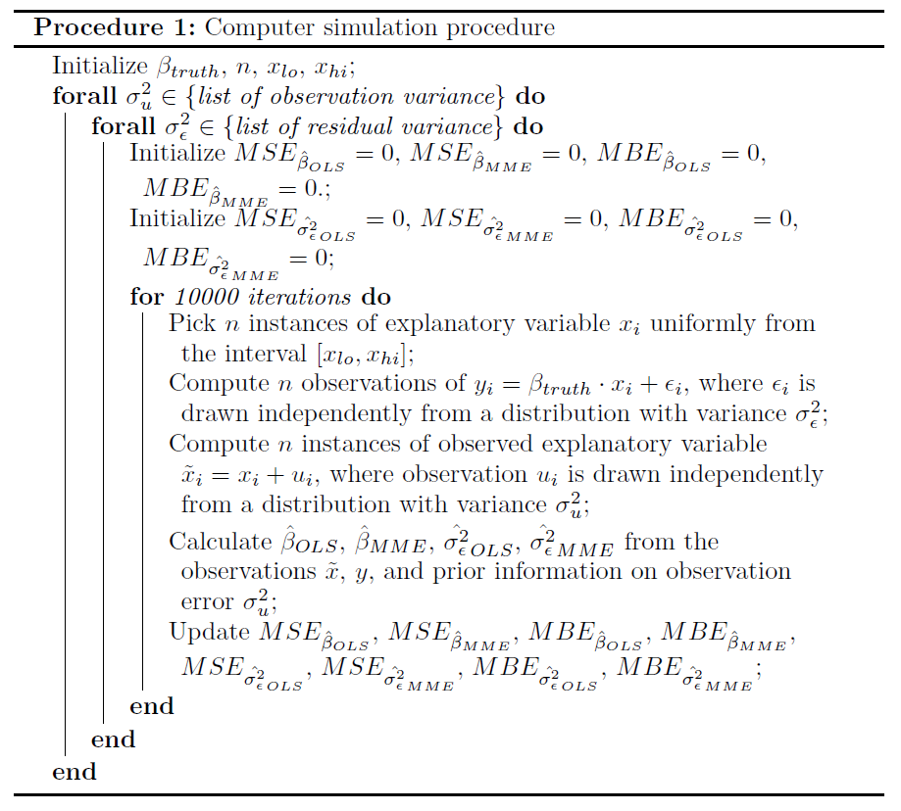

Slide 20
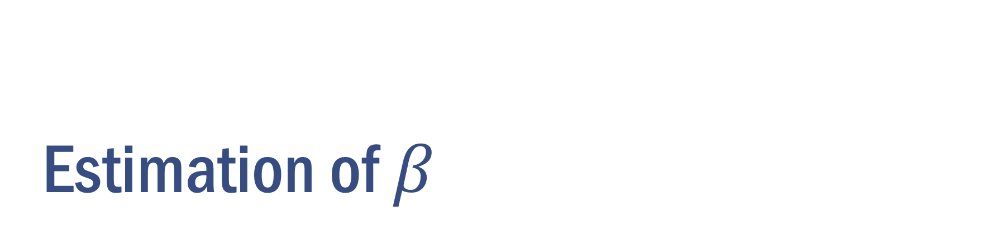
Estimation of $β$

Slide 21

Estimators
${\hat{β}}_{OLS}=\frac{cov\left(\tilde{x}, y\right)}{var\left(\tilde{x}\right)}$
${\hat{β}}_{MME}=\frac{cov\left(\tilde{x}, y\right)}{var\left(\tilde{x}\right)−σ_{u}^{2}}$

Slide 22
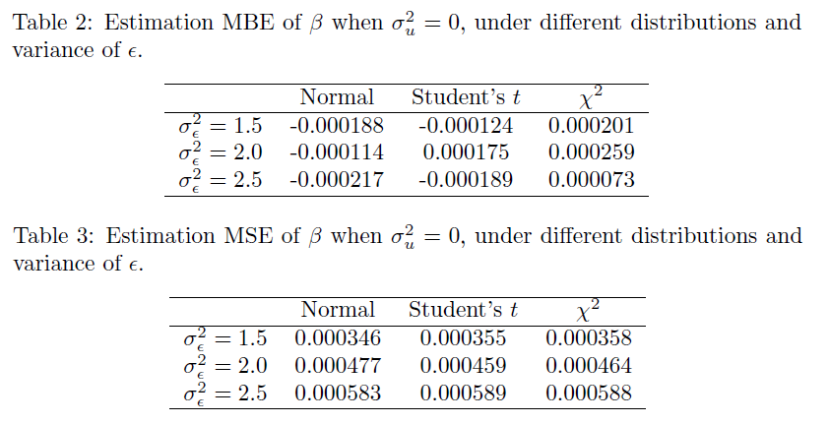
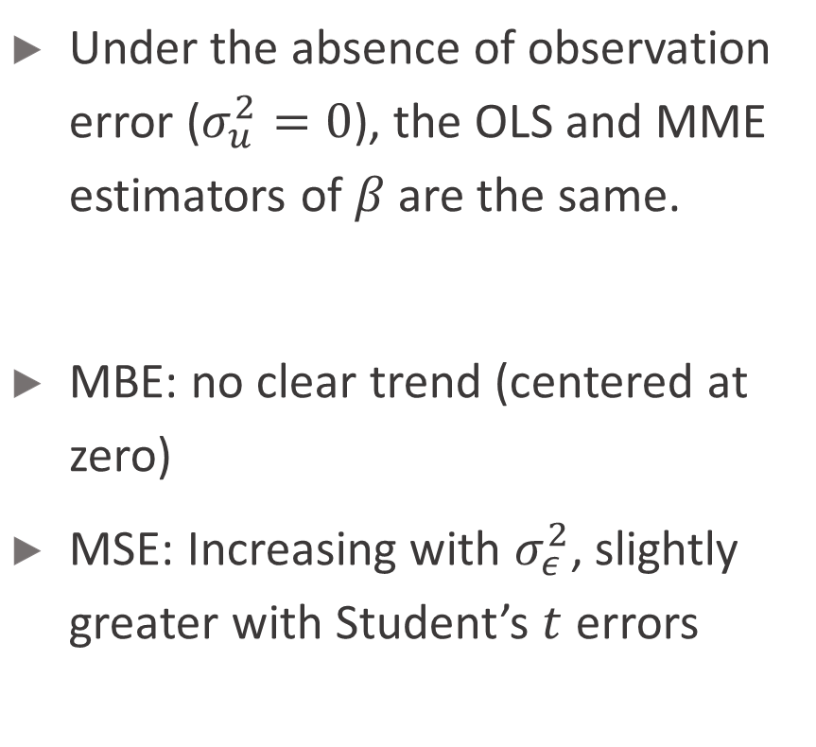
Absence of observation error
Under the absence of observation error ($σ_{u}^{2}=0$), the OLS and MME estimators of $β$ are the same.
MBE: no clear trend (centered at zero)
MSE: Increasing with $σ_{ε}^{2}$, slightly greater with Student’s $t$ errors

Slide 23
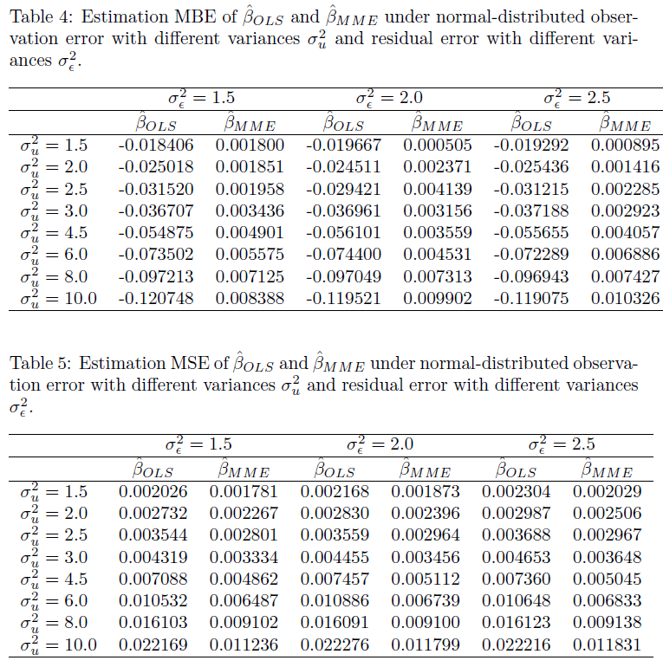
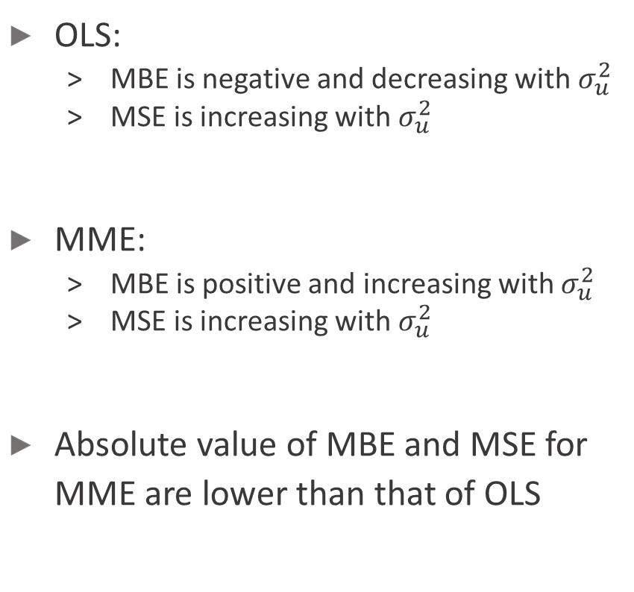
Normal-distributed measurement error and residual error
OLS:
MBE is negative and decreasing with $σ_{u}^{2}$
MSE is increasing with $σ_{u}^{2}$
MME:
MBE is positive and increasing with $σ_{u}^{2}$
MSE is increasing with $σ_{u}^{2}$
Absolute value of MBE and MSE for MME are lower than that of OLS

Slide 24
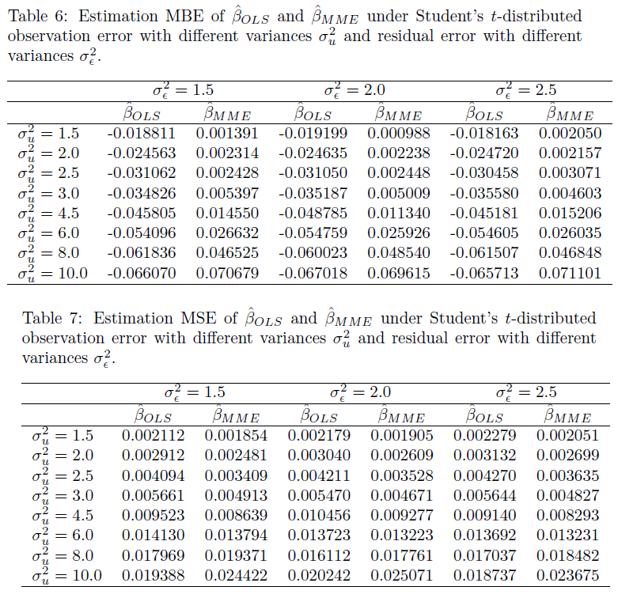
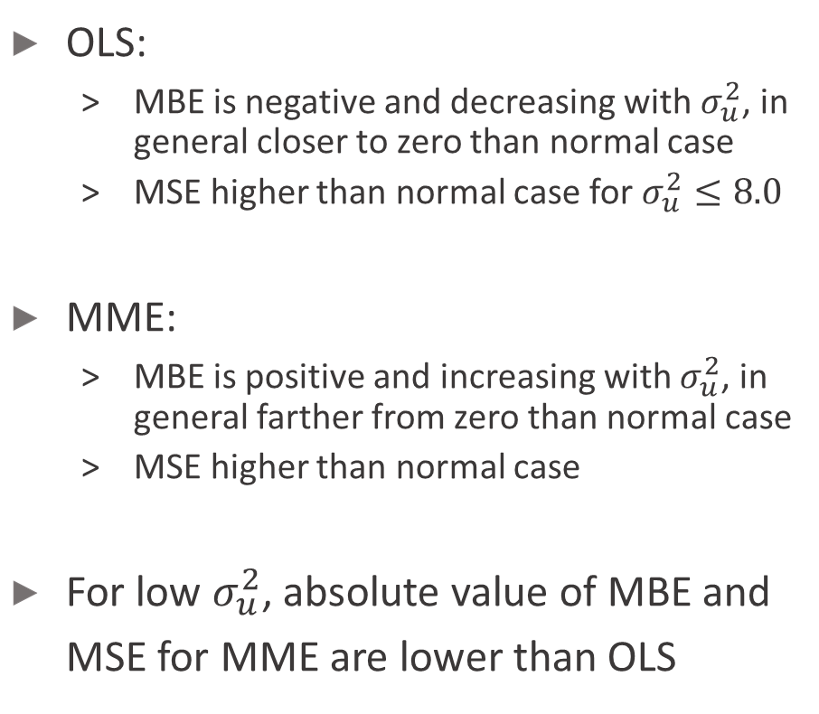
Student’s $t$-distributed measurement error and residual error
OLS:
MBE is negative and decreasing with $σ_{u}^{2}$, in general closer to zero than normal case
MSE higher than normal case for $σ_{u}^{2}≤8.0$
MME:
MBE is positive and increasing with $σ_{u}^{2}$, in general farther from zero than normal case
MSE higher than normal case
For low $σ_{u}^{2}$, absolute value of MBE and MSE for MME are lower than OLS

Slide 25
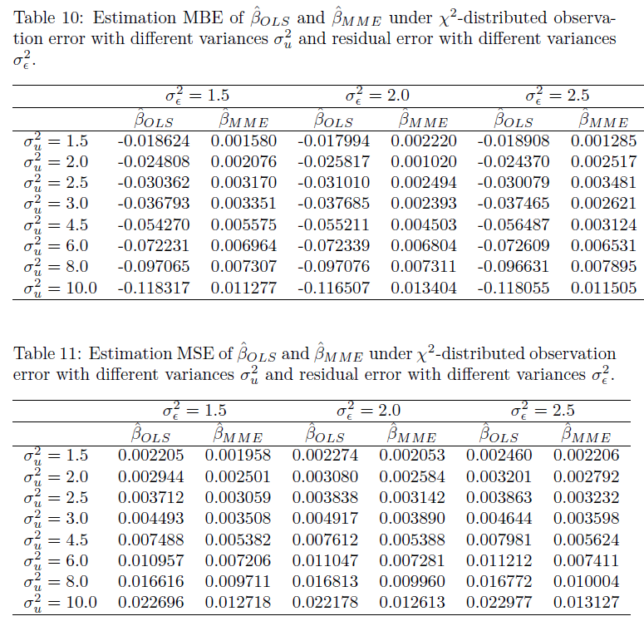
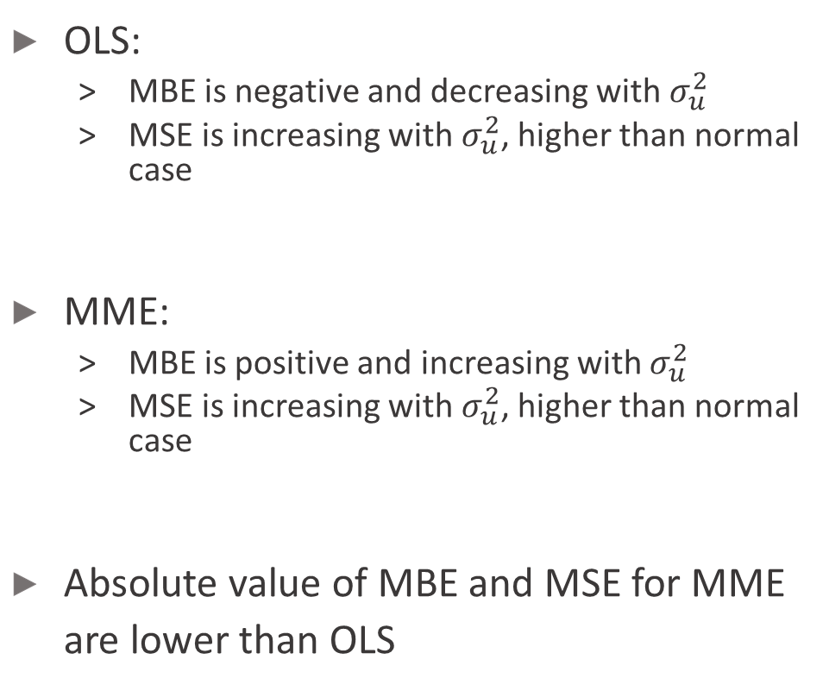
Re-centered $χ^{2}$-distributed measurement error and residual error
OLS:
MBE is negative and decreasing with $σ_{u}^{2}$
MSE is increasing with $σ_{u}^{2}$, higher than normal case
MME:
MBE is positive and increasing with $σ_{u}^{2}$
MSE is increasing with $σ_{u}^{2}$, higher than normal case
Absolute value of MBE and MSE for MME are lower than OLS

Slide 26
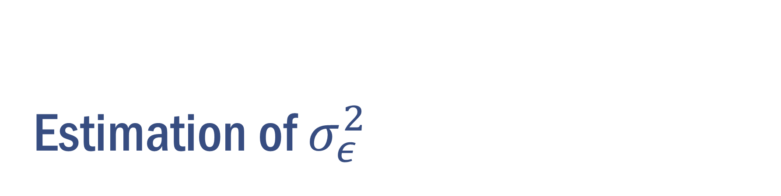
Estimation of $σ_{ε}^{2}$

Slide 27

Estimators
${\hat{σ_{ε}^{2}}}_{OLS}=\frac{∑{\hat{ε}}^{2}}{n−1}$
${\hat{σ_{ε}^{2}}}_{MME}={\hat{σ_{ε}^{2}}}_{OLS}−{\left(1−λ\right)}^{2}{\left({\hat{β}}_{MME}\right)}^{2}\left(var\left(\tilde{x}\right)−σ_{u}^{2}\right)+λ^{2}{\left({\hat{β}}_{MME}\right)}^{2}σ_{u}^{2}$

Slide 28
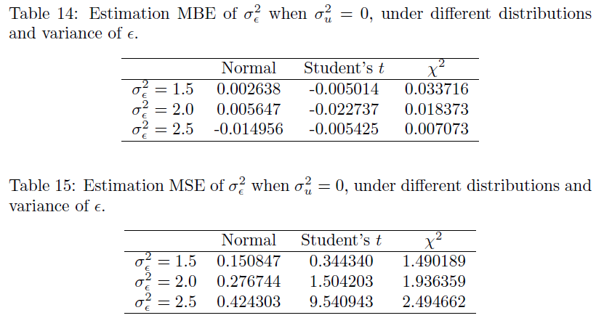
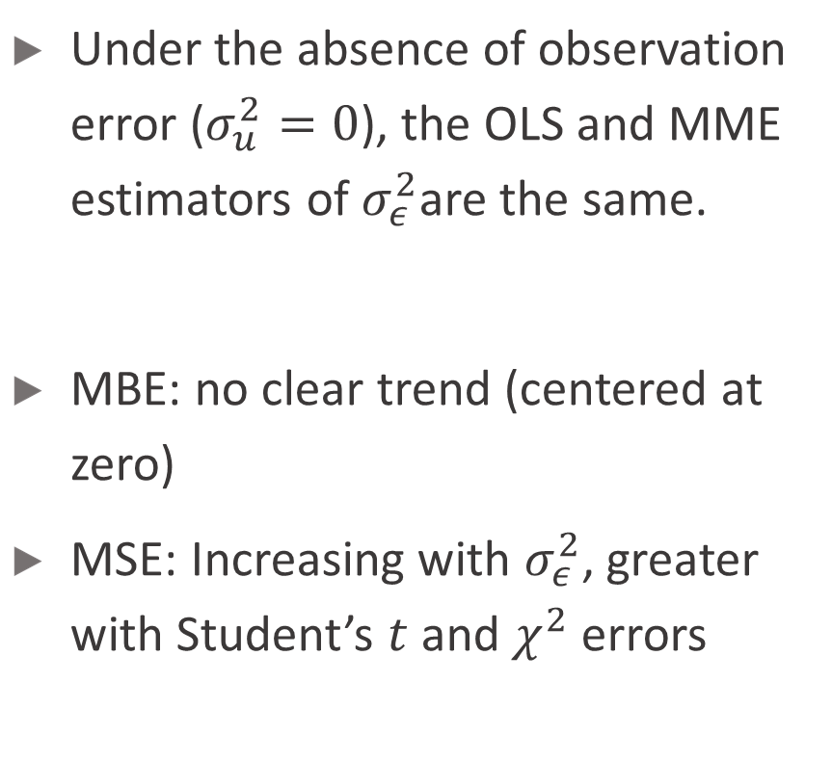
Absence of measurement error
Under the absence of observation error ($σ_{u}^{2}=0$), the OLS and MME estimators of $σ_{ε}^{2}$are the same.
MBE: no clear trend (centered at zero)
MSE: Increasing with $σ_{ε}^{2}$, greater with Student’s $t$ and $χ^{2}$ errors

Slide 29
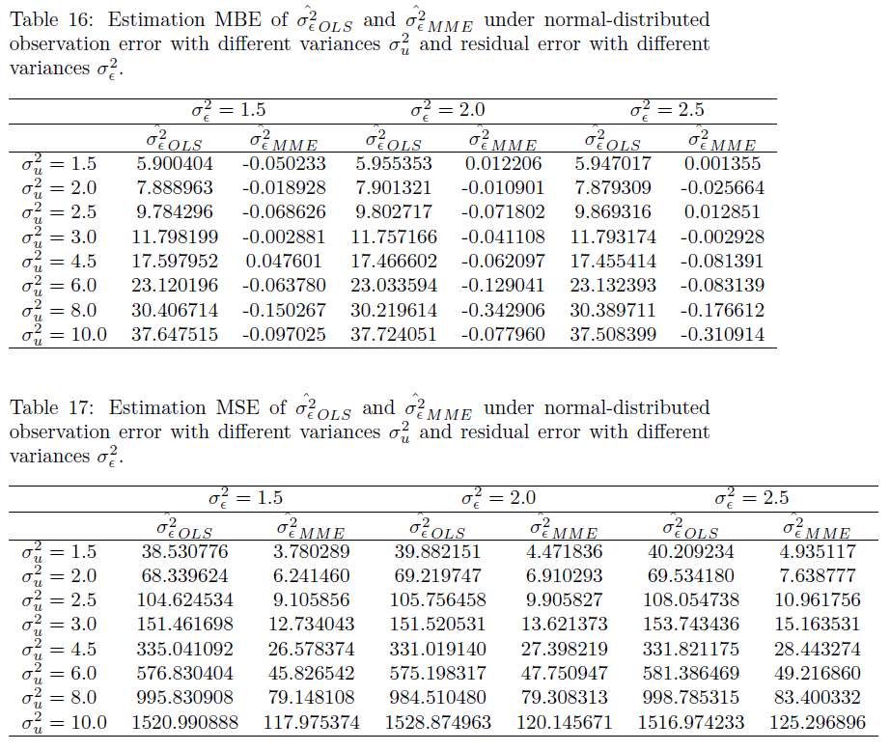
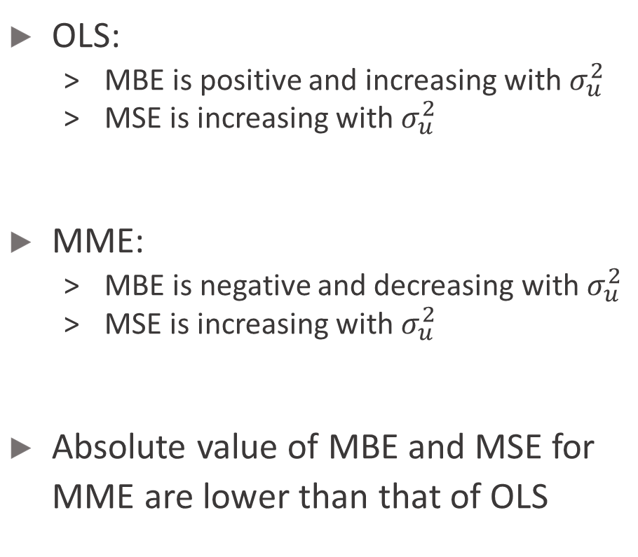
Normal-distributed measurement error and residual error
OLS:
MBE is positive and increasing with $σ_{u}^{2}$
MSE is increasing with $σ_{u}^{2}$
MME:
MBE is negative and decreasing with $σ_{u}^{2}$
MSE is increasing with $σ_{u}^{2}$
Absolute value of MBE and MSE for MME are lower than that of OLS

Slide 30
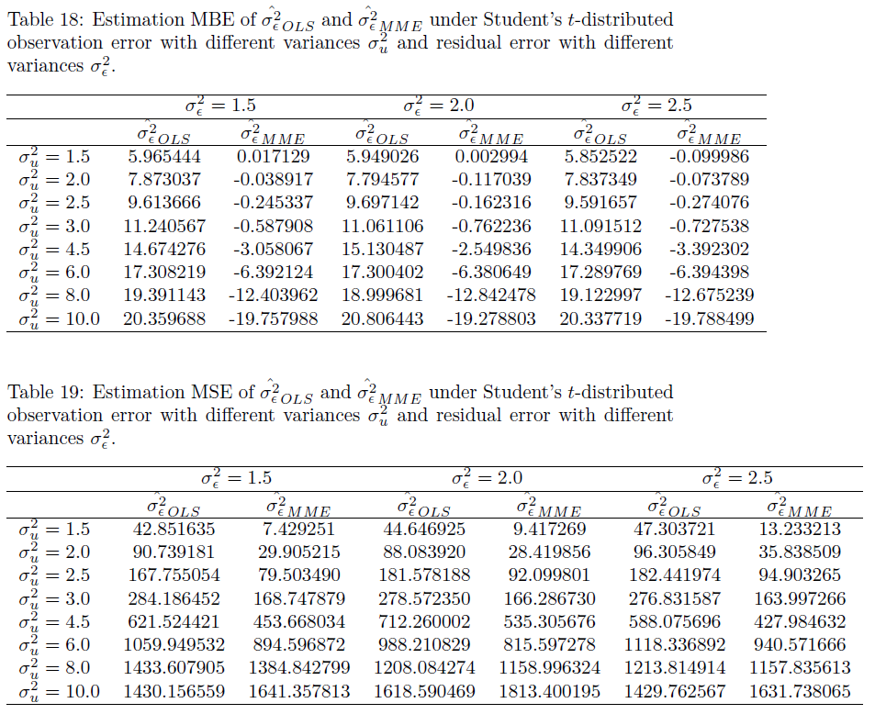
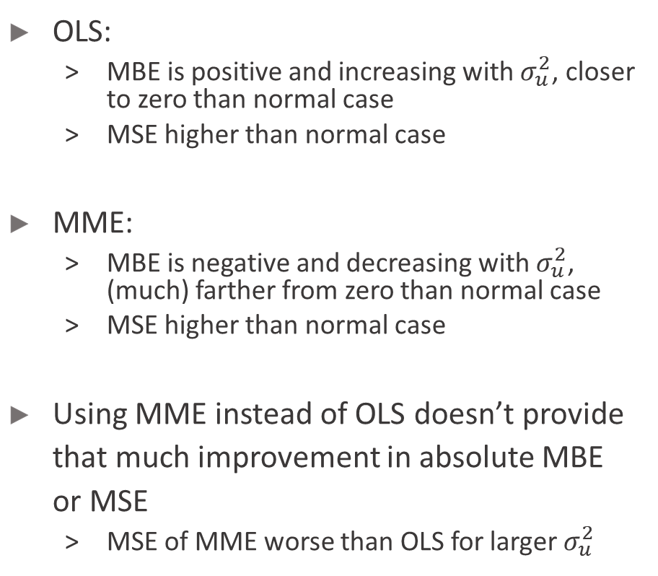
Student’s $t$-distributed measurement error and residual error
OLS:
MBE is positive and increasing with $σ_{u}^{2}$, closer to zero than normal case
MSE higher than normal case
MME:
MBE is negative and decreasing with $σ_{u}^{2}$, (much) farther from zero than normal case
MSE higher than normal case
Using MME instead of OLS doesn’t provide that much improvement in absolute MBE or MSE
MSE of MME worse than OLS for larger $σ_{u}^{2}$

Slide 31
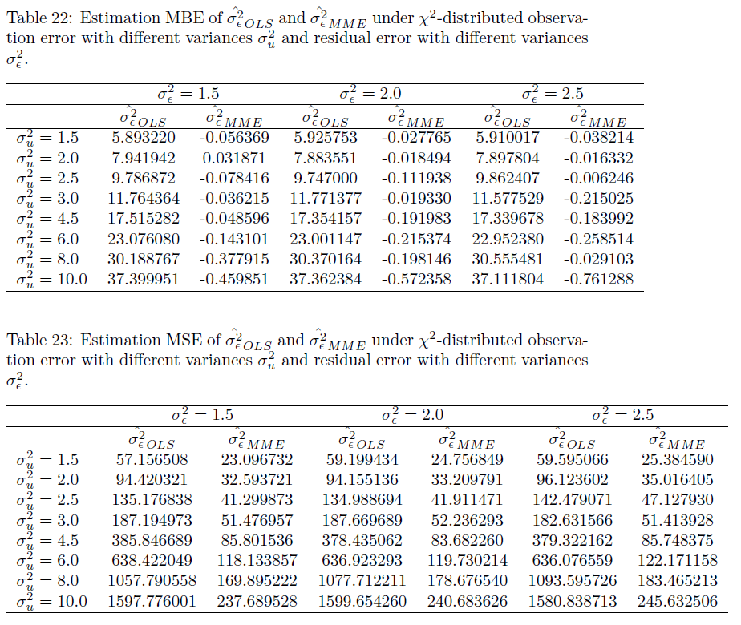
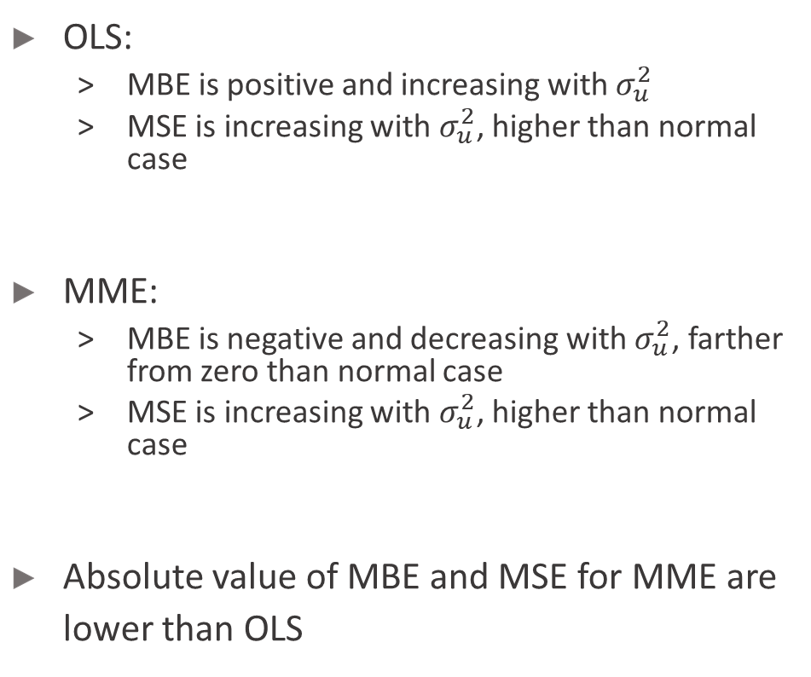
Re-centered $χ^{2}$-distributed measurement error and residual error
OLS:
MBE is positive and increasing with $σ_{u}^{2}$
MSE is increasing with $σ_{u}^{2}$, higher than normal case
MME:
MBE is negative and decreasing with $σ_{u}^{2}$, farther from zero than normal case
MSE is increasing with $σ_{u}^{2}$, higher than normal case
Absolute value of MBE and MSE for MME are lower than OLS

Slide 32
Conclusion

Slide 33
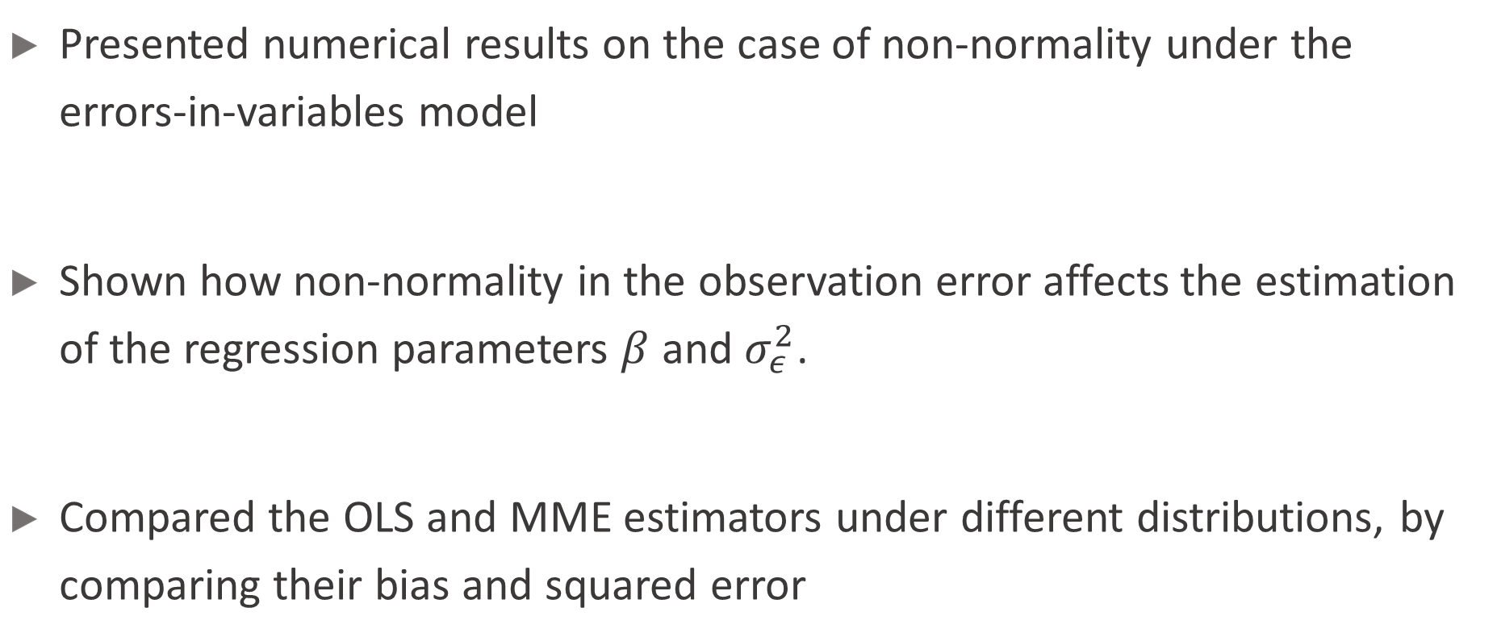
Conclusion
Presented numerical results on the case of non-normality under the errors-in-variables model
Shown how non-normality in the observation error affects the estimation of the regression parameters $β$ and $σ_{ε}^{2}$.
Compared the OLS and MME estimators under different distributions, by comparing their bias and squared error

Slide 34

Future work
Inference of statistical parameters under non-normality and measurement errors
Non-normality on multivariate errors-in-variables models
Other estimators of $β$ and $σ_{ε}^{2}$

Slide 35
Acknowledgments
Dr. Raymond W.L. Wong, for his support and guidance for this directed studies.
HKU Department of Statistics and Actuarial Science, for providing me with this opportunity to pursue in this directed studies capstone project.

Slide 36
Q&A

