Slide 1

G2M insight for Cab Investment firm
Exploratory Data Analytics Date: 23-March-2024

Slide 2

Agenda
Description
Executive Summary
Approach
EDA
EDA Summary
Recommendations

Slide 3
Description:
XYZ is a private equity firm in US. Due to remarkable growth in the Cab Industry in last few years and multiple key players in the market, it is planning for an investment in Cab industry.
Provide actionable insights to help XYZ firm in identifying the right company for making investment.
Cab Companies:
Yellow Cab
Pink Cab

Slide 4
Summary – G2M strategy for cab investment
Understand the market before investing in the cab sector using the Go-to-Market (G2M) method.
Go-to-market strategies typically focus on short-term objectives, but good ones evaluate how any initial success may be sustained in the long run.
Steps involved:
Data Understanding & Preparation
Exploratory Data Analysis (EDA)
Profit & Demand Analysis
Recommendations

Slide 5
Data Preparation:
There are 4 datasets:
Cab_Data.csv – includes details of transaction for 2 cab companies.
Customer_ID.csv – this is a mapping table that contains a unique identifier which links the customer’s demographic details.
Transaction_ID.csv – this is a mapping table that contains transaction to customer mapping and payment mode.
City.csv – this file contains list of US cities, their population and number of cab users.

Slide 6
EXPLORATORY DATA ANALYSIS

Slide 7
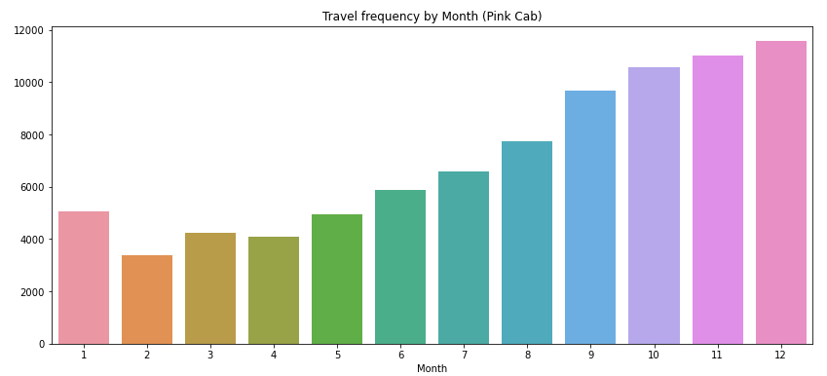
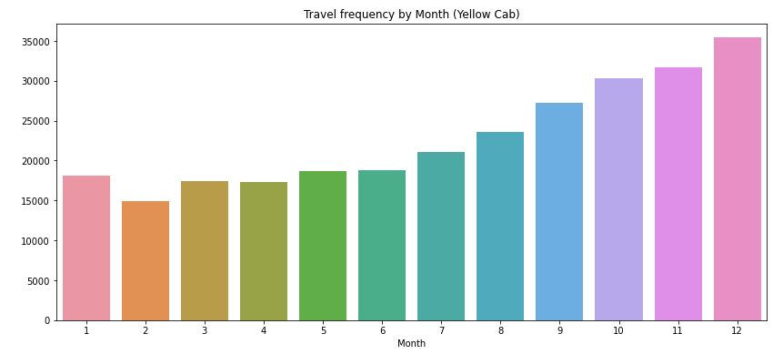
Travel Frequency per Month:
Yellow Cab has higher travels (35000) in the month of December which is the holiday season compared to Pink Cab (11000).

Slide 8
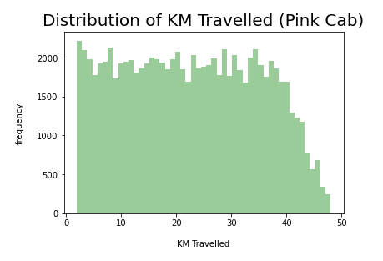
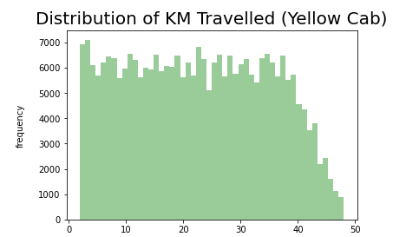
Distribution of KM Travelled for both Cabs:
From the above graphs, we can see that for both the Cabs most of the rides are in the range of approximately 2 to 48 KM.

Slide 9
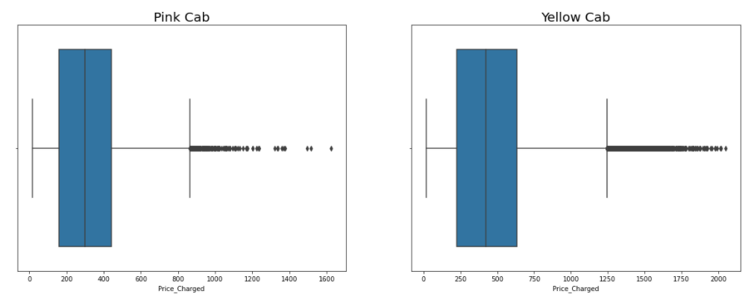
Distribution of Price Charged for both Cabs:
The Price Charge range for Yellow cab is more than the Pink cab.
The outliers are maybe due to use of high-end cars.

Slide 10
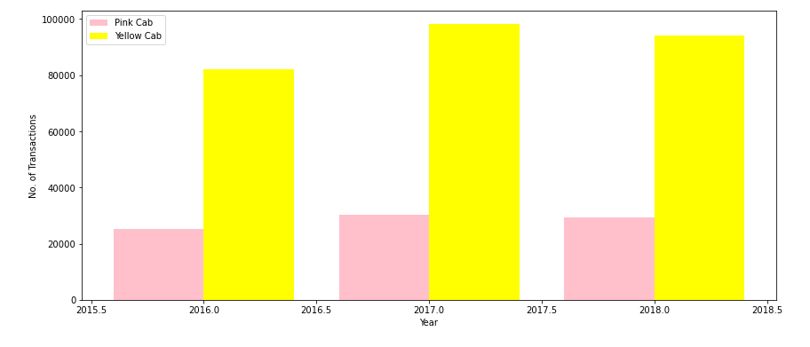
Transaction per Year for both Cabs:
From the graph it shows that on yearly basis no. of transactions for Yellow cab is higher than Pink cab.

Slide 11
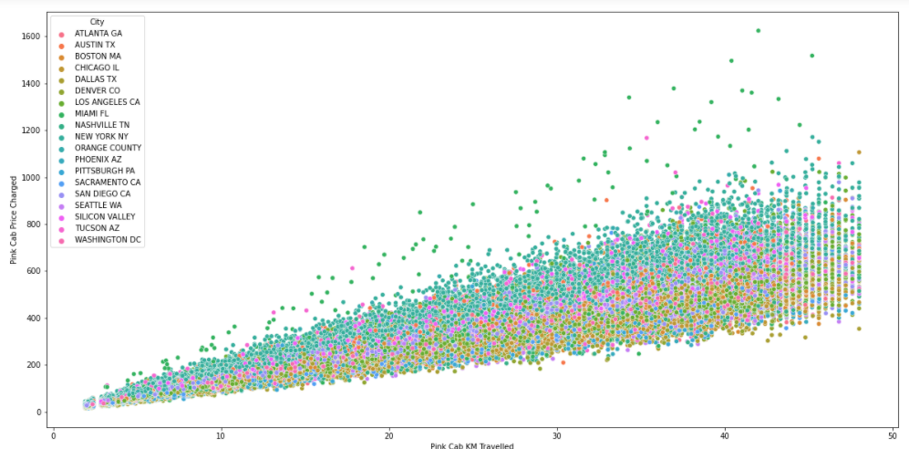
Pink Cab: Price Charged per KM per City
For Pink cab all the cities have the same increase in price charge with increase in distance

Slide 12
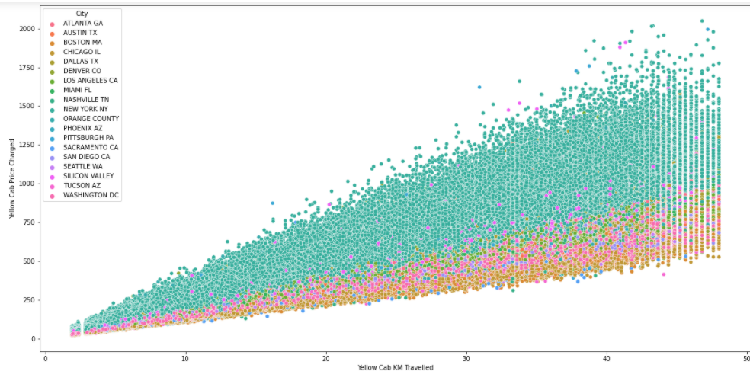
Yellow Cab: Price Charged per KM per City
In New York City the Price charged for Yellow Cab is more in comparison to the other cities

Slide 13
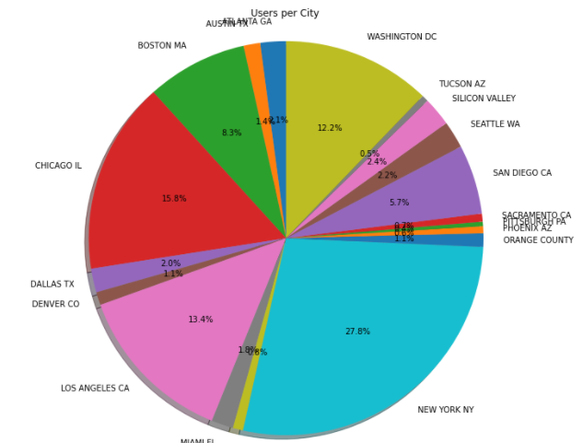
Cab Users per City:
New York City has the highest Cab users with 28% followed by Chicago with 16% and Los Angeles with 13%

Slide 14
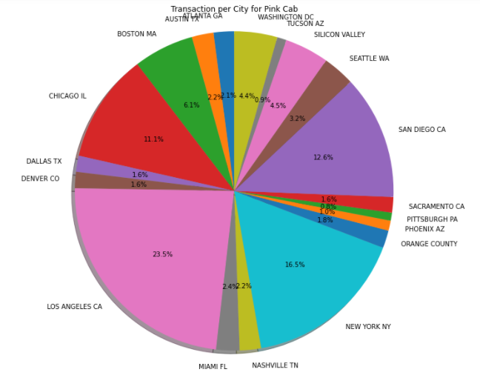
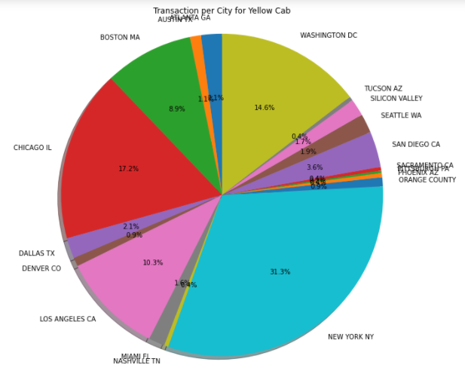
Transaction per City for both Cabs:
Transaction for Yellow Cab is highest in New York City(31.3%).
Transaction for Pink Cab is highest in Los Angeles City (23.5%).

Slide 15
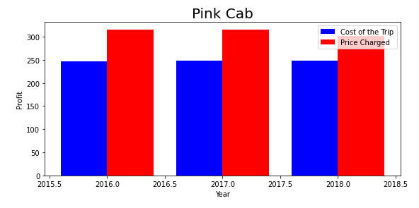
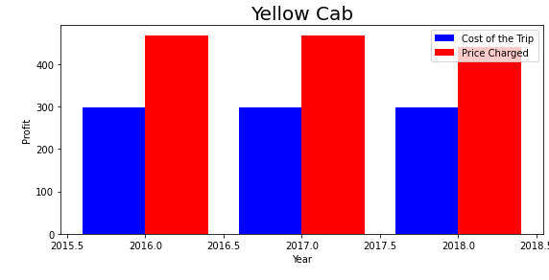
Profit Margin per year for both Cabs:
From the Graphs, it shows that the Yellow cab has a higher Profit Margin (Price Charged - Cost of Trip) compared to Pink cab.

Slide 16
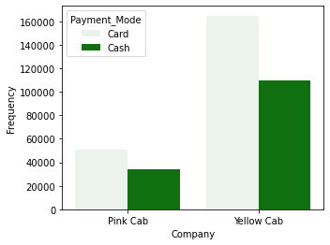
Company and Payment mode Analysis
The choice between card and cash transactions may reflect customer preferences.
Yellow cab has higher card transaction rate indicating they are technologically advanced.
Indicate that Yellow cab serves a broad spectrum of customers with varying payment preferences.
Yellow cab might have invested in efficient systems that allow for seamless processing of both card and cash transactions.

Slide 17
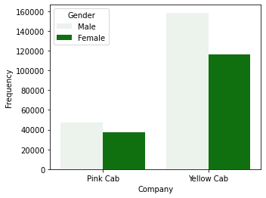
Company and Gender Analysis
From the graph it can be seen that customer base is higher for yellow cab than pink cab.
Building a brand that is inclusive and relatable to a diverse audience can enhance market appeal.
The higher number of male consumers can be due to the population base.
The marketing and branding strategies employed by both companies may inadvertently target or resonate more with male consumers.

Slide 18
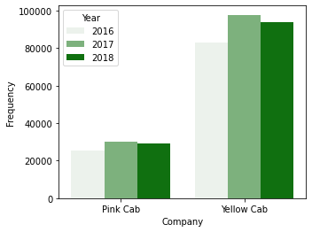
Yearly Cab Users Analysis
The increase in cab usage from 2016 to 2017 suggests potential market growth.
The graph suggests that the customer base of yellow cab is minimum 3 times higher than pink cab.
Higher usage in 2017 may be attributed to increased customer satisfaction or loyalty, potentially due to improved service quality or better user experiences.

Slide 19
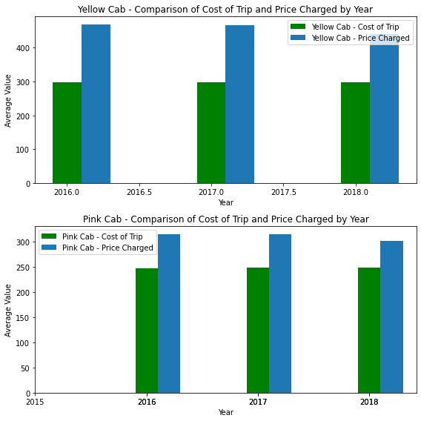
Profit Analysis

Slide 20
EDA SUMMARY

Slide 21


Rides - range of approximately 2 to 48 KM.
Rides - range of approximately 2 to 48 KM.
Price Charge - 150 to 450 dollars.
Price Charge - 250 to 600 dollars.
In December (holiday season) no. of travels was around 11000.
In December no. of travels was around 35000.
Transaction per year:
2016: 20000 – 40000
2017: 20000 – 40000
2018: 20000 – 40000
Transaction per year:
2016: 80000 – 100000
2017: 80000 – 100000
2018: 80000 – 100000
All the cities have the same increase in price charge with increase in distance.
In New York City the Price charged for Yellow Cab is more in comparison to the other cities.

Slide 22
Pink Cab charges same for both Male and Female Customers.
Yellow Cab charge less from Female Customers.
Female customers are around 20.5% out of the total Customers.
Female customers are around 25.5% out of the total Customers.
Profit Margin is low each year (2016-2018) compared to Yellow Cab.
Profit Margin is high each year (2016-2018) compared to Pink Cab.

Slide 23
Recommendations
Yellow cab has almost 3 times higher customer reach than pink cab.
Customers choose yellow cabs because they may offer advanced payment methods or several payment modes, which attract a wide range of customers.
Yellow cab has higher number of customers from both genders especially male when considering male/female gender reach which shows that yellow cab must be more inclusive as they are preferred more.
Average profit is 3 times higher for yellow cab when comparing their profit analysis.
From these above analysis and insights, we can recommend yellow cab for investment.

Slide 24
Thank You

