Slide 1
Genome Sequencing AI/ML Model
Srujana Vanka , Jewel Benny

Slide 2
Aim
To develop and deploy an AI/ML model/web app that is capable of accurately predicting from which location a particular sequence originated or spread from.
Black Box
Sequence
Location

Slide 3
Concept
Common Transmission Chains - In a given location, if multiple individuals are infected with the same viral strain and they pass it on to others in a similar way, a common transmission chain is established. This means that the virus is being transmitted locally within a specific geographic area.
Limited Introduction of New Variants – There may be limited introduction of new viral variants from outside the location. This is because most cases are linked by local transmission, and new variants have a lesser chance of being introduced from other locations.

Slide 4
Example
AACCAACCAACTTTCGATCTCTTGTAGATCTGTTCTCTAAACGAACTTTAAAATCTGTGTGGCTGTCACTCGGCTGCATGCTTAGTGCACTCACGCAGTATAATTAATAACTAATTACTGTCGTTGACAGGACACGAGTAACTCGTCTATCTTCTGCAGGCTGCTTACGGTTTCG…
ACCAACCAACTTTCGATCTCTTGTAGATCTGTTCTCTAAACGAACTTTAAAATCTGTGTGGCTGTCACTCGGCTGCATGCTTAGTGCACTCACGCAGTATAATTAATAACTAATTACTGTCGTTGACAGGACACGAGTAACTCGTCTATCTTCTGCAGGCTGCTTACGGTTTCGT…
Sample 1 - Karnataka
Sample 2 - Karnataka
CTTTCGATCTCTTGTAGATCTGTTCTCTAAACGAACTTTAAAATCTGTGTGGCTGTCACTCGGCTGCATGCTTAGTGCACTCACGCAGTATAATTAATAACTAATTACTGTCGTTGACAGGACACGAGTAACTCGTCTATCTTCTGCAGGCTGCTTACGGTTTCGTCCGTTTTGC…
ACTTTCGATCTCTTGTAGATCTGTTCTCTAAACGAACTTTAAAATCTGTGTGGCTGTCACTCGGCTGCATGCTTAGTGCACTCACGCAGTATAATTAATAACTAATTACTGTCGTTGACAGGACACGAGTAACTCGTCTATCTTCTGCAGGCTGCTTACGGTTTCGTCCGTTTTG…
Sample 3 - Delhi
Sample 4 - Delhi

Slide 5
Stakeholder Buy In
Public Health Authorities
Public health authorities would be interested in accurate predictions for disease spread. Early detection and containment of outbreaks can help them allocate resources efficiently and implement targeted interventions.
Healthcare Providers:
Hospitals and healthcare providers could benefit from timely information on the potential spread of diseases. This could assist in preparing for an influx of patients, managing resources, and implementing preventive measures.
Researchers and Scientists:
Researchers and scientists might find value in understanding the patterns of disease spread. Accurate predictions can contribute to epidemiological studies, which can enhance our understanding of infectious diseases and inform future research.
Academic Institutions:
Academic institutions could be interested in collaborating on research projects related to the development and improvement of AI/ML models for disease prediction. This could lead to academic publications and advancements in the field.

Slide 6
The Dataset – RCoV19
RCoV19 is a comprehensive collection of data related to the COVID-19 pandemic caused by the SARS-CoV-2 virus - https://ngdc.cncb.ac.cn/ncov/?lang=en
Created to facilitate research and analysis of the virus, its transmission, and its impact on public health.
Includes a wide range of information, such as epidemiological data, clinical data, genomic data, and more.

Slide 7
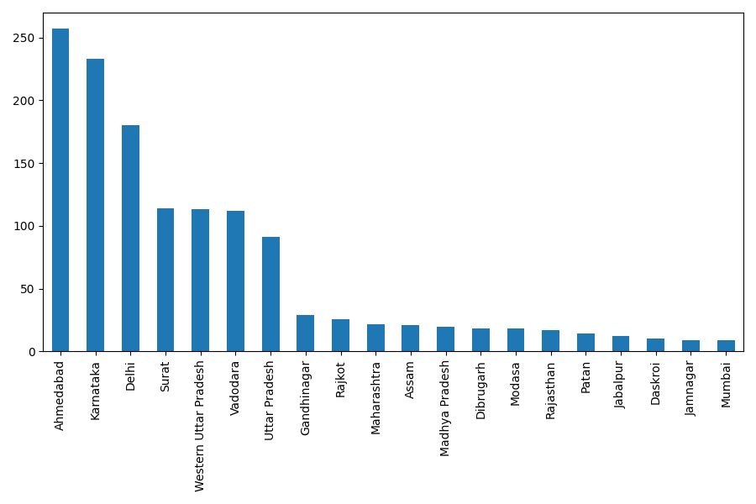
Location Distribution
The location distributions are largely unbalanced.

Slide 8
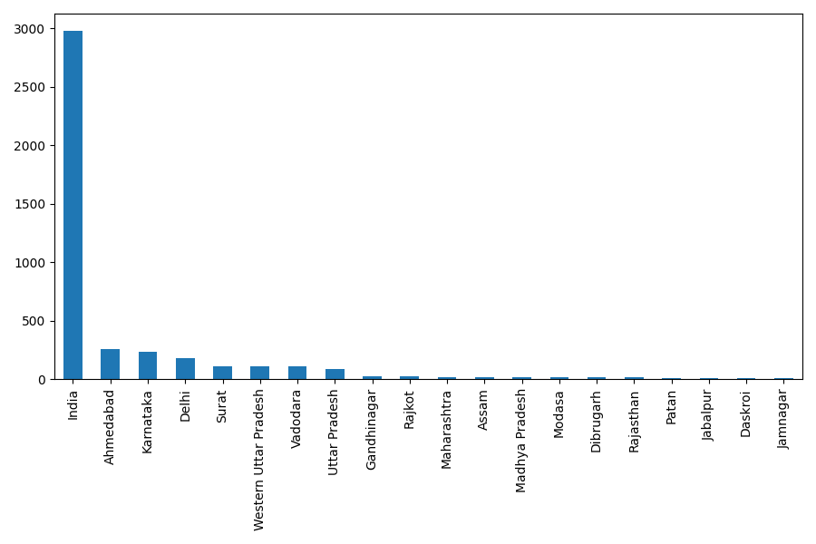
Location Distribution
The location distributions are largely unbalanced.

Slide 9
The Dataset – EpiCoV
EpiCoV19 is a comprehensive collection of data related to the COVID-19 pandemic caused by the SARS-CoV-2 virus – https://gisaid.org/
Used with permission (doi: 10.55876/gis8.231206fs) https://epicov.org/epi3/epi_set/231206fs
FASTA dataset is 230GB!!
Drawback is that either the entire dataset must be downloaded or in sets of maximum 10000 samples.

Slide 10
EpiCoV – Some Quick Facts
~16,309,260
SARS-COV-2 sequences
~9428
Locations
~297,203
SARS-COV-2 sequences sampled from India
1
2
3

Slide 11
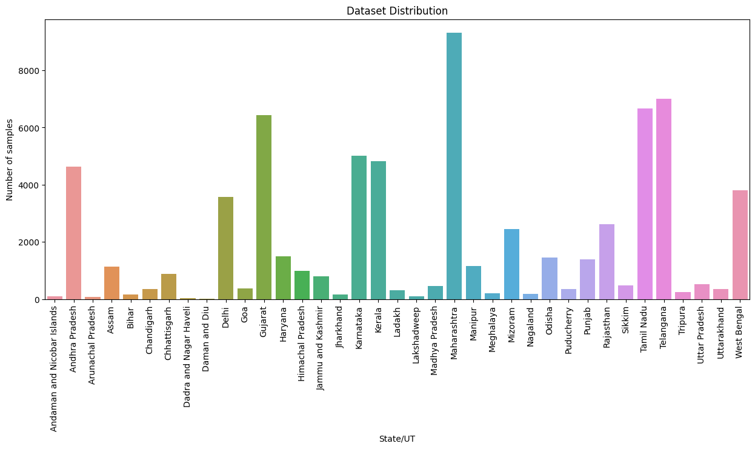
Location Distribution
Dataset used was a subset with 70151 samples, with samples from 37 states/ union territories.

Slide 12
Software System

Slide 13
System Flow Diagram

Slide 14
Functional Requirements
Frontend
ReactJS
Simple, responsive UI
Backend
Python
FastAPI
AI/ML Model
Tried and tested out around 10 different models.
Dataset
The sourced dataset was converted into FASTA, csv and txt formats for testing.
Ready to Dockerize and deploy!

Slide 15
Non-Functional Requirements
Usability
Simple, intuitive UI that anyone can use.
Performance
ML model was chosen to deliver a good balance of prediction speed and accuracy.
Scalability
Sequences with even millions of bases can be uploaded.
Security
Login page

Slide 16

UI Demo

Slide 17
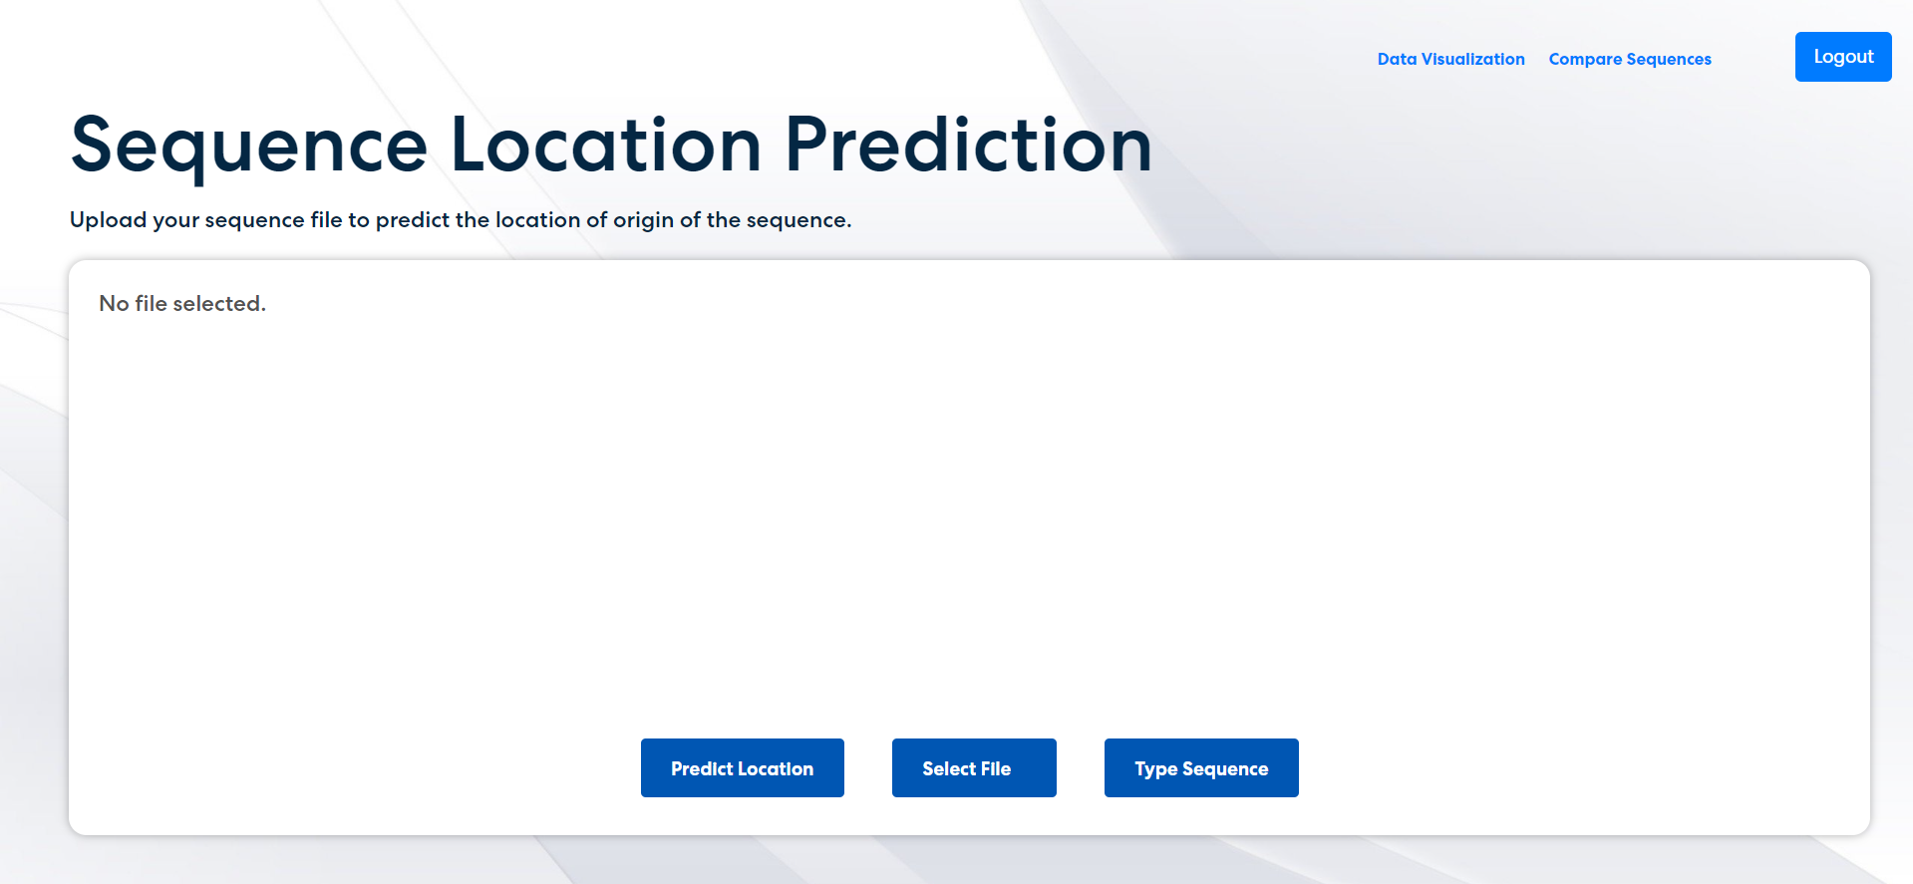
UI Demo
You can upload .fasta, .txt files or even type in the sequence!!

Slide 18
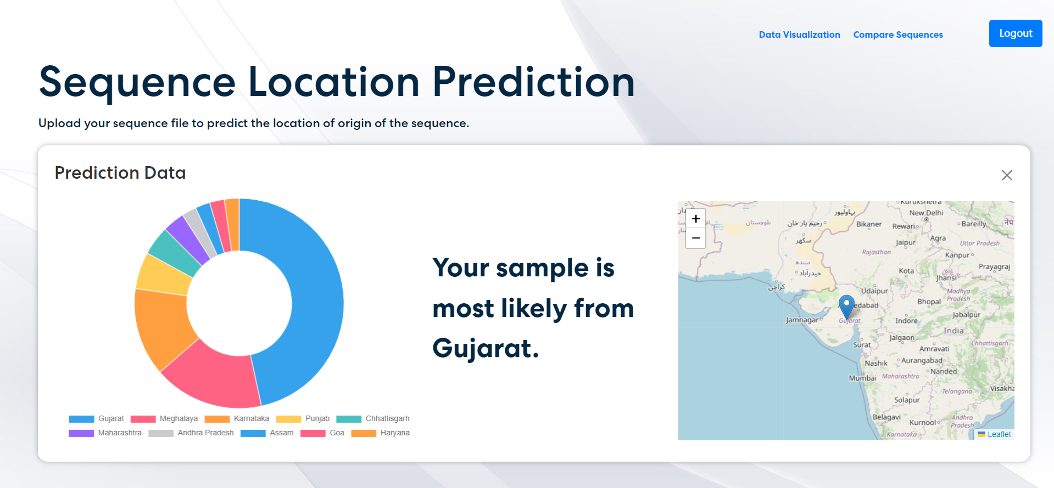
UI Demo
Pie chart that displays probabilistic location prediction…
The most likely location is shown on an interactive map..

Slide 19
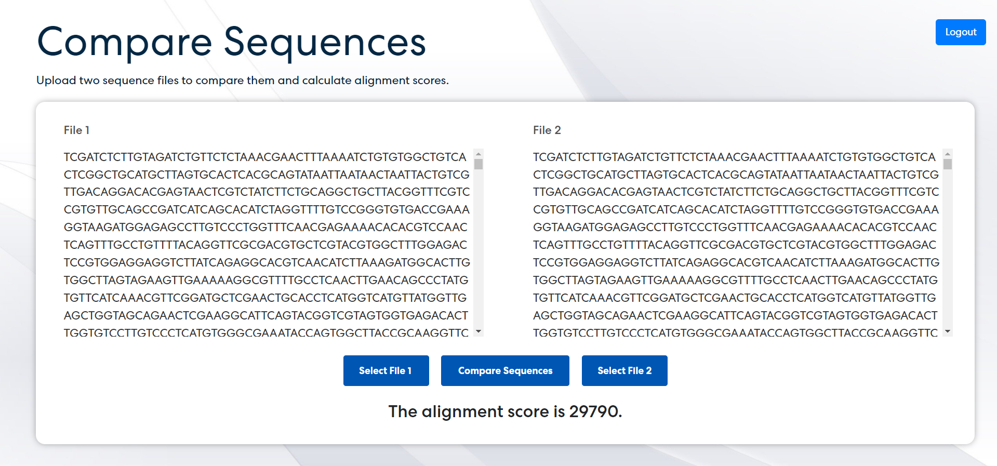
UI Demo

Slide 20
Backend and ML Model

Slide 21
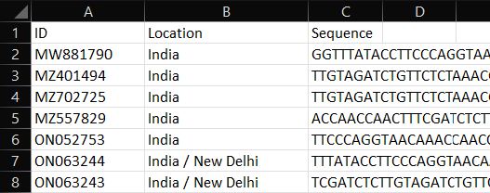
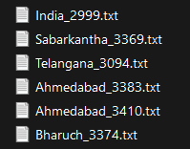
Data Preprocessing
BioPython is a library for biological computation in Python.
Data preprocessing –
Splitting the FASTA dataset into each individual sequences
FASTA to .txt conversion
FASTA to .csv conversion
Merging of metadata with sequence data with key as ID
.csv dataset
.txt dataset

Slide 22
ML Model
K-Merize
The sequence is split into K-mers. For example, if K=3 and the sequence is AATGC, the K-Mers are AAT, ATG and TGC.
1
Convert to N-Grams
The K-Mers are split into N-grams. For example, if the K-Mers are AAT, ATG and TGC; and N=2, the N-grams are AAT ATC and ATG TGC. This preserves some ordering present in the original sequence.
2
Vectorize Using Count Vectorizer
The tokens are the N-grams. The tokens are vectorized using a bag of words model (count vectorizer).
3
Classify Using Suitable Classifier
The vectors are used to train a location classifier. The classifier predicts the location of test samples.
4

Slide 23
Classifier Models
Multiple models were tested, namely –
Bayes Classifier
Logistic Regression
Random Forest
Support Vector Classifier
K Nearest Neighbours
Decision Tree
Multi-Layer Perceptron
Gradient Boosting Classifier
Ada Boost Classifier
Deep Learning

Slide 24
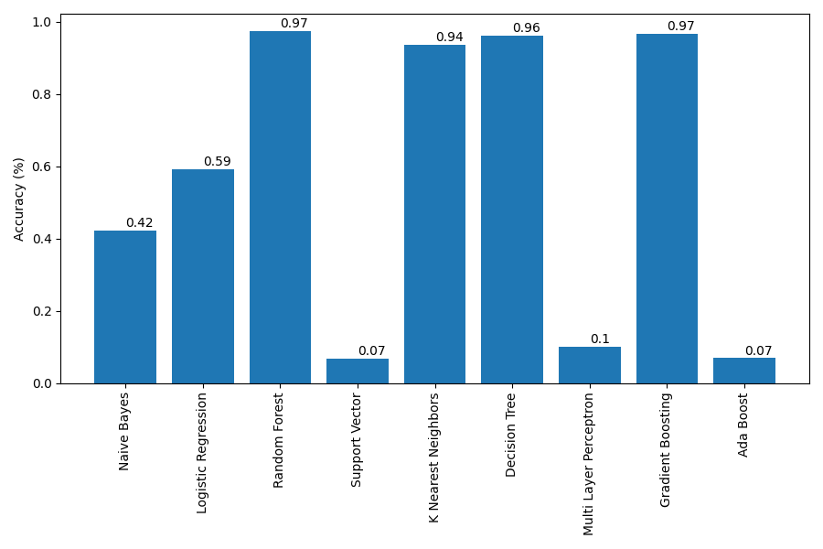
Classifier Accuracy Comparison
Random forest classifier provided the best accuracy of 97% (old dataset).

Slide 25
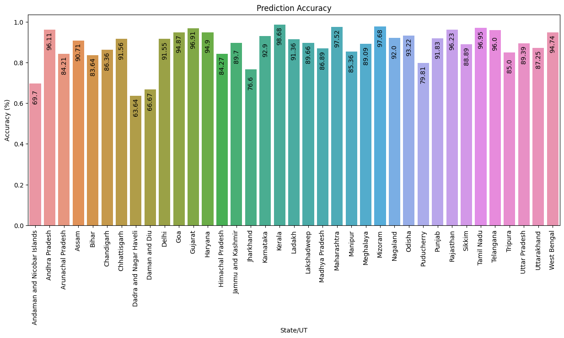
Random Forest Classifier Accuracy
Random forest classifier provided the best accuracy of 94.8% (new dataset).
Low accuracy due to small sample size

Slide 26
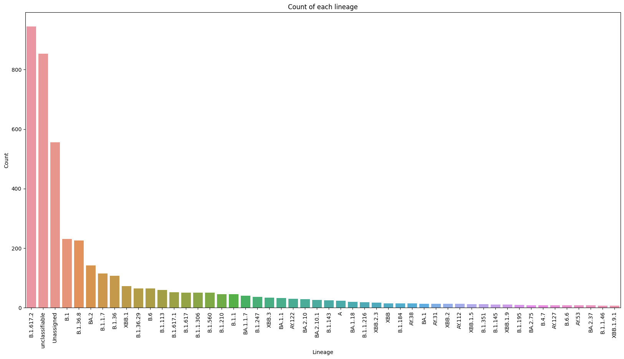
Lineage Analysis
B.1.617.2 (Delta)
(First identified in India)
B.1
(Omicron)
BA.2, BA.2.75
(Omicron subvariant)
B.1.617 and its subvariants were the most dominant in India.

Slide 27
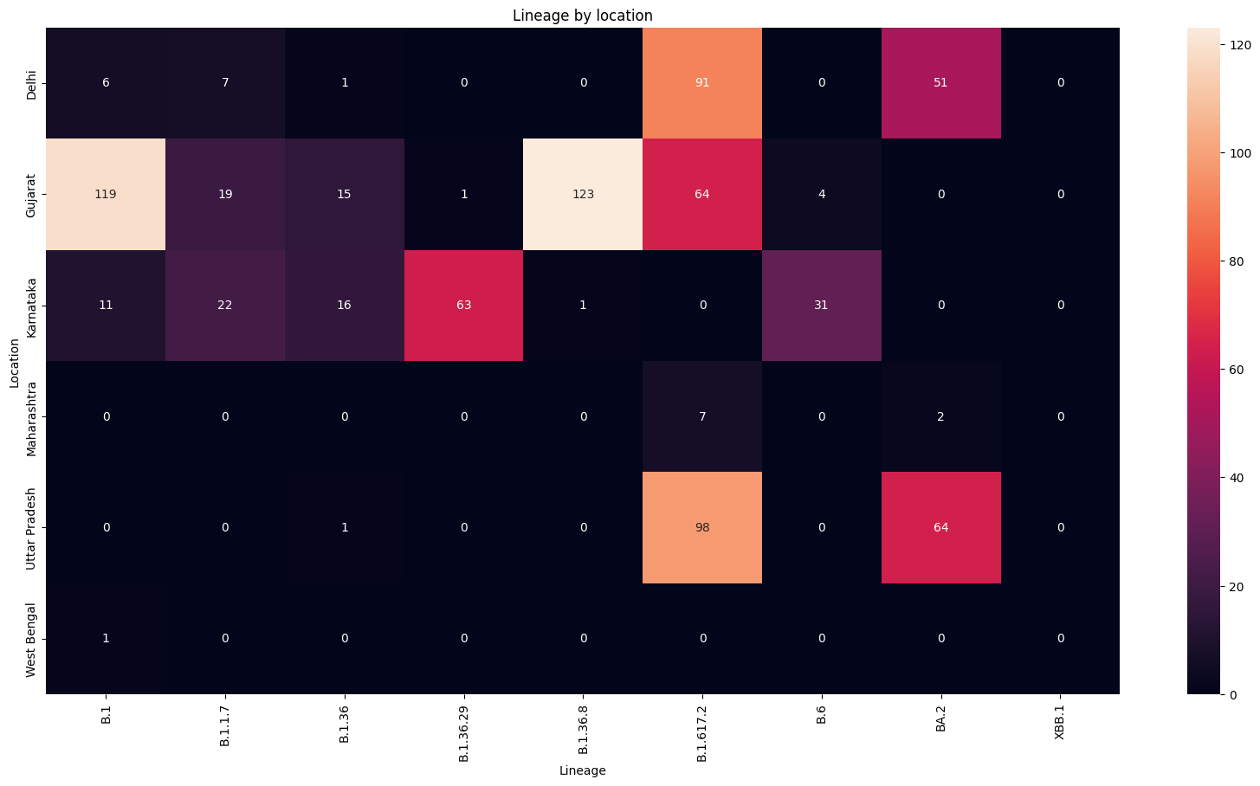
Lineage Analysis
Omicron cases start to spread in Gujarat

Slide 28
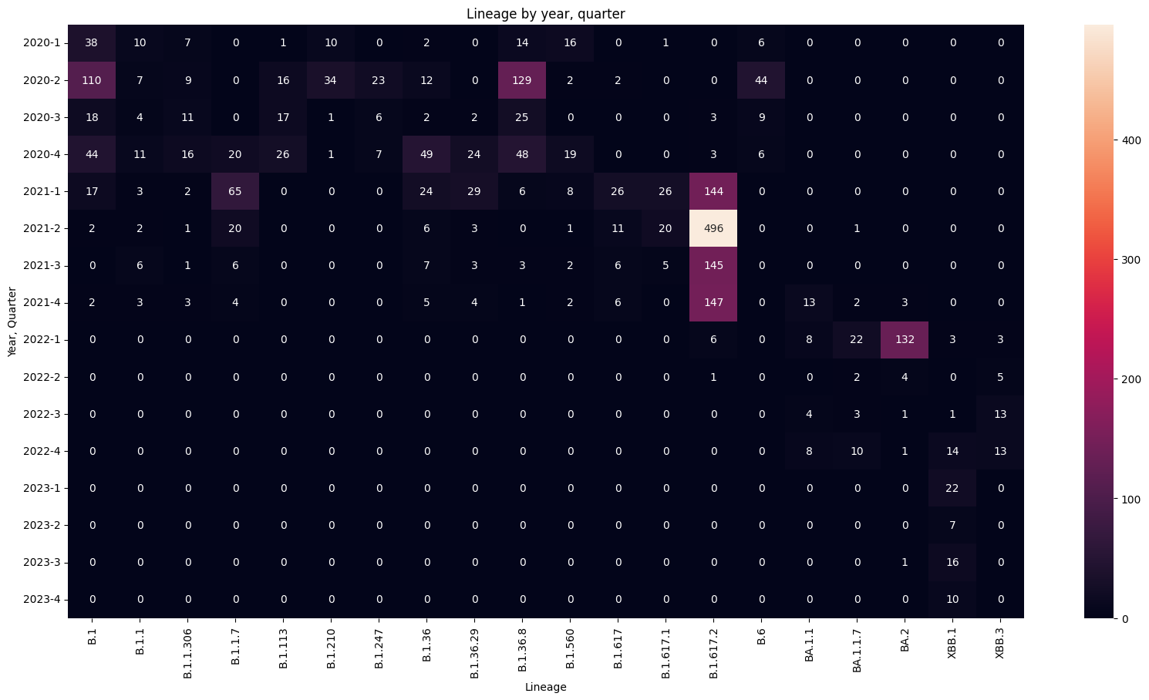
Lineage Analysis
Delta variants spread a lot in 2021
Omicron variants dominated from early 2022

Slide 29

Timeline
1
2
3
4
September
Team formation, project allocation and initial efforts
October
Dataset scraping, initial model training and testing
November
Frontend and backend development, shifting to new dataset and model training
December
Frontend and backend integration, optimization and model fine tuning

Slide 30
Challenges Faced
Due to the length of sequences (30 kilobases), the feature dimensionality needed for model training is very high (~2000).
Better accuracy can be obtained if dimensionality is increased but this amount of computation is not possible on a personal computer.
Full dataset is 230GB! Processing this in Python would prove to be difficult due to memory constraints.

Slide 31
Thank you

