Slide 1
Mobile Application Development Lab Course Code: CSE-3212

Slide 2
Prerequisite
Programming Knowledge
Java or Kotlin
Integrated Development Environment (IDE)
Java Development Kit(JDK) & Android Software Development Kit (SDK)
Version Control Systems (GIT & GitHub)

Slide 3
Development Break-down
Frontend
Backend
Full-stack

Slide 4
Frontend Development
React Native
It was created by Facebook and allows developers to build native mobile apps(iOS and Android) using JavaScript/TypeScript and the React library.
Java with Android SDK
Required knowledge of Java programming language
Kotlin with Android SDK
Required knowledge of Kotlin programming language
Flutter
Popular open-source user interface (UI) toolkit developed by Google. It is used for building natively compiled applications for mobile, web, and desktop platforms from a single codebase.
Required knowledge of Dart programming language

Slide 5
Backend
PHP+Laravel
Python + Django
Java+SpringBoot
NodeJS + Express JS

Slide 6


Environment Setup (IDE)
Must Have Installed JAVA JDK
Must Have Installed JAVA JDK
Intellij IDEA
Ultimate- subscriptions
Community - free
Light-weight
Android Studio - free
Heavy-weight
Required more RAM

Slide 7

Environment Setup (API Testing) - POSTMAN
For Using the API’s without Frontend
For Testing the API’s

Slide 8



Environment Setup (Database)
MySQL DB (XAMPP)
PostgreSQL DB (recommanded)
MySQL Workbench

Slide 9
JAVA OOP

Slide 10
Encapsulation
Encapsulation is one of the core principles of Object-Oriented Programming (OOP) that aims to bundle data and methods together within a class
Hiding the internal implementation details from external access.
It provides control over access to the class members and promotes data integrity and security.
In Java, encapsulation is achieved through the use of access modifiers and getter/setter methods.

Slide 11
Polymorphism
Polymorphism in object-oriented programming (OOP) refers to the ability of objects of different classes to be treated as objects of a common superclass.
In Java, polymorphism is achieved through method overriding and method overloading.

Slide 12
Method overriding
Method overriding allows a subclass to provide a specific implementation of a method that is already defined in its superclass.
The overridden method in the subclass can have the same name, return type, and parameters as the method in the superclass.
When a method is called on an object, Java determines the actual
type of the object at runtime and invokes the appropriate overridden
method.

Slide 13
Method overloading
Method overloading, on the other hand, allows multiple methods with the same name but different parameters to co-exist in the same class.
The methods must have different parameter lists, which can differ in the number of parameters, types of parameters, or both.
When a method is called, Java determines the best match for the method based on the arguments provided.

Slide 14
Inheritance
In object-oriented programming (OOP), inheritance is a mechanism that allows a class to acquire properties (methods and fields) from another class.
It enables the creation of a hierarchy of classes, where a subclass inherits the characteristics of its superclass.

Slide 15
Abstraction
In Java object-oriented programming (OOP), abstraction refers to the process of simplifying complex systems by representing them at a higher level of abstraction.
Abstraction is achieved through the use of abstract classes and interfaces
An abstract class is a class that cannot be instantiated and is meant to be subclassed.
It can contain both abstract and non-abstract methods.

Slide 16
Getting Started Backend Development with Spring Boot

Slide 17
Why spring boot?
Easy and Quick Setup
Convention over Configuration
Microservices-Friendly
Robust Ecosystem
Production-Ready Features
Strong Community and Support

Slide 18
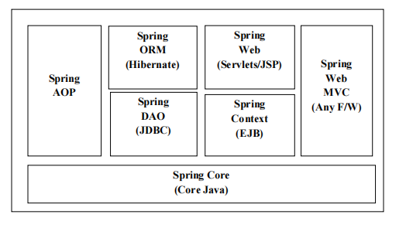
Modules of Spring Framework/ Spring Boot

Slide 19
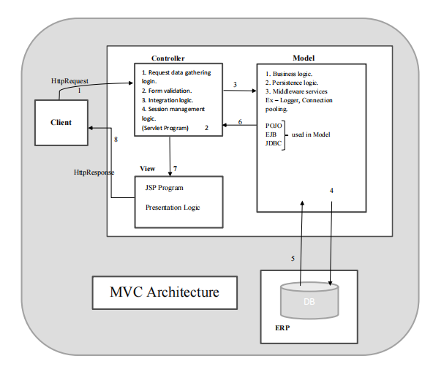
MVC Architecture of Spring Boot

Slide 20
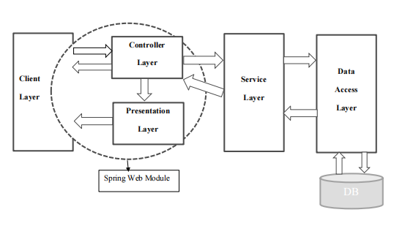
Enterprise Application Architecture

Slide 21
Spring Beans and Container
Spring Beans
Beans are Java objects managed by the Spring container.
Spring Container
The Spring container is responsible for instantiating, configuring, and assembling the Spring beans.
It manages application life cycle from birth to death.

Slide 22
Spring Application Context
Application context is the central container for managing and wiring beans (objects) within a Spring-based application.
It provides the infrastructure and services necessary for creating, configuring, and managing beans.
The most commonly used ApplicationContext implementations are −
1. **FileSystemXmlApplicationContext**
2. **ClassPathXmlApplicationContext**
3. **WebXmlApplicationContext**

Slide 23
Bean Loading Strategies
There are two types of bean loading strategies:
Lazy loading- Bean is only created when it is first requested (On Demand)
Eager loading - Beans are created at application startup

Slide 24
Spring Beans Scope
The scope of a bean defines the life cycle and visibility of that bean in the context.
The latest version of the Spring framework defines 6 types of scopes:
singleton - The singleton scope creates a single instance of the bean per Spring IoC container. This bean is cached and reused for all requests for the bean within the container. This is the default scope in Spring.
prototype - The prototype scope creates a new instance of the bean each time it is requested from the Spring IoC container. This scope is useful when you want to create a new object for each request.

Slide 25
Spring Beans Scope
request -The request scope creates a new instance of the bean for each HTTP request. This scope is useful in web applications where you want to create a new object for each request.
session - The session scope creates a new instance of the bean for each HTTP session. This scope is useful in web applications where you want to create a new object for each session.
application - The application scope creates a single instance of the bean for the entire web application. This scope is useful when you want to create a shared object for all users of the application.
WebSocket - The web socket scope creates a new instance of the bean for each WebSocket session. This scope is useful in web applications that use WebSocket communication.

Slide 26
External configuration
Application Properties – By default, Spring Boot searches for the application properties file or its YAML file in the current directory, classpath root, or config directory to load the properties.
Command-line properties – Spring Boot provides command-line arguments and converts these arguments to properties. Then it adds them to the set of environment properties.
Profile-specific properties – These properties are loaded from the application-{profile}.properties file or its YAML file. This file resides in the same location as that of the non-specific property files and the{profile} placeholder refers to an active profile.

Slide 27
Spring Boot Annotation
Annotations are special markers that you can apply to classes, methods, or fields to provide additional metadata and instructions to the Spring framework.
Here are some commonly used Spring Boot annotations:
1. @SpringBootApplication: This annotation is typically placed on the main class of a Spring Boot application. It combines three commonly used annotations: `@Configuration`, `@EnableAutoConfiguration`, and `@ComponentScan`. It enables auto-configuration and component scanning within the package and its sub-packages.
2. @RestController: This annotation is used to mark a class as a RESTful controller. It combines the functionality of `@Controller` and `@ResponseBody` annotations. It is commonly used to build RESTful APIs.
ment and configuration.

Slide 28
Spring Boot Annotation
3. @RequestMapping: This annotation is used to map HTTP requests to specific methods or classes. It can be applied at the class level to define a base URI for all methods in the class or at the method level to specify a specific URI for a method.
4. @GetMapping, @PostMapping, @PutMapping, @DeleteMapping: These annotations are specialized versions of `@RequestMapping` and are used to map HTTP GET, POST, PUT, and DELETE requests to specific methods or classes, respectively.
5. @PathVariable: This annotation is used to bind a method parameter to a path variable in a URI. It is commonly used in RESTful APIs to extract dynamic values from the URI.

Slide 29
Spring Boot Annotation
6. @RequestParam: This annotation is used to bind a method parameter to a query parameter in the request URL. It is commonly used to extract query parameters from HTTP requests.
7. @Autowired: This annotation is used to automatically wire dependencies by type. It can be applied to fields, constructors, or setter methods. It enables dependency injection and reduces the need for manual bean wiring.
8. @Qualifier: This annotation is used along with `@Autowired` to specify the qualified bean name when multiple beans of the same type are present.

Slide 30
Spring Boot Annotation
9. @Configuration: This annotation is used to define a class as a configuration class. It is commonly used with `@Bean` annotations to define and configure beans.
10. @Bean: This annotation is used to declare a method as a bean producer. It is typically used within a `@Configuration` class to define beans that can be injected into other parts of the application.
11. @Component: This annotation is used to mark a class as a Spring component. It is a generic stereotype annotation that can be used with any class. Spring will automatically detect and instantiate these components during application startup.

Slide 31
Dependency Injection (DI)
The process of injecting/pushing/initialization to dependencies into an object (Dependent Object) is known as Dependency Injection.
Inversion of Control (Ioc)
It is a design principal
It is an external entity of DI i.e. injecting the dependency into dependent object.
Spring container performs the Dependency Injection with IOC.

Slide 32
Examples

Slide 33
Thank You

