Slide 1
"Unveiling the Shadows of History: Exploring the Largest Dataset of Slave Records Online to Quantify the Human Toll of the Americas' Slave Trade Industry"

Slide 2
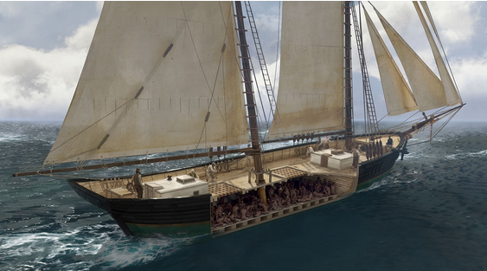
The Slave Trade has left an indelible mark on history,, shaping societies and cultures worldwide. This presentation offers a profound analysis of the trade's impact, from its origins to its enduring legacy.

Slide 3

Origins of the Slave Trade
The transatlantic and trans-Saharan slave trades were driven by the demand for labor in the Americas and the Arab world. This led to the forced migration of millions of Africans, resulting in profound social and economic consequences.

Slide 4
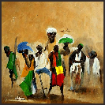
Impact on African Societies
The slave raids and inter-tribal warfare disrupted African societies, leading to the loss of skilled labor and intellectual capital. This had long-lasting effects on political structures and cultural traditions.

Slide 5
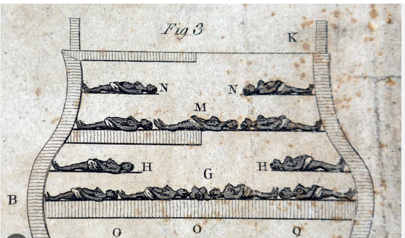
Middle Passage
The Middle Passage was a harrowing journey for enslaved Africans,, marked by overcrowding, disease, and brutality. The dehumanizing conditions aboard slave ships underscore the inhumanity of the trade.

Slide 6
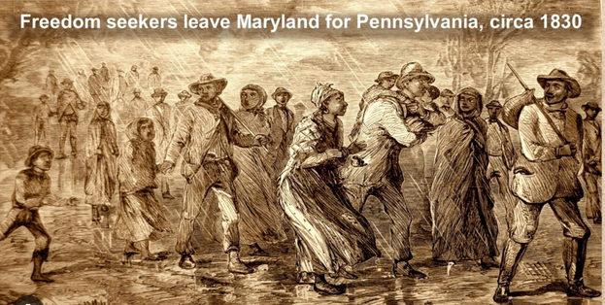
Enslaved individuals demonstrated remarkable resilience through acts of resistance and revolts, challenging the oppressive system of slavery and inspiring future movements for liberation.

Slide 7

The legacy of the slave trade is evident in the enduring racial inequalities and social disparities that persist in many societies.. Understanding this legacy is essential for addressing the ongoing impact of historical injustices..

Slide 8

Economic Implications
The slave trade fueled the economic growth of European powers and the development of the Americas, but it also perpetuated inequality and exploitation.. Examining its economic implications sheds light on the roots of modern global economic disparities.

Slide 9
Historical Analysis of the Slave Trade
My Rpub Published Data Science paper will explore the largest data set of slave records online and calculate the total amount of humans trafficked and sold to the Americas slave trade industry.

Slide 10

Remembering the Victims
Honoring the memory of the millions of individuals who suffered and perished in the slave trade for acknowledging the depth of human suffering and the resilience of the human spirit..

Slide 11
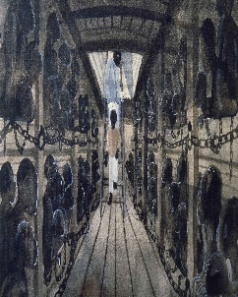
Conclusion
The profound historical analysis of the slave trade reveals the enduring impact of this dark chapter in human history. By acknowledging its legacy and honoring the resilience of enslaved individuals, we can strive for a more just and equitable future.
Publish Paper
https://rpubs.com/jewelercart/slavevoyagesanalysis

