Slide 1
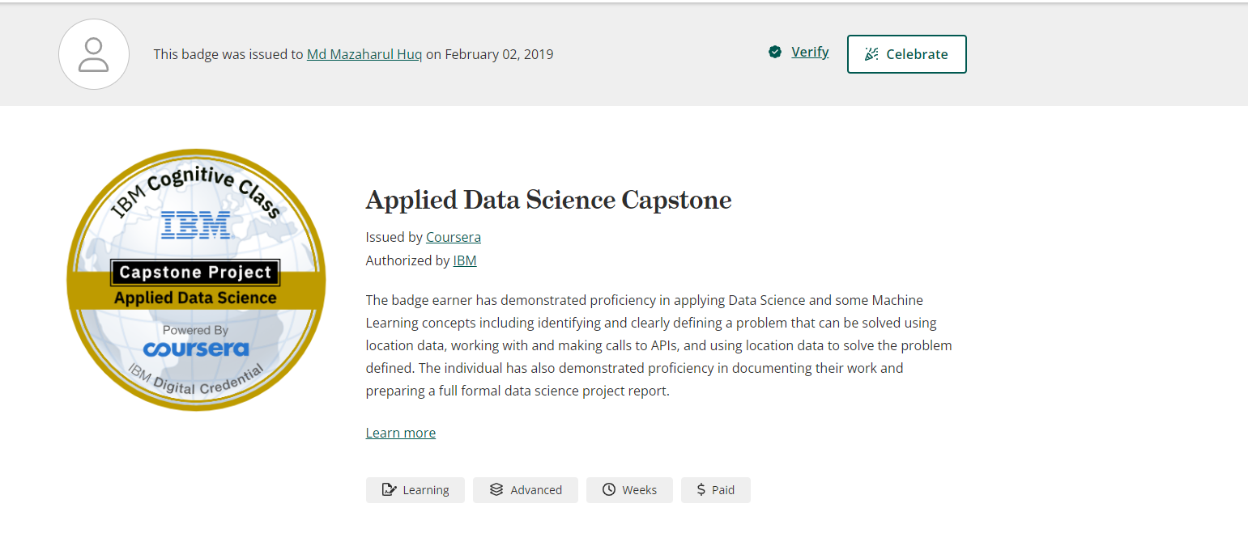
EMPLOYEE OF THE MONTH
Awarded to
{name}
for a stellar performance for the month of January
February 04, 20XX
Aiko Wantanabe, Manager
Date

