Slide 1

Hierarchical Representation Learning
Fan Feifan
2015-12-03
Notes:
Good afternoon, everyone, My name is Fan Feifan, I come from Peking University, Today my report title is improving microblog retrieval with feedback entity model.

Slide 2
Outline
Review: Hierarchical Neural Language Model for Joint Representation of Streaming Documents and their content (WWW’15)
E-commerce in Your Inbox: Product Recommendations at Scale (KDD’15)
Context- and Content-aware Embeddings for Query Rewriting in Sponsored Search (SIGIR’15)
Learning Hierarchical Representation Model for Next Basket Recommendation (SIGIR’15)
Notes:
Now we simply introduce the related work
Query expansion based on pseudo-relevance feedback is widely used in microblog search to improve the retrieval performance. It is based on an assumption that most of the frequent terms in the pseudo-relevance documents are useful.
While that doesn’t always hold in reality. So some work integrated a term classification process to predict the effectivess of expanded terms.
Likely, other work utilized a first-stage manual tweet selection feedback
Some other works tried to acquire knowledge from external sources such as wikipedia and freebase.

Slide 3
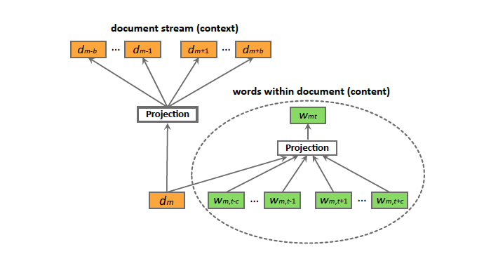

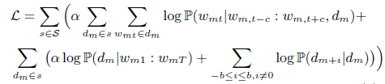

Review
Hierarchical Language Model
Notes:
Motivation
Loss function
Movie genre classification, document retrieval, keyword suggestion, document tag recommendation

Slide 4


Slide 5
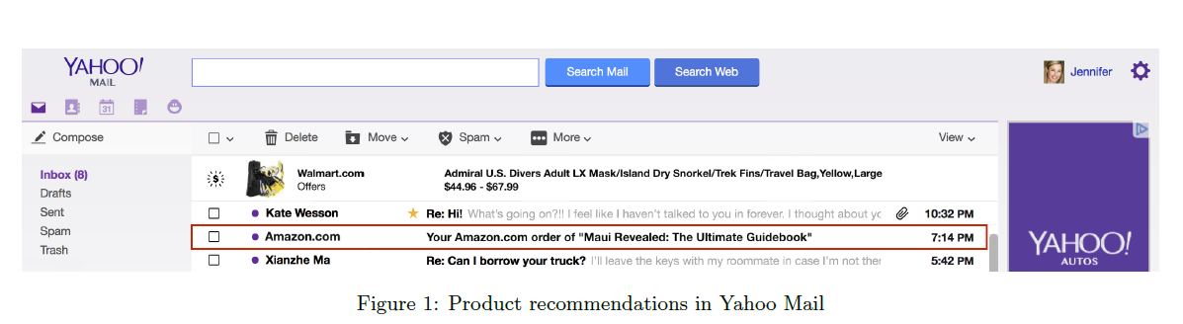
E-commerce in Your Inbox
Motivation
Hundreds of millions of people in the world visit their e-mail inboxes daily
checking utility bills, reading newsletters and tracking purchases
tailor ads to the tastes of each individual: improve user experience, loyalty and retention
only 10% human-generated, >22% about online shopping
Challenge
MRT: mail retargeting: need more detailed data
email receipt extraction brings opportunity through product advertising to users based on their individual purchase history
Notes:
Now we simply introduce the related work
Query expansion based on pseudo-relevance feedback is widely used in microblog search to improve the retrieval performance. It is based on an assumption that most of the frequent terms in the pseudo-relevance documents are useful.
While that doesn’t always hold in reality. So some work integrated a term classification process to predict the effectivess of expanded terms.
Likely, other work utilized a first-stage manual tweet selection feedback
Some other works tried to acquire knowledge from external sources such as wikipedia and freebase.

Slide 6
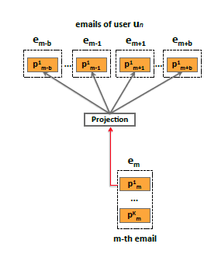
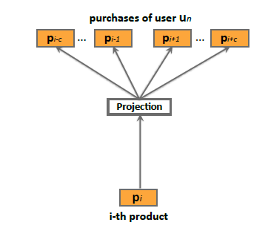
E-commerce in Your Inbox
Proposed Approach
Given a set S of e-mail receipt logs obtained from N users
Low-dimensional Product embeddings
prod2vec
bagged-prod2vec
Notes:
1. bagged-prod2vec: 考虑到不同的产品可能被同时购买

Slide 7


E-commerce in Your Inbox

Slide 8
E-commerce in Your Inbox
Product-to-product predictive models
Having learned low-dimensional product representations:
prod2vec-topK
Given a purchased product, the method calculates cosine similarities with all other products
prod2vec-cluster
more diverse: cluster similar products into clusters (K-means)
select top similar products from top related clusters
Notes:
Now we simply introduce the related work
Query expansion based on pseudo-relevance feedback is widely used in microblog search to improve the retrieval performance. It is based on an assumption that most of the frequent terms in the pseudo-relevance documents are useful.
While that doesn’t always hold in reality. So some work integrated a term classification process to predict the effectivess of expanded terms.
Likely, other work utilized a first-stage manual tweet selection feedback
Some other works tried to acquire knowledge from external sources such as wikipedia and freebase.

Slide 9
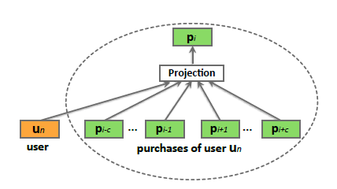
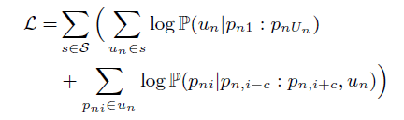

E-commerce in Your Inbox
User-to-product predictive models
user2vec
Notes:
Now we simply introduce the related work
Query expansion based on pseudo-relevance feedback is widely used in microblog search to improve the retrieval performance. It is based on an assumption that most of the frequent terms in the pseudo-relevance documents are useful.
While that doesn’t always hold in reality. So some work integrated a term classification process to predict the effectivess of expanded terms.
Likely, other work utilized a first-stage manual tweet selection feedback
Some other works tried to acquire knowledge from external sources such as wikipedia and freebase.

Slide 10
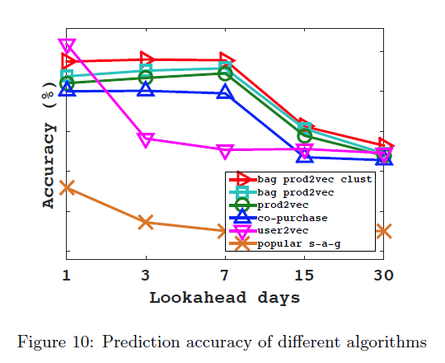
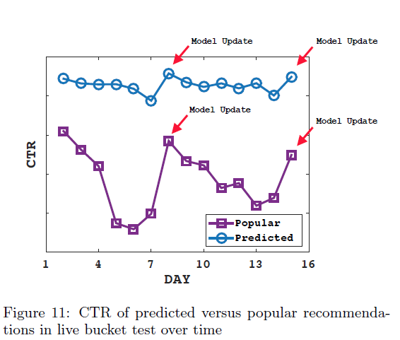
E-commerce in Your Inbox
Recommending popular products
Recommending predicted products
prod2vec-topK
bagged-prod2vec-topK
bagged-prod2vec-cluster
user2vc
co-purchase
Notes:
Now we simply introduce the related work
Query expansion based on pseudo-relevance feedback is widely used in microblog search to improve the retrieval performance. It is based on an assumption that most of the frequent terms in the pseudo-relevance documents are useful.
While that doesn’t always hold in reality. So some work integrated a term classification process to predict the effectivess of expanded terms.
Likely, other work utilized a first-stage manual tweet selection feedback
Some other works tried to acquire knowledge from external sources such as wikipedia and freebase.

Slide 11
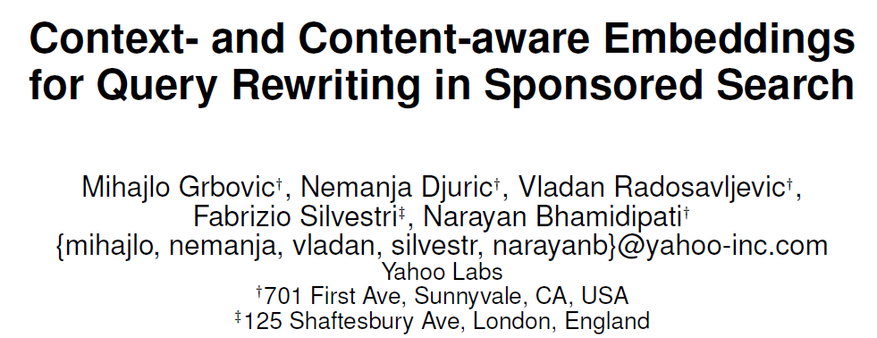

Slide 12
Context- and context-aware embedding
Motivation
ads targeting
A query is issued all advertisers with a matching keyword
they bid for the query and the winner gets to show their ad
while a query may not match many keywords, resulting in lower auction value, lower ad quality and lost revenue for advertisers and publishers
expand query into a set of related queries and use them to increase the number of matched ads (query rewriting)
Notes:
Now we simply introduce the related work
Query expansion based on pseudo-relevance feedback is widely used in microblog search to improve the retrieval performance. It is based on an assumption that most of the frequent terms in the pseudo-relevance documents are useful.
While that doesn’t always hold in reality. So some work integrated a term classification process to predict the effectivess of expanded terms.
Likely, other work utilized a first-stage manual tweet selection feedback
Some other works tried to acquire knowledge from external sources such as wikipedia and freebase.

Slide 13
Context- and context-aware embedding
Methodology
Given a set S of search sessions obtained from online users
each session is defined as an uninterrupted sequence of queries
Models
context2vec
content2vec
context-content2vec
Notes:
1. Query summarization

Slide 14
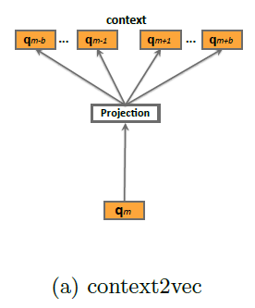


Context- and context-aware embedding
context2vec
Note search session as “sentence”, queries within the session as words
Notes:
1. Query summarization

Slide 15
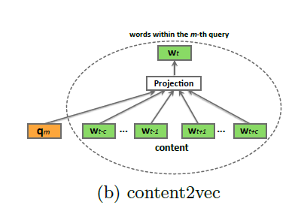
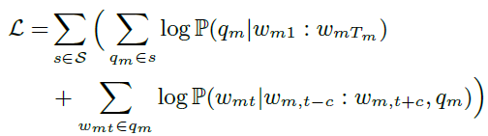


Context- and content-aware embedding
content2vec
Note query as “sentence”
Notes:
1. Query summarization

Slide 16
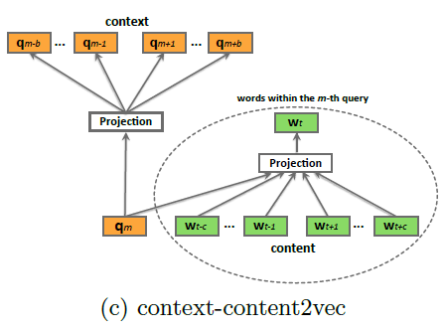
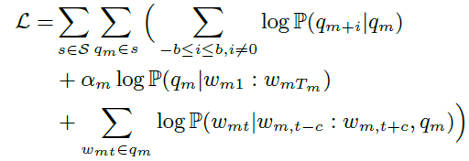
Context- and content-aware embedding
Context-content2vec
Two layer architecture
upper layer: temporal context of query sequence
bottom layer: content information of word sequences found within queries
Notes:
1. Query summarization

Slide 17
Context- and content-aware embedding
Ad clicks and search links clicks
In a search session, queries are often accompanied by ad clicks and search link clicks
rewrite queries to match as many bid items as possible
extend the session data set by adding click events to user sessions
adding search link clicks to the user sessions
Notes:
1. Query summarization

Slide 18
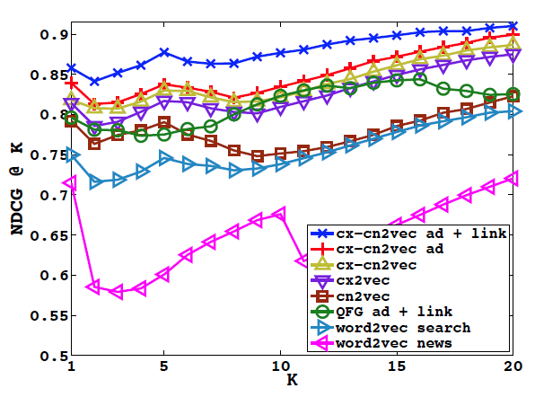
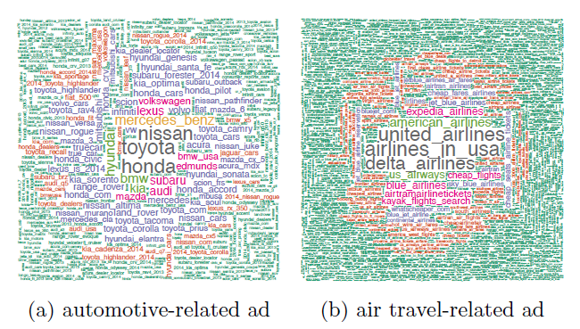
Context- and content-aware embedding
Compared methods
word2vec_{news}
word2vec_{search}
content2vec
context2vec
context-content2vec
cx-cn2vec_{ad}
cx-cn2vec_{ad+link}
QFG_{ad+link} (using a click-flow graph)
Notes:
1. Query summarization

Slide 19


Slide 20
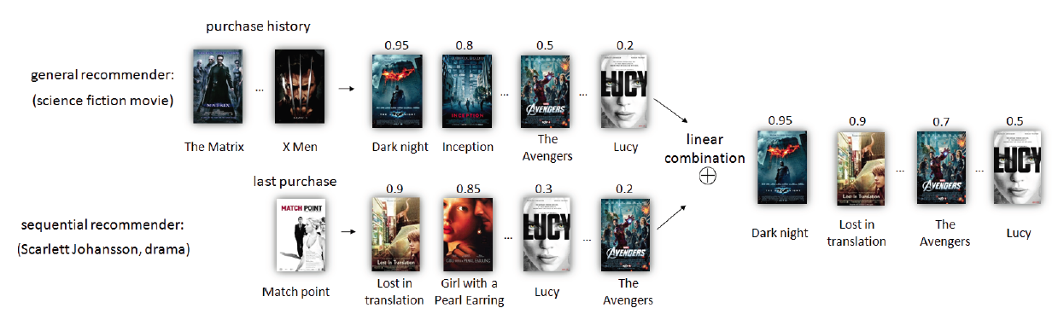
Next Basket Recommendation
Motivation
Next basket recommendation
Sequential recommender, mostly relying on Markov chains
predicting the next purchase based on the last actions
can capture the sequential behavior
general recommender, discard any sequential information
Based on collaborative filtering (i.e. matrix factorization models)
capture the general taste of the user by learning the user’s whole purchase history
Should be together: both sequential behavior and users’ general taste
FPMC: factorizing personalized Markov chains
model sequential behavior (interaction between items in the last transaction and the item in the next basket
model general taste: (interaction between items in the last transaction and the item in the next basket)
linear combined
Notes:
Now we simply introduce the related work
Query expansion based on pseudo-relevance feedback is widely used in microblog search to improve the retrieval performance. It is based on an assumption that most of the frequent terms in the pseudo-relevance documents are useful.
While that doesn’t always hold in reality. So some work integrated a term classification process to predict the effectivess of expanded terms.
Likely, other work utilized a first-stage manual tweet selection feedback
Some other works tried to acquire knowledge from external sources such as wikipedia and freebase.

Slide 21


Next Basket Recommendation
Formalization
Let
Let I =
For each user u, a purchase history
purchase history of all user:
given the history of user u, the task is to recommend the next visit:
Notes:
1. Query summarization

Slide 22
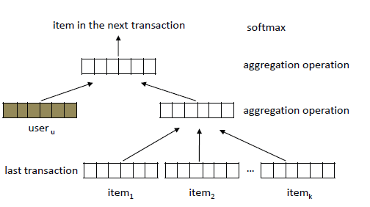


Next Basket Recommendation
Hierarchical representation model (HRM)
all the user vectors:
all the item vectors:

Slide 23

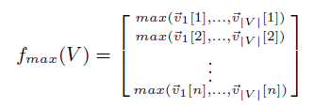
Next Basket Recommendation
Typical aggregation operations
average pooling
linear operation: assume the independence among input representations in forming higher level representation.
max pooling
Nonlinear operation: only those most significant features will be selected to the next level.
HRM_{avgavg}, HRM_{maxavg}, HRM_{avgmax}, HRM_{maxmax}

Slide 24

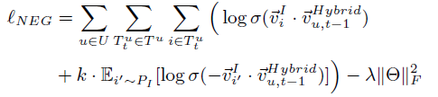
Next Basket Recommendation
Learning and Prediction
HRM maximizes the log probability:
the goal of next basket recommendation is to derive a ranking model:
negative sampling to optimize the function
maximize the probability of observed item i
minimize the probability of unobserved item i’

Slide 25
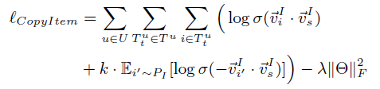


Next Basket Recommendation
Connection to previous models
HRM vs Markov Chain Model
special aggregation operation: select-copy
PMI: (Pointwise mutual information)
Factorized Markov Chain Model [23]

Slide 26
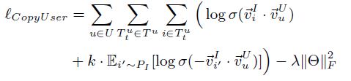

Next Basket Recommendation
Connection to previous models
HRM vs Matrix Factorization Model
only use select-copy on the second layer
the user-item matrix is factorized where the association between a user and a item is measured by shifted PMI

Slide 27
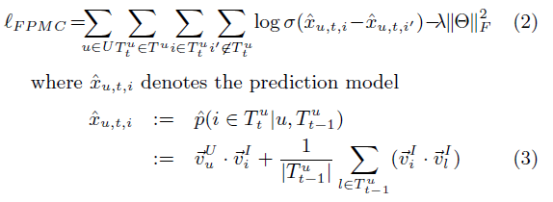
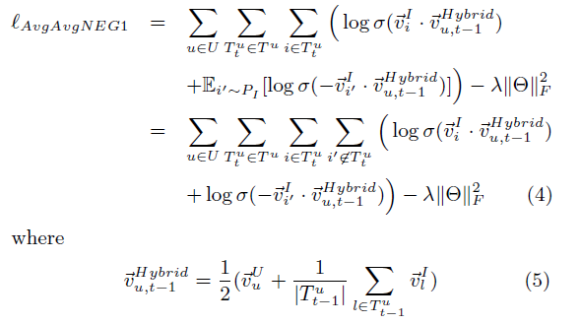
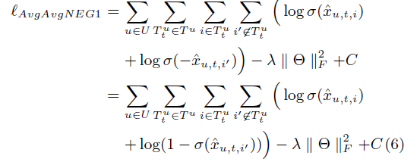
Next Basket Recommendation
Connection to previous models
HRM vs FMPC
FMPC
HRM

Slide 28
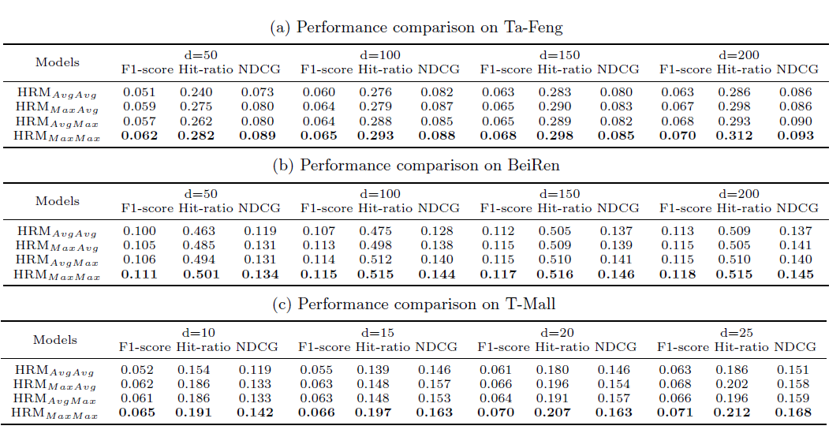
Next Basket Recommendation
Experiments

Slide 29
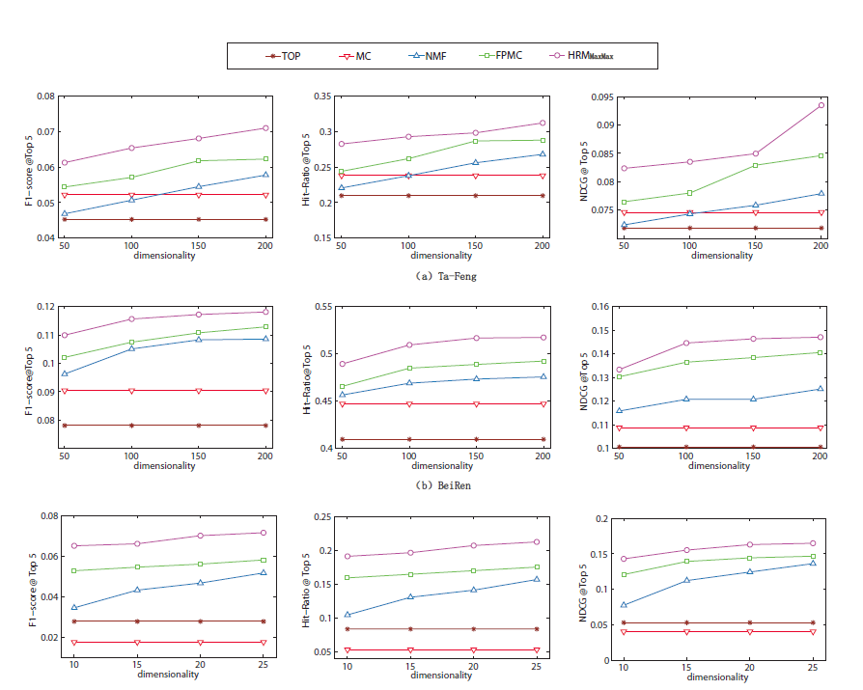
Next Basket Recommendation
Experiments

Slide 30
Thanks!

