Slide 1
WWW15:Hierachical Neural Language Models for Joint Representation of Streaming Documents and their content
Main Contributions
Take advantage of the context of document sequences and the context of each word within a document to learn vector representations
Capture inherent connections between documents in the data stream
Learning framework is flexible and it is straight-forward to add more layers in order to learn additional representations for related concepts

Slide 2

Review: Neural language models
Assumption: for n-gram models, words closer in a sequence are statistically more dependent.
A neural language model learns the probability distribution of next word given a fixed number of preceding words (context)
Objective of the model is to maximize log-likehood of the sequence:

Slide 3




Review: Continuous bag-of-words
Simplified neural language model without any non-linear hidden layer
CBOW is to maximize the log-likehood:
The probability is defined using the softmax:

Slide 4



Review: Skip-gram model
Skip-gram model tries to predict the surrounding words within a certain distance based on the current one
The objective function is to maximize the log-likehood:

Slide 5
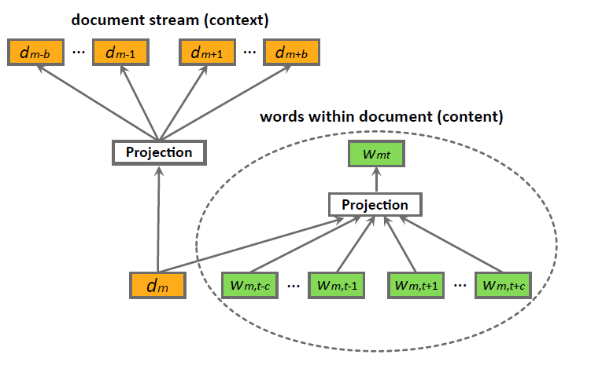
Hierarchical Language Model
Model the probability of observing a particular document by taking into account its temporally-close documents

Slide 6

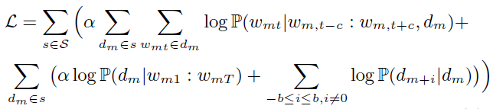

Model architecture
The architecture consists of two embedded layers
The upper layers learns the temporal context of a document sequence, based on the assumption that temporally closer documents in a document stream are statistically dependent.
The bottom layer models the contextual information of word sequences.
Objective of the model is to maximize the log-likehood:

Slide 7





Variants of the model
Feed-forward models
Feed-backward models
Additional user layer on top of the document layer
Model optimization:

Slide 8
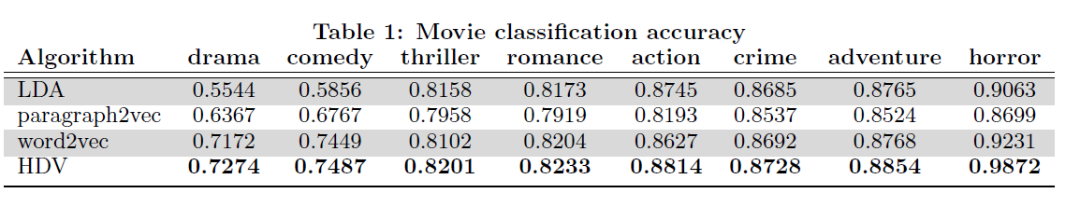
Experiments
Movie genre classification
View movies as documents
Remove low-rated movies
Order them in a sequence according to the timestamp of the rating
SVM

Slide 9
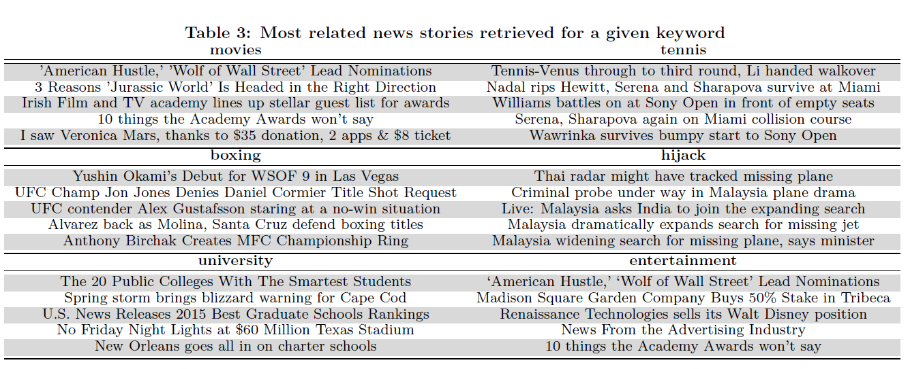
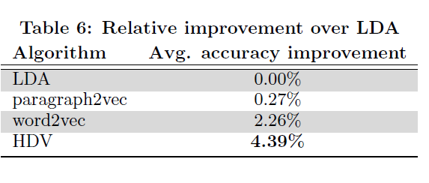
Large-scale document representation
Keyword suggestion
Document retrieval
Document tag recommendation
Document recommendation
News topic classification

Slide 10
PTE:Predictive Text Embedding through large-scale heterogeneous Text Networks
Main contribution
Learn predictive text embeddings in a semi-supervised manner. Unlabeled data and labeled data information are integrated into a heterogeneous text network.
Propose an efficient algorithm “PTE”, which embedded the heterogeneous text network into a low dimensional space
Construct extensive experiments using various real word data sets

Slide 11
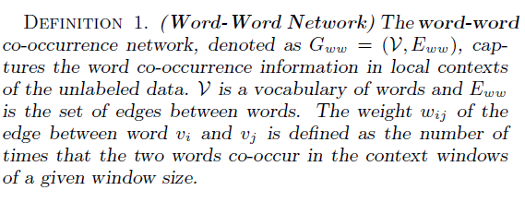
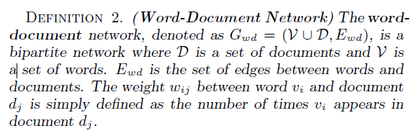
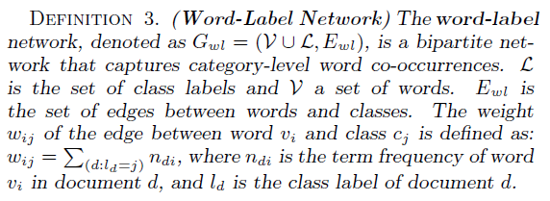
Problem Definition
Goal is to learn a representation of text that is optimized for given text classification task
Basic idea is to incorporate both the labeled and unlabeled information when learning embeddings

Slide 12
Heterogeneous Network
Combination of word-word, word-document and word-label networks constructed from both unlabeled and labeled text data.
Predictive Text Embedding
Aims to learn low dimensional representations of words by embedding the heterogeneous text network

Slide 13



Bipartite Network Embedding
LINE is mainly designed for homogeneous networks as weights on different types of edges are not comparable
Make use of the second-order proximity between vertices, which assumes vertices with similar neighbors are similar to each other
, the conditional probability of is:

Slide 14
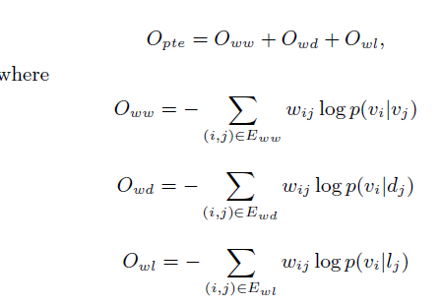
Heterogenous Text Network Embedding
Minimize the objective function:

Slide 15
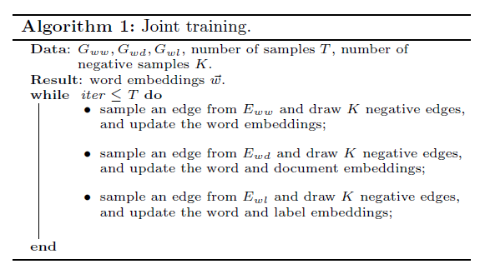
Heterogenous Text Network Embedding
Joint training: train the model with unlabeled data (word-word, and word-document networks) and the labeled data simultaneously

Slide 16
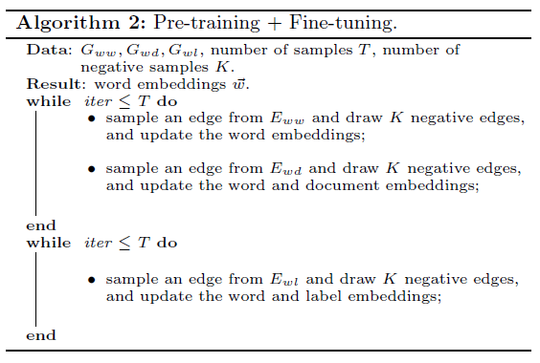
Heterogenous Text Network Embedding
Pre-training and fine-tuning: learn the embeddings with unlabeled data first, and then fine-tune the embeddings with the word-label network

Slide 17
Experiments
Datasets
Long Document Corpora
20NG, WIKI, IMDB, RCV
Short Document Corpora
DBLP, MR, Twitter
Compared Algorithms
BOW
Skip-gram
PVDBOW
PVDM
LINE
CNN
PTE

Slide 18
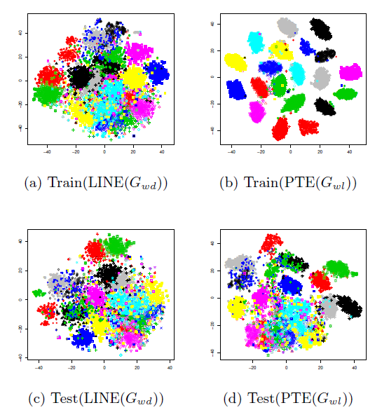
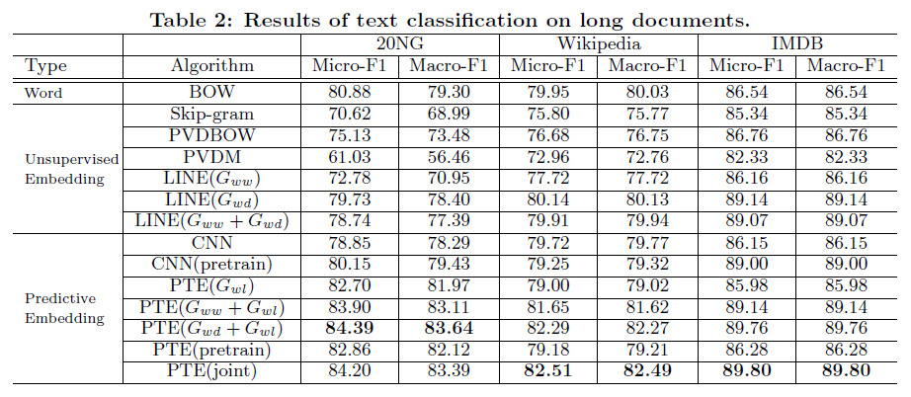
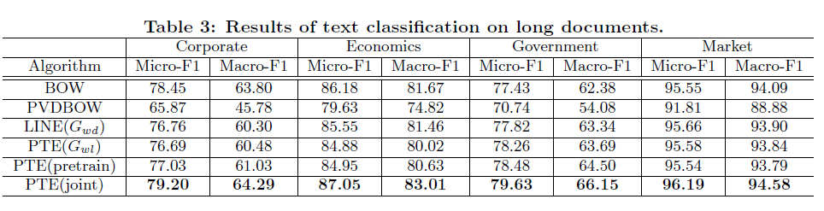
Results

