Slide 1


Knowledge-based Query Expansion in Real-Time Microblog Search
Chao Lv, Runwei Qiang, Feifan Fan and Jianwu Yang
Peking University
Notes:
Hi, everyone. My name is Lv Chao, I come from Peking University.
Today my report title is Knowledge-based Query Expansion in Real-Time Microblog Search.

Slide 2
Outline
Motivation
Related Work
Approach
Experiment
Conclusion
Notes:
I will introduce our work from five parts.
First I will introduce the motivation and related work.
Then I will discuss our approach and experiment detailedly.
In the last, I will conclude our work.

Slide 3
Outline
Motivation
Related Work
Approach
Experiment
Conclusion
Notes:
Now, motivation.

Slide 4



Motivation
Twitter
200 million users
50 million tweets per day
Weibo
360 million users
110 million tweets per day
Find what user cares
Notes:
With the rapid growth of microblog, more and more users post tweets on the internet,
and they tend to search tweets for some specific topics they care.
Hence improving the microblog retrieval performance is very important to enhance the user experience.

Slide 5
Motivation
Challenge 1 – Vocabulary Mismatch
Due to the length limitation, relevant tweets may not contain words in query
Vocabulary Mismatch
Query
Expansion
Notes:
In contrast to traditional web search, real-time microblog search has to face to the problem of severe vocabulary mismatch.
Since the tweets are very short, there is a large risk that query terms fail to match any words in relevant tweets.

Slide 6
Motivation
Challenge 1 – Vocabulary Mismatch
Due to the length limitation, relevant tweets may not contain words in query
Vocabulary Mismatch
Query
Expansion
Challenge 2 – Recency Preference
Users prefer to recent tweets than old ones
Recency
Preference
Temporal
Evidence
Notes:
Besides, real-time search usually indicates the information need concerning something that is happening right now.
So, search engine should trade off between the recency and relevance.

Slide 7
Outline
Motivation
Related Work
Approach
Experiment
Conclusion
Notes:
Now we simply introduce the related work

Slide 8
Related Work
Query Expansion
Query expansion based on pseudo-relevance feedback (PRF) [SIGIR2011, JCDL2012]
widely used in microblog search
Assumption: most of the frequent terms in the pseudo-relevance documents are useful
Selecting good expansion terms for pseudo-relevance feedback [SIGIR2008]
Using dempster-shafers evidence theory for query expansion based on freebase knowledge [IRT2013]
Query dependent pseudo-relevance feedback based on Wikipedia [SIGIR2009]
Notes:
Query expansion based on pseudo-relevance feedback is widely used in microblog search to improve the retrieval performance.
It is based on an assumption that most of the frequent terms in the pseudo-relevance documents are useful.
While that doesn’t always hold in reality.
So some work integrated a term classification process to predict the effectiveness of expanded terms.
Some other works tried to acquire knowledge from external sources such as wikipedia and freebase.

Slide 9
Related Work
Temporal Evidence
Time-based language models [CIKM2003]
Exploiting real-time information retrieval in the microblogosphere [JCDL2012]
Answering general time-sensitive queries [KDE2012]
Time is of the essence: improving recency ranking using twitter data [WWW2010]
On sparsity and drift for effective real-time filtering in microblogs. [CIKM2013]
Notes:
Previous works showed that temporal evidence can be incorporated into IR.
Li adopted a prior distribution regarding to the recency of documents into language modeling frameworks for retrieval.
Liang proposed a temporal re-ranking component to evaluate the temporal aspects of documents.
Albakour introduced a decay factor to balance the short-term and long-term interests for a given topic.

Slide 10
Outline
Motivation
Related Work
Approach
Experiment
Conclusion
Notes:
Then, let’s focus on our proposed approach.

Slide 11

Approach
For a given query Q and document D, the relevant score function S :
estimated
query model
Q
-KL
Score
estimated
document model
D
Notes:
We assume that a query Q is obtained as a sample from a generative model theta Q,
while the document D is generated by model theta D.
The relevance score of D with respect to Q can be computed by the following negative KL-divergence function.

Slide 12

Approach
With the help with knowledge from Freebase, estimated query model would be updated.
estimated
query model
Q
…
estimated
freebase model
-KL
Freebase
Score
D
…
Notes:
By interpolate the freebase knowledge query model theta fb with the original query model theta Q,
the query will become more comprehensible.
The parameter alpha controls the influence of the freebase knowledge query.

Slide 13
Approach
Generation of Knowledge Query
Concept Match
Domain Ranking
Term Selection
Notes:
The generation of knowledge query includes three parts.

Slide 14
Approach
Concept Match
“Mila Kunis in Oz Movie”
Notes:
The first part is concept match.
Let’s take query “Mila Kunis in Oz Movie”for example.

Slide 15
Approach
Concept Match
Noun Phrase Detection
All the noun phrase are extracted with rule-based method
“ Mila Kunis ”
“Mila Kunis in Oz Movie”
“ Oz Movie ”
Notes:
We detect all noun phrase from the query first.

Slide 16
Approach
Concept Match
Noun Phrase Detection
All the noun phrase are extracted with rule-based method
Maximum Match
For each noun phrase, find corresponding concept
“ Mila Kunis ”
“ Mila Kunis ”
“Mila Kunis in Oz Movie”
“ Oz Movie ”
“ The Wizard of Oz ”
Notes:
Then we use the maximum match algorithm to find corresponding concept for each noun phrase.

Slide 17


Approach
Domain Ranking
common
“ Mila Kunis ”
Film
TV
Award
Notes:
The concept in Freebase may be involved in several domains, such as TV, book and Award.
When searching microblog about an concept during a specific time period,
users usually focus on one specific domain of that concept.
Thus, aside from the common domain, we only use Freebase knowledge from one specific domain.

Slide 18
Approach
Domain Ranking
common
“ Mila Kunis ”
Film
TV
TV
Award
Award
Sort
Film
Notes:
So we sort other domain based on the KL-divergence between domain language model and pseudo-relevance documents language model.

Slide 19
Approach
Domain Ranking
common
Used
“ Mila Kunis ”
Film
TV
TV
Award
Award
Sort
Film
Notes:
Then we use the common domain and top-1 related domain for term selection.

Slide 20
Approach
Term Selection
alias
Meta type
name
notable
for
domain
word 1
Other type
word 2
Sort
…
Select Top-n
word n
Notes:
For each domain, words in meta type are brief and important.
So we use them directly.
For other type, words in them are sorted and top-n words are selected.

Slide 21
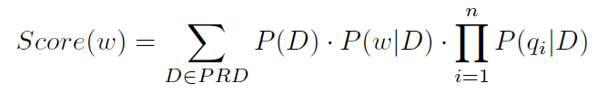
Approach
Term Selection
Notes:
The word score function contains three parts.

Slide 22
Approach
Term Selection
The document prior
The query likelihood
The word frequency
Notes:
The document prior, the word frequency and the query likelihood.

Slide 23

Approach
Term Selection
replaced by
Notes:
We replace the document prior by a time punishment function.

Slide 24
Approach
Term Selection
relevance score
replaced by
recency score
Notes:
So these two part could reflect the relevance score and recency score at the same time.
Until now, we could generate the freebase knowledge model,
And update the original query model with it.

Slide 25
Approach
Mixture Feedback Model
Q
…
…
Freebase
…
…
F
…
-KL
Score
D
…
Notes:
With the knowledge query environment, we believe the information need is more understandable.
More specifically, we update the query model with the simple mixture model
which is widely used in microblog retrieval.

Slide 26
Outline
Motivation
Related Work
Approach
Experiment
Conclusion
Notes:
Then, Let’s talk about the experiment.

Slide 27
Experiment
Setup
Data Set
Tweets11 : Jan 24, 2011 to Feb 8, 2011, 16 million tweets
TREC11 : 50 official queries
TREC12 : 60 official queries
Tweets13 : Feb 1, 2013 to Mar 31, 2013, 259 million tweets
TREC13 : 60 official queries
queries
TREC11
TREC12
TREC13
Tweets11
Tweets13
tweets
Notes:
We employ three query sets in our experiment, which are published by TREC Microblog Track using a streaming API, namely TREC11, TREC12, TREC13.

Slide 28
Experiment
Setup
Evaluation Metric
Mean Average Precision (MAP) : MAP@1000
Precision at N (P@N): P@30
Baselines
Models | Description
SimpleKL | no query expansion
QESMM | query expansion with SMM
RTRM | query expansion with Issue first, then SMM secondly
QEFB | query expansion with FreeBase
QEFB+SMM | query expansion with FreeBase first, then SMM secondly
Notes:
We use Mean Average Precision and Precision at N as the main metrics which are the official main metrics in TREC Microblog Track.
Five models are created to test the effectiveness of our proposed method.
SimpleKL means we do not use any query expansion.
QESMM means we do query expansion with simple mixture model.
RTRM means we do query expansion with Issue at first, then simple mixture model secondly.
QEFB means we do query expansion with Freebase.
QEFB+SMM means we do query expansion with Freebase first, then simple mixture model secondly.

Slide 29
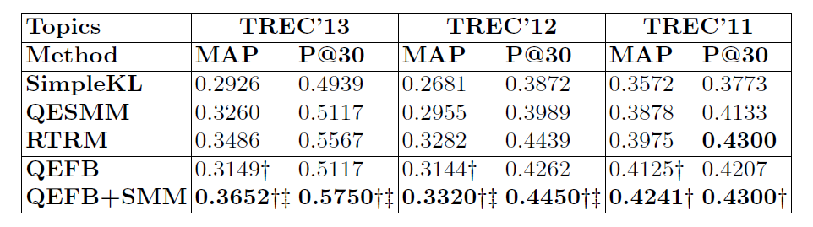
Experiment
Overall results
Notes:
The table shows the MAP and P@30 performances of different methods.
The best performances are marked in bold typeface.
The results indicates that QEFB can get purer concept-associated topic terms and thus leads to higher precision in top retrieved results.
We can further improve the retrieval performance by combining simple mixture model as second-stage query expansion.
We can find that when incorporating with simple mixture model,
our proposed method QEFEM+SMM also performs better than the other two-stage query expansion methods.

Slide 30
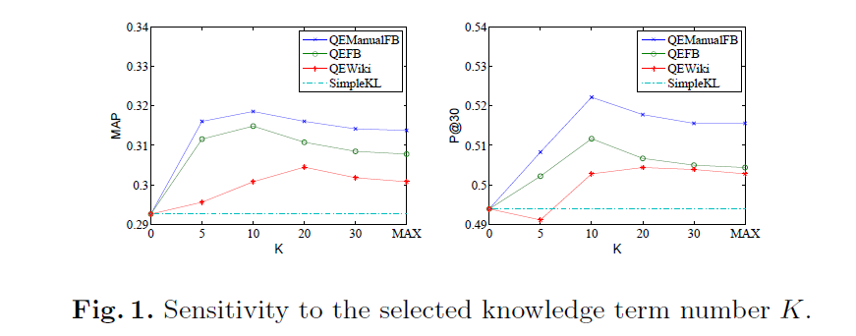
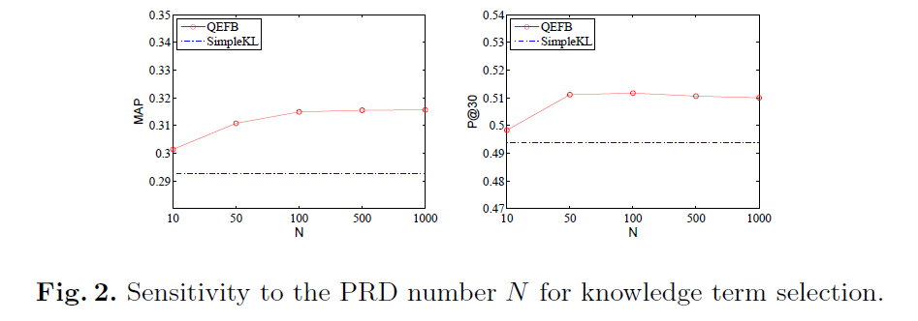
Experiment
K and N in PRD
Notes:
We also analyze the robustness of the parameter settings in knowledge-based query expansion method.
Figure 1 shows the MAP and P@30 scores of all the models for different K and fixed N = 100.
MAX means we use all the candidate terms.
We can see that though QEFB is not better than QEManualFB, the performance gap between them is not large, which verifies the effectiveness of our concept match algorithm.
QEFB is consistently better than QEWiki, which proves the importance of the structured information in Freebase. Moreover, when K is set around 10, QEFB can get its best retrieval performance.
We then fix the term number K to 10 and change the PRD number N.
We can observe that when N is larger than 100, the performance changes slightly.
It means that top 100 pseudo-relevance documents can provide enough information.

Slide 31
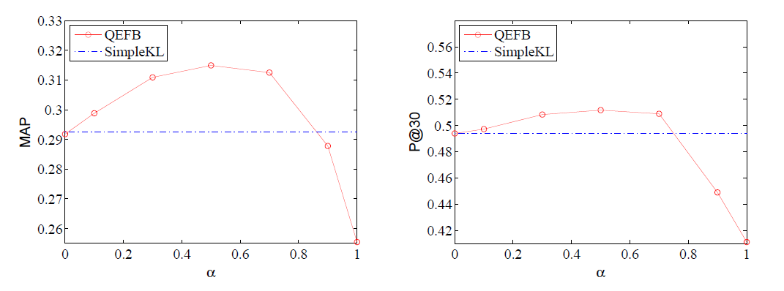
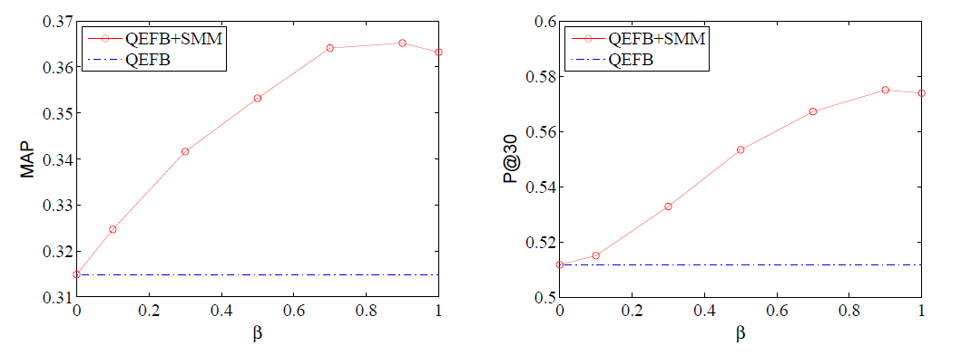
Experiment
ɑ and β
Notes:
Recall that we first expand the query with freebase knowledge query,
and further expand the updated query with simple fixture model.
The first-stage query expansion is controlled by alpha
while the second-stage expansion is controlled by beta.
From these figures, we can see that when alpha = 0.5 and beta = 0.9,
We can get the best retrieval performance.

Slide 32
Outline
Motivation
Related Work
Approach
Experiment
Conclusion
Notes:
In the last, we come to conclude our work.

Slide 33
Conclusion
Query expansion with Freebase
Temporal evidence incorporated into expansion process
Various experiments
Notes:
We propose using knowledge-based query expansion to solve the vocabulary mismatch problem in microblog search.
With the knowledge terms derived from the Freebase, the query can be more comprehensible and thus more relevant documents can be retrieved.
Moreover, we incorporate the temporal evidence into query representation.
Thus the proposed method favors recent tweets which satisfy the real-time information nee.
Our thorough evaluation, using two standard TREC collections, demonstrates the effectiveness of the proposed method.

Slide 34
Q&A
Q & A
Notes:
That’s all, thank you very much.

