Slide 1
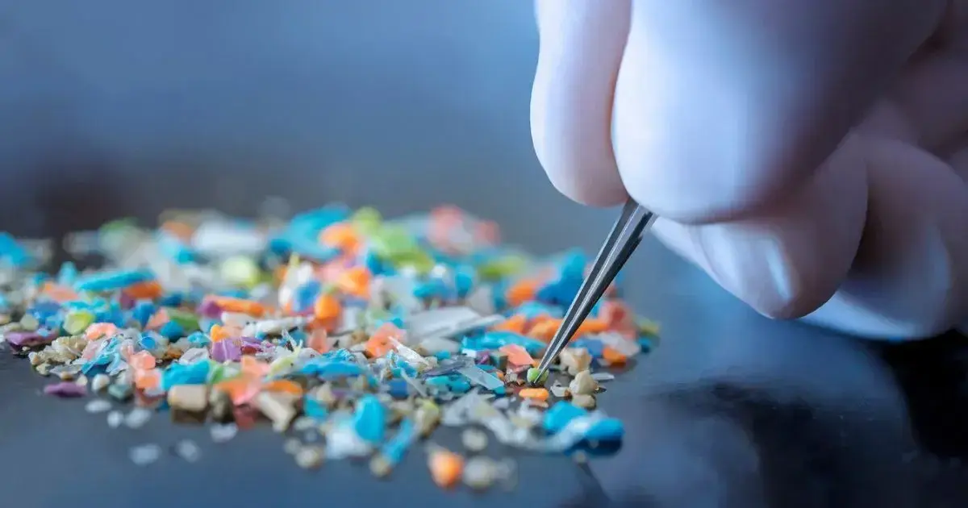
From Lab to Landscape:
Mobile AI for Real-Time
Microplastic Detection

Slide 2
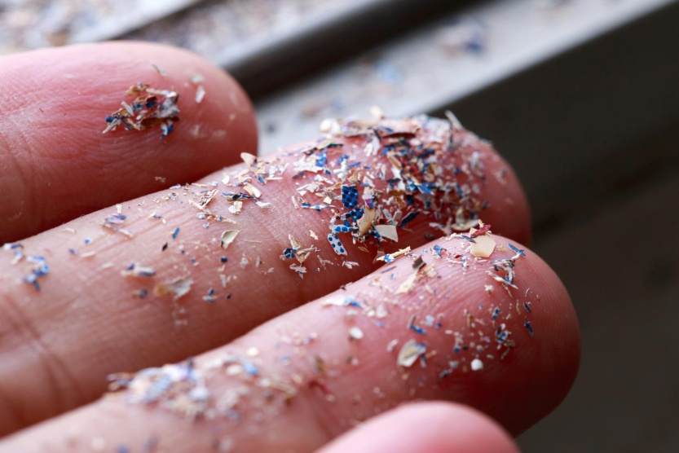
What are microplastics?
Small plastic pieces
less than 5 millimeters
long.
Fig: Microplastics

Slide 3
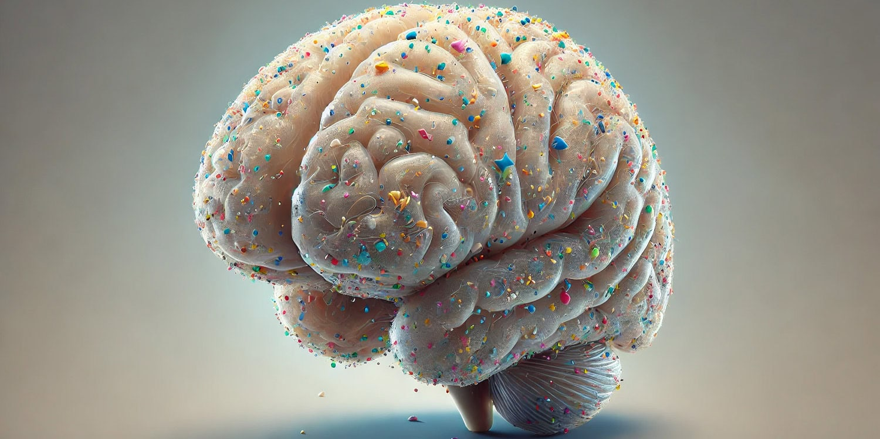
Why should we concern about microplastics?
Microplastics discovered in human
brains for the first time: What it means for our health
Fig: Microplastics in brain

Slide 4
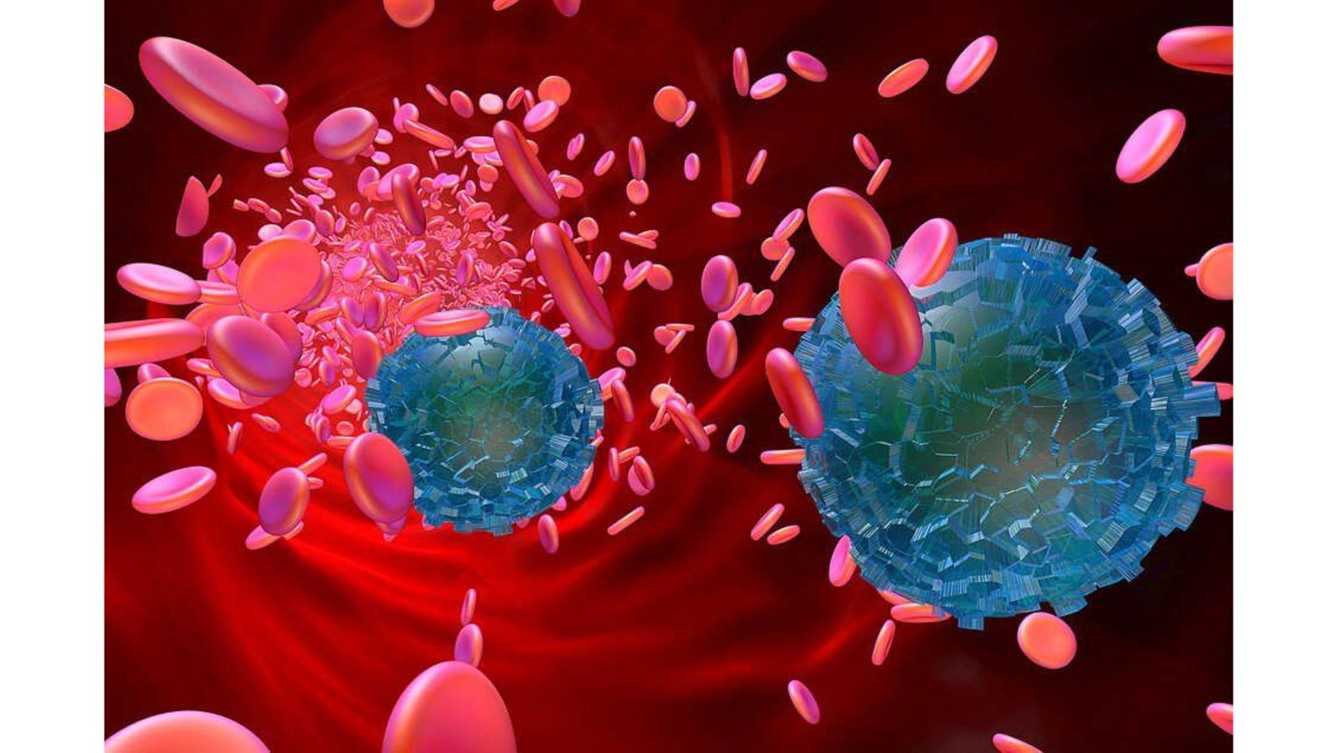
Microplastics found in human blood
Fig: Microplastics in blood

Slide 5
After earth, is human body a dumping ground to microplastics?

Slide 6
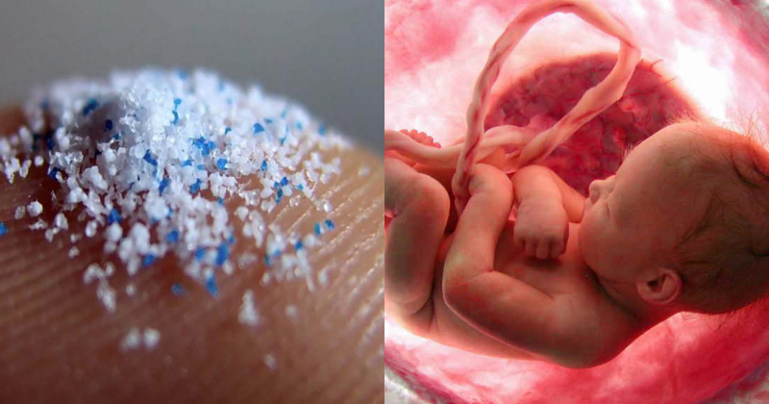
“Matter of great concern’: Microplastics found in placentas of pregnant women”
Fig: Microplastics in placenta

Slide 7
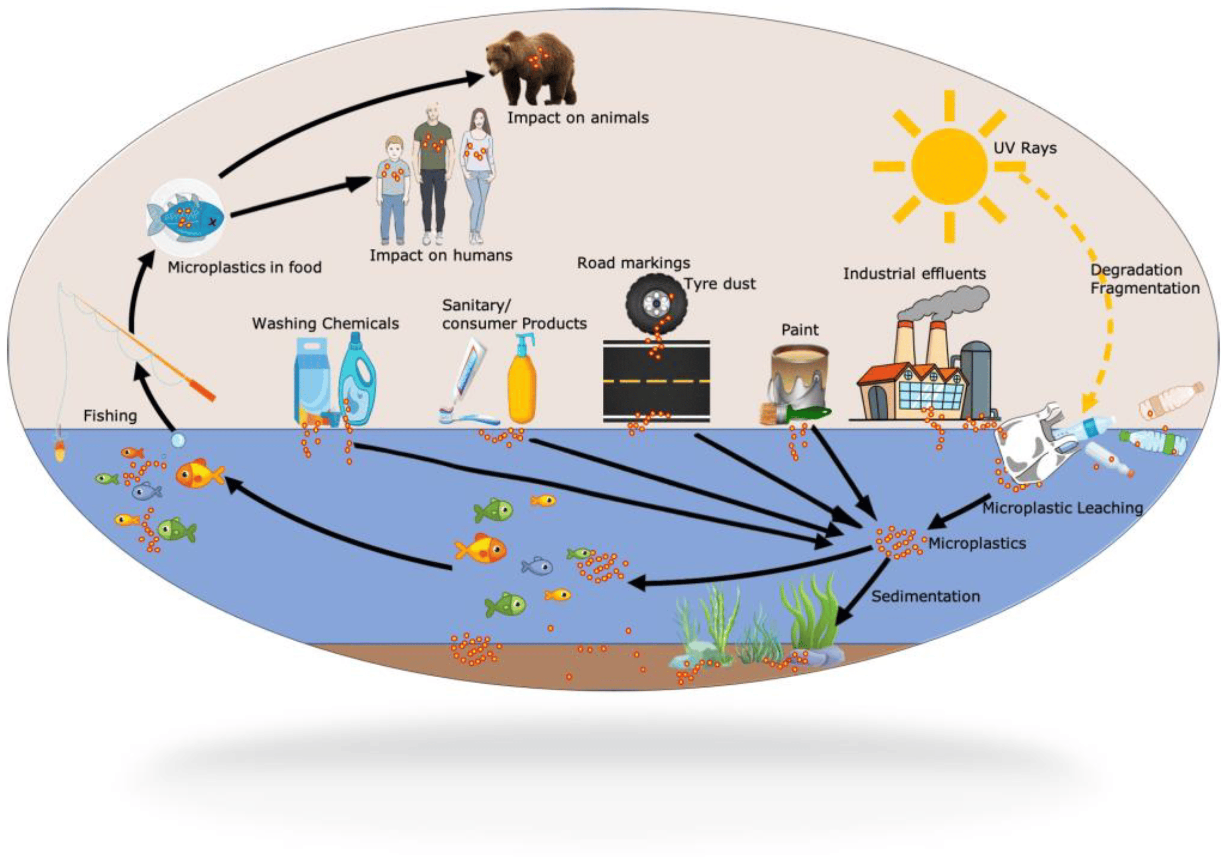
microplastics threads
Visualization of
how the ecosystem is being
affected by microplastics

Slide 8
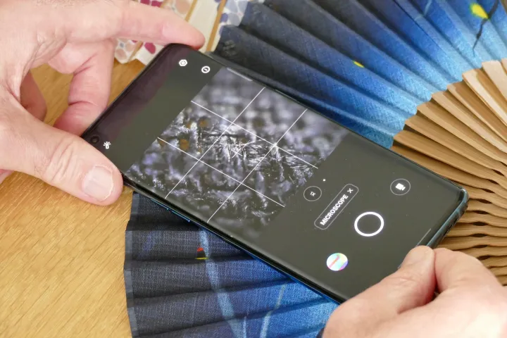
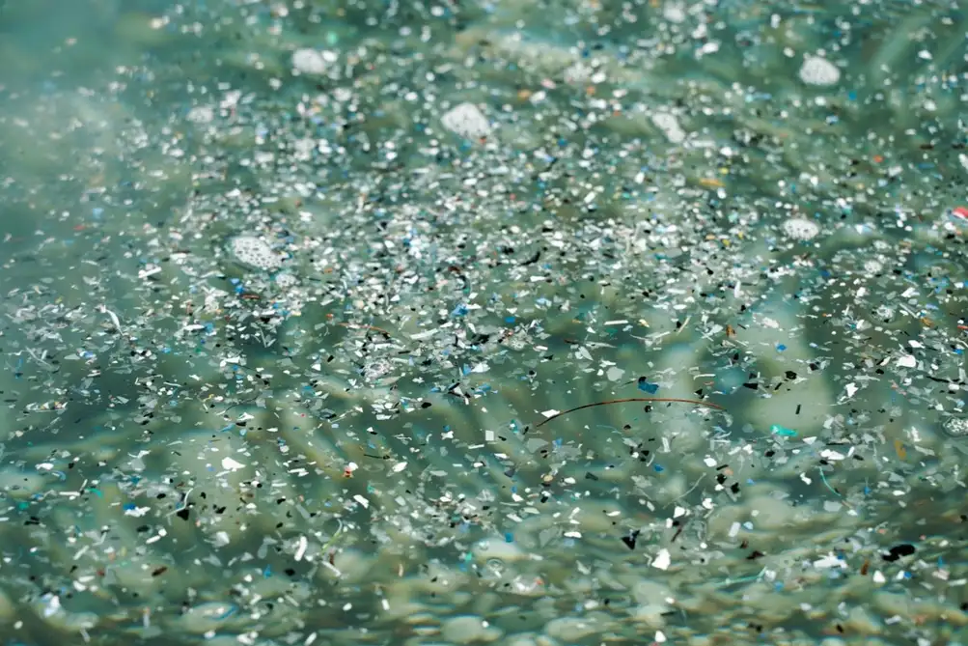
Solution Idea
Microscope AI Mobile

Slide 9
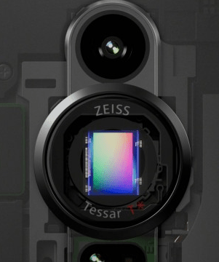
Sensor (785nm)
Microscope Camera

Slide 10
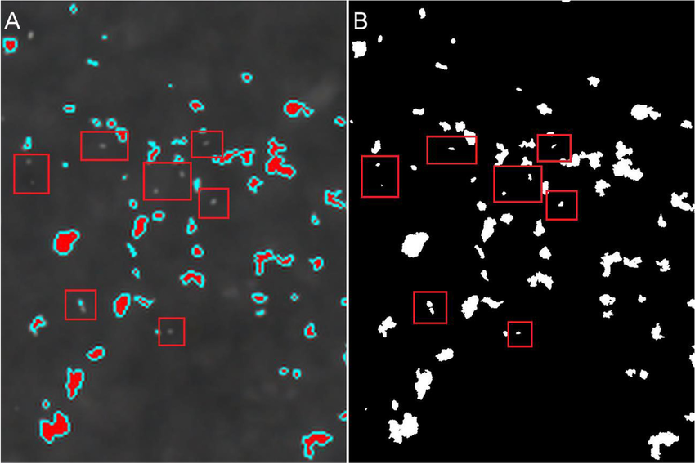
AI (VGG19 + MedSAM-2)
VGG19 (Object Detection & Classification)
MedSAM-2 ( segmentation image )

Slide 11
AI
VGG19
Result
MedSAM-2
classification and
identification
Camera & Laser Sensor
segmentation
high resolution camera
with laser light emission
methodology

Slide 12
Reference: 1. Sarker, M.A.B.; Imtiaz, M.H.; Holsen, T.M.; Baki, A.B.M. Real-Time Detection of Microplastics Using an AI Camera. Sensors 2024, 24, 4394. https://doi.org/10.3390/s24134394
2. Ma, J., He, Y., Li, F. et al. Segment anything in medical images. Nat Commun 15, 654 (2024). https://doi.org/10.1038/s41467-024-44824-z
3. Huang, Yihe & Shang, Ce & Li, Lin. (2021). Novel N-doped graphene enhanced ultrafiltration nano-porous polyvinylidene fluoride membrane with high permeability and stability for water treatment. Separation and Purification Technology. 267. 118622. 10.1016/j.seppur.2021.118622.
4. Qian N, Gao X, Lang X, Deng H, Bratu TM, Chen Q, Stapleton P, Yan B, Min W. Rapid single-particle chemical imaging of nanoplastics by SRS microscopy. Proc Natl Acad Sci U S A. 2024 Jan 16;121(3):e2300582121. doi: 10.1073/pnas.2300582121. Epub 2024 Jan 8. PMID: 38190543; PMCID: PMC10801917.
5. Zhao B, Rehati P, Yang Z, Cai Z, Guo C, Li Y. The potential toxicity of microplastics on human health. Sci Total Environ. 2024 Feb 20;912:168946. doi: 10.1016/j.scitotenv.2023.168946. Epub 2023 Dec 2. PMID: 38043812.
6. Schwabl P, Köppel S, Königshofer P, Bucsics T, Trauner M, Reiberger T, Liebmann B. Detection of Various Microplastics in Human Stool: A Prospective Case Series. Ann Intern Med. 2019 Oct 1;171(7):453-457. doi: 10.7326/M19-0618. Epub 2019 Sep 3. PMID: 31476765.
7. Jones RR, Hooper DC, Zhang L, Wolverson D, Valev VK. Raman Techniques: Fundamentals and Frontiers. Nanoscale Res Lett. 2019 Jul 12;14(1):231. doi: 10.1186/s11671-019-3039-2. PMID: 31300945; PMCID: PMC6626094.

