Slide 1
Investing in Our Future:
Proposal to Reduce Burden and Increase Quality of Life
Presented by: Joshua Ewer, Policy Advocate
For: Senator Schneider, State of California

Slide 2
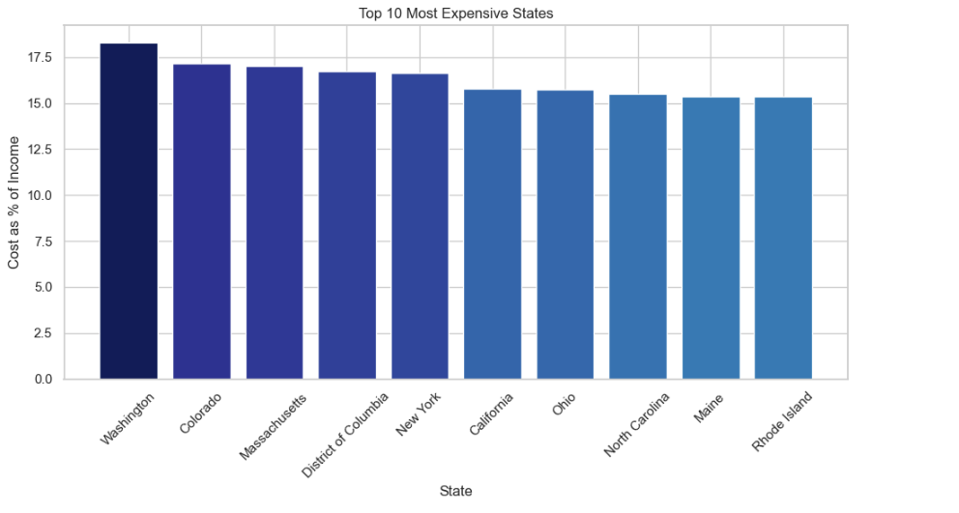
Why Childcare Costs Matter
California has some of the highest childcare cost burden in the country
Average weekly cost of infant care: $173
Yearly cost: ~$9000, comparable to in-state college tuition

Slide 3
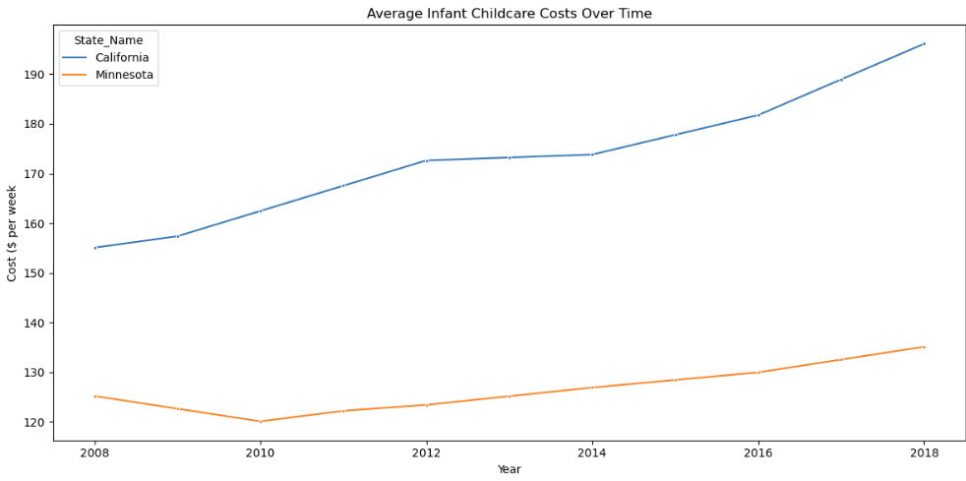
A Tale of Two States
California: ~15% of income goes to childcare
Minnesota: < 10% of income
Costs in both states are rising, but much more dramatically in California

Slide 4
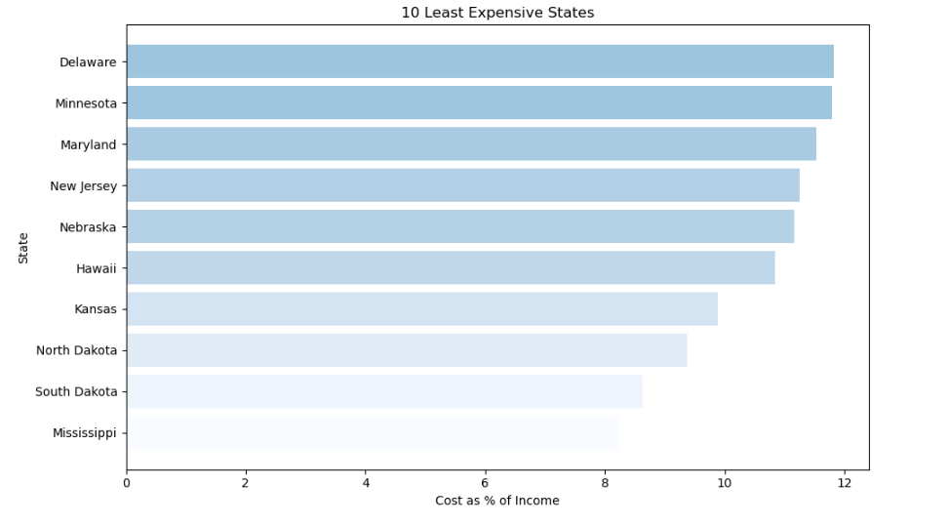
National Comparison
Many states have 2x less of a burden on their taxpayers
  Direct comparisons to all may be unfair, but may of these states have nationally recognized quality of life standards (e.g. Minnesota) while maintaining relatively low cost for childcare due to existing public subsidies*
* Child Care Assistance Program | Minnesota Department of Children, Youth, and Families

Slide 5
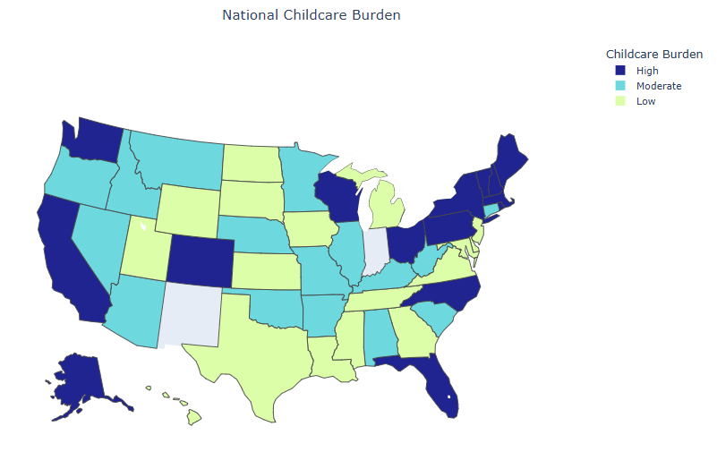
National Comparison
Even when taking into regional income differences, California continues to have a high burden of care when compared other states.

Slide 6
Our Investment
Establish a public childcare investment fund
Trial subsidies for families earning under a specific threshold
Invest in training and retention for childcare workers
Create regional childcare cost monitoring in public health services departments,
  can be used to transparently manage costs, and
  support advertisement to relocating families

Slide 7
Success Defined
Families spend less on childcare, more in line with the states like Minnesota
Increased employment for parents, especially working mothers
Growth market for licensed, quality care centers
Higher workforce retention and productivity

Slide 8
Commitment to Thriving Families
Childcare is not a luxury; it’s public infrastructure that demands investment
In states with high burdens for childcare, families must choose between work and care
When we act with bold, bipartisan leadership, we can help thriving families drive a thriving economy

Slide 9
Thank You

