Slide 1
Predicting Heart Disease Presence
Through Clinical Results
Joshua Ewer
DSC680 – Applied Data Science
January 2026

Slide 2
Business Problem
Heart disease is a leading global cause of mortality
Clinical indicators are difficult to interpret collectively
Goal: predict heart disease presence using common data

Slide 3
Motivation & Background
Personal and academic motivation
Publicly available cardiovascular datasets

Slide 4
Dataset Overview
UCI Heart Disease dataset (Kaggle)
1,025 patient records
14 clinical variables, binary target

Slide 5
Data Preparation & Exploration
No missing values
Mixed numeric and categorical data
Balanced target variable

Slide 6
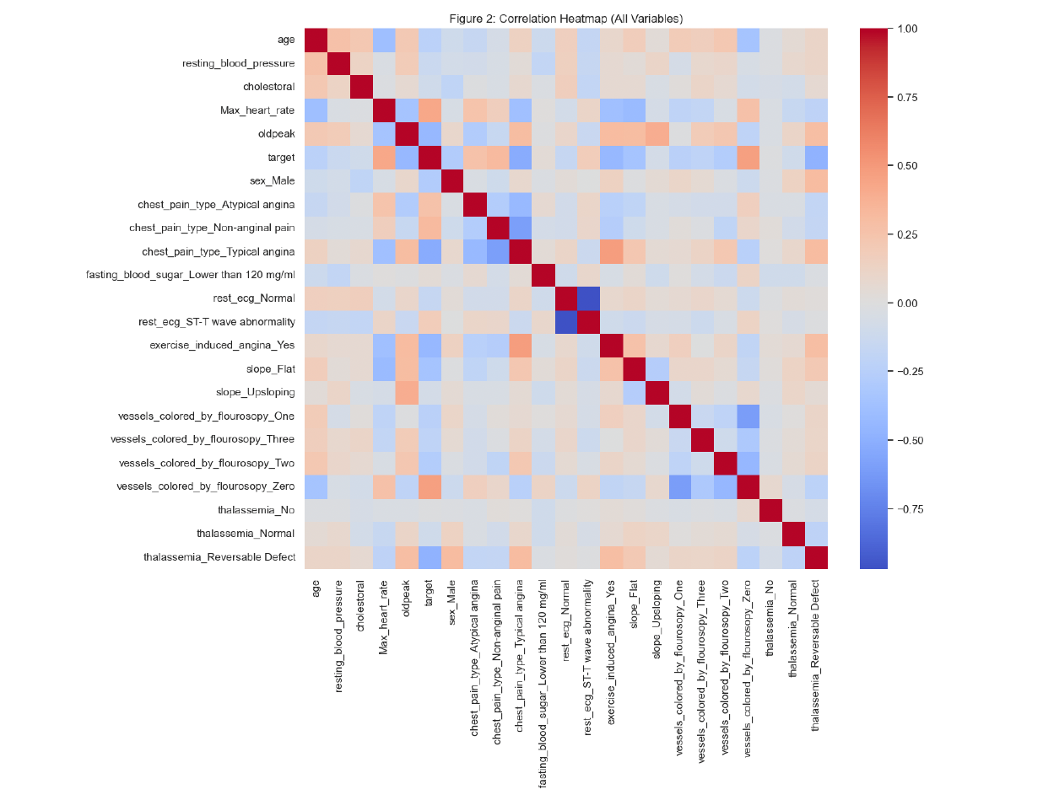
Exploratory Findings
Strong correlations with chest pain and imaging variables
Patterns align with clinical expectations

Slide 7
Modeling Approach
Logistic Regression baseline
Gradient Boosting for non-linear patterns
Emphasis on validation

Slide 8
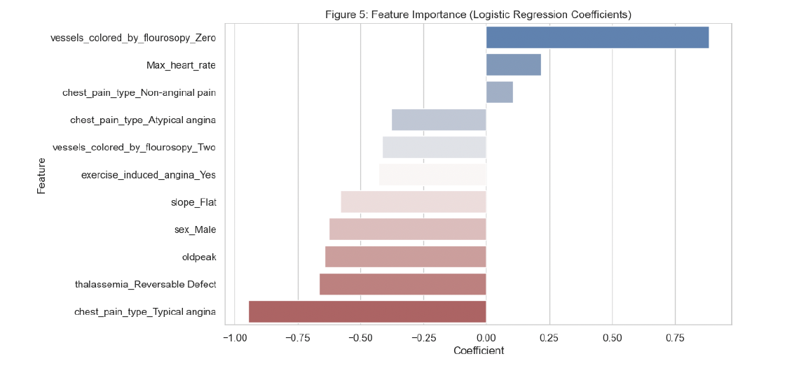
Evaluation Strategy
Train/test split with stratification
Cross-validation
Accuracy, Recall, ROC-AUC

Slide 9
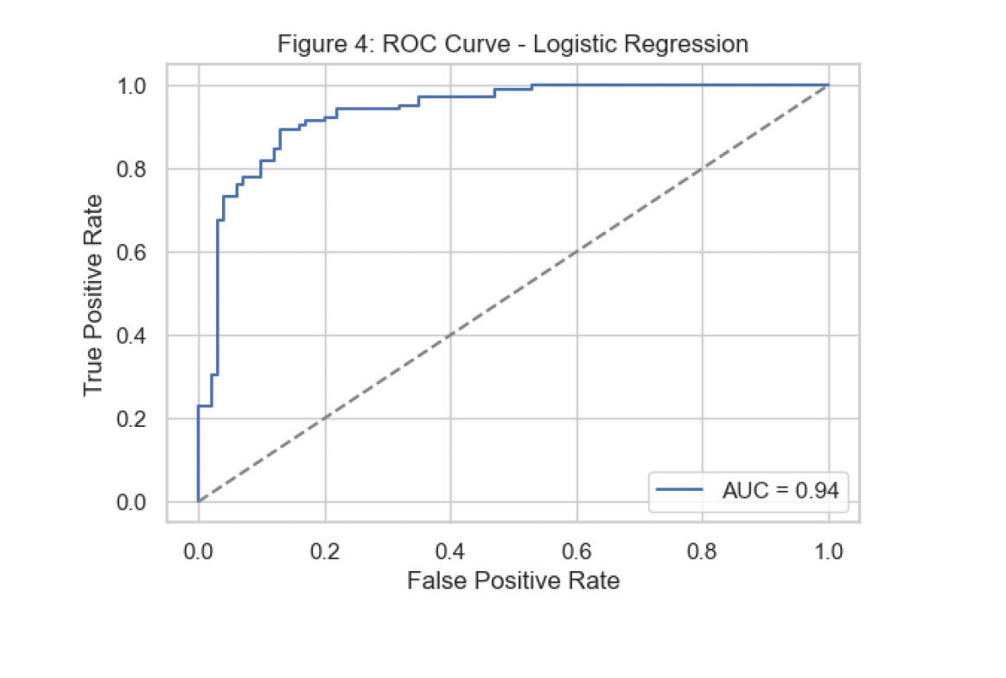
Logistic Regression Results
ROC-AUC ≈ 0.82
Strong and interpretable baseline

Slide 10
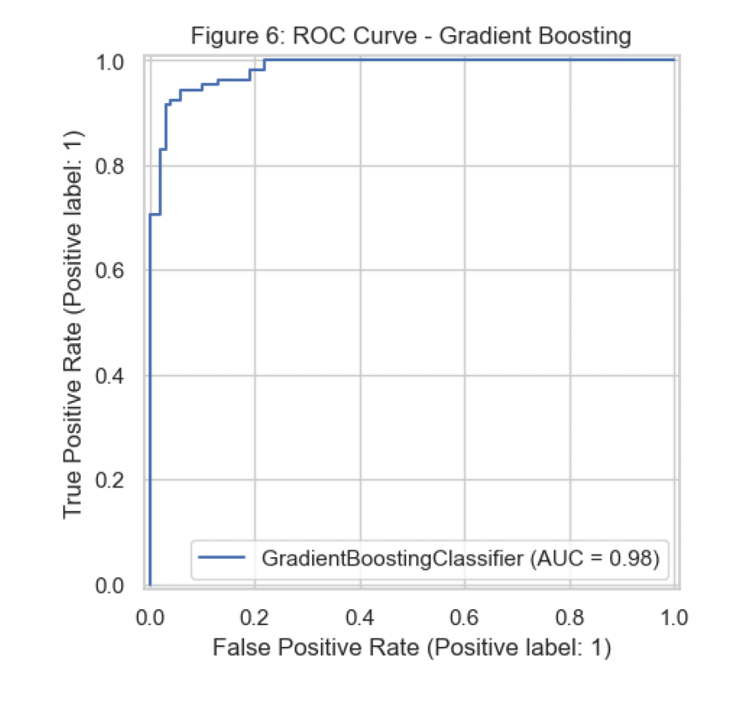
Gradient Boosting Results
ROC-AUC ≈ 0.98
Higher recall and accuracy

Slide 11
Model Comparison
Logistic Regression: interpretable
Gradient Boosting: higher performance

Slide 12
Limitations & Ethics
Limited demographic data
Exploratory results
Decision-support use only

Slide 13
Conclusion & Future Work
Clinical data can support prediction
Ensemble methods outperform baselines
Future validation needed

Slide 14
QUESTIONS AND ANSWERS
1. Why did you choose Logistic Regression as your baseline?
2. The Gradient Boosting model performed much better. Why not just use that model?
3. A ROC-AUC of 0.98 seems very high. Are you concerned about overfitting?
4. Why did you emphasize recall over accuracy?
5. Some correlations, like maximum heart rate, seemed counterintuitive. How did you handle that?
6. Why didn’t you include demographic or lifestyle variables?
7. Could this model be used in a real clinical setting?
8. How did you decide which features to keep in the model?
9. Why didn’t you tune hyperparameters more aggressively?
10. What would you do differently if you were continuing this project?

