Slide 1
DSC530 Final Project
Joshua Ewer
Bellevue University
August 9, 2024

Slide 2
Statistical Hypothesis
I recently experienced an unexpected death in the family, and it got me wondering if there are any specific variables that contribute to life expectancy more than others. I found several World Health Organization (WHO) datasets that were extremely large and full of sketchy data. Then, I found a sample dataset on kaggle that included some data cleaning to help reduce some of the unrealistic values in the raw dataset.
I chose this dataset to answer the question “What factors have the largest correlation with life expectancy?”

Slide 3
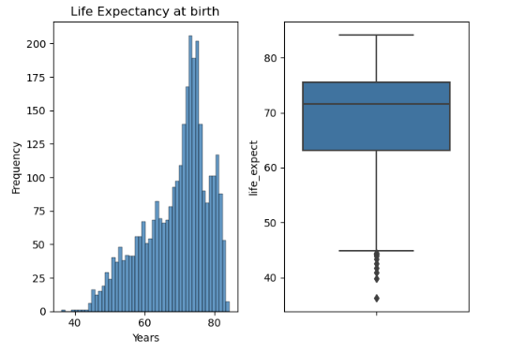
Variables Used in Analysis
life_expect
This is the dependent variable for the regression analysis later.
Definition: Life expectancy at birth measured in years
While there is a slight tail in this left skewed distribution, there were no significant outliers to handle

Slide 4
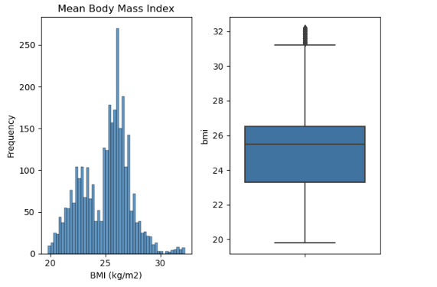
Variables Used in Analysis
bmi
Definition: This is calculated by an individual’s weight (kg) / height^2 (meters) and is a rough way to estimate health of an individual. This data is age-standardized (per 100k population).
This distribution is bimodal, with peaks at 22-24 and 26. There were no significant outliers.

Slide 5
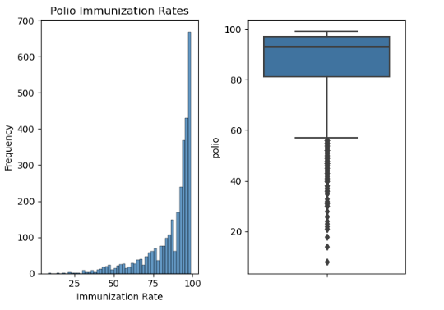
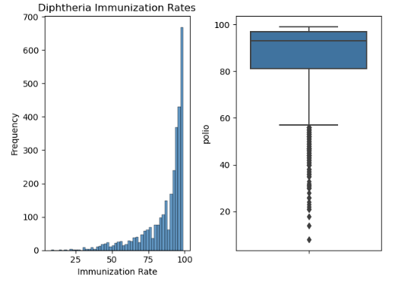
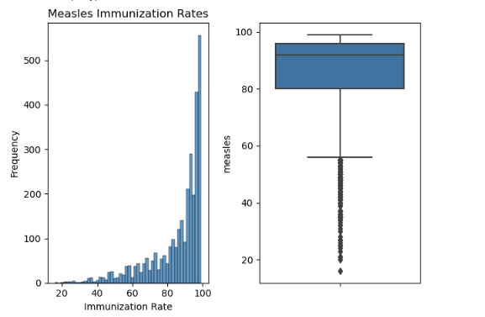
Variables Used in Analysis
polio/diphtheria/measles
Definition: first dose coverage among 1-year olds (%)
In researching, I found the distributions for these individual variables were near identical, leading me to believe (and later confirm) that each of these vaccinations are typically given at the same time.
These distributions are very negatively skewed with the mean being 86% (yay for the children!)

Slide 6
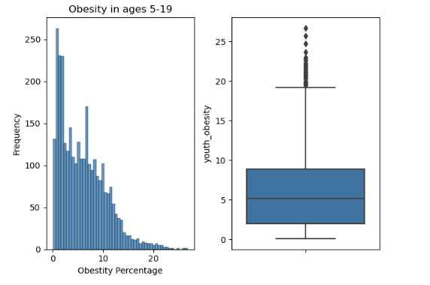
Variables Used in Analysis
Youth obesity
Definition: This variable represents the prevalence of obesity in youth and is measured by a crude estimate percentage for children with a BMI > (median - 2 stdev)
This distribution is positively skewed and has a very long tail for percentages above 15%. There were some outliers above the 20 mark, but I did not find them to be inaccurate (> 30 is considered obese) so I left these outliers in the dataset.

Slide 7
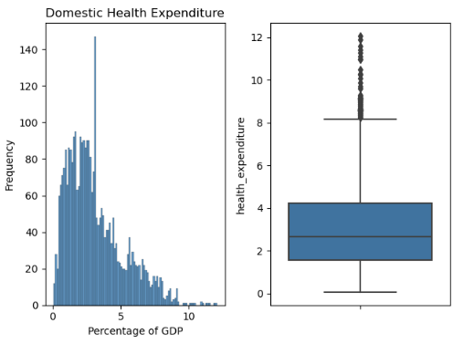
Variables Used in Analysis
Government Health Expenditure
Definition: This variable measures the domestic general government health expenditure (GGHE-D) as percentage of gross domestic product (GDP)
Depending on the number of bins in the histogram, this distribution is _almost_ bimodal, but it smooths out with more bins. There is a very long tail of expenditures in the +10% range, but I was able to identify that those values are correct and not outliers do to error or poor quality data.

Slide 8
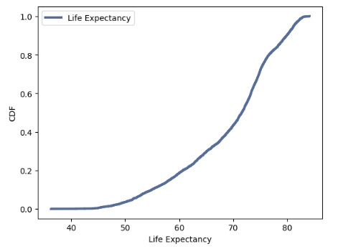
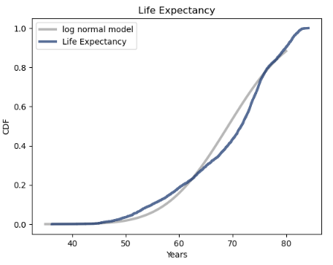
Examining Analytical Distributions via a CDF
Over half of life expectancies are 60+ years.
When comparing the CDF of life expectancy to a log normal model, there is a clearly visible steep increase in 70-75 age range, indicating a more rapid increase in cumulative probabilities.

Slide 9
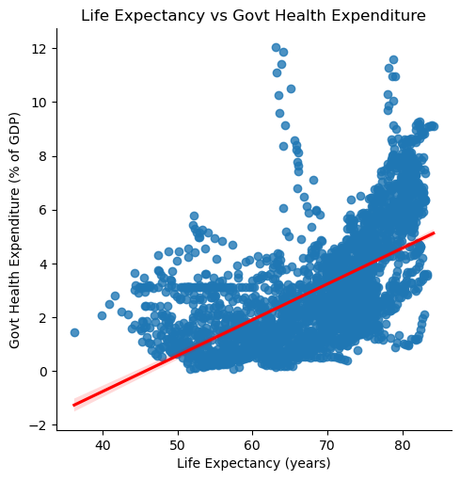
Scatter Plots
There was a strong positive correlation between life expectancy and the expenditure of a government’s budget on healthcare.
Both spearman and Pearson correlations showed that there was a statistical significance to this correlation, but it was minor.

Slide 10
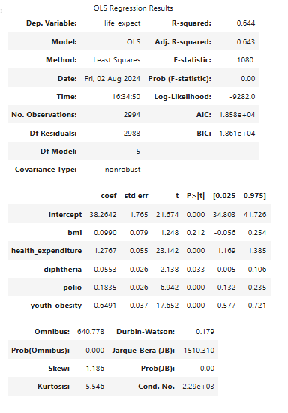
Regression Analysis
In reviewing the results from the regression analysis, we can conclude:
The R-squared value is greater than 0.5 so it is better than random, though not a large amount. An r-squared value that approaches 1 is a better fit.
Durbin-Watson measures homoscedasticity, and a low number of 0.179 implies a strong positive serial correlation in the residuals.
The kurtosis value of 5.5 implies that there are more extreme values in the distribution that would be a normal distribution. Therefore, there must be significant outliers or extreme values.

