Slide 1
“Molecular Cellular Automata”
A parallelizable strategy for simulating any active coarse grained molecular model

Slide 2
Definition: Molecular cellular automaton
A hybrid simulation method:
a) run ordinary molecular dynamics for a short time,
b) make decisions that modify “atom” and “bond” properties
c) goto → a) (repeat…)

Slide 3
Definition: Molecular cellular automaton
A hybrid simulation method:
a) run ordinary molecular dynamics for a short time,
b) make decisions that modify “atom” and “bond” properties
c) goto → a) (repeat…)

Slide 4
Definition: Molecular cellular automaton
A hybrid simulation method:
a) run ordinary molecular dynamics for a short time,
b) make decisions that modify “atom” and “bond” properties
c) goto → a) (repeat…)
Δx=vΔt

Slide 5
Definition: Molecular cellular automaton
A hybrid simulation method:
a) run ordinary molecular dynamics for a short time,
b) make decisions that modify “atom” and “bond” properties
c) goto → a) (repeat…)
Δx=vΔt

Slide 6
Definition: Molecular cellular automaton
A hybrid simulation method:
a) run ordinary molecular dynamics for a short time,
b) make decisions that modify “atom” and “bond” properties
c) goto → a) (repeat…)
Δx=vΔt

Slide 7
Definition: Molecular cellular automaton
A hybrid simulation method:
a) run ordinary molecular dynamics for a short time,
b) make decisions that modify “atom” and “bond” properties
c) goto → a) (repeat…)
Δx=vΔt

Slide 8
Definition: Molecular cellular automaton
A hybrid simulation method:
a) run ordinary molecular dynamics for a short time,
b) make decisions that modify “atom” and “bond” properties
c) goto → a) (repeat…)
Δx=vΔt

Slide 9
Definition: Molecular cellular automaton
A hybrid simulation method:
a) run ordinary molecular dynamics for a short time,
b) make decisions that modify “atom” and “bond” properties
c) goto → a) (repeat…)
Δx=vΔt

Slide 10
Definition: Molecular cellular automaton
A hybrid simulation method:
a) run ordinary molecular dynamics for a short time,
b) make decisions that modify “atom” and “bond” properties
c) goto → a) (repeat…)

Slide 11
Definition: Molecular cellular automaton
Decisions are made locally
a) At each iteration, atom types (and bond types) are modified
b) Each new atom type depends on the old atom type, and the atom types of it’s bonded neighbors according to arbitrary rules which the user can specify.

Slide 12
Definition: Molecular cellular automaton
Decisions are made locally
a) At each iteration, atom types (and bond types) are modified
b) Each new atom type depends on the old atom type, and the atom types of it’s bonded neighbors according to arbitrary rules which the user can specify.

Slide 13
Definition: Molecular cellular automaton
Decisions are made locally
a) At each iteration, atom types (and bond types) are modified
b) Each new atom type depends on the old atom type, and the atom types of it’s bonded neighbors according to arbitrary rules which the user can specify.

Slide 14
Definition: Molecular cellular automaton
Decisions are made locally
a) At each iteration, atom types (and bond types) are modified
b) Each new atom type depends on the old atom type, and the atom types of it’s bonded neighbors according to arbitrary rules which the user can specify.

Slide 15
Definition: Molecular cellular automaton
Decisions are made locally
a) At each iteration, atom types (and bond types) are modified
b) Each new atom type depends on the old atom type, and the atom types of it’s bonded neighbors according to arbitrary rules which the user can specify.

Slide 16
Definition: Molecular cellular automaton
Decisions are made locally
a) At each iteration, atom types (and bond types) are modified
b) Each new atom type depends on the old atom type, and the atom types of it’s bonded neighbors according to arbitrary rules which the user can specify.

Slide 17
Definition: Molecular cellular automaton

Slide 18
Definition: Molecular cellular automaton

Slide 19
Definition: Molecular cellular automaton

Slide 20
Definition: Molecular cellular automaton

Slide 21
Definition: Molecular cellular automaton
A hybrid simulation method:
a) run ordinary molecular dynamics for a short time,
b) make decisions that modify “atom” and “bond” properties
c) goto → a) (repeat…)

Slide 22
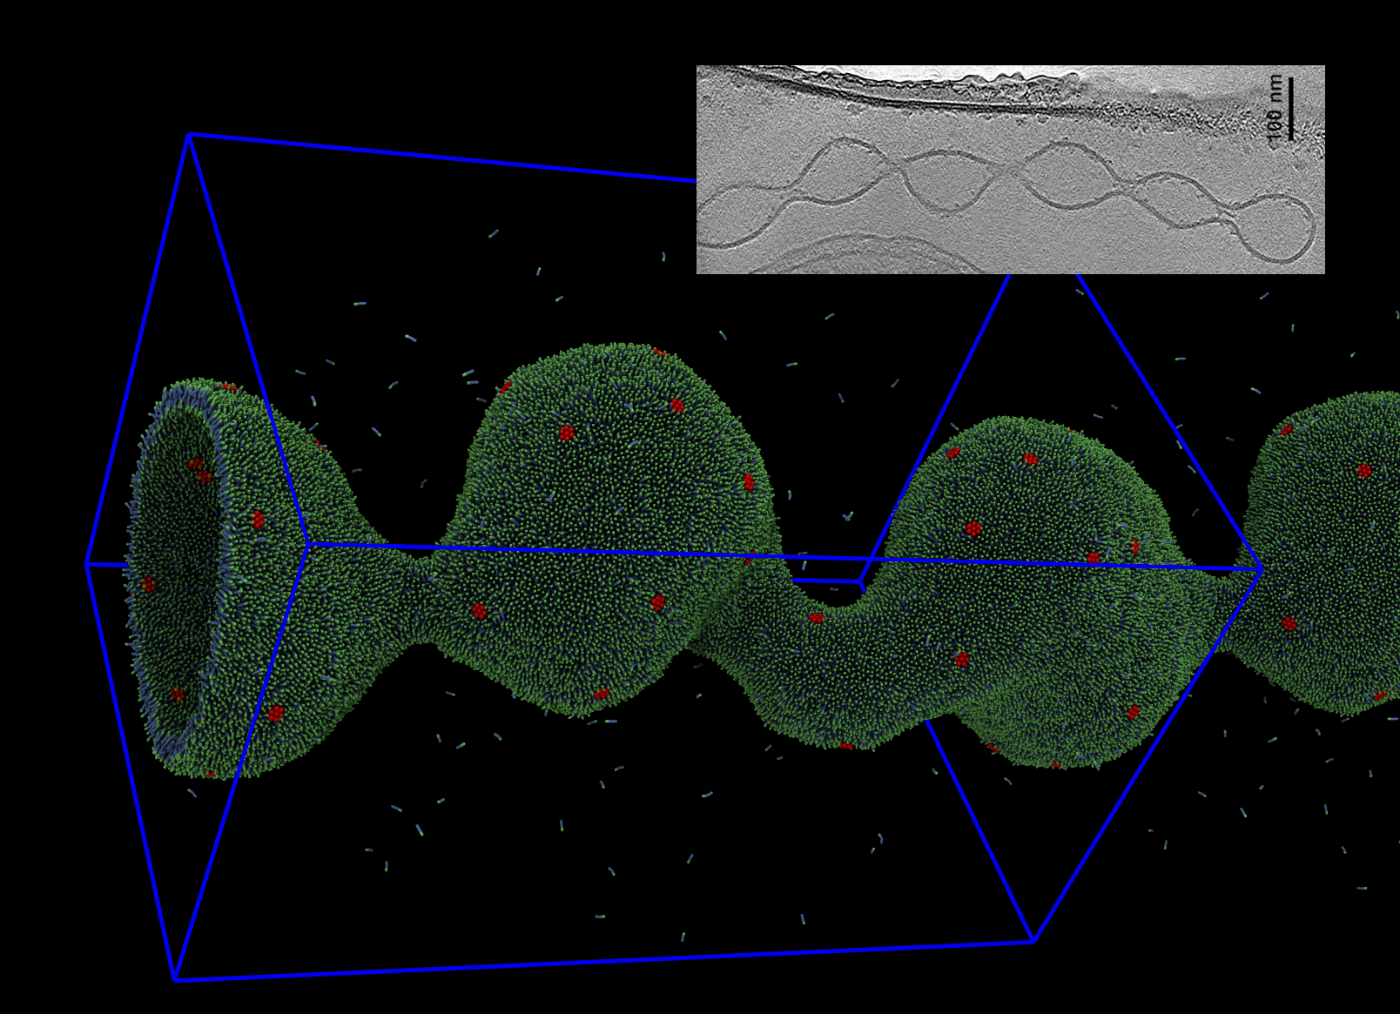
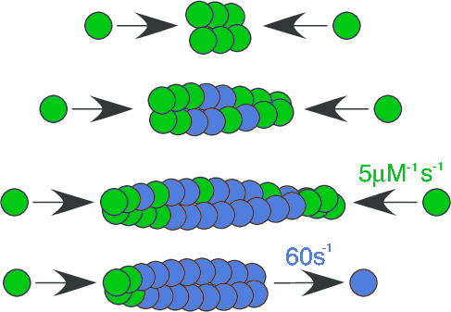
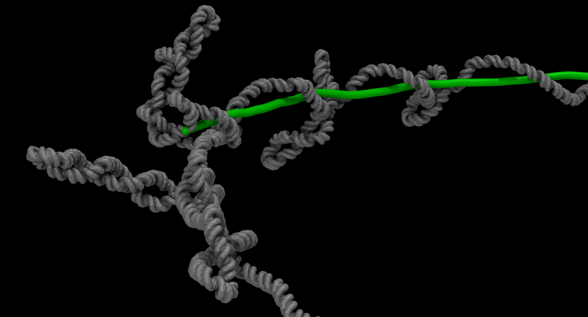
Example Uses in Biology:
membrane trafficking
cytoskeletal filament growth dynamics
transcriptional stalling

Slide 23
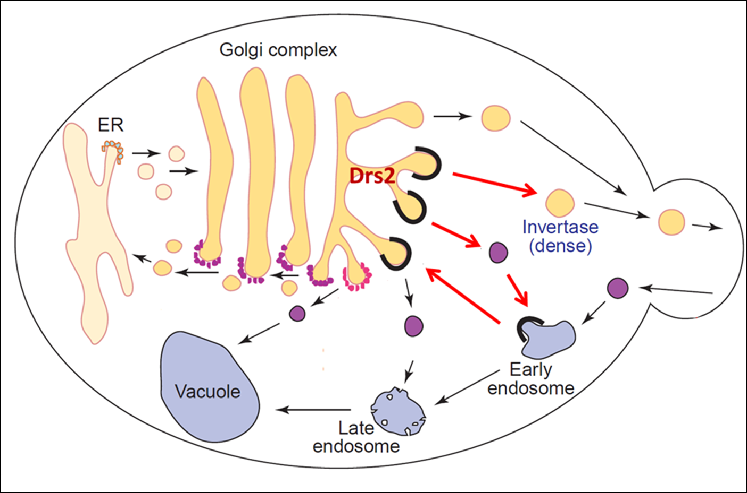
Example: Flippase mediated membrane curvature
Graham Lab, Vanderbilt, website image
Notes:
Flippases are believed to play a role in the maturation and vesiculation of the Golgi apparatus and ER.

Slide 24
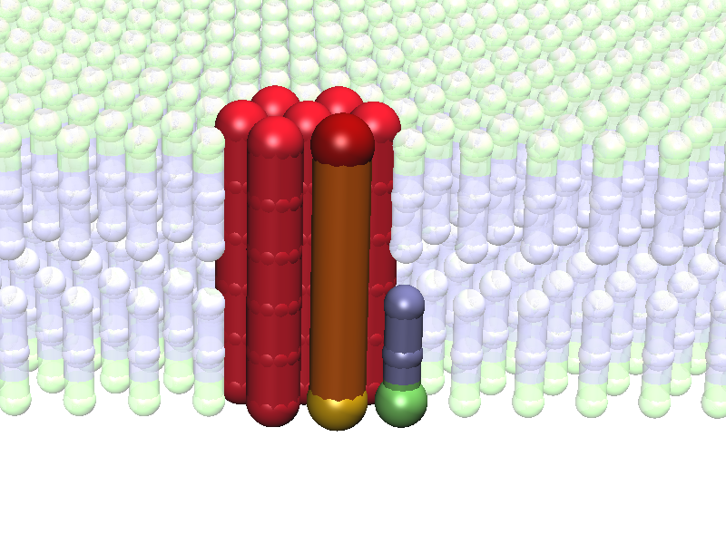
Example: Flippase mediated membrane curvature
Notes:
Flippases are believed to play a role in the maturation and vesiculation of the Golgi apparatus and ER.

Slide 25
Example: Flippase mediated membrane curvature
Flippase are motors which pull lipids (or proteins from one side of the membrane to the other)
Notes:
Flippases are believed to play a role in the maturation and vesiculation of the Golgi apparatus and ER.

Slide 26
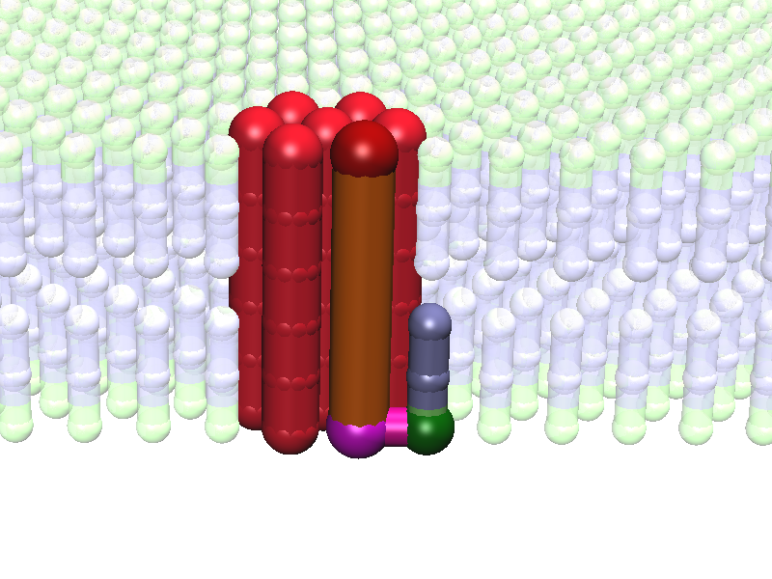
Example: Flippase mediated membrane curvature
Notes:
Flippases are believed to play a role in the maturation and vesiculation of the Golgi apparatus and ER.

Slide 27
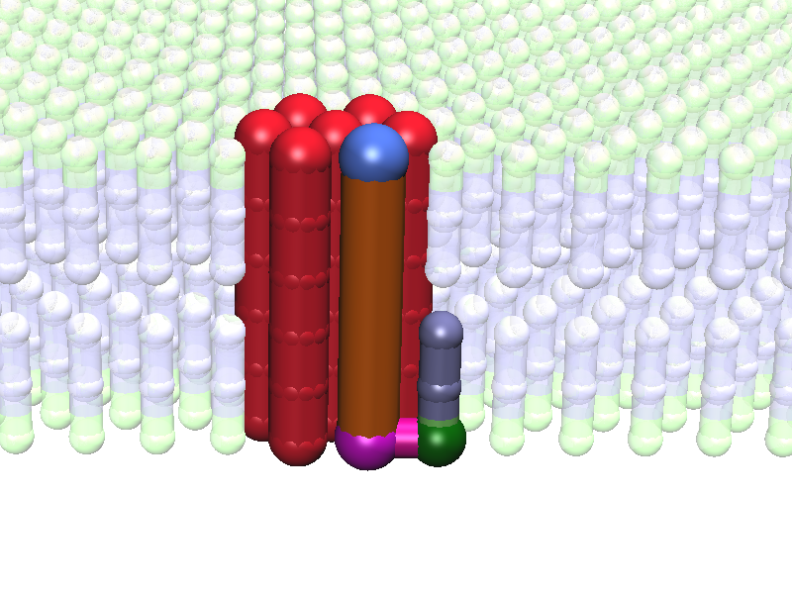
Example: Flippase mediated membrane curvature
Notes:
Flippases are believed to play a role in the maturation and vesiculation of the Golgi apparatus and ER.

Slide 28
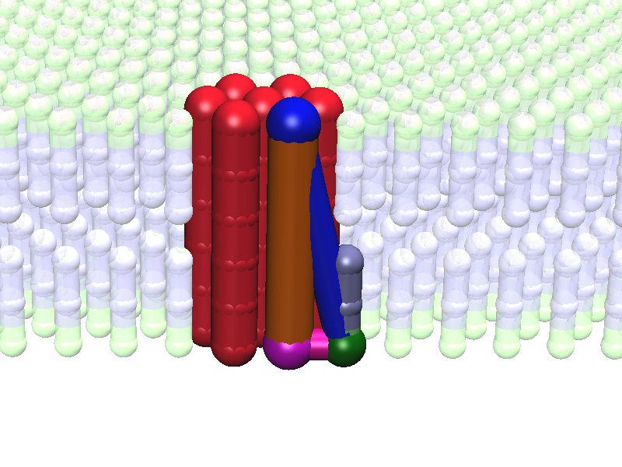
Example: Flippase mediated membrane curvature
Notes:
Flippases are believed to play a role in the maturation and vesiculation of the Golgi apparatus and ER.

Slide 29
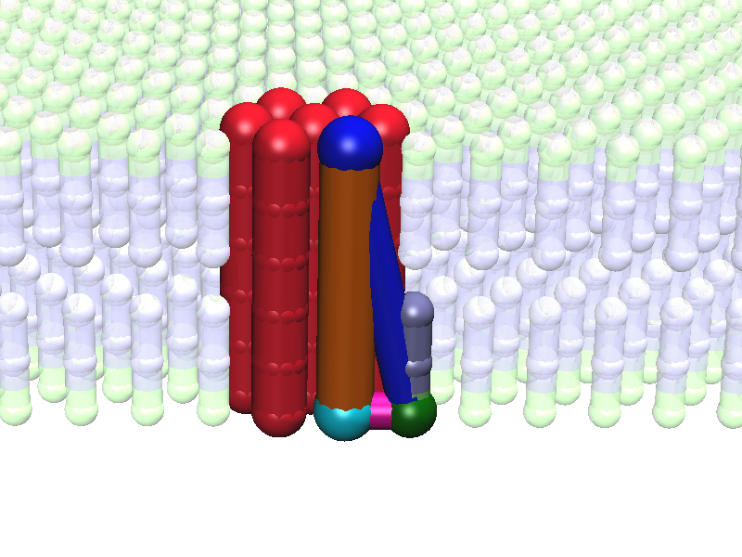
Example: Flippase mediated membrane curvature
Notes:
Flippases are believed to play a role in the maturation and vesiculation of the Golgi apparatus and ER.

Slide 30
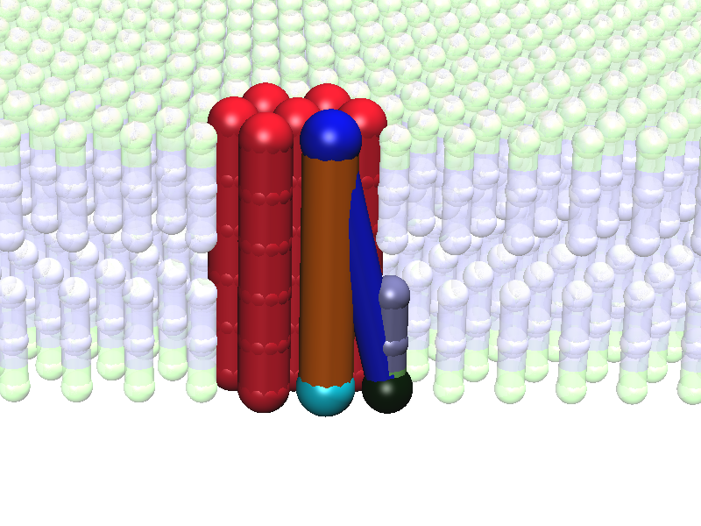
Example: Flippase mediated membrane curvature
Notes:
Flippases are believed to play a role in the maturation and vesiculation of the Golgi apparatus and ER.

Slide 31
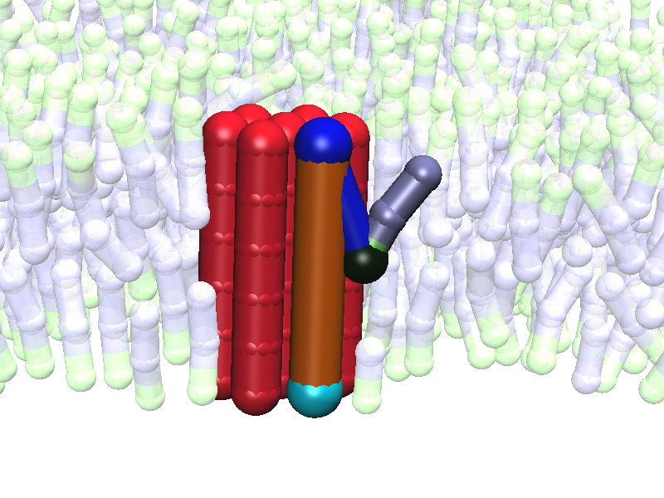
Example: Flippase mediated membrane curvature
Notes:
Flippases are believed to play a role in the maturation and vesiculation of the Golgi apparatus and ER.

Slide 32
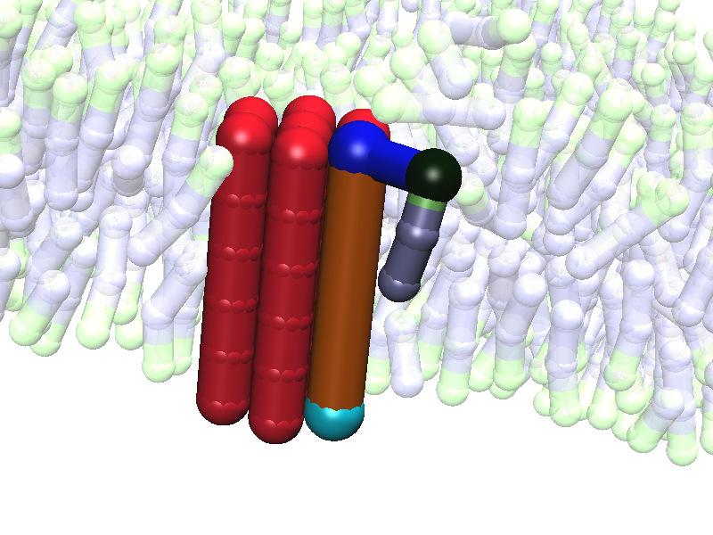
Example: Flippase mediated membrane curvature
Notes:
Flippases are believed to play a role in the maturation and vesiculation of the Golgi apparatus and ER.

Slide 33
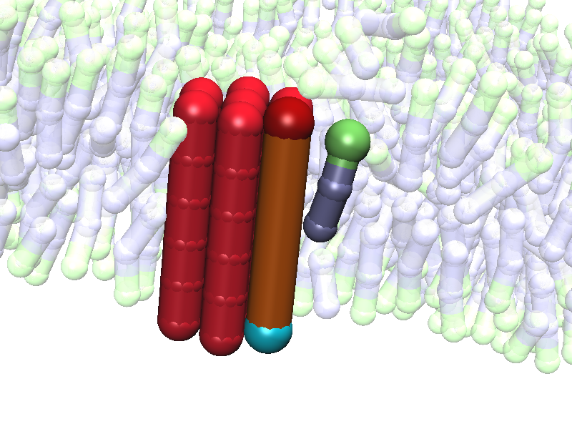
Example: Flippase mediated membrane curvature
Notes:
Flippases are believed to play a role in the maturation and vesiculation of the Golgi apparatus and ER.

Slide 34
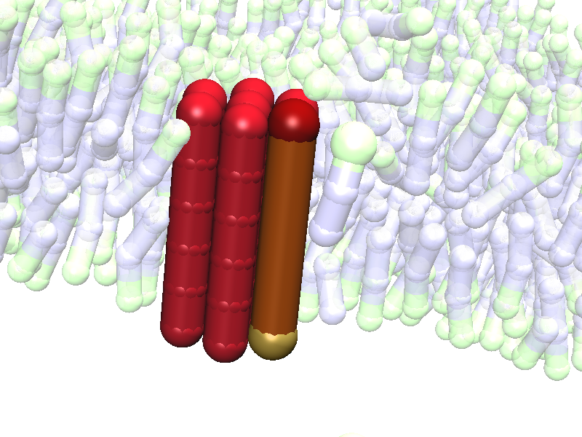
Example: Flippase mediated membrane curvature
CYCLE REPEATS...
Notes:
Flippases are believed to play a role in the maturation and vesiculation of the Golgi apparatus and ER.

Slide 35
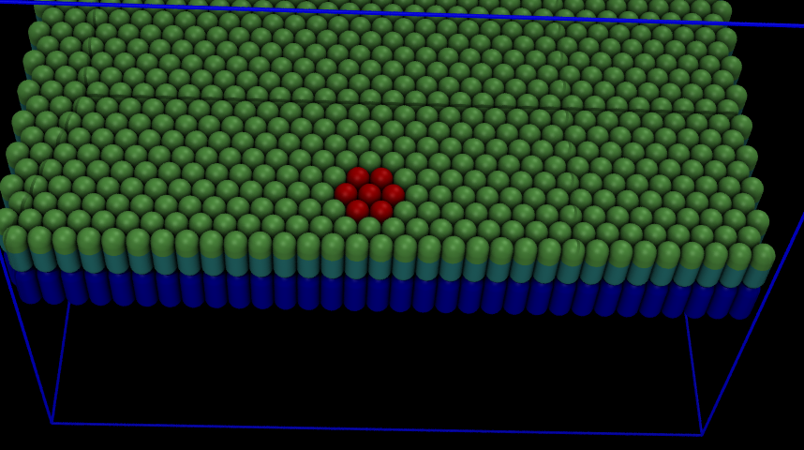
Example: Flippase mediated membrane curvature
Notes:
We are checking whether flippases could explain the creation of outer-membrane-vesicle-chains (OMVCs) seen in many prokaryotes, including Shewanella oneidensis.

Slide 36
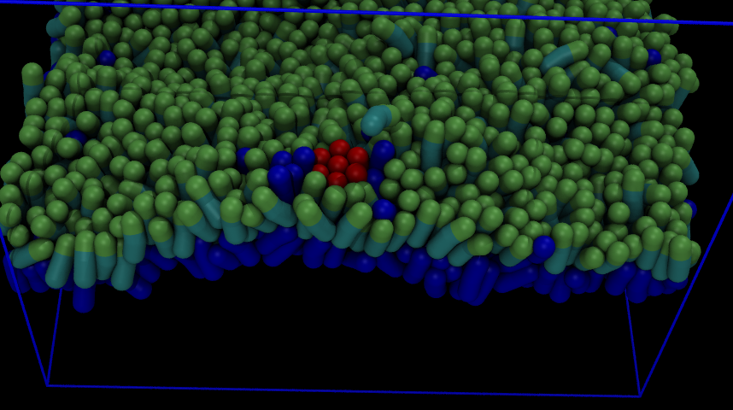
Example: Flippase mediated membrane curvature
Notes:
We are checking whether flippases could explain the creation of outer-membrane-vesicle-chains (OMVCs) seen in many prokaryotes, including Shewanella oneidensis.

Slide 37
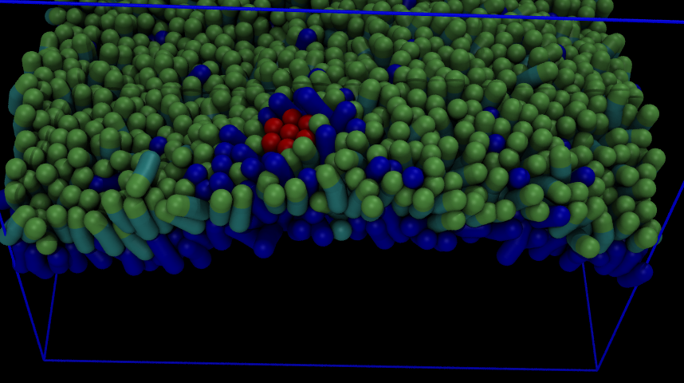
Example: Flippase mediated membrane curvature
Notes:
We are checking whether flippases could explain the creation of outer-membrane-vesicle-chains (OMVCs) seen in many prokaryotes, including Shewanella oneidensis.

Slide 38
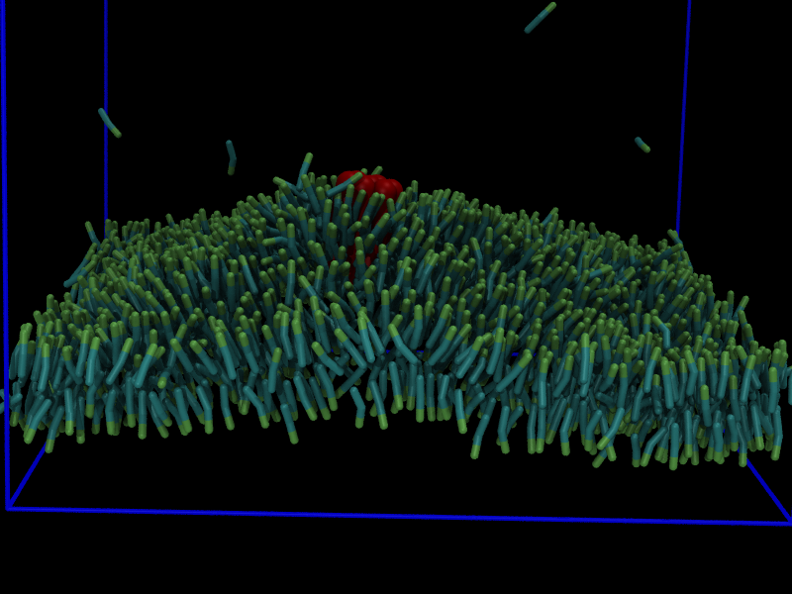
Example: Flippase mediated membrane curvature
Notes:
We are checking whether flippases could explain the creation of outer-membrane-vesicle-chains (OMVCs) seen in many prokaryotes, including Shewanella oneidensis.

Slide 39
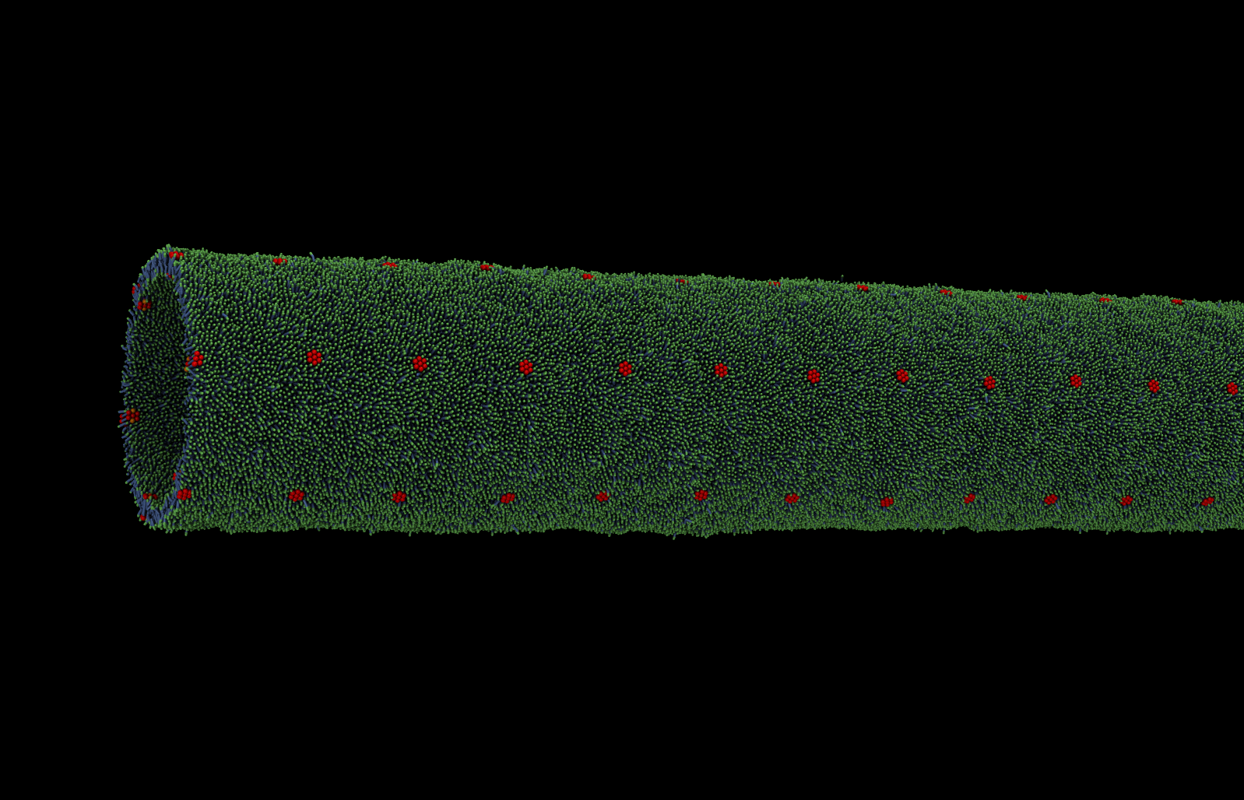
Example: Flippase mediated membrane curvature
P. Subramanian, … G.J.Jensen, BioRXiv(2016)
Notes:
We are checking whether flippases could explain the creation of outer-membrane-vesicle-chains (OMVCs) seen in many prokaryotes, including Shewanella oneidensis.

Slide 40
Example: Flippase mediated membrane curvature
P. Subramanian, … G.J.Jensen, BioRXiv(2016)
SEE:
https://www.youtube.com/watch?v=0cuEeCdyokU
Notes:
We are checking whether flippases could explain the creation of outer-membrane-vesicle-chains (OMVCs) seen in many prokaryotes, including Shewanella oneidensis.

Slide 41
Example 2: Dynamic Instabilty of ParM
ParM + ATP
ParM + ADP
Garner, …, Mullins, Science (2004)

Slide 42
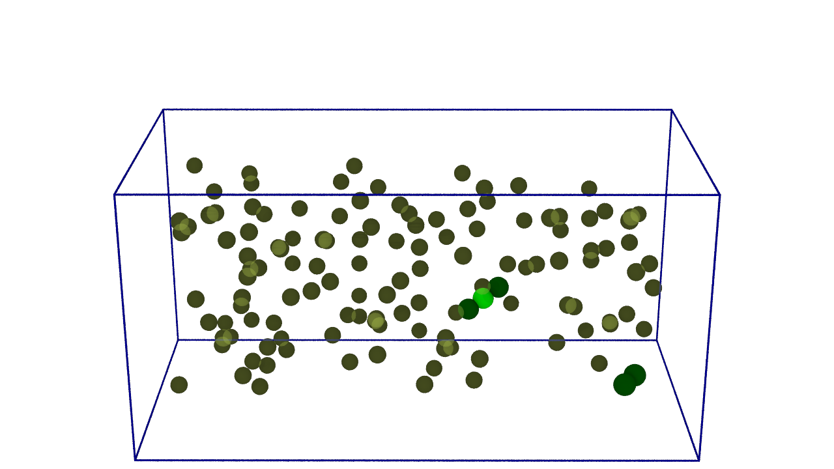
Example 2: Dynamic Instabilty of ParM
ParM + ATP
ParM + ADP
Garner, …, Mullins, Science (2004)

Slide 43
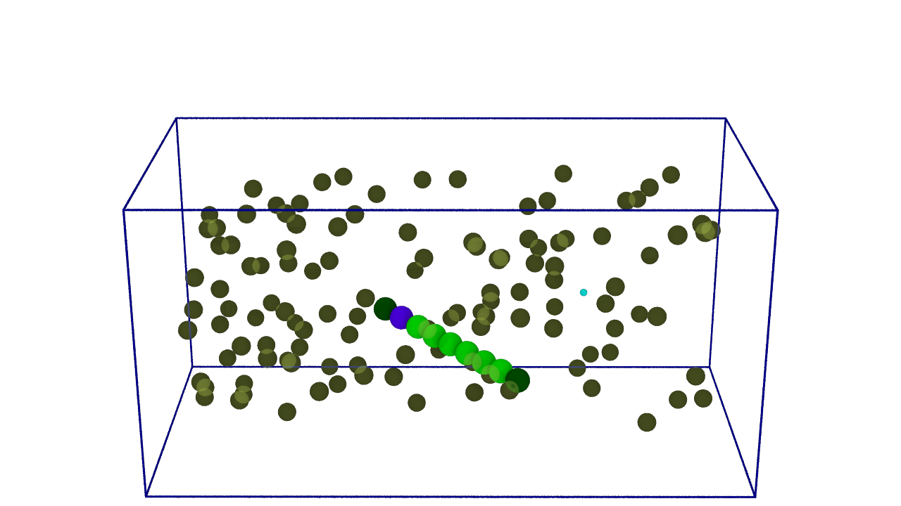
Example 2: Dynamic Instabilty of ParM
ParM + ATP
ParM + ADP
Garner, …, Mullins, Science (2004)

Slide 44
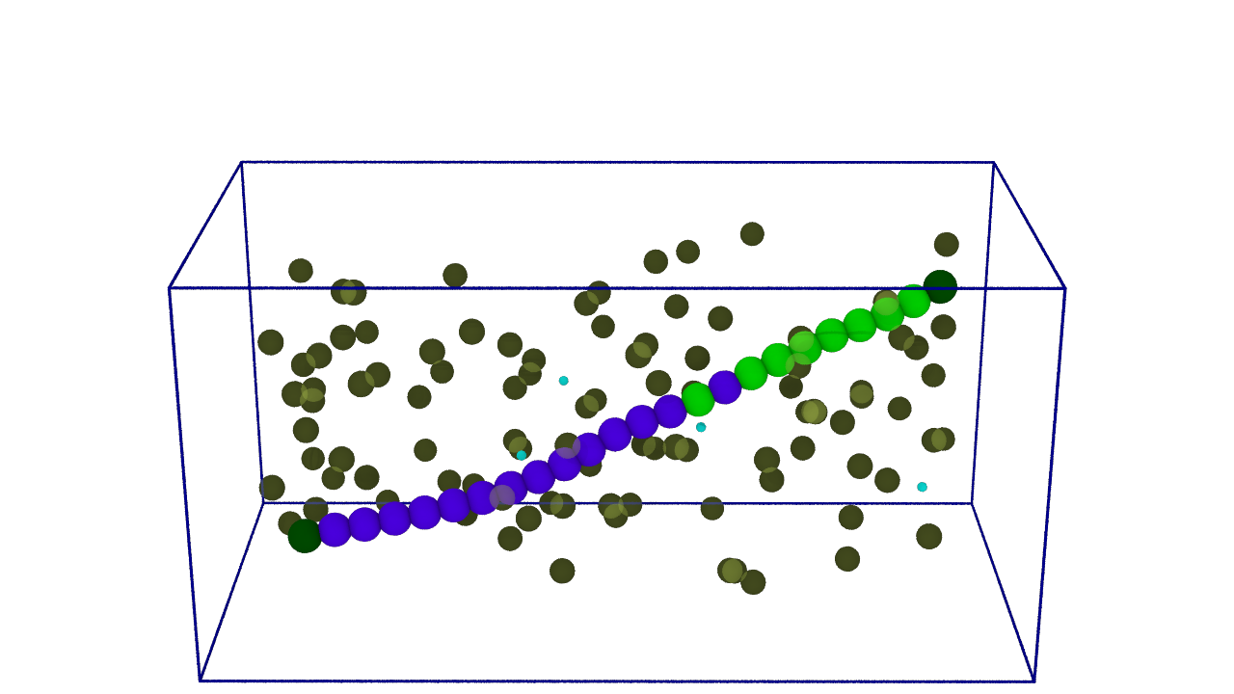
Example 2: Dynamic Instabilty of ParM
ParM + ATP
ParM + ADP
Garner, …, Mullins, Science (2004)

Slide 45
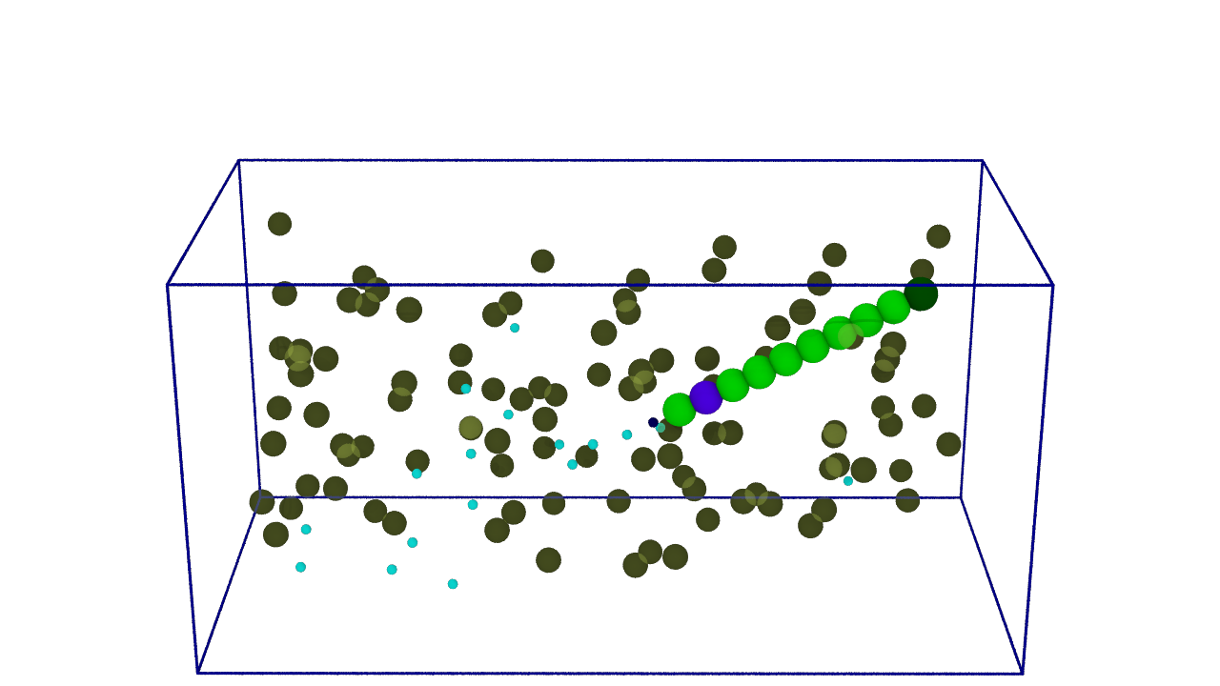
Example 2: Dynamic Instabilty of ParM
ParM + ATP
ParM + ADP
Garner, …, Mullins, Science (2004)

Slide 46
Example 2: Dynamic Instabilty of ParM
SEE:
https://www.youtube.com/watch?v=EEbt07vZHew

Slide 47

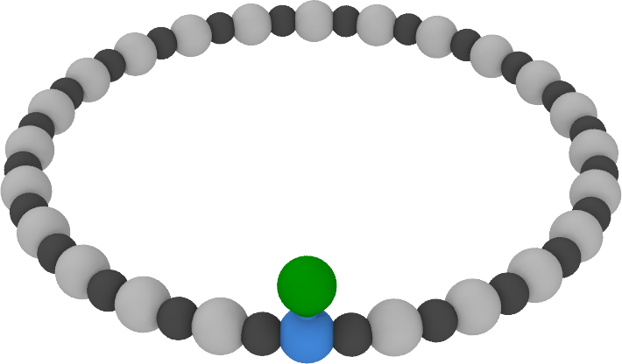



Example: Walking along a polymer
W
v
L
R
L
R
L
R
L
R
L
A
B
At
B
A
B
A
B
SEE:
https://www.youtube.com/watch?v=QO4LbHGAgxU

Slide 48
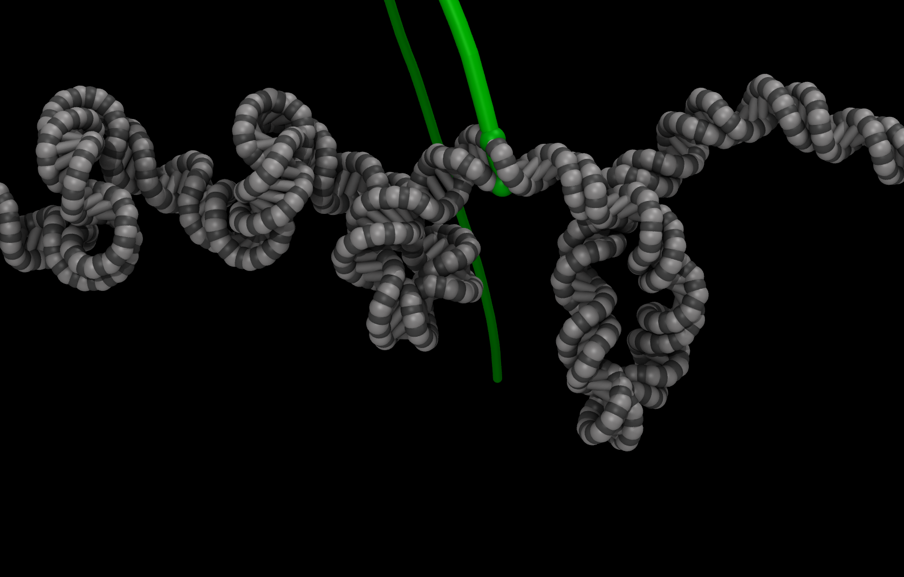
Example: DNA supercoiling during transcription
W
v
L
R
L
R
L
R
L
R
L
A
B
At
B
A
B
A
B
(DNA version with supercoiling)

Slide 49
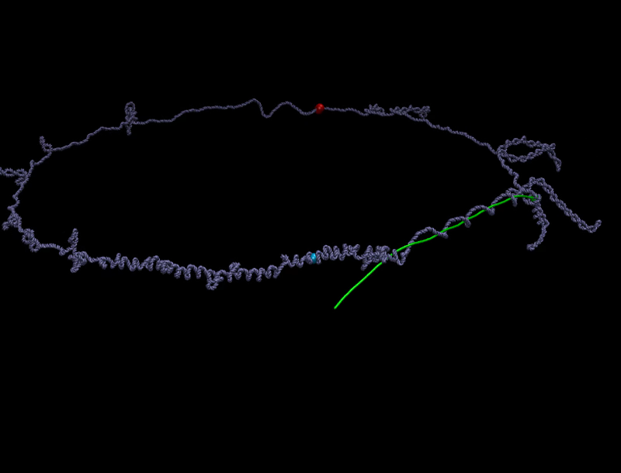
Example: DNA supercoiling during transcription
Notes:
We are checking whether flippases could explain the creation of outer-membrane-vesicle-chains (OMVCs) seen in many prokaryotes, including Shewanella oneidensis.

Slide 50
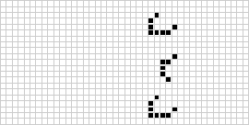
Conways Game of Life in Moltemplate
fix ac1 all bond/change 1 &
atoms @atom:C0 @atom:Live and bond @bond:NeighborUnread
-> atoms @atom:C1 @atom:Dead and bond @bond:NeighborRead
fix ac2 all bond/change 1 &
atoms @atom:C1 @atom:Live and bond @bond:NeighborUnread
-> atoms @atom:C2 @atom:Dead and bond @bond:NeighborRead
fix ac3 all bond/change 1 &
atoms @atom:C2 @atom:Live and bond @bond:NeighborUnread
-> atoms @atom:C3 @atom:Dead and bond @bond:NeighborRead
fix ac4 all bond/change 1 &
atoms @atom:C3 @atom:Live and bond @bond:NeighborUnread
-> atoms @atom:C4 @atom:Dead and bond @bond:NeighborRead
fix aResetNeighbors all bond/change 1 &
bond @bond:NeighborRead -> bond @bond:NeighborUnread
# Underpopulation: Any live cell with less than 2 living neighbors dies
fix aUnderpopulation all bond/change 1 &
atoms @atom:Live @{atom:C0}*@{atom:C1} and bond @bond:SendTotal &
-> atoms @atom:Dead SAME
# Overpopulation: Any live cell with 4 living neighbors dies
fix aOverpopulation all bond/change 1 &
atoms @atom:Live @atom:C4 and bond @bond:SendTotal &
-> atoms @atom:Dead SAME
# Birth: Any dead cell with exactly 3 living neighbors lives
fix aBirth all bond/change 1 &
atoms @atom:Dead @atom:C3 and bond @bond:SendTotal &
-> atoms @atom:Live SAME
fix aResetCounters all atom/change 1 &
atom * -> atom @atom:C0
Notes:
Systems of arbitrary complexity can be simulated this way. This is what Conways Game of life looks like in moltemplate format. You can simulate anything this way.
What is surprising is that it’s convenient to simulate biomolecules this way. The longest program I showed you before this was only 8 lines long. In the bad old days somebody would spend their PhD writing tens of thousands of lines of C++ code to do it
Experimentalists don’t have time for this, but they have the best intuition which ideas should be tested by simulation.
What I want to do is to make my job obsolete. I want the people in this room to be able to come up with their own models and test their own ideas.

