Slide 1
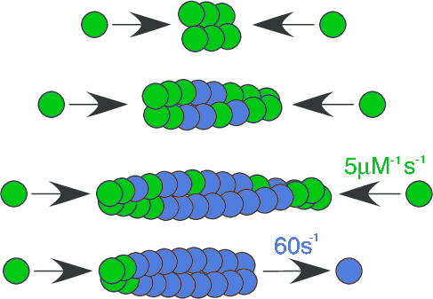
Example: Dynamic Instabilty of ParM
ParM + ATP
ParM + ATP
Garner, …, Mullins, Science (2004)

Slide 2
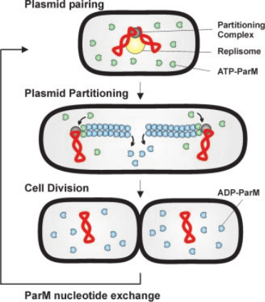
Example: Dynamic Instabilty of ParM
Møller-Jensen, …, Gerdes, EMBOJ (2002)

Slide 3
Example: Dynamic Instabilty of ParM
ParM + ATP
ParM + ATP
Garner, …, Mullins, Science (2004)

Slide 4

Example: Dynamic Instabilty of ParM
TF
TF
# Transition 1: Create a polymer (a dimer)
fix tr1 all bond/new 100 delay 1 &
atoms @atom:TF @atom:TF and distance <= 7.1 and prob 0.1 &
-> atoms @atom:TE @atom:TE and bond @bond:F #(bond type "F")

Slide 5
Example: Dynamic Instabilty of ParM
TF
TF
# Transition 1: Create a polymer (a dimer)
fix tr1 all bond/new 100 delay 1 &
atoms @atom:TF @atom:TF and distance <= 7.1 and prob 0.1 &
-> atoms @atom:TE @atom:TE and bond @bond:F #(bond type "F")
Each LAMMPS command must begin this way
(blame LAMMPS)

Slide 6
Example: Dynamic Instabilty of ParM
TF
TF
# Transition 1: Create a polymer (a dimer)
fix tr1 all bond/new 100 delay 1 &
atoms @atom:TF @atom:TF and distance <= 7.1 and prob 0.1 &
-> atoms @atom:TE @atom:TE and bond @bond:F #(bond type "F")
Must supply a unique name for each command
(eg.“tr1”)

Slide 7
Example: Dynamic Instabilty of ParM
TF
TF
# Transition 1: Create a polymer (a dimer)
fix tr1 all bond/new 100 delay 1 &
atoms @atom:TF @atom:TF and distance <= 7.1 and prob 0.1 &
-> atoms @atom:TE @atom:TE and bond @bond:F #(bond type "F")
What do you want LAMMPS to do?
(eg. create a new bond
bond)

Slide 8
Example: Dynamic Instabilty of ParM
TF
TF
# Transition 1: Create a polymer (a dimer)
fix tr1 all bond/new 100 delay 1 &
atoms @atom:TF @atom:TF and distance <= 7.1 and prob 0.1 &
-> atoms @atom:TE @atom:TE and bond @bond:F #(bond type "F")
How frequently do you want LAMMPS to do it?

Slide 9
Example: Dynamic Instabilty of ParM
TF
TF
# Transition 1: Create a polymer (a dimer)
fix tr1 all bond/new 100 delay 1 &
atoms @atom:TF @atom:TF and distance <= 7.1 and prob 0.1 &
-> atoms @atom:TE @atom:TE and bond @bond:F #(bond type "F")
When do you want LAMMPS to do it?
(similar to a “line number”)

Slide 10
Example: Dynamic Instabilty of ParM
TF
TF
# Transition 1: Create a polymer (a dimer)
fix tr1 all bond/new 100 delay 1 &
atoms @atom:TF @atom:TF and distance <= 7.1 and prob 0.1 &
-> atoms @atom:TE @atom:TE and bond @bond:F #(bond type "F")

Slide 11
Example: Dynamic Instabilty of ParM
TF
TF
# Transition 1: Create a polymer (a dimer)
fix tr1 all bond/new 100 delay 1 &
atoms @atom:TF @atom:TF and distance <= 7.1 and prob 0.1 &
-> atoms @atom:TE @atom:TE and bond @bond:F #(bond type "F")

Slide 12
Example: Dynamic Instabilty of ParM
TF
TF
# Transition 1: Create a polymer (a dimer)
fix tr1 all bond/new 100 delay 1 &
atoms @atom:TF @atom:TF and distance <= 7.1 and prob 0.1 &
-> atoms @atom:TE @atom:TE and bond @bond:F #(bond type "F")

Slide 13
Creating a new polymer
TF
TF
# Transition 1: Create a polymer (a dimer)
fix tr1 all bond/new 100 delay 1 &
atoms @atom:TF @atom:TF and distance <= 7.1 and prob 0.1 &
-> atoms @atom:TE @atom:TE and bond @bond:F #(bond type "F")

Slide 14

Creating a new polymer
tr1
TF
TE
TE
TF
# Transition 1: Create a polymer (a dimer)
fix tr1 all bond/new 100 delay 1 &
atoms @atom:TF @atom:TF and distance <= 7.1 and prob 0.1 &
-> atoms @atom:TE @atom:TE and bond @bond:F #(bond type "F")

Slide 15
Creating a new polymer
tr1
TF
TE
TE
TF
# Transition 1: Create a polymer (a dimer)
fix tr1 all bond/new 100 delay 1 &
atoms @atom:TF @atom:TF and distance <= 7.1 and prob 0.1 &
-> atoms @atom:TE @atom:TE and bond @bond:F #(bond type "F")

Slide 16
Creating a new polymer
tr1
TF
TE
TE
TF
# Transition 1: Create a polymer (a dimer)
fix tr1 all bond/new 100 delay 1 &
atoms @atom:TF @atom:TF and distance <= 7.1 and prob 0.1 &
-> atoms @atom:TE @atom:TE and bond @bond:F #(bond type "F")

Slide 17
tr1
TF
TE
TE
TF
# Transition 1: Create a polymer (a dimer)
fix tr1 all bond/new 100 delay 1 &
atoms @atom:TF @atom:TF and distance <= 7.1 and prob 0.1 &
-> atoms @atom:TE @atom:TE and bond @bond:F #(bond type "F")

Slide 18
Creating a new polymer
tr1
TF
TE
TE
TF
# Transition 1: Create a polymer (a dimer)
fix tr1 all bond/new 100 delay 1 &
atoms @atom:TF @atom:TF and distance <= 7.1 and prob 0.1 &
-> atoms @atom:TE @atom:TE and bond @bond:F #(bond type "F")

Slide 19
Creating a new polymer
tr1
TF
tr2
TE
TE
TF
# Transition 1: Create a polymer (a dimer)
fix tr1 all bond/new 100 delay 1 &
atoms @atom:TF @atom:TF and distance <= 7.1 and prob 0.1 &
-> atoms @atom:TE @atom:TE and bond @bond:F #(bond type "F")
# Transition 2: Destabilize dimers (only trimers are stable)
fix tr2 all bond/change 100 delay 2 &
atoms @atom:TE @atom:TE and prob 0.9 &
-> atoms @atom:TF @atom:TF and bond BREAK

Slide 20
Creating a new polymer
tr1
TF
tr2
TE
TE
TF
# Transition 1: Create a polymer (a dimer)
fix tr1 all bond/new 100 delay 1 &
atoms @atom:TF @atom:TF and distance <= 7.1 and prob 0.1 &
-> atoms @atom:TE @atom:TE and bond @bond:F #(bond type "F")
# Transition 2: Destabilize dimers (only trimers are stable)
fix tr2 all bond/change 100 delay 2 &
atoms @atom:TE @atom:TE and prob 0.9 &
-> atoms @atom:TF @atom:TF and bond BREAK

Slide 21
tr1
TF
tr2
TE
TE
TF
# Transition 1: Create a polymer (a dimer)
fix tr1 all bond/new 100 delay 1 &
atoms @atom:TF @atom:TF and distance <= 7.1 and prob 0.1 &
-> atoms @atom:TE @atom:TE and bond @bond:F #(bond type "F")
# Transition 2: Destabilize dimers (only trimers are stable)
fix tr2 all bond/change 100 delay 2 &
atoms @atom:TE @atom:TE and prob 0.9 &
-> atoms @atom:TF @atom:TF and bond BREAK

Slide 22

Growing the polymer
TF
tr3
TE
TB
TE
TE
TB
TB
TE
# Transition 3: Attach monomers to the end of a polymer:
fix tr3 all bond/new 100 delay 3 &
atoms @atom:TE @atom:TF and distance <= 7.1 and prob 0.25 &
-> atoms @atom:TB @atom:TE and bond @bond:F angle @angle:S TB TB TE
angle_coeff @angle:S harmonic 851.1 180 #(persistence=10um)

Slide 23
Growing the polymer (details)
TF
TE
TB
TE
# Transition 3: Attach monomers to the end of a polymer:
fix tr3 all bond/new 100 delay 3 &
atoms @atom:TE @atom:TF and distance <= 7.1 and prob 0.25 &
-> atoms @atom:TB @atom:TE and bond @bond:F

Slide 24
Growing the polymer
TF
TE
TB
TE
# Transition 3: Attach monomers to the end of a polymer:
fix tr3 all bond/new 100 delay 3 &
atoms @atom:TE @atom:TF and distance <= 7.1 and prob 0.25 &
-> atoms @atom:TB @atom:TE and bond @bond:F

Slide 25
Growing the polymer
TE
TE
TB
TB
# Transition 3: Attach monomers to the end of a polymer:
fix tr3 all bond/new 100 delay 3 &
atoms @atom:TE @atom:TF and distance <= 7.1 and prob 0.25 &
-> atoms @atom:TB @atom:TE and bond @bond:F

Slide 26
Growing the polymer
TE
TE
TB
TB
# Transition 3: Attach monomers to the end of a polymer:
fix tr3 all bond/new 100 delay 3 &
atoms @atom:TE @atom:TF and distance <= 7.1 and prob 0.25 &
-> atoms @atom:TB @atom:TE and bond @bond:F

Slide 27
polymer stiffness (add 3-body interaction)
TE
TE
TB
TB

Slide 28
polymer stiffness (add 3-body interaction)
TE
TB
TB
TE
# Transition 3: Attach monomers to the end of a polymer:
fix tr3 all bond/new 100 delay 3 &
atoms @atom:TE @atom:TF and distance <= 7.1 and prob 0.25 &
-> atoms @atom:TB @atom:TE and bond @bond:F

Slide 29
polymer stiffness (add 3-body interaction)
TE
TB
TB
TE
# Transition 3: Attach monomers to the end of a polymer:
fix tr3 all bond/new 100 delay 3 &
atoms @atom:TE @atom:TF and distance <= 7.1 and prob 0.25 &
-> atoms @atom:TB @atom:TE and bond @bond:F angle @angle:S TB TB TE

Slide 30
polymer stiffness (add 3-body interaction)
TE
TB
TB
TE
# Transition 3: Attach monomers to the end of a polymer:
fix tr3 all bond/new 100 delay 3 &
atoms @atom:TE @atom:TF and distance <= 7.1 and prob 0.25 &
-> atoms @atom:TB @atom:TE and bond @bond:F angle @angle:S TB TB TE

Slide 31
polymer stiffness (add 3-body interaction)
TE
TB
TB
TE
# Transition 3: Attach monomers to the end of a polymer:
fix tr3 all bond/new 100 delay 3 &
atoms @atom:TE @atom:TF and distance <= 7.1 and prob 0.25 &
-> atoms @atom:TB @atom:TE and bond @bond:F angle @angle:S TB TB TE
angle_coeff @angle:S harmonic 851.1 180 #(persistence=10um)

Slide 32
polymer stiffness (add 3-body interaction)
TE
TB
TB
TE
# Transition 3: Attach monomers to the end of a polymer:
fix tr3 all bond/new 100 delay 3 &
atoms @atom:TE @atom:TF and distance <= 7.1 and prob 0.25 &
-> atoms @atom:TB @atom:TE and bond @bond:F angle @angle:S TB TB TE
angle_coeff @angle:S harmonic 851.1 180

Slide 33
polymer stiffness (add 3-body interaction)
TE
TB
TB
TE
# Transition 3: Attach monomers to the end of a polymer:
fix tr3 all bond/new 100 delay 3 &
atoms @atom:TE @atom:TF and distance <= 7.1 and prob 0.25 &
-> atoms @atom:TB @atom:TE and bond @bond:F angle @angle:S TB TB TE
angle_coeff @angle:S harmonic 851.1 180 #(persistence=10um)

Slide 34
maturation and depolymerization
TB
# Transition 4: Hydrolize ATP (ATP -> ADP)
fix tr4 all atom/change 100 delay 4 &
atom @atom:TB and prob 0.0015 -> ?

Slide 35

maturation and depolymerization
TB
tr4
DB
# Transition 4: Hydrolize ATP (ATP -> ADP)
fix tr4 all atom/change 100 delay 4 &
atom @atom:TB and prob 0.0015 -> atom @atom:DB

Slide 36
maturation and depolymerization
TB
tr4
DB
# Transition 4: Hydrolize ATP (ATP -> ADP)
fix tr4 all atom/change 100 delay 4 &
atom @atom:TB and prob 0.0015 -> atom @atom:DB

Slide 37

maturation and depolymerization
TE
tr5
DE
# Transition 5: Hydrolize ATP (ATP -> ADP)
fix tr5 all atom/change 100 delay 5 &
atom @atom:TE and prob 0.0015 -> atom @atom:DE

Slide 38
maturation and depolymerization
DB
TB
TB
TB
TB
TB
TE
# Transition 4: Hydrolize ATP (ATP -> ADP)
fix tr4 all atom/change 100 delay 4 &
atom @atom:TB and prob 0.0015 -> atom @atom:DB

Slide 39
maturation and depolymerization
DB
TB
DB
TB
TB
TB
TE
# Transition 4: Hydrolize ATP (ATP -> ADP)
fix tr4 all atom/change 100 delay 4 &
atom @atom:TB and prob 0.0015 -> atom @atom:DB

Slide 40
maturation and depolymerization
DB
DB
DB
TB
DB
TB
TE
# Transition 4: Hydrolize ATP (ATP -> ADP)
fix tr4 all atom/change 100 delay 4 &
atom @atom:TB and prob 0.0015 -> atom @atom:DB

Slide 41
maturation and depolymerization
DB
DB
DB
DB
DB
DB
TE
# Transition 4: Hydrolize ATP (ATP -> ADP)
fix tr4 all atom/change 100 delay 4 &
atom @atom:TB and prob 0.0015 -> atom @atom:DB

Slide 42
maturation and depolymerization
DB
DB
DB
DB
DB
DB
TE
# Transition 4: Hydrolize ATP (ATP -> ADP)
fix tr4 all atom/change 100 delay 4 &
atom @atom:TB and prob 0.0015 -> atom @atom:DB
# Transition 5: Hydrolize ATP (ATP -> ADP)
fix tr5 all atom/change 100 delay 5 &
atom @atom:TE and prob 0.0015 -> atom @atom:DE

Slide 43
maturation and depolymerization
DB
DB
DB
DB
DB
DB
DE
# Transition 4: Hydrolize ATP (ATP -> ADP)
fix tr4 all atom/change 100 delay 4 &
atom @atom:TB and prob 0.0015 -> atom @atom:DB
# Transition 5: Hydrolize ATP (ATP -> ADP)
fix tr5 all atom/change 100 delay 5 &
atom @atom:TE and prob 0.0015 -> atom @atom:DE

Slide 44
maturation and depolymerization
DB
DB
DB
DB
DB
DB
DE

Slide 45
maturation and depolymerization
DB
DB
DB
DB
DB
DB
DE
# Transitions 5: Depolymerize ADP-bound ParM at the end (DE)
fix tr6 all bond/change 100 delay 5 &
atoms @atom:DB @atom:DE &
-> atoms @atom:DE @atom:DF and bond BREAK

Slide 46

maturation and depolymerization
DB
DB
DB
DB
DB
DE
DF
# Transitions 5: Depolymerize ADP-bound ParM at the end (DE)
fix tr6 all bond/change 100 delay 5 &
atoms @atom:DB @atom:DE &
-> atoms @atom:DE @atom:DF and bond BREAK

Slide 47
maturation and depolymerization
maturation and depolymerization
DF
DB
DB
DB
DB
DB
DB
DB
DB
DE
DF
# Transitions 5: Depolymerize ADP-bound ParM at the end (DE)
fix tr6 all bond/change 100 delay 5 &
atoms @atom:DB @atom:DE &
-> atoms @atom:DE @atom:DF and bond BREAK

Slide 48
maturation and depolymerization
DF
DB
DB
DB
DE
DB
DB
DB
DF
DF
# Transitions 5: Depolymerize ADP-bound ParM at the end (DE)
fix tr6 all bond/change 100 delay 5 &
atoms @atom:DB @atom:DE &
-> atoms @atom:DE @atom:DF and bond BREAK

Slide 49
maturation and depolymerization
DF
DF
DB
DB
DE
DF
DF
# Transitions 5: Depolymerize ADP-bound ParM at the end (DE)
fix tr6 all bond/change 100 delay 5 &
atoms @atom:DB @atom:DE &
-> atoms @atom:DE @atom:DF and bond BREAK

Slide 50
maturation and depolymerization
DF
DF
DB
DE
DF
DF
DF
# Transitions 5: Depolymerize ADP-bound ParM at the end (DE)
fix tr6 all bond/change 100 delay 5 &
atoms @atom:DB @atom:DE &
-> atoms @atom:DE @atom:DF and bond BREAK

Slide 51
maturation and depolymerization
DF
DF
DB
DE
DF
DF
DF
# Transitions 5: Depolymerize ADP-bound ParM at the end (DE)
fix tr6 all bond/change 100 delay 5 &
atoms @atom:DB @atom:DE &
-> atoms @atom:DE @atom:DF and bond BREAK

Slide 52
maturation and depolymerization
DF
tr6
TF
# Transition 6: Recycle ATP -> ADP (bound to ParM)
fix tr6 all atom/change 100 delay 6 &
atom @atom:DF and prob 0.0015 -> atom @atom:TF

Slide 53
maturation and depolymerization
DF
TF
TF
DF
tr6
TF
DF
TF
DF
# Transition 6: Recycle ATP -> ADP (bound to ParM)
fix tr6 all atom/change 100 delay 6 &
atom @atom:DF and prob 0.0015 -> atom @atom:TF

Slide 54
Example: Dynamic Instabilty of ParM
tr1
TF
TE
TE
TF
# Transition 1: Create a polymer (a dimer)
fix tr1 all bond/new 100 delay 1 &
atoms @atom:TF @atom:TF and distance <= 7.1 and prob 0.1 &
-> atoms @atom:TE @atom:TE and bond @bond:F

Slide 55
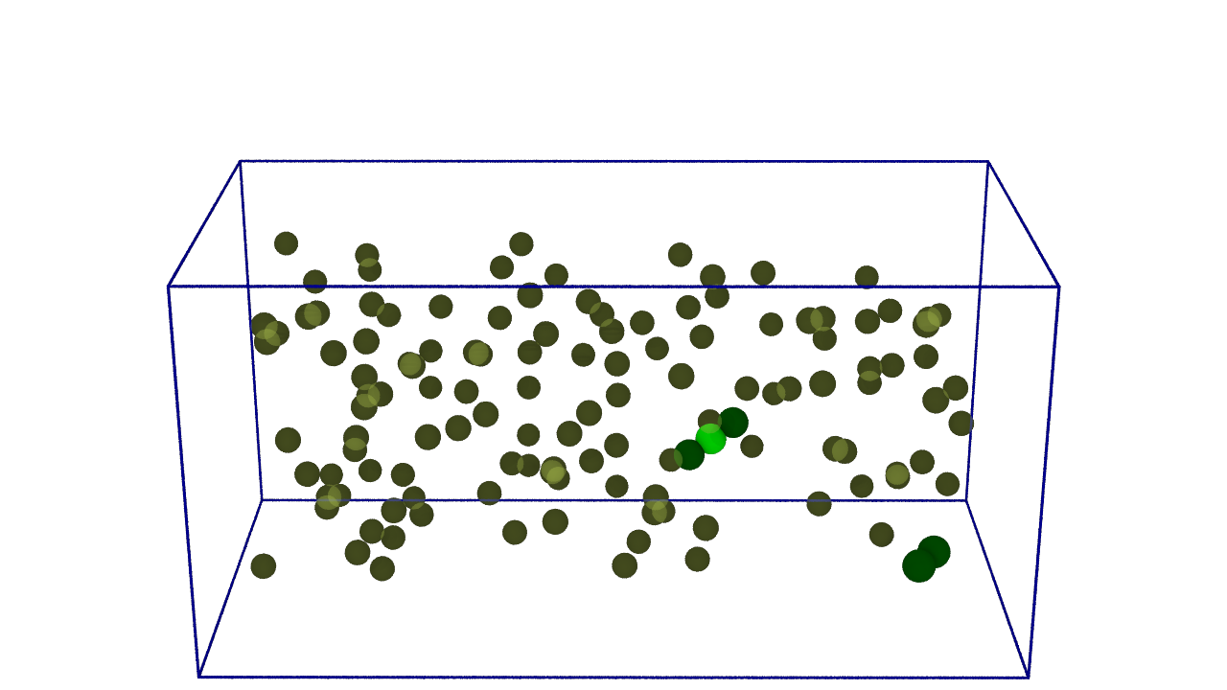
slow growth...
ParM + ATP
ParM + ADP
Garner, …, Mullins, Science (2004)

Slide 56
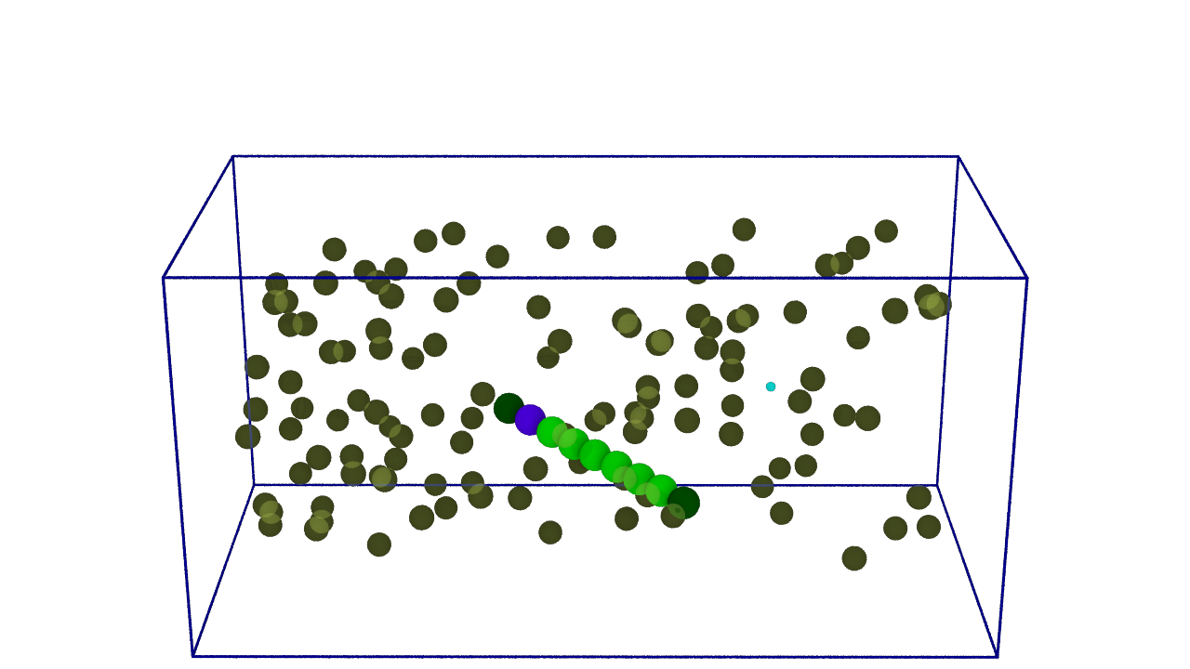
slow growth...
ParM + ATP
ParM + ADP
Garner, …, Mullins, Science (2004)

Slide 57
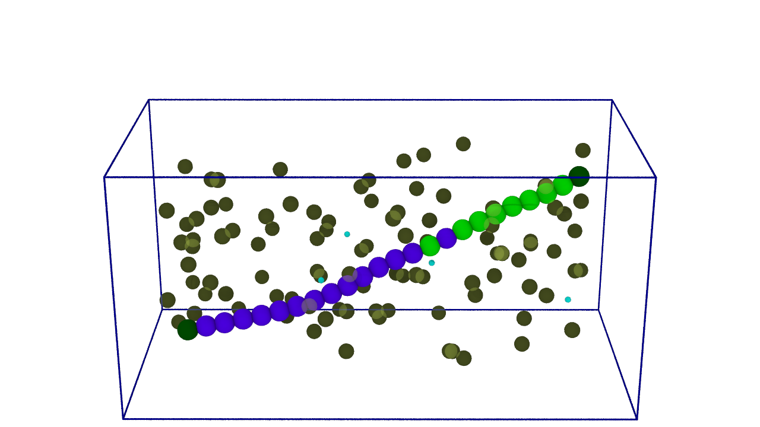
slow growth...
ParM + ATP
ParM + ADP
Garner, …, Mullins, Science (2004)

Slide 58
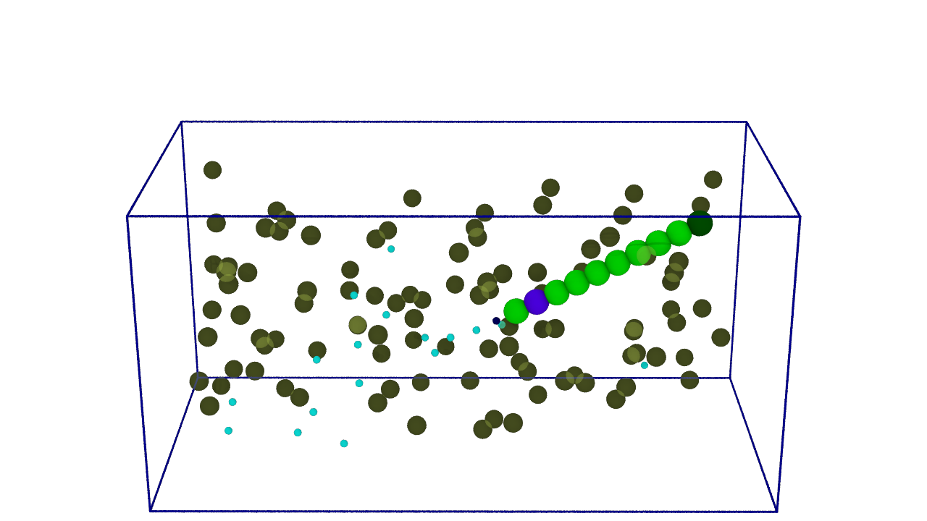
sudden collapse
ParM + ATP
ParM + ADP
Garner, …, Mullins, Science (2004)

Slide 59
repeat...
If you have time, see the youtube video at:
https://www.youtube.com/watch?v=EEbt07vZHew

