Slide 1



Example: Walking along a polymer
W
We want the green bead to “walk” along the polymer
v
A
B
A
A
A
A
A
Notes:
A simpler approach I’ve found is to have two different types of bonds, one on either side (“R” and “L”).
We can add an additional particle between the white atoms to pass messages from one white atom to the next.
This actually need not slow down the simulation. The forces on these atoms need not be calculated because the only role they play is to pass messages from one white atom to the next atom (on the right side).

Slide 2
Walker
molecule
W
Attachment
site
v
A
B
A
A
A
A
A
Notes:
A simpler approach I’ve found is to have two different types of bonds, one on either side (“R” and “L”).
We can add an additional particle between the white atoms to pass messages from one white atom to the next.
This actually need not slow down the simulation. The forces on these atoms need not be calculated because the only role they play is to pass messages from one white atom to the next atom (on the right side).

Slide 3
Example: Walking along a polymer
W
v
A
B
A
A
A
A
A
fix tr1 all bond/change 100 delay 1
if atoms @atom:B @atom:A and ordered
-> atoms @atom:A @atom:Bt
fix tr2 all bond/new 100 delay 2
if atoms @atom:W @atom:Bt and distance <= 1.5
-> atoms @atom:Wt @atom:B and bond @bond:V
fix tr3 all bond/modify 100 delay 3
if atoms @atom:Wt @atom:A
-> atoms @atom:W @atom:A and bond BREAK
Notes:
A simpler approach I’ve found is to have two different types of bonds, one on either side (“R” and “L”).
We can add an additional particle between the white atoms to pass messages from one white atom to the next.
This actually need not slow down the simulation. The forces on these atoms need not be calculated because the only role they play is to pass messages from one white atom to the next atom (on the right side).

Slide 4
Example: Walking along a polymer
W
v
A
B
A
A
A
A
A
fix tr1 all bond/change 100 delay 1
if atoms @atom:B @atom:A and ordered
-> atoms @atom:A @atom:Bt
Notes:
A simpler approach I’ve found is to have two different types of bonds, one on either side (“R” and “L”).
We can add an additional particle between the white atoms to pass messages from one white atom to the next.
This actually need not slow down the simulation. The forces on these atoms need not be calculated because the only role they play is to pass messages from one white atom to the next atom (on the right side).

Slide 5
Example: Walking along a polymer
W
v
A
B
A
A
A
A
A
fix tr1 all bond/change 100 delay 1
if atoms @atom:B @atom:A and ordered
-> atoms @atom:A @atom:Bt
Notes:
A simpler approach I’ve found is to have two different types of bonds, one on either side (“R” and “L”).
We can add an additional particle between the white atoms to pass messages from one white atom to the next.
This actually need not slow down the simulation. The forces on these atoms need not be calculated because the only role they play is to pass messages from one white atom to the next atom (on the right side).

Slide 6
Example: Walking along a polymer
W
v
A
B
A
A
A
A
A
fix tr1 all bond/change 100 delay 1
if atoms @atom:B @atom:A and ordered
-> atoms @atom:A @atom:Bt
Notes:
A simpler approach I’ve found is to have two different types of bonds, one on either side (“R” and “L”).
We can add an additional particle between the white atoms to pass messages from one white atom to the next.
This actually need not slow down the simulation. The forces on these atoms need not be calculated because the only role they play is to pass messages from one white atom to the next atom (on the right side).

Slide 7

Example: Walking along a polymer
W
v
A
A
Bt
A
A
A
A
fix tr1 all bond/change 100 delay 1
if atoms @atom:B @atom:A and ordered
-> atoms @atom:A @atom:Bt
Notes:
A simpler approach I’ve found is to have two different types of bonds, one on either side (“R” and “L”).
We can add an additional particle between the white atoms to pass messages from one white atom to the next.
This actually need not slow down the simulation. The forces on these atoms need not be calculated because the only role they play is to pass messages from one white atom to the next atom (on the right side).

Slide 8
Example: Walking along a polymer
W
v
A
A
Bt
A
A
A
A
fix tr1 all bond/change 100 delay 1
if atoms @atom:B @atom:A and ordered
-> atoms @atom:A @atom:Bt
Notes:
A simpler approach I’ve found is to have two different types of bonds, one on either side (“R” and “L”).
We can add an additional particle between the white atoms to pass messages from one white atom to the next.
This actually need not slow down the simulation. The forces on these atoms need not be calculated because the only role they play is to pass messages from one white atom to the next atom (on the right side).

Slide 9
Example: Walking along a polymer
W
v
A
A
Bt
A
A
A
A
fix tr1 all bond/change 100 delay 1
if atoms @atom:B @atom:A and ordered
-> atoms @atom:A @atom:Bt
fix tr2 all bond/new 100 delay 2
if atoms @atom:W @atom:Bt and distance <= 1.5
-> atoms @atom:Wt @atom:B and bond @bond:V
Notes:
A simpler approach I’ve found is to have two different types of bonds, one on either side (“R” and “L”).
We can add an additional particle between the white atoms to pass messages from one white atom to the next.
This actually need not slow down the simulation. The forces on these atoms need not be calculated because the only role they play is to pass messages from one white atom to the next atom (on the right side).

Slide 10
Example: Walking along a polymer
W
v
A
A
Bt
A
A
A
A
fix tr1 all bond/change 100 delay 1
if atoms @atom:B @atom:A and ordered
-> atoms @atom:A @atom:Bt
fix tr2 all bond/new 100 delay 2
if atoms @atom:W @atom:Bt and distance <= 1.5
-> atoms @atom:Wt @atom:B and bond @bond:V
Notes:
A simpler approach I’ve found is to have two different types of bonds, one on either side (“R” and “L”).
We can add an additional particle between the white atoms to pass messages from one white atom to the next.
This actually need not slow down the simulation. The forces on these atoms need not be calculated because the only role they play is to pass messages from one white atom to the next atom (on the right side).

Slide 11
Example: Walking along a polymer
W
v
A
A
Bt
A
A
A
A
fix tr1 all bond/change 100 delay 1
if atoms @atom:B @atom:A and ordered
-> atoms @atom:A @atom:Bt
fix tr2 all bond/new 100 delay 2
if atoms @atom:W @atom:Bt and distance <= 1.5
-> atoms @atom:Wt @atom:B and bond @bond:V
Notes:
A simpler approach I’ve found is to have two different types of bonds, one on either side (“R” and “L”).
We can add an additional particle between the white atoms to pass messages from one white atom to the next.
This actually need not slow down the simulation. The forces on these atoms need not be calculated because the only role they play is to pass messages from one white atom to the next atom (on the right side).

Slide 12
Example: Walking along a polymer
W
v
v
A
A
Bt
A
A
A
A
fix tr1 all bond/change 100 delay 1
if atoms @atom:B @atom:A and ordered
-> atoms @atom:A @atom:Bt
fix tr2 all bond/new 100 delay 2
if atoms @atom:W @atom:Bt and distance <= 1.5
-> atoms @atom:Wt @atom:B and bond @bond:V
Notes:
A simpler approach I’ve found is to have two different types of bonds, one on either side (“R” and “L”).
We can add an additional particle between the white atoms to pass messages from one white atom to the next.
This actually need not slow down the simulation. The forces on these atoms need not be calculated because the only role they play is to pass messages from one white atom to the next atom (on the right side).

Slide 13
Example: Walking along a polymer
W
v
v
A
A
Bt
A
A
A
A
fix tr1 all bond/change 100 delay 1
if atoms @atom:B @atom:A and ordered
-> atoms @atom:A @atom:Bt
fix tr2 all bond/new 100 delay 2
if atoms @atom:W @atom:Bt and distance <= 1.5
-> atoms @atom:Wt @atom:B and bond @bond:V
Notes:
A simpler approach I’ve found is to have two different types of bonds, one on either side (“R” and “L”).
We can add an additional particle between the white atoms to pass messages from one white atom to the next.
This actually need not slow down the simulation. The forces on these atoms need not be calculated because the only role they play is to pass messages from one white atom to the next atom (on the right side).

Slide 14

Example: Walking along a polymer
Wt
v
v
A
A
B
A
A
A
A
fix tr1 all bond/change 100 delay 1
if atoms @atom:B @atom:A and ordered
-> atoms @atom:A @atom:Bt
fix tr2 all bond/new 100 delay 2
if atoms @atom:W @atom:Bt and distance <= 1.5
-> atoms @atom:Wt @atom:B and bond @bond:V
Notes:
A simpler approach I’ve found is to have two different types of bonds, one on either side (“R” and “L”).
We can add an additional particle between the white atoms to pass messages from one white atom to the next.
This actually need not slow down the simulation. The forces on these atoms need not be calculated because the only role they play is to pass messages from one white atom to the next atom (on the right side).

Slide 15
Example: Walking along a polymer
Wt
v
v
A
A
B
A
A
A
A
fix tr1 all bond/change 100 delay 1
if atoms @atom:B @atom:A and ordered
-> atoms @atom:A @atom:Bt
fix tr2 all bond/new 100 delay 2
if atoms @atom:W @atom:Bt and distance <= 1.5
-> atoms @atom:Wt @atom:B and bond @bond:V
Notes:
A simpler approach I’ve found is to have two different types of bonds, one on either side (“R” and “L”).
We can add an additional particle between the white atoms to pass messages from one white atom to the next.
This actually need not slow down the simulation. The forces on these atoms need not be calculated because the only role they play is to pass messages from one white atom to the next atom (on the right side).

Slide 16
Example: Walking along a polymer
Wt
v
v
A
A
B
A
A
A
A
fix tr1 all bond/change 100 delay 1
if atoms @atom:B @atom:A and ordered
-> atoms @atom:A @atom:Bt
fix tr2 all bond/new 100 delay 2
if atoms @atom:W @atom:Bt and distance <= 1.5
-> atoms @atom:Wt @atom:B and bond @bond:V
fix tr3 all bond/modify 100 delay 3
if atoms @atom:Wt @atom:A
-> atoms @atom:W @atom:A and bond BREAK
Notes:
A simpler approach I’ve found is to have two different types of bonds, one on either side (“R” and “L”).
We can add an additional particle between the white atoms to pass messages from one white atom to the next.
This actually need not slow down the simulation. The forces on these atoms need not be calculated because the only role they play is to pass messages from one white atom to the next atom (on the right side).

Slide 17
Example: Walking along a polymer
Wt
v
v
A
A
B
A
A
A
A
fix tr1 all bond/change 100 delay 1
if atoms @atom:B @atom:A and ordered
-> atoms @atom:A @atom:Bt
fix tr2 all bond/new 100 delay 2
if atoms @atom:W @atom:Bt and distance <= 1.5
-> atoms @atom:Wt @atom:B and bond @bond:V
fix tr3 all bond/modify 100 delay 3
if atoms @atom:Wt @atom:A
-> atoms @atom:W @atom:A and bond BREAK
Notes:
A simpler approach I’ve found is to have two different types of bonds, one on either side (“R” and “L”).
We can add an additional particle between the white atoms to pass messages from one white atom to the next.
This actually need not slow down the simulation. The forces on these atoms need not be calculated because the only role they play is to pass messages from one white atom to the next atom (on the right side).

Slide 18
Example: Walking along a polymer
W
v
v
A
A
B
A
A
A
A
fix tr1 all bond/change 100 delay 1
if atoms @atom:B @atom:A and ordered
-> atoms @atom:A @atom:Bt
fix tr2 all bond/new 100 delay 2
if atoms @atom:W @atom:Bt and distance <= 1.5
-> atoms @atom:Wt @atom:B and bond @bond:V
fix tr3 all bond/modify 100 delay 3
if atoms @atom:Wt @atom:A
-> atoms @atom:W @atom:A and bond BREAK
Notes:
A simpler approach I’ve found is to have two different types of bonds, one on either side (“R” and “L”).
We can add an additional particle between the white atoms to pass messages from one white atom to the next.
This actually need not slow down the simulation. The forces on these atoms need not be calculated because the only role they play is to pass messages from one white atom to the next atom (on the right side).

Slide 19
Example: Walking along a polymer
W
v
v
A
A
B
A
A
A
A
fix tr1 all bond/change 100 delay 1
if atoms @atom:B @atom:A and ordered
-> atoms @atom:A @atom:Bt
fix tr2 all bond/new 100 delay 2
if atoms @atom:W @atom:Bt and distance <= 1.5
-> atoms @atom:Wt @atom:B and bond @bond:V
fix tr3 all bond/modify 100 delay 3
if atoms @atom:Wt @atom:A
-> atoms @atom:W @atom:A and bond BREAK
Notes:
A simpler approach I’ve found is to have two different types of bonds, one on either side (“R” and “L”).
We can add an additional particle between the white atoms to pass messages from one white atom to the next.
This actually need not slow down the simulation. The forces on these atoms need not be calculated because the only role they play is to pass messages from one white atom to the next atom (on the right side).

Slide 20
Example: Walking along a polymer
W
v
A
A
B
A
A
A
A
fix tr1 all bond/change 100 delay 1
if atoms @atom:B @atom:A and ordered
-> atoms @atom:A @atom:Bt
fix tr2 all bond/new 100 delay 2
if atoms @atom:W @atom:Bt and distance <= 1.5
-> atoms @atom:Wt @atom:B and bond @bond:V
fix tr3 all bond/modify 100 delay 3
if atoms @atom:Wt @atom:A
-> atoms @atom:W @atom:A and bond BREAK
Notes:
A simpler approach I’ve found is to have two different types of bonds, one on either side (“R” and “L”).
We can add an additional particle between the white atoms to pass messages from one white atom to the next.
This actually need not slow down the simulation. The forces on these atoms need not be calculated because the only role they play is to pass messages from one white atom to the next atom (on the right side).

Slide 21
Example: Walking along a polymer
W
v
A
A
B
A
A
A
A
fix tr1 all bond/change 100 delay 1
if atoms @atom:B @atom:A and ordered
-> atoms @atom:A @atom:Bt
fix tr2 all bond/new 100 delay 2
if atoms @atom:W @atom:Bt and distance <= 1.5
-> atoms @atom:Wt @atom:B and bond @bond:V
fix tr3 all bond/modify 100 delay 3
if atoms @atom:Wt @atom:A
-> atoms @atom:W @atom:A and bond BREAK
Notes:
A simpler approach I’ve found is to have two different types of bonds, one on either side (“R” and “L”).
We can add an additional particle between the white atoms to pass messages from one white atom to the next.
This actually need not slow down the simulation. The forces on these atoms need not be calculated because the only role they play is to pass messages from one white atom to the next atom (on the right side).

Slide 22
Example: Walking along a polymer
W
v
A
A
B
A
A
A
A
fix tr1 all bond/change 100 delay 1
if atoms @atom:B @atom:A and ordered
-> atoms @atom:A @atom:Bt
fix tr2 all bond/new 100 delay 2
if atoms @atom:W @atom:Bt and distance <= 1.5
-> atoms @atom:Wt @atom:B and bond @bond:V
fix tr3 all bond/modify 100 delay 3
if atoms @atom:Wt @atom:A
-> atoms @atom:W @atom:A and bond BREAK
NOW RUN
MOLECULAR
DYNAMICS
(allow particles
to move)
Notes:
A simpler approach I’ve found is to have two different types of bonds, one on either side (“R” and “L”).
We can add an additional particle between the white atoms to pass messages from one white atom to the next.
This actually need not slow down the simulation. The forces on these atoms need not be calculated because the only role they play is to pass messages from one white atom to the next atom (on the right side).

Slide 23
Example: Walking along a polymer
W
v
A
A
B
A
A
A
A
fix tr1 all bond/change 100 delay 1
if atoms @atom:B @atom:A and ordered
-> atoms @atom:A @atom:Bt
fix tr2 all bond/new 100 delay 2
if atoms @atom:W @atom:Bt and distance <= 1.5
-> atoms @atom:Wt @atom:B and bond @bond:V
fix tr3 all bond/modify 100 delay 3
if atoms @atom:Wt @atom:A
-> atoms @atom:W @atom:A and bond BREAK
NOW RUN
MOLECULAR
DYNAMICS
(allow particles
to move)
Notes:
A simpler approach I’ve found is to have two different types of bonds, one on either side (“R” and “L”).
We can add an additional particle between the white atoms to pass messages from one white atom to the next.
This actually need not slow down the simulation. The forces on these atoms need not be calculated because the only role they play is to pass messages from one white atom to the next atom (on the right side).

Slide 24
Example: Walking along a polymer
W
v
A
A
B
A
A
A
A
fix tr1 all bond/change 100 delay 1
if atoms @atom:B @atom:A and ordered
-> atoms @atom:A @atom:Bt
fix tr2 all bond/new 100 delay 2
if atoms @atom:W @atom:Bt and distance <= 1.5
-> atoms @atom:Wt @atom:B and bond @bond:V
fix tr3 all bond/modify 100 delay 3
if atoms @atom:Wt @atom:A
-> atoms @atom:W @atom:A and bond BREAK
NOW RUN
MOLECULAR
DYNAMICS
(allow particles
to move)
Notes:
A simpler approach I’ve found is to have two different types of bonds, one on either side (“R” and “L”).
We can add an additional particle between the white atoms to pass messages from one white atom to the next.
This actually need not slow down the simulation. The forces on these atoms need not be calculated because the only role they play is to pass messages from one white atom to the next atom (on the right side).

Slide 25
Example: Walking along a polymer
W
v
A
A
B
A
A
A
A
fix tr1 all bond/change 100 delay 1
if atoms @atom:B @atom:A and ordered
-> atoms @atom:A @atom:Bt
fix tr2 all bond/new 100 delay 2
if atoms @atom:W @atom:Bt and distance <= 1.5
-> atoms @atom:Wt @atom:B and bond @bond:V
fix tr3 all bond/modify 100 delay 3
if atoms @atom:Wt @atom:A
-> atoms @atom:W @atom:A and bond BREAK
NOW RUN
MOLECULAR
DYNAMICS
(allow particles
to move)
Notes:
A simpler approach I’ve found is to have two different types of bonds, one on either side (“R” and “L”).
We can add an additional particle between the white atoms to pass messages from one white atom to the next.
This actually need not slow down the simulation. The forces on these atoms need not be calculated because the only role they play is to pass messages from one white atom to the next atom (on the right side).

Slide 26
Example: Walking along a polymer
W
v
A
A
B
A
A
A
A
fix tr1 all bond/change 100 delay 1
if atoms @atom:B @atom:A and ordered
-> atoms @atom:A @atom:Bt
fix tr2 all bond/new 100 delay 2
if atoms @atom:W @atom:Bt and distance <= 1.5
-> atoms @atom:Wt @atom:B and bond @bond:V
fix tr3 all bond/modify 100 delay 3
if atoms @atom:Wt @atom:A
-> atoms @atom:W @atom:A and bond BREAK
NOW RUN
MOLECULAR
DYNAMICS
(allow particles
to move)
Notes:
A simpler approach I’ve found is to have two different types of bonds, one on either side (“R” and “L”).
We can add an additional particle between the white atoms to pass messages from one white atom to the next.
This actually need not slow down the simulation. The forces on these atoms need not be calculated because the only role they play is to pass messages from one white atom to the next atom (on the right side).

Slide 27
Example: Walking along a polymer
W
v
A
A
B
A
A
A
A
fix tr1 all bond/change 100 delay 1
if atoms @atom:B @atom:A and ordered
-> atoms @atom:A @atom:Bt
fix tr2 all bond/new 100 delay 2
if atoms @atom:W @atom:Bt and distance <= 1.5
-> atoms @atom:Wt @atom:B and bond @bond:V
fix tr3 all bond/modify 100 delay 3
if atoms @atom:Wt @atom:A
-> atoms @atom:W @atom:A and bond BREAK
Notes:
A simpler approach I’ve found is to have two different types of bonds, one on either side (“R” and “L”).
We can add an additional particle between the white atoms to pass messages from one white atom to the next.
This actually need not slow down the simulation. The forces on these atoms need not be calculated because the only role they play is to pass messages from one white atom to the next atom (on the right side).

Slide 28
Problem: direction ambiguity
“Walker” can move right or left...
W
v
A
B
A
A
A
A
A
fix tr1 all bond/change 100 delay 1
if atoms @atom:B @atom:A and ordered
-> atoms @atom:A @atom:Bt
Notes:
A simpler approach I’ve found is to have two different types of bonds, one on either side (“R” and “L”).
We can add an additional particle between the white atoms to pass messages from one white atom to the next.
This actually need not slow down the simulation. The forces on these atoms need not be calculated because the only role they play is to pass messages from one white atom to the next atom (on the right side).

Slide 29
Problem: direction ambiguity
“Walker” can move right or left...
W
v
A
B
A
A
A
A
A
fix tr1 all bond/change 100 delay 1
if atoms @atom:B @atom:A and ordered
-> atoms @atom:A @atom:Bt
Notes:
A simpler approach I’ve found is to have two different types of bonds, one on either side (“R” and “L”).
We can add an additional particle between the white atoms to pass messages from one white atom to the next.
This actually need not slow down the simulation. The forces on these atoms need not be calculated because the only role they play is to pass messages from one white atom to the next atom (on the right side).

Slide 30
Solution Strategy: Break symmetry
One way to do this is to use different bond types (L and R)
L
R
L
R
L
R
L
R
L
A
A
A
A
Notes:
A simpler approach I’ve found is to have two different types of bonds, one on either side (“R” and “L”).

Slide 31

Example: Walking along a polymer
W
v
L
R
L
R
L
R
L
R
L
A
B
At
B
A
B
A
B
fix tr1 all bond/change 100 delay 1
if atoms @atom:At @atom:B and bond @bond:R and prob 0.2
-> atoms @atom:A @atom:Bt
fix tr2 all bond/change 100 delay 2
if atoms @atom:Bt @atom:A and bond @bond:L
-> atoms @atom:B @atom:AT
fix tr3 all bond/new 100 delay 3
if atoms @atom:W @atom:AT and distance <= 1.5
-> atoms @atom:Wt @atom:At and bond @bond:V
and angle @angle:Ra @atom:B @atom:Aw @atom:W
fix tr4 all bond/change 100 delay 4
if atoms @atom:Wt @atom:A and bond @bond:V
-> atoms @atom:W @atom:A and bond BREAK

Slide 32
Example: Walking along a polymer
W
Walker
molecule
v
L
R
L
R
L
R
L
R
L
A
B
At
B
A
B
A
B
fix tr1 all bond/change 100 delay 1
if atoms @atom:At @atom:B and bond @bond:R and prob 0.2
-> atoms @atom:A @atom:Bt
fix tr2 all bond/change 100 delay 2
if atoms @atom:Bt @atom:A and bond @bond:L
-> atoms @atom:B @atom:AT
fix tr3 all bond/new 100 delay 3
if atoms @atom:W @atom:AT and distance <= 1.5
-> atoms @atom:Wt @atom:At and bond @bond:V
and angle @angle:Ra @atom:B @atom:Aw @atom:W
fix tr4 all bond/change 100 delay 4
if atoms @atom:Wt @atom:A and bond @bond:V
-> atoms @atom:W @atom:A and bond BREAK

Slide 33
Example: Walking along a polymer
W
Attachment
site
v
L
R
L
R
L
R
L
R
L
A
B
At
B
A
B
A
B
fix tr1 all bond/change 100 delay 1
if atoms @atom:At @atom:B and bond @bond:R and prob 0.2
-> atoms @atom:A @atom:Bt
fix tr2 all bond/change 100 delay 2
if atoms @atom:Bt @atom:A and bond @bond:L
-> atoms @atom:B @atom:AT
fix tr3 all bond/new 100 delay 3
if atoms @atom:W @atom:AT and distance <= 1.5
-> atoms @atom:Wt @atom:At and bond @bond:V
and angle @angle:Ra @atom:B @atom:Aw @atom:W
fix tr4 all bond/change 100 delay 4
if atoms @atom:Wt @atom:A and bond @bond:V
-> atoms @atom:W @atom:A and bond BREAK

Slide 34
Example: Walking along a polymer
W
v
L
R
L
R
L
R
L
R
L
A
B
At
B
A
B
A
B
fix tr1 all bond/change 100 delay 1
if atoms @atom:At @atom:B and bond @bond:R and prob 0.2
-> atoms @atom:A @atom:Bt
fix tr2 all bond/change 100 delay 2
if atoms @atom:Bt @atom:A and bond @bond:L
-> atoms @atom:B @atom:AT
fix tr3 all bond/new 100 delay 3
if atoms @atom:W @atom:AT and distance <= 1.5
-> atoms @atom:Wt @atom:At and bond @bond:V
and angle @angle:Ra @atom:B @atom:At @atom:W
fix tr4 all bond/change 100 delay 4
if atoms @atom:Wt @atom:A and bond @bond:V
-> atoms @atom:W @atom:A and bond BREAK

Slide 35
Example: Walking along a polymer
W
v
L
R
L
R
L
R
L
R
L
A
B
At
B
A
B
A
B
fix tr1 all bond/change 100 delay 1
if atoms @atom:At @atom:B and bond @bond:R and prob 0.2
-> atoms @atom:A @atom:Bt

Slide 36
Example: Walking along a polymer
W
v
L
R
L
R
L
R
L
R
L
A
B
At
B
A
B
A
B
Each command must begin this way
(blame LAMMPS)
fix tr1 all bond/change 100 delay 1
if atoms @atom:At @atom:B and bond @bond:R
-> atoms @atom:A @atom:Bt

Slide 37
Example: Walking along a polymer
W
v
L
R
L
R
L
R
L
R
L
A
B
At
B
A
B
A
B
Must supply a unique name for each command
(eg.“tr1”
Sorry, this is a LAMMPS requirement)
fix tr1 all bond/change 100 delay 1
if atoms @atom:At @atom:B and bond @bond:R
-> atoms @atom:A @atom:Bt

Slide 38
Example: Walking along a polymer
W
v
L
R
L
R
L
R
L
R
L
A
B
At
B
A
B
A
B
What do you want to do?
(modify an existing
bond)
fix tr1 all bond/change 100 delay 1
if atoms @atom:At @atom:B and bond @bond:R
-> atoms @atom:A @atom:Bt

Slide 39
Example: Walking along a polymer
W
v
L
R
L
R
L
R
L
R
L
A
B
At
B
A
B
A
B
When do you want to do it?
(similar to a “line number”)
fix tr1 all bond/change 100 delay 1
if atoms @atom:At @atom:B and bond @bond:R
-> atoms @atom:A @atom:Bt

Slide 40
Example: Walking along a polymer
W
v
L
R
L
R
L
R
L
R
L
A
B
At
B
A
B
A
B
Time interval
(in MD timesteps) between cycles of logic transitions
fix tr1 all bond/change 100 delay 1
if atoms @atom:At @atom:B and bond @bond:R
-> atoms @atom:A @atom:Bt

Slide 41
Example: Walking along a polymer
W
v
L
R
L
R
L
R
L
R
L
A
B
At
B
A
B
A
B
fix tr1 all bond/change 100 delay 1
if atoms @atom:At @atom:B and bond @bond:R and prob 0.2
-> atoms @atom:A @atom:Bt

Slide 42
Example: Walking along a polymer
W
v
L
R
L
R
L
R
L
R
L
A
B
At
B
A
B
A
B
fix tr1 all bond/change 100 delay 1
if atoms @atom:At @atom:B and bond @bond:R and prob 0.2
-> atoms @atom:A @atom:Bt

Slide 43
Example: Walking along a polymer
W
v
L
L
R
L
R
L
R
L
R
L
A
B
At
B
A
B
A
B
fix tr1 all bond/change 100 delay 1
if atoms @atom:At @atom:B and bond @bond:R and prob 0.2
-> atoms @atom:A @atom:Bt

Slide 44

Example: Walking along a polymer
W
v
L
R
L
R
L
R
L
R
L
A
B
A
Bt
A
B
A
B
fix tr1 all bond/change 100 delay 1
if atoms @atom:At @atom:B and bond @bond:R and prob 0.2
-> atoms @atom:A @atom:Bt

Slide 45
Example: Walking along a polymer
W
v
L
R
L
R
L
R
L
R
L
A
B
A
Bt
A
B
A
B
fix tr1 all bond/change 100 delay 1
if atoms @atom:At @atom:B and bond @bond:R and prob 0.2
-> atoms @atom:A @atom:Bt

Slide 46
Example: Walking along a polymer
W
v
L
R
L
R
L
R
L
R
L
A
B
A
Bt
A
B
A
B
fix tr1 all bond/change 100 delay 1
if atoms @atom:At @atom:B and bond @bond:R and prob 0.2
-> atoms @atom:A @atom:Bt
fix tr2 all bond/change 100 delay 2
if atoms @atom:Bt @atom:A and bond @bond:L
-> atoms @atom:B @atom:AT

Slide 47
Example: Walking along a polymer
W
v
L
R
L
R
L
R
L
R
L
A
B
A
Bt
A
B
A
B
fix tr1 all bond/change 100 delay 1
if atoms @atom:At @atom:B and bond @bond:R and prob 0.2
-> atoms @atom:A @atom:Bt
fix tr2 all bond/change 100 delay 2
if atoms @atom:Bt @atom:A and bond @bond:L
-> atoms @atom:B @atom:AT

Slide 48
Example: Walking along a polymer
W
v
L
R
L
R
L
R
L
R
L
A
B
A
B
AT
B
A
B
fix tr1 all bond/change 100 delay 1
if atoms @atom:At @atom:B and bond @bond:R and prob 0.2
-> atoms @atom:A @atom:Bt
fix tr2 all bond/change 100 delay 2
if atoms @atom:Bt @atom:A and bond @bond:L
-> atoms @atom:B @atom:AT

Slide 49
Example: Walking along a polymer
W
v
L
R
L
R
L
R
L
R
L
A
B
A
B
AT
B
A
B
fix tr1 all bond/change 100 delay 1
if atoms @atom:At @atom:B and bond @bond:R and prob 0.2
-> atoms @atom:A @atom:Bt
fix tr2 all bond/change 100 delay 2
if atoms @atom:Bt @atom:A and bond @bond:L
-> atoms @atom:B @atom:AT

Slide 50
Example: Walking along a polymer
W
v
L
R
L
R
L
R
L
R
L
A
B
A
B
AT
B
A
B
fix tr1 all bond/change 100 delay 1
if atoms @atom:At @atom:B and bond @bond:R and prob 0.2
-> atoms @atom:A @atom:Bt
fix tr2 all bond/change 100 delay 2
if atoms @atom:Bt @atom:A and bond @bond:L
-> atoms @atom:B @atom:AT
fix tr3 all bond/new 100 delay 3
if atoms @atom:W @atom:AT and distance <= 1.5
-> atoms @atom:Wt @atom:At and bond @bond:V

Slide 51
Example: Walking along a polymer
W
v
L
R
L
R
L
R
L
R
L
A
B
A
B
AT
B
A
B
fix tr1 all bond/change 100 delay 1
if atoms @atom:At @atom:B and bond @bond:R and prob 0.2
-> atoms @atom:A @atom:Bt
fix tr2 all bond/change 100 delay 2
if atoms @atom:Bt @atom:A and bond @bond:L
-> atoms @atom:B @atom:AT
fix tr3 all bond/new 100 delay 3
if atoms @atom:W @atom:AT and distance <= 1.5
-> atoms @atom:Wt @atom:At and bond @bond:V

Slide 52
Example: Walking along a polymer
W
v
v
L
R
L
R
L
R
L
R
L
A
B
A
B
AT
B
A
B
fix tr1 all bond/change 100 delay 1
if atoms @atom:At @atom:B and bond @bond:R and prob 0.2
-> atoms @atom:A @atom:Bt
fix tr2 all bond/change 100 delay 2
if atoms @atom:Bt @atom:A and bond @bond:L
-> atoms @atom:B @atom:AT
fix tr3 all bond/new 100 delay 3
if atoms @atom:W @atom:AT and distance <= 1.5
-> atoms @atom:Wt @atom:At and bond @bond:V

Slide 53
Example: Walking along a polymer
W
v
v
L
R
L
R
L
R
L
R
L
A
B
A
B
AT
B
A
B
fix tr1 all bond/change 100 delay 1
if atoms @atom:At @atom:B and bond @bond:R and prob 0.2
-> atoms @atom:A @atom:Bt
fix tr2 all bond/change 100 delay 2
if atoms @atom:Bt @atom:A and bond @bond:L
-> atoms @atom:B @atom:AT
fix tr3 all bond/new 100 delay 3
if atoms @atom:W @atom:AT and distance <= 1.5
-> atoms @atom:Wt @atom:At and bond @bond:V

Slide 54

Example: Walking along a polymer
Wt
v
v
L
R
L
R
L
R
L
R
L
A
B
A
B
At
B
A
B
fix tr1 all bond/change 100 delay 1
if atoms @atom:At @atom:B and bond @bond:R and prob 0.2
-> atoms @atom:A @atom:Bt
fix tr2 all bond/change 100 delay 2
if atoms @atom:Bt @atom:A and bond @bond:L
-> atoms @atom:B @atom:AT
fix tr3 all bond/new 100 delay 3
if atoms @atom:W @atom:AT and distance <= 1.5
-> atoms @atom:Wt @atom:At and bond @bond:V

Slide 55
Example: Walking along a polymer
Wt
v
v
L
R
L
R
L
R
L
R
L
A
B
A
B
At
B
A
B
fix tr1 all bond/change 100 delay 1
if atoms @atom:At @atom:B and bond @bond:R and prob 0.2
-> atoms @atom:A @atom:Bt
fix tr2 all bond/change 100 delay 2
if atoms @atom:Bt @atom:A and bond @bond:L
-> atoms @atom:B @atom:AT
fix tr3 all bond/new 100 delay 3
if atoms @atom:W @atom:AT and distance <= 1.5
-> atoms @atom:Wt @atom:At and bond @bond:V

Slide 56
Example: Walking along a polymer
Wt
v
v
L
R
L
R
L
R
L
R
L
A
B
A
B
At
B
A
B
fix tr1 all bond/change 100 delay 1
if atoms @atom:At @atom:B and bond @bond:R and prob 0.2
-> atoms @atom:A @atom:Bt
fix tr2 all bond/change 100 delay 2
if atoms @atom:Bt @atom:A and bond @bond:L
-> atoms @atom:B @atom:AT
fix tr3 all bond/new 100 delay 3
if atoms @atom:W @atom:AT and distance <= 1.5
-> atoms @atom:Wt @atom:At and bond @bond:V
fix tr4 all bond/change 100 delay 4
if atoms @atom:Wt @atom:A and bond @bond:V
-> atoms @atom:W @atom:A and bond BREAK

Slide 57
Example: Walking along a polymer
Wt
v
v
L
R
L
R
L
R
L
R
L
A
B
A
B
At
B
A
B
fix tr1 all bond/change 100 delay 1
if atoms @atom:At @atom:B and bond @bond:R and prob 0.2
-> atoms @atom:A @atom:Bt
fix tr2 all bond/change 100 delay 2
if atoms @atom:Bt @atom:A and bond @bond:L
-> atoms @atom:B @atom:AT
fix tr3 all bond/new 100 delay 3
if atoms @atom:W @atom:AT and distance <= 1.5
-> atoms @atom:Wt @atom:At and bond @bond:V
fix tr4 all bond/change 100 delay 4
if atoms @atom:Wt @atom:A and bond @bond:V
-> atoms @atom:W @atom:A and bond BREAK

Slide 58
Example: Walking along a polymer
Wt
v
v
L
R
L
R
L
R
L
R
L
A
B
A
B
At
B
A
B
fix tr1 all bond/change 100 delay 1
if atoms @atom:At @atom:B and bond @bond:R and prob 0.2
-> atoms @atom:A @atom:Bt
fix tr2 all bond/change 100 delay 2
if atoms @atom:Bt @atom:A and bond @bond:L
-> atoms @atom:B @atom:AT
fix tr3 all bond/new 100 delay 3
if atoms @atom:W @atom:AT and distance <= 1.5
-> atoms @atom:Wt @atom:At and bond @bond:V
fix tr4 all bond/change 100 delay 4
if atoms @atom:Wt @atom:A and bond @bond:V
-> atoms @atom:W @atom:A and bond BREAK

Slide 59
Example: Walking along a polymer
W
v
v
L
R
L
R
L
R
L
R
L
A
B
A
B
At
B
A
B
fix tr1 all bond/change 100 delay 1
if atoms @atom:At @atom:B and bond @bond:R and prob 0.2
-> atoms @atom:A @atom:Bt
fix tr2 all bond/change 100 delay 2
if atoms @atom:Bt @atom:A and bond @bond:L
-> atoms @atom:B @atom:AT
fix tr3 all bond/new 100 delay 3
if atoms @atom:W @atom:AT and distance <= 1.5
-> atoms @atom:Wt @atom:At and bond @bond:V
fix tr4 all bond/change 100 delay 4
if atoms @atom:Wt @atom:A and bond @bond:V
-> atoms @atom:W @atom:A and bond BREAK

Slide 60
Example: Walking along a polymer
W
v
v
L
R
L
R
L
R
L
R
L
A
B
A
B
At
B
A
B
fix tr1 all bond/change 100 delay 1
if atoms @atom:At @atom:B and bond @bond:R and prob 0.2
-> atoms @atom:A @atom:Bt
fix tr2 all bond/change 100 delay 2
if atoms @atom:Bt @atom:A and bond @bond:L
-> atoms @atom:B @atom:AT
fix tr3 all bond/new 100 delay 3
if atoms @atom:W @atom:AT and distance <= 1.5
-> atoms @atom:Wt @atom:At and bond @bond:V
fix tr4 all bond/change 100 delay 4
if atoms @atom:Wt @atom:A and bond @bond:V
-> atoms @atom:W @atom:A and bond BREAK

Slide 61
Example: Walking along a polymer
W
v
L
R
L
R
L
R
L
R
L
A
B
A
B
At
B
A
B
fix tr1 all bond/change 100 delay 1
if atoms @atom:At @atom:B and bond @bond:R and prob 0.2
-> atoms @atom:A @atom:Bt
fix tr2 all bond/change 100 delay 2
if atoms @atom:Bt @atom:A and bond @bond:L
-> atoms @atom:B @atom:AT
fix tr3 all bond/new 100 delay 3
if atoms @atom:W @atom:AT and distance <= 1.5
-> atoms @atom:Wt @atom:At and bond @bond:V
fix tr4 all bond/change 100 delay 4
if atoms @atom:Wt @atom:A and bond @bond:V
-> atoms @atom:W @atom:A and bond BREAK

Slide 62
Example: Walking along a polymer
W
v
L
R
L
R
L
R
L
R
L
A
B
A
B
At
B
A
B
fix tr1 all bond/change 100 delay 1
if atoms @atom:At @atom:B and bond @bond:R and prob 0.2
-> atoms @atom:A @atom:Bt
fix tr2 all bond/change 100 delay 2
if atoms @atom:Bt @atom:A and bond @bond:L
-> atoms @atom:B @atom:AT
fix tr3 all bond/new 100 delay 3
if atoms @atom:W @atom:AT and distance <= 1.5
-> atoms @atom:Wt @atom:At and bond @bond:V
fix tr4 all bond/change 100 delay 4
if atoms @atom:Wt @atom:A and bond @bond:V
-> atoms @atom:W @atom:A and bond BREAK

Slide 63
Example: Walking along a polymer
W
v
L
R
L
R
L
R
L
R
L
A
B
A
B
At
B
A
B
fix tr1 all bond/change 100 delay 1
if atoms @atom:At @atom:B and bond @bond:R and prob 0.2
-> atoms @atom:A @atom:Bt
fix tr2 all bond/change 100 delay 2
if atoms @atom:Bt @atom:A and bond @bond:L
-> atoms @atom:B @atom:AT
fix tr3 all bond/new 100 delay 3
if atoms @atom:W @atom:AT and distance <= 1.5
-> atoms @atom:Wt @atom:At and bond @bond:V
fix tr4 all bond/change 100 delay 4
if atoms @atom:Wt @atom:A and bond @bond:V
-> atoms @atom:W @atom:A and bond BREAK
NOW RUN
MOLECULAR
DYNAMICS
(100 Verlet steps)
(Allow
particles
to move)

Slide 64
Example: Walking along a polymer
W
v
L
R
L
R
L
R
L
R
L
A
B
A
B
At
B
A
B
fix tr1 all bond/change 100 delay 1
if atoms @atom:At @atom:B and bond @bond:R and prob 0.2
-> atoms @atom:A @atom:Bt
fix tr2 all bond/change 100 delay 2
if atoms @atom:Bt @atom:A and bond @bond:L
-> atoms @atom:B @atom:AT
fix tr3 all bond/new 100 delay 3
if atoms @atom:W @atom:AT and distance <= 1.5
-> atoms @atom:Wt @atom:At and bond @bond:V
fix tr4 all bond/change 100 delay 4
if atoms @atom:Wt @atom:A and bond @bond:V
-> atoms @atom:W @atom:A and bond BREAK
NOW RUN
MOLECULAR
DYNAMICS
(100 Verlet steps)
(Allow
particles
to move)

Slide 65
Example: Walking along a polymer
W
v
L
R
L
R
L
R
L
R
L
A
B
A
B
At
B
A
B
fix tr1 all bond/change 100 delay 1
if atoms @atom:At @atom:B and bond @bond:R and prob 0.2
-> atoms @atom:A @atom:Bt
fix tr2 all bond/change 100 delay 2
if atoms @atom:Bt @atom:A and bond @bond:L
-> atoms @atom:B @atom:AT
fix tr3 all bond/new 100 delay 3
if atoms @atom:W @atom:AT and distance <= 1.5
-> atoms @atom:Wt @atom:At and bond @bond:V
fix tr4 all bond/change 100 delay 4
if atoms @atom:Wt @atom:A and bond @bond:V
-> atoms @atom:W @atom:A and bond BREAK
NOW RUN
MOLECULAR
DYNAMICS
(100 Verlet steps)
(Allow
particles
to move)

Slide 66
Example: Walking along a polymer
W
v
L
R
L
R
L
R
L
R
L
A
B
A
B
At
B
A
B
fix tr1 all bond/change 100 delay 1
if atoms @atom:At @atom:B and bond @bond:R and prob 0.2
-> atoms @atom:A @atom:Bt
fix tr2 all bond/change 100 delay 2
if atoms @atom:Bt @atom:A and bond @bond:L
-> atoms @atom:B @atom:AT
fix tr3 all bond/new 100 delay 3
if atoms @atom:W @atom:AT and distance <= 1.5
-> atoms @atom:Wt @atom:At and bond @bond:V
fix tr4 all bond/change 100 delay 4
if atoms @atom:Wt @atom:A and bond @bond:V
-> atoms @atom:W @atom:A and bond BREAK
NOW RUN
MOLECULAR
DYNAMICS
(100 Verlet steps)
(Allow
particles
to move)

Slide 67
Example: Walking along a polymer
W
v
L
R
L
R
L
R
L
R
L
A
B
A
B
At
B
A
B
fix tr1 all bond/change 100 delay 1
if atoms @atom:At @atom:B and bond @bond:R and prob 0.2
-> atoms @atom:A @atom:Bt
fix tr2 all bond/change 100 delay 2
if atoms @atom:Bt @atom:A and bond @bond:L
-> atoms @atom:B @atom:AT
fix tr3 all bond/new 100 delay 3
if atoms @atom:W @atom:AT and distance <= 1.5
-> atoms @atom:Wt @atom:At and bond @bond:V
fix tr4 all bond/change 100 delay 4
if atoms @atom:Wt @atom:A and bond @bond:V
-> atoms @atom:W @atom:A and bond BREAK
NOW RUN
MOLECULAR
DYNAMICS
(100 Verlet steps)
(Allow
particles
to move)

Slide 68
Example: Walking along a polymer
W
v
L
L
R
L
R
L
R
L
R
L
A
B
A
B
At
B
A
B
fix tr1 all bond/change 100 delay 1
if atoms @atom:At @atom:B and bond @bond:R and prob 0.2
-> atoms @atom:A @atom:Bt
fix tr2 all bond/change 100 delay 2
if atoms @atom:Bt @atom:A and bond @bond:L
-> atoms @atom:B @atom:AT
fix tr3 all bond/new 100 delay 3
if atoms @atom:W @atom:AT and distance <= 1.5
-> atoms @atom:Wt @atom:At and bond @bond:V
and angle @angle:Ra @atom:B @atom:At @atom:W
fix tr4 all bond/change 100 delay 4
if atoms @atom:Wt @atom:A and bond @bond:V
-> atoms @atom:W @atom:A and bond BREAK

Slide 69
Example: Walking along a polymer
W
v
Ra
L
R
L
R
L
R
L
R
L
A
B
A
B
At
B
A
B
fix tr1 all bond/change 100 delay 1
if atoms @atom:At @atom:B and bond @bond:R and prob 0.2
-> atoms @atom:A @atom:Bt
fix tr2 all bond/change 100 delay 2
if atoms @atom:Bt @atom:A and bond @bond:L
-> atoms @atom:B @atom:AT
fix tr3 all bond/new 100 delay 3
if atoms @atom:W @atom:AT and distance <= 1.5
-> atoms @atom:Wt @atom:At and bond @bond:V
and angle @angle:Ra @atom:B @atom:At @atom:W
fix tr4 all bond/change 100 delay 4
if atoms @atom:Wt @atom:A and bond @bond:V
-> atoms @atom:W @atom:A and bond BREAK

Slide 70
Example: Walking along a polymer
W
Ra
v
L
R
L
R
L
R
L
R
L
A
B
A
B
At
B
A
B
fix tr1 all bond/change 100 delay 1
if atoms @atom:At @atom:B and bond @bond:R and prob 0.2
-> atoms @atom:A @atom:Bt
fix tr2 all bond/change 100 delay 2
if atoms @atom:Bt @atom:A and bond @bond:L
-> atoms @atom:B @atom:AT
fix tr3 all bond/new 100 delay 3
if atoms @atom:W @atom:AT and distance <= 1.5
-> atoms @atom:Wt @atom:At and bond @bond:V
and angle @angle:Ra @atom:B @atom:At @atom:W
fix tr4 all bond/change 100 delay 4
if atoms @atom:Wt @atom:A and bond @bond:V
-> atoms @atom:W @atom:A and bond BREAK

Slide 71
Example: Walking along a polymer
W
v
Ra
L
R
L
R
L
R
L
R
L
A
B
A
B
At
B
A
B
fix tr1 all bond/change 100 delay 1
if atoms @atom:At @atom:B and bond @bond:R and prob 0.2
-> atoms @atom:A @atom:Bt
fix tr2 all bond/change 100 delay 2
if atoms @atom:Bt @atom:A and bond @bond:L
-> atoms @atom:B @atom:AT
fix tr3 all bond/new 100 delay 3
if atoms @atom:W @atom:AT and distance <= 1.5
-> atoms @atom:Wt @atom:At and bond @bond:V
and angle @angle:Ra @atom:B @atom:At @atom:W
fix tr4 all bond/change 100 delay 4
if atoms @atom:Wt @atom:A and bond @bond:V
-> atoms @atom:W @atom:A and bond BREAK

Slide 72
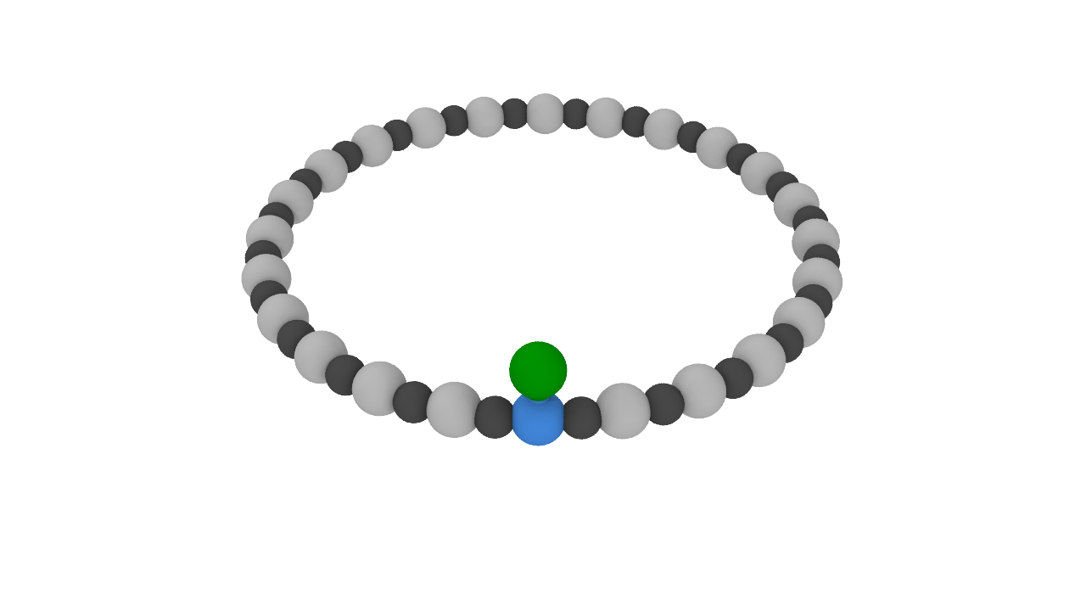
Example: Walking along a polymer
SEE:
https://www.youtube.com/watch?v=QO4LbHGAgxU

Slide 73
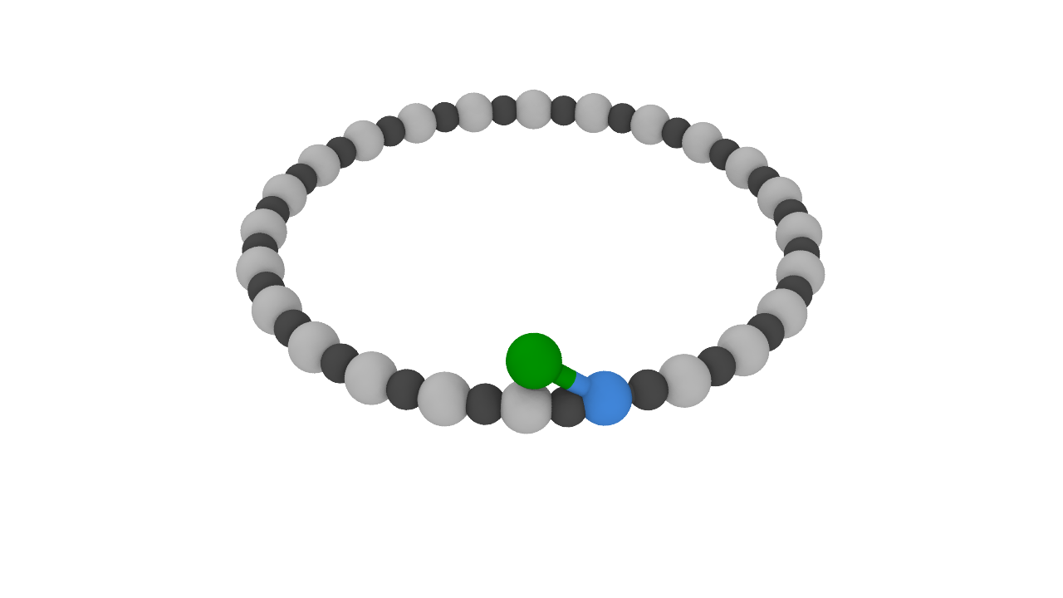
Example: Walking along a polymer
SEE:
https://www.youtube.com/watch?v=QO4LbHGAgxU

Slide 74
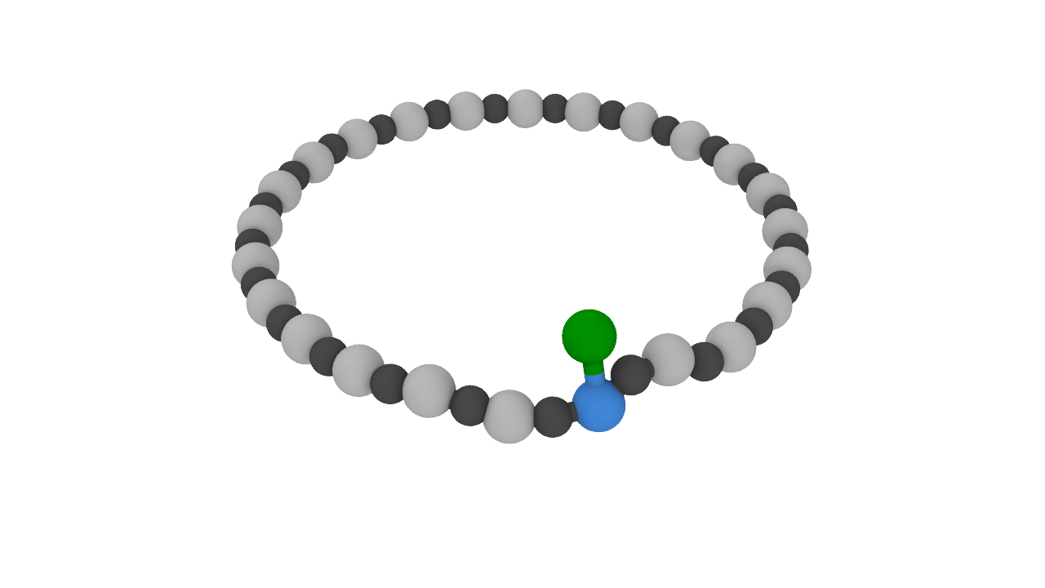
Example: Walking along a polymer
SEE:
https://www.youtube.com/watch?v=QO4LbHGAgxU

Slide 75
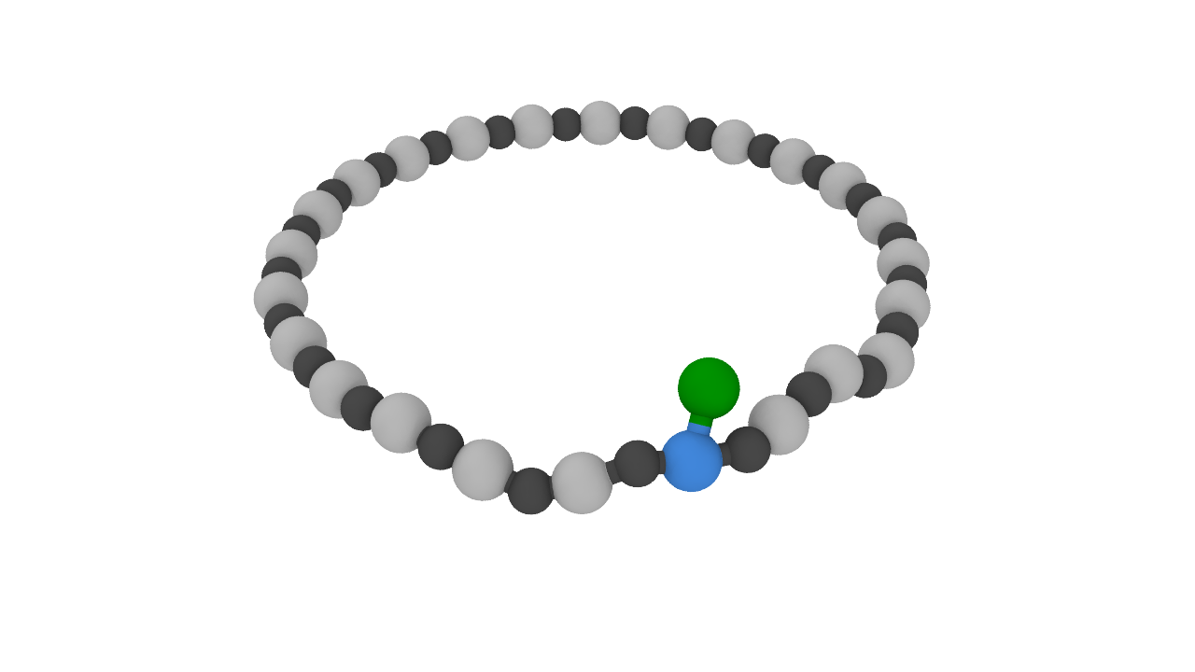
Example: Walking along a polymer
SEE:
https://www.youtube.com/watch?v=QO4LbHGAgxU

Slide 76
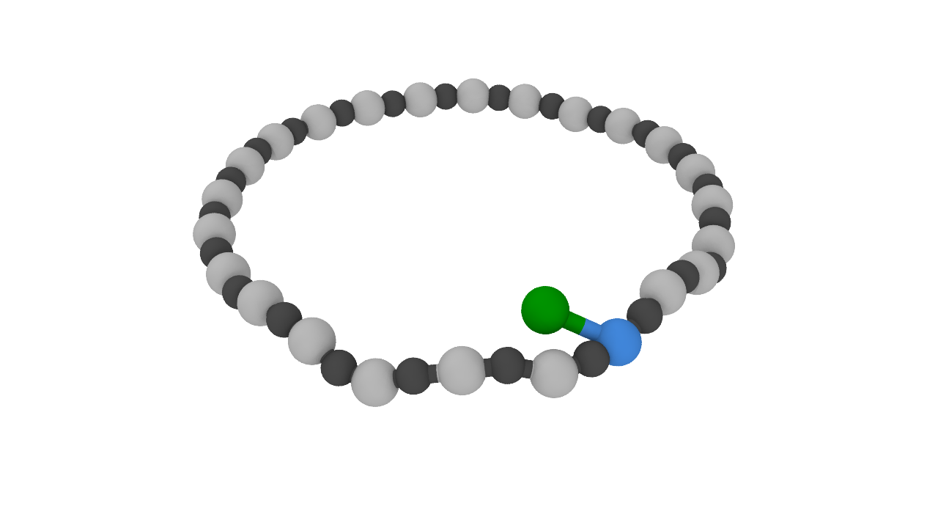
Example: Walking along a polymer
SEE:
https://www.youtube.com/watch?v=QO4LbHGAgxU

Slide 77
Example: Walking along a polymer
...
SEE:
https://www.youtube.com/watch?v=QO4LbHGAgxU

Slide 78
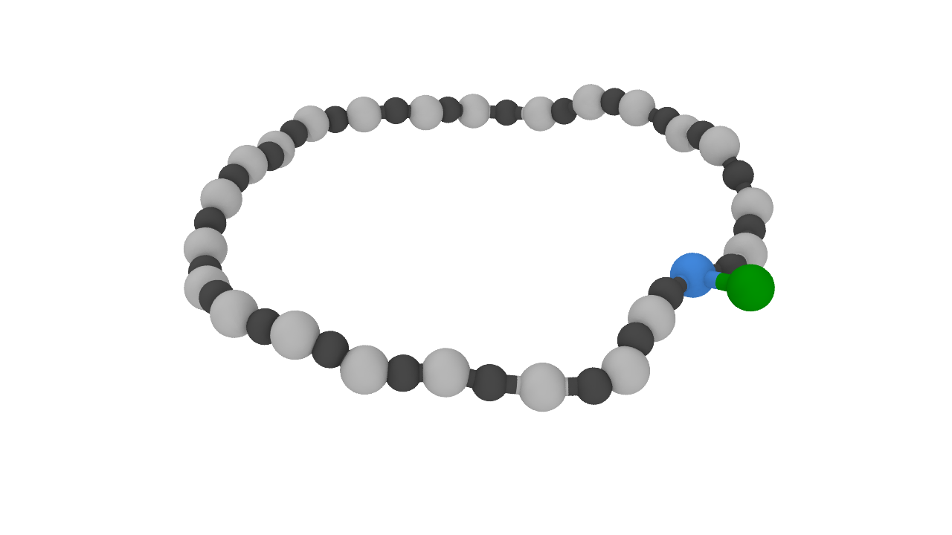
Example: Walking along a polymer
SEE:
https://www.youtube.com/watch?v=QO4LbHGAgxU

Slide 79
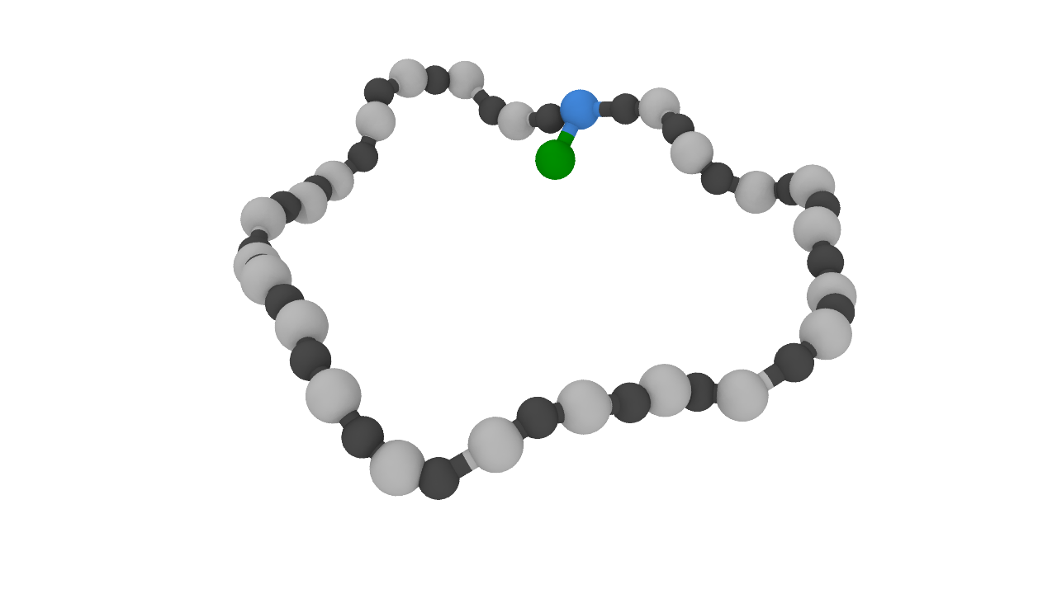
Example: Walking along a polymer
SEE:
https://www.youtube.com/watch?v=QO4LbHGAgxU

Slide 80
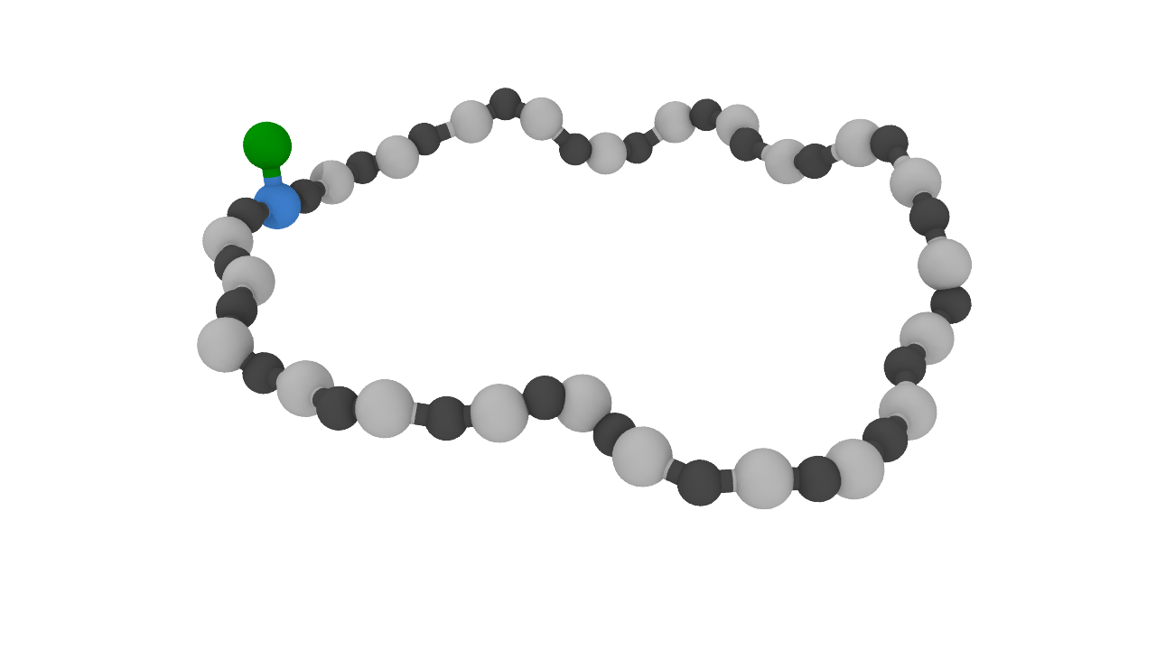
Example: Walking along a polymer
...
SEE:
https://www.youtube.com/watch?v=QO4LbHGAgxU

Slide 81
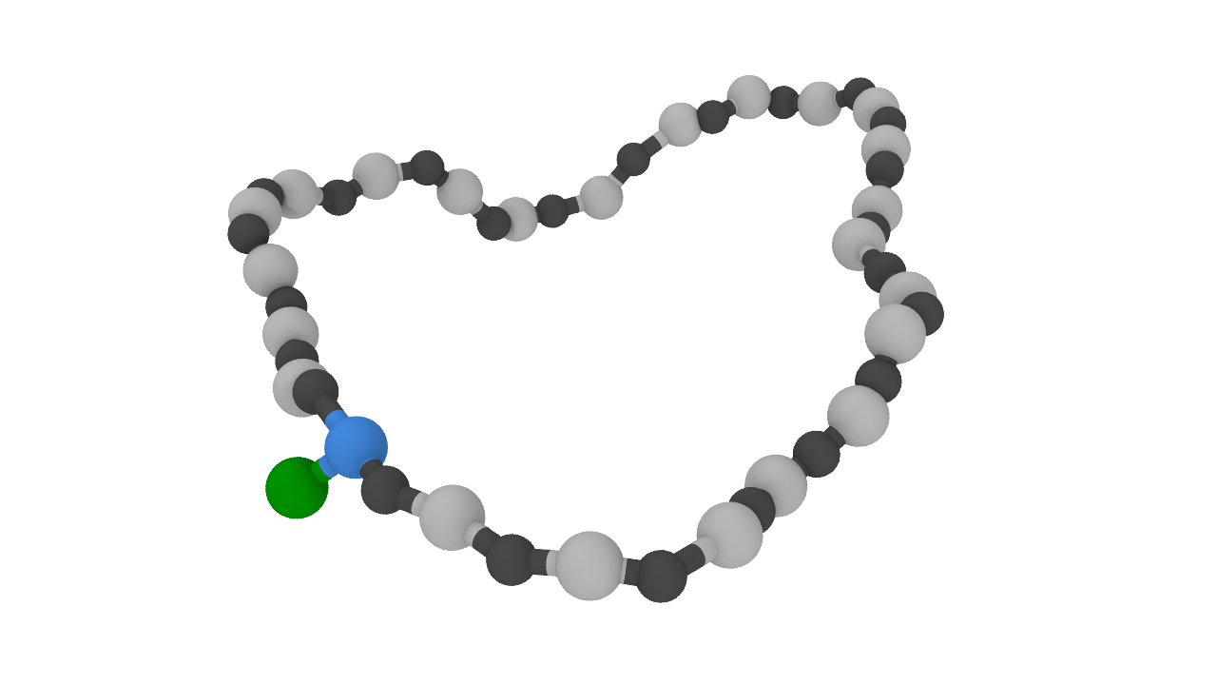
Example: Walking along a polymer
...
SEE:
https://www.youtube.com/watch?v=QO4LbHGAgxU

Slide 82
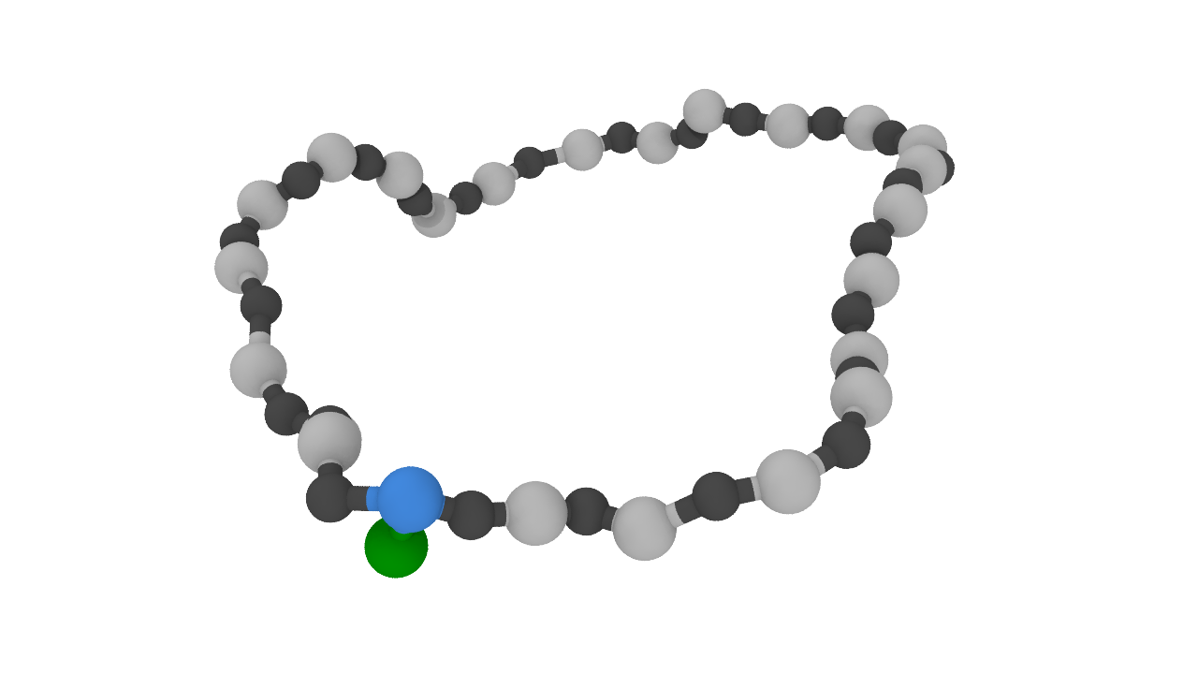
Example: Walking along a polymer
...
SEE:
https://www.youtube.com/watch?v=QO4LbHGAgxU

Slide 83
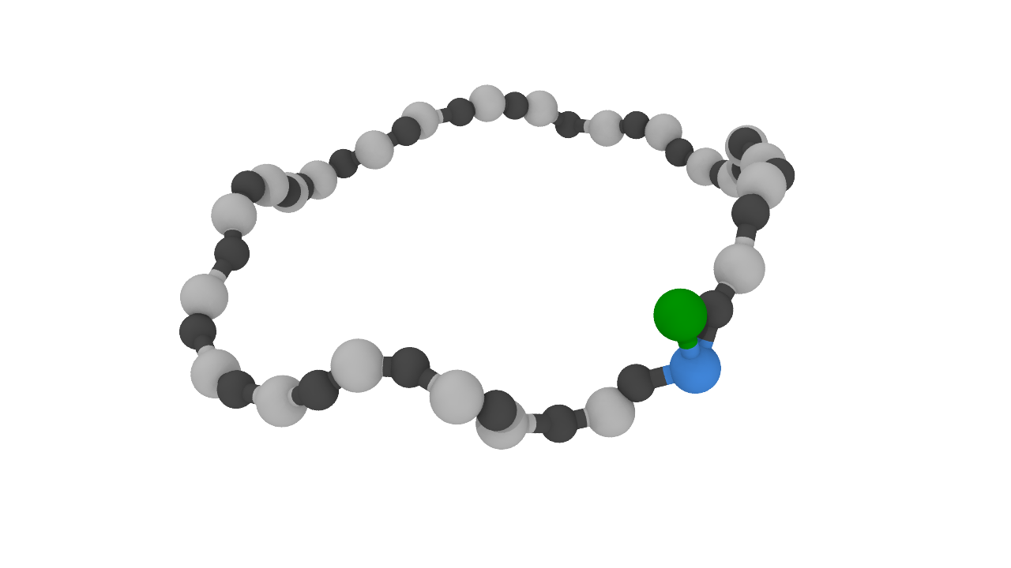
Example: Walking along a polymer
...
SEE:
https://www.youtube.com/watch?v=QO4LbHGAgxU

Slide 84
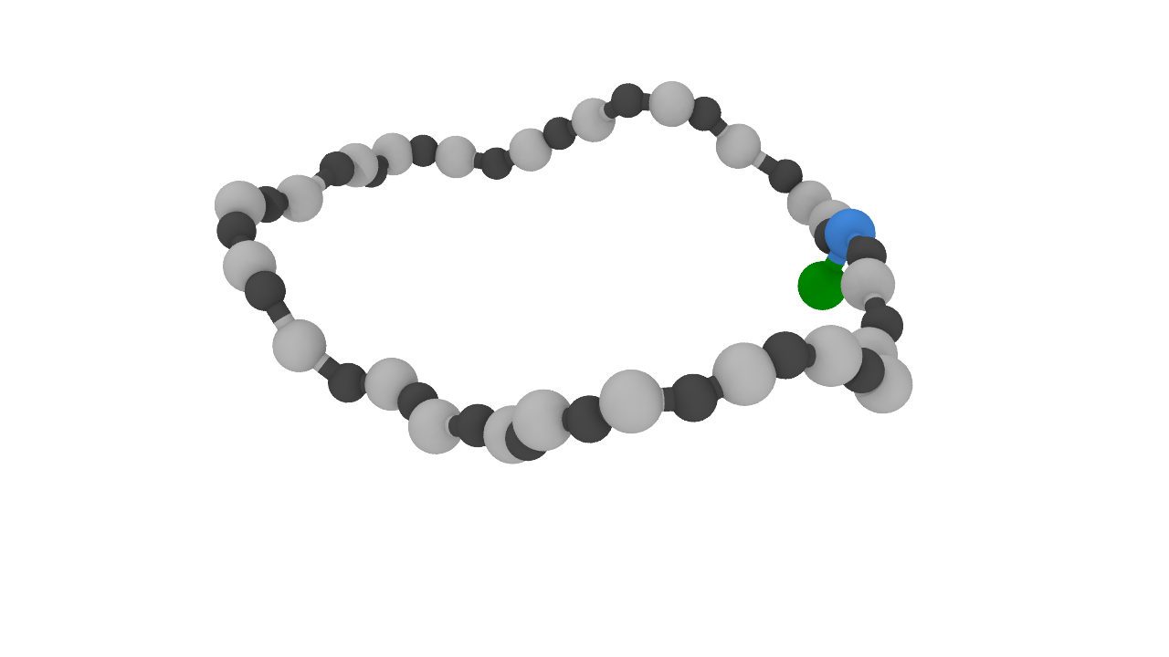
Example: Walking along a polymer
...
SEE:
https://www.youtube.com/watch?v=QO4LbHGAgxU

Slide 85
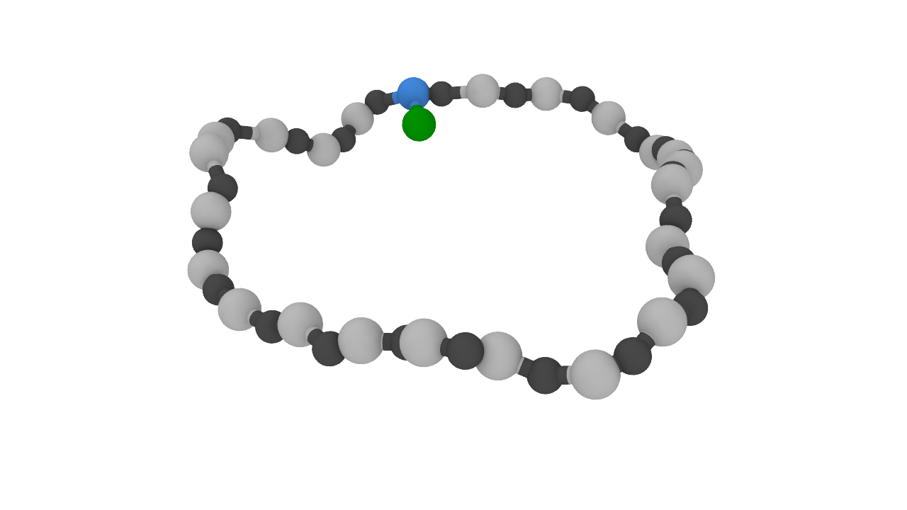
Example: Walking along a polymer
...
SEE:
https://www.youtube.com/watch?v=QO4LbHGAgxU

Slide 86
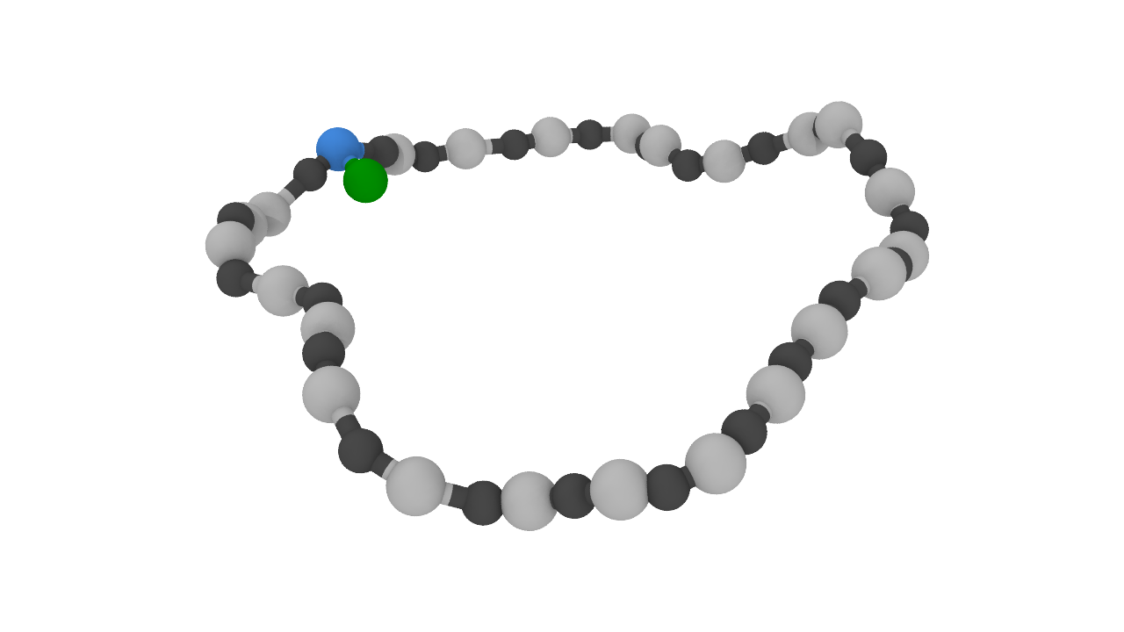
Example: Walking along a polymer
...
SEE:
https://www.youtube.com/watch?v=QO4LbHGAgxU

Slide 87
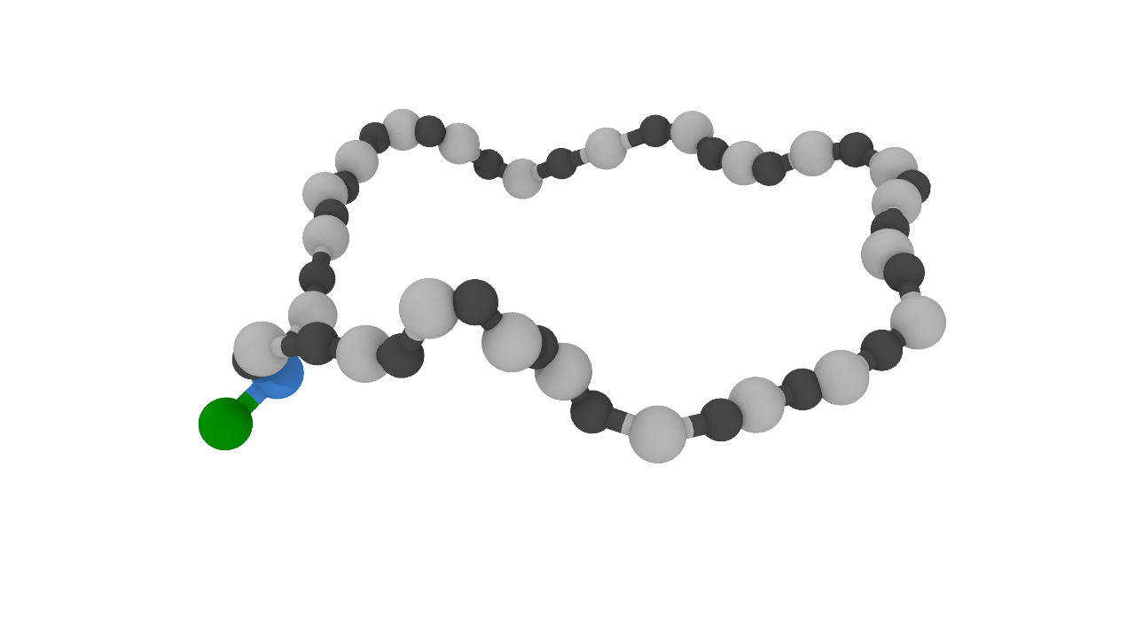
Example: Walking along a polymer
...
SEE:
https://www.youtube.com/watch?v=QO4LbHGAgxU

