Slide 1
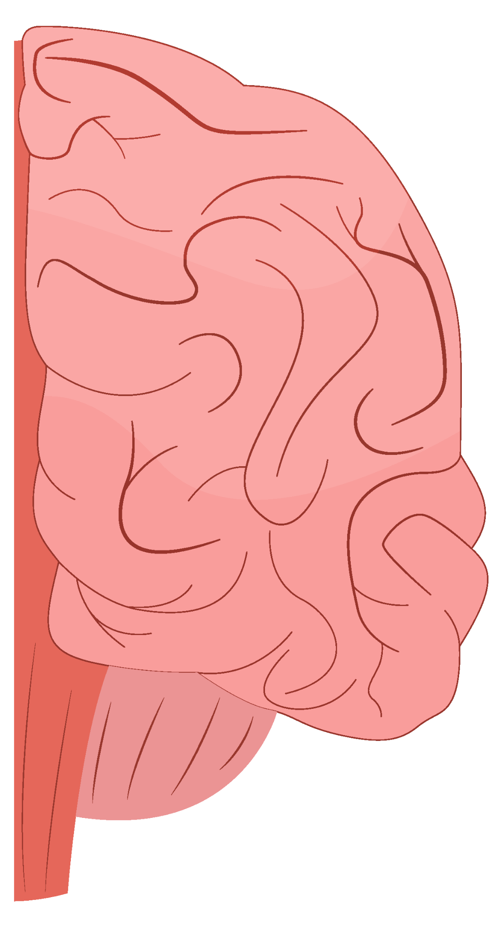
Predicting Mental Health Symptom Severity Using Behavioral and Neuroimaging Data
Shreya Sureshbabu Banumathi, Ayomide Olushola Arulogun, Albin Rahman, Abdelrahman Mohamed, Madeline Jewett, Soham Sinha

Slide 2
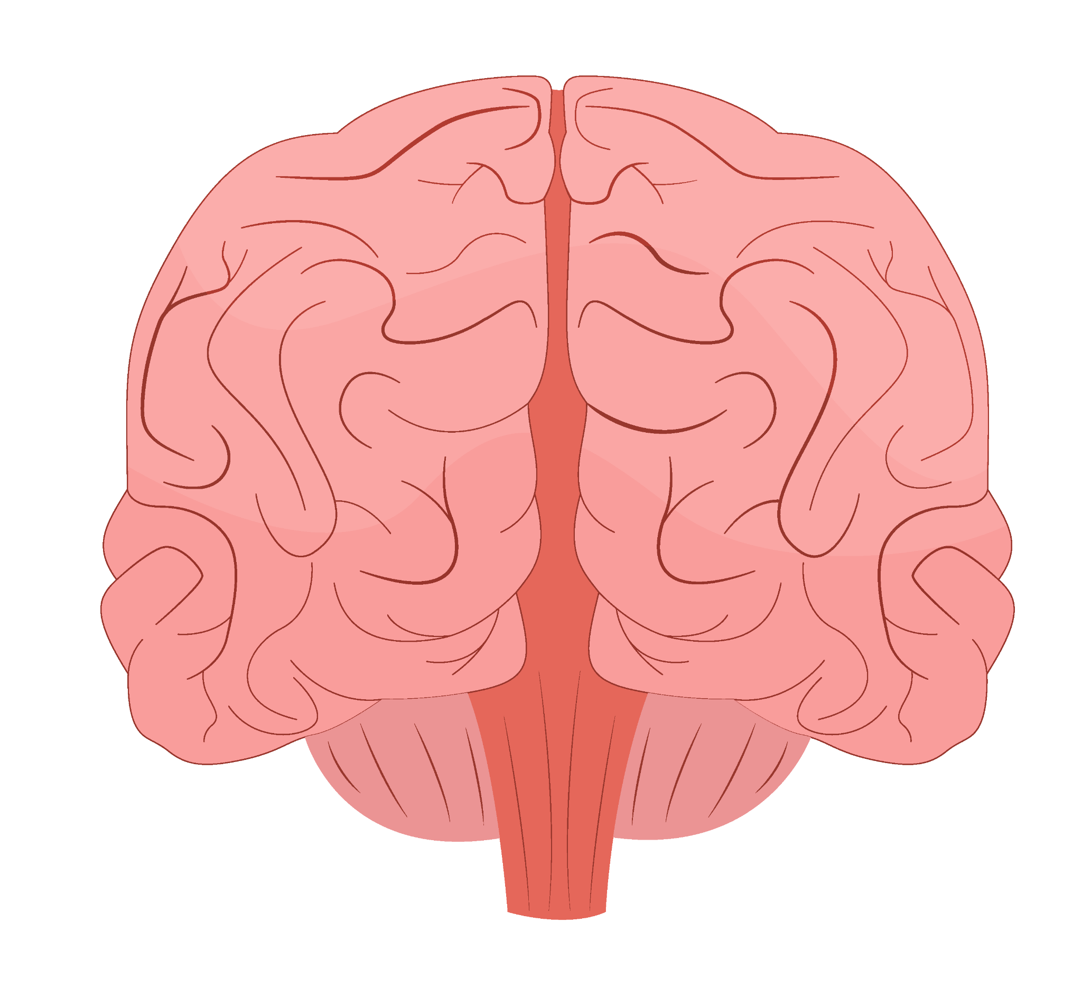
Table of contents
01
Description
02
Demo + Video
03
Data Visualizations
04
Algorithm
05
Essential Question
06
Key Takeaways
07
Positive + Negative Impact
08
GitHub Link + Next Steps
09
Citations

Slide 3
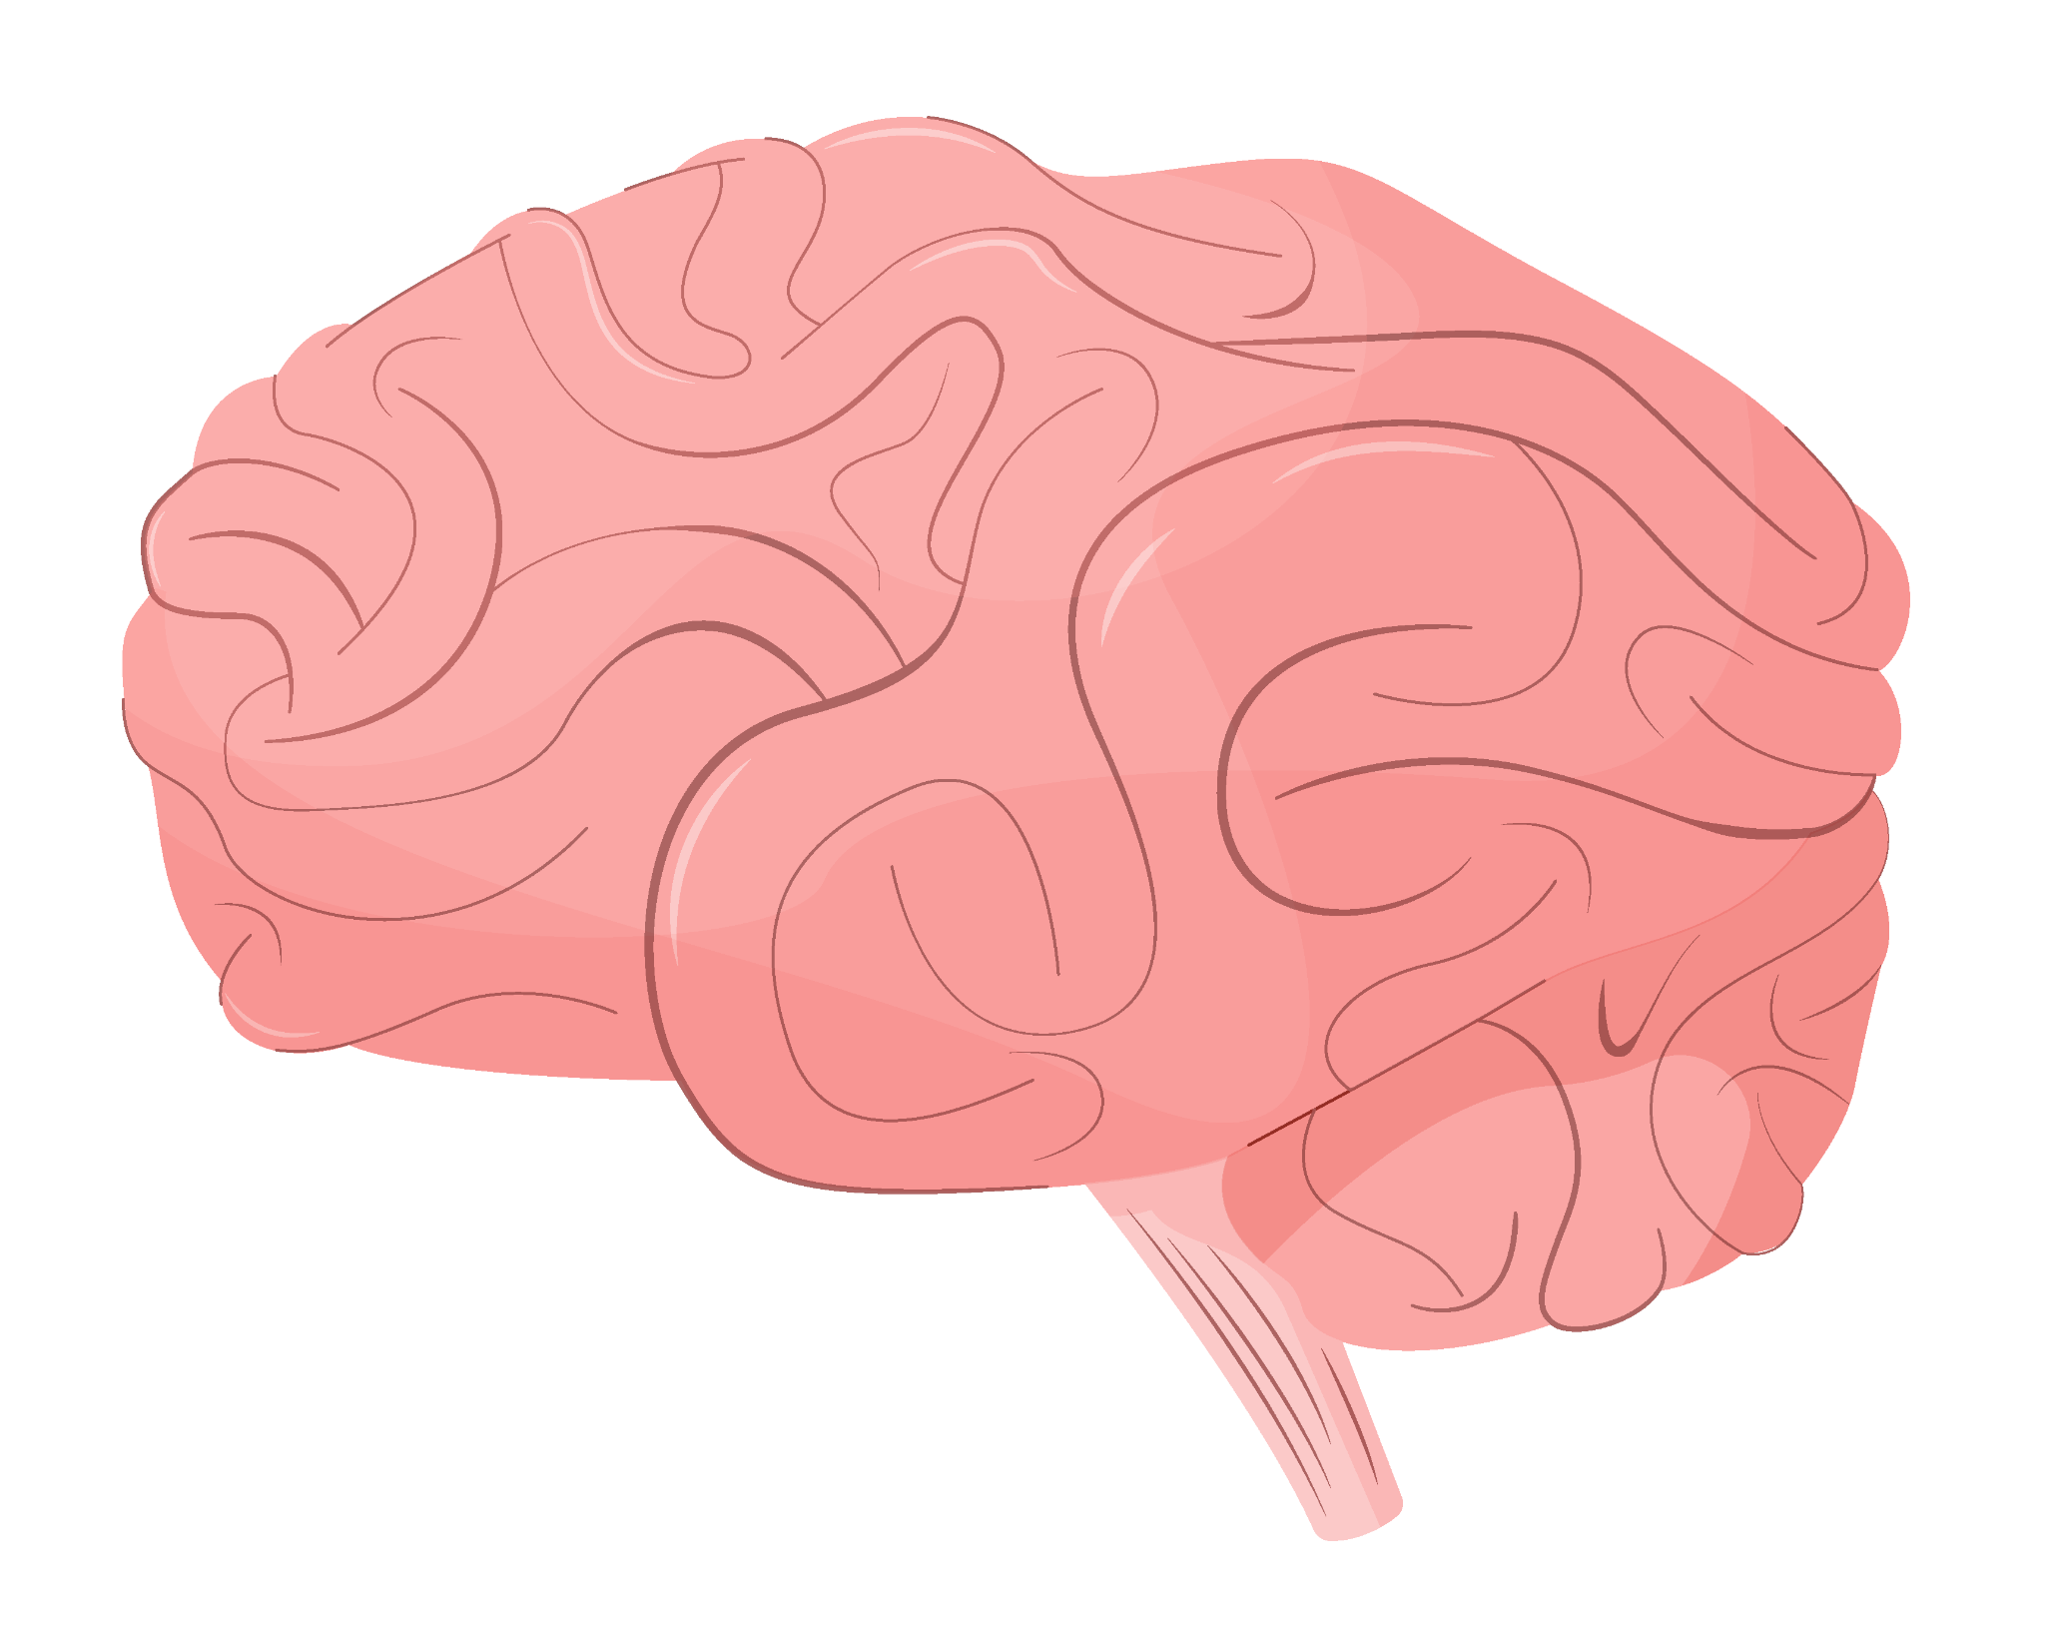
Description
This project aims to predict continuous symptom severity using behavioral + imaging data through the random forest regression.
Metrics: QIDS (depression), STAI-State (state anxiety), SHAPS (anhedonia), and PSS (perceived stress).
Compares 4 behavioral, imaging, and 4 multimodal models to determine which best predicts symptom severity.
Goal: determine which data modality provides the strongest predictive performance
Project Timeline:
Selected multimodal mental health dataset (behavioral + fMRI).
Built 28 Random Forest Regression models across four symptom targets.
Compared behavioral, imaging, and multimodal feature sets.
Discovered and addressed target leakage by removing symptom-scale predictors.
Expanded to 36 models with a new non-symptom feature set.
Validated that behavioral characteristics remained strong predictors even without overlapping symptom questionnaires.
Challenge: Some behavioral questionnaires measured same mental health symptoms as prediction target → target leakage + performance inflation
Solution: Added non-symptom behavioral feature set by removing symptom questionnaires from the predictors.
The models continued to perform well, showing that personality, cognitive, and lifestyle factors provide meaningful predictive information independent of symptom scales.

Slide 4
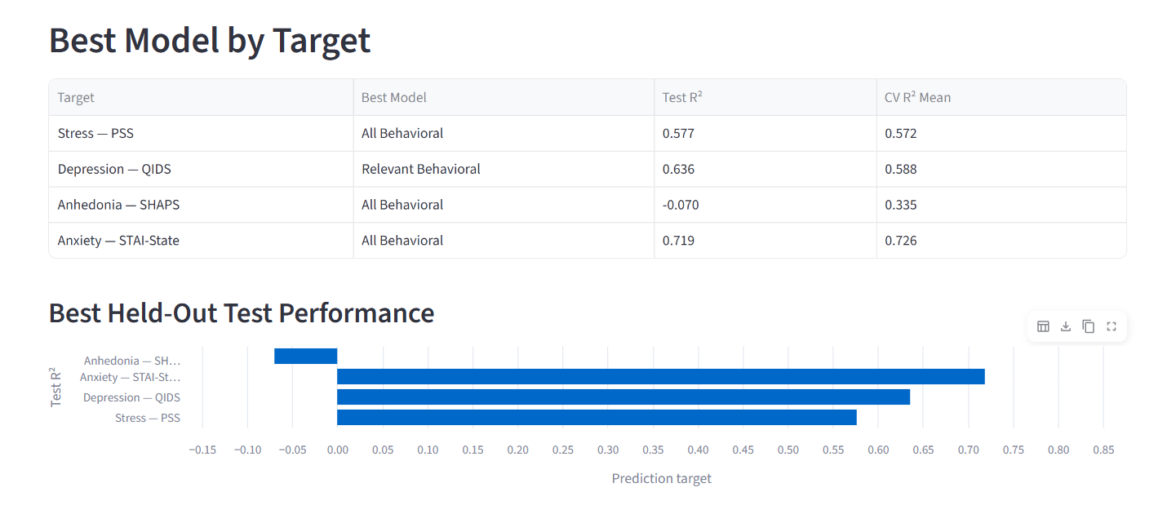
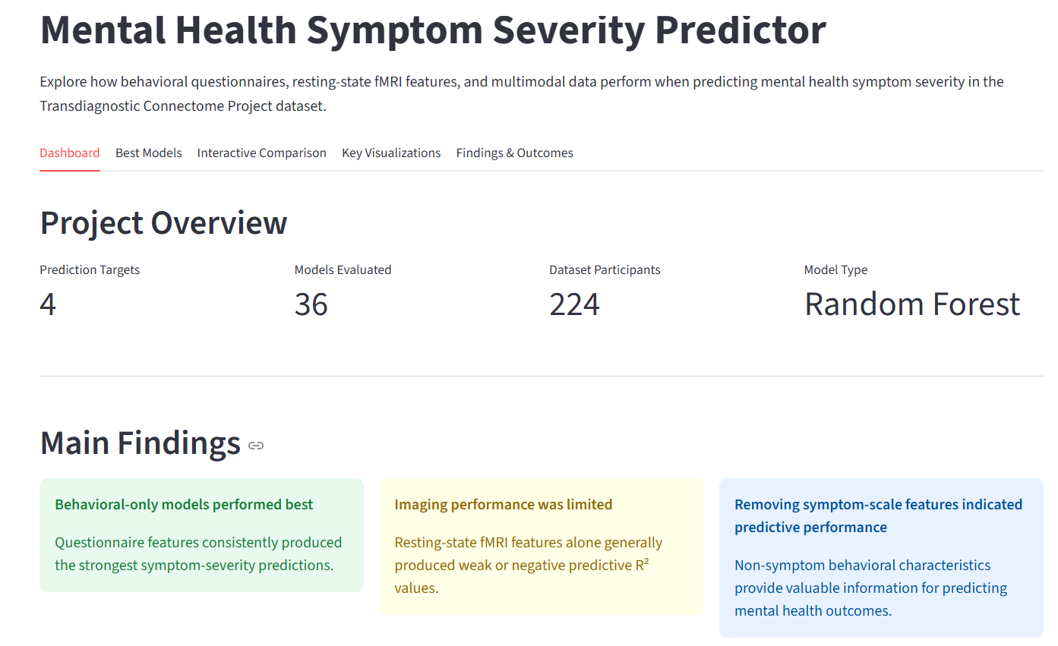
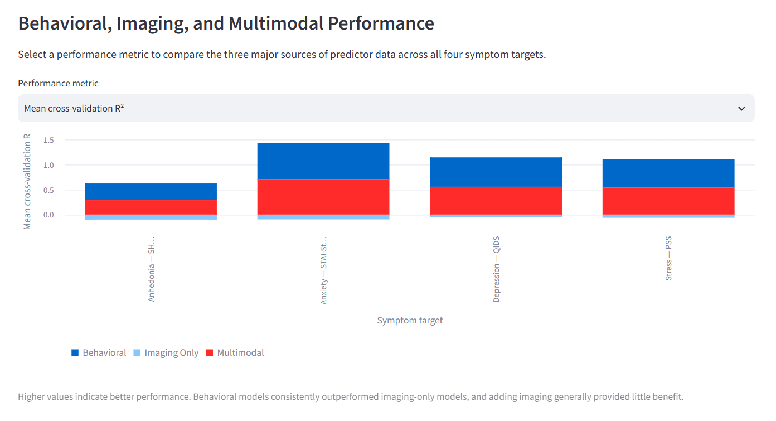
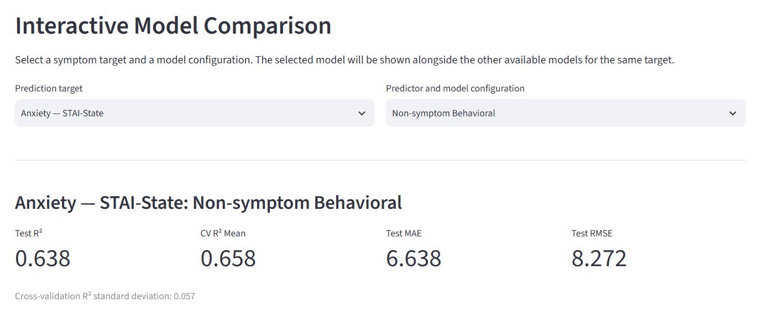
Demo

Slide 5
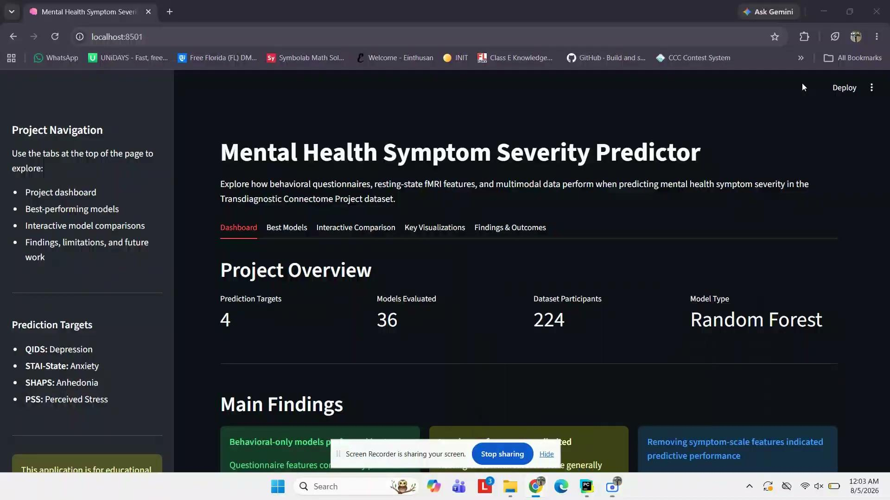

Slide 6
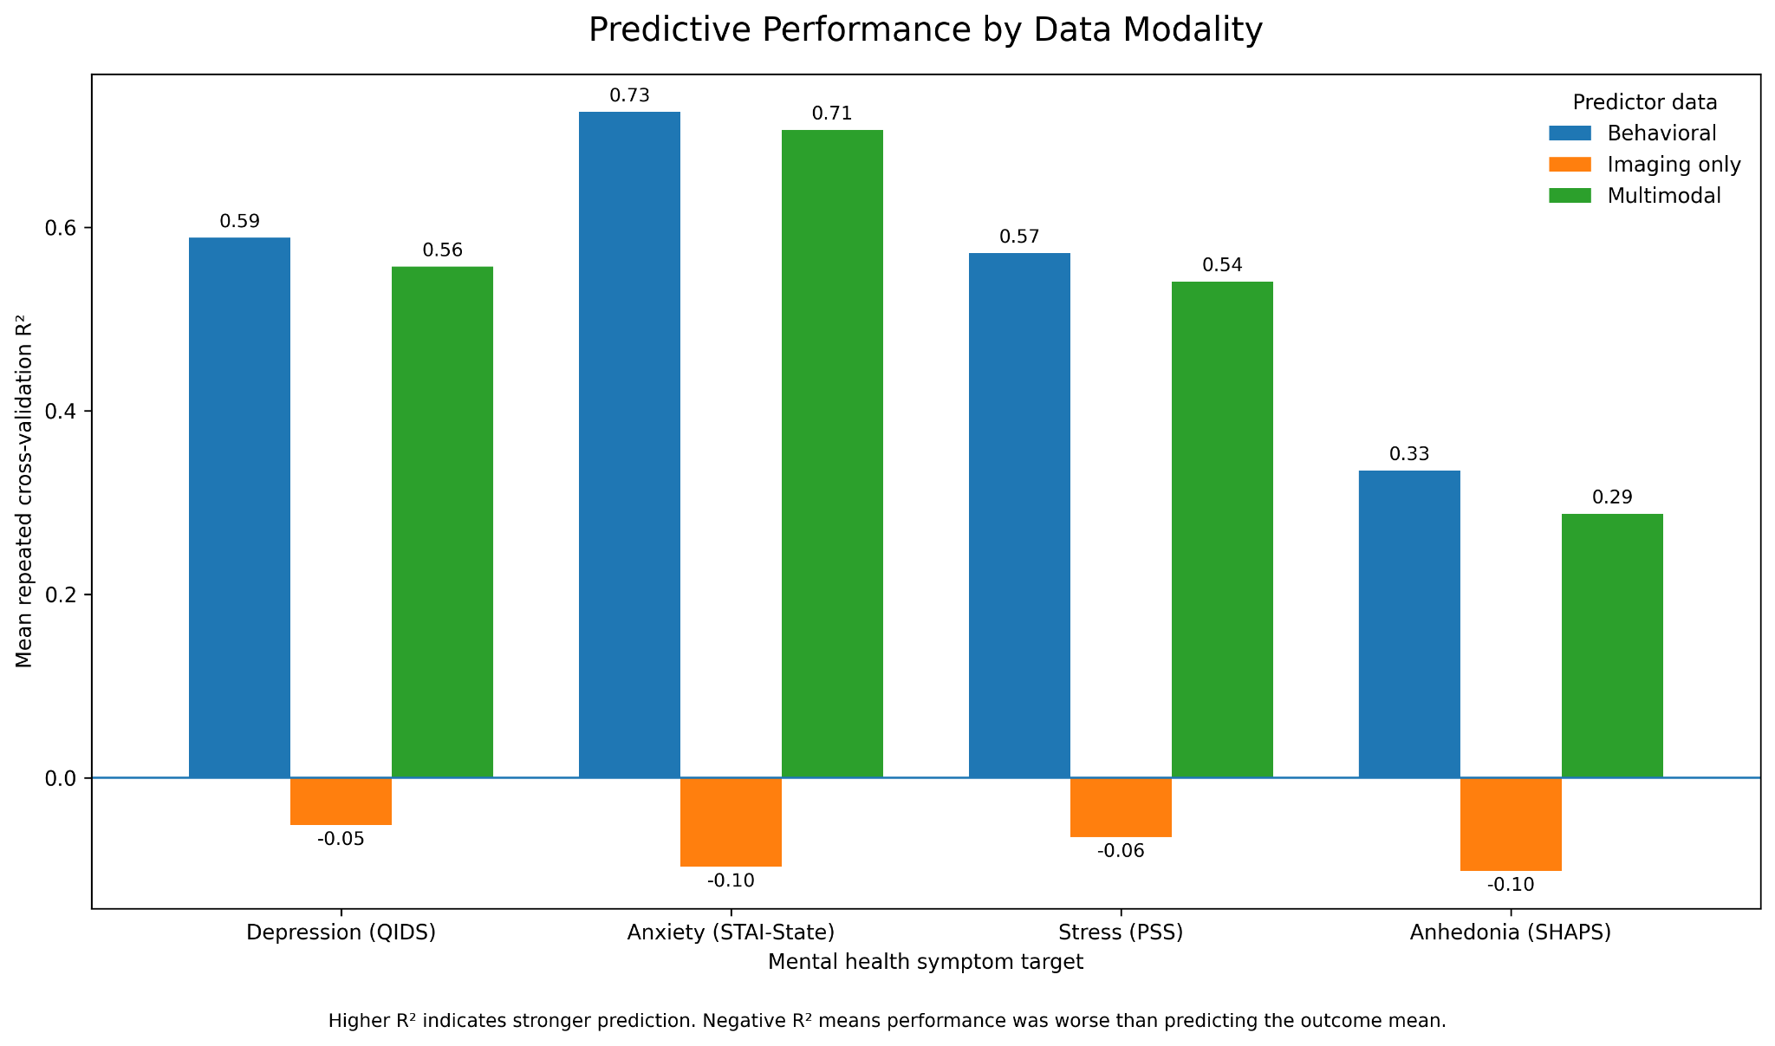
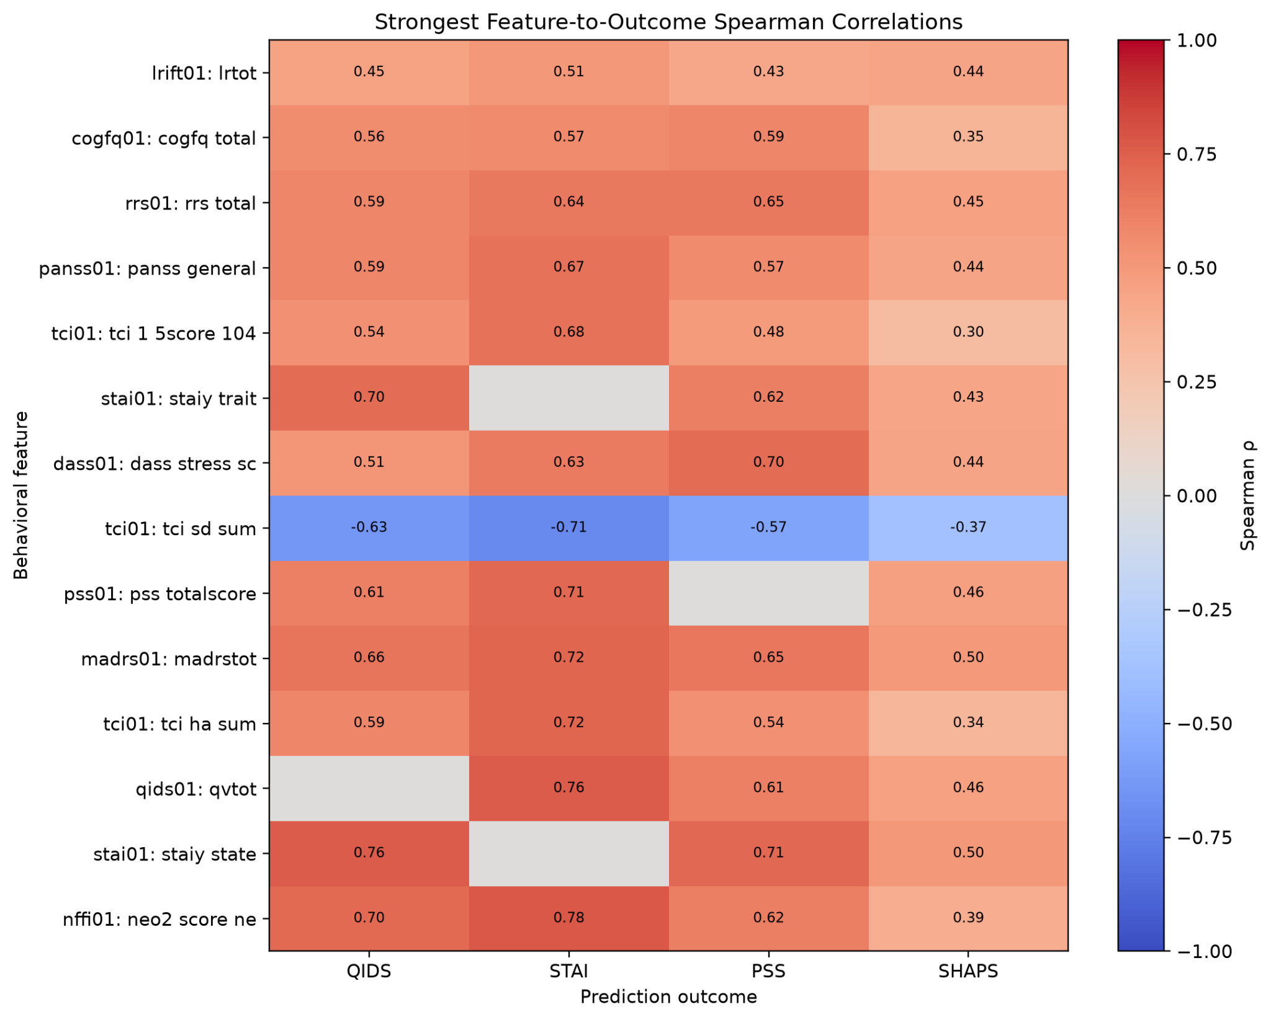
How Well Did Models Predict Mental Health Symptoms?
Key Takeaway: Behavioral questionnaire data consistently outperformed imaging features, while no behavioral feature showed evidence of excessive correlation (ρ ≥ 0.80) with its prediction target.
Notes:
This slide summarizes how our models performed and validates that our predictors were appropriate. The graph on the left compares behavioral, imaging-only, and multimodal models across the four prediction targets. We found that behavioral data consistently achieved the highest predictive performance. Imaging alone generally performed poorly, and combining imaging with behavioral data produced little improvement. On the right is the Spearman correlation matrix, which we used to check for overly correlated predictors that could indicate feature leakage. No feature exceeded our threshold of 0.80, suggesting that our models were learning meaningful relationships rather than simply reproducing the target from nearly identical variables.

Slide 7
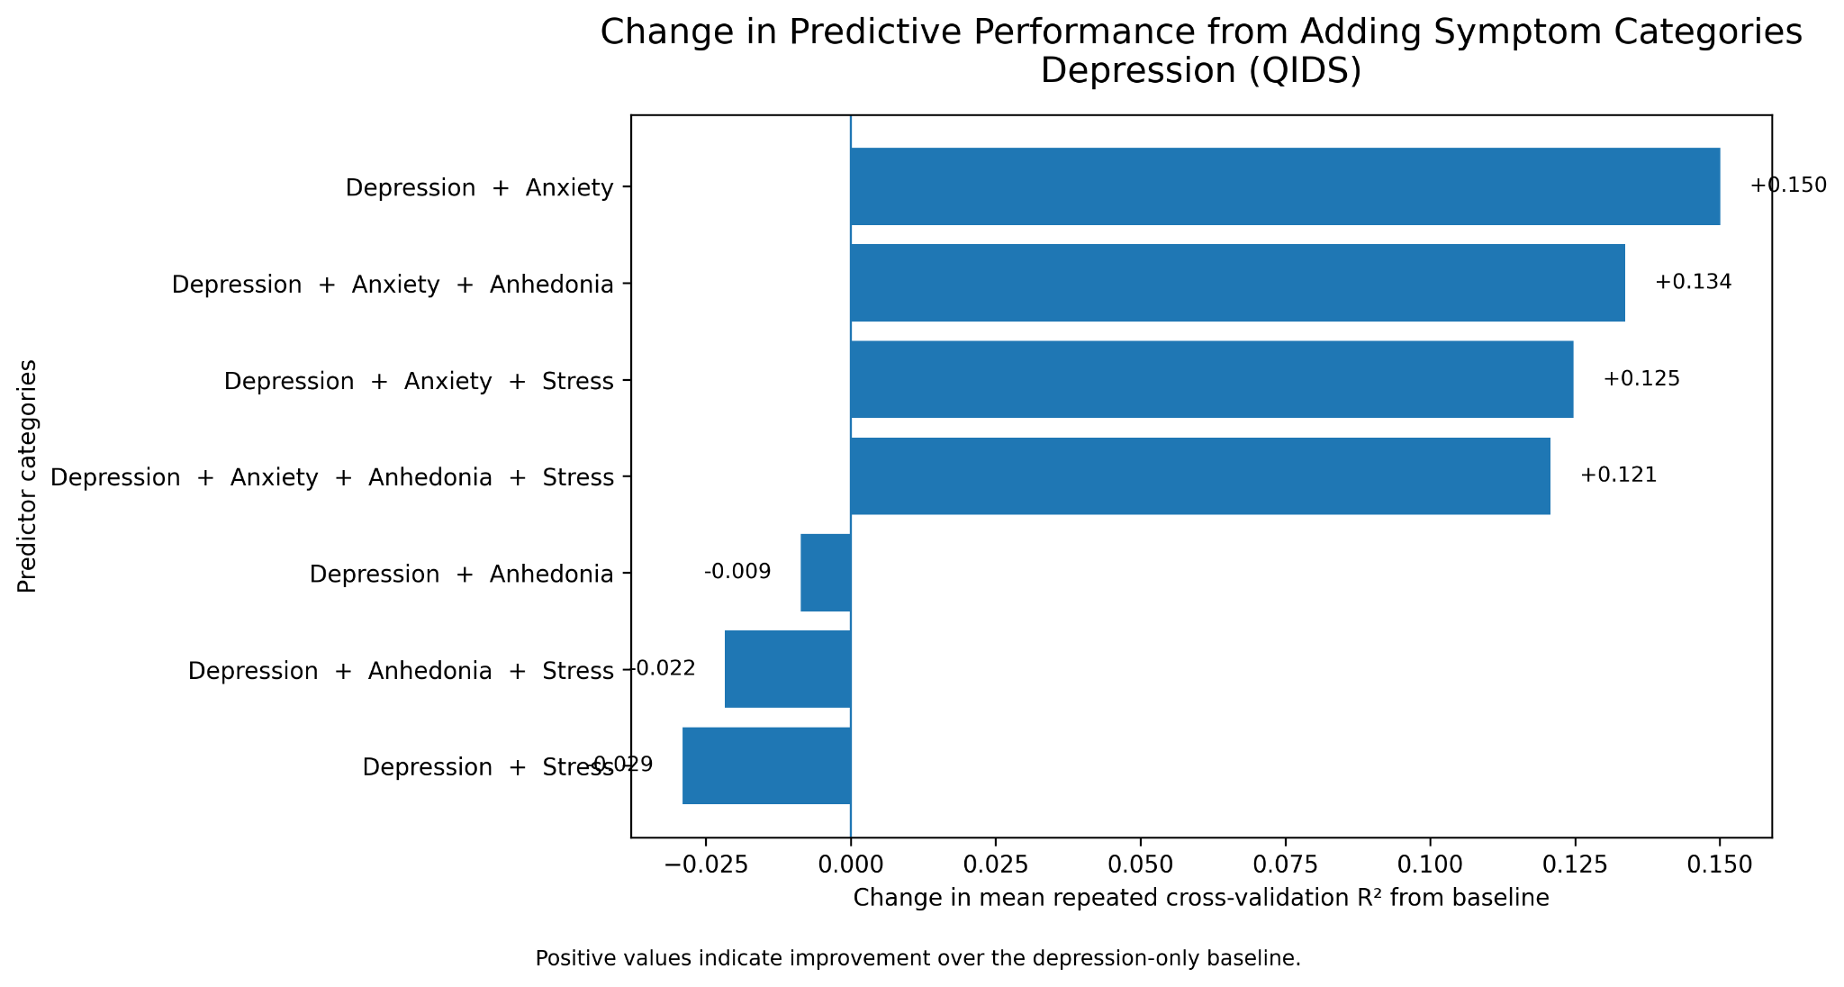
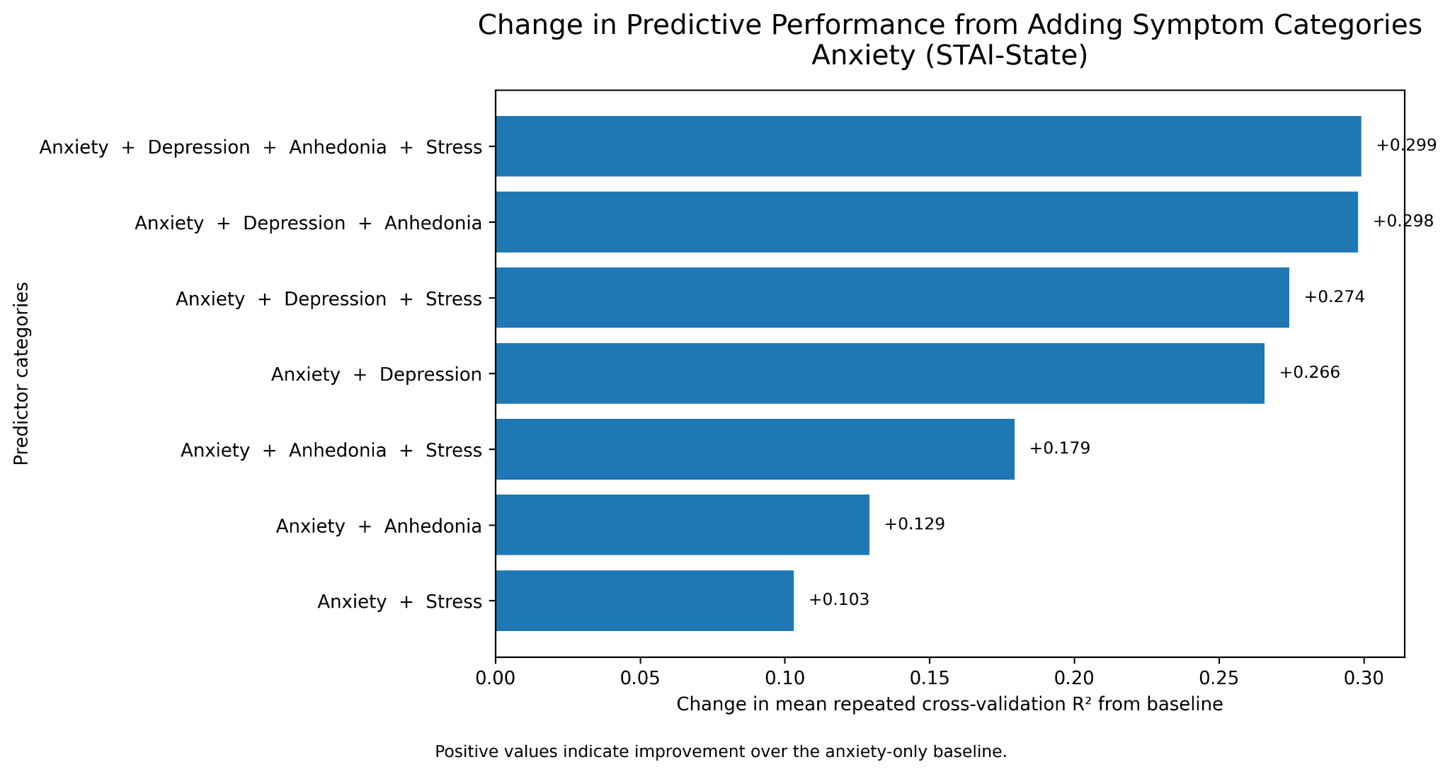
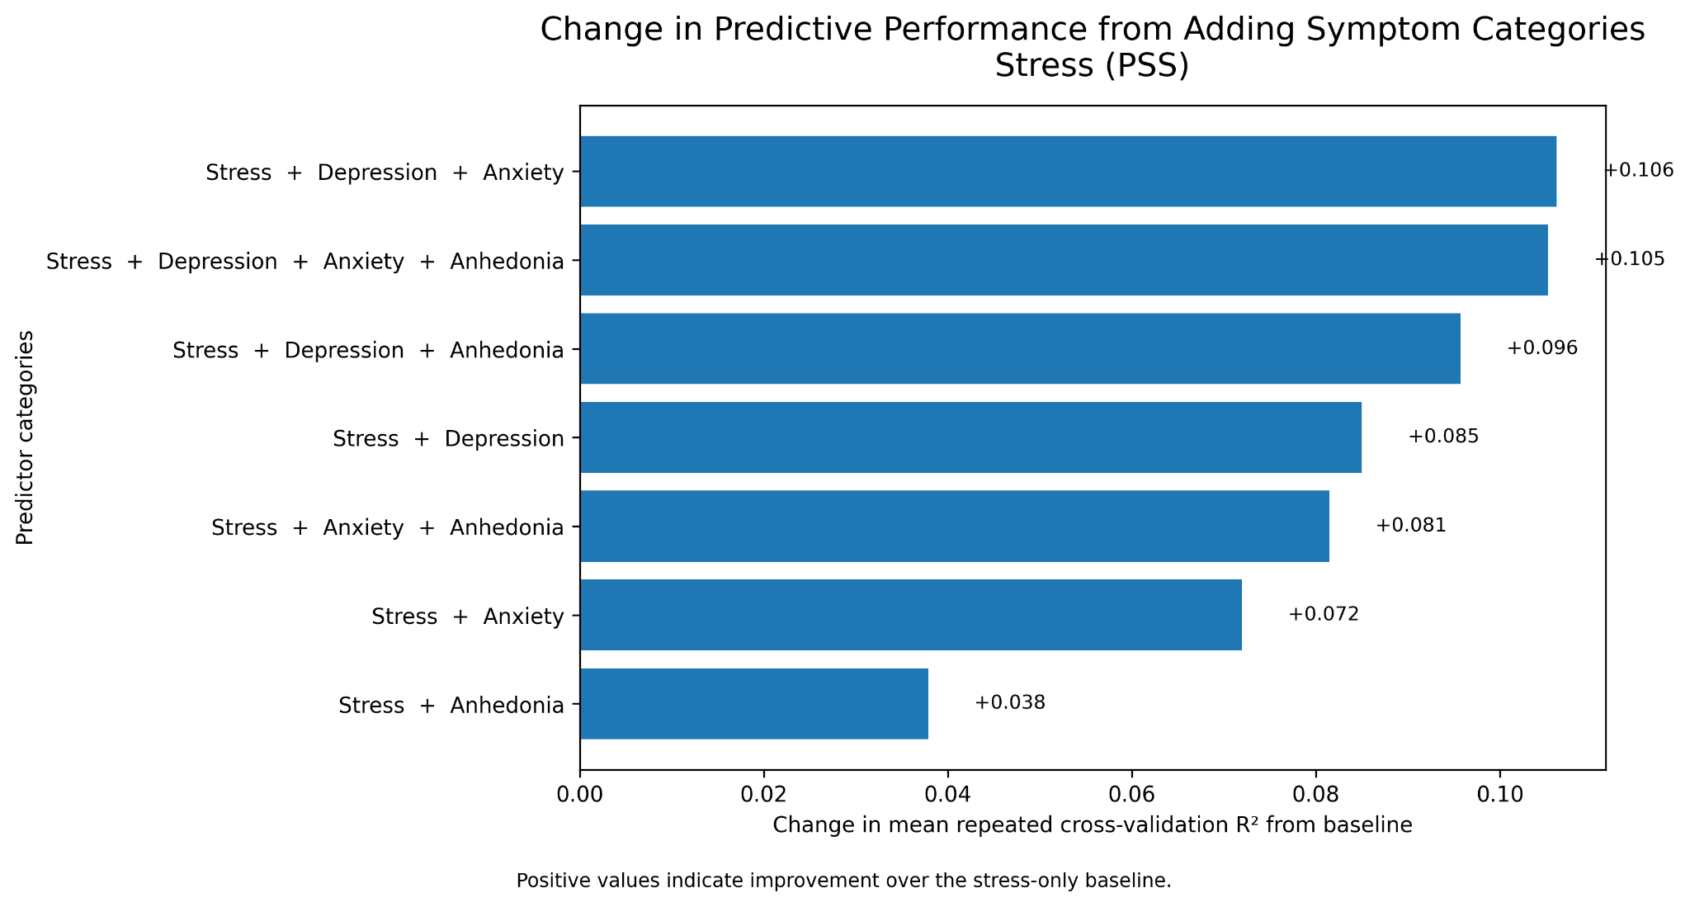
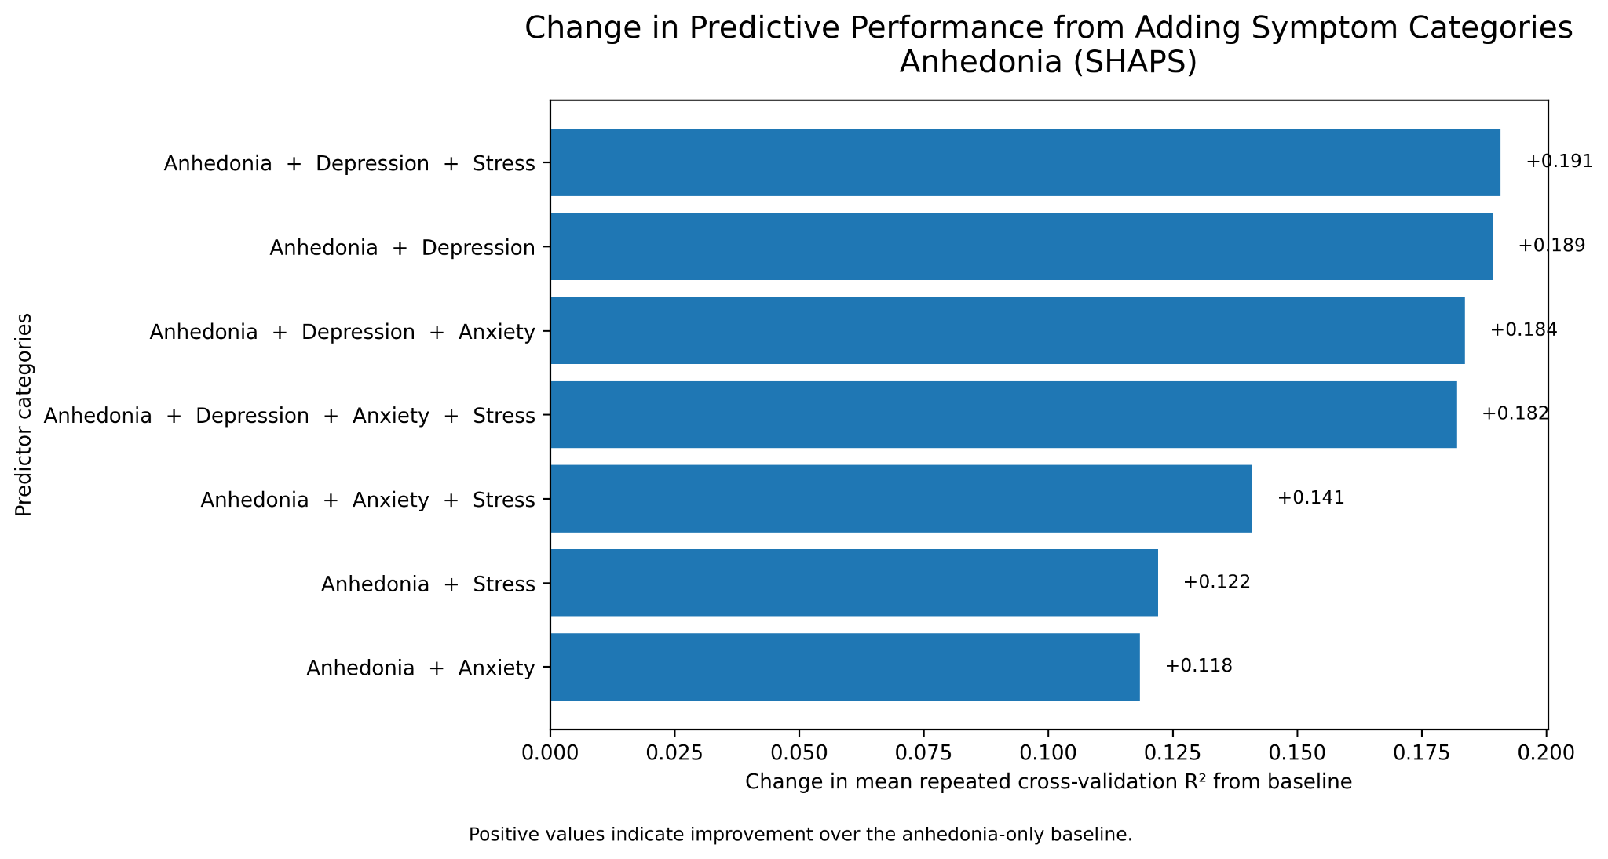
How do cross-category symptom domains influence prediction?
*Positive values indicate improvement over baseline
Key Takeaway: Related symptom domains often improved prediction, but the amount of improvement differed across mental health outcomes.
Notes:
One unique part of our project was examining how different symptom domains contribute to predicting one another. Rather than only using questionnaires from the target domain, we evaluated whether adding information from anxiety, depression, stress, or anhedonia improved prediction. These graphs show the change in cross-validated R² after adding additional symptom categories. Some domains benefited substantially from information in related symptom areas, while others showed only modest improvements. This demonstrates that mental health symptoms are interconnected and that related symptom domains can provide useful predictive information.

Slide 8
Algorithm
Supervised Random Forest Regression
Inputs: behavioral data from questionnaires (all, relevant, category, non-symptom), imaging data from f-MRI scans, and multimodal data (behavioral + imaging).
These predictors were used for QIDS, STAI-State, PSS, and SHAPS which represent depression, anxiety, stress, and anhedonia respectively.
Random Forest Regression builds many decision trees and combines their predictions to produce a final result.
This helps capture complex relationships between behavioral and imaging variables while reducing overfitting compared to a single decision tree.
Notes:
Our algorithmic approach takes into account the characteristics of the dataset we used for this project
The inputs consist of behavioral data from questionnaires (all, relevant, category, non-symptom), imaging data from f-MRI scans, and multimodal data (behavioral + imaging)... Due to these inputs and the size of the dataset, we decided random forest regression was the way to go
From the four predictor targets:
QIDS: depression severity
STAI-State: state anxiety
SHAPS: anhedonia
PSS: perceived stress
The model pipeline compares nine feature configurations:
4 of which are behavioral
1 of which is imaging only
and the remaining 4, which are multimodal
Our algorithm utilizes Random Forest Regression to build decision trees and then combine their predictions to produce a final result.
Not only does this help capture the complex relationships between behavioral and imaging variables in the dataset, but it simultaneously reduces overfitting compared to a single decision tree

Slide 9
Essential Question
How can the process of creating AI/ML solutions amplify or mitigate bias in the case our group is using?
Bias enters at every step of the process. Our choices decide which way it goes.
What amplifies bias
What reduces bias
Only 241 people, all from one study
Removed symptom scales to stop leakage
Self report scales carry their own bias
Compared 36 models, not just one
Leaky features can fake a good score
Shared our weak results and all our code
We cannot remove bias, only make it visible. That is why this stays a research tool and never a diagnosis.
Notes:
Read the question out loud. Say the one line answer. Three points on the left, three on the right. Finish with the closing line.

Slide 10
Key Takeaways
Major Findings
Project Outcomes
Lessons learned
Behavioral features consistently outperformed imaging features
Multimodal models provided little improvement over behavioral data alone
Cross-category symptom information improved prediction for some outcomes
Removing behavioral symptom questionnaires that could introduce target leakage outperformed imaging features
Developed an end-to-end machine learning pipeline
Compared behavioral, imaging-only, and multimodal models
Built an interactive Streamlit dashboard for exploring model results
Preprocessing and feature engineering greatly affects model performance
More features do not necessarily produce better predictions
Thorough validation is essential for trustworthy machine learning models
Notes:
Overall, our results showed that behavioral questionnaire data was the strongest predictor of symptom severity across all four targets. While we expected imaging to add predictive value, the current imaging features provided only limited improvement over behavioral data alone. We successfully developed a complete machine learning pipeline, compared multiple feature sets and data modalities, and created an interactive dashboard to explore the results. One of the biggest lessons from this project was that success depends not only on choosing a machine learning model, but also on thoughtful preprocessing, feature engineering, and rigorous validation.

Slide 11

Positive and Negative Impact
Benefits
Challenges
Earlier Identification
May help identify individuals at risk for worsening mental health symptoms earlier.
Improved Research
Enables researchers to study relationships between behavioral measures and brain imaging more efficiently.
Clinical Decision Support
Could assist clinicians by providing an additional source of information alongside professional evaluation.
Better Understanding of Mental Health
Cross-category analyses reveal how different symptom domains relate to one another.
Not a Diagnostic Tool
Predictions should never replace evaluation by a qualified mental health professional.
Limited Generalizability
Models trained on one research dataset may not perform equally well in different populations.
Imaging Limitations
Resting-state fMRI features alone showed limited predictive value in this study.
Privacy & Ethics
Mental health and neuroimaging data require careful handling to protect participant privacy and confidentiality.
Link to Albin’s Recorded Presentation
Notes:
Like any machine learning system used in healthcare, our model has both potential benefits and important limitations. On the positive side, it could help researchers better understand mental health symptom relationships, support earlier identification of individuals at risk, and provide clinicians with additional information to supplement—not replace—their assessments. However, there are also important challenges. Our model is not intended to diagnose mental illness, and its predictions should never replace evaluation by a licensed professional. In addition, models trained on a specific research dataset may not generalize to other populations, and sensitive mental health and neuroimaging data must be handled responsibly. Overall, our project highlights how machine learning can support mental health research while emphasizing the importance of ethical use and human oversight.

Slide 12
GitHub Link + Next Steps
Limitations
Small dataset.
Only Random Forest models were evaluated.
Resting-state fMRI features may not capture all relevant brain information.
Single dataset limits generalizability.
Future work
Test additional machine learning models.
Improve imaging feature engineering.
Evaluate other neuroimaging modalities.
Validate on external datasets.
Increase sample size.
https://github.com/jewettm530/MH_Severity_Behavioral_and_Scans

Slide 13
Citations
Chopra, S., Cocuzza, C. V., Lawhead, C., Ricard, J. A., Labache, L., Patrick, L. M., Kumar, P., Rubenstein, A., Moses, J., Chen, L., Blankenbaker, C., Gillis, B., Germine, L. T., Harpaz-Rotem, I., Yeo, B. T. T., Baker, J. T., & Holmes, A. J. (2025). The Transdiagnostic Connectome Project: an open dataset for studying brain-behavior relationships in psychiatry. Scientific Data, 12, 923. https://doi.org/10.1038/s41597-025-04895-z
Parkes, L., Satterthwaite, T. D., & Bassett, D. S. (2020). Towards precise resting-state fMRI biomarkers in psychiatry: synthesizing developments in transdiagnostic research, dimensional models of psychopathology, and normative neurodevelopment. Current Opinion in Neurobiology, 65, 120–128.
Chopra, S., Cocuzza, C. V., Lawhead, C., et al. (2024). The Transdiagnostic Connectome Project dataset: a richly phenotyped open resource for advancing the study of brain-behavior relationships in psychiatry. medRxiv. https://doi.org/10.1101/2024.06.18.24309054
Woo, C.-W., Chang, L. J., Lindquist, M. A., & Wager, T. D. (2017). Building better biomarkers: Brain models in translational neuroimaging. Nature Neuroscience, 20, 365–377.
Bzdok, D., & Meyer-Lindenberg, A. (2018). Machine learning for precision psychiatry: opportunities and challenges. Biological Psychiatry: Cognitive Neuroscience and Neuroimaging, 3(3), 223–230.
Insel, T. R. (2014). The NIMH Research Domain Criteria (RDoC) Project: precision medicine for psychiatry. American Journal of Psychiatry, 171(4), 395–397.
Yuwon Kim. (2025). Beyond Missing Data: A Multimodal Approach Using VR-EEG-MRI (VEEM) Biomarkers for Detecting MCI. In Proceedings of the Extended Abstracts of the CHI Conference on Human Factors in Computing Systems (CHI EA '25). Association for Computing Machinery, New York, NY, USA, Article 895, 1–7. https://doi.org/10.1145/3706599.3719284
Jinxia Wang, Liang Qiao, Haibin Lv, and Zhihan Lv. 2022. Deep Transfer Learning-Based Multi-Modal Digital Twins for Enhancement and Diagnostic Analysis of Brain MRI Image. IEEE/ACM Trans. Comput. Biol. Bioinformatics 20, 4 (July-Aug. 2023), 2407–2419. https://doi.org/10.1109/TCBB.2022.3168189

