Slide 1
How are subscribers different from one-time users?
Case Study by Jex De Los Santos
on September 2, 2026

Slide 2
Problem
How are subscribers different from one-time users?
Subscribed bikers - riders who are part of an annual membership
One-time bikers - casual riders with no annual membership

Slide 3
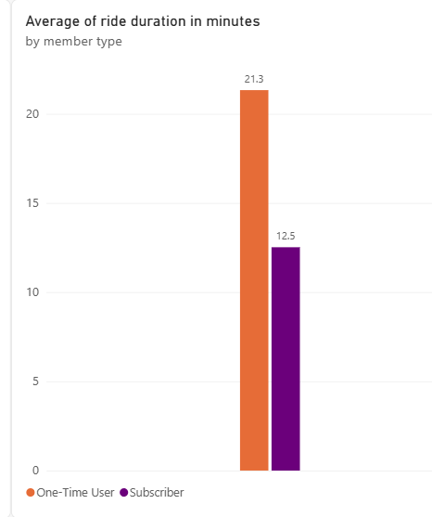
How are subscribers different from one-time users?
One-time users tend to have longer rides than subscribers.

Slide 4
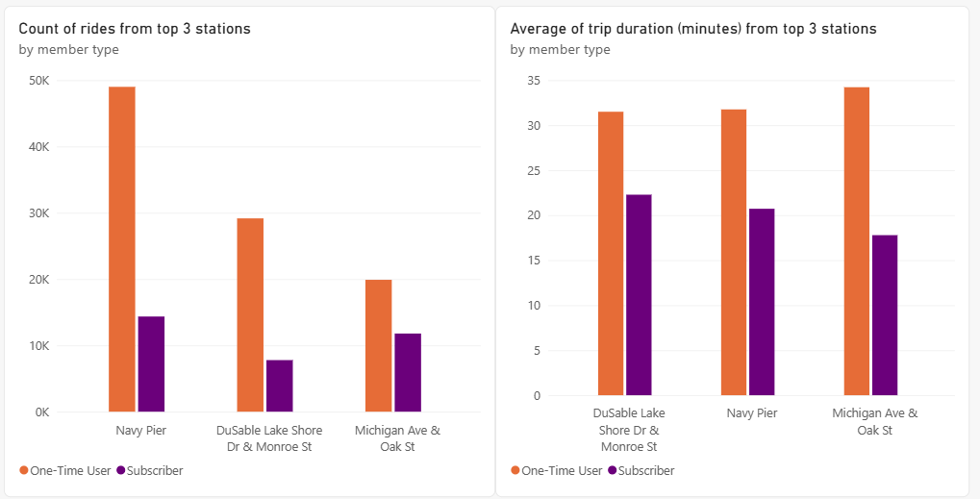
How are subscribers different from one-time users?
One-time users have more number of rides as well as have longer rides than subscribed bikers in the top 3 stations that most bike rides start at.

Slide 5
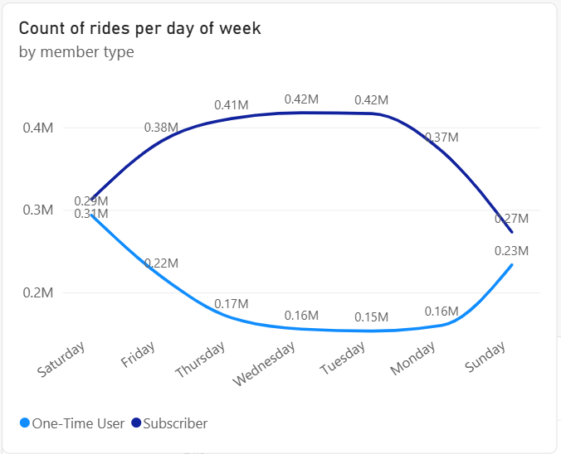
How are subscribers different from one-time users?
During weekdays, there is an increase of rides from subscribers, and a decrease of rides from one-time users.
During the weekends, there is an increase of one-time users.

Slide 6
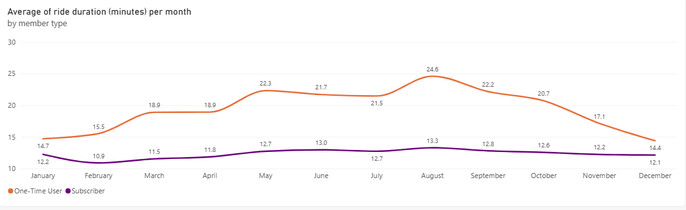
How are subscribers different from one-time users?
One-time users have longer rides from May to October while subscribers have a sustained duration of rides throughout the year.

Slide 7
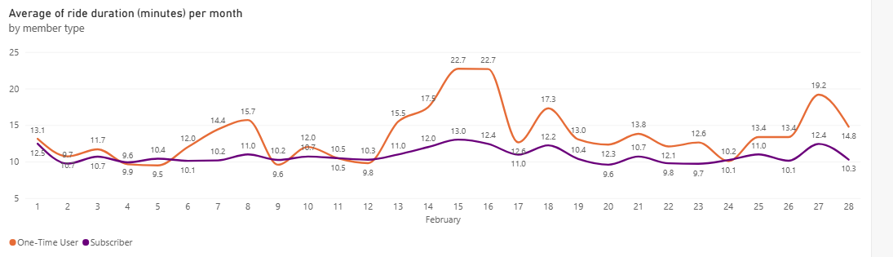
How are subscribers different from one-time users?
One-time users have longer duration of rides on special days like February 14, 15, and 16 while subscribers have a sustained duration of rides throughout the days.

Slide 8
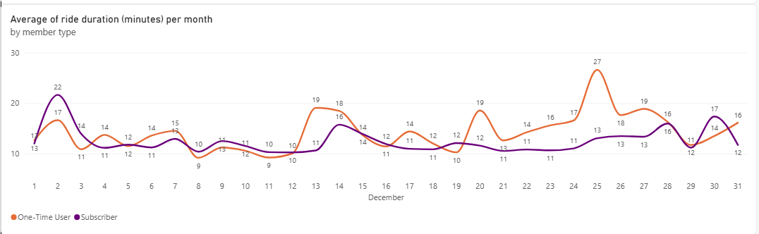
How are subscribers different from one-time users?
One-time rides have longer duration of rides on special days like December 25 while subscribers have a sustained duration of rides throughout the day.

Slide 9
Conclusion
One-time users appear to use bikes primarily for leisure, while subscribers appear to use it more frequently for routine activities such as commuting.

Slide 10
Recommendation
Create member-only offers that save money for long rides during special days like Christmas.
Promote these offers in the top 3 stations Navy Pier, Michigan Ave & Oak St., and DuSable Lake Shore Dr & Monroe St. to maximize reaching one-time users.
Create enticing offers that are available for members during weekends.

