Slide 1
Skyfault
Your Worst Nightmare Segfault
University of California, San Diego
October 23, 2015

Slide 2
Purpose
Provide customers with the cheapest flights possible
Remove stress from the booking process
Forecast the strength of the market

Slide 3
Methodology
Analyze
Fuel prices
Fuel consumption
Number of customers
Big data techniques

Slide 4
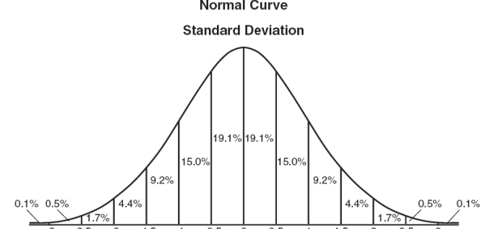
Methodology

Slide 5
Expected Customers
Frequent fliers
Vacationers
Company clients

Slide 6
Potential Risks
Disrupt air travel and related industries
Predictions may not always reflect true prices

