Slide 1
Skyfault
Your Worst Nightmare Segfault
University of California, San Diego
October 23, 2015

Slide 2
Purpose
Offer customers the most affordable months to purchase flight tickets
Remove stress from the booking process
Forecast the strength of the market

Slide 3
Methodology
Analyze
Fuel prices
Fuel consumption
Number of customers
Big data techniques
Hash maps
Teradata datasets

Slide 4
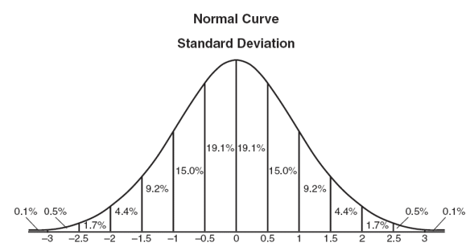
Methodology

Slide 5
Expected Customers
Frequent fliers
Vacationers
Company clients

Slide 6
Potential Risks
Disrupt air travel and related industries
Predictions may not always reflect true prices
Predictions are based on the last 12 years of data

Slide 7
Looking Forward
Expand to include both customers and airlines
Account for changes in the market
i.e. GDP
Scale up to larger operations
Acquire more extensive datasets

