Slide 1


Skyfault
Your Worst Nightmare Segfault
University of California, San Diego
October 23, 2015

Slide 2

Purpose

Slide 3
Purpose
Offer customers the most affordable months to purchase flight tickets
Remove stress from the booking process, by providing a simple user interface to get information
Forecast the strength of the market

Slide 4
Methodology
Analyze
Fuel prices
Fuel consumption
Number of customers
Extracting data from Teradata database and manipulating it to output

Slide 5
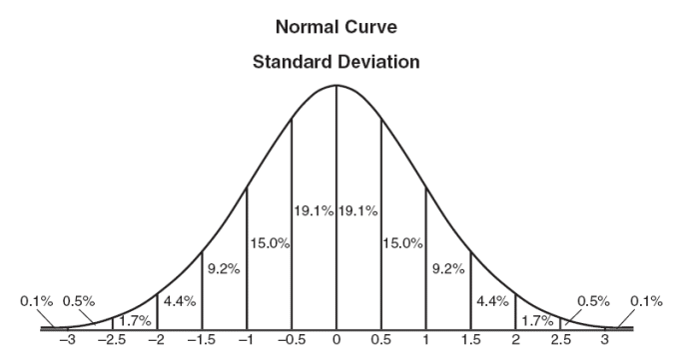
Methodology

Slide 6
Expected Customers
Frequent flyers
Vacationers
Company clients
Aircraft enthusiasts
COLLEGE STUDENTS

Slide 7
Potential Risks
Disrupt air travel and related industries
Predictions may not always reflect true prices
Predictions are based on the last 12 years of data

Slide 8
Looking Forward
Expand to include both customers and airlines
Account for changes in the market
i.e. GDP
Scale up to larger operations
Acquire more extensive datasets

