Slide 1

H1 2025 Incident Management Overview
Significant Improvements in System Reliability Metrics
Incident Count Reduction: Reduced by 65.38% from February’s peak (26 incidents) to May/June (9 incidents), indicating enhanced operational stability.
MTTR Improvement: Mean Time To Resolve dropped by 94.31%, from January’s 1358.63 hours to February’s 77.28 hours.
MTBF Extension: Mean Time Between Failures increased by 68.72%, from 25.85 hours in February to 82.67 hours in May.
Photo by engin akyurt on Unsplash
Notes:
H1 2025 marked a notable shift in our operational performance, as evidenced by key incident metrics. We observed a dramatic 65.38% reduction in incident count, falling from 26 incidents in February to just 9 in May/June. This drop reflects systemic improvements across detection, mitigation, and process execution.
Equally impressive was our Mean Time To Resolve (MTTR), which plunged by over 94%, drastically cutting downtime and boosting service continuity. This is a clear indication that teams responded faster and more effectively to incidents. Meanwhile, the Mean Time Between Failures (MTBF) rose by nearly 69%, showcasing enhanced system stability and reliability.
Together, these improvements paint a compelling picture: we’ve not only reduced the number of issues but have fundamentally improved how we respond to and recover from them. This sets a strong foundation for scaling further reliability efforts through H2 2025.

Slide 2



Key Issue Categories - H1 2025
Analysis of Major System Disruptions
Connection Issues (28%)
Most frequent issue, including repository failures and pool refresh constraints impacting CM access.
Infrastructure Problems (19%)
Disk space exhaustion, memory saturation, and server performance bottlenecks contributed significantly.
Data Retrieval/Analysis (17%)
Failures in MIMIR and AAAS tools limited data extraction and read-only detail availability.
Notes:
Analyzing incident trends from H1 2025, we categorized key system disruptions to pinpoint core instability areas. The dominant issue, accounting for 28% of incidents, stemmed from connection-related failures. This includes CM Connection Repository issues and challenges in refreshing connection pools, both of which directly impacted access to critical systems.
Infrastructure-related problems followed closely at 19%. These stemmed from low disk space—especially inode exhaustion—alongside memory saturation and server underperformance. These resource constraints were pivotal contributors to service disruptions.
Finally, 17% of issues involved data retrieval and analysis. Failures in MIMIR query execution and AAAS tool processing hindered access to essential read-only and validation data, revealing gaps in our data tooling stability. Understanding this issue breakdown allowed teams to target the most impactful areas for resolution.

Slide 3

Top Root Causes Identified
Key Technical and Operational Failures
Legacy System Limitations: CDS system failed to autoscale for 2500+ documents due to outdated architecture.
Network Configuration Gaps: TCP-level failures in CM connectivity due to absence of real-time network diagnostics.
Operational Oversights: Missed alert on MSSQL password change caused manual restart delay.
Photo by ThisisEngineering RAEng on Unsplash
Notes:
A detailed analysis of major incidents revealed a recurring set of root causes impacting system performance and reliability. Firstly, architectural bottlenecks in legacy infrastructure led to critical breakdowns—most notably, the CDS system could not auto-scale when handling document volumes exceeding 2500 in a single request.
Secondly, network diagnostics gaps were evident during the CM intermittent connectivity issue. With no real-time TCP tracing in place, identifying transient failures took longer, increasing recovery times.
Finally, human and operational process gaps emerged. A case in point: the MSSQL password update failed to trigger an alert, causing an overlooked manual restart and affecting all Swiss CDS consumers. These root causes have now been prioritized for systemic remediation.

Slide 4



Corrective Actions Taken
Tactical and Strategic Measures Deployed
GAP Infrastructure Scaling
CDS transitioned to vertical scaling in GAP to handle document volume spikes; completed March 2025.
CM TCP Diagnostics
Reboot strategy and proactive TCP dump monitoring introduced for intermittent connection issues.
Alerting Improvements
Password lockout alerts refined after MSSQL oversight to ensure prompt human response.
Notes:
Corrective efforts during H1 2025 were both tactical and strategic. The CDS system, previously crippled by auto-scaling failures, was upgraded with vertical scaling capabilities within GAP infrastructure. This adjustment was successfully completed by March 2025 and significantly improved throughput during peak load.
For the CM connectivity problem, UNIX and application teams introduced TCP dumps and monthly server reboot protocols to proactively manage and detect anomalies during high-failure periods.
Lastly, process alerts were reengineered following the MSSQL password lockout incident. Updated alerting ensures that such system signals are now visible and actionable, closing the loop on previous manual oversights.

Slide 5



Resolution Outcomes
Sustained Improvements and System Recovery
Incident Volume Drop
Key failure points addressed, reducing incident frequency by over 65% from peak levels.
Infrastructure Resilience
Post-mitigation metrics show higher MTBF and faster recoveries across services.
Process Maturity
Governance upgrades and proactive remediation improved SLA adherence and response workflows.
Notes:
The outcome of our H1 2025 interventions has been tangible and far-reaching. Incident volume saw a dramatic decline—over 65%—once the root causes were tackled and mitigations enforced. The system became inherently more stable, with the infrastructure scaling delivering resilience under pressure.
Operational metrics confirmed this transformation. MTBF rose sharply, and incidents resolved faster—some within a fraction of earlier durations. The impact was not just technical but procedural, with response playbooks, alerting systems, and governance workflows elevated to a new level of maturity.
This sustained improvement paves the way for further reliability gains in H2. With foundational issues now addressed, our focus shifts toward resilience engineering and predictive detection.

Slide 6

Case Study: CDS Out of Memory (OOM) Issue
System Overload During Document Distribution
Trigger: Volume Spike: Processing request for 2500+ documents overloaded legacy CDS infrastructure.
Root Cause: CDS lacked auto-scaling capacity to handle burst demand under legacy architecture.
Resolution: GAP vertical scaling deployed in March 2025; strategic re-architecture underway.
Photo by Martin Sanchez on Unsplash
Notes:
One of the most critical incidents in H1 was the CDS Distribution Out of Memory failure. Triggered by a spike in document processing volume—exceeding 2500 items in a single request—the legacy architecture failed to scale, leading to systemic failure.
The root cause was clear: CDS's legacy infrastructure did not support auto-scaling, making it vulnerable to bursty traffic loads. This limitation had long been a technical debt that materialized under growing usage pressure.
To resolve this, we implemented vertical scaling within the GAP infrastructure by March 2025, enabling CDS to handle such bursts more effectively. In parallel, a long-term strategic re-architecture has been prioritized to eliminate such scaling issues permanently.

Slide 7
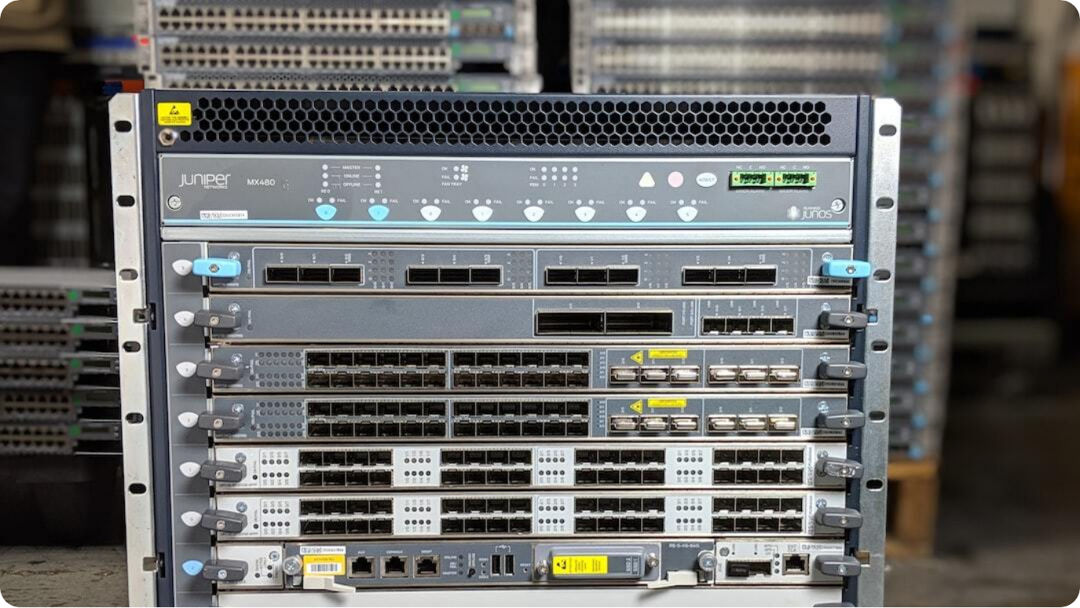
Case Study: CM Intermittent Connectivity
Network Diagnostics and Infrastructure Gaps
Failure Event: CM experienced six hours of intermittent connectivity affecting IPB and STC teams.
Root Cause: No clear system-side issues found; lack of real-time diagnostics delayed resolution.
Fix & Prevention: TCP dumps and scheduled monthly CM server reboots implemented.
Photo by Joe Murray on Unsplash
Notes:
In early February, a six-hour-long intermittent connectivity issue struck the CM platform, disrupting services for IPB and STC teams. These teams rely heavily on continuous connectivity to meet trade SLAs, so the service disruption posed a significant operational risk.
Despite a thorough investigation, both the network and UNIX teams found no specific issues or misconfigurations on the system. The absence of real-time TCP diagnostics hindered root cause identification and response speed. This gap highlighted the need for better proactive infrastructure tooling.
As a result, engineering implemented tactical countermeasures—TCP dumps are now standard during high-failure periods, and monthly CM application server reboots have been scheduled as a preventive action.

Slide 8



Case Study: MSSQL Password Locking
Alert Failure and Manual Recovery Delay
Trigger Event
MSSQL password change failed silently, locking CDS services for Swiss consumers.
Alert Failure
No system alert was triggered due to a misconfigured monitoring rule.
Resolution
Manual restart conducted after delayed detection; alerting mechanisms updated.
Notes:
This incident, though brief, had a high impact on Swiss consumers of CDS. A routine MSSQL password change triggered a lockout across multiple services due to a failure in the alerting system.
What made this incident noteworthy was not the password change itself but the fact that no alert was triggered. The alert mechanism, which should have notified teams of the failed authentication sequence, had a configuration flaw that let the issue go undetected until users began to escalate.
After manually restarting affected services, engineering teams overhauled the alerting logic. This case highlighted the risks of silent failures and the importance of precise monitoring for routine tasks.

