Slide 1
UNVEILING MARKET INSIGHTS: ANALYZING SPENDING BEHAVIOR AND IDENTIFYING OPPORTUNITIES FOR GROWTH
PROJECT: 1
TEAM ID:NM2023TMID43126
PROJECT NAME:UNVEILING MARKET INSIGHTS:Analysis spending behaviour and Identify opportunities for growth
Team Members:
1.A.KALLALGAR
2.P.MANOJKARTHIK
3.A.ARULJEYANTH
4.A.ALAGUMANI

Slide 2

INTRODUCTION
Welcome to the presentation on Unveiling Market Insights: Analyzing Spending Behavior and Identifying Opportunities for Growth. In this presentation, we will delve into the factors that drive consumer spending and explore strategies to capitalize on emerging market trends. Join us as we uncover valuable insights that will empower your business to achieve sustainable growth.

Slide 3

UNDERSTANDING CONSUMER BEHAVIOR
To unlock growth opportunities, it is crucial to understand consumer behavior. By analyzing purchasing patterns, preferences, and motivations, businesses can tailor their strategies to meet customer needs effectively. In this section, we will explore various aspects of consumer behavior and highlight key insights that can drive business success.

Slide 4

MARKET RESEARCH TECHNIQUES
Robust market research is essential for gaining a deeper understanding of your target audience. We will discuss qualitative and quantitative research methods, including surveys, focus groups, and data analytics. By leveraging these techniques, businesses can gather valuable insights to make informed decisions and stay ahead of the competition.

Slide 5

IDENTIFYING KEY MARKET TRENDS
In this section, we will identify and analyze the most signiﬁcant market trends that are shaping consumer behavior. By staying attuned to these trends, businesses can anticipate changes in demand, identify new opportunities, and adapt their strategies accordingly. We will explore both global and industry-speciﬁc trends to provide a comprehensive perspective.

Slide 6


SEGMENTATION AND TARGETING
Segmenting your target market based on relevant criteria allows for more precise targeting and personalized marketing efforts. We will discuss various segmentation strategies, such as demographic, psychographic, and behavioral segmentation. By tailoring your approach to speciﬁc customer segments, you can enhance customer engagement and maximize conversion rates.

Slide 7

CONSUMER DECISION-MAKING PROCESS
Understanding the consumer decision- making process is crucial for effective marketing. By comprehending the stages consumers go through when making purchase decisions, businesses can optimize their marketing efforts and create persuasive messaging. We will explore the stages of awareness, consideration, and decision, providing insights into consumer behavior at each step.

Slide 8

INFLUENCING FACTORS ON CONSUMER BEHAVIOR
Numerous factors inﬂuence consumer behavior, including cultural, social, psychological, and economic factors. By recognizing these inﬂuences, businesses can tailor their marketing strategies to resonate with their target audience. We will delve into each factor and provide actionable insights on how to leverage them to drive consumer engagement and loyalty.

Slide 9

The rise of e-commerce and digital transformation has revolutionized consumer behavior. We will explore the impact of digital platforms, online shopping, and mobile technologies on consumer spending.
By embracing these trends and leveraging
E-COMMERCE AND DIGITAL TRANSFORMATION
digital channels effectively, businesses can expand their reach, enhance customer experiences, and unlock new growth opportunities.

Slide 10
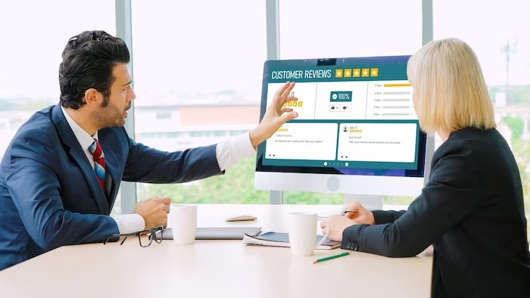
CONSUMER LOYALTY AND RETENTION
Building consumer loyalty is crucial for long- term business success. We will discuss strategies to foster customer loyalty, including personalized experiences, exceptional customer service, and loyalty programs. By prioritizing customer retention, businesses can maximize customer lifetime value and create a strong competitive advantage in the marketplace.

Slide 11

EMERGING MARKET OPPORTUNITIES
Identifying emerging market opportunities is essential for sustained business growth. We will explore emerging consumer trends, untapped market segments, and potential niche markets. By proactively identifying and capitalizing on these opportunities, businesses can gain a competitive edge and position themselves as industry leaders in the evolving market landscape.

Slide 12

STRATEGIES FOR GROWTH
In this section, we will discuss effective strategies for driving growth based on the insights gained from analyzing consumer behavior. We will explore product innovation, market expansion, strategic partnerships, and customer-centric approaches. By aligning your business strategies with market insights, you can position your organization for sustainable growth and long-term success.

Slide 13

CASE STUDIES: SUCCESSFUL IMPLEMENTATIONS
We will examine real-world case studies of businesses that successfully applied market insights to drive growth. These case studies will provide practical examples and actionable takeaways that you can apply to your own business. By learning from the experiences of industry leaders, you can gain valuable insights and inspiration for implementing effective growth strategies.

Slide 14

KEY TAKEAWAYS
In this section, we will summarize the key takeaways from this presentation. By recapping the main points and insights covered, you can reinforce your understanding of the importance of analyzing spending behavior and identifying growth opportunities. These takeaways will serve as a valuable reference for implementing effective strategies and driving business success.

Slide 15

Q&A SESSION
We will now open the ﬂoor for a Q&A session. Feel free to ask any questions related to the topics covered in this presentation. Our team of experts is here to provide insights and clariﬁcation to help you further understand the concepts discussed.

Slide 16
CONCLUSION
As we conclude this presentation on Unveiling Market Insights: Analyzing Spending Behavior and Identifying Opportunities for Growth, we hope you have gained valuable knowledge and insights that will empower your business. By understanding consumer behavior, leveraging market trends, and implementing effective growth strategies, you can position your organization for sustainable success in a dynamic marketplace.

Slide 17
Thanks!

