Slide 1
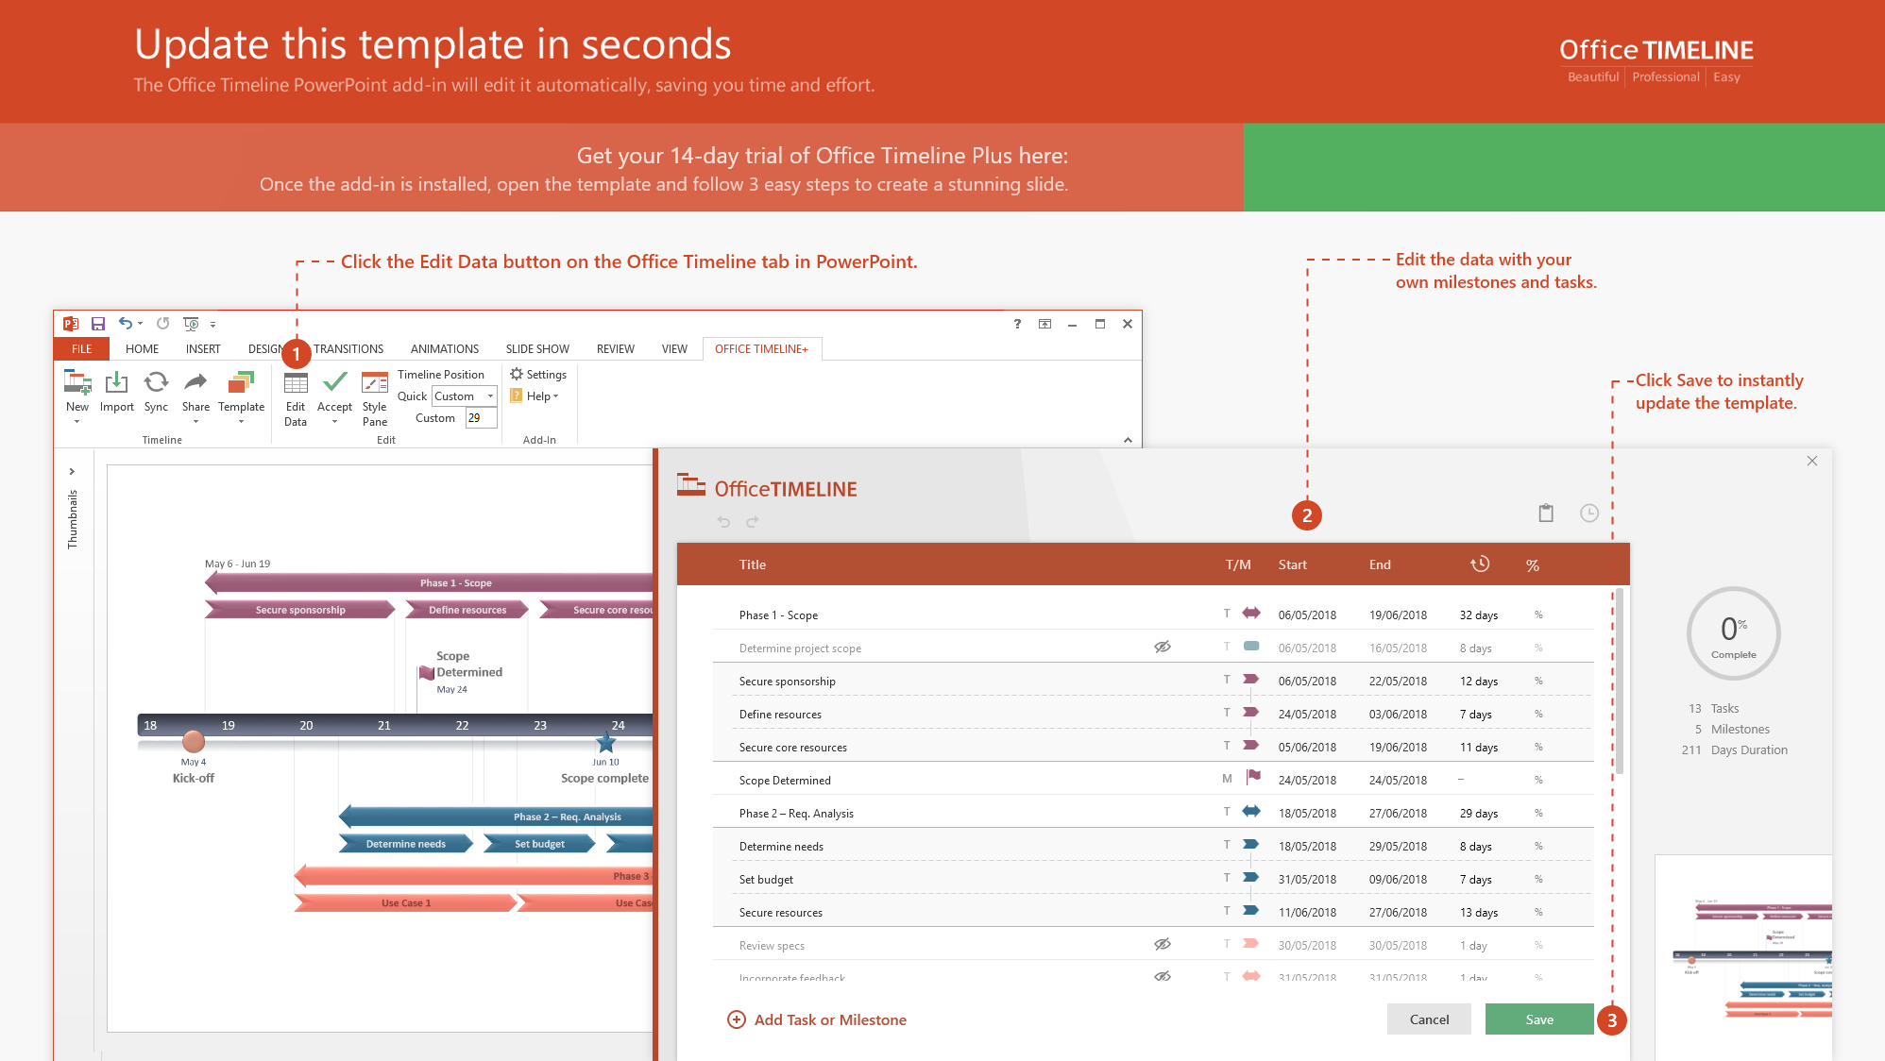
https://www.officetimeline.com/14-days-trial

Slide 2
Final Evaluation
Kick Off
Mid Evaluation
Oct 26
Dec 10
Aug 6
Sign Off
Nov 16
2020
Dec
2020
Feb
Mar
Apr
May
Jun
Jul
Aug
Sep
Oct
Nov
Today
Dec 10
Read and understand the context of the Problem
Dec 20
Dive into the Research Domain
Dec 21
Go through previous arts and create Bibliography
2019
Dec 31
Jan 1
Go deep and Analyze selected previous arts
Feb 24
Narrow down and define the Research Problem
Feb 24 - Feb 25
Choose a methodology for the experiment
Proposal submission
Feb 26 - Feb 27
Define appropriate measurements for experiment
Feb 28 - Mar 7
Proposal and Proposal Presentation Preparation
Mar 8 - Mar 29
Extracting features
Mar 29 - Apr 7
Apr 8
Evaluating impact of the feature
Apr 22
Research and Experiments
Prioritizing features
Apr 23 - Apr 29
Group the features for functions
Apr 30 - May 6
Set the features into classes
May 7 - May 31
Design the Library of functions
May 31 - Jul 17
Library design and implementation
Implement the Library (mid evaluation)
Jul 18 - Aug 6
Aug 7
Implement the Library (finalevaluation)
Oct 6
Evaluate the functions
Library Testing and Reimplementation
Oct 6 - Oct 16
Reimplementation of the Library
Final Report
Oct 17 - Oct 26
Completion and Final Report
Aug 10
Oct 26
Oct 27
Final Presentation
Nov 16
Total Duration
Dec 10
-
Nov 16

