Slide 1
Hub Client Features
Technology Connect Session – Aug 2022
Sampathkumar S

Slide 2
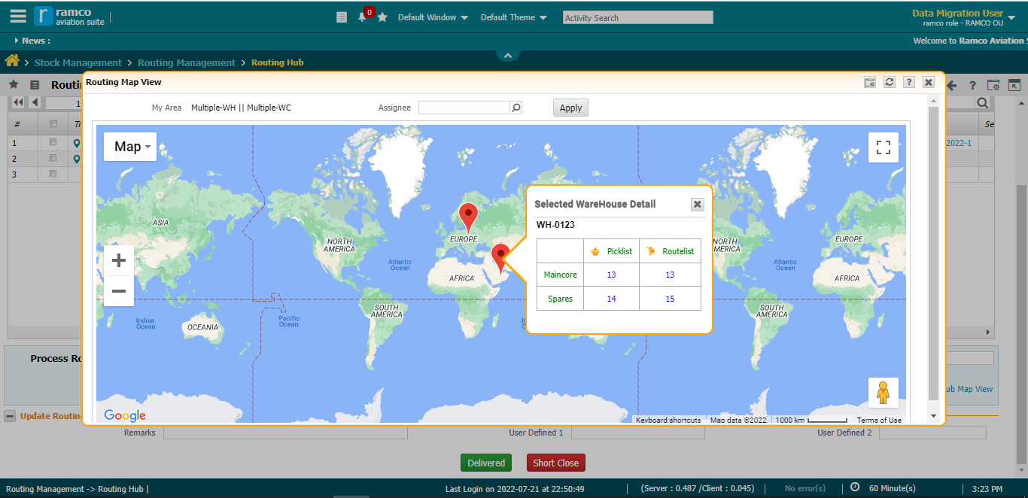
Map
Info Window Style

Slide 3
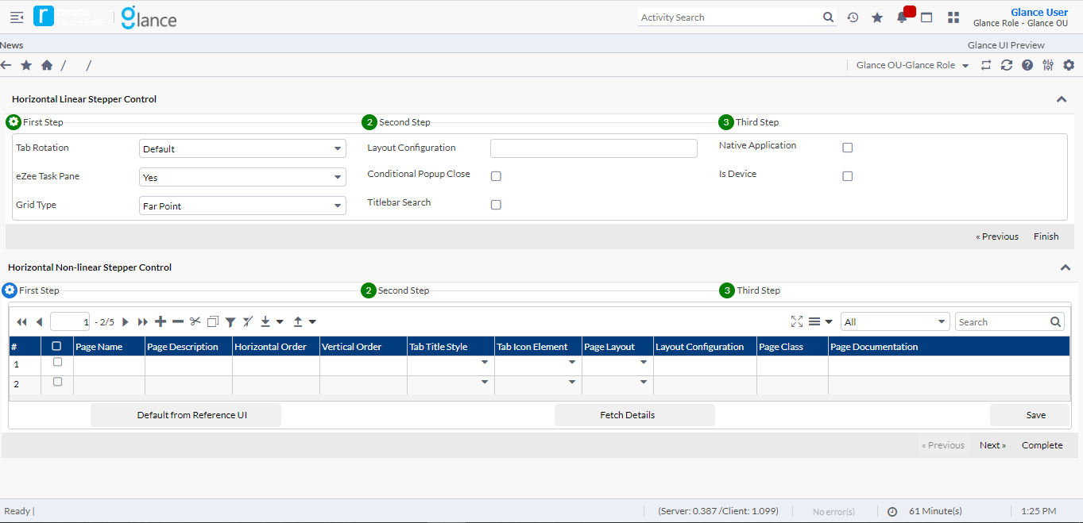
Horizontal Linear, Non-Linear Stepper Control

Slide 4
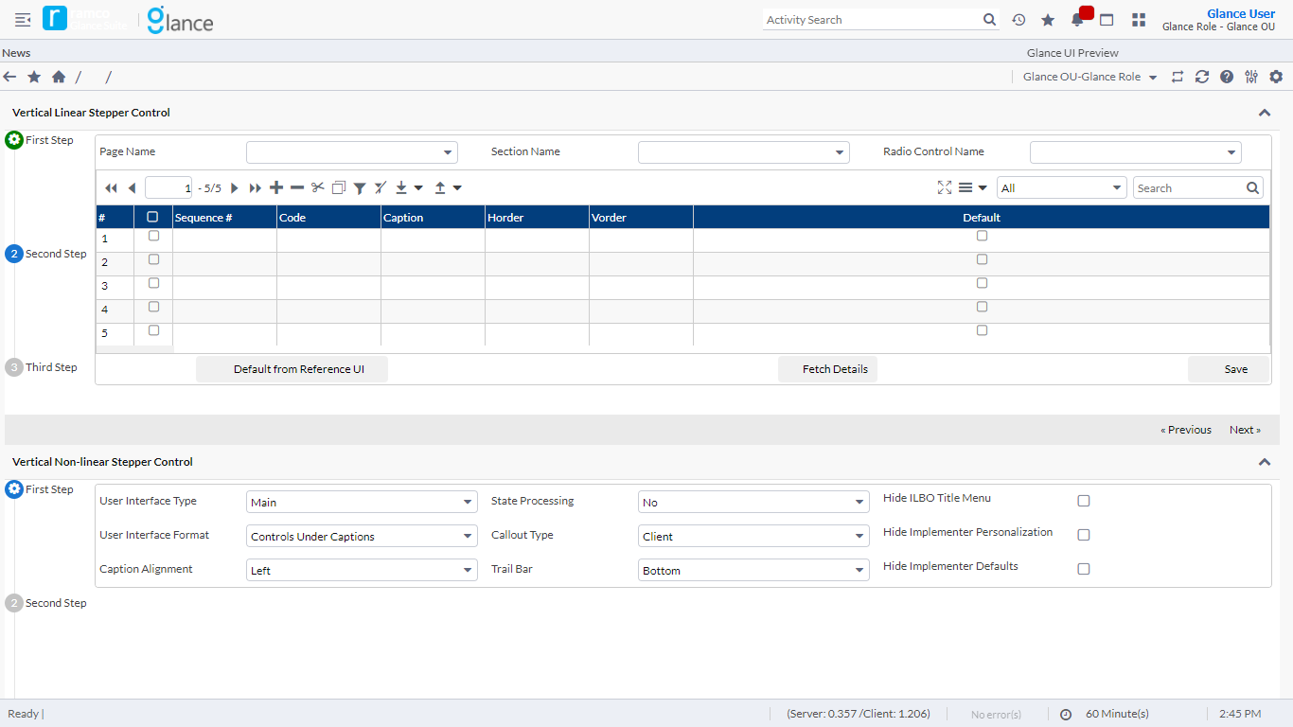
Vertical Linear, Non-Linear Stepper Control

Slide 5
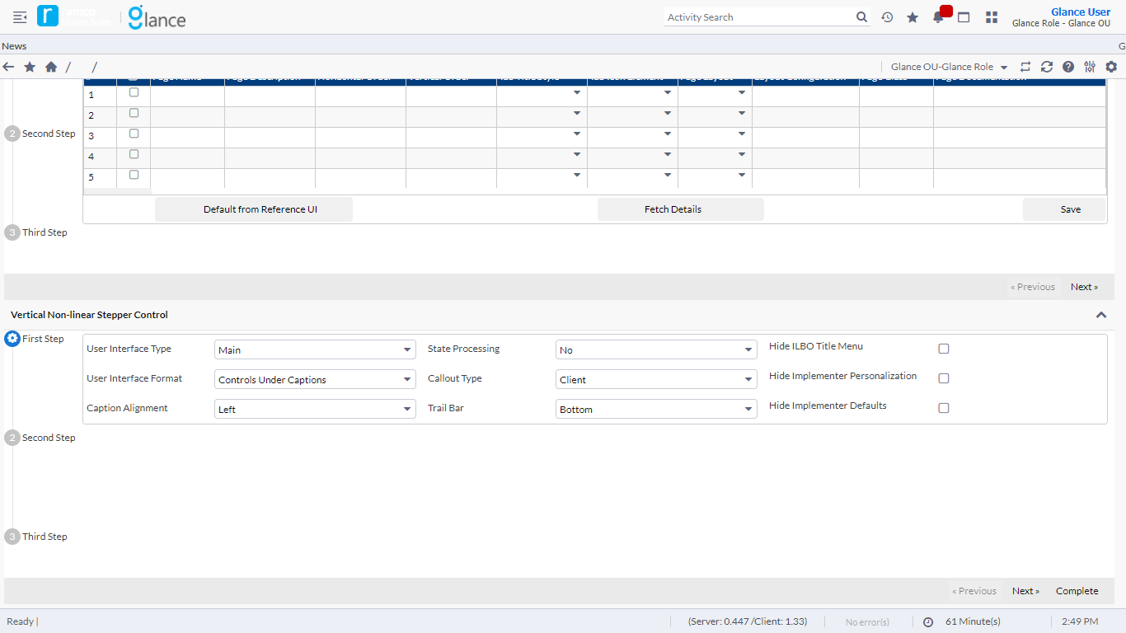
Vertical Linear, Non-Linear Stepper Control

