Slide 1
Devops - SCM
Version 2.0

Slide 2
Agenda
Product repository modelling & Workflow
Support repository modelling & workflow
Project repository modelling & workflow
Support workflow to fix the downgraded CU version
Support fix packaging and deliverables using GIT tags/ Rtrack ids
Tools used at present for deployment, packaging, dependency object pulling.
Upcoming DevOPS tools
CU upgrade procedure using GIT for project & support team
Use cases – specific to Product/ Project / customer support (inputs from the teams required)
GIT User disciplines to be followed – from Logistics lessons learnt

Slide 3
GIT Rollout
16 processes
15 Tools
Built Around
VSS
Transition to
GITLAB
JENKINS
Release Packager
Single Installer

Slide 4
GIT Rollout
Category | ToolName | Purpose | Equivalent DevOps Tools/Process | Status | Responsibility | Target Date | Remarks
DFN | DFNAddClientTool` | To adding BE and FE new objects to vss | Commit | Complete | Devops
DFN | DFNFEClientTool | To checkin FE objects | Commit | Complete | Devops
DFN | DFNBEClientTool | To Checkin BE objects | Commit | Complete | Devops
DFN | DFNBEServerTool | Server tool to deploy request from BE Client Tool | Jenkins | Complete | Devops
DFN | DFNFEServerTool | Server tool to deploy request from FE Client Tool | Jenkins | Complete | Devops
DFN | MS2Msenhpulltool | Client Tool to Pull objects from Ms Vss to Msenh vss | Merge Request | Complete | Devops |  | To Initiate the Merge Request from Enhancement to To Be Released using the same EPE case ID for tracking.
DFN | BulkCheckinTool | Client tool To chekin Bulk objects | Commit | Complete | Devops
Others | AppSetup | Deployer tool for Full Product Cd | Single Installer | Complete | RVW - Alice Devops - Shan | 30th April 2020 | Pilot Testing Completed Good to use with no installation error condition Identified gaps in error handling,
Others | Sp_Setup | Deployer tool for CU and Servicepacks
Others | PackagerTool | Packager Tool for Full Cd | Single Installer Packager | Complete | RVW - Alice Devops- Shan | 30th April 2020 | Product Packaging Completed Project Packaging In Progress,
Others | DFNNote | Excel Tool for giving TL Submits | Merge Requests | Complete | Devops
Others | DFNNote | Excel Tool for giving RE Submits | Jenkins | Complete | Devops |  | Jenkins stage configured for QA approval of all releases to QA environment after testing
Others | Object_Shipment_Tool | To generate shipment for a Single defect ( It generates with Dependency ) | Dependency Extractor for Single Installer Packager | Complete | Devops- Shan | 15th April 2020 | Manual Mode Packaging In Progress
Others | FixDeployer | To deploy the generated shipment in Customer server | Single Installer Packager | Complete | RVW - Alice Devops- Shan | 30th April 2020 | Product Packaging complete Project package requires package composition enhancement from RVW
Others | SpAnalyser | To analyse SP and generate report | Static Code Anlayzer | Complete | Devops |  | Integrated with GIT for static code analysis
Others | SearchUtility | To do Unicode string search. | Global Search | Complete | Devops

Slide 5
Transformation
Product Planning, Dev, QA and Release Process

Slide 6
Transformation
Product repository modelling & Workflow

Slide 7
Product Source Repository Structure
Multi Version
Enh-v3.187.X.XX Released
PSS Version
v3.187.1.01
v3.187.2.00
PSS Version - Environment
v3.187.1.00
v3.187.1.02
Defect Fixes
v3.187.00.000
Product Master Version
ST/Feature Test/r egression - Environment
QA Branch 3.188 BETA
Build Test - Environment
UT/Enhancement Preview Version - Environment
Change Sets – Pending Preview
Change Sets – Moved to QA
Version base Line
vX.XXX.XX.XXX-rcx
Represents Release Candidate Version for Early Adopters,
Feature Branches
Represents Defect Fixes. Periodicity Daily/As and When Needed
Fixes Regularization into Product
Represents Maintenance Release Version, Periodicity Four to Six Weeks
Represents Major Enhancement Version Periodicity Six to Eight Months
Mandatory Fixes Release into Higher Version
Represents Technology or New Business Line Upgrade
Notes:
3.187 Released and Branched out from Master for Support
New Dev Branch Created for Next Version ie 3.188BETA
Defect Fixes Done in 3.187 regularized into 3.188BETA by Creating Defect Fix Branch from Dev Branch
Defect Fixes after deployment into preview environment , merged back into Dev branch
New Feature branch Created from Dev Branch for features targeted for 3.188 version

Slide 8
Product Source Repository Structure
Multi Version
Enh-v3.187.X.XX Released
PSS Version
PSS Version - Environment
v3.187.1.01
v3.187.2.00
v3.187.1.00
v3.187.1.02
Enh-v3.188X.XX Released
PSS Version
Defect Fixes
PSS Version - Environment
v3.187.00.000
v3.188.00.000
Product Master Version
ST/Feature Test/r egression - Environment
QA Branch 3.188 BETA
Build Test - Environment
UT/ Enhancement Preview Version - Environment
Change Sets – Pending Preview
Change Sets – Moved to QA
Version base Line
vX.XXX.XX.XXX-rcx
Represents Release Candidate Version for Early Adopters,
Feature Branches
Represents Defect Fixes. Periodicity Daily/As and When Needed
Fixes Regularization into Product
Represents Maintenance Release Version, Periodicity Four to Six Weeks
Represents Major Enhancement Version Periodicity Six to Eight Months
Mandatory Fixes Release into Higher Version
Represents Technology or New Business Line Upgrade
Notes:
3.188 QA Completed
3.188 Dev Branch Merged to Master Branch
A Support Branch Created for 3.188 support
A new Dev Branch Created for 3.189BETA

Slide 9
Product Source Repository Structure
Multi Version
Enh-v3.186.X.XX Released
PSS Version
v3.187.1.01
v3.187.2.00
PSS Version – Controlled Environment
v3.187.1.00
v3.187.1.02
v3.188.1.01
v3.188.1.02
v3.188.1.00
v3.188.2.00
PSS Version – Dev Environment
Enh-v3.188X.XX Released
PSS Version
Defect Fixes
PSS Version – Controlled Environment
PSS Version – Dev Environment
v3.186.00.000
v3.188.00.000
Product Master Version
ST/Feature Test/r egression - Environment
QA Branch 3.188 BETA
QA Branch 3.189 BETA
Build Test - Environment
UT/Enhancement Preview Version - Environment
Change Sets – Pending Preview
Change Sets – Moved to QA
Version base Line
vX.XXX.XX.XXX-rcx
Represents Release Candidate Version for Early Adopters,
Feature Branches
Represents Defect Fixes. Periodicity Daily/As and When Needed
Fixes Regularization into Product
Represents Maintenance Release Version, Periodicity Four to Six Weeks
Represents Major Enhancement Version Periodicity Six to Eight Months
Mandatory Fixes Release into Higher Version
Represents Technology or New Business Line Upgrade
Notes:
State: Two Support branches
Support Fixes From Lower Version to Higher version merged automatically or manual mode depending on mergeability
Support Fixes from Both Support Branches Moved to Dev branch for merge back into product future versions

Slide 10
Product Source Repository Structure – Unit /System Testing GIT Flow
Product Release
Product Master Version
Regression Testing Environment
System/Integration Testing Environment
Enhancement Development Branch
L3 fixes regularization
Unit Testing Environment
Pull from remote
Resolve conflicts
!
!
Smoke and Sanity Test in System test Environment
!
Commit By Developer
Static Code Analyzer
!
!
!
Version base Line
Regression Release
Developer Raises Merge request
Regression Fixes
Merge Request Approved after Code review
Enhancement Branch
Unit Testing environment deployed
Feature/Branches
Unit Testing Completed
Feature Branch Merged to Dev Branch
Developer Branch
!
!
Merge Branch
ST Deployment
Package from enhancement branch to Regression environment
L3 fix Regularization Branch
Support engineer Raises Merge request

Slide 11
Product Source Repository Structure – Unit /System Testing GIT Flow
Product Release
master
V3.18x-Controlled
Product Master Version
Regression Testing Environment
System/Integration Testing Environment
Enhancement Development Branch
enh-dev
L3 fixes regularization
Unit Testing Environment
ut-<Featue rTack ID>
Pull from remote
Resolve conflicts
!
!
Smoke and Sanity Test in System test Environment
!
dev-merge-<Featue rTack ID>
Commit By Developer
dev-merge--<Featue rTack ID>
Static Code Analyzer
!
!
!
dev-<Featue rTack ID>-<Task ID/defectID>
Regression Release
Version base Line
Developer Raises Merge request
Regression Fixes
Merge Request Approved after Code review
Enhancement Branch
Unit Testing environment deployed
Feature/Branches
Unit Testing Completed
Feature Branch Merged to Dev Branch
Developer Branch
!
!
Merge Branch
ST Deployment
ut-tms-l3fix / ut-wms-l3fix / ut-rnb-l3fix / ut-ipo-l3fix
Package from enhancement branch to Regression environment
L3 fix Regularization Branch
Support engineer Raises Merge request
!
dev-merge--xxx-l3-fix
!
dev-<defect rTrackID>

Slide 12
Product Source Repository Structure – Statutory GIT Flow
Product Release
Product Master Version
Enhancement Development Branch
Regression Testing Environment
System/Integration Testing Environment
Statutory Development Branch
System/Integration Testing Environment
India
Unit Testing Environment
Australia statutory
Pull from remote
!
!
!
Resolve conflicts
Commit By Developer
!
!
!
Static Code Analyzer
!
!
Version base Line
Developer Raises Merge request
Enhancement branch
Merge Request Approved after Code review
Unit Testing environment deployed
Statutory Branches
Unit Testing Completed
!
!
Feature Branch Merged to Dev Branch
!
!
Developer Branch
ST Deployment
Package from enhancement branch to Regression environment
Bug fixing Branch

Slide 13
Feature Branch
Unit /System Testing
Each Feature would have one Feature branch.
The Feature Owner Create the branch and pushes to remote repository for developers to branch and commit code changes
Each Developer Creates Branch From Feature branch for Code Changes
After code completion, Raises Merge Request for Feature Owner to Review Code and Approve the Merge Request to Feature Branch. Static Code Analyzer run for each merge request
Merge Request Approval Triggers Deployment in UT
On UT Completion, Merge Feature branch to Dev Branch
On Feature Branch Merge to Dev Branch, Jenkins Pipeline automatically deploys into ST branch
For any defect Fixing in ST, Process Continue from UT
Note: Same Object Can not be Modified in More than One Feature Branch same time. Ie still Feature Branch ST completed and Feature Branch Closed/Removed.

Slide 14
RVW Model
Version Management
Review of the Pros and Cons Each Release To have Independent Model DB Identified
Max of two versions (n-2) would be managed
Show Stopper Fixes to be Undertaken for Front End changes
Enhancement would be undertaken in previous versions based on PMC approval
Merge of changes from one model version to another to be planned
Two options considered Handler Changes Or Model DB Changes

Slide 15
Engg Process – rTrack
Transitions
S.No | Actor | rTrack Project | Issue Type | rTrack Transitions and Status
 |  |  |  | Source Transition | Stage | Status | Next Transition | Remarks
1 | Requirment Engineer | Product Engineering | User Story |  | Requirements | Pending Requirements | Initiate Requiremnt | Initiated as soon as Solution User Story Released
2 | Requirment Engineer | Product Engineering | User Story | Initiate Requiremnt | Requirements | Under Requirements | Release Requirements
3 | Requirment Engineer | Product Engineering | User Story | Release Requirements | Requirements | Requirements Completed | Initiate Design
4 | Requirment Engineer | Product Engineering | User Story | Release Requirements | Requirements | Requirements Completed | Initiate Coding
5 | Technical Lead | Product Engineering | User Story | Initiate Design | Design | Under Design | Release Design
6 | Technical Lead | Product Engineering | User Story | Release Design | Design | Design Completed | Initiate Coding
7 | Developer | Product Engineering | User Story | Initiate Coding | Coding | Under Coding | Initiate Code Review
8 | Technical Lead | Product Engineering | User Story | Initiate Code Review | Code Review | Under Code Review | Complete Code Review
9 | Technical Lead | Product Engineering | User Story | Complete Code Review | Code Review | Ready for UT | Initiate UT
10 | Developer | Product Engineering | User Story | Initiate UT | Unit Testing | Under UT | Complete UT
11 | Developer | Product Engineering | User Story | Complete UT | Unit Testing | Ready for Preview | Initiate Preview
12 | Developer | Product Engineering | User Story | Initiate Preview | System Testing | Under Preview | Complete Preview
13 | Developer | Product Engineering | User Story | Complete Preview | System Testing | Ready for ST | Initiate ST | Initiates Test Execution
14 | QA | Product Engineering | User Story | Complete ST | System Testing | Ready for Regression | Initiate Regression
15 | QA | Product Engineering | User Story | Initiate Regression | Regression | Complete Regression | Complete Regression
16 | QA | Product Engineering | User Story | Complete Regression | Release | Under Release | Initiate Packaging
17 | CMI | Product Engineering | User Story | Initiate Packaging | Release | Under Release | Complete Packaging
18 | CMI | Product Engineering | User Story | Complete Packaging | Release | Packaged | Initiate Release
19 | CMI | Product Engineering | User Story | Initiate Release | Release | Released

Slide 16
Engg Process – rTrack
Transitions
S.No | Actor | rTrack Project | Issue Type | rTrack Transitions and Status
 |  |  |  | Source Transition | Stage | Status | Next Transition | Remarks
1 | Test Lead | Quality Assurance | User Story |  | Test Design | Pending | Initiate Test Design
2 | Test Lead | Quality Assurance | User Story | Initiate Test Design | Test Design | Under Test Design | Initiate Test Design Review | Initiated as soon as Solution User Story Released
3 | Test Lead | Quality Assurance | User Story | Initiate Test Design Review | Test Design | Under Test Design Review | Complete Test Design
4 | Test Lead | Quality Assurance | User Story | Complete Test Design | Test Design | Test Design Completed | Release for Test Execution | Initiated once the Feature is Ready for ST
5 | Tester | Quality Assurance | User Story | Release for Test Execution | Test Execution | Ready for Test Execution | Initiate Test Execution
6 | Tester | Quality Assurance | User Story | Initiate Test Execution | Test Execution | Test Execution In Progress | Complete Test Execution
7 | Tester | Quality Assurance | User Story | Complete Test Execution | Test Execution | Test Execution Completed
8 | Tester | Quality Assurance | User Story | Hold test Execution | Test Execution | Test Execution On Hold | Initiate Test Execution

Slide 17
Transformation
Version Numbering

Slide 18
Version Numbering
Product Version Numbering
Product version consists of four parts. The first part represents the technology or New Business Line addition to the product
Major Enhancment
Updates to second part of version represents Major Enhancement Version Periodicity Six to Eight Months for GA
Maintenance Pack
Updates the Third Part of the Version Number ie 3.187.00.000 becomes 3.187.01.000 for Maintenance Pack Version Change
Maintenance Pack would have two packages one incremental and another Cumulative from last Major version
Frequency – Planned Monthly
Consists of Defect Fixes Across projects
Minor Version Numbering
Updates the Fourth Part of the Version Number ie 3.187.01.000 becomes 3.187.01.001 for Minor Version Change
Frequency – Max Weekly, Min Daily
Consists of Defect Fix
Hot Fix Version Numbering
Hot Fix on Base version of the Product . The base version can be Major or Maintenance Pack or Minor Version
The version number follows as HF-v3.187.01.001-01, HF-v3.187.01.001-02 for Hot fixes on v3.187.01.001 base version.
Hot Fix can only be extracted from released Service Packs, Minor versions. Objects of hot fix will take the max version from which the object extracted.
Version Check for Hot Fixes
Previous Base version should exist in the target environment
Objects getting deployed by the Hot Fix are not below the version of the object already deployed

Slide 19
Product Version Management Rules
Package Generator extracts package from last generated package till the cut off time and tags the cut off-time version in GIT
For base version of 3.187.03.000, On package generation it tags the GIT as 3.187.03.001 for Daily/as and when needed (Minor) Packages. Next package generation tags the repository as 3.187.03.001
Monthly Package version goes as 3.187.04.000 consisting of all daily packages from previous monthly package ie 3.187.03.000
Monthly – Cumulative package get generated and the version number as 3.187.04.000-CUM, it consist of all previous packages from 3.187.0 to 3.187.4. Cumulative package packages latest objects for each object. Very critical to keep the table scripts etc runnable repeatedly. Similarly metadata scripts should check for existence before insert data. A file should not have different contents at different version as the latest object identified based on file name.
Each package consists of script to load ICMS tables with objects and version of object getting installed
Each package would have a version check script which calls the version check SP (tod be built) which checks the previous version requirement met ie 3.187.03.005 requires 3.187.03.004 installed and no later Packages installed ie 3.187.03.006 not installed to avoid incorrect sequence of installation
For cumulative packages , the previous version requirement is base version ie for 3.187.04.000-CUM , the base version requirement is 3.187.00.000 and there should not be any higher version ie 3.187.04.001 or above deployed in the environment
The version check is basically putting together all sub version numbers into single digit ie 3.187.03.000 becomes 318703000 and 3.187.03.001 becomes 318703001 . The same number to be maintained in ICMS table in addition to released version number

Slide 20
Product Package Generation
Select the Product Repository from which the package to be generated
Select the Package Type
Select Package Format
Generate package
Tag the Git repository with version number
Major (Quarterly/Half Yearly)
Service Pack (Monthly)
Minor (Weekly)
Hot Fix (On Demand)
Single Installer
Generate the ICMS details and header with version number of the tag

Slide 21
Project Version Management Rules
Applicable for Projects which are having customization
Packaging done over and above the base package
Version number of the Project Package follows Base Package as Suffix, A two digit number used for project version
Project version can independently increase on any specific base product version based on customization releases
All base objects customized by project would have base product version of the object
If base product object customized by the project, base product package can not be deployed as it is . Version check ensures it
Version check for any customized objects checked similar to the base objects .

Slide 22
Project Package Generation
Select the Project Repository from which the package to be generated
Select the Package Type
Select Package Format
Generate package
Tag the Git repository with version number as Base Package version Suffixed with Project Released Two digit version
Major (Quarterly/Half Yearly)
Service Pack (Monthly)
Minor (Weekly)
Hot Fix (On Demand)
Single Installer
Generate the ICMS details and header with version number of the tag. For all customized base objects, the ICMS should have information on base and customization versions
Select Base Package On which the Project Package required
#Customized Base Objects to have Base and Customization version Numbers
#version check to consider base and customized version numbers

Slide 23
Regularization
Regularization Matrix
 | Product Enhancement (Dev) | PSS Version n | PSS Version (n-1) | PSS Version (n-2)
Product Enhancement (Dev) | NA
PSS Version n |  | NA
PSS Version (n-1) |  |  | NA
PSS Version (n-2) |  |  |  | NA
All Defect Fixes
Mandatory Fixes

Slide 24
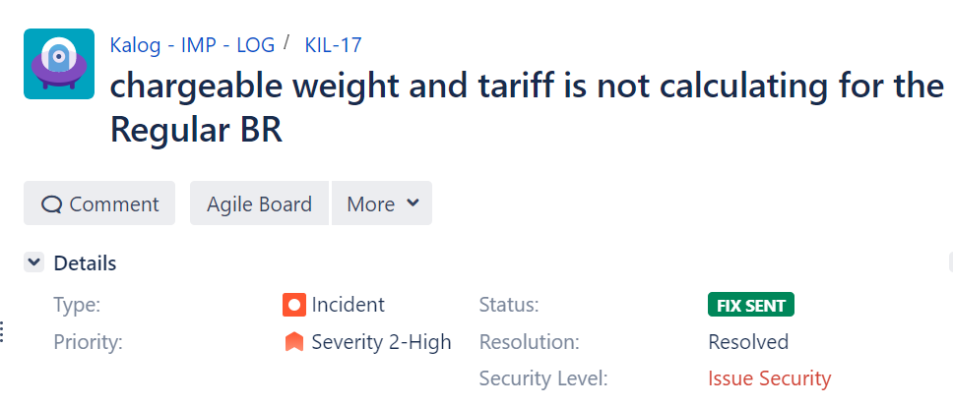
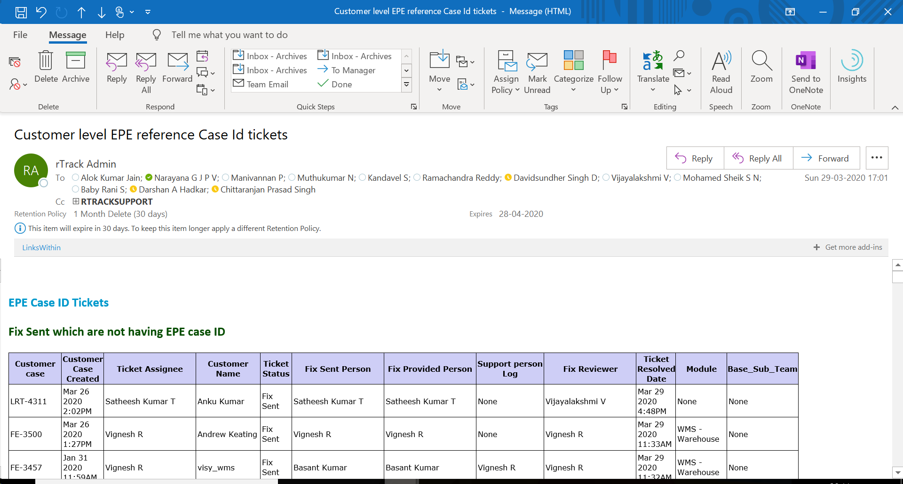
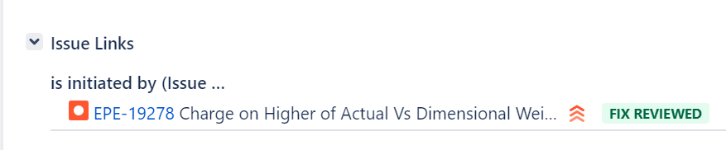
Regularization
Tracking Report
Based on Regularization Matrix, for all fixes done in PSS versions, a regularization case registered in the product and tracked to release
Once regularization completed, such issue can be marked as closed
An exception report provides the pending regularization for all issues which are not lined with regularization

Slide 26
Product Source Repository Structure - Statutory Releases to n-1 versions
Enh-v3.186.X.XX Released
PSS Version
v3.188.1.01
v3.188.1.02
v3.188.1.00
v3.188.2.00
Enh-v3.188X.XX Released
PSS Version
v3.186.00.000
v3.188.00.000
Product Master Version
ST/Feature Test/r egression - Environment
QA Branch 3.188 BETA
QA Branch 3.189 BETA
Enhancement Preview Version - Environment
Change Sets – Pending Preview
Change Sets – Moved to QA
Version base Line
vX.XXX.XX.XXX-rcx
Represents Release Candidate Version for Early Adopters,
Feature Branches
Represents Defect Fixes. Periodicity Daily/As and When Needed
Fixes Regularization into Product
Represents Maintenance Release Version, Periodicity Four to Six Weeks
Represents Major Enhancement Version Periodicity Six to Eight Months
Mandatory Fixes Release into Higher Version
Represents Technology or New Business Line Upgrade
Notes:
State: Two Support branches
Support Fixes From Lower Version to Higher version merged automatically or manual mode depending on mergeability
Support Fixes from Both Support Branches Moved to Dev branch for merge back into product future versions

Slide 27
Product Source Repository Structure
Single Version
N-1 version
Regression Phase
N version
L3 Support Fix
L3 Support Fix
vVersion N -X
Development
Support Fix Validation
Product Master Version
Version: n
Dev branch
Version:n+1
ST Environment
Version:n+1
UT Environment
Regression Fix
Version base Line
Feature Branches
Enhancement Merge to Master Branch
Merge Support Fixes
Regression Fixes

Slide 28
Product Planning
Project Readiness
D&O Awareness
D & O Design
Development Awareness
Development Delivery
Project Review & Acceptance
RADADR

Slide 29
Product Planning
Project Readiness
D&O Awareness
D & O Design
Development Awareness
Development Delivery
Project Review & Acceptance
RADADR

Slide 30
Development
Development Delivery
Technical BP
Study Requirements
Update Data Model
Update Unit Test Cases
Identify Service & UI Changes
Create Branch By Feature or Group Similar Features
Design Download
FID
Review FID
Coding
Implement Service & UI Changes
Commit Code to Feature/Defect Branch
Back End Code
Run Static Code Analyzer & Resolve any Findings (Self)
Raise Merge Request
FID
Code Review By Maintainer
Approve Merge Request (MR)
Record GIT Issue – Static Code Analyzer
Resolve Code Review Points
Unit Testing
Prepare for Unit Test
Conduct Unit Test
Raise MR –Code Change
Approved Merge Request
Code Review- Maintainer
Approve Merge request
Conduct Preview With QA Team
Resolve Any Feedback
Raise MR to QA Branch
Approve MR to QA
Feature Testing
Prepare Test Cases in X-ray , Map to Features
Feature Preview Completed
Execute Test Cases & Record Defects,
Resolution of Defects by Development Team
Re-testing of defects till all test cases passed
Feature Marked as Certified
Prepare Test Plan As Per Engg. Sprint Plan
Review Test Plan and Test Cases
Regression Testing
Script Regression Test Using Test Complete
Feature Certified
Execute Regression Test
Review Regression Test Run, Correct Script for any errors in Scripts
Record Defects for Regression Failures
Defect Resolution & Re-run
Regression Certification
Version Ready for Release
Stages
Entry Criteria
Process
Exit Criteria
Legend
Schedule In Parallel with development sprint
Intermediate Review Points

