Slide 1
Technology Connect Session June-2023

Slide 2
Platform : Completed Features – May 2023
S No | Features | Initiated By
1 | Bulk validation for ECR publish | TECH
2 | Eventing - Design time changes for publishing event for unit for work at method level | TECH
3 | Eventing - Topic combo changed to listedit | TECH
4 | Dependency Viewer –APIs to GET Method stored procedures for a given service Application backend object dependency tree for given list of method stored procedures Integration of dependency viewer Generate Service platform workbench screen | TECH
5 | States preview in proto – applicable for both platform and iRule states | AAD

Slide 3
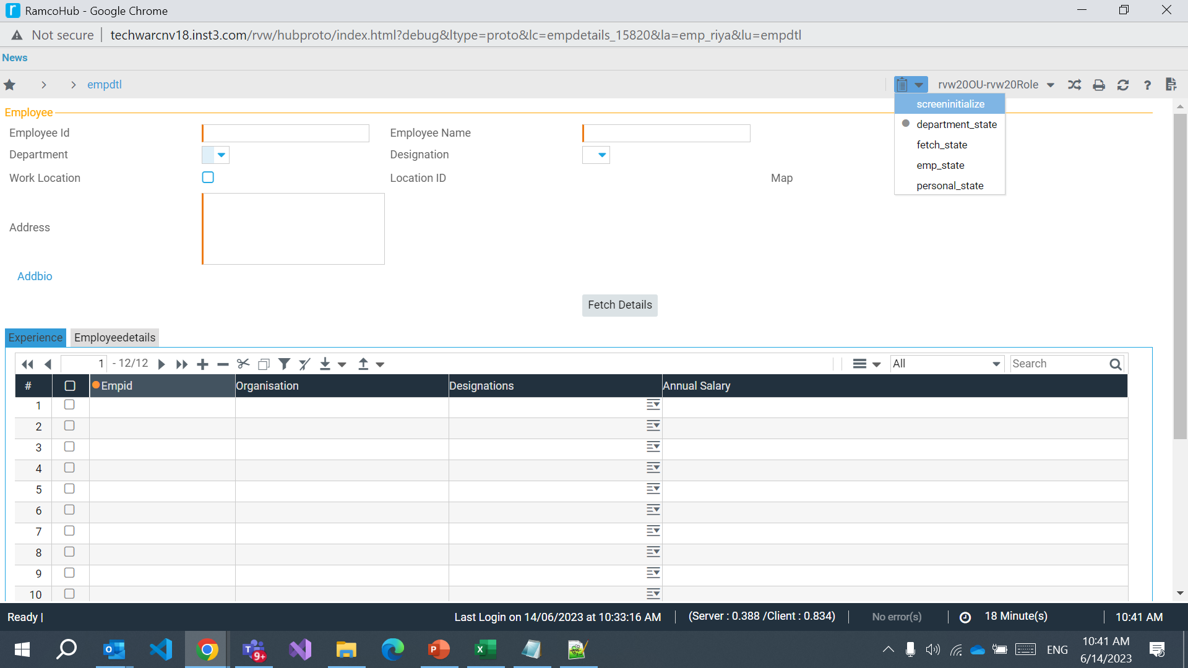
States preview in proto

Slide 4
Platform : Planned Features – Q2–2023-24
S No | Features | Initiated By
1 | Code Generation Integration with Devops (Provision to commit generated source code in git repo as part of code generation) | TECH
2 | Publish ECR in offline mode (queuing) | AAD
3 | Template specification, mapping and preview in specify layout screen | AAD
5 | Autocomplete property for combo – Mobility screens | ERP
6 | Resource histogram for Gant Control | ERP
7 | UDS – Phase 5 features | TECH
8 | Dependency Viewer Api to GET integration service dependency Api to GET impacted services for an application stored procedure | TECH

Slide 5
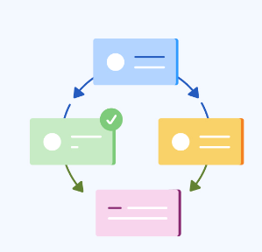
DW and Infra : Workflow - Completed Features – May 2023
Workflow - Rejection cycle – Reinitiated document routing to any given prior level instead of traversing all level in same path
GSG - GPG/PGP decryption for download and MDCF service & skip files of size 0kb and processing next file
Default configuration changes for increasing maxsize property bindings.config for DWCustomBinding (to handle high volume data xml)
Encryption for consolidated zip with password protected PDF (HRP)

Slide 6
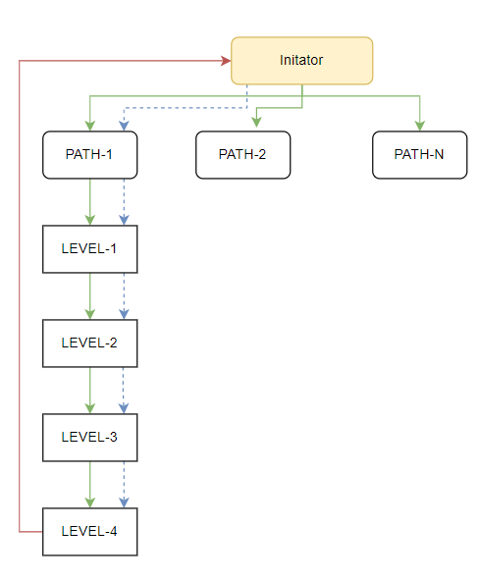
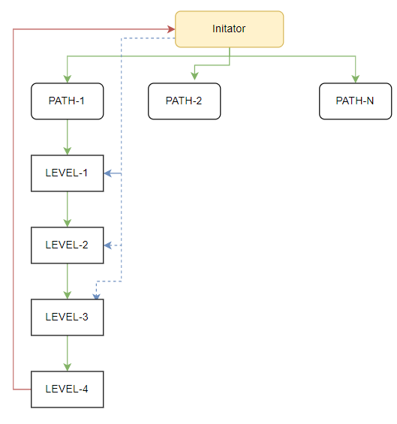
Workflow - Rejection Cycle
Current
New (Based on configuration)

Slide 7
DW and Infra : Planned Features – Q2–2023-24
S No | Features | Initiated By
1 | eMudhra remote bulk signing for offline sp based reports | LGT
2 | NextGen Workflow - Support for new SMS provider - SMSPORTAL | AAD
3 | Connection objects changes in reporting and infra component for MultiSubnetFailover | AAD
4 | Reporting infra logger movement to Serilog from Microsoft.EnterpriseLibrary.Logging | TECH
5 | Provision to export and import report schedule information across environments | HRP
6 | Provision to download generated reports for multi-instance schedule reports | TECH

